Slide 1

Ischemia Reperfusion
Part 2
Kelly Blackstock
Resident Board Review
August 18, 2010

Slide 2
OUTLINE
Review from last week
Assessment of IR injury/diagnostics
Treatment modalities
Yes, pay attention there is a quiz at the end of this!

Slide 3
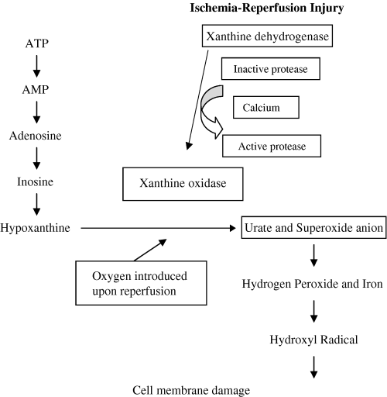
0
NAD
XYANTHINE
SOD
Fe⁺⁺
CATALASE
GSH
O2 and Water
Taken from McMicheal, JVECC 2004, 14(4); 231-41

Slide 4
ROS Formation
Hypoxanthine accumulation
Increased intracellular Ca²⁺
Xanthine dehydrogenase (XD) undergoes conformational change to xanthine oxidase (XO)
Return of perfusion: O2 now available, excessive production of O₂•
O₂^{-•} and H₂O₂ in the presence of iron combine to form Hydroxyl Radical

Slide 5
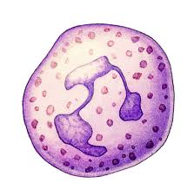
Inflammatory Mediators
IL-1β
ROS
TLR
Ca
TNFα
NF-κB
PLA₂
ICAM-1, E-selectin
TXA2
PAF, Cytokines
LTB4
Complement
Notes:
Important cytokines are TNF alpha, IL1, IL6, IL8 and MCP-1

Slide 6
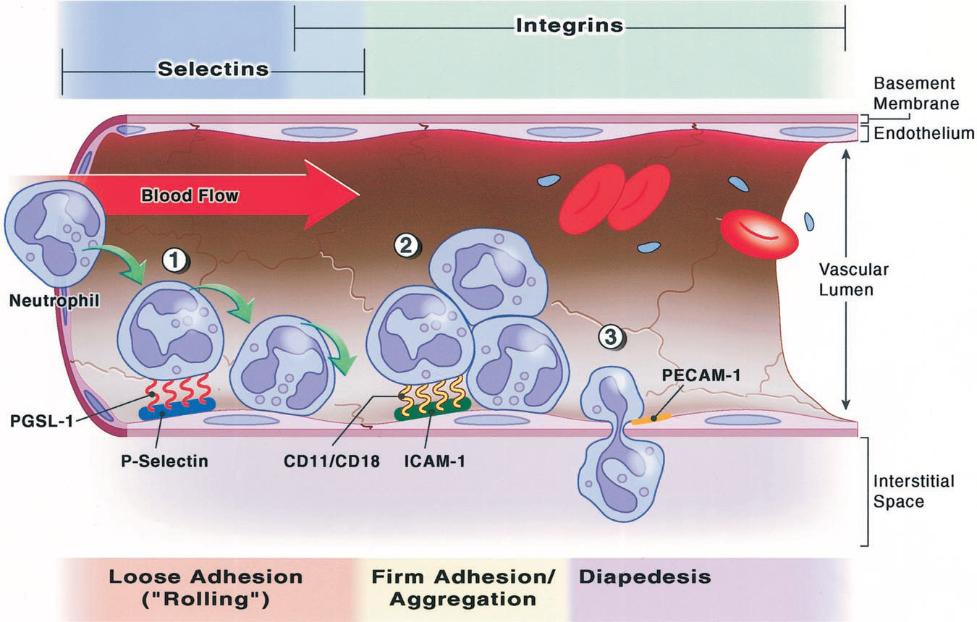
Anesthesiology, V 94, No 6, Jun 2001
Notes:
tethering/rolling, firm adhesion, transmigration and chemotaxis

Slide 7
Impaired Vasodilation
Mechanisms:
  Decreased NO, prostacyclin
  Increased Endothelin
  Thromboxanes and Leukotrienes
  Complement
Contributes to “No Flow Phenomenon”
Notes:
* One of the most sensitive indicators of EC dysfunction
Within the endothelium, ischemia promotes expression of certain proinflammatory gene products (e.g., leukocyte adhesion molecules, cytokines) and bioactive agents (e.g., endothelin, thromboxane A2), while repressing other “protective” gene products (e.g., constitutive nitric oxide synthase, thrombomodulin) and bioactive agents (e.g., prostacyclin, nitric oxide).

Slide 8

Assessment of IR Injury
Histology
Products formed by reaction of ROS
Levels of ROS
Depletion of Antioxidants

Slide 9
Problems with Diagnostic
Testing
No standardization
Differences in type, method, parts sampled and timing
Timing is key as auto-oxidation occurs ex vivo
Many are clinically inapplicable
Notes:
Testing for markers if IR injury is not standardized and is fraught with inaccuracies depending upon
Test used, lab method, parts sampled (tissue, serum, urine, CSF), timing of test in relation to sample collection

Slide 10
1. Histology
Used to assess for changes that reflect oxidative damage
Typically evaluated for evidence of treatment effect
Rarely practical in clinical setting

Slide 11

2. Biproducts of IR
Malondialdehyde (MDA)
Isoprostanes
Ferrous oxidation of xylenol (FOX)
Expired gases

Slide 12
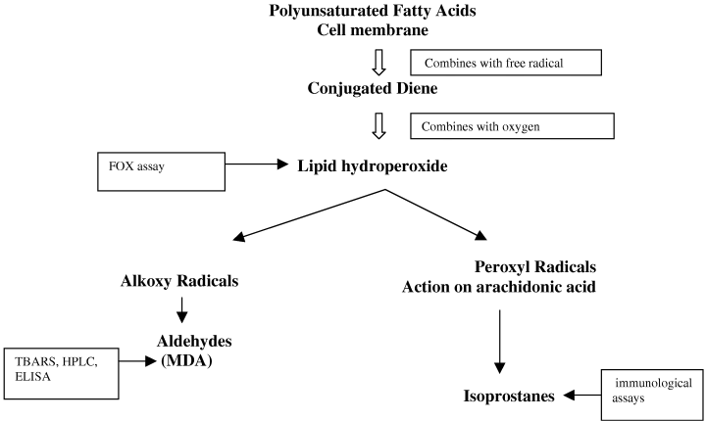
Lipid Peroxidation
Taken from McMicheal, JVECC 2004, 14(4); 242-52

Slide 13
Malondialdehyde
Most common test is TBARS
  First used to test for rancidity of fats
  Most frequently used test for lipid peroxidation
  Several problems
  Specificity improved in vivo with HPLC
ELISA test
Notes:
TBARS stands for thiobarbituric acid reactive substances
HPLC is high-performance liquid chromatography which is gas chromatography with further identification by mass spectrometry
ELISA test has recently been developed, which may make the testing more readily available

Slide 14

Problems with TBARS testing
Close to 98% of MDA formed is reacted after collection in incubation period
MDA can also come from thromboxane synthesis
Inconsistent sensitivity and specificity in vivo
Cumbersome test
Notes:
-So you get artifactual increases in lipid peroxidation outside the body in many testing methods. Tests must be conducted quickly to minimize spontaneous oxidation
-Especially when using samples of plasma or serum as there is some degree of platelet activation

Slide 15
Isoprostanes (aka iso-prostaglandins)
Formed by oxidation of arachadonic acid
Independent of COX enzymes
Very stable
αF₂ isoprostane is most frequent studied
Present in all biologic fluids and tissues
Problems
Notes:
There are 3 precursors and 4 classes of these compounds. Interestingly, at least 2 of these cause oxidative injury as well
Free form is found in urine and plasma
Esterified complex that is located in tissues and metabolites within urine
Recent research suggests that urinary F2 as a non-invasive marker of lipid peroxidation may be one of the best markers of oxidative damage in vivo
Problems include 1) auto-oxidation of lipid containing samples, especially in process and storage
2) Requires the use of mass spec, which is labor intensive and not readily available.

Slide 16
Ferrous oxidation of xylenol
Xylenol is a FERRIC sensitive dye
Basis of test is conversion of FERROUS TO FERRIC iron
*Remember: Fe²⁺ + H₂O₂ → OH• + OH⁻ + Fe³⁺
Problem: numerous pathways can lead to this

Slide 17

Exhaled gases
Oxidation of ω-3 PUFAs = ethane gas
Oxidation of ω-6 PUFA = pentane gas
Can be measured in expired gases
Limitations involve contamination:
  Air pollution
  Isoprene gas
  Gases by bacteria
Notes:
These have been studied in RA, MI and ARDS

Slide 18
Lipid Peroxidation
Taken from McMicheal, JVECC 2004, 14(4); 242-52

Slide 19

3. Measurement of ROS
Very difficult to measure, short half-life
Electron Paramagnetic Resonance (EPR)
“Spin Trapping”
Notes:
EPR is a form of spectroscopy, can be used as a direct measure of ROS. The unpaired electron gives rise to a typical absorbance spectrum when placed in a magnetic field.
Spin trapping is a technique that forces the radical to react with scavenger (spin trap) yielding a more stable product that has a longer half life and a spectrum that can then be identified by spectroscopy.

Slide 20
4. Measurement of Antioxidants
Glutathione Peroxidase:
  Glutathione as a substrate has 2 forms, reduced (GSH) and oxidized (GSSH)
  Can compare the ratio of GSH to GSSH
  Susceptible to ex vivo spontaneous oxidation
  (Multiple liver studies done by Dr. Center)
α-tocopherol:
  Evaluation of serum concentrations
  Documented to be decreased in sled dogs

Slide 21
Treatment of IR Injury
Blocking neutrophils
Block the formation of ROS
Scavenging ROS
Miscellaneous
Preconditioning
Notes:
Misc includes NHE inhibitors, protease inhibitors, adenosine, NO, aminosteroids, etc

Slide 22
Treatment:
Greater than 13,000 research articles, over 1000 different intervention since 1971
Majority of research is not applicable or impractical in clinical setting
IR’s complex cascade allows for several treatment targets
Other variables: timing of intervention, combo tx
No established treatment to date
Notes:
Timing can be 1) prior to the onset of ischemia, 2) after ischemia but before reperfusion or 3) after reperfusion
To date there is no established targeted treatment to safely and significantly decrease the effects of IR
IMPORTANT to note that, as we just discussed, there is no gold standard for assessment which makes if very difficult to assertain what role if any the treatments are having
In addition d/t the complexity of IR, single therapy involving only 1 target will not likely show any positive results

Slide 23

1. Blocking Neutrophils
Neutrophil generated ROS plays a large part in damage done
Strong pre-clinical data suggesting benefit
Targeted therapies:
  Anti ICAM-1 antibodies
  Anti integrin antibodies
  Inhibition of infiltration

Slide 24
Blocking Neutrophils
Large clinical trials (human) disappointing
  FESTIVAL
  LIMIT-AMI
Arguments against:
  Cell depletion did not decrease “no-flow” damage
  Failed to influence infarct size
  All forms of reperfusion seen in Neutrophil-free conditions.
Notes:
Studies showed no attributable effect to neutrophil depletion
Failed to influence infarct size in several spp and models

Slide 25

2. Block ROS Formation
N-acetylcysteine
Vitamins E, C and Ubiquino
Ca++ channel blockers
XO inhibitors

Slide 26
N-acetylcysteine
Cysteine is rate limiting aa in GSH production
Exogenous supplementation of GSH can’t penetrate cell membranes
N-acetylcysteine does penetrate cells and can be used as a precursor for GSH
Allows for continued production of GSH
*REMEMBER why GSH is important?
Notes:
Cysteine Rate of synthesis dep upon intracellular stores. Only place this isn’t true is liver, where both cysteine and methionine are used. Liver is where 90% of GSH is made
REMEMBER why GSH is important…GSH is a substrate for GSH peroxidase whose roles include chain-breaking

Slide 27
Glutathione
Considered the first line of defense against ROS
Reduces hydrogen peroxide to water, acting as substrate for peroxidase
Can act as a chain-breaking antioxidant
Metal chelator (preventing the formation of hydroxyl radical)

Slide 28
N-acetylcysteine Studies
Decrease myocardial edema
Scavenger of OH• and hypochlorous acid
Possible inhibition of NF-κB
Has shown some benefit in Sepsis and ARDS

Slide 29
Ca⁺⁺ Channel Blockers
Mechanism of action
-may inhibit the conversion of XD to XO
-prevention of the cytotoxic affects of Ca++
Most studies only show benefit if given prior to the onset of ischemia
May be beneficial in the “no-flow” phenomenon

Slide 30
Antioxidant Supplementation
Vitamin E
-antagonize peroxidative injury and destruction of membrane lipids
Vitamin C
-Allows for the regeneration of Vitamin E
-Superoxide scavenger at very high doses
Ubiquinol (Co enzyme Q-10)
- inhibits the initiation and propagation of lipid peroxidation
- unknown mechanism of action
Notes:
Whats interesting about vit C is that is also has prooxidant properties: can reduce ferric to ferrous iron
In combination these three antioxidants work together to break the “chain-reaction” of ROS mediated destruction

Slide 31

Allopurinol
A structural analog of XO
Leads to competitive inhibition
Shown some benefit in decreasing intestinal vascular permeability
Clinical trials are lacking

Slide 32
3. Scavenging ROS
SOD and Catalase
Iron chelators
DMSO
Notes:
Manitol is thought to have ability to scavenge free radicals. It was mentioned in several review articles but I did not find sp studies.

Slide 33
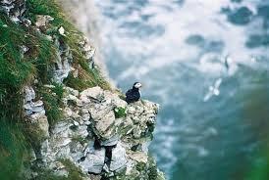
SOD and Catalase
SOD could be considered a pro-oxidant without catalase

Slide 34
0
NAD
XYANTHINE
SOD
Fe⁺⁺
CATALASE
GSH
O2 and Water
Taken from McMicheal, JVECC 2004, 14(4); 231-41

Slide 35
SOD and Catalase
SOD could be considered a pro-oxidant without catalase
Together superoxide converted to O2 and H2O
Large clinical trial (given with Vit E), no benefit
Potential reasons for lack of benefit
  Short half-life, treatment requires CRI
  Supplementation does not go intracellularly
New investigation with conjugation
Notes:
Lou Gehring’s disease is actually a familial defect in SOD gene, get build up of superoxide in the brain!
If not intracellular than not truly getting oxygen radicals
Conjugation with macromolecules may allow for increased half-life and possible intracellular migration

Slide 36
Iron Chelators
Block free iron
Decrease the production OH•
*Remember: Fe²⁺ + H₂O₂ → OH• + OH⁻ + Fe³⁺
Deferoxamine most studied chelator
Problems:
  Short half-life
  Toxic side effects
Notes:
Many other biological processes need iron
Possibly new chelators on the horizon

Slide 37
DMSO
Scavenges OH • and metabolite traps ROS
Inhibits platelet aggregation
Increased vasodilation
Inhibits leukocyte migration
Interferes with Arachadonic acid metabolism
Believed levels to do all this are toxic to cells

Slide 38

4. Miscellaneous
Preconditioning
Aminosteroids
NO
Adenosine
NHE inhibitors
Protease inhibitors

Slide 39
Preconditioning
“Ischemic Preconditioning”: brief sublethal exposure to ischemia prior to a prolonged ischemic event
Exact mechanism not entirely understood
  Not the endogenous enhancement of antioxidant defenses
  May involve initial ROS stimulating antioxidant defenses
Notes:
First described in 1986

Slide 40
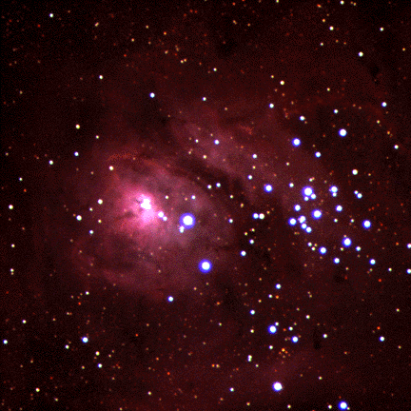
Preconditioning
“Ischemic tolerance”
  Decrease energy demands of the cell
  Altered energy metabolism
  Better electrolyte homeostasis
“Reperfusion tolerance”
  Decreased ROS from neutrophils
  Decreased apoptosis
  Increased microvascular perfusion
  Decreased systemic IR injury
Ischemia of select skeletal muscle was found to be protective for ischemic events of the heart, lung and gut
Notes:
Tissues subjected to preconditioning show both ischemic and reperfusion tolerance
Initial evidence has shown that ischemia of select skeletal muscle was found to be protective for ischemic events of the heart, lung and gut

Slide 41
Aminosteroids
Also known as Lazaroids
Modified to have high antioxidant properties with low steroid activity
Inhibit all O2 and lipid radicals
Membrane stabilizing
Some bind and inact iron
Not currently on the market

Slide 42
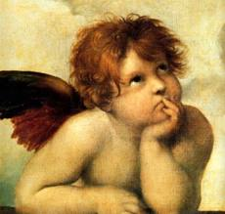

Nitric Oxide
Bad
Good
Large amounts cause severe non-responsive vasodilation
superoxide radical to form peroxynitrite (ONOO⁻)
vasodilation via cGMP,
↓platelet aggregation
↓leukocyte adhesion
↓ cytokines
neutralizes ROS
anti-microbial and anti-apoptotic effects
block endothelin’s effect
GI protective
Notes:
GI protective: ROS inhibition contributed to increased intestinal mucosal permeability.
Few studies:
GOOD= NO to cats, improved endothelial function, improved hemodynamics and liver function in pigs and cats. BAD=Blockade of iNOS markedly reduced liver injury in several studies.

Slide 43
Adenosine
ATP breakdown product
Also released by neutrophils, endothelial cells and monocytes
Possible preconditioning effect
  May inhibit conversion of XD to XO
  Increased synthesis of NO
  Prevent leukocyte adhesion and emigration
Problems
Notes:
Treatment with adenosine can cause hypotension and AV block if given IV
Two large clinical trials AMISTAD I AND II, showed no difference in infarct size or clinical outcome

Slide 44
^{Inhibition of Na+/H+Exchanger}
Inhibition has little effect on other cellular processes
GUARDIAN, EXPEDITION, clinical trials with Cariporide
Timing was critical in studies, needed to be given prior to ischemia
Possible neurologic side effects
Notes:
2 large clinical trials that showed reduced death rates following cardiac surgery however subsequent study suggested neurologic side effects. This has been proven with later studies and the medication is now off market

Slide 45
Protease Inhibitors
Most studied is Aprotinin, serine protease inhibitor
Potential benefits:
  Reduction of neutrophil and monocyte infiltration
  Decreases proinflammatory genes
  Increased hepatic microvascular circulation
  Decreased apoptosis
  Blockade of damaging effects of proteases
No prospective clinical trials
Serious side effects reported
Notes:
Side effects include renal impairment, MI, stroke and anaphylaxis

Slide 46
Take Home Message
There is a lack of sensitive/specific, non-invasive standardized testing for IR injury.
Isoprostenes are perhaps the most promising clinically
Thousands of therapies have been investigated.
As of yet there is no recommended treatment for IR injury.

Slide 47

QUESTIONS

Slide 48

IR INJURY QUIZ

Slide 49
1. List 5 syndromes of small animals that can lead to the development of IR
GDV
ATE
Hemorrhagic shock
Diaphragmatic hernia
Head trauma
Intestinal incarceration
CPCR

Slide 50
2. Which of the following is not a breakdown product of ATP?
Adenosine
Alanine
Inosine
Hypoxyanthine
B

Slide 51
3. Calcium stimulates what protease to convert XD to XO?
Calpin

Slide 52
4. Which of the following compound “builds up” during ischemia?
Inosine
Xanthine oxidase (XO)
Hypoxanthine
A and B
B and C
C and A
E

Slide 53
5. List the four major ROS involved with IR injury.
a) Superoxide (O₂•)
b) Hydrogen peroxide (H2O2)
c) Hydroxyl radical (OH•)
d) Peroxynitrite (ONOO⁻)

Slide 54
6. Which antioxidant is considered the first line of defense against ROS?
Vitamin E
Lycopene
Glutathione
Superoxide dismutase
Vitamin C
C

Slide 55
8. Intracellular elevation of which ion is most responsible for damage observed following IR?
Calcium
Sodium
Potassium
All of the above
None of the above
A

Slide 56
9. The Haber-Weiss reaction requires__________ to take place in biological systems and the end product is______________________.
Magnesium, superoxide radical
Magnesium, hydroxyl radical
Iron, superoxide radical
Iron, hydroxyl radical
D

Slide 57
10. What two antioxidants can be used to convert hydrogen peroxide to oxygen and water?
Catalase and Glutathione

Slide 58
11. Write out the Haber-Weiss reaction.
Write out the Fenton Reaction
O₂• + H₂O₂ → OH• + O₂ + OH⁻
Fe²⁺ + H₂O₂ → OH• + OH⁻ + Fe³⁺

Slide 59
12. Upregulation of this nuclear factor leads to a majority of the inflammation following IR
NF-αβ
NF-1E
NF-κB
NF- κM
C

Slide 60
13. True or False. In IR injury early and loose adhesion of neutrophils is mediated by selectins, then tighter binding by integrins
True

Slide 61
14. The following is not considered a mechanism of the “no flow” phenomenon.
B
Cellular swelling
Decreased endothelin release
Impaired vasodilation
Cellular infiltrate secondary to chemotaxis
Elevations in arachadonic acid byproducts

