Slide 1
Infectious Disease
Joel Green Weltman
June 21, 2011 and June 28, 2011

Slide 2

A brief review of various diseases
Influenza
Leptospirosis
Hepatozoon
Tetanus
Toxoplasmosis
Mycoplasmosis

Slide 3
Influenza

Slide 4
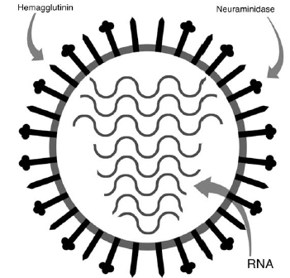
Canine Influenza
Virology
Family Orthomyxoviridae
Three major types: A, B and C
Enveloped, RNA virus
  Subcategorized based on 2 different proteins:
    Hemagglutinin
    Neuraminidase
Undergo mutation:
  Antigenic drift
  Antigenic shift
Notes:
Family Orthomyxoviridae
Three major types: A, B and C
Enveloped, RNA virus
8 strands of RNA encoding 11 proteins
Subcategorized based on 2 different prtoeins:
Hemagglutinin
Allow virus to attach to sialic acid receptors
Plays predominant role in species specificity of virus
Sixteen different serotypes identified (H1-H16)
Neuraminidase
Cleaves sialic acid receptors and allows exit for virons from infected cell
Nine different serotypes identified
Undergo mutation:
Antigenic drift-individual nucleic acid changes whilst replicating within an infected cell-leads to seasonable variability to human flu virus
Antigenic shift-occurs when two different viruses are infecting one host and they trade genes when replicating-results in different H/N and new host range

Slide 5

Canine Influenza H3N8
Epidemiology
Adapted to dogs
First reported in Florida 2004
  Respiratory disease and hemorrhagic pneumonia in racing greyhounds
Thought to be derived from equine H3N8
  Horse meat meals
Notes:
A key difference between CIV and EIV H3N8 is that CIV has the capability of spreading from dog to dog
Standard serologic testing cannot tell the difference between CIV and EIV infections
No evidence for a carrier state, so maintenance of the virus depends upon acute infection of susceptible individuals

Slide 6
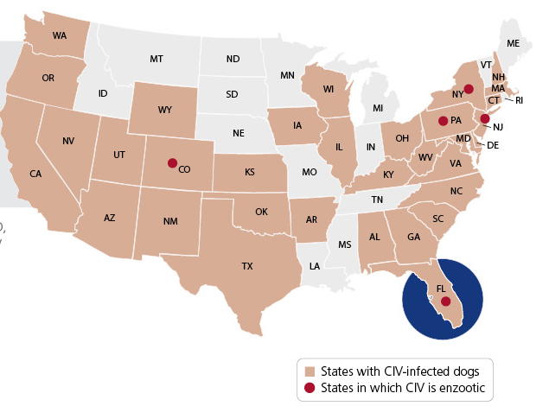
Canine Influenza H3N8
Geographic distribution
Animal health diagnostic center statistics
  Endemic states:
    New York
    New Jersey
    Colorado
    Florida
    Pennsylvania
  High infection rates
    California
    Wyoming
    Illinois
    Massachusetts
Notes:
High positive virus isolations from samples submitted to the ahdc here.
Report in JVIM last year investigating seroprevalence in companion dogs in colorado, 2.9-4.5% seropositivity, risk of seropositivity was sign. associated with boarding at kenneling facilities. Significant increase in seropositivity since 2004, samples tested retrospectively.
Report in JAVMA last year investigating seroprevalence in shelter dogs in philly, dogs randomly selected and tested with 42% seropositivity with only 15% of dogs positive if sheltered for less than or equal to seven days and 71% seropositive if greater than 7 days. Only factor evaluated that was significantly associated w/ seropositivity was length of stay, 2.2 increase of odds of positive serologic test result for every 3 days in shelter

Slide 7
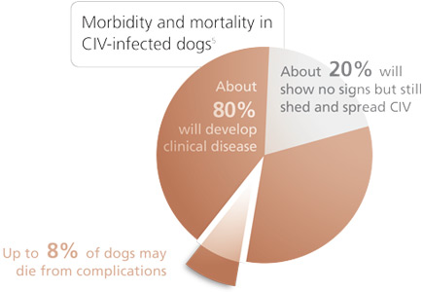
Canine Influenza H3N8
Presentation
Recent boarding or kenneling
20 percent asymptomatic
Peak shed 2-4 days post infection
Virus undetectable on day 7
Notes:
Unlike other respiratory diseases in dogs, the infection rate is very high with 60-80% attack rates in group settings
Peak of shed is 2-4 days postinfection and viabile virus undetectable by day seven postinfection
Infected dogs do not shed virus beyond 10 days post-infection

Slide 8

Canine Influenza
Clinical signs
Low-grade fever first sign
Rapid onset of signs:
  Cough
  Nasal discharge-serous or purulent
  Lethargy/anorexia/depression
  Ocular discharge
Notes:
Clinical signs persistent for 3 weeks postinfection
Subset of dogs will only develop fever or mild cough which persists for several weeks
Subset develop:
High fever
pneumonia

Slide 9
Canine Influenza H3N8
Diagnosis
PCR
  Nasal swabs
  Most accurate if collected prior to onset of signs
  Viral shedding occurs prior to onset of signs and tapers over the next 2-3 days
Virus isolation
Serology
  Seroconvert by day 7 after onset of clinical signs
  ELISA
  HI test
Notes:
PCR is the current test of choice if samples are able to be collected early in the disease course
ELISA testing is undesirable due to timing of infectionsIn non-endemic areas,
single positive serum antibody titer in the face of appropriate clinical signs is highly suggestive
Four fold increase in titer 2-3 weeks later confirms diagnosis
HI testing is the standard serologic test in the US, detects antibody response in dogs at day 7

Slide 10
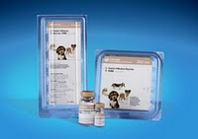
Canine Influenza H3N8
Treatment and control
Transmitted by direct contact and aerosol
  Fomitic transmission may play a role
Minimal movement through hospital
Quarantine at home during treatment
Treatment:
  Broad spectrum antibiotics for secondary infections
  Supportive care as necessary
  Oseltamivir is not recommended
Vaccination
Notes:
Transmitted by direct contact and aerosol
Fomitic transmission may play a role
Minimal movement through hospital
Quarantine at home during treatment
Treatment:
Broad spectrum antibiotics for secondary infections
Supportive care as necessary
Reasons oseltamivir is not recommended:
timing-must be administered very early in course of idsease to be of benefit
safety and efficacy trials have not been performed in dogs
not necessary as the disease has a low mortality rate
possible resistence-may be needed for a flu pandemic in the future
Mortality rate 1-5% is reported
Not considered zoonotic
Vaccination:
Killed adjuvanted products
Decreases virus shedding
Decreased lung pathology
Do not prevent infection
Yearly vaccinations are recommended
Unclear if H3N8 undergoes significant antigenic drift

Slide 11
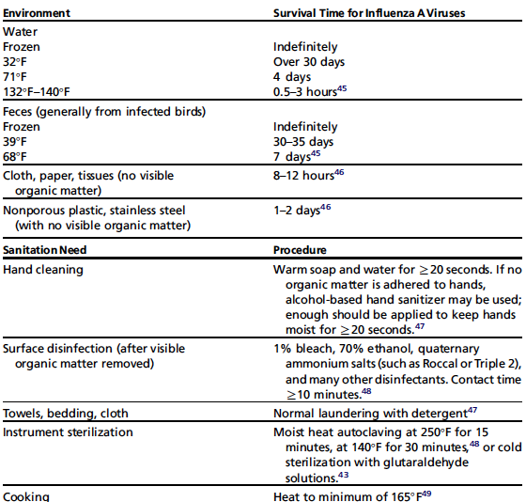
Canine Influenza H3N8
Environmental control

Slide 12
Canine Influenza
Other variants
H3N2
  South Korea 2007
    Spread of disease between several kennels
    Questionable dog to dog transmission
    Serosurvey showed high prevalence of antibodies
H1N1
  One report of a dog with respiratory signs testing positive
  Owner tested positive for H1N1 as well
  Likely does not have a large circulating population

Slide 13
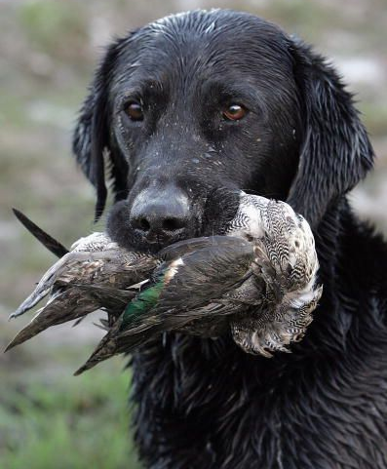
Canine Influenza H5N1
Highly Pathogenic Avian Influenza H5N1
Isolated reports
Does not appear to spread dog-to-dog
Experimental inoculation:
  Minimal clinical signs
  No gross lesions on pathology
  No virus isolated
Prevention:
  Feed only cooked meat
  No hunting of wild birds
Notes:
Reports of both deaths as well as just systemic illness
One report of avian origin H3N2 in 2007 in several dogs in South Korea
signs were sneezing/nasal discharge to fever cough and death
all dogs in a kennel seroconverted, suggesting strong dog-to-dog transmission

Slide 14
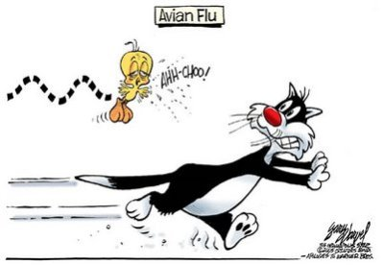
Feline Influenza
Highly pathogenic avian influenza (H5N1)
High morbidity and mortality
Ingestion of raw, infected birds or direct contact with poultry feces
Cat-to-cat transmission unclear
Notes:
Previous experimental infection of human influenza to cats
Shed virus from nose or pharynx, developed antibody response and transmitted from cat-to-cat
No systemic illness observed
Highly pathogenic avian influenza (H5N1)
High morbidity and mortality
High fever, dyspnea, panting, ataxia and convulsions
Mostly associated with ingestion of raw infected birds or direct contact with poultry feces
Reported in domestic cats, tigers, leopards
Unclear if cats can transmit the virus to other cats, no reports of transmission to humans
Much concern on development of a human host adapted H5N1 as a result of incubation in cat populations

Slide 15
leptospirosis

Slide 16
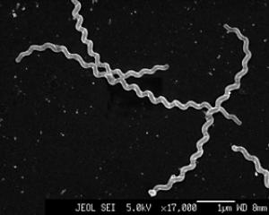
Leptospirosis
Bacteriology
Thin, motile spirchetes
Grouped into serovars and further divided into related serogroups
Maintained in definitive hosts
Clinical disease seen in incidental hosts
Notes:
Thin, very motile flexible and filamentous made up of fine spirals with hook-shaped ends
mobility is gained by writhing and flexing movements while rotating along long axis
obligate aerobic spirochete sharing features of both gram-neg and gram-pos bacteria
Saprophytic and pathogenic species exist
Grouped into serovars and further divided into related serogroups
Maintained in definitive hosts
Bacteria maintened in renal tubules of reservoir hosts
Excreted in urine
Clinical disease seen in incidental hosts

Slide 17
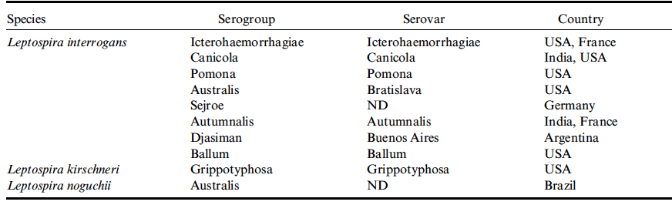
Leptospirosis
Common Serovars
Saxkoebing
Gautam, 2010
Notes:
Most common serovars currently in the US are thought to be pomona, bratislava and grippotyphosa
Recent study in JAVMA suggests increasing incidence of dogs testing positive in US for autumnalis
In germany the predominant serovars seem to be grippotyphosa, saxkoebing, icterohaemorrhagiae, canicola and bratislava

Slide 18
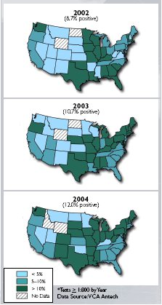
Leptospirosis
Geographic distribution
Hawaii
West coast
  Northern california
  Oregon
  Washington
Upper Midwest
Texas
Colorado
Northeast and mid-Atlantic coastal regions
Southeastern United States

Slide 19
Leptospirosis
Risk Factors
Access to lakes, rivers or streams
Recent rainfall
Seasonality: late summer to fall
Free range to rural property
Access to sewage
Outdoor
Intact, male
Working dog
Contact with rodents
Notes:
IDEALLY GROW IN NEUTRAL OR SLIGHTLY ALKALINE ph soils
Ambient temperature 0-25 C favor survival and their survival is markedly decreased in freezing temps
All mammal susceptible, most severe infections with non-host-adapted serovars
Definitive hosts tend to be infected at young ages and show minimal clinical disease
One study showed seroprevalence lower in dogs >10 years of age, similar across other age groups
Higher prevalence in urban areas in dogs used to track scents
Also appears to be higher in dogs in crowded conditions or unsanitary conditions

Slide 20
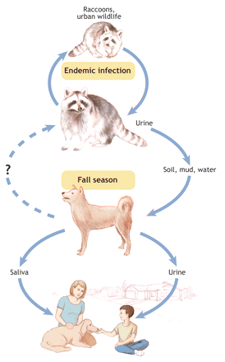
Leptospirosis
Transmission
Direct:
  Close contact with urine
  Venereal
  Placental transfer
  Bites
  Ingestion of infected tissues
Indirect
  Exposure to contaminated environment
Notes:
Direct:
Close contact with urine
Venereal
Placental transfer
Bites
Ingestion of infected tissues
Organisms penetrate mucosa or broken skin
Indirect
Happens more frequently
Exposure to contaminated environment

Slide 21
Leptospirosis
Pathophysiology
Course of disease:
  Leptospiremic phase
    Rapid multiplication
    Endothelial damage
  Invasion of end organs
    Kidneys
    Liver
    CNS
    Eyes
    Genitalia
Notes:
Course of disease:
Leptospiremic phase
Rapid multiplication 1 day after entering bloodstream
Lasts a few days
Endothelial damage
Invasion of end organs
Kidneys
Liver
CNS
Eyes
Genitalia
Extent of damage depends on: virulence of organism, serovar and strain, inoculum and host susceptibility and immune response

Slide 22
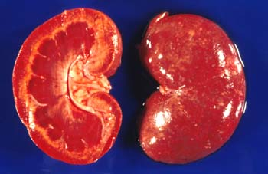
Leptospirosis
Pathophysiology
Kidney
  Occurs in most experimental models
  Multiply in tubular epithelial cells
  Results in cytokine release
    Inflammatory cell recruitment
    Acute nephritis
Notes:
Generally associated w/ infections w/ canicola, bratislava and grippotyphosa
Enter the kidneys by 2 weeks post infection which coinsides with their onset in shedding
Damage to the endothelium may also result in renal ischemic disease
Leptospiral LPS activates machorphages and stimulates secretion of IL-1 and interferon
Also may have an increase in TNF alpha

Slide 23
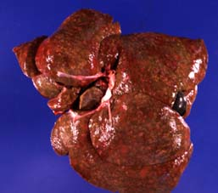
Leptospirosis
Pathophysiology
Liver
  Centrilobular necrosis
  Subcelluar damage
  Occlusion of bile canaliculi and ducts
Notes:
Icterohaemorrhhagiae and pomona primarily do liver disease
Younger dogs tend to be more likely to get liver disease
May result in chornic active hepatitis and has been associated with grippotyphosa infection

Slide 24
Leptospirosis
Pathophysiology
Endothelium
  Results in:
    Tissue edema
    Disseminated intravascular coagulation

Slide 25
Leptospirosis
Pathophysiology
CNS
  Benign meningitis
Eyes
  Uveitis
Genitalia
  Aborition
  Infertility
Immune mediated disease
  Polyarthritis, IMHA, etc.
  Incidence is unknown

Slide 26
Leptospirosis
Pathophysiology
Leptospirosis Pulmonary Hemorrhage Syndrome
  Suggested mechanisms
    Endothelial damage and vasculitis
    Autoimmune disease
    Exposure to circulating toxins
    Inducible nitric oxide synthetase and NO production
  Reported in 70% of dogs with leptospirosis
  Severe, acute alveolar and subpleural hemorrhage on necropsy
  Poor prognosis if associated with severe signs
Kohn, 2010
Notes:
Leptospirosis Pulmonary Hemorrhage Syndrome
Most likely due to endothelial damage and vasculitis
Autoimmune mechanisms
Exposure to ciruclating toxins
Inducible nitric oxide synthetase and NO production→hypotension, bradycardia and autonomic dysfunction
Reported in 70% of dogs with leptospirosis
No correlation with MAT titers and presence
No correleation with lung disease and anemia
Higher percentagae of patients with LPHS had thrombocytopenia (83% vs 53%) but authors made no conclusions on this
Severe, acute alveolar and subpleural hemorrhage on necropsy
Poor prognosis if associated with severe signs
67% with severe signs were euthanised due to respiratory disease
15% of mild respiraotyr signs and 21% with no respiratory signs were euthanised due to ARF

Slide 27
Leptospirosis
Clinical syndromes
Renal failure
Hepatic failure
Uveitis
Pulmonary hemorrhage
Acute febrile illness
Abortion
Coagulopathies
Vasculitis
Myocarditis
Intussusception
Notes:
Renal failure
Acute interstitial nephritis and tubular dysfunction, also acute tubular necrosis
PU/PD→in the absence of azotemia
Experimentally, leptospiral infections cause decrease responsiveness to vasopressin
Dehydration
Vomiting
Diarrhea
Innappetance
Lethargy
Abdominal pain
Hepatic failure
Icterus
Mild to moderate scattered hepatic necrosis and periportal hepatitis
Uveitis
Pulmonary hemorrhage
Tachypnea or dyspnea
Acute febrile illness
Early in the disease course
Associated with muscle tenderness and reluctance to move
Abortion
From transplacental spread
Reported in beunos aires and associated with bratislava infection
Coagulopathies
Hematemesis, hematochezia, hemoptysis, melena, epistaxis and petechial hemorrhages
Vasculitis
Peripheral edema
Mild pleural or peritoneal effusions
Myocarditis
Intussusception was noted in a case series in JVECCS
5 dogs with ARF and suspected leptospirosis
Strongest MAT serology was for L. interrogans serovar australis
Recommended with patients with australis may be at increased risk of intussussception and should be monitored for
Have been associated with increased amylase activities

Slide 28
Leptospirosis
Clinicopathologic findings
Complete blood count
  Neutrophilia +/- left shift
  Lymphopenia
  Non-regenerative anemia
  Thrombocytopenia
Serum Biochemistry panel
  Azotemia
  Increased ALT/AST/ALP and Tbili
  Hyponatremia, hypochloridemia
  Hypo or hyperkalemia
  Increased CK
Urinalysis
  Isosthenuria
  Glucosuria
  Proteinuria
  Bilirubinuria
  Hematuria
  Pyuria
  Cylindruria
Notes:
Complete blood count
Nutrophilia +/- left shift
Lymphopenia
Non-regenerative anemia
Thrombocytopenia
Up to 58% of dogs
Serum Biochemistry panel
Azotemia
>80-90% of dogs
Increased ALT/AST/ALP and Tbili
Almost always in conjunction with azotemia
Increases in ALP and tbili are more common than ALT
Hyponatremia, hypochloridemia
Hypo or hyperkalemia
Based on oliguria/anuria or not
Increased CK

Slide 29
Leptospirosis
Coagulation
DIC panel
  Increased fibrinogen
  Increased D-dimer and FDP concentration
  Decreases in AT activity
  Prolongations in PT/PTT
Notes:
DIC panel
Variable increases in fibrinogen, D-dimer, and FDP concentration
Decreases in AT activity
Prolongations in PT/PTT
6-50% of tested dogs
Most prevalent in western European dogs

Slide 30
Leptospirosis
Imaging
Thoracic radiographs
  Diffuse nodular interstitial to alveolar pattern
Abdominal ultrasound
  Renomegaly
  Increased cortical echogenicity
  Perirenal fluid accumulation
  Mild pylectasia
  Medullary band of increased echogenicity
  Enlargement and hypoechogenicity of pancreas
  Thickened gastric and intestinal wall
  Splenomegaly with moddled echotexture
  Mild abdominal lymphadenomegaly

Slide 31
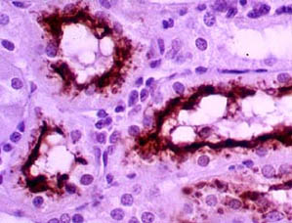
Leptospirosis
Diagnosis
Microscopic agglutination test (MAT)
  Highest serum dilution causing agglutination of 50% of leptospires in reaction
  Recommend acute and convalescent testing
Culture
  Requires special media
  Growth is slow (3-6 months)
Polymerase Chain Reaction
Direct visualiation
  Darkfield microscopy
  Histopathology
Notes:
MAT technique:
mixing serial diluation of canine sera w/ cultured leptospira organisms of different serovars
A 4-fold change in titer supports recent infection→increase in titer may be blunted by antimicrobial therapy
In one study sensitivity for single MAT titer >800 for diagnosis was 22-67% and specificity was 69-100% so lots of false positives are expected
Negative aspects:
hazardous b/c need ot maintain live cultures of pathogenic serovars
subjective interpretation, requires expertise
cross-contamination of serovars is likely over time
lack of consensus of what titer should be used as a cut-off for negative result
frequently negative in the first week of illness
falsely negative if the infecting serovar is not included in panel used to perform test
persistence of antibodies in a subclinical infection→positive test without current infections
does not differentiate between vaccination and infection
serovars w/in the same serogroup will cross-react extensively-in human study MAT results only accurately predicted serovar in 46
Culture
Useful early in course of disease
In the first 10 days of infection, blood samples are preferred as the organisms are highest there, after that organisms are highest in urine
If time of infection is unknown, recommendation is to test both urine and blood
Requires special media
Growth is slow (3-6 months)
Risks exposure to the lab personalle
Falsely negative if antibiotics are already instituted
Polymerase Chain Reaction
Useful early in the course of disease
Considered most sensitive
Recommended to perform on urine and blood early in course of disease to increase sensitivity
Do not differentiate between different serovars or serogroups
Falsely negative in low organismal burden, antibiotic therapy or when PCR inhibitors are present
Direct visualiation
Darkfield microscopy
Lacks sensitivity and specificity-not recommended anymore
Histopathology
Giemsa or modified Steiner stian, immunofluorescence or immunihistochemistry

Slide 32
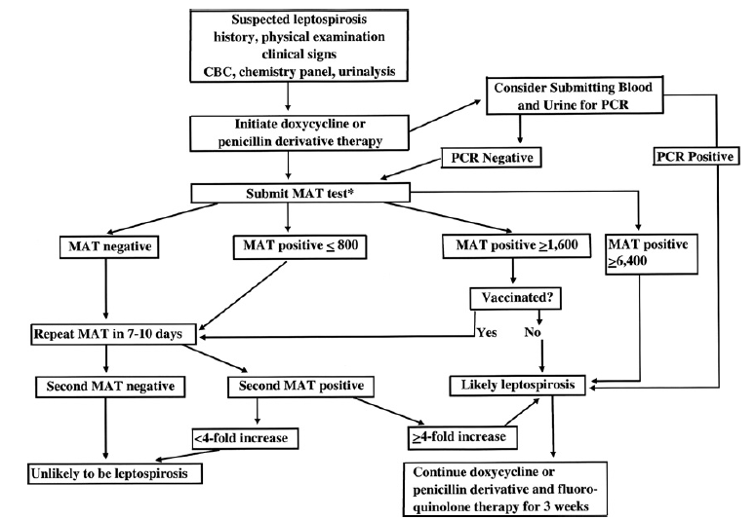
Leptospirosis
Diagnosis

Slide 33
Leptospirosis
Treatment
Supportive care
Antibiotic therapy
  Penicillins
  Doxycycline
  Azithromycin
Dialysis
  Indications:
    Inadequate urine output and volume overload
    Hyperkalemia
    BUN > 80 mg/dL
    Uremia non-responsive to medical care
Notes:
Consensus panel recommends treatment with doxy 5 mg/kg PO or IV q 12hr for 2 weeks
If vomiting ensues then treatemnt with ampicillin 20 mgkg IV q 6 hr w/ dose reduction for azotemia
PenG 25k-40k u/kg IV q12 hr can also be used
Recommend for other dogs in the household to be treated with antibiotics as well
More than 80% of patients that would otherwise die from uremia survive with rrt
Sometimes only 1-3 treatments are necessary
RRT indicated

Slide 34
Leptospirosis
Treatment
Leptospirosis Pulmonary Hemorrhage
  Cyclophosphamide
  Plasma exchange
  No improvement with dexamethasone and desmopressin therapy
Diltiazem
  Suggested MOA:
    Reversal of renal vasoconstriction with pre-glomerular dilation
    Improved naturesis independent of
  Reduction of creatinine 1.76 times faster with diltiazem
Mathews, 2007
Notes:
Leptospirosis Pulmonary Hemorrhage
Cyclophosphamide
Plasma exchange
No improvement with dexamethasone and desmopressin therapy
Hohn paper suggested attempting steroids due to possibility of immune mediated disease and humans do better with them
Diltiazem
Suggested MOA:
Reversal of renal vasoconstriction with pre-glomerular dilation
Improved naturesis independent of
Reduction of creatinine 1.76 times faster with diltiazem
No clinically relevant effect on SBP

Slide 35
Leptospirosis
Prognosis
Successful treatment associated with return of urea and creatinine within 10-14 days
  Renal tissue regeneration may continue for over 4 weeks
Bilirubin may decline more slowly than ALT and ALP
Platelet counts normal within 1 week of antimicrobial therapy
80% survival rates reported
Poor with severe respiratory complications
  Mortality reported 48% and 36%

Slide 36
Leptospirosis
Public health
Human disease:
  2-25 day incubation period
  Manifestations:
    Subclinical
    Influenza-like illness
    Hepatic failure
    Renal failure
    Pulmonary Hemorrhage

Slide 37
Leptospirosis
Public Health
Human risk factors
  Recreational activities involving water
  Farm animal contact
    Involves approximately 10% of cases
  Wild rodent contact

Slide 38
Leptospirosis
Public Health
In hospital setting
  Acute leptospirosis represents incidental host infection
    Dogs do not become chronic carriers
  Rare reports of spread of disease from pet dogs to humans
    Not substantiated by molecular methods
  Further studies warranted
    Consensus recommends further investigation into patients receiving antimicrobials and risks to human infection
Barmettler, 2011
Notes:
In hospital setting
Acute leptospirosis represents incidental host infection
Dogs do not become chronic carriers
Rare reports of spread of disease from pet dogs to humans
Not substantiated by molecular methods
Investigation of humans (50 vets, 19 techs, 9 admin people and 13 dog owners) exposed to lepto showed no humans to be seropositive for antibodies against leptospiral serovars
Further studies warranted
Consensus recommends further investigation into patients receiving antimicrobials and risks to human infection

Slide 39
Leptospirosis
Public Health
Recommended precautions
  Minimal movement of suspect cases
  Warning labels placed
  Pregnant and immunocompromised people should have no contact with patient
  Floor-level cages away from high traffic areas
  Glove, gown, protective eyewear and facemask
  No pressure washing
  Indwelling urinary cathter
Notes:
Recommended precautions
Minimal movement of suspect cases
Movement should be on devoted gurney
Warning labels placed
Pregnant and immunocompromised people should have no contact with patient
Floor-level cages away from high traffic areas
Glove, gown, protective eyewear and facemask
Care should be taken with handling urine contaminated bedding, and bedding should be placed in a biohazard bag for apprprieate management
No pressure washing
May encourage aerosolization
Indwelling urinary cathter
Should only be allowed to urinate in specified areas, preferably on hard concrete or something else easy to disinfect
Bathe hair that becomes urine soaked

Slide 40
Leptospirosis
Public Health
Appropriate disinfectants
  1:1 aqueous dilution of 10% bleach
  Iodine-based accelerated by hydrogen peroxide
  Quaternary ammonium solutions
Notes:
Appropriate disinfectants
1:1 aqueous dilution of 10% bleach
Iodine-based accelerated by hydrogen peroxide
Quaternary ammonium solutions
Recommend injecting disinfectant into urine collection systems prior to removal of urine

Slide 41
Leptospirosis
Cats
Serovars Canicola, Grippotyphosa and pomona isolated from cats
Clinical disease rarely reported
Experimental infections cause mild renal and hepatic inflammation
Unclear the extent cats play in environmental contamination

Slide 42
Leptospirosis
Prevention
Vaccine against serovars:
  Icterohaemorrhagiae
  Canicola
  Grippotyphosa
  Pomona
Efficacy
  Prevent disease from experimental challenge
  Prevent shedding
  Effective for 12 months
Recommended for at risk dogs
Notes:
Vaccine against serovars:
Icterohaemorrhagiae
Canicola
Grippotyphosa
Pomona
Efficacy
Prevent disease from experimental challenge
Prevent shedding
Effective for 12 months
Recommended for at risk dogs
Recommends 4-serovar vaccination (so all of them)

Slide 43
Leptospirosis
Prevention
Decrease access to sources of infection
  No contact with marshes or stagnant water
  Fenced yards
  Minimized wild animal contact
  Adequate rodent control
Immunity after infection
  Unclear if life-long immunity is conferred
  Recommend vaccination 1 year after recovery

Slide 44
hepatozoon

Slide 45
Hepatozoon americanum
Epidemiology and pathophysiology
Protozoal infection
Amblyomma maculatum, the Gulf Coast tick
Geographic distribution: southern United States plus Kansas and Kentucky
Transmitted by ingestion of tick
Sporozoites spread hemotogenously or by lymphatics within macrophages to skeletal or cardiac muscle
Form cysts there and multiply until the cyst ruptures and the merozoites can then be recycled to other sites
Notes:
Protozoal infection
Sexually develop and sporogenate in arthropod vector with subsequent transmission to host (Amblyomma maculatum, the gulf coast tick)
Geographic distribution: southern United States plus Kansas and Kentucky
Target tissues: striated muscle
Pathologic changes: cysts, meronts and pyogranulomatus inflammation in skeletal and cardiac muscles
Transmitted by ingestion of ticks from self grooming or consumption of ticks from birds or rodents as well as ingestion of cytozoites from other animal’s muscle tissues
Sporozoites are spread hemotogenously or by lymphatics within macrophages to skeletal or cardiac muscle
Form a cyst there and multiply until the cyst ruptures and the merozoites can then be recycled to other sites

Slide 46
Hepatozoon americanum
Clinical signs
Fever unresponsive to antibiotics
Mucopurulent ocular discharge
Muscle pain and lameness
Weight loss despite normal appetite
Chronic renal failure
Death within 12 months with no therapy
Notes:
Weight loss thought to be due to hypermetabolic state
Renal failure is secondary to amyloid deposition or immunoprolierative glomerulonephritis

Slide 47
Hepatozoon americanum
Diagnostic findings
Mild to severe leukocytosis
Mild normochromic, normocytic anemia
Normal to elevated platelet count
Elevated ALKP
Decreased albumin
Azotemia and isothenuria in patients developing CRF
Periosteal bony proliferation
Notes:
Mild to severe leukocytosis
Majority are from mature neutrophilia
Mild normochromic, normocytic anemia
Normal to elevated platelet count
Thrombocytopenias would be indicating a secondary tick bourne disease infection (RMSF or ehrlicia)
Elevated ALKP
Thought to be due to perioestal reactions secondary to myositis
Decreased albumin
Chornic inflammation, decreased protein intake and altered protein metabolims
Azotemia and isothenuria in patients developing CRF
Periosteal bony proliferation
Similar to Hypertrophic osteopathy
Thoght to be secondary to myositis

Slide 48
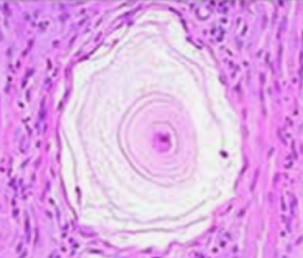
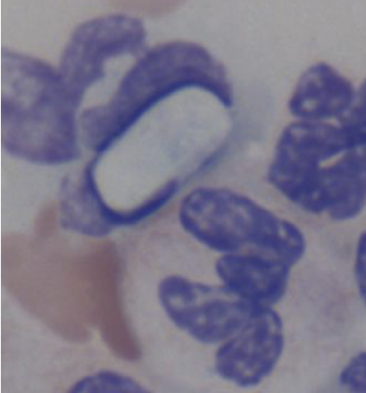
Hepatozoon americanum
Diagnosis
Identification of intracellular gamonts
Muscle biopsy
Serology
PCR
Notes:
Identification of intracellular gamonts
In PMN cells
Uncommon due to low levels of parasitemia
Muscle biopsy
Shows the classic onion skin cysts
Serology
Elisa at OSU
False positives when dog has been exposed to amblyomma ticks b/c of tick residue in the test
PCR

Slide 49
Hepatozoon americanum
Treatment and Prevention
Supportive care as necessary
Combination therapy for 2 weeks:
  Trimethoprim-sulfadiazine (15 mg/kg PO q12h)
  Clindamycin (10 mg/kg PO q8h)
  Pyrimethadmine (0.25 mg/kg PO q24h)
Decoquinate (15 mg/kg PO q12h)
Tick prevention therapy
Feed only cooked foods
Notes:
No treatment is able to clear an infection…
TCP combination clears the merozoite stage, Relapse typically occurs within 1-6 months
Decoquinate can be started after TCP is done and repeat PCRs are done every 3-6 months until negative

Slide 50
Infectious Disease
Joel Green Weltman
June 21, 2011 and June 28, 2011

Slide 51
A brief review of various diseases
Influenza
Leptospirosis
Hepatozoon
Tetanus
Toxoplasmosis
Mycoplasmosis

Slide 52
tetanus

Slide 53
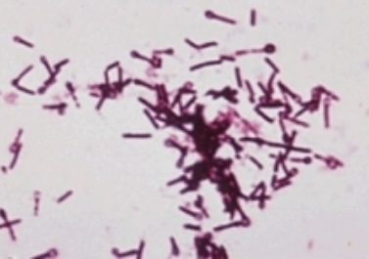
Tetanus
Pathophysiology
Bacteriology
  Anaerobic, spore-forming, non-encapsulated gram-positive bacillus
  Ubiquitous in environment
Exposure
  External wounds
  Surgical wounds
Toxins:
  Tetanolysin
  Tetanospasmin
Notes:
Bacteriology
Anaerobic, spore-forming, non-encapsulated gram-positive bacillus
Ubiquitous in environment
Relatively low prevalence in dogs and cats, may be due to incomplete reporting, misdiagnoses, low number of cases truly
Generally dogs and cats are considered to be less effected by tetanus than other mammals-dogs 200 times and cats 2400 times more resistant
Exposure
External wounds
Surgical wounds
Spores vegitate in respose to anaerobic conditions at cite of injury
Presence of a foreign body, tissue necrosis, other micro organisms or abscess formation contributes to germination
Toxins:
Tetanolysin/tetanolepsin (as in greene)
Lyses red blood cells in vitro, in vivo consider to cause tissue damage resulting in an optimal local environment for bacterial growth
Not considered clinically significant
Tetanospasmin
Cannot be absorbed from the GI tract b/c it is destroyed
Too large to pass through placenta
Produces classical nuerologic features w/ tetanus

Slide 54
Tetanus
Tetanospasmin
Mechanism of disease
  Exposure through wound
    Requires low oxygen tension
    Median 9 days following trauma
  Inactive peptide cleaved to active
    Heavy chain mediates attachment to peripheral nerves
    Internalization and retrograde migration through neurons
  Prevents release of inhibitory neurotransmittors
  Hematogenous spread in high load
Notes:
Mechanism of disease
Exposure through wound
Requires low oxygen tension-presence of necrotic tissue, foreign material along side poor blood supply is the spore’s favourite
Reported with large burns, after IM injections and following snakebites
Median interval b/t wound occurance and onset of signs is 9 days
In humans a shorter incubation period correlates to a poorer prognosis
Inactive peptide cleaved to active form by tissue or bacttereial proteases
Forms into a light chain and a heavy chain
Light chain blocks release of neurotransmitters
Heavy chain portion mediates attachment to peripheral nerves followed by internalization and migration through neurons
it enters axons of nearest motor nerves at the neuromuscular end plate
Then the toxin is incorporated into a vesicle and transported 75-250 mm/day retrograde
Transport is enhanced by neuronal stimulation
Produces classical nuerologic features w/ tetanus
Prevents release of glycine and gaba
An inhibitory neurotransmitter
Results in irreversible blockade of neuronal inhibition of skeletal muscle and generalized muscle spasms
Overstimulation of motor neurons→rigidity
Spread hematogenously in high loads to other neuro end plates and directly into the cns at the 4th ventricle.
With direct intravenous injection the facial nerves are first affected and presumed to be due to the fact that these are shorter nerves compared to the peripheral nerves

Slide 55
Tetanus
Pathophysiology
Autonomic disturbances
  30% of human tetanus patients
  Theory:
    Impaired inhibitory circuits in autonomic nervous system
  Can affect sympathetic or parasympathetic
    Dogs mostly get parasympathetic, humans mostly get sympathetic
  Human findings: ptyalism, tachycardia, tachypnea, hypertension, increased protein catabolism

Slide 56
Tetanus
Classification system
Class I:
  Only facial signs
Class II:
  Generalized rigidity or dysphagia
  With or without class I signs
Class III:
  Recumbency or seizures
  Class I or class II signs
Class IV:
  Abnormal HR, RR or BP
  Class I, II or III signs
Burkitt 2007
Notes:
50% of cases in Burkitt study progressed to class III/IV
Was retrospective at a referral hospital so may not represent generalized population

Slide 57
Tetanus
Human classification
Four forms:
  Cephalic
    Seen with otitis media
  Localized
    Muscle rigidity at site of infection
    May progress to contralateral limb
  Generalized
    Extreme muscle rigidity with extensor groups dominating
    May progress from localized form to CNS
  Neonatal
Notes:
Four forms:
Cephalic
Seen with otitis media
Localized
Associated with lower toxin load
Muscle rigidity at site of infection
May progress to contralateral limb
Lower mortality
Cranial nerve signs develop late in disease→risus sardonicus is facial muscle spasms, trismus is lockjaw
Generalized
Extreme muscle rigidity with extensor groups dominating most commonly, actually the stronger of each of the opposing muscle groups will predominate so in the limbs the extensor groups do, this is also why the muscles for closing the jaw rather than opening the jaw predominate
May progress from localized form to CNS
Cranial nerve signs develop early in disease
Neonatal
Reported mostly in developing countries at the umbilicus

Slide 58
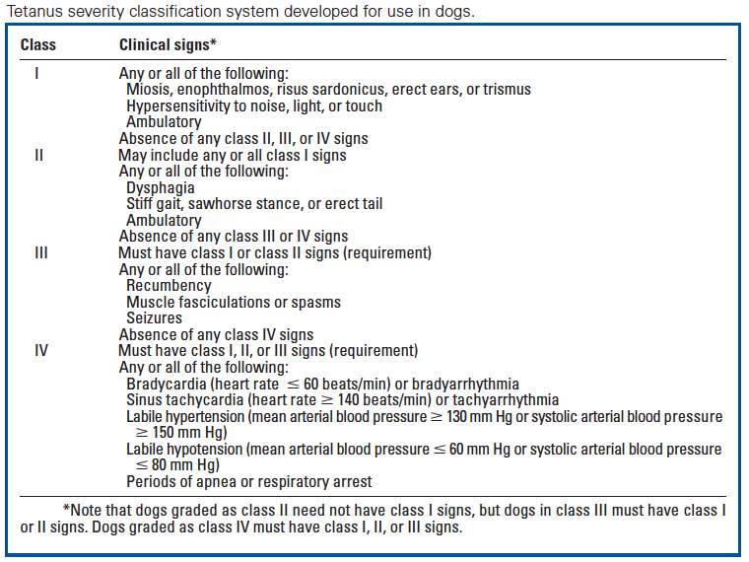
Tetanus
Classification system
Notes:
Risus sardonicus—drawing back of the lips
Trismus—lockjaw

Slide 59
Tetanus
Risk factors
Recent trauma
  Grass awns
  Tick bite wounds
  Excessive claw grooming
Surgical wounds
  More likely to progress to higher class (not significantly different however)
  No association between wound type and 28 day mortality rate
  No association b/t earlier wound management and progression of clinical signs
Teething
Notes:
Wounds closer to the head are associated w/ more rapid onset and generalized cns signs than injuries to distant extremities

Slide 60
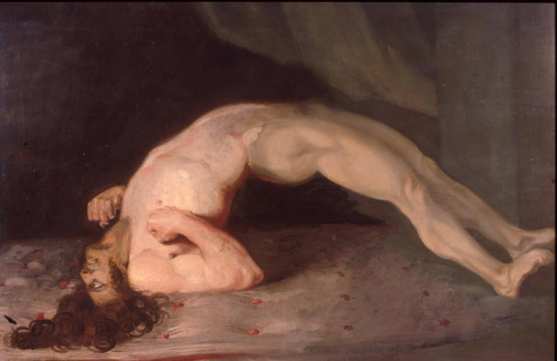
Tetanus
Clinical signs
Ocular signs
Cervical muscle tension
Facial swelling
Dysphagia
Hypersalivation
Regurgitation/vomiting
Limb stiffness
Trembling/spasms
Lateral recumbency
Voice change
Urinary incontinence
Notes:
Ocular signs
Most common presenting sign-45% of cases in Burkitt study it was the first sign noted
Third eyelid prolapse from retraction of the globe
Squinting/swollen eyelids
Miosis is also present often
Cervical muscle tension
Facial swelling
Dysphagia
Hypersalivation
Both hypersalivation and dysphagia due to parasympathteic involvement and somatic cranial nerve nuclei
Regurgitation/vomiting
Often a complication of animals with hiatal hernias
Limb stiffness
Typically associate locialized pelvic limbs with female reproductive tract surgical disease
In the thoracic limb the elbow is usually extended and the carpus flexed or exended
Generalized diseases typically also have dorsiflxcion of the tail
Doing proprioceptive tests typically they have normal reactions just stiff in their responses
Typically myotactic reflexes are increased and flexion reflexes are decreased
Trembling
Often the muscle spasms are painful and they will vocalize during the episodes
Lateral recumbency
Urinary incontinence:
Also can get constipation from persistent anal and urethral sphincter contractions

Slide 61
Tetanus
Initial assessment
Physical exam
  Hyperthermia
    Result of tetanic spasms
  Dyspnea
    During tetanic spasms of the diaphragm and intercostal muscles
    Respiratory failure was leading cause of death in humans prior to mechanical ventilation
  Bradycardia, potentially episodic
  Increase in muscle tone, episodic
Notes:
Stastic episodes can be triggered by sound, touch or sight

Slide 62
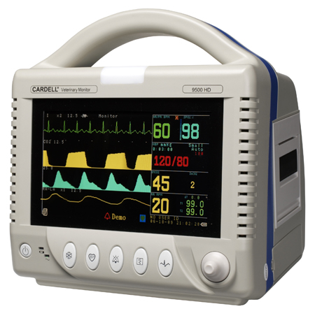
Tetanus
Diagnostic findings
Blood pressure
  Episodic hypertension or hypotension
EKG:
  Sinus tachycardia
  Bradycardia
Complete blood count
  Neutrophilic leukocytosis
Chemistry
  Elevations in CK and AST
Imaging
  Hiatal hernia
Electromyography
  Prolonged electral discharge
  Normal nerve conduction velocities
Notes:
Blood pressure
Episodic hypertension or hypotension
EKG:
Sinus tachycardia or bradycardia with AV block, sinus arrest and ventricular escape
Complete blood count
Neutrophilic leukocytosis
Chemistry
Elevations in CK and AST
Imaging
Hiatal hernia
Theory: abnormalities in esophageal motility and tone combined with diaphragmatic contractions
Electromyography
Prolonged electral discharge
Normal nerve conduction velocities
Recommend to delay disting as it may hasten the progression of disease
Isolation of organism is difficult and only successful in 30% of human cases, not generally performed in our patients, you can test for anibody titers and compare to a control population but this has to be interpreted alongside all other clinical data

Slide 63
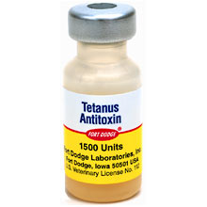
Tetanus
Treatment
Antitoxin
  2 types:
    Equine anti-tetanus serum
    Human tetanus immune globulin
  Neutralize tetanospasmin in the blood
    Ineffective if already in nerve cell
    Cannot enter CNS
  Adverse reaction:
    Anaphylactic
    Anaphylactoid
    Serum sickness
Notes:
Antitoxin
2 types:
Equine anti-tetanus serum
Human tetanus immune globulin
Neutralize tetanospasmin when toxin is present in the blood, ineffective if already in nerve cellsand at that point you have to wait for regeneration
Have done some lab tests doing intrathecal injections and may reduce morbidity and mortality
Argued that it doesn’t need to cross BBB then and may partially neutralize the toxin
Not proven effective for use in people
Also can try a local IM injection proximal to the wound
Cannot enter CNS, so only effective intrathecally for cns SIGNS
Adverse reaction:
Anaphylactic
Anaphylactoid
Serum sickness
Previous recommendations were to perform an interdermal skin test with the antitoxin prior to administration, however in the Burkitt paper the dogs that had positive tests (2/35) were pretreated with benedryl and had no problems, and there were dogs with negative skin test that had reactions anyways.

Slide 64
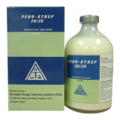
Tetanus
Treatment
Wound management
  Thorough debridement
  Hydrogen peroxide flushing
Antimicrobials
  Penicillin G
  Tetracycline
  Clindamycin
  Metronidazole
    Considered choice treatment in humans
Notes:
Wound management
Thorough debridement—gives the best prognosis
Hydrogen peroxide flushing
Increases the oxygen tension
May put patient at risk for air emboli
Hyperbaric oxygen therapy has been infestigated but does not have adequate proof at this point
Antimicrobials
Goal to prevent further production of toxins
Will not have an affect on the toxins already present
Reduces mortality and need for muscle relaxant in humans
Penicillin G
Is a GABA agonist and may result in increased risk of convulsions
Tetracycline
Clindamycin
Metronidazole
Considered choice treatment in humans

Slide 65
Tetanus
Treatment
Muscle relaxation
  Phenothiazines
  Benzodiazepines
  Dantrolene
  Methocarbamol
  Phenobarbital
Notes:
Muscle relaxation
Phenothiazines
Benzodiazepines
Dantrolene
Direct skeletal muscle relaxant, often combined with baclofen-GABA agonist
Methocarbamol
Not continued for longer than 1 day in study
Suggest that it was not effective
Phenobarbital
Not discontinued, suggests that it is very effective
Autonomic disturbances
Temporary pacing

Slide 66
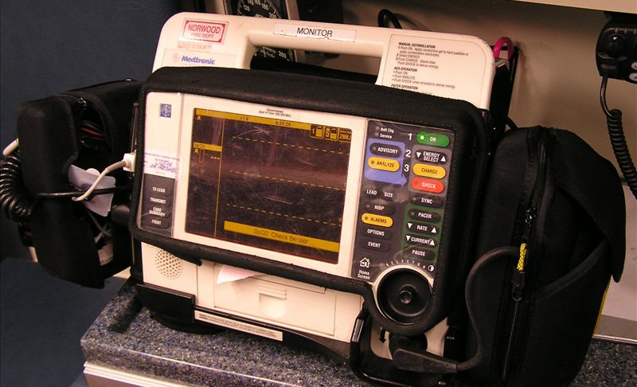
Tetanus
Treatment
Autonomic disturbances
  Temporary pacing
  Magnesium
    Loss of patellar reflex
Notes:
Can consider a parasympatholytic agent (atropine/glyco) as needed
Have used CRI of atropine in humans which helps with bronchospasm, bronchial hypersecrion and hypersalvation.
Clonidine may also be considered

Slide 67
Tetanus
Treatment
Environment
  Dark, quiet
  Well padded
  Minimal stimulus
    Loud patients
    Fluid pumps

Slide 68
Tetanus
Complications
Aspiration pneumonia
  Lateral recumbency
  Decreased gag reflex
  Trismus-disallows expulsion of material from mouth
Gastrointestinal bleeding
  Steroids contraindicated in treatment for tetanus
SIRS/MODS
Respiratory or cardiac failure
Long term:
  Abnormal movements in sleep
Notes:
Aspiration pneumonia
Lateral recumbency
Decreased gag reflex
Trismus-disallows expulsion of material from mouth
Gastrointestinal bleeding
¾ dogs developing had received steroids prior to admission
Steroids should not be used in tetanus b/c increased risk of GI ulcers in humans
SIRS/MODS
3/35 dogs in study
Due to initial infection, severe hyperthermia, aspiration pneumonia or bacterial translocation from denuded GI tract
Respiratory or cardiac failure is generally going to be the cause of death in humans (if on ventilator they die from cardiac arrest)
Long term:
Abnormal movements in sleep (3/35 dogs)
May represent permanent damage to inhibitory circuits w/in cns
2 days

Slide 69
Tetanus
Prognosis
28 day survival:
  Overall: 77%
  Class I: 100%
  Class II: 100%
  Class III/IV: 58%
Poor prognostic factors
  High severity class
  Autonomic signs
  Young age
Notes:
Those with higher scores significantly more likely to die than those w/ lower scores
Signficantly worse outcome with autonomic signs
Older dogs are actually less likely to develop tetanus and authors suggest that chronic, subclinical exposure leads to natural resistance in older patients

Slide 70
Tetanus
Prevention and Environmental control
Vaccination
  Not generally performed in dogs and cats
  Directed against tetanospasmin
Natural immunity does not occur
Highly resistant
  Survive high temperatures
  Resistant to common disinfectants
Notes:
Can survive for months to years in optimal conditions in environment
Can be destroyed by autoclaving at 1 atm of pressure and 120 C for 15 min

Slide 71
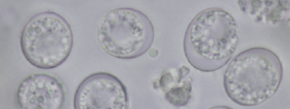
Toxoplasma

Slide 72
Toxoplasmosis
Biology
Intracellular protazoan parasite
  Obligate intracellular
  Found in the intestinal tract of definitive host

Slide 73
Toxoplasmosis
Lifecycle intraintestinal
Sexual and asexual cycles
Unsporulated oocyst passed in feces
  Sporulate in warm temps and moistures
  Form 2 sporocystes each containing 4 sporozoites
Ingestion by animal host
  Sprozoites form schizonts or meronts
  Merozoites released when host cell ruptures
Continue with asexual reproduction or sexual reproduction based on further differentiation
Notes:
Only happens in the cat!
Sexual and asexual cycles
Both occur in the cat
Only asexual in non-feline hosts
Unsporulated oocyst passed in feces
Can be passed through the canine GI tract with no excystation and remain as patent oocysts
Sporulate in warm temps and moistures
Form 2 sporocystes each containing 4 sporozoites
Sporozoites highly resistant to environment
Ingestion by animal host
Most cats are thought to be infected by ingestion of tissue cysts
Sporocysts pop and sprozoites form schizonts or meronts
Merozoites form w/in schizonts
Merozoites released when host cell ruptures
First generation merozoites continue with asexual reporduction, second generation form male (micro) and female (macro) gamets which undergo eexual reporduction to form oocysts→microgamont will divide into small biflagellate organisms which swim up the macrogamont and penetrate the wall, fertilizae and make an oocyst

Slide 74
Toxoplasmosis
Lifecycle extraintestinal
Same for cats and intermediate hosts
Sporozoites excist in lumen of intestine
Penetrate intestinal cells
  Divide into 2 by endodyogeny becoming tachyzoites
  Tachyzoites multiply and eventually encyst
  Cysts grow and now contain bradyzoites
    Bradyzoites different from tachyzoites as they are resistant to digestion
Notes:
Can happen in any species
Will multiply for an indefinite amount of time, if the cell ruptures prior to forming a cyst then they can go on to infect new cells, otherwise it develops into a cyst

Slide 75
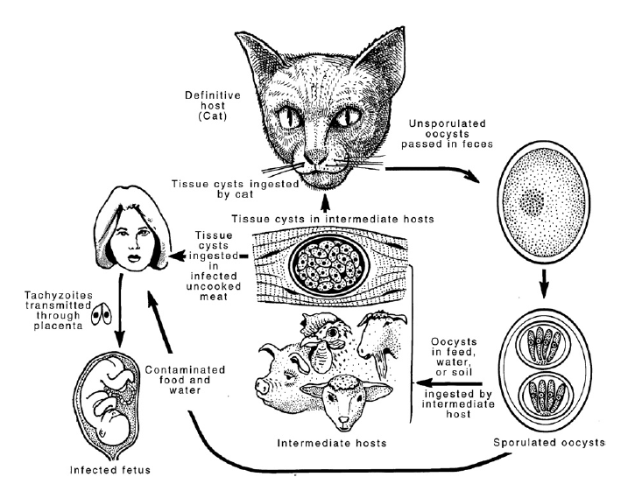
Toxoplasmosis
Lifecycle

Slide 76
Toxoplasmosis
Transmission
Modes of transmission
  Fecal-oral
  Carnivorism
  Transplacental
  Transmammary-kittens
Predisposing factor
  Concomittant illness
  Immunosuppression
  Stress
  Postnatal infections less severe than prenatal
Notes:
Modes of transmission
Fecal-oral
Most common would be from contaminated water sources
Carnivorism
Transplacental
Placentitis leads to spread of tachyzoites
Transmammary-kittens
Can also be transmitted by transfusion or transplant
Marine mammals have been effected potentially due to run off from sewage but also maybe from mollusks carrying the protazoa
Predisposing factor
Concomittant illness
Canine distemper
Ehrlichiosis
Glucocorticoid use
No evidence that FeLv , FIV or bartonella in cats modify course of disease, however greene says that there are isolated reports of FIV/mycoplasma that are associated w/ disease and urban cats w/ FIV are more likely to have a high t. gondii titer than non-FIV cats
Immunosuppression
Stress
Postnatal infections less severe than prenatal
Seroprevelance is hisghest in otdoor cats, homeless cats and cats living in shelters

Slide 77
Toxoplasmosis
Clinical findings
Cats
  Transplacental
    Stillbirth
    Poor doers
    Hepatitis
    Pneumonitis
    Encephalitis
  Post-natal infection
    Pneumonia
    Fever
    Anorexia and weight loss
    Hepatitis/cholangiohepatitis
    Abdominal effusion
    CNS
    Pancreatic
    Ocular
    Muscle pains
Notes:
Clinical signs may be sudden or chronic in onset
Naïve cats ingesting bradyzoites from tissues develop self-limiting small bowel diarrhea, lasts about 10 days
Some cats/dogs can become infected and show minimal clinical signs and the cause is not fully understood:
age, sex, host species, strain, number of organisms and stage of parasite at ingestion may account
Post-natal infection is generally less severe than pre-natal, overwhelming transmission of tachzoites from this form, also lactational spread
Most post mordem show changes most commonly in pulmonary in post-natal followed by CNS, hepatic, panreatic, cardiac and ocular
Anterior or posterior uveitis is common but also iritis, iridocyclitis and chorioretinitis
manifesations of uveitis: aqueous flare, keratic precipitate, lens luxation, glaucoma, and retinal detachment

Slide 78
Toxoplasmosis
Clinical findings
Dogs
  Neurologic
  Respiratory
  Myositis
  Hepatic
  Myocarditis
  Generalized
  Ocular
Notes:
Dogs
Neurologic
May be chronic type disease, and may be the only sign with no other systems effected
Signs depend upon site of infection: can be cerebrum, cerebellum or spinal cord
Seizure, CN defitis, tremors, ataxia, paresis or paralysis
Respiratory
Usually die quickly
Myositis
Abnormal gait, muscle asting or stiffness leading to parapareis sand tetra paresis, may develop LMN paralysis
Hepatic
Extensive hepatitc necrosis, usually die quickly
Myocarditis-usually subclinical
Generalized→dogs <1 year old
Fever
Tonsillitis
Dyspenea
Diarrhea/vomiting
Ocular: retinitis, anterior uveitis, iridocyclitis, ciliary epithelium phyperplasia, optic neve neuritis, keratoconjunctivitis

Slide 79
Toxoplasmosis
Clinical laboratory findings
Complete blood count
  Nonregenerative anemia
  Neutrophilic leukocytosis
  Lymphocytosis
  Monocytosis
  Eosinophilia
Serum chemistries
  Hypoalbuminemia
  Hyperglobulinemia in chronic disease in cats
  ALT/AST elevation
  ALKP elevation

Slide 80
Toxoplasmosis
Imaging findings
Thoracic radiographs
  Diffuse interstitial to alveolar pattern with mottled lobar disribtuion
  Pleural effusion
Abdominal Radiographs
  Masses in intestine, lymph nodes or decreased serosal detail
Myelography and MRI:
  CNS signs may show changes

Slide 81
Toxoplasmosis
Diagnosis
Organism identification
  Tachyzoites
  Oocytes
Serology
  IgM
  Acute and convalescent IgG titers
  Interpretations:
    Seronegative cats: unlikely infected but likely to shed oocysts if exposed
    Seropositive cats: likely exposed but unlikely to shed oocysts if reexposed
Notes:
Organism identification
Tachyzoites
Blood
CSF
FNA
Endotracheal wash
Cavitary effusions
Oocytes
Rarely found in feces—usually only shed in the feces for the first 1-2 weeks post initial exposure
Centrifugation using Sheather sugar solution
Serology
30% of cats have T. gondii antibodies
Seropositivity increaes w/ age
IgM
Considered more specific than IgG
In experimental innoculation, 80% develop IgM titers, 100% devlop IgG titers
Acute and convalescent IgG titers
Four fold or greater increase or decrease with treatment
Interpretations:
Seronegative cats: unlikely infected but likely to shed oocysts if exposed
Seropositive cats: likely exposed but unlikely to shed oocysts if reexposed
Positive disease considered if IgM is high, IgG consistent alongside exclusion of other causes of same syndromes and positive response to therapy
Four fold increase in IgG titer or a postive IgM titer verifies recent infection but not shedding

Slide 82
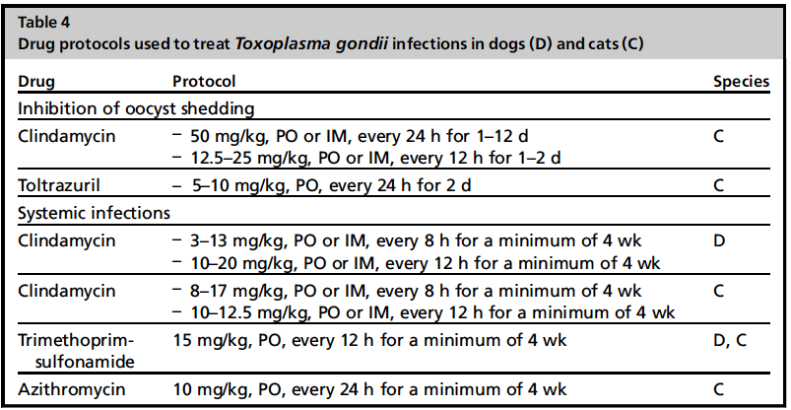
Toxoplasmosis
Therapy
Notes:
Goal is to inhibt shedding and minimize clinical signs, clearing infection has not been investigated but requires concurrent immunosuppression
Invitro studies support clinda, potentiated sulfas, azithromycin and ponazuril have activity against it
If uveitis is present should treat with steroids (topical, oral or parenteral)
Anticonvulsants may be necessary for CNS disease
Ocular and CNS disease typically responds more slowly than other syndromes, other diseases respond to therapy in 2-3 days

Slide 83
Toxoplasmosis
Prevention
Feed only commercially processed feed
Restriction from hunting
Restriction from entering buildings where food producing animals are held

Slide 84
Toxoplasmosis
Public Health
Prevention of infection
  Only spread disease in acute infection, so minimize interactions when this may happen
  Scoop litterbox daily
  Cover sandboxes
Disinfection
  10% ammonia, 10 minute exposure
  Emersion in boiling water
Notes:
Seronegative cats are considered the greatest public health risk b/c when they get exposed they are expected to be shedding

Slide 85
Mycoplasma

Slide 86
Mycoplasma
Bacteriology
Very small size
Lack a cell wall
Require close association with mammalian cell to grow
  Utilize the nutrition of mammalian cells
Readily pass through cell membranes
Notes:
Approximately 0.3-0.8 mcmeter in size
Readily pass through 450 to 300 nm membranes

Slide 87
Mycoplasma
Types
Thought to be host specific
  Non-specific hosts may harbor the organism but not have clinical disease as a result
  Pathogenic and non-pathogenic strains may be in a host
Canine:
  M. cynos
  M. canis
Feline
  M. felis
Notes:
Thought to be host specific
Non-specific hosts may harbor the organism but not have clinical disease as a result
Pathogenic and non-pathogenic strains may be in a host
Canine:
M. cynos
M. canis-has been recovered from the genital tract of healthy and diseased dogs, thought to potentially cause decreases in fertility
Many different mycoplasmas have been isolated from animals w/ disease; however, only cynos has been capable of causeing disease after innoculation
Feline
M. felis: implicated in the causes of conjunctivitis and upper respiratory disease

Slide 88
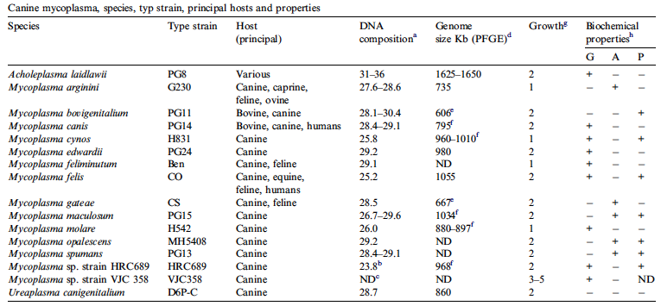
Mycoplasma
Canine Taxonomy

Slide 89
Canine Mycoplasmosis
Clinical syndromes
Respiratory disease
  Normal commensal of upper airways
  20-25% healthy dogs mycoplasma positive in trachea and lungs
  Young>older
  Shelter settings
  Case report of lethal bronchopneumonia in Golden Retriever puppies
Notes:
Normal commensal of upper airways
Have identified bovigenitalum, canis, cynos, edwardii, feliminutum, gatae, and spumans from dogs with respiratory disease
only cynos has caused respiratory disease by experiemental innoculation and by exposure of healthy dogs to ill dogs.
Prevalence of CIRD was significantly associated w/ presence of mycoplasma cynos from the trachea and lung
20-25% healthy dogs mycoplasma positive in trachea and lungs—randolph 1993, though has not been able to be reproduced by other investigators
78% of dogs <1 year had mycoplasma as a part of pneumonia
Unclear if is secondary or primary
M. cynos is the only mycoplasma thought to cause respiratory disease
Higher rate of infection in shelter settings with endemic respiratory disease
Chalker 2004 reported 20% of dogs entering shelters found mycoplasa in lower airways in first 2 weeks of entering
Significantly decreased after 4 weeks in kennel, author suggests an adaptive immune response
High titers to m. cynos were documented in dogs entering kennels and 80% of dogs w/ positive m. cynos went on to develop respiratory disease
Case report of lethal bronchopneumonia in Golden Retriever puppies

Slide 90
Canine Mycoplasmosis
Clinical syndromes
Urogenital disease
  M. canis
  Commonly present as a mixed infection
  Pathology found in prostate, epididymis, urethra, uterus, and bladder wall
Meningoencephalitis
  Case report-six week old puppy with acute neurologic signs
  M. edwardii ID by culture and sequencing
Colitis
  Normal commensal, unlikely causes disease
Notes:
Urogenital disease
M. canis
30-50% of dogs have mycoplasma in genital tract and 23-75% of females
Commonly present as a mixed infection
Isolated from dogs with infertility and urogenital disease despite prolonged antibiotic therapy
Prostate, epididymis and bladder wall culture positive in dogs w/ infertility and in experimental infections found urethritis and epiddiymytis in males and enlarged uteri and endometritis in females
Meningoencephalitis
Case report-six week old puppy with acute neurologic signs
M. edwardii ID by culture and sequencing
Colitis
Normal commensal, unlikely causes disease

Slide 91
Feline mycoplasmosis
Clinical syndromes
Conjunctivitis
  M. felis
  Recent data suggests 50% of these cases are mycoplasma
Upper respiratory disease
  Presnce of M. felis is positively associated w/ feline URTd
Feline pneumonia
  Variant severity reported
Notes:
Conjunctivitis
M. felis
Recent data suggests 50% of these cases are mycoplasma
More cats id’ed mycoplasma than FHV (27%) however we all know how reliable herpes identification is.
Hartmann 2010: four new species of mycoplasma identified in conjunctivitis
Upper respiratory disease
Holst, et. al 2010. significantly higher Mycoplasma infections in ill and healthy cats from case households compared to controls
Presnce of M. felis is positively associated w/ feline URTd
Feline pneumonia
11/21 cases of lower respiratory disease in retrospective
Also some case series presented.
Respiratory failure necessitating mechanical ventilation in one case report

Slide 92
Mycoplasmosis
Diagnosis
Culture
  Form fried egg like colonies
  Cannot differentiate between different types based on appearance from culture
Serology
  Allows for differentiation between types
Biochemical properties
  Glucose fermentation
  Arginine hydrolysis
  Phosphatase production
PCR
Notes:
Culture
Feline mycoplasmas are not fastidious and should be grown on hayflick’s agar
Canine: Rapid growth on B medium
Form fried egg like colonies
Cannot differentiate between different types based on appearance from culture
Serology
Growth inhibition
Immunoflourescence
Metabolism inhibition
immunodiffusion
Allows for differentiation b/t types
Biochemical properties
Allows differentiation between species
Time consuming and costly
PCR
Chalker 2002 looked at PCR and culture and similar percentages of animals had positive for both but a subset (15%) tested culture negative and PCR positive

Slide 93
Mycoplasma
Treatment
Resistant to beta-lactams
  Prolonged therapy with beta-lactams can exacerbate infections
Doxycycline
Pradofloxicin
  Feline upper respiratory tract infections
  Efficacious against Mycoplasma
  Does not clear C. felis.
Notes:
Public health:
Unclear if zoonotic
Mycoplasmas found in dogs have been found in humans and other animals

Slide 94
References
Greene CE. Infectious Disease of the Dog and Cat. 3rd Ed. 2006.
Barrel EA, et. al. “Seroprevalence and risk factors for canine H3N8 influenza virus exposure in hosehold dogs in Colorado.” JVIM. 24: 2010.
Holt DE, et. al. “Serologic prevalence of antibodies against canine influenza virus (H3N8) in dogs in a metropolitan animal shelter.” JAVMA. 237: 2010.
Dubovi E. “Canine Influenza.” Vet Clin Small Anim 40: 2010.
Sykes JE, Hartmann K, Lunn KF, Moore GE, Stoddard RA, Goldstein RE. “2010 ACVIM Small Animal consensus statement on leptospirosis.” JVIM. 25: 2011.
Goldstein RE. “Canine Leptospirosis.” Vet Clin Small Animl. 40: 2010.
Barmettler, R, et. al. “Assessment of exposure to Leptospira serovars in veterinary staff and dog owners in contact with infected dogs.” JAVMA. 238: 2011.
Gautam et al. “Detection of antibodies against Leptosira serovars via microscopic agglutination tests in dogs in the United States, 200-2007.” JAVMA. 237: 2010.

Slide 95
References
Kohn B, et.al. “Pulmonary Abnormalities in dogs with Leptospirosis.” JVIM. 24: 2010.
Schweighauser A et.al. “Small intestinal intussusception in five dogs with acute renal failure and suspected leptospirosis.” JVECC. 19: 2009.
Mathews KA, Monteith G. “Evaluation of adding diltiazem therapy to standard treatment of acute renal failure caused by leptospirosis: 18 dogs (1998-2001).” JVECC. 17: 2007.
Potter TM, Macintire DK. “Hepatozoon americanum: an emerging disease in the south-central/southeastern United States.” JVECC. 20(1): 2010.
Beeler E. “Influenza in Dogs and Cats.” Vet Clinics of Small Animal Practice. 39: 2009.
Burkitt, JM, et.al. “Risk factors associated w/ outcome in dogs w/ tetanus: 38 cases (1987-2005).” JAVMA. 230: 2007.
Linnenbrink T, McMichael M. “Tetanus: pathophysiology, clinical signs, diagnosis, and update on new treatment modalities.” JVECC 16: 2006.
Whitford HW, Rosenbusch RF, Lauerman LH. Mycoplasmosis in Animals: Laboratory Diagnosis” 1994.

Slide 96
References
Chalker VJ. “Canine mycoplasmas.” Res Vet Sci. 79:2009.
Hartmann AD, et. al. “Detection of bacterial and viral organisms from the conjunctiva of cats with conjunctivitis and upper respiraotry tract disease.” JFMS. 12: 2010.
Hartmann AD et. al. “Efficacy of Pradovfloxicin in cats with Feline Upper Respiratory tract disease due to C. felis and Mycoplasma infection. JVIM. 22: 2008.
Holst BS, et. al. “Infectious causes of feline upper respiratory diseases-a case-controlled study.” JFMS. 12:2010.
Zeugwetter F et. al. “Lethal bronchopneumonia caused by Mycoplasma cynos in a litter of golden retriever puppies.” Vet Rec. 2007.
Iiha MRS, et. al. “Meningoencephalitis caused by Mycoplasma edwardii in a dog.” J Vet Diagn Invest.22: 2010.

Slide 97
References
Chalker VH. Et al. “Mycoplasmas associated with canine infectious respiratory disease.” Microbiology. 150: 2004.
Trow AV. Et. al. “Primary mycoplasma pneumonia associated w/ respiratory failure in a cat.” JFMS. 10: 2008.
Rycroff AN. Et. al. “Serologic evidence of Mycoplasma cynos infectious in canine infectious respiratory disease.” Vet microbiol. 120: 2007.

