Slide 1
Immunology, part II
Joel Green Weltman
12/21/10

Slide 2
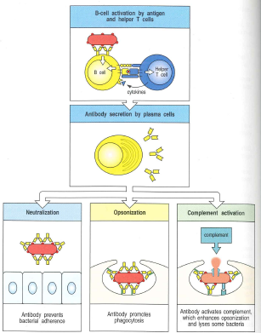
B-cell functions
Neutralization
Opsonization
Complement activation
Notes:
Neutralization: antibody binds the bacterial surface preventing it from entering cells
Opsonization: facilitating phagocytosis
Complement activation

Slide 3
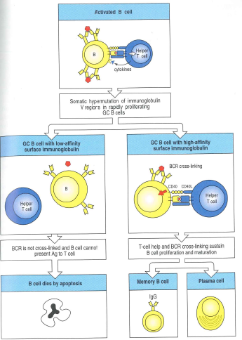
B cell Activation
T-cell Mediated:
  Recognize MHC class II bound to peptides
  Deliver an activating signal to B cell
  Called thymus dependent or TD antigens
B-cell recognition of microbial constituent
  Two potential routes:
    Direct recognition of common microbial constituent
    Nonthymus-derived accessory cell w/ massive cross-linking of B-cell receptors
  Called thymus independent or TI antigens
Notes:
B-cell activation
T-cells recognize MHC class II bound to peptides and deliver an activating signal to B cell
Antigen presenting cell is traditionally a dendritic cell but may also be a B cell
Signal is enhanced by CD19:CD21:CD81 co-receptor complex
Called thymus dependent or TD antigens
IL-4 and CD-40L are synthesized and secreted by helper T cell and activate clonal expansion of B cells
B cells become trapped in T-cell zones of the lymphoid tissue allowing interaction with T cells and activation
B-cell recognition of microbial constituent
Two potential routes:
Direct recognition of common microbial constituent
Nonthymus-derived accessory cell w/ massive cross-linking of B-cell receptors
Called thymus independent or TI antigens

Slide 4
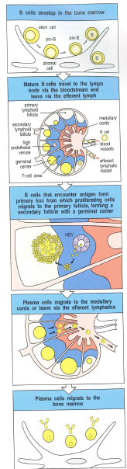
B cell Activation
Proliferating B cells
  Plasma cell
  Development of the germinal center
    Site of rapid B cell proliferation
    Surviving cells will differentiate into plasma cells or memory B cells
Notes:
Two different destinations of proliferating B cells
B cell differentiates into plasma cells for antibody synthesis
B cell migrates to primarly lymphoid follicle to develop the germinal center
Site of rapid B cell proliferation
B cells undergoing somatic mutation are selected for highest affinity to surface immunoglobulins
Surviving cells will differentiate into plasma cells or memory B cells

Slide 5
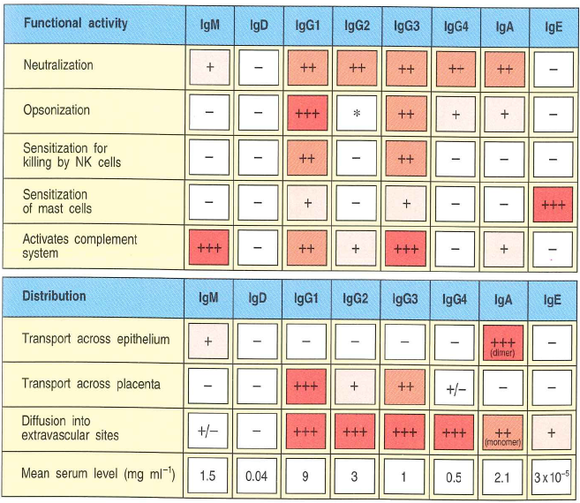
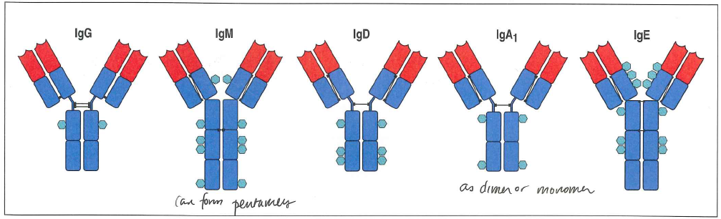
Antibody isomers
IgM
IgA
IgG
IgE
Notes:
IgM:
First to be distributed
Of low general affinity
Forms pentamers allowing for simultaneous binding to multivalent antigens such as bacterial capsules
Extremely effective at activating the complement system
Typically does not diffuse into tissues due to large size
IgA:
Diffuse easily into tissues
Forms dimers
Principle isotype in secretions such as mucous of epithelium, intestinal and respiratory tracts
Less potent than IgG as opsonin and complement activator
Primarily functions as neutralizing antibody
IgG:
Always monomeric
Selected for high affinity
Principle isotype in the blood and extracellular fluids
Efficient at opsonization for phagocytes and complement
IgE:
Highly bound by mast cells beneath skin and mucosa and along blood vessels in connective tissues
Stimulates degranulation of mast cell

Slide 6
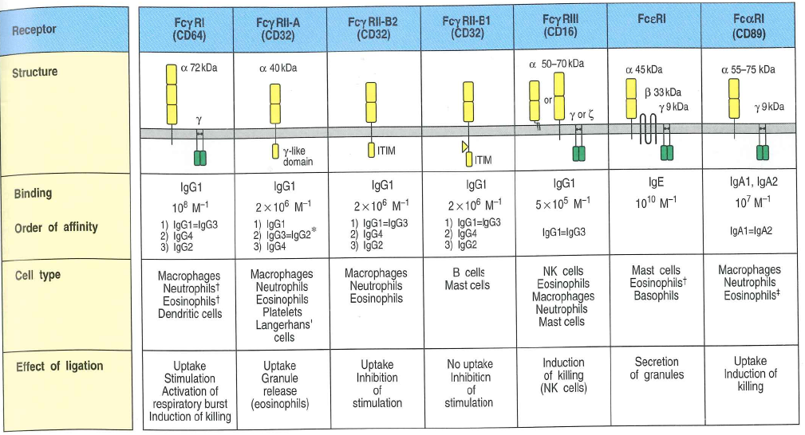
Fc Receptors
d
Notes:
Fc receptors of accessory cells are signaling receptors specific for immunoglobins of different isotypes
Phagocytes are activated to ingest and destroy pathogens by IgG antibodies
Facilitated by binding of complement protein C3b
Antibody dependent cell mediated cytotoxicity:
Antibody bound to the surface of the cell interacts w/ Fc receptors on the NK cell
IgG is typically involved
Results in activity similar to cytotoxic t cells with granzyme and perforins
Mast cells, basophils and eosinophils bind IgE antibody by high affinity FcE receptor
Results in degranulation
Crucial to defense against parasite infestation

Slide 7
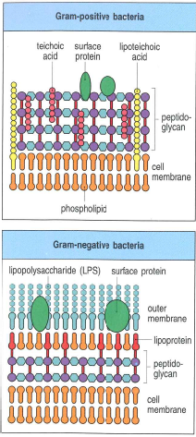
Pattern Recognition
Pattern associated molecular patterns (PAMP)
  Recognize pattern recognition receptors (PRR)
Damage associated molecular patterns DAMP
Notes:
Microorganisms typically bear repeating patterns on surfaces-pattern recognition receptors
Cell wall of gram positive and gram negative bacteria have repetitive matrix of proteins, carbohydrates and lipids
Lipopolysaccharide on gram neg
lipotechoic acid on gram pos
Also capable of recognizing DAMPs (danger associated molecular patterns)
Basically an umbrella term for PAMPs and endogenous alarm signals from dying/injured cells

Slide 8
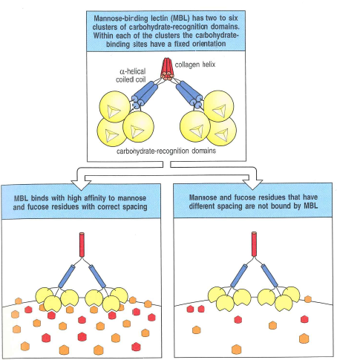
Mannose-binding lectin
Recognize specific array of mannose if repetitive in the cell wall

Slide 9
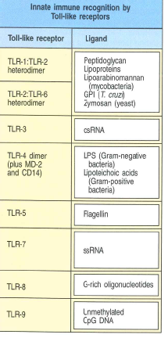
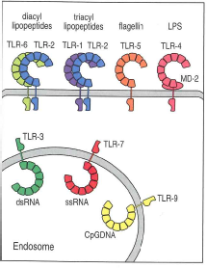
Toll-like receptors
13 different receptors
TLR-4 well studied as it binds LPS
Response will vary based on the type of infection
RIG-I and Mda5 helicases also capable of recognizing PRR
Notes:
13 different receptors each having different ligands identified by 2010
Most thoroughly studied of PAMPS
TLR-4 well studied as it binds LPS
Has been shown to be important in the response to sepsis
TLR-4 negative mice have diminished cellular and humoral immune responses in sepsis
Responses will vary based on the type of infection they are responding to
MAP kinase
PI 3-kinase
Results in NFkB liberation from inhibitor which allows it to move into the nucleus
NFkB is associated with HDP production as well as cytokines and cell adhesion molecules
Also stimulates the activation of NJK and p38 MAP kinases
RIG-I and Mda5 helicases also capable of recognizing PRR

Slide 10
JakStat
Cytokines of hematopoietin family signal by the Janus kinase family
  Phosphorylate associated receptors generating new binding sites
  Some SH2 containing factors recruited which contain signal transducers and activators of transcription (STAT)
  STATs will form dimers and translocate to nucleus to initiate gene transcription
Notes:
Cytokines of hematopoietin family can signal by the Janus kinase family
Will phosphorylate associated receptors generating binding sites for proteins w/ SH2 domains
Some SH2 containing factors are recruited which contain signal transducers and activators of transcription (STAT)
Stats will form dimers and translocate to nucleus to initiate gene transcription

Slide 11
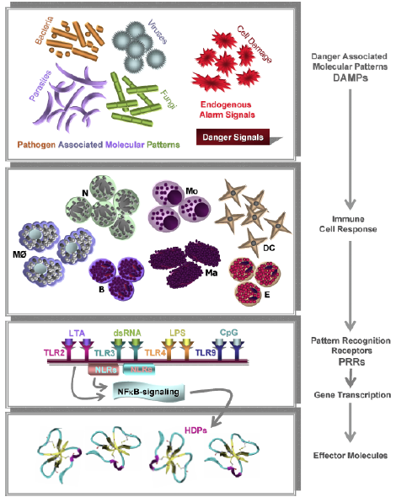
Host Defense Peptides
Consists of defensins and cathelicidins (most reviewed) as well as other substances
Recognition by membrane potential and cholesterol content in plasma membrane
Notes:
Membrane potential of eukaryotes is low compared to bacterial transmembrane potentials
Cholesterol is found in all eukaryotes

Slide 12
Host Defense Peptides
Synthesis and expression
  Can be constinuently expressed or expressed in response to inflammation/infection
  Promoted by LPS, IL-1β, and TNFα

Slide 13
Host Defense Peptides
Biological activity:
  Act as chemoattractant for immune cells
  Enhance cellular adhesion and subsequent cellular transepithelial migration
  Enhance cytotoxicity of NK cells
  Inhibit the activation of classical complement pathway
  Bind LPS and LTA
  Chemotactic for monocytes
  Interact with the ACTH receptor

Slide 14
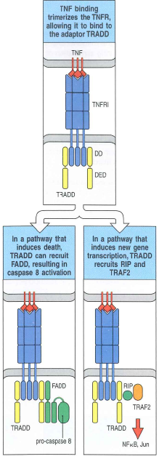
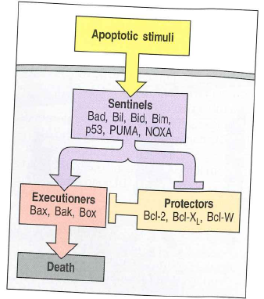
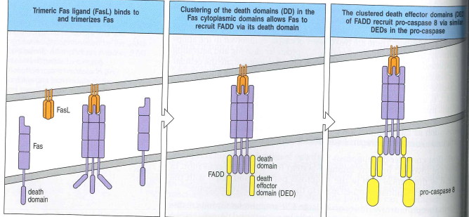
Extrinsic Apoptosis
Activation of death receptors
  Part of TNF family
  Contain a special cytoplasmic region called the death domain
  Fas ligand will trimerize Fas
  Recruits Fas-associated via death domain (FADD)
  Signals release of caspase
Notes:
Activation of death receptors
Part of TNF family and have a special cytoplasmic region called the death domain
Fas ligand will trimerize Fas
Clustering will recruit fas-associated via death domain which contains the death effector domain
Results in release of caspase which is a protease and the effector of apoptosis

Slide 15
Intrinsic Apoptosis
Response to noxious stimuli
  UV radiation, chemotherapy, starvation
Cytochrome C release
  Result of signaling from Bcl-2 family of proteins
    Some Bcl-2 will promote apoptosis and some will inhibit it

Slide 16
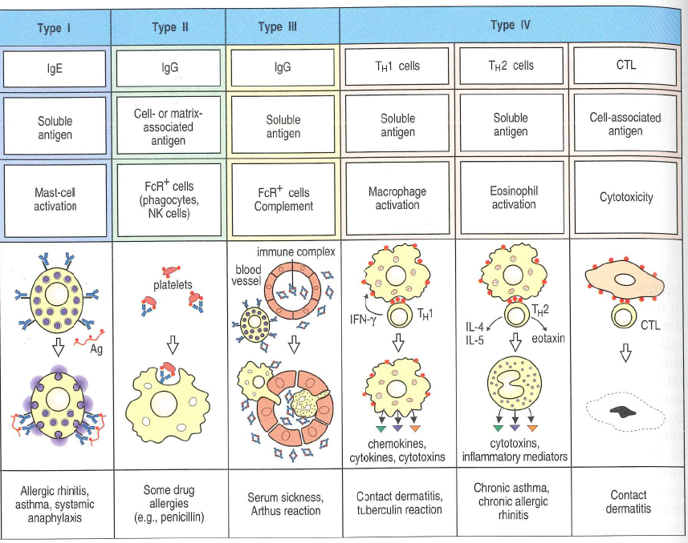
Notes:
Type 1 hypersensitivity
Result of binding of antigen to IgE resultant mast cell, basophil or eosinophil degranulation
Immediate/antibody mediated
Allergen is an antigen that evokes T_{H}2 to drive an IgE response
A highly diffusible particle
Often only necessary in small quantities in order to selectively evoke T_{H}2
Enzymes have been specifically implicated as allergens in asthma as well as dust allergies
Involves two phases:
Immediate reaction: due to histamine and prostaglandins→rapid increase in vascular permeability and contraction of smooth muscle
Late-phase reaction, 8-12 hours later, induced synthesis of leukotrienes, chemokines and cytokines drawing more eosinophils and T_{H}2 lymphocytes to site
Clinically less marked than the immediate response
Associated with second phase of smooth muscle contraction, sustained edema and development of airway hyperreactivity to nonspecific bronchoconstrictor stimuli (histamine)
Systemic anaphylaxis
Allergen is introduced directly into the bloodstream or rapidly absorbed
Widespread increased vascular permeability, airway constriction
Initially believed to be immunoglobin mediated but anaphylactoid reactions with cytotoxic and immune complex mechanisms are known (e.g. blood transfusion)
Asthma: allergen induced activation of submucosal mast cells in lower airways
May include an acute response
Also includes chronic inflammation of the airways with increased numbers of T_{H}2 and eosinophils as well as other inflammatory mediators such as neutrophils
Skin allergies and GI allergies also associated with type I hypersensitivity
Type II hypersensitivity
Binding of a cell by antigen
“immune complexes”
Referred to as cytotoxic
Attack of the antigen by preformed antibody
Example would be penicillin hypersensitive people
Type III hypersensitivity
Soluble antigens give rise to antigen:antibody complexes or immune complexes
Delayed, t-cell dependent
Pathogenic potential determined by size as well as the amount, affinitiy and isotype of responding antibody
Large aggregates are fixed by complement and cleared from the system
Small complexes tend to deposit in blood vessel walls
Can ligate Fc receptors on leukocytes leading to leukocyte activation and tissue injury
Serum sickness-systemic type III hypersensitivity response
Injection of large quantities of poorly catabolized foreign antigen
Occurs 7-10 days after the injection of the antigen
Clinical features: chills, fever, rash, arthritis and glomerulonephritis
Type IV hypersensitivity
Delayed-type hypersensitivity
Mediated by antigen specific effector T cells
Can be mediated by CD4 or CD8 cells

Slide 17
Type I Hypersensitivity
Eosinophilic pneumopathy
Flea bite hypersensitivity
Anaphylaxis
Notes:
Eosinophilic pneumopathy type I
Thought to be a sensitivity to fungi, molds, drugs, bacteria or parasites (heartworm)
Most cases inciting antigen is not identified
Likely a combo of type I and IV in humans
Involves a pulmonary infiltration of IgE
Flea bite hypersensitivity
Can present as type I or type IV
Anaphylaxis
two mechanisms have been shown-IgE w/ stimulation of mast cells, basophils, histamine, prostaglandins, leukotrienes, serotonin and PAF and IgG, Fc, macrophages, and PAF

Slide 18
Type II and III
Blood transfusion:
  Acute hemolytic transfusions
  TRALI more T cell mediated
Albumin Transfusions:
  Conflicted reports in literature
Notes:
Blood transfusion
Acute hemolytic reactions with previously formed antibody
Albumin in ill dogs:
Delayed reactions 5-14 days following administration included lethargy, edema, urticarial, lameness, ppyrexia and vasculitis, vomiting, generalized pain and inappetance in 3 dogs. All 3 recovered
Albumin type IV
Six healthy dogs received albumin transfusion and all developed delayed signs including peripheral edema, vasculitis, inappetance, lameness, depression and lethargy. One dog developed oliguric renal failure and died and another dog died from e coli bacteremia

Slide 19
Type IV Hypersensitivity
Food sensitivity
  Lack of antigen-specific iGE and low correlation b/t intradermal skin test and oral food provocation tests.
  High lymphocyte stimulation tests in dogs with food sensitivity
  Indicates circulating lymphocytes reactive to food antigens in peripheral blood
Sulfonamide hypersensitivity type IV
  Delayed onset of signs with fever, skin eruptions, hepatotoxicity, blood dyscrasias and KCS
  Time frame of 5 days exposure plus one patient with dermal antibodies suggests type IV hypersensitivity
Notes:
Food sensitivity type IV
Humans often have type I to foods, previously presumed to be so in dogs
Lack of antigen-specific iGE and low correlation b/t intradermal skin test and oral food provocation tests.
High lymphocyte pstimulation tests in dogs with food sensitivity
Indicates circulating lymphocytes reactive to food antigens in peripheral blood
Other studies have shown histamine release from peripheral basophils in food antigen responses, suggesting type I
Food exposure up to 14 days necessary to elicit responses, suggesting type IV
Sulfonamide hypersensitivity type IV
Delayed onset of signs with fever, skin eruptions, hepatotoxicity, blood dyscrasias and KCS
Time frame of 5 days exposure plus one patient with dermal antibodies suggests type IV hypersensitivity

Slide 20
Exogenous manipulation of immunity
Immunosupression
  Steroids
  Cytotoxic drugs
  Cyclosporin A
Immunomodulation
  Lymphocyte T cell modulator
  Levamisole
  Herbals
  Cytokines

Slide 21
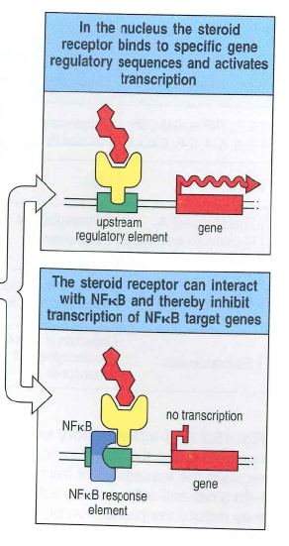
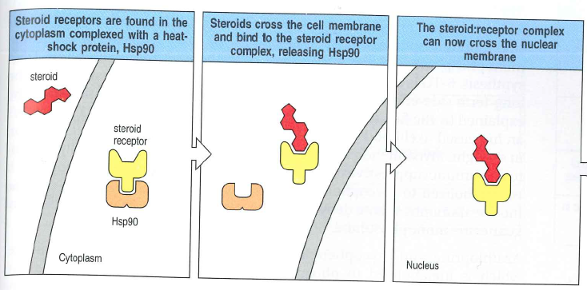
Steroids
Two different receptors
  Intracellular steroid receptors
  Poorly characterized membrane-bound receptors expressed in nearly every cell in the body
Notes:
Corticosteroids:
Acts through two different receptors
Intracellular steroid receptors
Poorly characterized membrane-bound receptors expressed in nearly every cell in the body

Slide 22
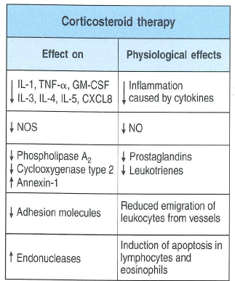
Steroids
Alter DNA transcription
Rapidly produce anti-inflammatory proteins
Notes:
Alter DNA transcription by two mechanisms
Directly bind specific sites on DNA
Interact with other transcription factors, such as NF-κB
Rapidly produce anti-inflammatory proteins
Target functions of monocytes and macrophages and reduce numbers of CD4 T cells
Adverse side effects are common

Slide 23
Cytotoxic
Kill rapidly dividing cells, particularly skin, GI tract and bone marrow
Azathioprine
Mycophenolate mofetil
Cyclophosphamide
Notes:
Azathioprine, cyclophosphamide, mycophenolate
Kill rapidly dividing cells, particularly skin, GI tract and bone marrow
Azathioprine:
Converted in vivo to purine analog 6-thioguanine
Competes with inosine monophosphate, blocking de novo synthesis of adenosine monophosphate and guanosine monophosphate
Blocks DNA synthesis
Mycophenolate mofetil
Metabolized to mycopheonlic acid
Inhibits the enzyme inosine monophosphate
Cyclophosphamide
Metabolized to phosphoramide mustard
Alkylates DNA
Cyclosporin A
Block T cell proliferation by inhibiting phosphatase activity of calcineurin5

Slide 24
Cyclosporin A
Block T cell proliferation
Inhibit phosphatase activity of calcineurin

Slide 25
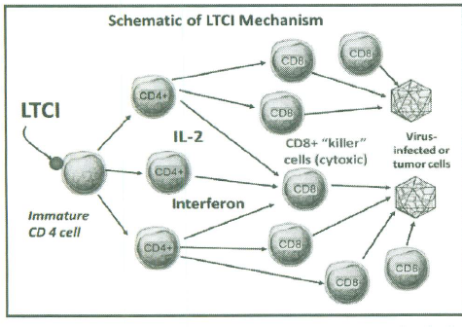
Lymphocyte T-cell modulator
Regulation of CD-4 T cells
Isolated thymic epithelial cell
Shown to increase lymphocyte numbers and IL-2
Approved for aid in treatment of FeLV and FIV
Notes:
2 studies in literature both ex-vivo on thymic cells
Appears some studies on mice and cats but I don’t believe they are published
Nothing clinical that I could find
Also increased red cell counts in anemia and also platelets
Currently on special

Slide 26
Levamisole
Suspected to be involved in altered metabolism of cyclic neucleotides S-AMP and c-GMP
Activates T lymphocytes and increases antibody production
Increased function of monocytes and neutrophils
Enhances maturation of dendritic cells
Upregulation of toll-like receptor 7 and 8
Notes:
Anthelminthic used in production medicine
MOA: suspected to be involved in altered metabolism of cyclic neucleotides S-AMP and c-GMP
Activates T lymphocytes and increases antibody production
Increased function of monocytes and neutorphils
Enhances maturation of dendritic cells
Upregulation of toll-like receptor 7 and 8
A few studies looking at immunotherapy for neoplasias in cats
Significantly earlier production of lymphocytes and neutrophils in dogs w/ demodex treated w/ amitraz and levamisole vs. just amitraz
Case reports of generalized papillomatosis and treatment
Mouse study w/ vaccination for hep B virus to increase PAMPs, upregulated t lymphocytes

Slide 27
Herbals
Adaptogens
Polysaccharide complexes and sterols
Echinacea
Astragalus
CpG oligodeoxynucleotides from bacterial DNA sequences
Notes:
Adaptogens
Most common would be Asian Ginseng
Generally work by modulation of the hypothalamic-pituitary-adrenal axis
Polysaccharide complexes and sterols
Shitake or reishi mushrooms
Enhance cell mediated immunity
Echinacea
Increases the activity of phagocytic cells
Promotes cytokine production
Enhanced activity of natural killer cells
studies of macrophages in mice performed showed increased macrphage activation in vivo, increased IL-12 production
Astragalus: increases T-cell mediated immunity
CpG oligodeoxynucleotides from bacterial DNA sequences
Induce systemic innate immune response of short duration
Stimulate B-cell proliferation, expression and cytokine production as well as enhanced NK cell cytotoxicity
Induce lymphocyte proliferation in the spleen and lymph node ex vivo
Considered a possibility for vaccine adjuvant
study showed ex vivo increased lymphocyte production in lymph node and spleen, not in blood though…
improves canine staph dematitis

Slide 28
Other drugs
Interferon omega
IL2 in cats with chronic rhinitis
Notes:
INF omega in cats w/ FELv:
interferon (IFN)-treated cats (n 5 39) had significantly reduced clinical scores (based on clinical signs such as interest in eating and stomatitis and death) compared with placebo (n 5 42),
IFN-treated group showed significantly lower rates of mortality:
The IFN treatment was associated with minor but consistent improvement in abnormal hematologic parameters (red blood cell count, packed cell volume, and white blood cell count),
Previously investigated in parvo dogs and showed statistically significant decreases in mortality in unvaccinated dogs
IL2 cats: adults showed significant decreases in number of sneezes, not in young and Th2 profiles not different in rhinitis from normal cats

Slide 29
Immunosupressive conditions
Non-infectious
  Nutrition
  Iatrogenic
  Environmental
Infection
  Viral
  Bacterial
  Fungal
  Protozoal
Notes:
Decreased IgG, C3, antibody titers, lymphocyte counts, lymphocyte response to mitogen, neutrophil counts and neutrophil chemotaxis from malnutrition
Decreased CD4:CD8 T cell ratio with malnorishment

Slide 30
Lipids
Polyunsaturated fatty acids (PUFAs)
  inhibit lymphocyte proliferation and NK cell activity
  decreased cytokine secretion
  lead to a shift away from helper 1 T cell response

Slide 31
Amino Acids
Involved in activation of T and B cells, NK cells and macrophages
Necessary for:
  Gene expression
  Lymphocyte proliferation
  GABA production
  Production of antibodies, cytokines and other cytotoxic substances
Studied amino acids:
  Arginine
  Aspartate
  Glutamine
  Lysine
  Methionine
  Cysteine
  Taurine
Notes:
Amino acids involved in activation of T and B cells, NK cells and macrophages
Necessary for:
gene expression
lymphocyte proliferation
arginine deprevation
glutamine for GABA production
production of antibodies, cytokines and other cytotoxic substances
Studied amino acids:
Arginine necessary for lymphocyte development
Deficiency leads to dcreased B cells in lymphoid organs
Aspartate and glutamine are involved in metabolism of leukocytes
Glutamine supplementation has been shown to enhance immunity
Lysine deficiency decreases immunity
Methionine and cysteine necessary for T and B cell proliferation and function
Taurine in cats→lymphopenia, spleen and lymph node atrophy, impaired oxidative burst by phagocytes

Slide 32
Minerals
Copper
Zinc
Iron
Selenium
Notes:
Dietary copper deficiency
Decreased antibody production and cell-mediated immunity
Zinc deficiency
Lymphopenia
Thymic atrophy
Reduction in lymphocyte function
Reduction in NK and CD4 cell function
Decreased neutrophil chemotaxis
Iron deficiency
Decreased T cell responses, cytokine and antibody production
Selenium deficiency
impairs lymphocyte proliferation
impairs antibody production
decreased neutrophil chemotaxis

Slide 33
Vitamins
Vitamin A
Vitamin E
B Complex Vitamins
Notes:
Vitamin A: decreased mucosal epithealization, impaired neutrophil and NK cell function, decreased number of B cells, increased risk of infection
Vitamin E: decrease in lymphocyte proliferation
B complex vitamins: may impair both humoral and cell-mediated immunity

Slide 34
Iatrogenic
Vaccination
Anesthesia
Notes:
Vaccination
Suppressed lymphocyte baslogenesis responses following parvo vaccination in one study
Decreased lymphocyte numbers day 5 and 7 post vaccination in larger study
One study in adult dogs showed increased levels of IgG, cytokines and complement activity and decreased lymphocyte responses
Suggests a shift from cell mediated to humoral immunity following vaccination
Anesthesia
Lymphocyte stimulation depressed 1 week post OHE
Most studies show no change in antibody responses with vaccination at or around anesthetic events

Slide 35
Stress and exercise
Shown in large animals with shipping fever
Sled dogs
Not repeatable in lab setting
Notes:
Shown in large animals with shipping fever
Sled dogs exercised 5 consecutive days
Mean serum globulin concentrations were low at rest and decreased progressively throughout the study
Not repeatable in lab setting

Slide 36
Patient Factors
Endocrinopathies
Advanced age
Notes:
Diabetes mellitus
Increased infections correlated to cell-mediated immunity and phagocytic function
Proposed decreased neutrophil adherence shown in poorly controlled diabetic dogs
Proposed that thyroid dysfunction and cortisol excess will be associated with immunodeficiency
Advancing age
Decreased mitogen activated lymphocyte proliferation
Decreased percentage of B lymphocytes
No changes in NK cell activity or phagocytic activity

Slide 37
Environmental
Trauma
Toxins
Radiation
Notes:
Trauma
Dysfunction of antigen presenting cells and T cells
Danger signals released after trauma
Causes cytokine release
May affect phagocytes and cell-mediated immunity, humoral immunity typically spared
Toxins
Drugs:
Typical immunosuppressants
Glucocorticoids
Cyclophosphamide
Chlorambucil
Methotrexate
Mycophenolate
Leflunomide
Bone marrow suppression
Phenobarbital
Sulfa drugs
Opioids
Results in decreased NK cell activity, reduced lymphocyte and interferon-gamma activity
Chronic opioid use will affect HPA axis
Via activation of adrenal glands to secrete glucocorticoids
Acute opoid use will affect sympathetic nervous system
Primary (thymus) and secondary (Peyer’s patches, lymph nodes) are affected by sympathetics
Opioids induce catecholamine release
These suppress NK cells and macrophage activity
Intereference of the phagocytic activities of macrophages
Inhibit B and T cell response
Interfere with chemotaxis
Modulate immune mediator production
Dopamine:
via receptors on immune cells w/ highest numbers found in b cells and NK cells
when T cells are activated likely results in their supression,
Suspected:
Insecticides
Herbicides
Fungicides
Halogenated cyclic hydrocarbons
Heavy metals
Mycotoxins
Radiation
Sun radiation
Changes in antigen presenting cells of skin and activation of regulatory T cells
Radiographs or radiation therapy will reduce lymphocytes

Slide 38
Viral
Canine distemper
Canine parvovirus 2 and feline panleukopenia virus
Feline Leukemia virus
FIV
Feline corona virus
Notes:
Canine distemper
Destruction of lymphocytes, particularly CD4+ in initial stages, CD8+ later
Necrosis of hematopoietic cells in bone marrow may cause leukopenia
Canine parvovirus 2 and feline panleukopenia virus
Leukopenia:
Sequestration of neutrophils in damaged GI tract
Destruction of precursors in bone marrow
Feline Leukemia virus
Viral protein inhibits T and B-cell function
Inhibited cytotoxic responses
Altered monocyte morphology and distribution→impaired cytokine production
CD4+ T cell malfunction can lead to decreased CMI and humoral functions
Lymphopenia is common along with decreased lymphocytes in lymph nodes
FIV
Progressive reduction in CD4+ T-cell numbers
Initially also neutropenia from apoptosis
Feline corona virus
Depletion of CD4+ and CD8+ cells
Hypergammaglobuinemia

Slide 39
Bacterial
Ehrlichia canis
Anaplasma phagocytophilum
Bartonella
Notes:
Ehrlichia canis
Organism infects monocytes forming morulae
Acute phase: transient cytopenias (esp. thrombocytopenia)
Unclear mechanism, may be associated with decreased MHC class II expression
Anaplasma phagocytophilum
Infects granulocytes, particularly neutrophils
Decreased superoxide production in infected cells
Decreased neutrophil mobility and phagocytosis
Reduces endothelial adherence and transmigration
Bartonella
Impaired leukocyte function
Cyclic CD8+ lymphopenia
Decreased adhesion molecules
Decreased MHC class II molecules
Decreased B lymphocytes

Slide 40
Protozoal and Fungal
  Leishmania
  Fungal:
    Aspergillus, Candida, Cryptococcus
Notes:
Leishmania
Intracellular to phagocytes
Inhibits respiratory burst
Inhibits macrophage function and apoptosis
Impaired antigen presentation through inhibiting MHC expression
Impairs chemotaxis
Interferes IL-2 transcription
Binds and suppresses NK activity
Fungal:
Aspergillus, Candida, Cryptococcus
Glucuronoxylomannan mediated immunosuppression
Inhibits phagocytosis
Interferes w/ migration of leukocyte from bloodstream to tissues
Depletes complement
Inhibits T-cell responses

