Slide 1
Immunology Basics
Joel Green Weltman
12/14/2010

Slide 2
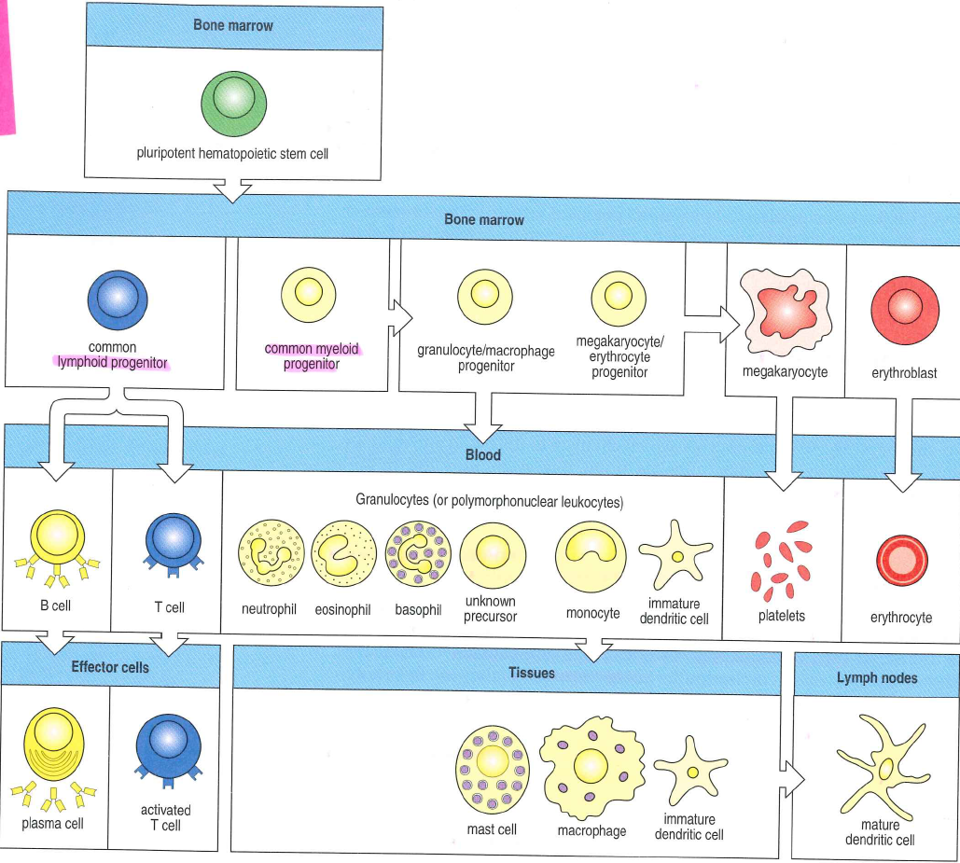
The major players
Notes:
Myeloid progenitor: precursor to granulocytes, macrophages, dendridic cells and mast cells
Common lymphoid progenitor: gives rise to both B and T cells
B cell: differentiate into the plasma cell
B cell antigen receptor secretes antibodies
T cell: gives rise to cytotoxic T cells and another T cell that activates B cells and macrophages

Slide 3
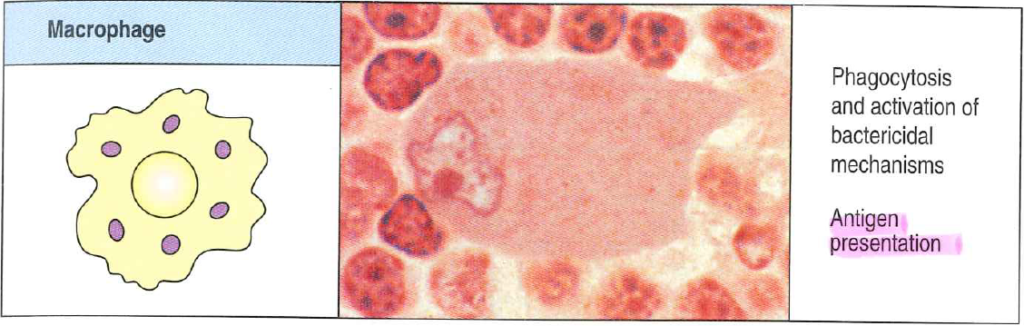
Macrophage
Mature or tissue form of monocyte, phagocytic
In innate immunity will recognize common bacterial surface antigens or a complement fixed to the bacterial surface
Release cytokines and chemokines
Also play a role in antigen presentation to T cells

Slide 4
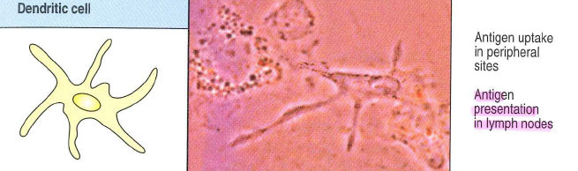
Dendritic Cell
Take up antigen and display it for recognition by lymphocytes
    Immature forms in most tissues-pick up antigens
    Have receptors recognizing common features of many pathogens
    Become activated by phagocytosis or macropinocytosis of antigen
    Following activation becomes an antigen-presenting cell
Notes:
Move via lymph to lymph nodes, present antigen to lymphocytes
Laangerhaans cell is epithelial one, common example

Slide 5
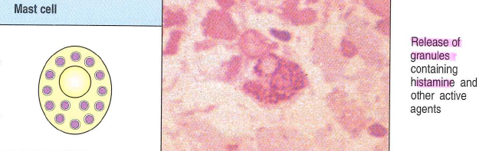
Mast Cell
  Release vasoactive substances and orchestrate allergic response, protect mucosal surface against pathogens
Notes:
release vasoactive substances and orchestrate allergic response, protect mucosal surface against pathogens

Slide 6
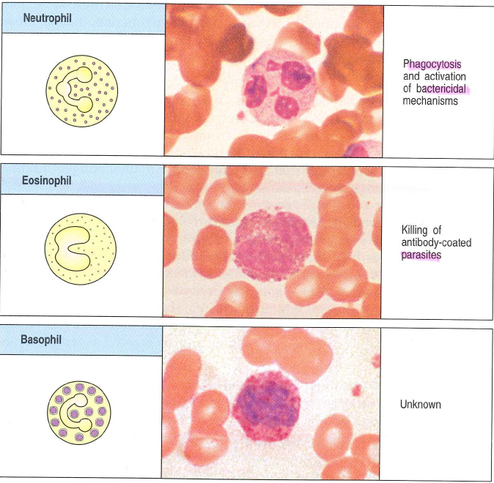
Granulocyte
Neutrophils: most important member of the innate immune system, phagocytic
Eosinophils: defense against parasitic infections
Basophils: complement the roles of eosinophils and mast cells
Notes:
Neutrophils: most important member of the innate immune system, phagocytic
Recognize bacterial constituents or complement fixed to bacterial surface

Slide 7
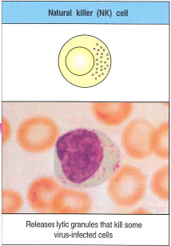
Natural Killer Cell
Member of the innate immune system
Large lymphoid type cell with special granules that react to particular antigens

Slide 8
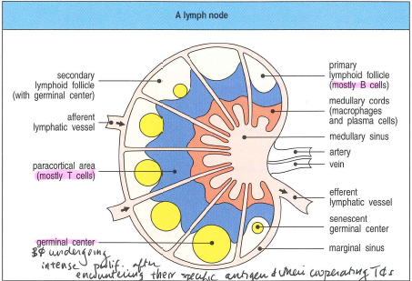
Lymphoid Organs
Bone Marrow
Thymus
Lymph node
Spleen
Gut associated lymphoid tissues
Bronchial Associated lymphoid tissues
Mucosal associated lymphoid tissues
Notes:
Bone marrow: where B cells mature
Thymus: where T cells mature in the fetus and juvenile
Adult t-cell numbers maintained by division of mature t-cells outside of the central lymphoid system
Lymph node: collects antigen from the lymph
Spleen: collects antigen from the blood
Red pulp responsible for removal of damaged or dead red cells
White pulp responsible for antigen recognition
Gut-associated lymphoid tissues: tonsils, adenoids, appendix and Peyer’s patches
Collect antigen from the epithelial surfaces of the GI tract

Slide 9
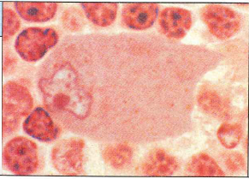
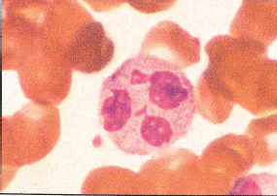
Innate Immunity:
The Front Line
Anatomical/physiologic
  Skin, saliva, tears
  Acidic stomach pH, digestive enzymes, normal flora
  Surfactant proteins A and D
Cellular
  Macrophages
  Neutrophils
Notes:
Surfactant A and D assist in opsonization
Cellular response involves phagocytization and cytokine production with resultant inflammation

Slide 10
Role of inflammation
Delivers effector molecules and cells to augment killing of invading microorganisms
Provides a physical barrier to spread of infection
Promotes repair of injured tissue
Notes:
First cells to arrive are neutrophils, then monocytes come and mature to macrophages
Later in inflammation, lymphocytes and eosinophils may arrive

Slide 11
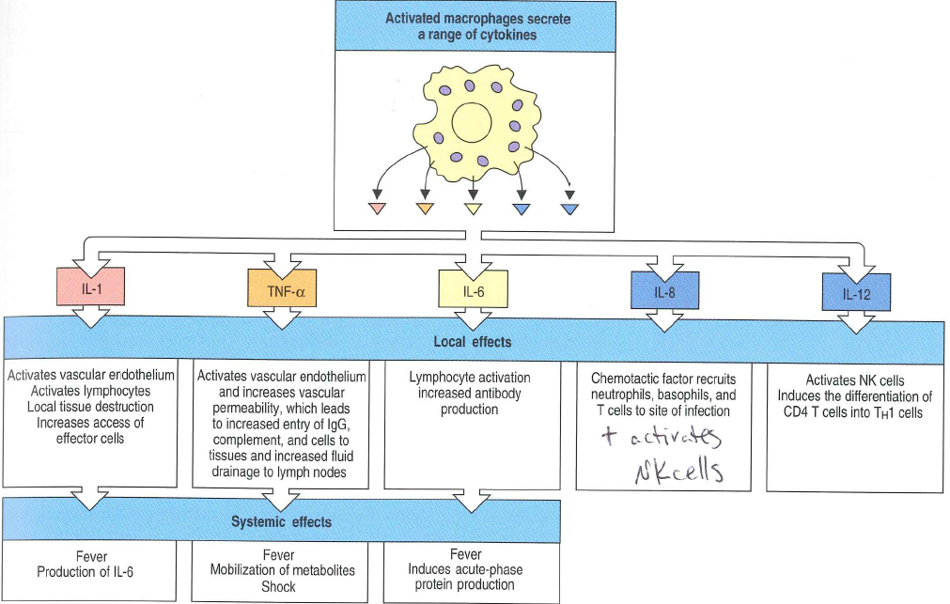
Induced innate immunity
Activated macrophage secrete cytokines
Autocrine, paracrine and endocrine effects
Notes:
Endocrine function if able to enter circulation and how long the half-life is, primarily TNF-α, IL-1 and IL-6
Endogenous pyrogens
Acute phase response
Mobilize neutrophils
Mobilize proteins and fats
Dendritic cell migration

Slide 12
Cytokines
Three major families:
  Hematopoietin family:
    Growth hormones
    Interleukins
  TNF family
    Membrane bound factors
    Chemokines
  Interferon family
Notes:
Hematopoietin family: roles in adaptive and innate immunity
TNF family; adapitve and innate immunity, chemokine functions
Interferons: induce resistence to viral replication in cells, increase MHC class I expression, increase antigen presentation to T cells, activate NK cells to kill virus infected cells

Slide 13
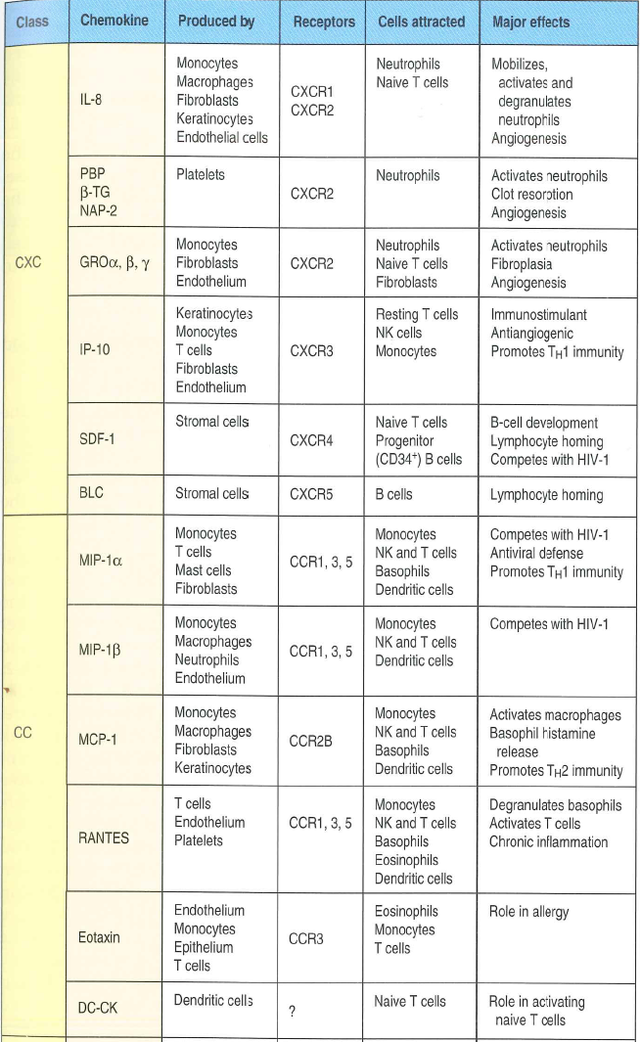
Chemokines
Two major classes, based on receptor:
  CXC: binds neutrophils and B cells
  CC: binds monocytes, T cells, basophils, eosinophils, and dendritic cells
Two major functions:
  Conformational change to leukocyte integrins allowing leukocytes to cross endothelium
  Migration of leukocytes along chemical gradient of chemokine to site of infection

Slide 14
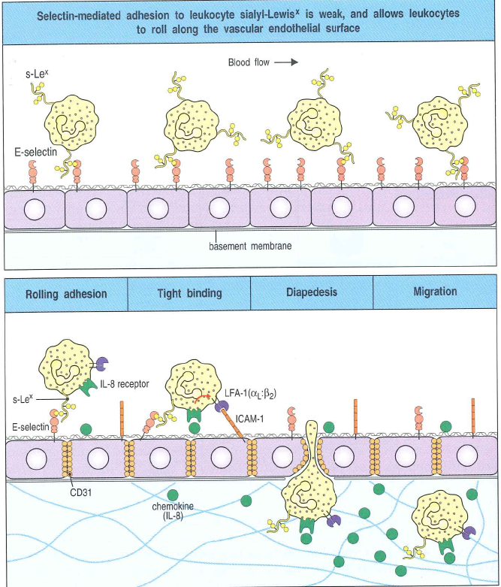
Cell adhesion
  Step 1: Selectins slow the movement of leukocytes:
    Membrane glycoproteins which bind specific carbohydrate groups in passing leukocytes
    Stimulated by TNF-α induced externalization of granules in the endothelial cells which contain P-selectin
    E-selectin production is stimulated shortly after

Slide 15
Cell adhesion
  Step 2: Integrin and ICAM interactions strengthen adhesion between leukocytes and endothelial cells
    Integrins: present on circulating Monocytes and polymorphonuclear leukocytes
    Intercellular adhesion molecules (ICAMs): bind heterodimeric proteins of leukocyte integrin family
Notes:
Integrins: LFA-1 is an example
ICAM1 is produced upon exposure to TNF-α and subsequently binds LFA-1

Slide 16
Cell adhesion
Step 3: Leukocyte diapedesis
  Interactions between PECAM and LFA-1
Step 4: Movement of the leukocytes through the tissues
  Directed by chemokines

Slide 17
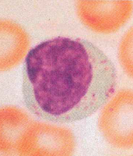
Natural Killer Cells
Secrete cytotoxic granules to the surface of target cell→cell death
Production stimulated by IFN-α, IFN-β and IL-12
Recognize uninfected host cells via inhibitory receptors specific for MHC class 1
Notes:
Likely detect alterations in MHC class 1 expression
Recognize changes in cell-surface glycoproteins from viral or bacterial infections

Slide 18
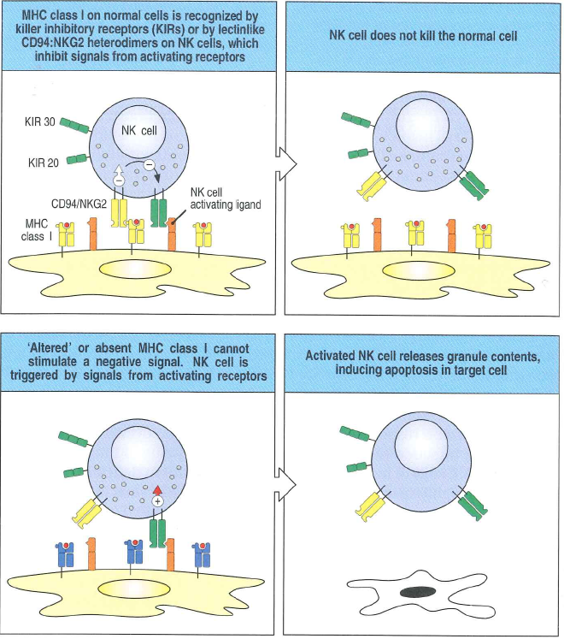
Natural Killer Cells
Recognize virus infected cells primarily by MHC alterations
  Some viruses inhibit protein synthesis→ decreased MHC class 1 proteins
  Viruses inhibit export of MHC class 1 molecules
  NK cells recognize alterations to MHC class 1 complexes with proteins in infected cells
  Detect changes in glycosylation of cell proteins
Notes:
Detect changes in glycosylation of cell proteins allowing recognition by activating receptors or altering the inhibitory receptor of the NK cells

Slide 19
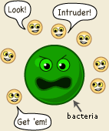
Complement
A series of cleavages
  Numerous distinct plasma proteins react with one another to opsonize pathogens
Many are zymogens
Three separate complement pathways exist, all converge on same effector molecules
Notes:
Zymogens: proteases that are activated by a proteolytic cleavage→Only activated locally at site of infection

Slide 20
Complement
Three primary functions:
  Complement molecules bind pathogens, opsonizing for phagocytes with receptors for complement
  Act as a chemoattractant drawing and activating phagocytes to the site of infection
  Damage certain bacteria by creating pores in the bacterial membrane

Slide 21
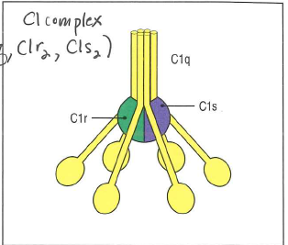
Classical Pathway
Initiated by:
  Binding of C1q directly to the pathogen surface
  Binding of C1q to a Ag-Ab complex
    After multiple C1q are bound, C1r of the C1r:C1s complex is activated and cleaves C1s
Notes:
Binding of C1q to a Ag-Ab complex
Serves as a link b/t the adaptive and innate immune systems

Slide 22
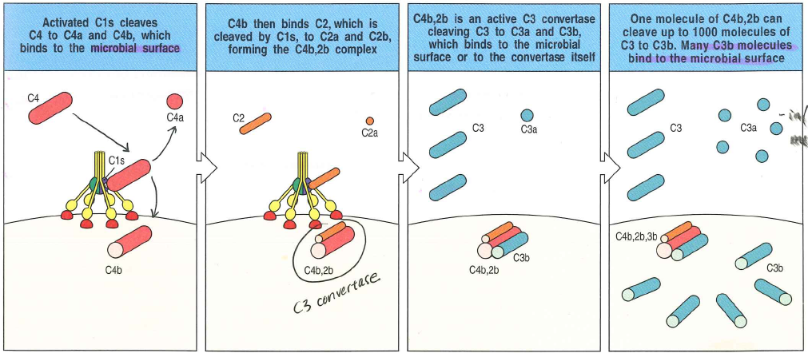
Classical Pathway
C1s cleaves C4 and C2 generating C4b and C2b which together make C3 convertase
Notes:
Following cleavage C4b binds C2 making it susceptible to C1s mediated cleavage
C3 convertase functions to cleave C3 to C3a and C3b
C3b then binds to the membrane

Slide 23
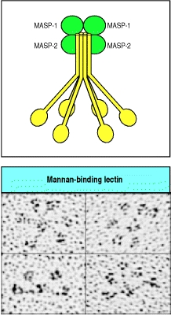
Mannan-Binding Lecitin Pathway
    Mannan-binding lectin binds to mannose-containing carbohydrates on bacteria and viruses
Mannan-binding lectin complex (MASP-1 and MASP-2) is activated to cleave C4 and C2
    Remainder of the pathway mimics the classical pathway

Slide 24
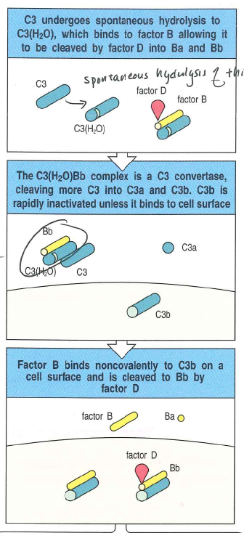
Alternative pathway
    Spontaneous cleavage of C3 forms circulating C3(H₂O)
    C3(H₂O) binds factor B
    Factor B undergoes cleavage by factor D to factor Ba and Bb
    C3(H₂O)Bb complex acts as a circulating C3 convertase
    Circulating C3 convertase forms C3b which may bind to pathogens
    C3b then binds Factor B, once again allowing its cleavage to Ba and Bb via Factor D
    Creates C3b,Bb, a pathogen bound C3 convertase and remainder of the complement cascade

Slide 25
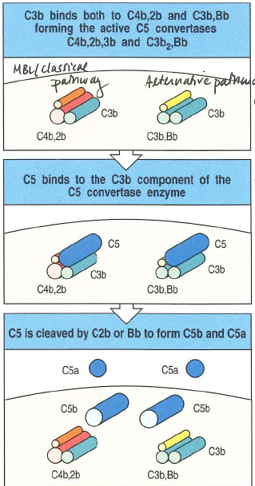
Final Common Pathway
    All pathways eventually generate a protease called C3 convertase
    C3 convertase cleaves C3 to C3b (main effector of complement) and C3a (inflammatory mediator)
    Phagocytes have receptors for C3b
    C3b binds C3 convertase to make C5 convertase
    C5 convertase cleaves C5 to C5a (inflammatory mediator) and C5b (complement effector)

Slide 26
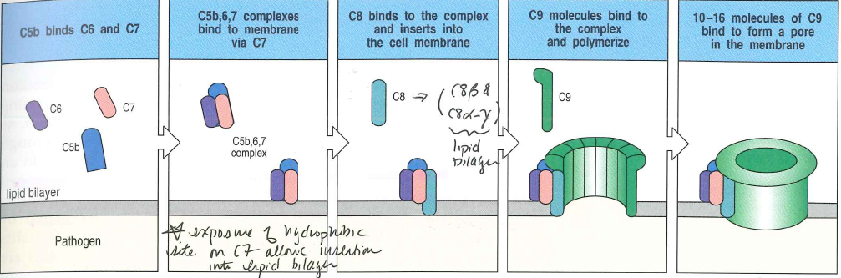
Final Common Pathway
C5b binds C6
C5b, 6 complex binds C7, causing exposure of hydrophobic sites on C7
C5b, 6, 7 complex inserts into the lipid bilayer
C5b binds C8β exposing the hydrophobic site of C8β/C8α-γ complex, allowing it to insert in lipid bilayer
C8α-γ induces polymerization of 10-16 C9s forming MAC

Slide 27
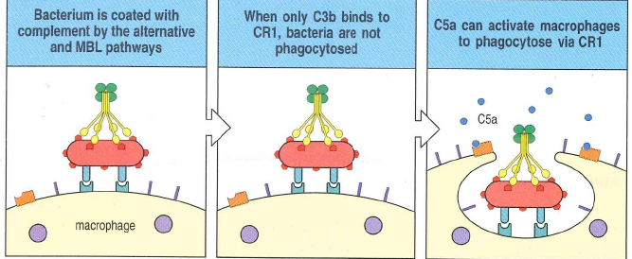
Complement and Phagocytosis
  Complement receptors are present on the phagocytic cells
  C3b is the primary opsonin in the complement cascade
  CR1 (CD35): macrophages, basophils, neutrophils, eosinophils
    Cannot independently stimulate phagocytosis, but does so in the presence of other inflammatory mediators, such as C5a
Notes:
, C4b opsonizes to a lesser extent

Slide 28
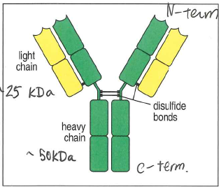
Antigen Recognition
Antibody
Functions of antibody:
  Bind molecules from pathogen eliciting immune response
  Recruit other cells to destroy antigen
  Contain light and heavy chains
  Antigenic determinant or epitope
  Conformational or discontinuous epitopes
  Continuous or linear epitope
Notes:
Bind to molecules from the pathogen which elicited the immune response
Facilitated by the variable region or V region
Contains two pairs of light-heavy chain pairs which each can bind an antigen
Recruit other cells to destroy the pathogen once the antibody is bound
Facilitated by the constant region or C region
Heavy chain differentiates the classes of immunoglobulins and thus the function
A structure of the pathogen is recognized by the antibody at the antigenic determinant or epitope
Conformational or discontinuous epitopes: identification of particular 3D protein structure
Continuous or linear epitope: identification of single segment of polypeptide chain

Slide 29
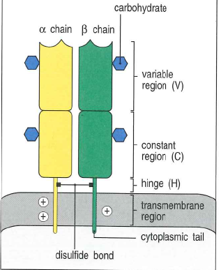
Antigen recognition
T cells
T cell receptor structure
  2 polypeptide chains linked by a disulfide bond
  1 antigen-binding site
  Never secreted
  Consists of the variable region and the constant region with hydrophobic transmembrane domain ending in the cytoplasmic tail
Notes:
2 polypeptide chains linked by a disulfide bond, similar to a portion of the antibody
1 antigen-binding site, different from antigen as it has 2

Slide 30
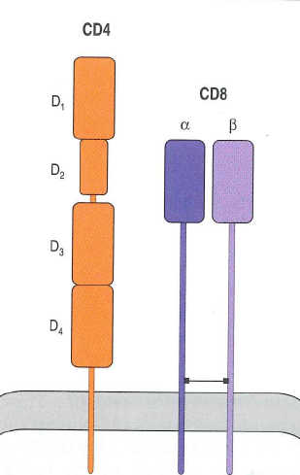
Antigen recognition
T cells
  T cell surface proteins CD4 and CD8 interact with MHC:
  Recognize a complex of antigentic peptide to the MHC molecule
  CD4 binds to MHC class II
    Activate effector cells of the immune system
  CD8 (cytotoxic T cell) binds to MHC class I
    Present peptides from pathogens to specialized T cells to kill any cell they recognize
Notes:
Major histocompatibility complex: specialized glycoproteins which facilitate antigen presentation
MHC expression is regulated by interferons
Peptides bound to MHC molecules stabilize the MHC molecule to the cell surface
MHC is able to bind many structurally different peptides simultaneously
CD4 binds to MHC class II
Activate effector cells of the immune system:
B lymphocytes: stimulates antibody production
Dendritic cells
Macrophages: stimulates digestion of pathogens in vesicles

Slide 31
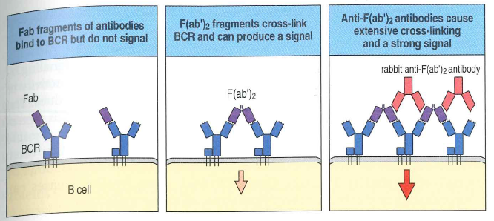
Cell Signaling
  Cross-linking of antigen receptors
    Ligand binding by lymphocyte results in antigen receptor clustering
    Results in activation of intracellular signaling molecules
Notes:
Process and signaling not fully understood at this time

Slide 32
Protein Tyrosine Kinase
Most common receptor type
Brought together by receptor clustering
Activated by transphosphorylation
Cytoplasmic domains contain an intrinsic tyrosine kinase activity
Following activation can phosphorylate and activate other cytoplasmic signaling molecules
Notes:
Example: Src family, important in lymphocyte transmembrane signaling of antigen exposure
Following activation can phosphorylate and activate other cytoplasmic signaling molecules
By phosphorylation of a enzyme or protein tail to activate

Slide 33
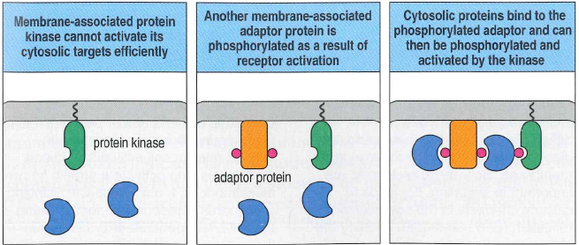
Protein Tyrosine Kinase
Mechanisms of signaling
  Phosphorylation or dephosphorylation of a segment of enzyme/protein to activate
  Creation of a new binding site on effector protein for a cytosolic target protein
  Recruitment of signaling components to amplify signal
Notes:
Recruitment of signaling components to amplify signal
Phospholipase C-γ enzyme (PLC-γ)
Small GTP-binding proteins

Slide 34
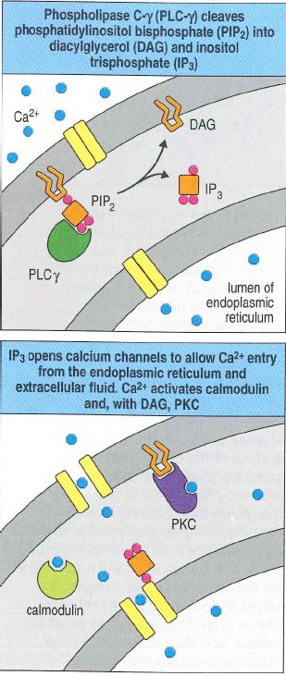
Phospholipase C-γ enzyme
Breaks PIP₂ into IP₃ and DAG
IP₃ opens calcium channels in endoplasmic reticulum
  Increased cytosolic calcium causes calcineurin activation
  Calcineurin activates NFAT
  NFAT moves to nucleus and acts as a transcriptional regulatory protein
DAG activates members of the protein kinase C family
  Responsible for several roles in cell activation including activation of NF-κB
Notes:
Breaks phosphatidylinositol bisphosphate (PIP₂) to inositol triphosphate (IP₃) and diacylglycerol (DAG)
IP₃ binds calcium channels in endoplasmic reticulum and opens them, moving calcium into cytosol
Depletion of ER calcium opens plasma membrane calcium channels, further increasing cytosolic calcium
Increased cytosolic calcium causes calcineurin activation
Calcineurin activated nuclear factor of activated T cells (NFAT)
NFAT moves to nucleus and acts as a transcriptional regulatory protein

Slide 35
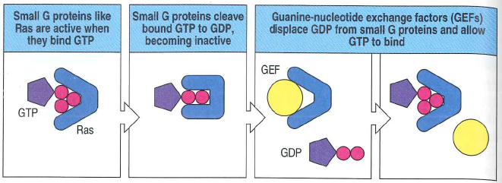
Small GTP-binding proteins
Gunanine-nucleotide exchange factor (GEF) involved in activation of Ras
Activate a cascade of protein kinases called the mitogen-activated protein kinase (MAP kinase)
Notes:
Ras is active when bound to guanosine triphosphate
cleaves to guanosine biphoshpate and inactivating it
GEF will come in and displace the GDP allowing GTP to bind and activate the GTP binding protein
Best known is Ras, involved in cell growth
GTP=guanosine triphosphate

Slide 36
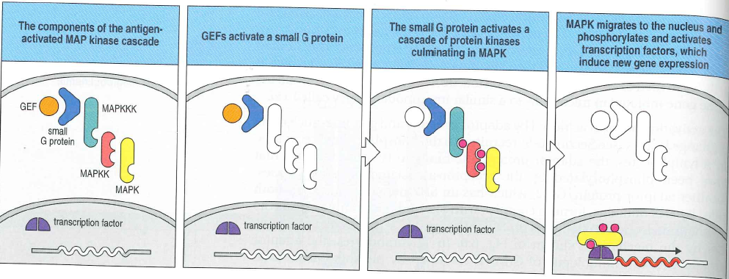
MAP Kinase
MAP kinase kinase kinase phosphorylates MAP kinase kinase
MAP kinase kinase phosphorylates MAP kinase
MAP kinase crosses into the nucleus and actives nuclear transcription factors

Slide 37
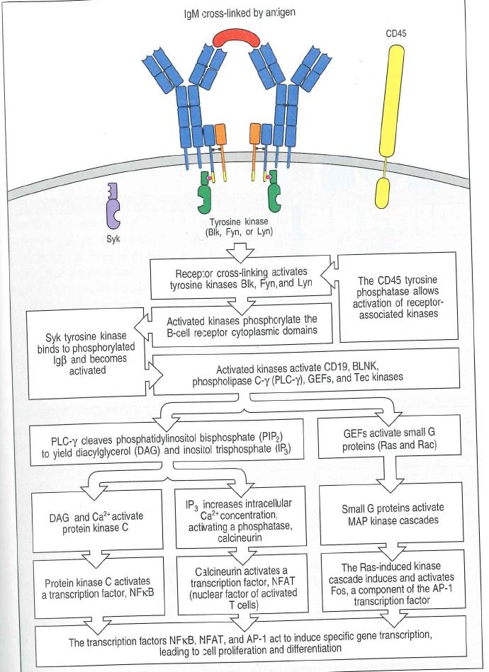
B cell Receptor
B cell receptor complex associated with non-specific signaling molecues Igα and Igβ
  Each Igα and Igβ have associated immunoreceptor tyrosine based activation motif (ITAM)
  B cell receptor provides antigen specificity (highly variable) and signaling molecules are not variable
Notes:
ITAMs are phosphorylated by protein kinases of Src family
Phosphorylated ITAMs bind protein kinases Syk and ZAP-70 to activate them
Results in signaling cascades unique each to B and T cells
Point out the PLC-y and the GEF

Slide 38
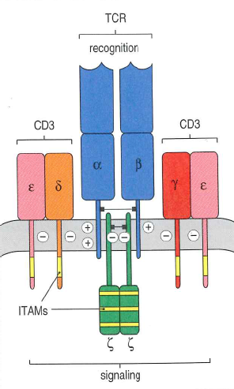
T cell Receptor
T cell receptor contains several different accessory chains:
  CD3 protein complex
    Resemble Igα and Igβ, contain single ITAM in cytoplasmic tail
  ζ chain
    only a short extracellular domain, but three ITAMs in cytoplasm

Slide 39
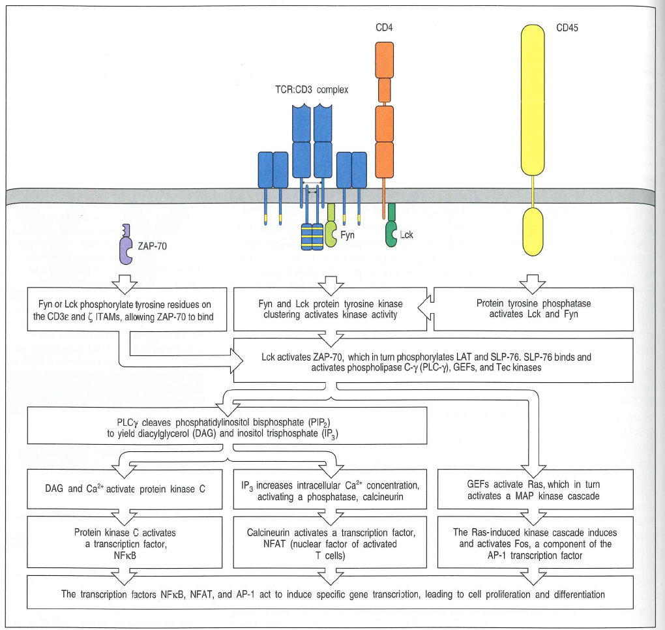
T cell Receptor
Co-receptors enhance the signals of a receptor
  CD4 and CD8 are T-cell receptor co-receptors
  CD19, CD21 and CD81 are B-cell receptor co-receptors
Notes:
Co-receptors enhance the signals of a receptor, requiring less complexes to form
CD19, CD21 and CD81 are B-cell receptor co-receptors
CD21 is a receptor for C3d fragment of complement and allows clustering of antigen receptor
Phosphatidylinositol 3-OH kinase is bound by phosphorylated CD19 and initiates signaling by guanine-nucleotide exchange factor Vav to receptor complex

Slide 40
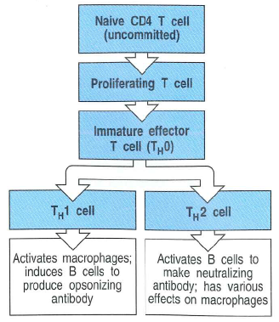
T cell mediated Immunity
Three general classes:
  Cytotoxic T cells
  T_{H}1 cells
  T_{H}2 cells
Primary immune response:
  activation of naïve T cells in response to antigen and subsequent proliferation and differentiation
Notes:
Cytotoxic T cells
Kill infected target cells
Peptides from cytosolic intracellular pathogens are broken down and presented to CD8 T cells by MHC class I
_{H}1 cells
Respond to pathogens within macrophage and dendritic cells
Peptides from intracellular vescicles presented to CD4 T cells by MHC class II
Induce the microbicidal properties of macrophages and induce B cells to make IgG for opsonization and uptake by phagocytes
T_{H}2 cells
Respond to pathogens from extracellular environment
Peptides presented to CD4 by MHC class II
Initiate humoral immune response by activating naïve antigen-specific B cells to produce IgM and has various effects on macrophages
Primary immune response: activation of naïve T cells in response to antigen and subsequent proliferation and differentiation
Also results in the production of armed effector T cells to create immunological memory

Slide 41
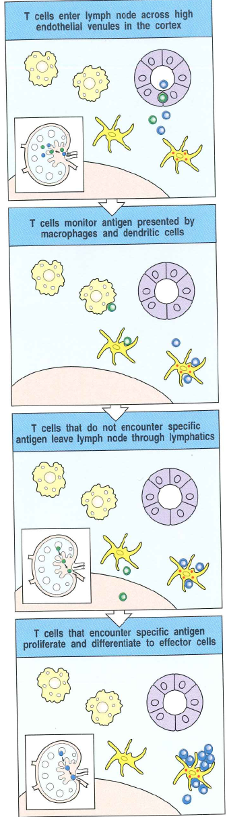
Armed effector T cells
Antigen delivered from site of infection to a peripheral lymphoid organ for presentation to naïve T cell
Naïve T cells circulate continuously from bloodstream to lymphoid organs and back to blood
Migration, activation and effector function dependent upon cell adhesion molecules
T cell receptor facilitates interaction between antigen presenting cell and T cell
Numerous co-stimulatory signals are necessary to continue with T cell clonal expansion in response to antigen presentation
Co-stimulatory signals will initiate cell division and produce IL-2 and the α chain of the IL-2 receptor
IL-2 receptors promote T-cell proliferation
Once armed, effector T cells can attack without co-stimulation
Notes:
Antigen delivered from site of infection to a peripheral lymphoid organ for presentation to naïve T cell
Dendritic cell is most important in this
Macrophages and B cells also present antigen
Naïve T cells circulate continuously from bloodstream to lymphoid organs and back to blood
Allows constant exposure to the antigen presenting cells in lymphoid tissues
Will Sample the MHC: peptide complexes on antigen presenting cells
Allows them exposure to self-antigen as well as foreign antigen
Interaction with self antigen is involved with lymphocyte survival
Migration, activation and effector function dependent upon cell adhesion molecules
Numerous co-stimulatory signals are necessary to continue with T cell clonal expansion in response to antigen presentation
B7.1 (CD80) and B7.2 (CD86) are examples which will bind at CD28
The same cell will present antigen and co-stimulatory signals
Co-stimulatory signals will initiate cell division and produce IL-2 and the α chain of the IL-2 receptor
NFAT binds promoter region of IL-2 leading to its production
CD28 ligation by B7 is necessary for IL-2 production
IL-2 receptors promote T-cell proliferation

Slide 42
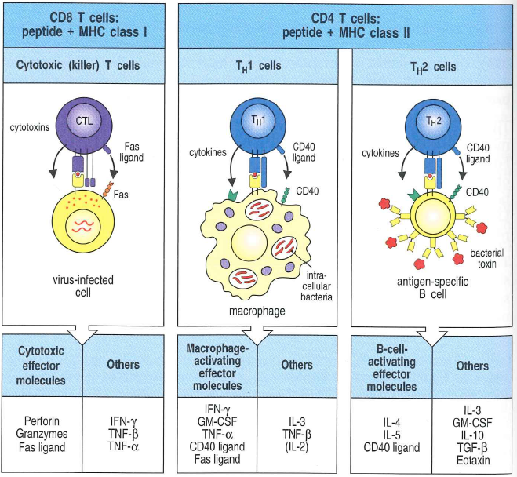
T cell effector molecules: Cytokines
Synthesized de novo by all effector T cells
  Exist as soluble or membrane bound effectors
  Most cytokines produced by T cells are interleukins (IL)
  Most cytokine effects regulated tightly
  TNF family most often a membrane bound effector, also found soluble
Notes:
Cytokines: synthesized de novo by all effector T cells
Exist as soluble or membrane bound effectors
Most cytokines produced by T cells are interleukins (IL)
Main cytokine produced by CD8 effector T cells is IFN-γ
T_{H}2 cells secrete IL-4 and IL-5 which activate B cells and IL-10 which inhibits macrophage function
T_{H}1 cells secrete IFNγ which is the main macrophage-activating cytokine
Derivitive cell T_{H}0 secretes IL-2, IL-4 and IFN-γ
Most cytokine effects regulated tightly
Will be specific for receptors to prevent inadvertent actions
Soluble cytokines have local actions and synergize w/ membrane bound counterparts
Also have tight regulation of synthesis
Some have distant effects for stimulation of macrophage and granulocyte production
TNF family most often a membrane bound effector, also found soluble
Contains TNF-α, TNF-β, Fas ligand and CD40 ligand
TNF-α activates macrophages and induces NO production
TNF-β which activates macrophages, inhibits B cells and is directly cytotoxic for some cells
Fas ligand contains death domain
CD40 linked to TNF-receptor associated factors and activates macrophages and B-cells

Slide 43
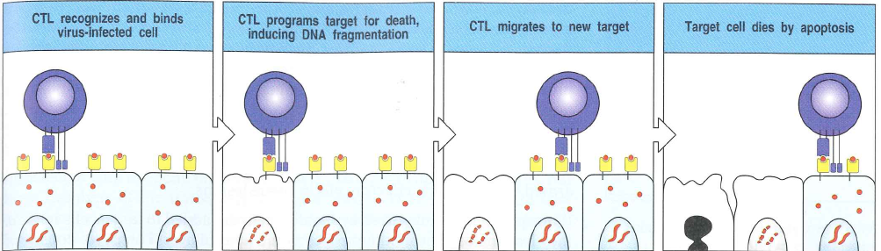
T cell effector molecules: Cytotoxins
Stored in specialized lytic granules and released by cytotoxic CD8 T cells
Induce programmed cell death (apoptosis)
  Perforin: polymerizes to form transmembrane pores in target cell membranes
  Granzymes: serine proteases
  Following apoptosis they are phagocytized
  Fas ligand to activated cytotoxic T cells and T_{H}1 cells leads to capsase mediated apoptosis
Notes:
Induce programmed cell death (apoptosis)
Calcium dependent release of lytic granules on recognition of antigen on surface of target cell
Perforin: polymerizes to form transmembrane pores in target cell membranes
Granzymes: serine proteases
Following apoptosis they are phagocytized
Likely are drawn to the apoptosis site by release of phosphatidylserine
Fas ligand to activated cytotoxic T cells and T_{H}1 cells leads to capsase mediated apoptosis

Slide 44
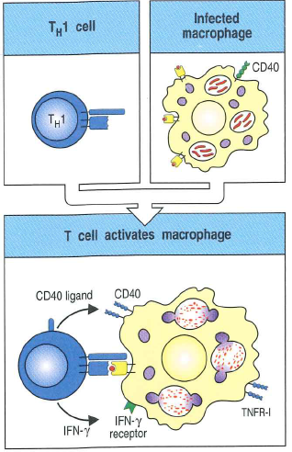
Macrophage activation
Capability of armed CD4 T_{H}1 cells
Important in intracellular infections (as in mycobacteria)
Require IFN-γ which is produced by armed T_{H}1 cells
CD40 ligand is important in sensitizing the macrophages to IFN-γ
Series of other cytokines including Fas ligand, TNF-β, IL-2, IL-3, TNF-α

Slide 45
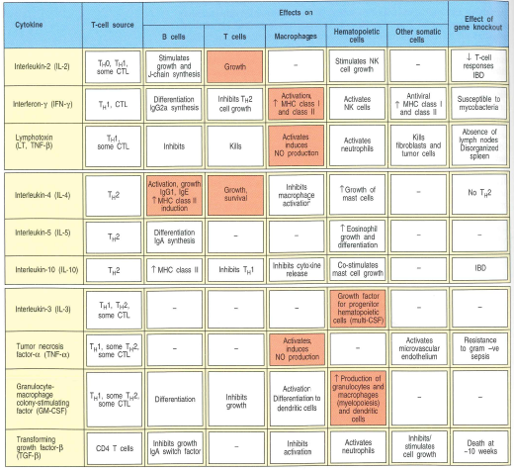
Cytokine summary

