Slide 1
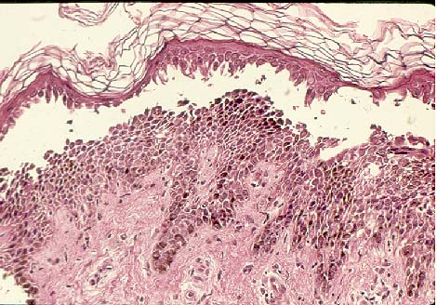
Immune Mediated Skin Disease

Slide 2

Overview:
Pemphigus Foliaceous
Discoid Lupus Erythematosus
Erythema Multiforme (Toxic Epidermal Necrolysis)
Notes:
The development of autoimmune diseases is not well understood, although the immunopathomechanism has been specifically determined in many of these diseases. Controlling mechanisms such as self antigen contact with B lymphocytes early in development, clonal deletion of autoreactive T lymphocytes in the developing thymus as well as other mechanisms of tolerance are important in preventing autoimmunity. Autoantibody production my occur when these mechanisms fail. Factors including environmental changes, infection, drugs and genetics may be associated with modifying the ability to rcognize self.

Slide 3
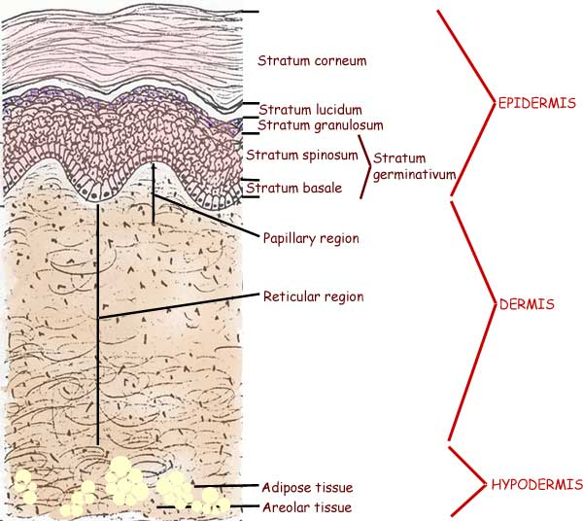
Histology of Skin

Slide 4

Pemphigus Foliaceous
The most common autoimmune disease in small animals
Acantholysis is the hallmark of Pemphigus
The primary lesion is pustules. However, these rupture easily so crusts and erosions are commonly seen
Clinical signs can come in waves, often preceded by lethargy and pyrexia

Slide 5
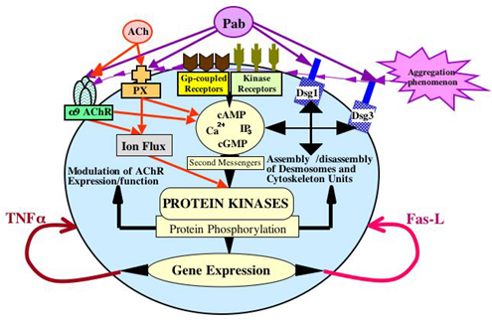
Pathophysiology
Autoantibodies are directed against the epidermal antigen desmogleins
Keratinocytes detatch from one another at the basal layer forming acanthocytes
Subcorneal to intragranular pustules filled with neutrophils and eosinophils
Notes:
Cause of this is unclear, it has been described as secondary to drug reactions, chronic skin disease or idiopathic, genetics may play a role in dogs.
Desmoglein I major autoantigen in humans with pemphigus foliaceus, However, in dogs, desmoglein 1 appears to be a minor autoantigen.^{11,16} In fact, there appears to be considerable immunological heterogeneity in canine pemphigus foliaceus.^{11,17}
Possible drugs include: itraconazole, lime sulfur, doxycycline, TMS (most common in dog), cimetidine, Penicillins (most common in cat), cephalexin

Slide 6
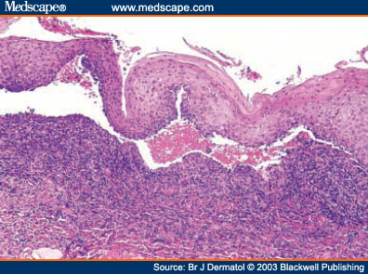
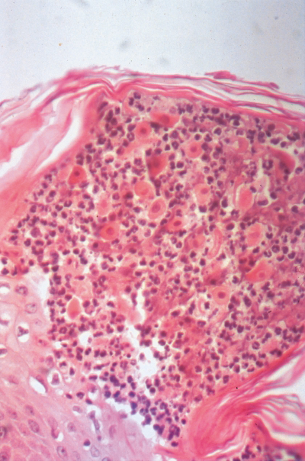

Slide 7


Dogs
Cats
No age or sex predilection
Akitas, Chow chows, Dachshunds, Bearded collies, Newfoundlands, Dobermans and Schipperkes
Pruritis is variable (22%)
Distribution is primarily generalized
No age, sex or breed predilection
Chronic allergic skin disease may predispose
Dermal infiltrates may also include large numbers of mast cells
Often pruritic (80%)
Most common site is the head, but lesions typically spread
Notes:
DOGS: In study only 22% of dogs had pruritis, with only 6% classified as severe
Most common areas for dogs be affected is the trunk, inner pinnea and muzzle.
Dr. Rosychuck at CSU describes one of four distributions, face and ears, pad skin junctions and foot pads and groin, then becoming more generalized.
CATS: pruritus was noted as mild to severe in 80% of cats

Slide 8
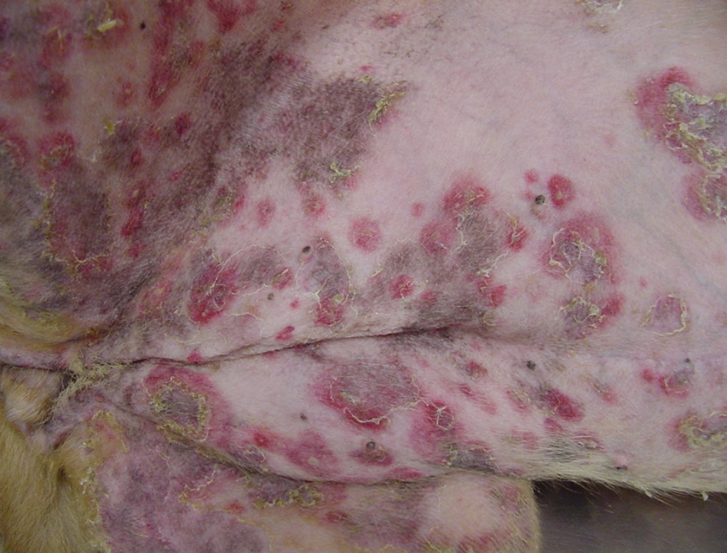
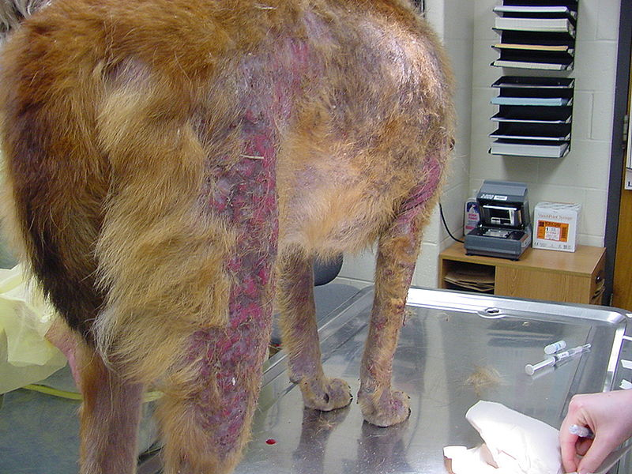
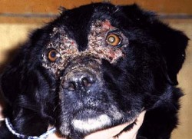
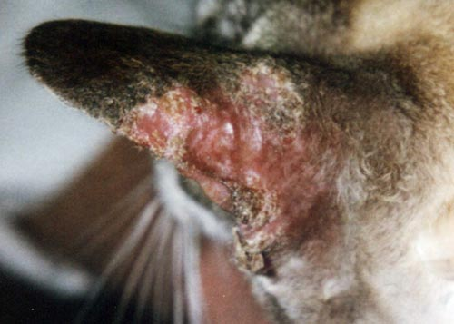

Slide 9

Differentials:
Demodicosis
Dermatophytosis
DLE/SLE
Drug eruptions
Erythema multiforme
Dermatomyositis
Miliary dermatitis
Idiopathic seborrhea
Necrolytic migratory erythema
Zinc responsive dermatosis

Slide 10
Diagnosis:
History Histopathology
Clinical signs Cytology
Skin scraping Fungal culture
Immunofluorescence Response to treatment
Immunohistochemistry
Treatment:
Gold standard is still immunosuppresive doses of a corticosteroid (as single agent, effective roughly 50% of the time)
Other additional medications include:
  azathioprine, chlorambucil, mycophenolate, triamcinolone, cyclophosphamide, cyclosporin, niacinamide, tetracycline, gold salts
  Topical steroids, topical tacrolimus
  IVIG
Notes:
Immunohistochemistry not encouraged because: a lot of false positives in negatives
Mueller study showed 77% of cytology was highly suggestive of PF
Concurrent bacterial infection can complicate DX
Induction with prednisone is 2.2=3.3 mg/kg every 12 hrs for 10-14 days, maintenance is usually b/n 0.5 mg/kg to 1 mg/kg EOD
Once study in cats showed 100% remission using triamcinolone alone, lesser side effects
IVIG: Case study published in JVIM, proposed mechanism of action includes blockade of Fc receptors on macrophages and effector cells, down-regulation of antbody production, direct neutralization of autoantibodies by anti-idiotypes, inhibition of lymphocyte proliferation and regulation of inflammatory mediators.

Slide 11

Prognosis
Guarded, most require life long medication
Survival 1 yr following diagnosis is reported to be between 39-87%
Animals that show a response in the first 10 days tend to have a better prognosis
Speed of onset, local v. generalized and treatment with antibiotics do not seem to be correlated with prognosis.
Notes:
Euthanasia generally due to intractable disease or side effects of therapy

Slide 12

Discoid Lupus Erythematosus
Common in dogs (esp dolicocephalic), rare in cats
Exacerbated or precipitated by exposure to UV light
No strong age or sex predilection
Breeds overrepresented include: Collies, Shetland sheepdogs, German shepherds, Huskies and Brittany spaniels
Notes:
Therefore severe in the summer and in sunny climates
Although primarily seen in younger dogs (2-4 yrs)

Slide 13

Pathophysiology
Current hypothesis:
UV light induces the enhanced expression of ICAM-1 and of autoantigens (Ro)
Specific autoantibodies to these antigens attach to keratinocytes and induce cytotoxicity
Injured keratinocytes release IL-2 and other lymphocyte chemoattractants
End result is inappropriate activation of apoptosis
Notes:
Mechanism not completely understood
UV light is both UVA and UVB
Ro previously found only in the nucleus or cytoplasm

Slide 14
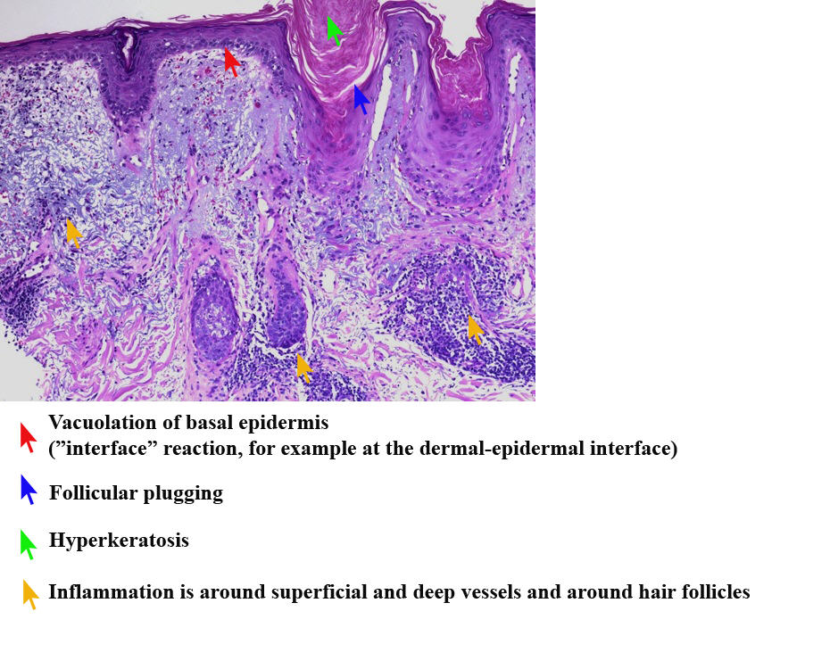
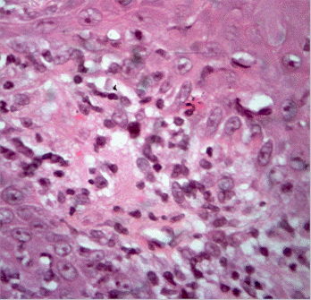
Notes:
Classically involves variable epidermal atrophy and hyperplasia, hydropic degeneration and single cell necrosis within the basal layer, superficial dermal accumulation of lymphocytes, lymphocytes and plasma cells.
The infiltrate may be band-like (lichenoid reaction) or may obscure the dermoepidermal junction (interface dermatitis)
There is usually pigmentary incontinence and variale thickening of the basement membrane

Slide 15
Clinical Signs
Early: depigmentation, erythema, and scaling of nasal planum
Later: erosion, ulceration and crusting
Less commonly seen periorbitally, on the pinnae, lips, distal limbs and genitals
Pruritus and pain are variable
Permanent leukoderma may occur
Not a systemic disease, dogs are otherwise healthy
Notes:
Common early change is the loss of the normally rough, cobblestone-like architecture of the nasal planum

Slide 16

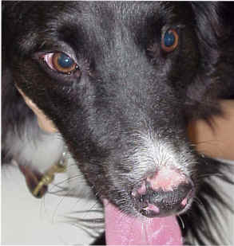
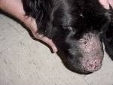

Slide 17

Differentials:
Demodicosis
Dermatophytosis
Dermatomyositis
Contact dermatitis
Eosinophilic folliculitis
Pemphigus foliaceus
Mycosis fungoides
Drug eruption
VKH (uveodermatologic syndrome)

Slide 18
Diagnosis:
History Histopathology
Clinical signs Skin scraping
Fungal culture Ocular exam
Immunofluorescence and immunohistochemical testing
Treatment:
Avoidance of sun exposure, sunscreens and topical steroids
Systemically, vitamin E and omega 3 fatty acids
With increased severity: systemic immunosuppressive therapy:
  Prednisolone
  Tetracycline
  Niacinamide
  Tacrolimus
Notes:
IF and IH demonstrate immunoglobulin and complement at the basement membrane zone, hwever, false-positive and false-negative results are common.
Results of routine labs and ANA are usually within normal limits
PROGNOSIS: GOOD, mostly inconvenience, lesions can be painful

Slide 19
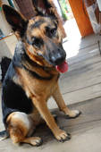
Erythema multiforme/Toxic Epidermal Necrolysis
Severe form of cutaneous drug reaction
Rare, immune-mediated dermatoses with varied clinical signs
Named “multiforme” for a reason
-EM minor: <10%
-EM major >10% but <50%
-SJS: >50% with 10-30% ulceration
-TEN: generalized disease with >30% ulceration
Notes:
Stevens-Johnson syndrome
Many consider TEN to be an entirely separate entity

Slide 20
Pathophysiology
Documented Causes
No age predilection
Breeds associated: GSHD and Welsh Corgi
A host specific T-cell mediated hypersensitivity reaction
Antigen-Keratinocyte reaction elicits a lymphocytic directed apoptosis
TMS
Penicillins
Cephalosporins
Aurothioglucose
Gentamycin/neomycin
Glucosamine supplementation
Food hypersensitivities
Idiopathic
Neoplasia
Viral diseases (CDV, Parvo, CHV)
Notes:
The idiopathic form is typically seen in older dogs, isolated to the face and the ears, is generally more proliferative and exudative
Viral causes make up a small percentage

Slide 21
Clinical Signs
Early: erythematous annular plaques and papules
Later: crusts, epidermal collarettes and possibly ulceration, serpiginous pattern with distinct borders
“Donut” lesion is classic
With severe cases: fever, anorexia, depression and pain
Typically seen on the trunk, especially groin and axillary regions
Notes:
Donut is concentric rings of alternate zones of erythema, blanching and crusting
Can also see the pinnea and paws, with severe cases the mucosal surfacees can develop vesicles and bullae that lead to ulceration
Clinical signs can spontaneously wax and wane

Slide 22
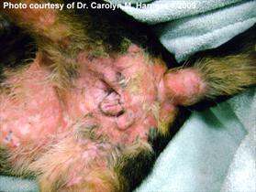
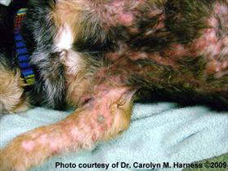

Slide 23

Differentials:
Superficial and deep bacterial infection
 Superficial and deep fungal infection
 Demodectic mange
 Pemphigus foliaceus and vulgaris
 Bullous pemphigoid
 Systemic lupus erythematosus
 Epitheliotropic lymphoma
 Thermal or chemical burns

Slide 24
Diagnosis:
History Histopathology
Clinical signs Skin scraping
Fungal culture +/-Rechallenging
Viral PCR/testing
Treatment:
Removal of inciting cause
Steroid use is controversial, many patients do not respond
Consider IVIG
Anecdotal reports: Atopica, pentoxifylline
Supportive care, pain and wound management with severe ulceration
Notes:
HISTOPATHOLOGY:
Epidermal melanosis
Vertical streaking of collagen
Hydropic degeneration of basal cells
Keratinocyte necrosis
This disease is extremely difficult to differentiate histologically from Lupus. KEY DIFFERENCE=keratinocyte apoptosis of EM is throughout theepidermis and LE should be confined to basal layer.
Other immunological methods of diagnosis in vivo and in vitro already tested (assays of: basophil degranulation, lymphocytic blastogenesis, lymphocytic toxicity; intradermal testing and serological-RAST) have proven themselves unsatisfactory given the great number of false-negative as well as false-positive results and for the necessity of causal drug re-exposure
IVIG: Intravenous human immunoglobulins* (IVIG) have been successfully used in cases of feline erythema multiforme. These would act through the blockage of macrophage FC receptors, inhibition of complement activity, modulation in cytokine synthesis and action in T and B lymphocyte function and neutralization of autoantibodies¹.

Slide 25
Prognosis
Prognosis varies depending on the extent of the reaction
Human mortality rate: EM 1%, SJS 5%, TEN 40%
Mortality directly proportional with age and surface area of epidermal detachment

Slide 26
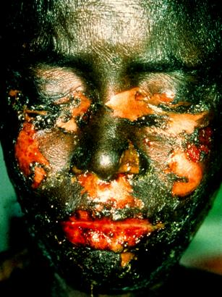
Questions?

