Slide 1

Immune mediated hemolytic anemia
Immune mediated thrombocytopenia
Julie Menard
Board review 2011
Happy new year!

Slide 2
Definitions
Auto immune hemolytic anemia = primary
  True autoantibody with a specificity for a self antigen of the RBC membrane
Immune mediated hemolytic anemia = secondary
  Antibody has specificity for an infectious agent or drug that is associated with RBC surface
  RBC destruction: bystander hemolysis, causative antibody not specific for the RBCs itself.

Slide 3
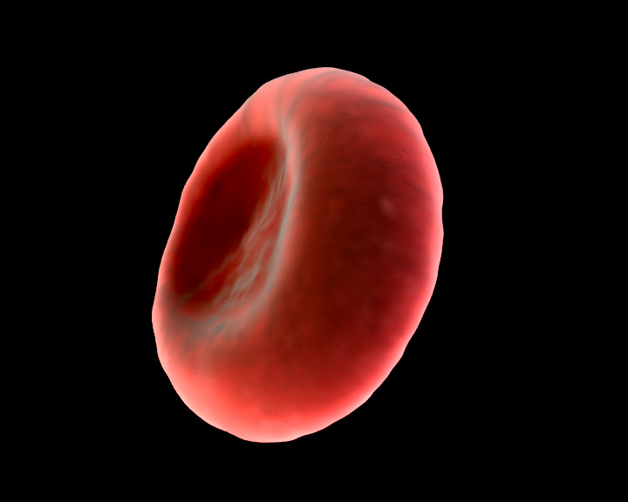
Red blood cell function
Transport oxygen to the cell
Hypoxemia
  Release ATP
  Release NO
    Local vasodilation

Slide 4
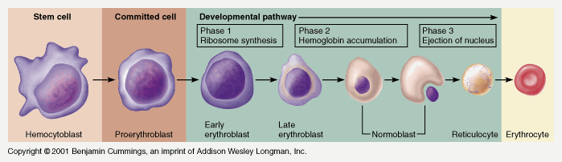
Erythropoiesis
Maturation reticulocyte to RBC: 3-4 days
10% of circulating RBCs

Slide 5
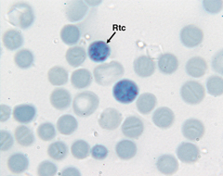
Reticulocyte
Normal healthy dog: absolute reticulocyte count: < 80, 000/ul and
Normal healthy cat: absolute reticulocyte count < 60,000/ uL
Detected by new methylene bleue

Slide 6
RBC lifespan
Dog: 100-115 days
Cats: 73 days
Release from marrow-> circulates thousand times -> Removed, dissembled recycled by macrophages
  Spleen, liver, bone marrow
Some RBC undergo random clearence independent of the RBC age

Slide 7
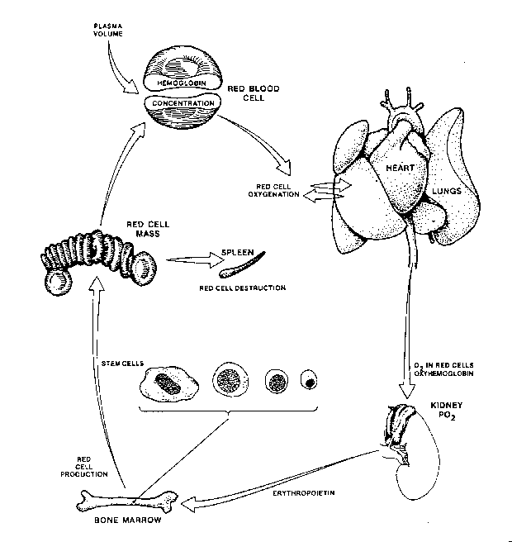

Slide 8
RBC clearence metabolism
RBC with age changes
  IgG bounded undergo opsonization
  IgG opsonized amplification of the signal by complement
Oxidation of protein (loss of antioxydant properties)
Digested within macrophages phagolysosomes
Hemoglobin dissociated into heme and globin.
  Globin: digested into aa: reutilized
  Heme catabolism

Slide 9
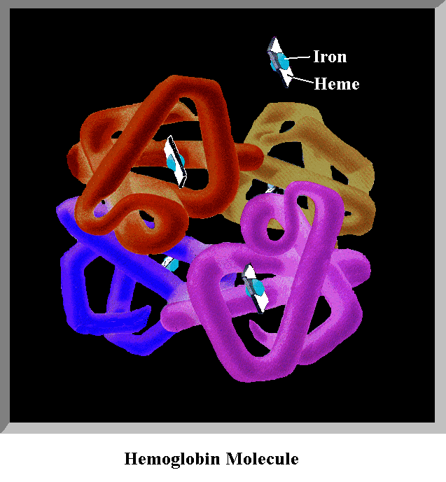
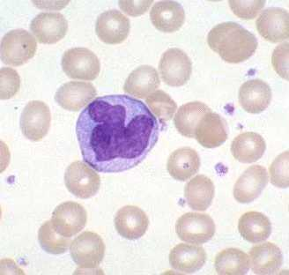
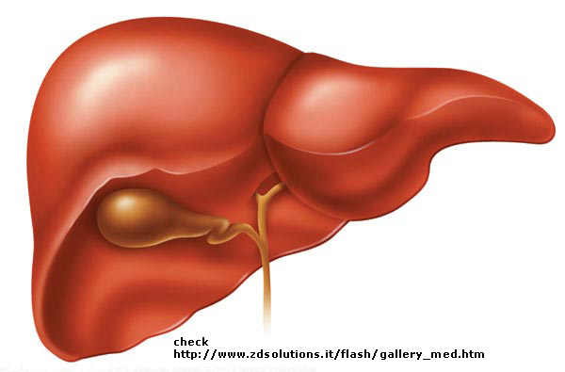
Heme catabolism
Transferrin: STORAGE
Iron
Ferric
Hemosiderin: LIVER
Ferritin: BONE MARROW
Biliverdin
Unconjugated bilirubin
Albumin
CO
Macrophage
(spleen)
Blood stream -> Liver

Slide 10
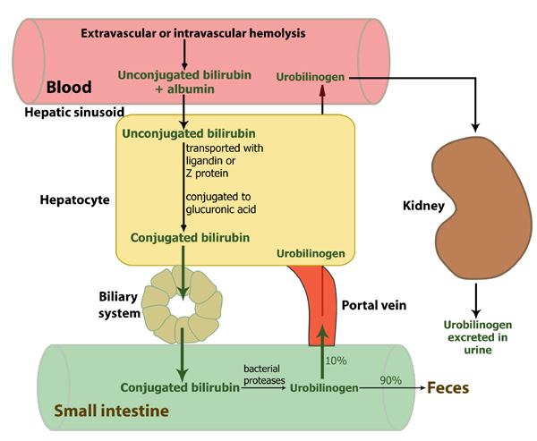

Slide 11
Pathophysiology IMHA
Type II hypersensitivity
Attachment of immunoglobulin to cell membrane

Slide 12
Extravascular hemolysis
RBCs phagocytosed by mononuclear phagocytosis system: MPS
Occurs in liver, spleen, bone marrow
Stimuli:
  Intracellular inclusions (Mycoplasma hemofelis Heinz body)
  Membrane coating w IgM or IgG
  Miminal complement mediated cell wall damage

Slide 13
Extravascular hemolysis
Fc receptor of macrophage reacts with the Fc component of the antibody coating RBCs
  Phagocytosis and destruction
Formation of spherocytes
RBC’s hemoglobin enters bilirubin metabolic pathway:
  Absence of hemoglobinemia and hemoglobinuria

Slide 14
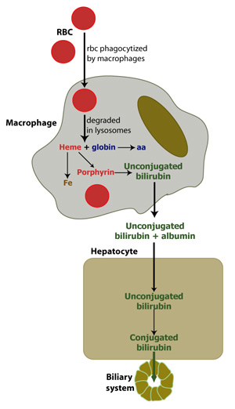

Slide 15
Intravascular hemolysis
IgM and IgG attach to RBC’s membrane
Activates classical pathway complement system
  Deposition complement component on the erythrocyte surface and activation
Membrane attack complex:
  Direct damage to cell membrane
  Influx extracellular fluid within the cell
  Rupture of the cell within circulation
    Hemoglobinemia and hemoglobinuria

Slide 16
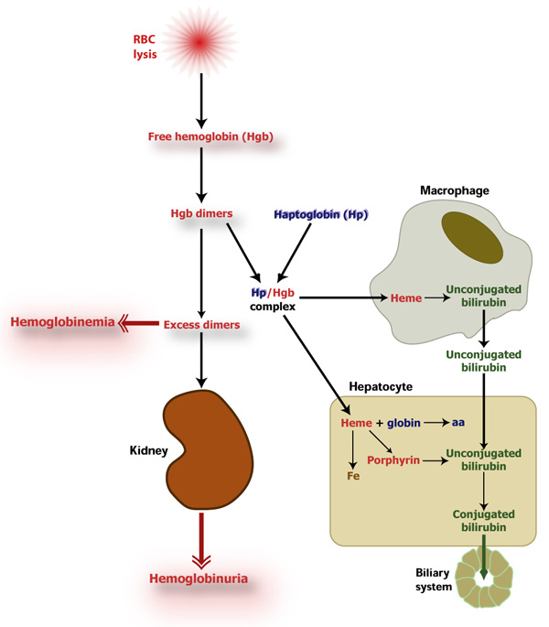

Slide 17
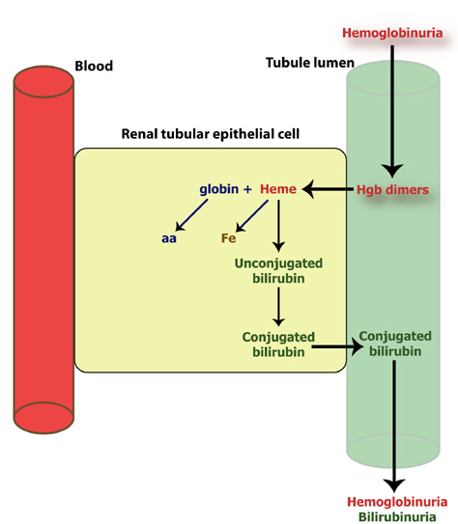

Slide 18
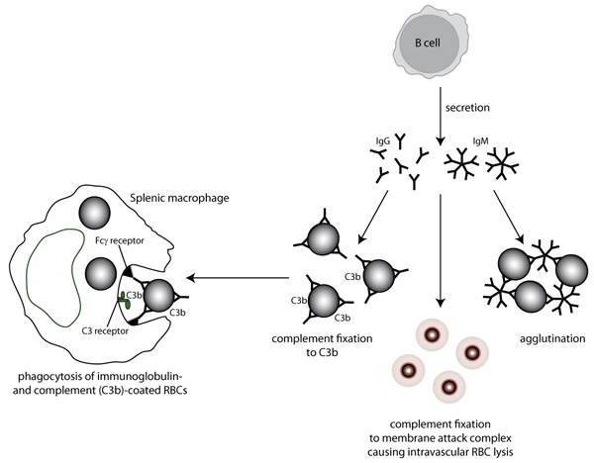
Extravascular hemolysis

Slide 19
Immunopathogenesis of canine AIHA
IgG1 and IgG4 dominate the IgG response
IgM though to be associated with intravascular hemolysis
Autoantibodies directed against:
  Erythrocyte membrane glycophorins
  Anion exchange molecule (aka band 3)
  Cytoskeletal molecule spectrin
Poorly regulated supressor T cell function or overstimulation of immune system

Slide 20
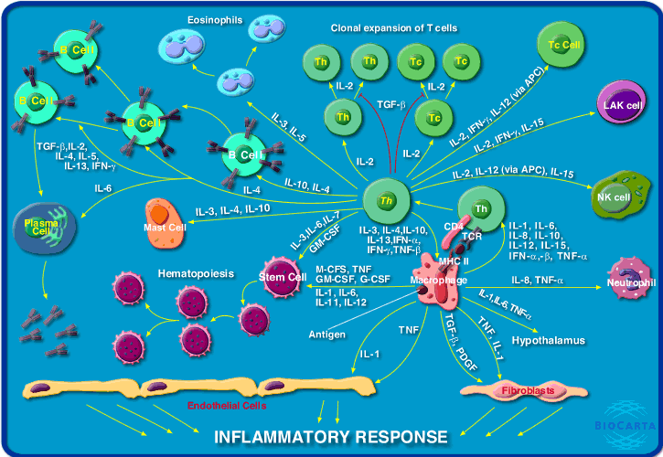
Cytokines and IMHA
IMHA in humans:
  Increase levels : IL-2, IL-4 and TFN α
  Imbalance IL-10 and IL-2
  Type 2 helper cells involved (Th2) involved and hyperactivated

Slide 21
Cytokines and IMHA
Kjejgaard-Hansen, Goggs, Willenberg and Chan. JVIM 2010.
Increased levels of:
    IL-2
    IL-10
    KC (keratinocyte chemoattractant)
    MCP-1 (monocyte chemoattractant protein-1)
IL-15, IL-18, MCP-1 and GM-CSF are associated with macrophage/ monocyte stimulation
  Levels are higher in non survivors vs. survivors
IL-18 and MCP-1 independently associated w mortality

Slide 22
AIHA
Unique disease
Associated concurrent disease
  Immune mediated thrombocytopenia (Evan’s syndrome)
  Primary autoimmune immune mediated neutropenia
  Multisystemic autoimmune disease systemic lupus erythematous

Slide 23
Secondary IMHA
Neoplasia
  Lymphoma
  Myeloproliferative disease
  Anaplastic sarcoma
  Hemangiosarcoma

Slide 24
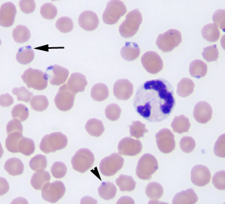
Secondary IMHA
Infectious disease:
  Babesiosis
  Ehrlichiosis
  Leishmaniosis
  Rickettsioses
  Anaplasmosis
  Bartonellosis

Slide 25
Secondary IMHA differentials
Drugs
  Sulfonamide
  Cephalosporin
  NSAID
  Vaccines (within 4 weeks)
    Rare incidence UK veterinary product committee: vaccine associated IMHA: 0.001 per 10 000 doses vaccines sold.

Slide 26
Mechanism of action drug induced
Cephalosporin:
  Drug or drug breakdown product adhere to RBC membrane
  Induction complement attack
Sulfa, quinidine, insulin, acetaminophen, tetracycline:
  induces IgM synthesis and IgM-drug binds to RBCs
  complement activation: intravascular hemolysis

Slide 27
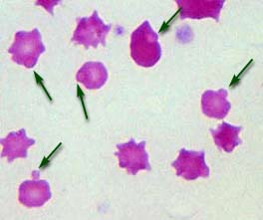
Secondary IMHA differentials
Oxidant agents
  onion
  garlic
  zinc
    Heinz body hemolytic anemia
  Bee-sting:
    hemolysin in venom

Slide 28
Secondary IMHA differentials
Intrinsic RBC deficiency
  Phosphofructokinase deficiency (English springer spaniel)
  Pyruavte kinase
  Hereditary osmotic fragility (Alaskan malamute, Schnauzers)
Severe hypophosphatemia
  DKA
  Refeeding syndrome

Slide 29
Secondary IMHA differentials
Microangiohepatic hemolytic anemia
  RBC physically damaged in the circulation
    HWD
    Vasculitis
    GI
    Neoplasia
    Heart valve disease
    IV catheter
    DIC
    Splenic disease

Slide 30
Other immune mediated anemias
Can be directed against bone marrow erythroid precursors : non regenerative IMHA
Acquired pure red cell aplasia
Reaction to blood group antigens (transfusion reaction or neonatal isoerythrolysis)
Cold agglutinin disease

Slide 31
Non regenerative IMHA dogs
Immune response target bone marrow erythroid precursors instead of/ in addition to circulating RBCs
Bone marrow exam needed in dogs w/o reticulocytosis after 5 days
  Impaired erythropoiesis but erythroid precursors present: NRIMHA
  Absence of erythropoiesis: acquired Pure red cell aplasia

Slide 32
Pure Red Cell Aplasia
Absence of erythroid precursors
  Coombs positive 57%
  ANA positive in 23%
Coombs negative: causative antibody that targets bone marrow may not cross react with antigen expressed by mature RBCs
  Associated bone marrow pathology: dysmyelopoiesis, myelonecrosis, myelofibrosis, intertitial edema, hemorrhage, acute inflammation, hemophagocytic syndrome, lymphoid aggregation, plasma cell hyperplasia

Slide 33
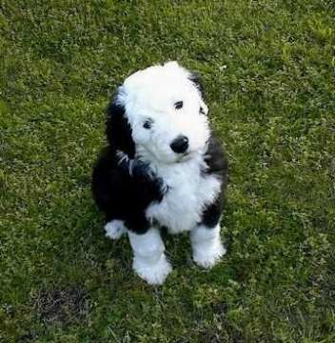
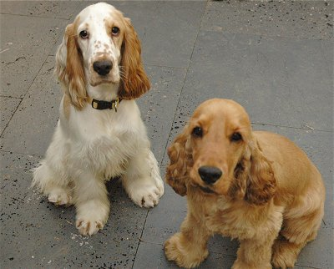
Predisposing factors in dogs
Genetic influence:
  Old English Sheepdog
  Cocker Spaniel
  Border Collie
  Poodle
  English Springer Spaniel
  Irish Setters
  Miniature Schnauzer
  Bichon Frise
Associations with Major histocompatibility group (MHC)
Cocker spaniel w DEA 7 reduced suceptibility to IMHA

Slide 34
Predisposing factors
Middle age dogs
  Median 6-7 yo
Female > male
Seasonal incidence
  US: May-june (Klog A JAVMA 1993- Weinkle and al. JAVMA 2005)
  Australia: Autumn
Vaccination? *
  26% dogs w IMHA vaccinated within a month
  No special vaccine
  Decrease platelet count, increase intravascular hemolysis and autoagglutination compared to non vaccine induced IMHA
  Other studies have failed to show an association.

Slide 35
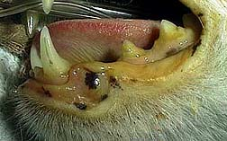
Clinical presentation
Acute onset:
  Severe intravascular hemolysis:
      Jaundice
      Hemoglobinemia
      Hemoglobinuria
  Pyrexia
  Vomiting

Slide 36
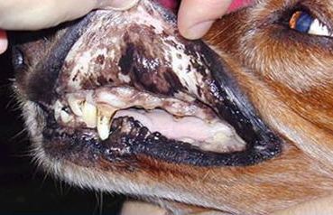
Clinical presentation
Chronic onset (days to weeks)
  Weakness
  Lethargy
  Anorexia
  Pallor of mm
  Tachypnea, tachycardia
  Hepatosplenomegaly
  Lymphadenomegaly
  Heart murmur S3 gallop
  Petechiae
  Pigmenturia

Slide 37
Criteria for diagnosis
Anemia Ht < 25-30%
Hemolysis
Antibodies against RBCs
  Autoagglutination
  Spherocytosis
  + Coombs test
  Erythrocyte antibody (flow cytometry)
Elimination other causes
Positive response to immunosupressive therapy

Slide 38
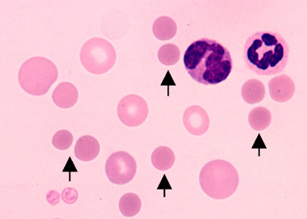
Complete blood count
Severe anemia
  88% IMHA: PCV< 20% (Klein JAVMA 1989)
50% cases: regenerative:
  Reticulocytosis
  Polychromasia
  Anisocytosis
  Nucleated red blood cells
Spherocytes (89-95%)*:
  Immune mediated RBC damage
Leukocytosis, neutrophilia, left shift
  TNFα, Il-1, Il-6
  Correlation between tissue necrosis and leukocytosis (centrolobular hepatic necrosis)

Slide 39
Coagulation
Normal platelet count
Thrombocytopenia ( 70%- severe < 50, 000= 22%)
  ITP (50-70% )
  DIC (45% dogs) (32%)
Prolonged PT (28%)
Prolonged aPTT (47%)
Elevated FDPs (57%) and D-dimers
Decreased AT

Slide 40
Hypercoagulable state
PTE found in 60-80% dogs necropsy with IMHA
Procoagulable state:
  Imbalance procoagulant
  DIC
  Endothelial cell mediated coagulation
  Microparticules
  Increased platelet activation

Slide 41
Activated platelets and IMHA
Weiss and Brazzell 2006 JVIM
  P selectin lies interior surface of α granules
  Transported to the exterior once platelet is activated
    Measure P selecting expression on patelets w flow cytometry
Results:
  8.1 fold increase in P selectin expression in IMHA
  75% dogs w IMHA:
    P selecting median fluoresence intensity>reference range
    2.1 fold increase in platelet activation after phorbol myristate acetate (platelet activator)

Slide 42

Thromboelastrography
Coagulation index:
  76% dogs had hypercoagulable TEG
  24% normocoagulable
Mortality
  100% with normocoagulable CI
  48% overall survival
All patients w normal PTT: hypercoagulable MA, K and α
Prolonged PT: no hypercoagulable R value

Slide 43
TEG
Goggs, Wiinberg, Kjelhaard-Hansen, Chan. ACVIM 2010 Abstract
  Serial TEG D1, D3, D5
  Exclusion pre treatment aspirin, clopidogrel, heparin, or glucocorticoids > 3 d
All dogs hypercoagulable state
TEG variable changes from admission and D5
MA values higher at admission in survivors vs non non survivors (= hypocoagulable may be negative)

Slide 44
TEG
Flint, Abraham-Ogg, Kruth, Bersenas, Wood, ACVIM 2010 Abstracts
  TEG ULDAsp, pred, and Aza
  50% mortality rate
  Negative factors mortality 90 days :
    decreased CI
    decreased G value
    decreased MA
    prolonged PT
    prolonged PTT
    Hyperbilirubinemia
  All dogs normacoagulable CI : died

Slide 45
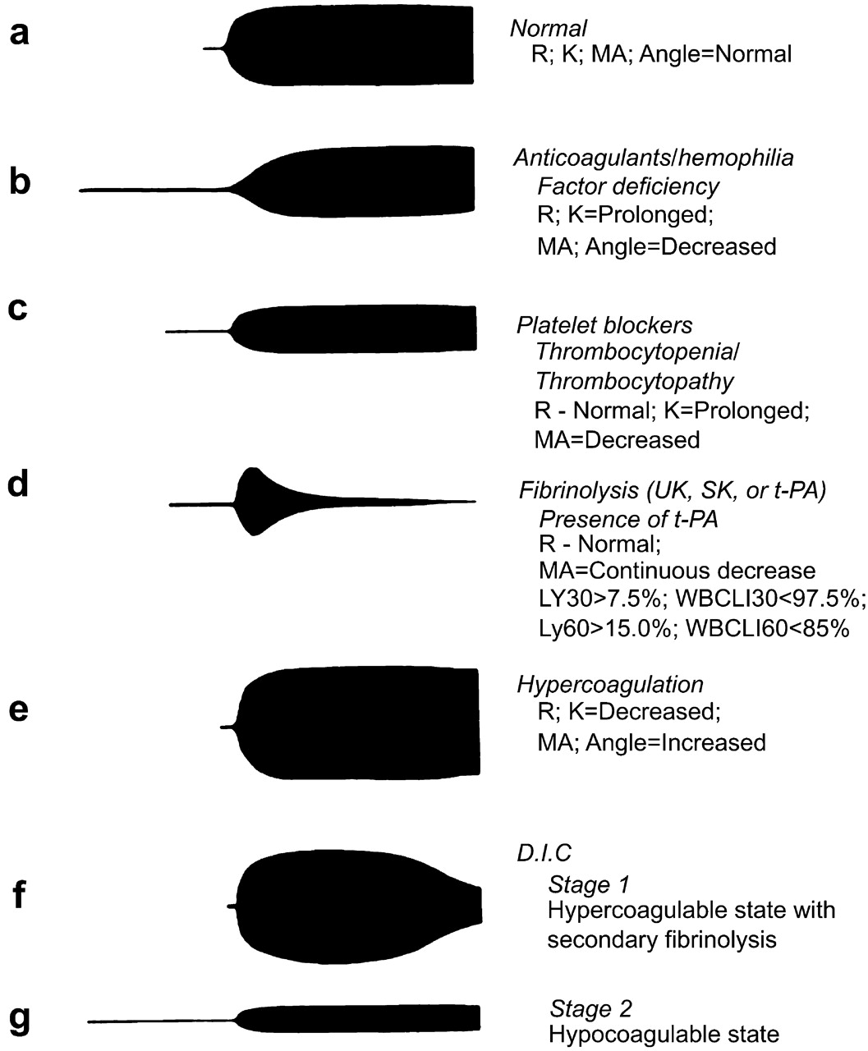

Slide 46
Anti-endothelial cell antibodies
Wells, Guth, Lappin, Dow. JVIM 2009
Retrospective study
  Flow cytometry and canine endothelial cell
  Sick dogs (IMHA, sepsis, SIRS) and controls
Results
  Detected AECA in only 2/91 sick cases 0/22 healthy
  AECA rare in dogs, may not play a part in pathophysiology of TE disease

Slide 47
Chemistry
Hyperbilinuria
Elevated AST
Elevated ALKP (cholestasis secondary to MPS hyperplasia or EMH in liver)
Hypoalbuminemia
Elevated BUN
Hypokaliemia

Slide 48
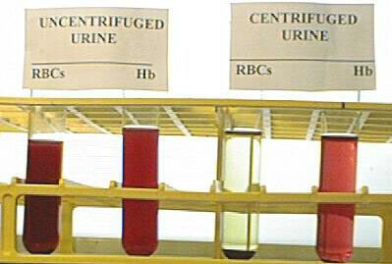
Urinalysis
Bilirubinuria
Hemoglobinuria

Slide 49
Other clinicopathology
Lipid peroxidation and serum vitamin E in IMHA
  MDA: marker of lipid peroxidation
  Vit E (tocopherol) : scavenger
    MDA higher in IMHA vs control
    Tocopherol lower IMHA vs control
      Imbalance antioxydant and prooxidant molecules

Slide 50
Acute phase protein in IMHA
Acute phase protein (APP)
  Albumin: negative
  C reactive protein (CPR): positive
  α1-acid glycoprotein (AAG): positive
IMHA:
  Increase in CPR and AAG during d1-7
  Decrease in Albumin during d1-7
  Normalization after 7 days
  APP on day 1: not predictive of survival, duration of hospitalization, # blood transfusion
  PCV and WBC correlated with APP concentration

Slide 51
Diagnosis
Weinkle and al 2005
  39% dogs with IMHA: serum ANA titer > 80
Holahan, Brown, Drobatz 2010 JVECC
Lactate:
  Lower in survivors vs non survivors
  Persistent hyperlactemia (< 2.0mmol/l) > 6 hrs poor outcome
  Cutoff 4.4 presentation predicted outcome 73%ofthe time
  Correlated with age, BUN, ALKP and inversely to PCV

Slide 52
Diagnosing antibodies against red blood cells

Slide 53
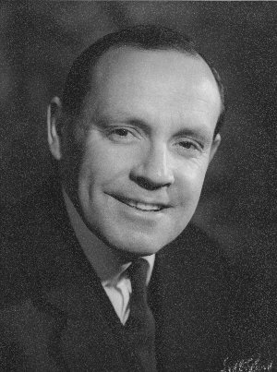
Coombs test
Direct antiglobulin test (DAT):
  Demonstrate presence of erythrocyte bound immunoglobulin and/ or complement
  Doesn’t differenciate between AIHA and IMHA
Positive in 35-60% cases

Slide 54
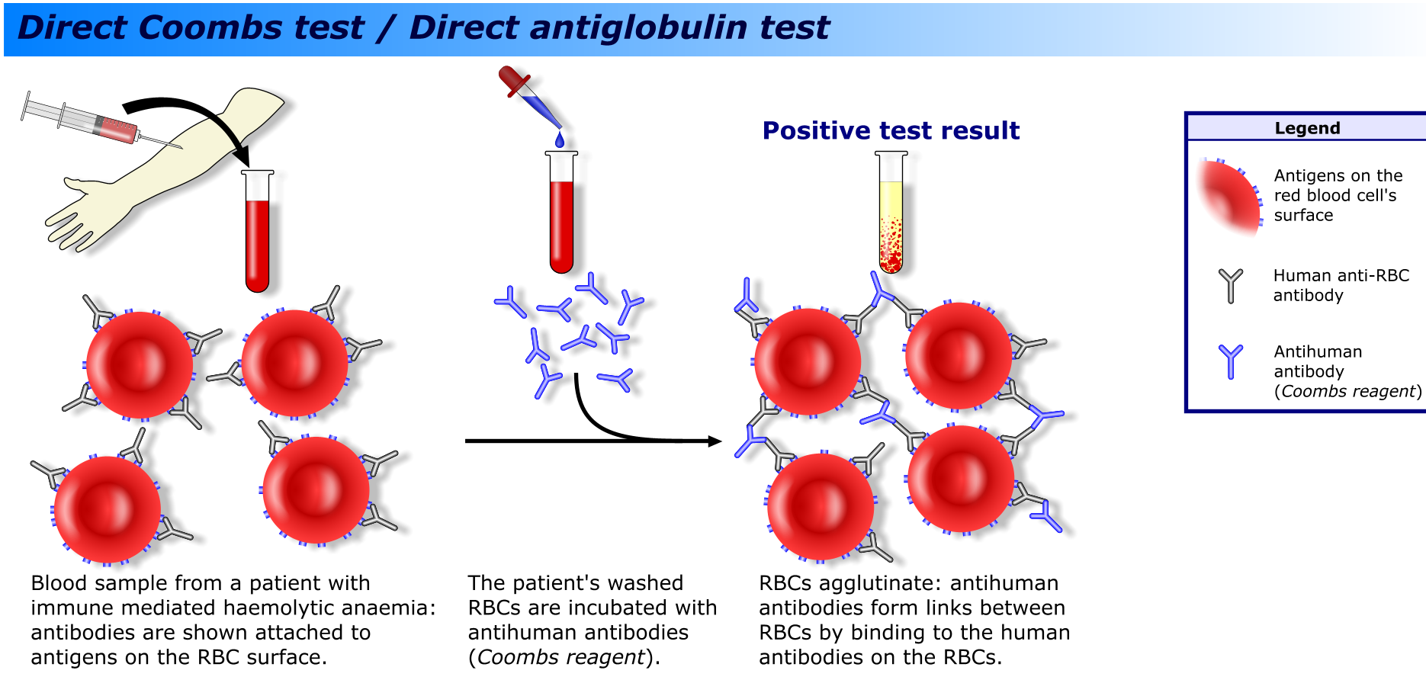

Slide 55
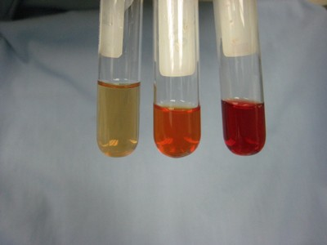
Coombs test
Sensitivity low: range from 60-89%
False negative:
  Incomplete washing of RBCs
  Insufficient RBc-bound antibody
  Elution og Ig or C3
  Prozone effect
False positive:
  Infection (babesiosis, mycoplasmosis, bacterial infection)
  inflammatory disorder
  Myeloproliferative
  Lymphoproliferative disease
  Improper antisera preparation

Slide 56

Coombs test in cats
16/20 anemic cats DAT +
DAT + in cats
  FelV +
  mycoplasma felis
  FIP
  myeloproliferative disease
  neoplasia
  chronic bacterial disease

Slide 57
DAT
Limits:
  Indirect assay
  Relatively insensitive
  Semi quantitative information about the degree of RBC antibody binding

Slide 58
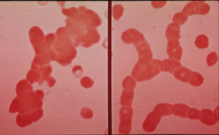
Diagnosis
EDTA agglutination test
  Can only occur at 4C so samples should be refrigerated
  Difference between rouleaux and agglutination by adding a drop of saline
Agglutination
Rouleaux

Slide 59
Alternate technologies
Direct Flow cytometry erythrocyte immunofluroesence assay
  “gold standard?”
  More sensitive than DAT
  Quantitative test
    Can detect RBCs antibody in > 50% patients w – DAT test
Morley, Mathes, Guth and Dow. JVIM 2008
  Positive predictive value in dog w IMHA: 69%
  Negative predictive value in dog w/o IMHA:94%
    Dogs w cancer and infectious disease & anemia can have + flow cytometry
Disadvantage:
  Limited availability

