Slide 1
Hypothermia
Jenefer Stillion, DVM
Resident Board Review
July 6, 2010

Slide 2
Definition
A condition in which the core body temperature is below the normal physiologic parameters for an individual species

Slide 3
Classification
Primary
  Subnormal temperature caused by excessive exposure to low environmental temperatures
Secondary
  Subnormal temperature resulting from disease, trauma, surgery or drug-induced alterations in heat production or thermoregulation
Notes:
Primary is also known as “accidental”

Slide 4
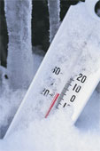
Severity
Primary Hypothermia
Secondary Hypothermia
Mild: 90⁰ to 99⁰
Moderate: 82⁰ to 90⁰
Severe: < 82⁰
Mild: 98⁰ to 99.9⁰
Moderate: 96⁰ to 98⁰
Severe: 92⁰ to 96⁰
Critical: < 92⁰
Notes:
Patient’s with secondary hypothermia have more profound clinical signs at higher temperatures than patients with primary hypothermia do. Novel grading system proposed to describe patients with secondary hypothermia

Slide 5
Predisposing Factors
Decreased heat production
Increased heat loss
Trauma
Immobility
Malnutrition
Cardiopulmonary disease
Endocrine disorders
CNS lesions
Age (young or old)
Anesthesia
Trauma
Immobility
Environmental exposure
Surgery
Anesthesia
Body surface (size)
Toxins
Iatrogenic
Notes:
Make sure you know why some of the toxins cause increased heat loss (like barbiturates?)
- cause peripheral vasodilation and loss of body heat, ethylene glycol/alcohol inhibits shivering
Toxins: ethylene glycol, barbiturates, carbon monoxide, vasodilator drugs
Iatrogenic: trmt for heat stroke, cold infusions

Slide 6
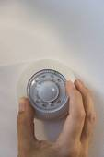
Impaired Thermoregulation
Central failure
Peripheral failure
Sepsis
Cardiopulmonary disease
Uremia
Hypotension
Hypovolemia
Notes:
Central failure: CNS trauma, toxins, metabolic, hypothalamic disease, cerebellar lesions, neoplasia
Peripheral failure: acute spinal cord injury, neuropathies, diabetes

Slide 7
Pathogenesis of Hypothermia
Exposure to cold
Increased activity in the afferent fibers from cutaneous cold receptors
Stimulation of pre-optic nucleus of anterior hypothalamus

Slide 8
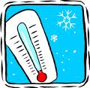
Hypothalamic Response
Immediate
  Autonomic nervous system
Delayed
  Endocrine system
  Adaptive behavioral response
  Skeletal muscle stimulation
  Shivering

Slide 9
Autonomic Control
Cold induced release of norepinephrine
Activation of sympathetic nervous system
Direct reflex vasoconstriction
Decreased blood flow to the skin

Slide 10
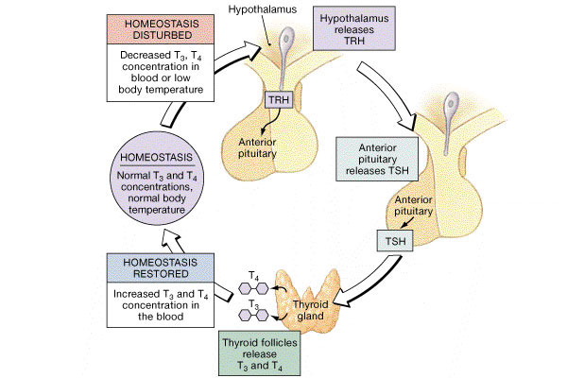
Endocrine Control
Notes:
Hypothalmus releases thyrotropin-releasing hormone in response to cold
Activates the pituitary
Releases thyroid-stimulating hormone
Results in release of thyroxine from thyroid

Slide 11
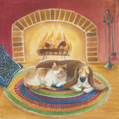
Adaptive Behavioral Response
Behavioral changes
  Seek shelter and heat
  Curl into a ball

Slide 12
Thermogenesis
Shivering
  Voluntary muscle activity
  Increases basal metabolic rate 2 to 5 times
  Increases oxygen consumption
  Modulated by the hypothalamus and spinal cord
  Maximal heat production lasts only a few hours
    Fatigue and glycogen depletion
Piloerection

Slide 13

Physiologic Effects of Hypothermia
Cardiovascular
Hematologic
Coagulation
Gastrointestinal
Respiratory
Neurologic
Metabolic

Slide 14

Cardiovascular
Mild hypothermia
Initial tachycardia
Peripheral vasoconstriction
Increased MAP
Increased CO

Slide 15
Cardiovascular
Moderate hypothermia
Decreased spontaneous depolarization of the cardiac pacemaker cells
  Bradycardia
  Decreased CO
  Increased SVR
Cardiac cycle prolongation
  Prolonged PR interval
  Prolonged QRS and QT intervals
Notes:
Conduction system of heart more sensitive to cold than the myocardium
Bradycardia refractory to atropine
Increased SVR due to autonomic reflex response and catecholamine release
Isn’t there something about Decreased affinity of α1 receptors for norepinephrine in hypothermia?

Slide 16
Cardiac Arrhythmias
Early hypothermia associated with atrial irritability
Predisposed to VPCs and ventricular tachycardia
  Antiarrhythmics may be ineffective
Fibrillation common with temp < 82⁰F
  Can be unresponsive to defibrillation
Notes:
Ventricular arrhythmias are due to decrease in transmembrane resting potential which decreases the threshold for ventricular arrhythmias.

Slide 17

2005 AHA Guidelines
Single defibrillation attempt if VF/VT present
  Defer additional attempts until temperature > 86⁰F (30⁰C)
Withhold all CPR drugs until temperature > 86⁰F (30⁰C)

Slide 18
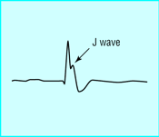
Osborn (J) Waves
Positive wave that follows S wave on ECG
Most common in leads aVL, aVF and left precordial leads
Appear at temp < 90⁰F in humans
Result from ion flux alterations with delayed or early repolarization of the left ventricular wall
Rarely recognized in small animals

Slide 19

Hematology
Hemoconcentration
  Increased vessel permeability
  Diuresis
  Increased plasma viscosity
PCV should increase 2% for every 1⁰C decrease in temperature
Normal PCV: acute blood loss or preexisting anemia
Notes:
Increased vascular permeability
Hypovolemia
Cold-induced diuresis
Bone marrow suppression and erythroid hypoplasia

Slide 20
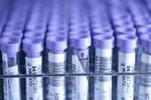
Hematology
Anemia
Decreased production
  Bone marrow suppression
Increased consumption or loss
  Gastrointestinal hemorrhage
  DIC

Slide 21
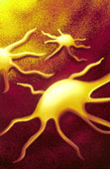
Hematology
Thrombocytopenia
Increased platelet destruction
  Sequestration in liver and spleen
  DIC
Decreased production
  Bone marrow suppression

Slide 22
Coagulation
Direct inhibition of enzymatic reactions of clotting cascade
Thrombocytopenia
Hyperfibrinogenemia
Impaired endothelial synthesis of PGI₂
  Platelet aggregation and thrombosis
Notes:
Rewarm and recheck coagulation times before giving blood products

Slide 23
Coagulation
DIC
Depletion of coagulation factors
Depletion of fibrinogen
Elevated D-dimers
  Fibrinolysis
Thrombocytopenia

Slide 24
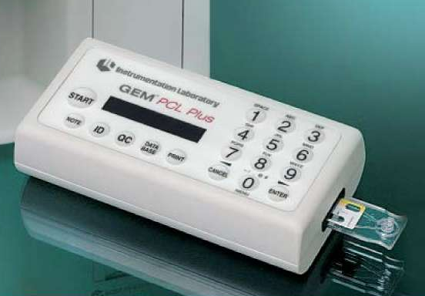
Coagulation
Prolonged PT and aPTT at temp < 30⁰C
Can have normal coagulation assay results despite clinical coagulopathy
  Altered enzyme kinetics with hypothermia
  Blood sample warmed to 37⁰C (98.6⁰F, body temperature
Recheck values after patient
rewarming

Slide 25
Gastrointestinal
Deranged liver function
Hepatic microinfarctions
  Increased platelet activation and thrombosis
  Sequestration of activated platelets in liver
Decreased lactate clearance

Slide 26
Gastrointestinal
Gastric erosions and submucosal hemorrhage
Increased production of gastric acid
Reduced duodenal bicarbonate secretion
Reduced intestinal motility
Microinfarction
Increased bleeding tendencies

Slide 27
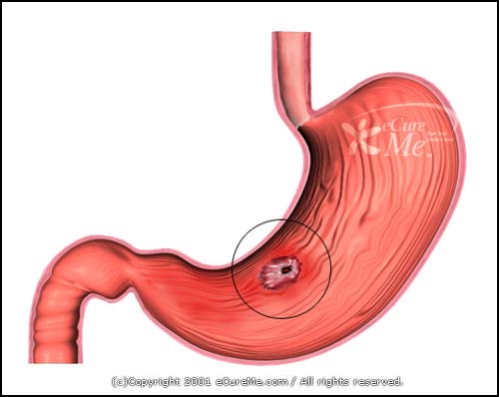
Gastrointestinal
Wischnevsky ulcers
Characteristic shallow ulcers associated with acute cold stress
  Shallow
  Dark-brown in color
  Set in lines with equal spacing
Notes:
Hemoglobin turns brown with exposure to stomach acid

Slide 28

Renal
Cold Diuresis
Increased GFR
Vasoconstriction
Decreased ADH
Decreased sensitivity to ADH
Notes:
Also decreased ADH overall (body perceives hypervolemic due to massive vasoconstriction so ADH decreases appropriately)

Slide 29
Renal
Ischemia and Acute Tubular Necrosis
Decreased renal blood flow
  Up to 50% at temp between 80⁰ and 86⁰F
Decreased GFR
  Secondary to decreased CO
Blood sludging
Notes:
Ischemia and ATN are secondary to the decreased RBF, GFR, and sludging
While initial increase in GFR with mild hypothermia, with prolonged or moderate hypothermia you see a decreased GFR due due to decreased CO and increased SVR

Slide 30
CNS
Decreased cerebral metabolism
  6-7% for every 1⁰C drop in temperature
  Decreased by 50% when temperature < 86⁰F
Impaired cerebral autoregulation
Decreased level of consciousness
  Depression to coma

Slide 31
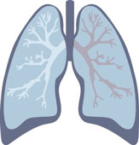
Respiratory
Decreased RR and tidal volume
Decreased cellular metabolism
Lowered CO2 production
Decreased respiratory drive
Notes:
ABG: When blood cools, the arterial pH increases and the pCO2 decreases. This is due to the direct effect of temperature on both the dissolution of hydrogen ions and gas pressures in a watery solution. Water dissociates less readily at lower temperatures.

Slide 32
Respiratory
Hypoxia
Pulmonary edema
ARDS
Pneumonia
PTE

Slide 33
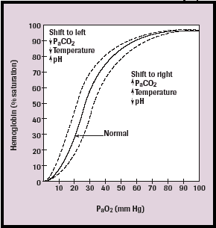
Tissue Oxygen Delivery
Hypothermia shifts
the oxyhemoglobin
dissociation curve
to the left
Notes:
Decreased O2 release into tissues at lower PO2
Vasoconstriction, V/Q mismatch, and increased blood viscosity also impede tissue oxygenation

Slide 34
Glucose
Hyperglycemia
Inhibition of insulin release
  Increased corticosteroid levels
  Direct cooling effect on islets of Langerhans
  Impaired tissue uptake of insulin
Catecholamine-induced glycogenolysis and gluconeogenesis
Increased glucagon levels
Notes:
Exogenous insulin has little effect on hypothermic state. Don’t treat, just rewarm and give insulin once > 30 degrees celcius if still hyperglycemic

Slide 35
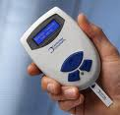
Glucose
Hypoglycemia
Prolonged hypothermia
Depletion of glycogen stores
  Shivering

Slide 36
Potassium
Hyperkalemia
  Marker of acidosis and cell death
  Rhabdomyolysis
  Renal failure
  Poor prognosis
Hypokalemia
  Shift of extracellular K into cells
  Changes in membrane permeability and function of Na/K pump

Slide 37
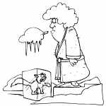
History
History of environmental exposure, trauma, illness, anesthesia or drug administration

Slide 38
Clinical Signs
Dull or obtunded
Ataxia
Shivering
Lethargy
Muscle stiffness
Muffled heart sounds
Decreased RR
Pupils fixed and dilated
“The hypothermic patient is not dead until it is warm and dead.”

Slide 39

Initial Diagnostics
PCV/TS
Electrolytes
Blood gas
Coagulation
BUN/Creatinine
USG

Slide 40
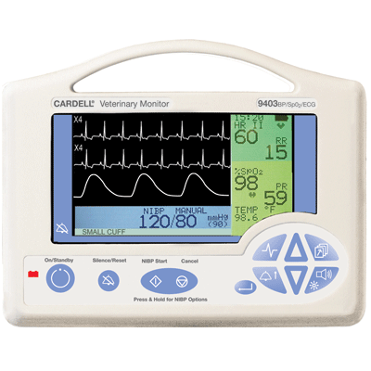
Monitoring
Continuous ECG
Core temperature
Arterial blood pressure
Urinary catheter

Slide 41
Therapy
Cardiovascular support
Appropriate rewarming
Management of complications and comorbid disease
Prevention of further complications

Slide 42

ABC
Ensure patent airway and monitor respiratory rate
Palpate and auscult for pulse and heart beat
Initiate CPR if indicated

Slide 43
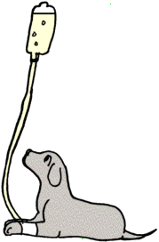
Volume Resuscitation
Rapid volume expansion
  Dehydration
  Natiuresis
  Gastrointestinal losses
Balanced crystalloid solution
  Warm to 104-106.8⁰
  Add 2.5% Dextrose if needed
  Avoid LRS (cold liver inefficiently metabolizes lactate)

Slide 44
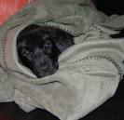
Passive Rewarming
Appropriate in all hypothermic patients
Augment patient’s own intrinsic heat production mechanisms
Prevents further heat loss
Enhances other warming
modalities

Slide 45
Initial Heating
Aimed at the trunk and not extremities
Maintain perfusion
  Extremities become heated by warmed blood returning from the heart
Rewarming shock
  Occurs when extremities are warmed first
  Rapid vasodilation and pooling of warm blood in extremities with return of cool blood to the heart
  Causes hypotension

Slide 46
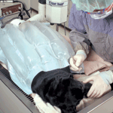
Active External Rewarming
Any technique that transfers heat to the patient
  Warm water bottles, heat lamps, forced air warmers
Avoid direct contact between
radiant warming device and
patient’s skin
Warm, humidified air via ET tube
or face mask
Notes:
Vasoconstricted skin is unable to conduct heat away, leading to burn injuries
Administering warmed air increases temp 1 to 2 degrees an hour

Slide 47
Core Rewarming
Indicated with severe hypothermia (< 82⁰F)
Warm intravenous fluids
  104 to 108⁰
Pleural and peritoneal lavage
  Isotonic crystalloid warmed to 104 to 113⁰
  Infused through aseptically placed pleural or peritoneal catheter
  10 to 20 ml/kg
Warm water enemas

Slide 48
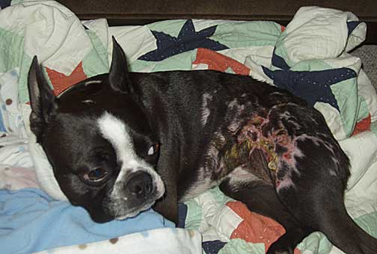
Rewarming Complications
Increased metabolic rate
Increased oxygen consumption
Thermal burn injury
Hyperthermia

Slide 49

Afterdrop
Core temperature continues to decrease during active or passive rewarming
External warming causes peripheral vasodilation
Movement of warmer core blood to periphery
Cooler blood from periphery is returned to core

Slide 50

Therapeutic Hypothermia
Neurologic conditions
Post cardiac arrest
Brain trauma
Hypoxic-ischemic encephalopathy in neonates
Stroke
Spinal cord injury
Hepatic encephalopathy
Notes:
Actively lowering a patient’s body temperature in order to help reduce the risk of ischemic injury to tissue following a period of insufficient blood flow

Slide 51

Therapeutic Hypothermia
Cardiovascular
Open cardiac surgery
Myocardial infarction
Notes:
Myocardial protection afforded by mild to moderate hypothermia is achieved mainly by reduced metabolic demand, which preserves mitochondrial function and spares ATP stores during reperfusion
The COOL-MI trial was a multicenter study, which randomized 357 patients within 6 hours of their AMI onset to primary PCI with or without cooling. An invasive endovascular cooling system set up in the catheterization laboratory was used to successfully induce mild hypothermia during PCI for STEMI.⁶ Hypothermia was thus initiated close to first balloon inflation. Although well tolerated and safe, this means cooling did not result in a difference in infarct size between the hypothermia and control groups (17.9% vs 19.2%, P = .92) except for patients with anterior myocardial infarction who reached a core temperature ≤35°C at the time of reperfusion (n = 16) (infarct size 9.3% vs 18.2%, P = .05).

Slide 52

Traumatic Brain Injury
Experimental brain trauma
Clinical adult TBI
Pediatric TBI

Slide 53
Experimental Brain Trauma
Rosomoff HL et al. 1954
Decreases cerebral metabolic rate
  6-7% reduction in glucose and oxygen consumption per 1⁰C
Kawamura S et al. 2000
Reduces cerebral oxygen consumption
  Improves oxygen supply to ischemic areas of brain
Notes:
Decreasing temperature decreases cerebral metabolic rate. Since the cerebral metabolic rate for oxygen is the main determinant of cerebral blood flow, IH may provide for a relative improvement in oxygen supply to areas of ischemic brain.

Slide 54
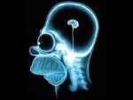
Experimental Brain Trauma
Decreases cerebral blood flow
  Cerebral vasoconstriction
  Decreases ICP
Reduces generation of glutamate and other excitotoxins
Decreases inflammation
Stabilizes neuronal cell membranes
Decreases cell lysis, apoptosis
Notes:
ICP Clifton et al. 2001

Slide 55
Clinical Adult TBI
Marion DW et al. 1997
TBI study with 82 patients
62% patients who underwent hypothermia had good outcome at 12 months versus 38% in normothermic group

Slide 56
Clinical Adult TBI
Jiang et al. 2000
87 patients with severe TBI
Effects of long term (3 to 14 days) mild hypothermia (33-35⁰C)
Rate of complications between normothermic and hypothermic not significantly different
Hypothermia markedly reduced ICP and inhibited hyperglycemia

Slide 57
Clinical Adult TBI
Clifton GL et al. 2001
Multicenter trial
392 patients with severe TBI
Mortality rates not different between normothermic and hypothermic groups
No beneficial effects on outcome reported
Notes:
Since publication, several limitations identified, including inconsistencies in patient care between sites and delay (> 8 hours) in initiating hypothermic therapy, patients rewarmed at 48 hours regardless of the ICP
No difference in outcome at 6 months

Slide 58
Clinical Adult TBI
Clifton GL et al. (unpublished)
Multicenter clinical trial focusing on adult patients younger than 45 with severe TBI
Stopped after midstudy analysis indicated no improvement with hypothermia treatment
Notes:
Post hoc analysis of initial study found that some subgroups had different outcomes. 81 patients < 45 years of age and hypothermic on admission had better outcome if maintained hypothermic

Slide 59
Clinical Adult TBI
Guidelines for the management of severe TBI, 2007
Meta analysis
Six clinical trials
Hypothermia treatment associated with a 46% increased chance of good outcome

Slide 60
Neuroprotection
Extent of neuroprotection by hypothermia depends on:
Time when cooling is begun
  Better outcome depends on earlier initiation (Maier et al., 2001)
Duration of cooling
  Prolonged cooling (24-48 hrs) essential for long-term protection (Colbourne et al., 2000)
  Cooling for 5 days better than for 3 days (Jiang JY et al. 2006)

Slide 61
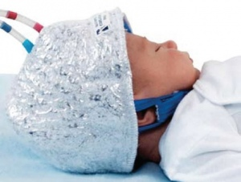
Pediatric TBI
Hutchinson JS et al. 2008
Multicenter international study
Use of moderate hypothermia (32.5⁰ for 24 hours) initiated within 8 hours
Children and adolescents with severe TBI
Hypothermia did not improve neurologic outcome and may increase mortality
Notes:
A total of 225 children were randomly assigned to the hypothermia group or the normothermia group; the mean temperatures achieved in the two groups were 33.1±1.2°C and 36.9±0.5°C, respectively. At 6 months, 31% of the patients in the hypothermia group, as compared with 22% of the patients in the normothermia group, had an unfavorable outcome (relative risk, 1.41; 95% confidence interval [CI], 0.89 to 2.22; P=0.14). There were 23 deaths (21%) in the hypothermia group and 14 deaths (12%) in the normothermia group (relative risk, 1.40; 95% CI, 0.90 to 2.27; P=0.06). There was more hypotension (P=0.047) and more vasoactive agents were administered (P<0.001) in the hypothermia group during the rewarming period than in the normothermia group. Lengths of stay in the intensive care unit and in the hospital and other adverse events were similar in the two groups.

Slide 62
Traumatic Brain Injury
Therapeutic hypothermia
Considered an experimental therapy
Not the standard of care for patients with severe TBI
Additional well-controlled clinical trials are needed
Notes:
At present, clinical studies do not support the use of IH as a routine therapy in severe TBI

Slide 63
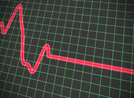
Hypothermia in Cardiac Arrest
Mild hypothermia improves neurologic outcome from cardiac arrest
2 major studies
  Bernard et al. NEJM 2002
  Zeiner et al. Stroke 2000 (HACA)

Slide 64
Treatment of comatose survivors of out-of-hospital cardiac arrest with induced hypothermia
77 patients with cardiac arrest
Treated with hypothermia (33⁰ C within 2 hrs of ROSC and for 12 hours) or remained normothermic
49% (vs. 26% normothermic) survived and had a good neurologic outcome
Hypothermia associated with ↓CO, ↑SVR, hyperglycemia
  Bernard et al. NEJM 2002

Slide 65
Mild resuscitative hypothermia to improve outcome after cardiac arrest
274 patients with cardiac arrest due to ventricular fibrillation
Cooled to 32-34⁰C for 24 hours
Decrease in 6 month mortality (41% vs 55% normothermic patients)
Improved neurologic outcome at 6 months
Zeiner et al. Stroke 2000

Slide 66
2005 AHA Guidelines
Unconscious adult patients with ROSC after out-of-hospital cardiac arrest should be cooled to 32°C to 34°C (89.6°F to 93.2°F) for 12 to 24 hours when the initial rhythm was ventricular fibrillation
Similar therapy may be beneficial for patients with non-VF arrest out of hospital or for in-hospital arrest
Notes:
-up to 20% of initially comatose survivors of cardiac arrest have been reported to have good 1 year neurologic outcome.
Hypothermia
2005 (New): Unconscious adult patients with ROSC after out-of-hospital cardiac arrest should be cooled to 32ºC to 34°Cfor 12 to 24 hours when the initial rhythm was VF (Class IIa). Similar therapy may be beneficial for patients with non-VF arrest out of hospital or for in-hospital arrest (ClassIIb). Further research is needed.
2000 (Old): Mild hypothermia may be beneficial to neurological outcome and is likely to be well tolerated (Class IIb). But hypothermia should not be induced actively after resuscitation from cardiac arrest (Class Indeterminate). In 2003 an interim ILCORstatement supported induced hypothermia.
Why: In 2 randomized clinical trials,induced hypothermia (cooling within minutes to hours after ROSC) resulted in improved survival and neurologic outcome in adults who remained comatose after initial resuscitation from out-of-hospital VF cardiac arrest. Patients in the study were cooled to 33ºC or to the range of 32ºC to34°C for 12 to 24 hours. One study, the Hypothermia After Cardiac Arrest (HACA) study, included a small subset of patients with in-hospital cardiac arrest.
Induced Hypothermia
Both permissive hypothermia (allowing a mild degree of hypothermia 33°C [91.5°F] that often develops spontaneously after arrest) and active induction of hypothermia may play a role in postresuscitation care. In 2 randomized clinical trials (LOE 13; LOE 24) induced hypothermia (cooling within minutes to hours after ROSC) resulted in improved outcome in adults who remained comatose after initial resuscitation from out-of-hospital ventricular fibrillation (VF) cardiac arrest. Patients in the study were cooled to 33°C (91.5°F)3 or to the range of 32°C to 34°C (89.6°F to 93.2°F)4 for 12 to 24hours. The Hypothermia After Cardiac Arrest (HACA) study3 included a small subset of patients with in-hospital cardiac arrest. A third study (LOE 2)10 documented improvement in metabolic end points (lactate and O2 extraction) when comatose adult patients were cooled after ROSC from out-ofhospital cardiac arrest in which the initial rhythm was pulseless electrical activity (PEA)/asystole. In the HACA3 and Bernard4 studies, only about 8% of patients with cardiac arrest were selected for induced hypothermia (ie, patients were hemodynamically stable but comatose after a witnessed arrest of presumed cardiac etiology). This highlights the importance of identifying the subset of patients who may most benefit. Although the number of patients who may benefit from hypothermia induction is limited at present, it is possible that with more rapid and controlled cooling and better insights into optimal target temperature, timing, duration, and mechanism of action, such cooling may prove more widely beneficial in the future.11 A recent multicenter study in asphyxiated neonates showed that hypothermia can be beneficial in another select population. Complications associated with cooling can include coagulopathy and arrhythmias, particularly with an unintentional drop below target temperature. Although not significantly higher, cases of pneumonia and sepsis increased in the hypothermia-induction group. Cooling may also increase hyperglycemia. Most clinical studies of cooling have used external cooling techniques (eg, cooling blankets and frequent applications of ice bags) that may require a number of hours to attain target temperature. More recent studies13 suggest that internal cooling techniques (eg, cold saline, endovascular cooling catheter) can also be used to induce hypothermia. Providers should continuously monitor the patient’s temperature during cooling.
In summary, providers should not actively rewarm hemodynamically stable patients who spontaneously develop a mild degree of hypothermia (33°C [91.5°F]) after resuscitation from cardiac arrest. Mild hypothermia may be beneficial to neurologic outcome and is likely to be well tolerated without significant risk of complications. In a select subset of patients who were initially comatose but hemodynamically stable after a witnessed VF arrest of presumed cardiac etiology, active induction of hypothermia was beneficial. Thus, unconscious adult patients with ROSC after out-of hospital cardiac arrest should be cooled to 32°C to 34°C (89.6°F to 93.2°F) for 12 to 24 hours when the initial rhythm was VF (Class IIa). Similar therapy may be beneficial for patients with non-VF arrest out of hospital or for in-hospitalarrest (Class IIb).
Hyperthermia
After resuscitation, temperature elevation above normal can create a significant imbalance between oxygen supply and demand that can impair brain recovery. Few studies (with either frequent use of antipyretics or “controlled normothermia” with cooling techniques) have directly examined the effect of temperature control immediately after resuscitation. Because fever may be a symptom of brain injury, it may be difficult to control it with conventional antipyretics. Many studies of brain injury in animal models, however, show exacerbation of injury if body/brain temperature is increased during or after resuscitation from cardiac arrest.14–17 Moreover, several studies have documented worse neurologic outcome in humans with fever after cardiac arrest (LOE 3)18 and ischemic brain injury (LOE 7 extrapolated from stroke victims18). Thus, the provider should monitor the patient’s temperature after resuscitation and avoid hyperthermia

Slide 67
References
Alty JE, Ford HL. Multi-system complications of hypothermia: a case of recurrent episodic hypothermia with a review of the pathophysiology of hypothermia. Postgrad Med J 2008;84:282-286
Armstrong SR, Roberts BK, Aronsohn M. Perioperative hypothermia. J Vet Emerg Crit Care 2005;15(1):32-37
Arrich J, Holzer M, Herkner H et al. Hypothermia for neuroprotection in adults after
cardiopulmonary resuscitation. Cochrane Database of Systematic Reviews 2009;4:CD004128
Bernard SA, Gray TW, Buist MD, et al. Treatment of comatose survivors of out-of-hospital cardiac arrest with induced hypothermia. New Eng J Med 2002;346(8):557-563
Bernard SA, Buist M. Induced hypothermia in critical care medicine: A review. Crit Care Med 2003:31;2041-2051
Clifton GL, Miller ER, Sung CC, et al. Lack of effect of induction of hypothermia after acute brain injury. N Engl J Med 2001;344:556-563
Dietrich WD, Bramlett HM. The evidence for hypothermia as a neuroprotectant in traumatic brain injury. Neurotherapeutics 2010;7:43-50

Slide 68
References
Hayes GM. Severe seizures associated with traumatic brain injury managed by controlled hypothermia, pharmacologic coma and mechanical ventilation in a dog. J Vet Emerg Crit Care 2009;19(6):629-634
J, Yu M, Zhu C. Effect of long-term mild hypothermia therapy in patients with severe traumatic brain injury: 1 year follow-up review of 87 cases. J Neurosurg 2000;93:546-549
Lynn M, Jeroukhimov I, Klein Y, et al. Updates in the management of severe coagulopathy in trauma patients. Intensive Care Med 2002; 28:S241-S247
Mallet ML. Pathophysiology of accidental hypothermia. Q J Med 2002;95(12):775-785
Marion DW, Penrod LE, Kelsey SF, et al. Treatment of traumatic brain injury with moderate hypothermia New Engl J Med 1997;336:540-546
Onken A, Kirby R, Rudloff E. Hypothermia in critically ill dogs and cats. Comp Cont Ed Pract Vet 2001; 23(6):506-520
Rosomoff HL, Holaday DA. Cerebral blood flow and cerebral oxygen consumption during hypothermia. Am J Physiol 1954; 179: 85-88
Todd J, Powell LL. Hypothermia. In Silverstein DC, Hopper K eds. Small Animal Critical Care Medicine, St, Louis: Saunders Elsevier; 2009, 720-722.

Slide 69
References
Varon J, Acosta P. Therapeutic hypothermia: past, present and future. Chest 2008;133:1267-1274
Wingfield WE. Accidental hypothermia. In Wingfield WE, Raffe MR eds. The Veterinary ICU Book, Jackson Hole: Teton NewMedia; 2002, 1116-1129
Zeiner A, Holzer M, Sterz F et al. Mild resuscitative hypothermia to improve neurological outcome after cardiac arrest. Stroke 2000;31:86-94

