Slide 1
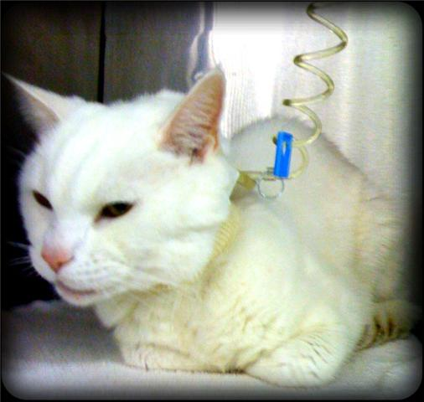
Diabetic Emergencies in Small Animals
Jenefer Stillion
Resident Board Review
Feb 2011

Slide 2
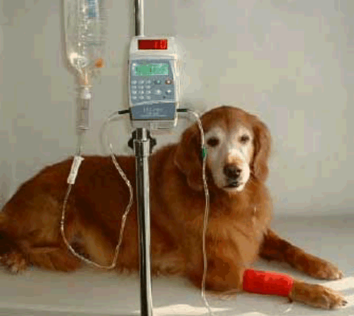
Diabetic Emergencies
Diabetic ketoacidosis
Hyperglycemic hyperosmolar syndrome

Slide 3
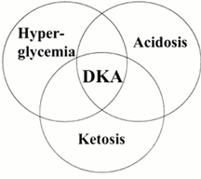
Diabetic ketoacidosis
Characterized by:
Hyperglycemia
Metabolic acidosis
Ketonemia
Ketonuria
Glucosuria
Notes:
Boichemical triad: hyperglycemia, acidosis, ketosis

Slide 4
Pathophysiology
Relative insulin deficiency?
In dogs with DKA:
  5/7 had detectable insulin levels
  2/7 had levels within normal range
Parsons SE et al JVECC 2002

Slide 5
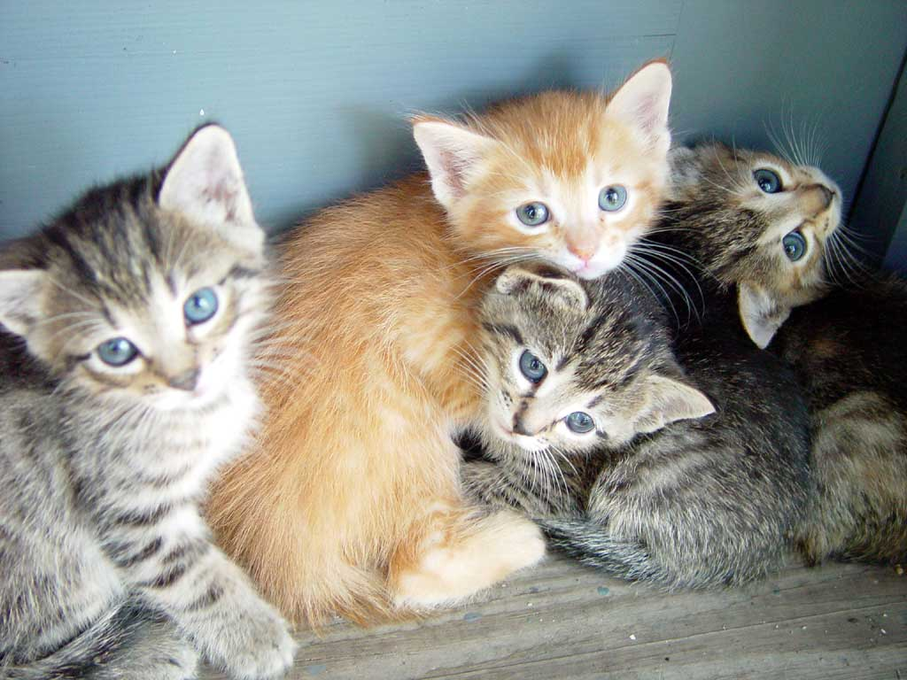
Pathophysiology
Increase in counterregulatory hormones
Glucagon
Cortisol
Epinephrine
Growth hormone

Slide 6
Glucagon
Secreted by pancreatic alpha cells in response to low blood glucose concentrations
Actions oppose those of insulin
  ↑ gluconeogenesis
  ↑ glycogenolysis
  Activates adipose cell lipase → increases FFA concentrations and inhibits storage of triglycerides
  Promotes ketogenesis

Slide 7
Ratio of glucagon/insulin
Determines the use and storage of glucose and FA by hepatocytes and adipocytes
Low (high insulin)
Glucose is converted to energy (ATP) and is stored as glycogen in hepatocytes
FA converted to triglycerides in hepatocytes
Triglycerides are transported by lipoproteins for storage in adipocytes
High (low insulin)
Glycogen liberated as glucose
Triglycerides converted to FFA in adipocytes by hormone-sensitive lipase
FFA are oxidized to ketones
Notes:
Ratio determines the use and storage of glucose and FA by hepatocytes and adipocytes

Slide 8
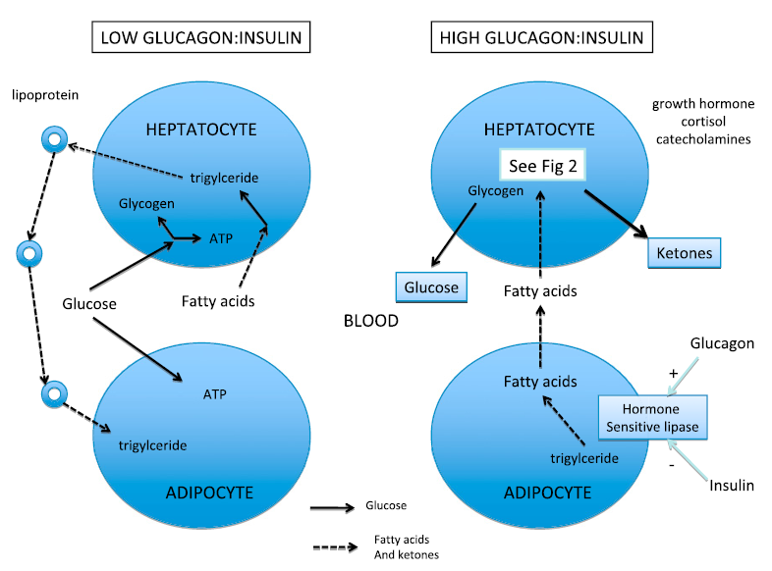
Glucagon:insulin

Slide 9
Pathophysiology: Hormone imbalance
Net effect:
Severe hyperglycemia
Increased serum free fatty acids (FFA)

Slide 10
Pathophysiology: Ketogenesis
Process by which FFA are transformed into ketones
Takes place in the mitochondria of perivenous hepatocytes

Slide 11
Ketogenesis
Rate of ketogenesis depends on the activity of three enzymes:
Hormone-sensitive lipase
Acetyl CoA carboxylase
HMG CoA synthase

Slide 12
Ketogenesis
In nondiabetics
Acetyl-CoA and pyruvate enter the citric acid cycle to form ATP
In diabetics
Production of pyruvate by glycolysis is reduced
Decreased utilization of acetyl-CoA
Acetyl-CoA → Ketones

Slide 13
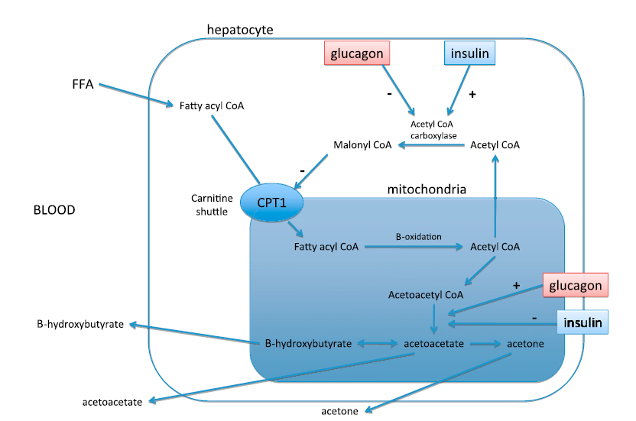
Ketogenesis
Notes:
Carnitine palmitoyltransferase I (CPT1) also known as carnitine acyltransferase I or CAT1 is a mitochondrial enzyme.^{[1][2]} In muscle and other non-liver tissues, CPT1 is associated with the outer mitochondrial membrane. CPT1 mediates the transport of long-chain fatty acids across the membrane by binding them to carnitine. This enzyme can be inhibited by malonyl CoA.

Slide 14
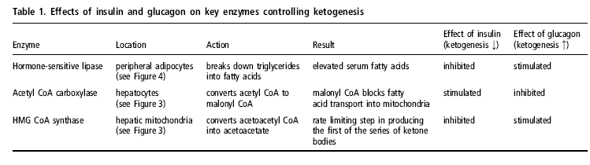
Ketogenesis

Slide 15
Ketone bodies
Synthesized as an alternative source of energy when intracellular glucose stores cannot meet metabolic demands
Acetoacetate (AcAc)
3-β-hydroxybutyrate (3HB)
Acetone
Notes:
AcAc – accumulates during fatty acid metabolism under low carbohydrate conditions
3HB – formed from the reduction of AcAc in the mitochondria
Acetone – generated by spontaneous decarboxylation of AcAc, responsible for sweet odor on the breath of patients with DKA
DKA – alteration in the ratio of AcAc and 3HB (increased 3HB)

Slide 16
Pathophysiology: acidosis
Ketones
Strong organic acids that dissociate at physiologic pH
Rapid and progressive rise in serum H+
Metabolic acidosis
Nausea and vomiting

Slide 17
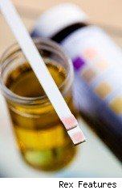
Pathophysiology: acidosis
Glucosuria
Osmotic diuresis
Severe dehydration
Tissue hypoperfusion
Lactic acidosis

Slide 18
Pathophysiology
Hyperosmolarity
Dehydration
Acidosis
Electrolyte derangements
Altered mentation

Slide 19
Pathophysiology
Insulin deficiency
Results in a loss of electrolytes
Required for normal Na, Cl, K and P reabsorption in tubular epithelial cells

Slide 20
Electrolytes
Hyponatremia
Osmotic diuresis
Dilutional
  Free water shifts from intracellular to extracellular compartment
Insulin deficiency
  Insulin stimulates salt and water reabsorption from proximal and distal tubules
Notes:
Solute diuresis secondary to urinary ketoanion excretion
For every 100 mg/dL increase in glucose there is a decrease in Na of 1.6 mmol/L
Alternate was to calculate Na is Measured Na + [(GLUpatient – GLUnormal)/GLUnormal] x 1.6

Slide 21
Electrolytes
Hypokalemia
Severe total body depletion
Acidosis
  Shift of K⁺ from intracellular to extracellular space in exchange for H⁺ ions
Osmotic diuresis
Secondary hyperaldosteronism
  Volume depletion from vomiting, diarrhea and diuresis
  Promotes potassium excretion
Notes:
Patients who present with hypokalemia have a SEVERE total body depletion

Slide 22
Electrolytes
Hypophosphatemia
Severe total body depletion
Acidosis
  Shifts from intracellular to extracellular space secondary to hyperglycemia and hyperosmolality
Osmotic diuresis
Insulin moves phosphorous intracellularly
Notes:
Insulin facilitates entry of phosphorous and glucose into the cell

Slide 23
Electrolytes
Osmotic diuresis can also lead to:
Hypomagnesemia
Hypocalcemia

Slide 24
Acidosis
K⁺
H⁺
H⁺
H⁺
H⁺
K⁺
K⁺
K⁺
PO₄⁻²
PO₄⁻²
PO₄⁻²
PO₄⁻²
Mg²⁺
Mg²⁺
Mg²⁺
Mg²⁺
Acidosis
Correction of Acidosis

Slide 25
Risk Factors
Median age of dogs is 8 years
Median age of cats is 9 years
No increased risk with breed or sex
Most animals are newly diagnosed diabetics

Slide 26
Concurrent Disease
Dogs
cats
Acute pancreatitis
Bacterial urinary tract infection
Hyperadrenocorticism
Pneumonia
Hepatic lipidosis
Chronic renal failure
Acute pancreatitis
Bacterial or viral infections
Neoplasia
Administration of exogenous steroids
Notes:
Documented in about 70% of dogs and 90% of cats with DKA

Slide 27
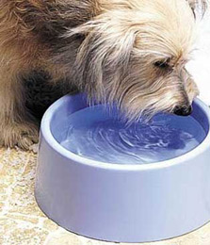
Historical Findings
Polyuria
Polydipsia
Lethargy
Inappetance
Anorexia
Vomiting
Weight loss

Slide 28

Clinical Signs
Hypovolemia → Shock
Dehydration
Weakness
Depression
Hepatomegally
Abdominal pain
Icterus (cat)
Sweet smelling breath
Tachypnea or Kussmaul breathing pattern
Notes:
Kussmal breathing pattern: deep and labored breathing pattern associated with severe metabolic acidosis. Deep, slow, labored and gasping breathing. May start out as rapid and shallow.

Slide 29
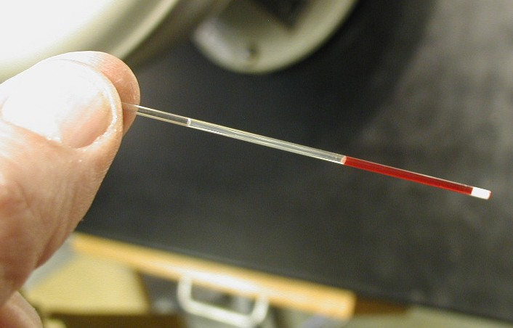
Diagnostics
Minimum emergency data base
PCV/TS
Blood glucose
Azo-Stick
Urine dipstick
Blood gas
Lactate

Slide 30
Documenting Ketones
Urine
Nitroprusside reagent reacts with acetoacetate and NOT β-hydroxybutyrate
Adding 2 drops of hydrogen peroxide to urine sample converts β-hydroxybutyrate to acetoacetic acid which is detectable on the dipstick reagent pad

Slide 31
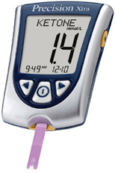
Documenting Ketones
Serum
Portable meter
  Measures β-hydroxybutyrate
  Shown to be more accurate that urinary tests for detection of DKA
Heparinized plasma
  Can be used on urine dipstick to detect ketones
Tommaso MD J Vet Intern Med 2009
Brady MA JVECC 2003

Slide 32
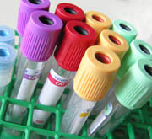
Diagnostics
CBC
Chemistry
Urinalysis
Urine culture and sensitivity

Slide 33
Hematology
50% of dogs had nonregenerative anemia, left shift neutrophilia and thrombocytosis
Anemia and left shift neutrophilia more common in cats
Degree of Heinz body formation is correlated with plasma β-hydroxybutyrate concentration
Hume DZ JVIM 2006
Christopher MM JVIM 1995

Slide 34
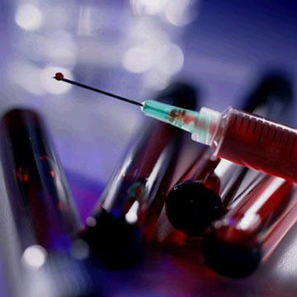
Serum Chemistry
Hyperglycemia
Elevated liver enzyme activity
Azotemia
Hyperlipidemia
Electrolyte abnormalities
Notes:
Hypovolemia can lead to decreased hepatic perfusion and elevations in hepatic enzyme concentrations.

Slide 35
Elevated Liver Enzymes
Hepatic lipidosis
Pancreatitis
Severe acidosis
Hypovolemia
Hypoxia
Sepsis
Cholanhiohepatitis
Extrahepatic biliary obstruction

Slide 36
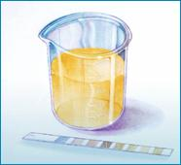
Urinalysis
Glucosuria
Ketonuria
+/- Active urinary sediment
  Proteinuria
  Hematuria
  Pyuria
  Bacteriuria
Notes:
Rarely can see oligoanuric renal failure secondary to DKA

Slide 37
Urine Culture and Sensitivity
Should be done regardless of urinary sediment
20% of dogs with DKA had positive growth on aerobic culture of urine despite lack of pyuria
Hume DZ JVIM 2006

Slide 38
Additional Diagnostics
Abdominal ultrasound
Chest radiographs
Serum osmolality
Adrenal (dog) or thyroid (cat) axis testing
Notes:
PLI, liver function tests or liver biopsy may be considered depending on concurrent clinical and laboratory findings

Slide 39
Serum Osmolality
Hyperosmolality is associated with morbidity and mortality in humans and animals with diabetes
Neurologic dysfunction is the major clinical manifestation
Initially causes loss of water from neuronal tissue → cellular dehydration
Fluid therapy → rapid change in tonicity and cerebral edema

Slide 40
Serum Osmolality
Two recent studies showing blood glucose does not correlate with serum osmolality in dogs and cats with DM and DK
Effective osmolality closely correlated with changes in serum sodium concentrations
Kotas S JVECC 2008
Schermerhorn T JVECC 2006
Notes:
Kotas study: retrospective looking at cats with DK. Serum Na, but not glucose, correlated with serum tonicity.
Schermerhorn study: retrospective looking at dogs and cats with DM. Serum Na correlated closely with effective osmolality in dogs and cats but glucose did not.

Slide 41
Treatment Goals
Restore intravascular volume
Correct dehydration
Correct electrolyte derangements
Correct acid-base imbalance
Decreased blood glucose
Get rid of ketones
Treat underlying or coexisting disease

Slide 42
Fluid Therapy
Type → Any isotonic crystalloid solution
0.9% NaCl advocated for high Na content
  May contribute to metabolic acidosis
Buffered solutions (Plasmalyte, Normosol-R, LRS)
  Adequate Na
  Buffer to aid in resolution of metabolic acidosis
  Contain some potassium
Notes:
0.9% NaCl has high chloride and no buffer = worse metabolic acidosis
The administration of fluids without concurrent insulin has been shown to decrease BG concentrations by 30-50% in children who have DKA during the first hour of fluid therapy.

Slide 43
Fluid Therapy
Contributes significantly to initial decrease in glucose, ketones and counterregulatory hormones by increasing GFR and urinary excretion
Rehydrate before starting insulin
Fluid deficit = % dehydration x BW(kg) x 1000 ml
Replace over 4 to 8 hours
Notes:
Rehydration is typically performed over a relatively short period of time although the speed of replacement should depend on the individual patients hemodynamic, cardiovascular, osmotic and neurologic status.

Slide 44
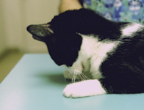
Hypokalemia
Clinical signs
Arrhythmias
Muscle weakness
Cervical ventroflexion (cats)
Respiratory muscle failure
Supplementation
Potassium chloride
Max 0.5 mEq/kg/hr
Notes:
Decreases due to rehydration (dilutional), insulin-mediated cellular uptake of potassium with glucose, continued urinary losses and correction of acidemia (moves into ICF)

Slide 45
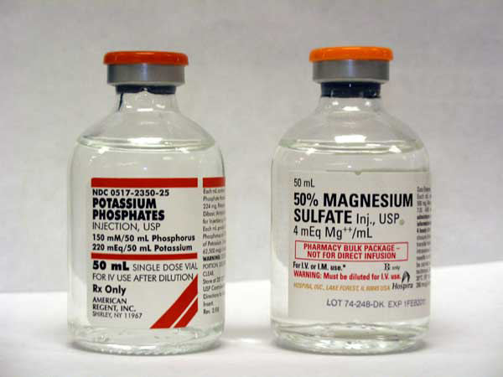
Hypophosphatemia
Clinical signs
May be clinically silent
Weakness
Ataxia
Seizures
Hemolysis
Supplementation
Potassium phosphate
Incompatible with lactated ringer’s
0.03 to 0.2 mmol/kg/hr for 6-12 hours

Slide 46
Hypomagnesemia
Clinical signs
May be clinically silent
Refractory hypokalemia
Weakness
Arrhythmias
Ataxia
Seizures
Supplementation
Magnesium sulfate or magnesium chloride
0.5-1 mEq/kg/day CRI
Notes:
Magnesium depletion promotes urinary potassium loss

Slide 47
Bicarbonate Therapy
Use is controversial
Acidosis usually corrects with fluid and insulin administration
American Diabetes Association
Treatment option for patients with a pH of < 7 after 1 hour of fluid therapy
No prospective randomized studies to prove its benefit
Notes:
Drives potassium intracellularly

Slide 48
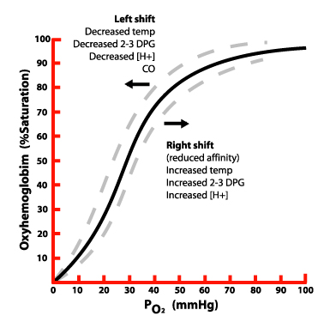
Bicarbonate Therapy: Risks
Exacerbates hypokalemia
Increases hemoglobin affinity for oxygen
  Decreased release of oxygen at tissue level
  Paradoxical CNS acidosis
  Cerebral edema
  Fluid overload
  Lactic acidosis
  Persistent ketosis
Notes:
It also can create paradoxical cerebral acidosis since CO2 generated by HCO3, crosses the BBB while HCO3 does not.

Slide 49
Insulin Therapy
Goals of therapy
Inhibit ketogenesis
Promote ketone metabolism
Lower blood glucose levels
  No more than 50-75 mg/dl/hr
Also may have anti-inflammatory effects
Hansen TK et al. JCIM 2003

Slide 50

Insulin Therapy
Regular insulin
Rapid onset and short duration of action
“Low-dose” infusion is standard of care for treatment of complicated DKA in humans
IM administration reserved for uncomplicated cases
Notes:
Lower mortality rates seen in humans using CRI

Slide 51
Insulin CRI
Dog: 2.2 U/kg regular insulin added to 250 ml of 0.9% NaCl
Cat: 1.1 U/kg regular insulin added to 250 ml of 0.9% NaCl
BG (mg/dl) | Fluid Composition | Rate of administration 9ml/hr)
>250 | 0.9% NaCl | 10
200 to 250 | 0.45% NaCl + 2.5% Dextrose | 7
150 to 200 | 0.45% NaCl + 2.5% Dextrose | 5
100 to 150 | 0.45% NaCl + 5% Dextrose | 5
<100 | 0.45% NaCl + 5% Dextrose | Stop
Hess RS, in Silverstein

Slide 52
Regular Insulin Infusion Doses in Critically Ill Diabetic Cats
Retrospectively compared cats with DK/DKA receiving regular insulin CRIs
  Group 1: 1.1 U/kg/day
  Group 2: 2.2 U/kg/day
  Group 3: started at 1.1 U/kg/day and increased to > 2.2 U/kg/day
No significant differences in biochemical parameters, neurologic function or duration of care
Most cats did not receive entire prescribed daily dose of insulin
Claus MA JVECC 2010
Notes:
Cats prescribed the higher dose of insulin (2.2 U/kg/day) did have complications associated with hypoglycemia, hypophosphatemia or hypokalemia.
Small sample size so each group too small to find significant differences between groups.

Slide 53
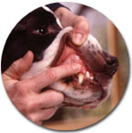
Patient Monitoring
Placement of a sampling IV catheter
  Femoral, lateral saphenous or jugular
Perfusion parameters
HR
Pulse quality
Mucous membrane color
Capillary refill time
Arterial blood pressure
Notes:
Placement of sampling catheter may be easier after several hours of fluid therapy

Slide 54
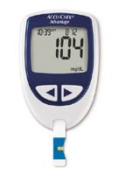
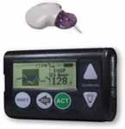
Patient Monitoring
Blood glucose
Intermittent
Continuous

Slide 55
Portable Blood Glucose Monitors
Evaluation of 6 common meters compared to reference chemistry analyzer
PBGM BG concentrations consistently lower when compared to reference analyzer
AlphaTrak and OneTouch were closest to reference
43% of AlphaTrak samples had higher BG than reference
Cohen TA JAVMA 2009

Slide 56
Real-time Continuous Glucose-Monitoring Systems
Guardian has been validated in diabetic cats
Clinically accurate with hyperglycemia and euglycemia
Less accurate for hypoglycemia
Only calibrates if BG is between 40-400 mg/dl
Moretti S JVIM 2010

Slide 57
CGMS in Dogs and Cats with DKA
Guardian compared to portable glucometer (Accutrend)
13 dogs and 11 cats with DKA
Correlated significantly regardless of calibration frequency
Guardian more accurate in hydrated patients
Not effected by body condition, perfusion or degree of ketosis
Reineke EL JVECC 2010

Slide 58
Patient Monitoring
URINE
Output
Specific gravity
Glucosuria
Ketonuria
Serum electrolytes
Acid-base
Body weight
PCV/TS
RR and effort
Temperature

Slide 59

Therapeutic Endpoints
Patient eating and drinking with no vomiting
Resolution of acidosis
Resolution of ketonuria
BG consistently in the 200-300 range

Slide 60
Insulin therapy
Switch initially to regular insulin SC q 6 hours
Maintain with longer acting insulin

Slide 61
Complications
Hypoglycemia
Hypokalemia
Hypophosphatemia
Hypomagnesemia
Heinz body anemia (cats)
Acute hemolytic anemia
Cerebral edema
Paradoxical cerebral acidosis
Notes:
Hemolytic anemia can occur if phosphorous levels drop significantly when insulin therapy is started

Slide 62
Cerebral Edema
1% of pediatric patients with DKA
Mortality rate of 40-90%
Usually occurs 12-24 hours after initiating therapy
Pathophysiologic mechanism is controversial
Cytotoxic theory→ osmotic gradients are created by overzealous fluid and insulin therapy
Vasogenic theory→ disruption of vascular permeability in the BBB as mechanism for cerebral edema
Glasser N et al. N Engl J Med 2001
Notes:
Pathophysiologic mechanisms include: ischemia and reperfusion injury, inflammation, increased blood flow, intracellular osmolyte formation, osmotic imbalance, cytotoxins

Slide 63
Prognosis
Mortality rates of 26-30%
Long-term prognosis depends on
Glycemic control at home
Avoidance of future ketoacidosis
Concurrent disease processes

Slide 64
Outcome of Dogs with DKA
Survival correlated with:
Degree of anemia
Hypocalcemia
Acidosis
  Base deficit*
  pH
Severity of acidosis was the only variable significantly correlated to all 3 outcome measures:
Time until SC insulin therapy
Length of hospitalization
Survival
Hume DZ et al. JVIM 2006
Notes:
All data was from initial presentation (admission blood work)
After multivariate analysis, BD was the only variable significantly associated with outcome

Slide 65
Remission of DM in Cats with DKA
Remission of DM in cats presenting with DKA is possible
12 cats with DKA and 7 cats with DM
7/12 cats with DKA had remission
Cats with DKA and remission were more likely to have pancreatitis and a stress leukogram compared to cats with uncomplicated DM
Steroid administration was not found to be significant (small sample size)
Sieber-Ruckstuhl NS JVIM 2008
Notes:
Diabetic remission defined as being clinically unremarkable, having normalized BG and fructosamine concentrations and needing no more insulin for at least 1 month after treatment cessation

Slide 66
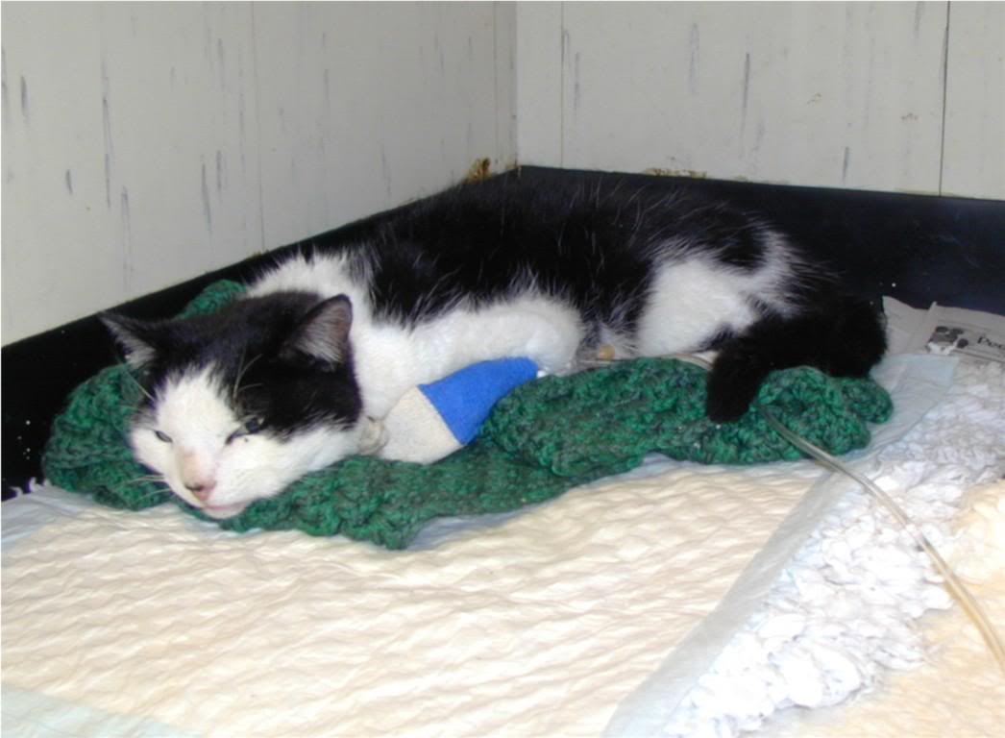
Hyperglycemic Hyperosmolar Syndrome

Slide 67
Definitions
Serum osmolarity
Number of osmotically active particles (solute) per liter of solution
Serum osmolality
Concentration of osmotically active particles (solute) per kg of solution
Effective osmolality (serum tonicity)
The portion of serum osmoles that are not freely permeable across biologic membranes
Notes:
Osmolality is only the number of particles in solution, size and charge of particle doesn’t matter

Slide 68
Osmolality
Serum osmolality
Measured using osmometer (freezing point depression or vapor pressure)
Calculated = 2(Na⁺)+BUN/2.8+Glu/18

Slide 69

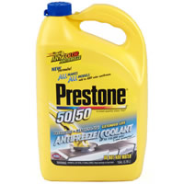
Osmolal Gap
Difference between measured and calculated osmolality
Normal ≤ 10 mOsm/kg
Increases due to unmeasured solute
Lactate
Ketones
Sulfates
Phosphates
Mannitol
Ethylene glycol
Sorbitol
Glycerol
Propylene glycol
Salicylic acid

Slide 70
Effective Osmolality
Also known as tonicity
Excludes BUN, which is an ineffective osmole (freely diffuses across cell membranes)
Calculated = 2(Na⁺) + Glu/18

Slide 71
Hyperglycemic Hyperosmolar Syndrome (HHS)
Form of diabetic crisis marked by:
Profound hyperglycemia (> 600 mg/dL)
Hyperosmolality (> 350 mOsm/kg)
No or minimal urine ketones

Slide 72
Incidence
Infrequent complication of DM
< 1% of human diabetic hospital admissions
6.4% of ER visits by diabetic cats
Incidence in dogs is unknown
Koenig A. JVECC 2004

Slide 73
Pathogenesis
Hormonal alterations
Reduction of GFR
Contributions from concurrent disease

Slide 74
Hormonal Alterations
Relative or absolute lack of insulin
Increase in counterregulatory hormones
Small amounts of insulin and hepatic glucagon resistance inhibit lipolysis → prevent ketosis
Results in hyperglycemia, progressive dehydration and hyperosmolality

Slide 75
Reduction in GFR
Progressive dehydration and hypovolemia
Osmotic diuresis
Additional losses from vomiting
Decreased water intake
Ultimately lead to decreased GFR
Vicious cycle:
↑GFR→↑hyperglycemia→↑glucosuria→↑osmotic diuresis
Notes:
There is no maximum rate of glucose loss via the kidney. All the glucose that enters the kidney in excess of the renal threshold will be excreted in the urine. Inverse correlation between GFR and serum glucose in diabetic humans.

Slide 76
Concurrent Disease
Concurrent disease identified in 88% of cats with HHS
Most common:
Renal failure*
Congestive heart failure*
Respiratory compromise
Neoplasia
GI disease
Koenig A. JVECC 2004
Notes:
*Both may decreased GFR
Most diseases also effect levels of counterregulatory hormones

Slide 77

History and Clinical Signs
May be previously diagnosed or new diabetics
Decreased appetite
Lethargy
Vomiting
Weakness
Polyuria
Polydipsia
Polyphagia
Neurologic signs

Slide 78
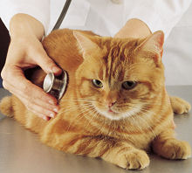
Physical Exam
Dehydration
Hypothermia
Depressed to stuperous mentation
Weakness
Ataxia
Plantigrade stance
+/- signs from concurrent illness
Notes:
Concurrent illness: heart murmur, increased respiratory effort, abdominal pain, oral ulcerations, small kidneys

Slide 79
Diagnostics
CBC
Chemistry
Urinalysis
Urine culture and sensitivity
Blood gas

Slide 80
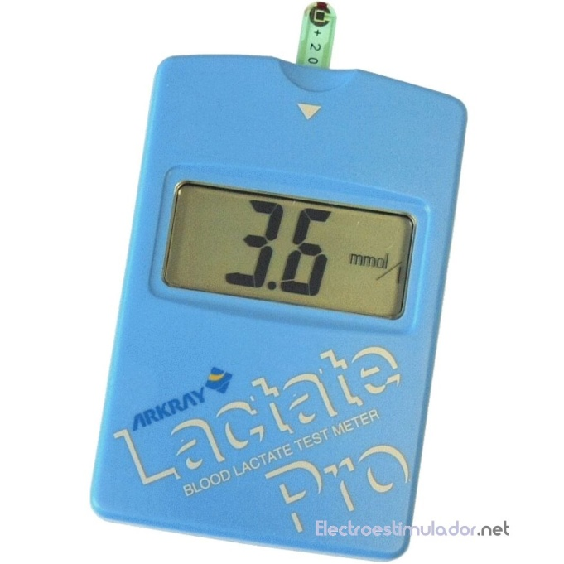
Biochemical Abnormalities
Azotemia
Hyperphosphatemia
Elevated AST
Acidosis
Elevated lactate
Hypochloremia
Notes:
Azotemia may be prerenal or renal

Slide 81
Acidosis
Cannot differentiate HHS from DKA in cats based on degree of metabolic acidosis
HHS acidosis due to uremic acids and lactate rather than ketones

Slide 82
Sodium
Prime determinate of serum osmolality
True magnitude of hypernatremia masked by hyperglycemia
Calculate corrected serum sodium for a better indication of severity of free water loss

Slide 83
Sodium
Corrected sodium
Blood glucose ≤ 400 mg/dL
Na⁺_{(corr)} = Na⁺_{(measured)} + 1.6([Glu_{(measured)} – Glu_{(normal)}]/100)
Blood glucose ≥ 400 mg/dL
Na⁺_{(corr)} = Na⁺_{(measured)} + 2.4([Glu_{(measured)} – Glu_{(normal)}]/100)
Hiller TA Am J Med 1999
DiBartola

Slide 84
Potassium
Cats with HHS tend to have a normal serum potassium level
Increased due to:
Insulin deficiency
Poor renal perfusion
Acidosis
Hyperosmolality

Slide 85

Additional Diagnostics
Thoracic radiographs
Abdominal ultrasound
Echocardiogram
FeLV/FIV testing
Endocrine testing (thyroid)

Slide 86
Treatment
Goals of therapy
Replace fluid deficit
Slowly reduce serum glucose levels
Address electrolyte abnormalities
Treat concurrent disease

Slide 87

Fluid Therapy
Dehydration deficit
Ongoing losses
Maintenance fluid needs

Slide 88
Fluid Therapy
First replace dehydration deficits
Isotonic crystalloid solution
0.9% NaCl fluid of choice
Replace glucose with sodium in extracellular space
Decrease Na⁺ no more than 1 mEq/L/hr

Slide 89
Insulin
Not as critical for resolution of HHS (versus DKA)
Should not be given until hypovolemia and dehydration are improved
  Minimum of 4 to 6 hours after starting fluids
Regular insulin at 50% dosage for DKA
0.025 to 0.05 U/kg/hr CRI
Add 0.5 U/kg regular insulin to 250 ml 0.9% NaCl
Prevents rapid decline in glucose

Slide 90
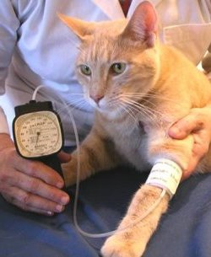
Monitoring
Blood glucose every 1 to 2 hours
Ketones
Serial neurologic exams
Electrolytes
ECG
Blood pressure
CVP

Slide 91
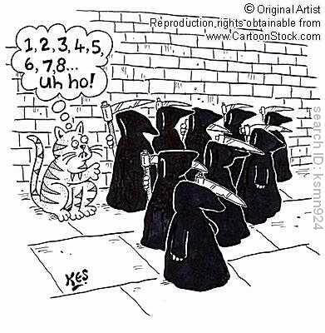
Prognosis
In humans, mortality rate is 15-17% of HHS admissions
Cats with HHS, mortality rate was 64.7% and long term survival (>2 months) was 12%
Outcome not predicted by presence of neurologic signs, serum glucose, serum sodium, total or effective serum osmolality
Koenig A. JVECC 2004
Notes:
Mortality rate is high and long term survival rate is low

Slide 92
References
Boysen SR. Fluid and electrolyte therapy in endocrine disorders: Diabetes mellitus and hypoadrenocorticism. Vet ClinSmall Anim 2008;38:699-717
Brady MA, Dennis JS, Wagner-Mann C. Evaluating the use of plasma hematocrit samples to detect ketones utilizing urine dipstick colorimetric methodology in diabetic dogs and cats. J Vet Emerg Crit Care 2003;13(1):1-6
Christopher MM, Broussard JD, Peterson ME. Heinz body formation associated with ketoacidosis in diabetic cats. J Vet Intern Med1995;9(1):24-31
Claus MA, Silverstein DC, Shofer FS et al. Comparison of regular insulin infusion doses in critically ill diabetic cats: 29 cases (1999-2007). J Vet Emerg Crit Care 2010;20(5):509-517
Cohen TA, Nelson RW, Kass PH et al. Evaluation of six portable blood glucose meters for measuring blood glucose concentrations in dogs. J Am Vet Med Assoc 2009;235:276-280
Hess RS. Diabetic ketoacidosis. In Silverstein DC, Hopper K eds: Small Animal Critical Care Medicine, St. Louis, 2009, Saunders
Hillier TA, Abbott RD et al. Hyponatremia: evaluating the correction factor for hyperglycemia. Am J Med 1999;106:399
Hoenig M, Dorfman M, Koenig A. Use of a hand-held meter for the measurement of blood beta-hydroxybutyrate in dogs and cats. J Vet Emerg Crit Care 2008;18(1):86-87

Slide 93
References
Hume DZ, Drobatz KJ, Hess RS. Outcome of dogs with diabetic ketoacidosis: 127 dogs (1993-2003). J Vet Intern Med 2006;20:547-555
Johnson BM, Fry MM et al. Comparison of a human portable glucose meter, veterinary portable blood glucose meter, and automated chemistry analyzer for measurement of blood glucose concentrations in dogs. J Am Med Assoc 2009;235:1309-1313
Koenig A, Drobatz KJ, Beale AB, et al. Hyperglycemic, hyperosmolar syndrome in feline diabetics: 17 cases (1995-2001). 2004;14(1):30-40
Koenig A. Hyperglycemic hyperosmolar syndrome. In Silverstein DC, Hopper K eds: Small Animal Critical Care Medicine, St. Louis, 2009, Saunders
Kotas S, Gerber L, Moore LE et al. Changes in serum glucose, sodium and tonicity in cats treated for diabetic ketosis. J Vet Emerg Crit Care 2008;18(5):488-495
Laffel L. Ketone bodies: a review of physiology, pathophysiology and application of monitoring to diabetes. Diabetes Metab Res Rev 1999;15:412-426
Moretti S, Tschuor F et al. Evaluation of a novel real-time continuous glucose-monitoring system for use in cats. J Vet Intern Med 2010;24:120-126

Slide 94
References
O’Brien M. Diabetic emergencies in small animals. Vet Clin Small Anim 2010;40:317-333
Parsons SE, Drobatz KJ, Lamb SV et al. Endogenous serum insulin concentrations in dogs with diabetic ketoacidosis. J Vet Emerg Crit Care 2002;12(3):147-152
Reineke EL, Fletcher DJ, King LG et al. Accuracy of a continuous glucose monitoring system in dogs and cats with diabetic ketoacidosis. J Vet Emerg Crit Care 2010;20(3):303-312
Schermerhorn T, Barr SC. Relationship between glucose, sodium and effective osmolality in diabetic dogs and cats. J Vet Emerg Crit Care 2006;16(1):19-24
Seiber-Ruckstuhl NS, Kley S et al. Remission of diabetes mellitus in cats with diabetic ketoacidosis. J Vet Intern Med 2008;22:1326-1332
Tommaso MD, Aste G et al. Evaluation of a portable meter to measure ketonemia and comparison with ketonuria for the diagnosis of canine diabetic ketoacidosis. J Vet Inter Med 2009;23:466-471

