Slide 1
Congenital Portosystemic Shunts
Jenefer Stillion, DVM
Resident board review
September 21, 2010

Slide 2

Congenital PSS
Hepatic Circulation
PSVA
  Extrahepatic
  Intrahepatic
Historical and clinical signs
Diagnosis
Treatment
  Medical
  Surgical
Primary Hypoplasia of the Portal Vein

Slide 3
Hepatic Blood Flow
Liver receives blood from both the portal vein and hepatic artery
  Circulations regulated independently
  The liver has no inherent ability to control portal blood flow
  Portal flow regulated by resistance vessels in the splanchnic viscera (pre-hepatic) with circulation determined by their net outflow
Notes:
Portal vein lacks valves
In the dog, hepatic outflow also is adjusted by throttling musculature surrounding hepatic venules

Slide 4
Hepatic Circulation
Arterial
Aorta → Celiac artery → Anterior Mesenteric artery → Proper Hepatic artery
  20-30% of hepatic blood flow
  60-70% oxygen supply
Notes:
Hepatic artery provides approximately 20-30% of the total hepatic blood flow in health, in the presence of portal hypoperfusion, this flow increases by up to 4 fold.

Slide 5
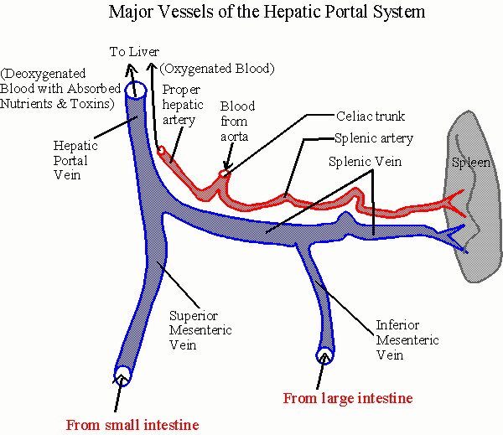
Hepatic Circulation

Slide 6
Hepatic Circulation
Venous
Portal vein
  Drains blood from intestines to liver
  70% of hepatic blood flow
  30-40% oxygen supply
  Hepatotrophic factors
Caudal Vena Cava

Slide 7
Hepatic Circulation

Slide 8
Hepatic Microscopic Anatomy
Portal Triad
  Blood entering liver from Hepatic Artery and Portal Vein
3 main anatomic structures:
  Branch of Hepatic Artery
  Branch of Portal Vein
  Bile duct

Slide 9
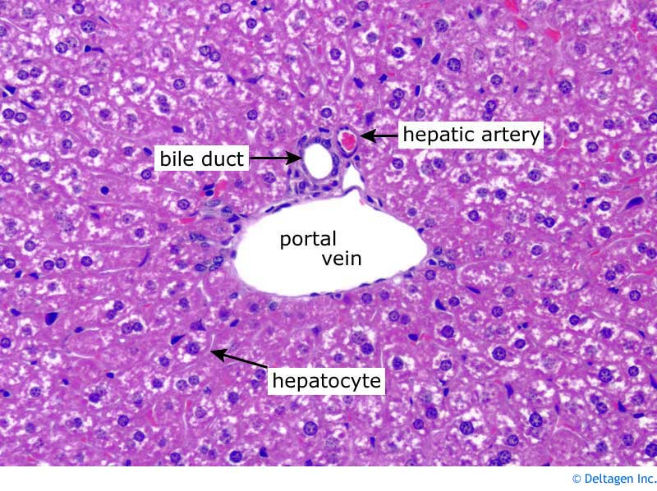
Hepatic Microscopic Anatomy

Slide 10
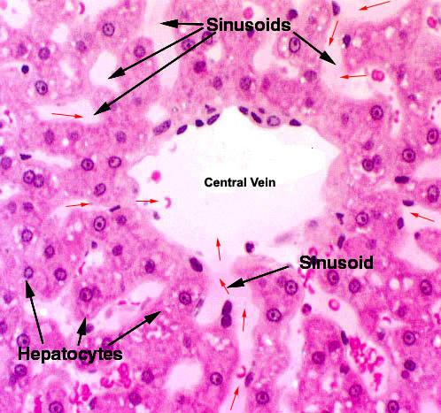
Hepatic Microscopic Anatomy
Hepatic sinusoids
  Nutrients
  Waste products
  Oxygen
Blood exits liver through hepatic vein to Caudal Vena Cava
Notes:
The blood derived from the portal vein and the hepatic artery runs down blood pathways called the hepatic sinusoids. These expose liver cells to nutrients, waste products and oxygen. Caudal vena cava drains blood from the caudal aspect of the body including the leg muscles and skin. After blood has been processed by the liver cells, it exits the liver through a collecting vein called the hepatic vein. That blood then enters the Caudal Vena Cava and flows back to the heart to once again be oxygenated by the lungs.

Slide 11
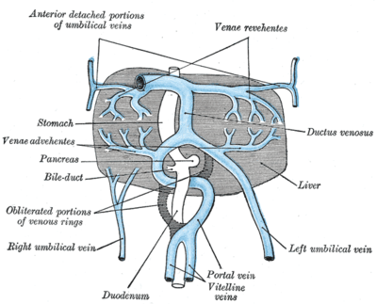
Fetal Circulation
Blood from the placenta bypasses the liver and goes into circulation via the ductus venosus
Notes:
Normally closes within 10 days of birth

Slide 12
Portosystemic Shunts
Vascular anomalies that divert blood from the abdominal viscera to the heart, bypassing the hepatic sinusoids and carrying intestinal absorption products directly to the systemic circulation
Classified as:
Congenital or acquired
Extrahepatic or intrahepatic
Single or multiple

Slide 13
Portosystemic Shunts
Congenital
Portosystemic vascular anomalies (PSVA)
Primary hypoplasia of the portal vein (PHPV)
Acquired
Portal hypertension
Notes:
Acquired PSS: represent circulation through redundant normally non functional small vessels that “open” between the portal vein and vena cava secondary to portal hypertension

Slide 14
Portosystemic Vascular Anomalies (PSVA)
Extrahepatic
Developmental abnormality of the vitelline veins, which connect the portal vein, or one of its tributaries, to the caudal vena cava
Intrahepatic
Failure of the ductus venosus to close
Notes:
EH are the most common anomaly
Tributaries of the portal vein include the splenic, cranial mesenteric, caudal mesenteric or gastroduodenal vein

Slide 15
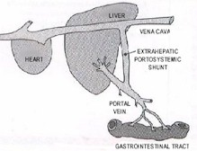
Extrahepatic Shunts
Veins most likely involved:
  - Main trunk of the portal vein
  - Cranial mesenteric
  - Caudal mesenteric
  - Gastroduodenal
  - Splenic
Notes:
Anomalous vessel arising from a major portal vein tributary, mostly involving the main trunk of the portal vein, the left gastric or splenic veins.
Least common type are complicated malformations of multiple vessels and severe microvascular dysplasia involving atresia of the portal veins. In severe portal atresia, portal hypertension causes APSS.

Slide 16

Extrahepatic Shunts
Small breed dogs
  Yorkshire terrier*
  Cairn terriers
  West Highland White Terriers
  Shih Tzu
  Miniature Schnauzer
  Pugs
  Maltese
  Cocker Spaniels
Notes:
Yorkies are the most commonly reported breed in the US. Risk of congenital PSS in this breed is 59 times greater than in mixed-breed dogs and 36 times greater than in all other breeds combined.

Slide 17

Extrahepatic Shunts
Cats
  Himalayans*
  Persians

Slide 18
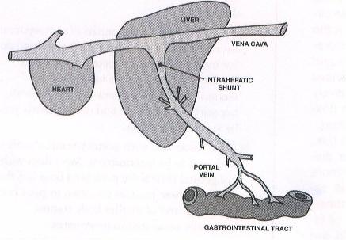
Intrahepatic Shunts
Patent Ductus Venosus
Notes:
Most commonly involve left lateral and medial liver lobes
Right-sided IHPSS are seen in Australian Cattle dogs and Australian Shepherds

Slide 19
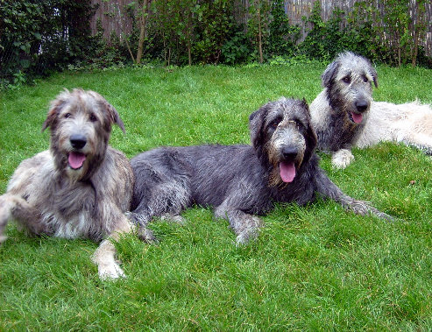
Intrahepatic Shunts
Large breed dogs
  Irish Wolfhounds*
  Scottish Deerhounds
  Australian Shepherds
  Australian Cattle dogs
  Golden Retrievers
  Labrador Retrievers
  Old English Sheepdogs
  German Shepherd
Notes:
Inherited (familial) in Irish Wolfhounds

Slide 20

Historical and Clinical Signs
Gastrointestinal
Urinary tract
Anorexia
Vomiting
Diarrhea
Ptyalism (cat)
Polydipsia
Polyuria
+/- Hematuria
+/- Stranguria
Notes:
15-20% of dogs with PSVA are asymptomatic

Slide 21
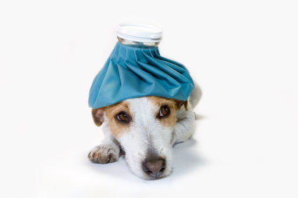
Historical and Clinical Signs
Neurologic
General
Ataxia
Head pressing
Circling
Seizures
Behavioral changes
Blindness
Fever
Higher rates of infection
Drug intolerance
Notes:
Circulatory bypass of the hepatic reticuloendothelial (RE) system that normally provides immune surveillance against infectious material derived from the intestines.
High relative risk for epilepsy
Drug intolerance: those requiring hepatic biotransformation or elimination

Slide 22
Hepatic Encephalopathy
Neuropsychiatric syndrome involving a number of neurologic abnormalities that occurs when more than 70% of liver function is lost
Spectrum of neurologic abnormalities associated with moderate to severe liver insufficiency
Holt D. In Silverstein DC, 2009
Notes:
Healthy liver filters neurotoxic substances that are absorbed across the GI barrier. When liver function is altered, liver cannot appropriately perform its role in substance clearance or metabolism, permitting toxic substances to enter the systemic circulation. Creates an encephalopathic state.
Causes of HE include: congenital portosystemic shunts, congenital urea cycle enzyme deficiencies, acquired portosystemic shunts, acute or chronic liver failure

Slide 23
Human HE Classifications
Type | Nomenclature
Type A | Acute hepatic failure
Type B | PSS without primary liver disease
Type C | Chronic liver insufficiency (cirrhosis)
Ferenci P, 2002
Notes:
HE: definition, nomenclature, diagnosis, and quantification: final report of the working party at the 11th World Congresses of Gastroenterology, Veinna 1998. Hepatology 2002.

Slide 24
Human HE Classifications
 | West Haven Criteria for Semiquantative Grading of Mental State
Grade 1 | Trivial lack of awareness, euphoria or anxiety, shortened attention span, impaired performance of addition
Grade 2 | Lethargy or apathy, minimal disorientation for time or place, subtle personality change, inappropriate behavior, impaired performance of subtraction
Grade 3 | Somnolence of semistupor, but responsive to verbal stimuli, confusion, gross disorientation
Grade 4 | coma
Ferenci P, 2002

Slide 25
Veterinary Classification Scheme
0 | Normal
I | Mildly decreased mobility, apathy or both
II | Severe apathy, mild ataxia or both
III | Hypersalivation, severe ataxia, head pressing, blindness, circling, or a combination of these signs
IV | Seizures, stupor, coma
Proot et al. 2009

Slide 26

Hepatic Encephalopathy
More than 90% of dogs with PSS have neurologic signs of HE
Pathogenesis is complex and incompletely understood
Linked to accumulation of
excess ammonia in the CNS
Notes:
Breznock EM, Whiting PG: Portocaval shunts and anomalies. In Slatter
DH, editor: Textbook of small animal surgery, ed 3, St Louis, 2003,
Saunders.

Slide 27
Toxins Implicated in Hepatic Encephalopathy
Ammonia
Glutamine
Bile acids
Aromatic amino acids
Short-chain fatty acids
GABA
Endogenous benzodiazepines
Tyrosine
Phenylalanine
Methionine
Tryptophan
Phenol

Slide 28
Ammonia Metabolism
Produced in the intestinal tract:
Bacterial degradation of amines, purines and amino acids
Degradation of urea by urease-producing bacteria
Intestinal catabolism of glutamine
Absorbed into the portal blood and rapidly converted to urea or glutamine in normal liver

Slide 29
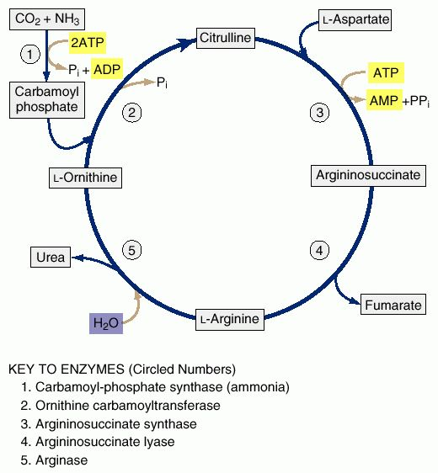
Urea Cycle
Notes:
major route for removal of the ammonia produced in the metabolism of amino acids in the liver and kidney.
*CATS – lack the ability to synthesize arginine and thus can develop HE in the absence of PSS and severe liver dysfunction. Simple fasting can result in hyperammonemia and HE. Compounded with liver dysfunction associated with HL.

Slide 30
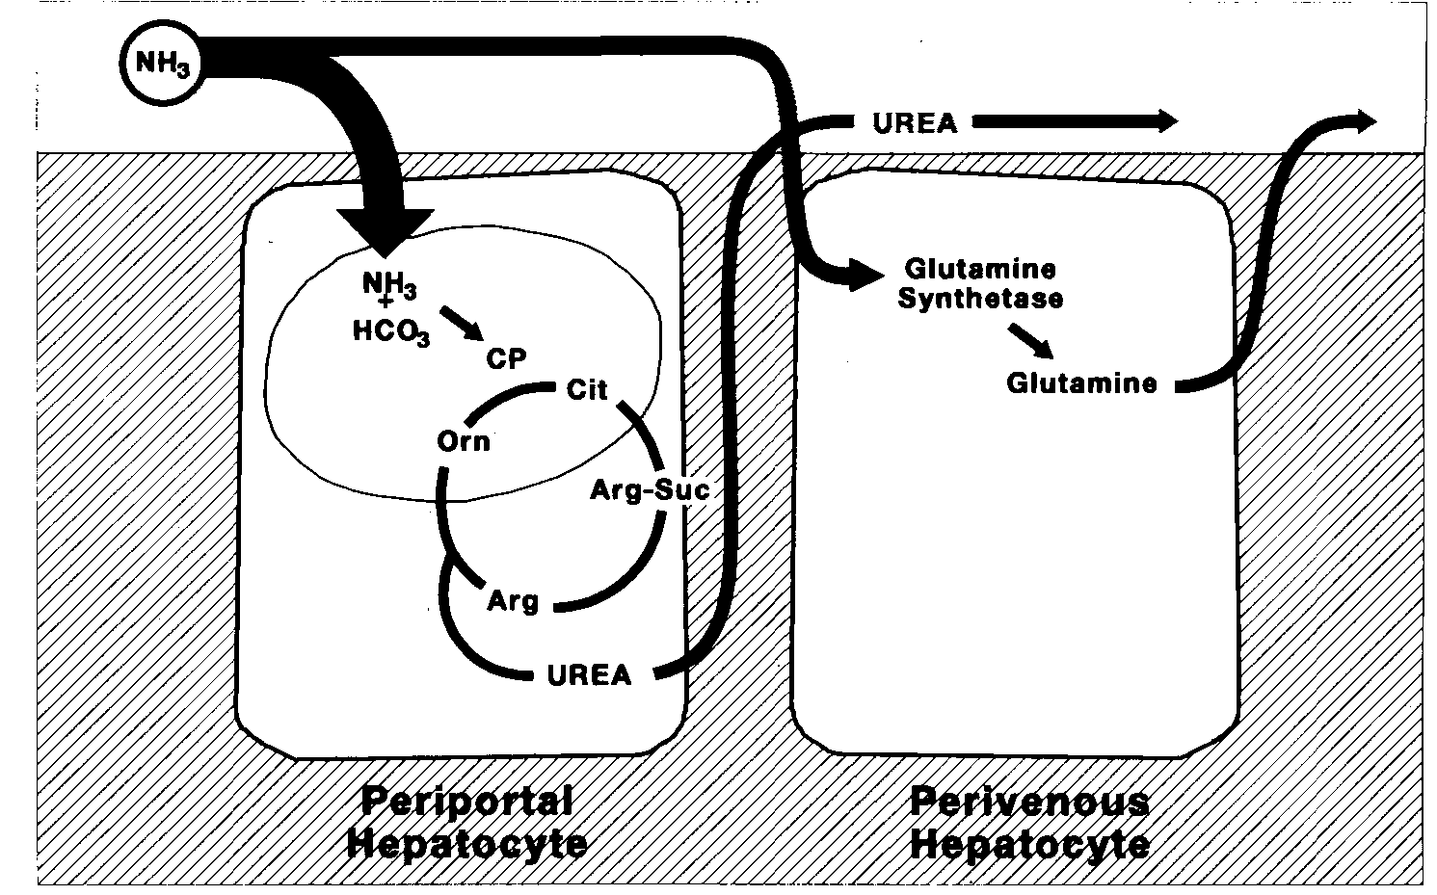
Glutamine Synthesis
Notes:
Scavenger role of the perivenous hepatocyte. The majority of the ammonia is metabolized to urea in the periportal hepatocytes. Ammonia not metabolized to urea is taken into the perivenous hepatocytes and metabolized to glutamine (catalyzed by glutamine synthetase). This prevents ammonia from entering the systemic circulation and allows for uncoupling of urea production, which may be useful in acid-base regulation.
Ammonia undergoes renal excretion. Glutamine can be metabolized to liberate ammonia in the intestines and kidneys.

Slide 31
Ammonia and the Brain
Brain has no urea cycle
Ammonia in CNS is removed by transamination of glutamate into glutamine
Increased glutamine has detrimental effects on astrocytes and neurons
Cellular edema
Increased oxidative stress
Notes:
Glutamine is osmotically active. Ammonia also potentiates aquaporin 4, water channel expressed widely in astrocytes.
Astrocyte edema depletes taurine
Accumulation of glutamine
Taken up by mitochondria
Elevated mitochondrial ammonia levels
Stimulates ROS, RNS

Slide 32
CNS Biochemical Changes
↑ ammonia → ↑ CSF tryptophan (TRP)
Direct stimulation of neutral amino acid transport across BBB
Increased production of glutamine (GLN) in CNS

Slide 33
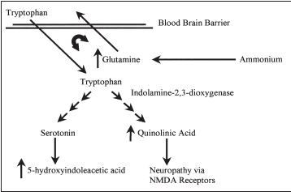
CSF Analysis in Dogs with PSS
↑ glutamine
↑ tryptophan
↑ tryptophan metabolites
  5-hydroxyindoleacetic acid (5-HIAA)
  Quinolinic acid (QUIN)
Holt DE, 2002
Notes:
11 dogs with confirmed PSS and 12 control dogs fed low and high protein diets. Serum levels of GLN, TRP and HIAA were not different between PSS dogs and control dogs. 1—Diagram of the proposed effect of ammonia on tryptophan metabolism. Ammonia is metabolized to glutamine,
which shares an antiport transport mechanism across the blood brain barrier with tryptophan. An increase in tryptophan transport leads to an increased flux through the serotonin and quinolinic acid pathways.NMDA = n-methyl-d-aspartate
QUIN is an NMDA agonist – neurotoxin, causes free radical formation independent of effects on NMDA receptor.
The tryptophan metabolites serotonin and QUIN are important agonists of inhibitory and excitatory neurotransmission although the exact alterations in both of these systems in patients with HE are complex and incompletely understood. Overstimulation of the NMDA receptors by glutamate and ammonia can cause seizures and neurotoxicity in part as a result of free radical formation.

Slide 34
Additional Mechanisms
Increased “GABA-ergic” tone
Increase in benzodiazepine-like compounds
Direct binding of GABA receptor complex by ammonia → stimulates production of additional GABA agonists
Notes:
Benzodiazepines are GABA-ergic. Increased synthesis and decreased clearance.
GABA is the most important inhibitory neurotransmitter in the CNS.

Slide 35
Additional Mechanisms
Inflammation
Synergistic relationship between inflammatory mediators, oxidative stress and ammonia
Innate immune dysfunction
Altered catecholamine neurotransmission
False neurotransmitters
Aromatic amino acids (AAA) metabolites
Notes:
Humans with HE and SIRS improve neurologically with resolution of SIRS
Increased BBB permeability
Altered glutamate uptake by astrocytes
Altered expression of GABA receptors
Ammonia has been shown to induce neutrophil dysfunction by inducing cell swelling, impaired phagocytosis, and increased oxidative burst in normal neutrophils. Makes patients vulnerable to developing bacterial and fungal infections, induces oxidative stress and may result in “sepsis-like” immune paralysis.
AAA (tryptophan, tyrosine, phenylalanine) normally removed by the liver. Metabolites of AAA block dopamine and NE induced neurotransmission – get an increase in the synthesis of false neurotransmitters and a decreased synthesis of NE and dopamine.

Slide 36
Factors Precipitating Hepatic Encephalopathy
Dehydration
Azotemia
Alkalemia
Hypokalemia
Hypoglycemia
Catabolism
Infection
PU/PD
Anorexia
Constipation
Hemolysis
Blood transfusion
GI hemorrhage
High dietary protein
Drugs
Notes:
Drugs: benzodiazepines, antihistamines, barbiturates, phenothiazines, metronidazole
Alkalosis increases ammonia diffusion into the CNS
Hypokalemia stimulates renal ammonia production
Use fresh blood products – stored blood can have increased ammonia levels

Slide 37

Physical Examination
Small body stature
Unthrifty
Prominent kidneys
Copper-colored iris (cats)
+/- Heart murmur
+/- Cryptorchid
+/- Icterus
+/- Abdominal distention
Notes:
Kidneys may palpate large secondary to increased GFR, renal gluconeogenesis, renal cell hypertrophy induced by high ammonia levels. Cystic calculi may be palpated.
In one study, 50% of male dogs were cryptorchid

Slide 38

Diagnosis
Hematology
Urinalysis
Liver function tests
Diagnostic Imaging
Histopathology/Surgery

Slide 39

Hematology
Microcytic normochromic nonregenerative anemia
Leukocytosis
Notes:
Mild to moderate microcytic normochromic nonregenerative anemia
Microcytosis reported with or without anemia in 60-72% of dogs but only 30% cats. Usually resolved after shunt fixation.
Leukocytosis is due to inadequate hepatic endotoxin and bacterial clearance from the portal circulation – has been associated with a poor prognosis.

Slide 40
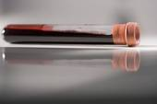
Serum Chemistry
↓ Albumin
↓ BUN
↓ Creatinine
↓ Cholesterol
↓ Glucose
Variable liver enzymes
  ↑ ALP
  ↑ ALT
Notes:
Serum biochemical abnormalities are extremely common. Most are due to decreased hepatic synthesis
In cats, low albumin is uncommon but low BUN and Cr are common
Liver enzyme elevations are usually mild to moderate. ALP is typically higher than ALT in dogs with PSS due to contribution from bone isoenzyme in growing animals.
Hypoglycemia occurs in 22-47% of dogs with CPSS and is associated with poor muscle mass, low body fat, low hepatic glycogen stores, impaired gluconeogenesis

Slide 41
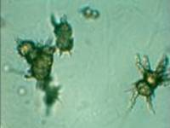
Urinalysis
Ammonium biurate crystalluria
Alkaline urine
Isosthenuria or hyposthenuria
+/- proteinuria
Notes:
Dogs with MVD DO NOT develop ammonium biurate urine crystals because the do not have high ammonia values
50% dogs have low USG likely from polydipsia and poor medullary concentrating gradient that occurs with low BUN.
Ammonium biurate crystalluria seen in 26-57% of dogs and 16-42% cats
Proteinuria can be seen secondary to glomerular sclerosis or underlying glomerulonephropathy – possibly occurs because liver can’t filter out antigens and they deposit in kidney.

Slide 42

Liver Function Tests
Serum Bile Acids
Urine Bile Acids
Ammonia tolerance test
Ammonia levels
Coagulation tests

Slide 43
Serum Bile Acids
Synthesized in the liver from cholesterol
Following conjugation, secreted into bile and stored in the gallbladder
Ingestion of a fatty meal stimulates gallbladder contraction

Slide 44
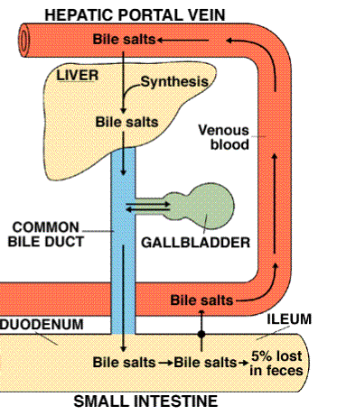
Bile Acid Enterohepatic Circulation
Bile expulsion into duodenum→ facilitate fat digestion
Most reabsorbed in the small intestines → portal vein → liver extraction

Slide 45
Serum Bile Acids
Collect paired sample
  Fasting (12 hour)
  2-hour postprandial
TBAC ≥ 25 uMol/L is abnormal
Bile acid values:
  Cannot diagnose a specific liver disease
  Patterns do not designate a precise diagnosis
  Do not correlate with histologic severity of disease
Notes:
Collect into lithium heparin vacutainer
Small number of animals have a NORMAL postprandial with ELEVATED fasting
Larger number of animals have a ELEVATED postprandial and NORMAL fasting

Slide 46
Serum Bile Acid Patterns in Different Disorders
False positive
False negative
Inappropriate sample handling
Hepatobilliary diseases
Cholestasis
Glucocorticoids
Anticonvulsants
Tracheal collapse
Seizures
GI disease
Delayed intestinal absorption
  Lack of gallbladder contraction
  Inadequate food intake
  Delayed gastric emptying
  Malabsorption
  Maldigestion
Notes:
False negative = falsely lowered values

Slide 47
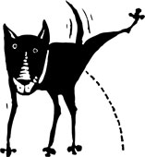
Urine Bile Acids
Effective screening test for abnormally elevated TSBA in dogs and cats
Values are normalized against the urine creatinine [UBA/Ucr (umol/L/mg) x100]
  > 7.3 abnormal in dog
  > 4.4 abnormal in cat
Random urine samples missed finding high bile acids in dogs with PSVA
Collect urine 4-8 hours after feeding
Balkman CE, 2003
Notes:
Balkman CE, 2003 JAVMA paper
Normally only small amounts of BA excreted in urine. High TSBA can lead to urinary excretion of water-soluble forms. Two prospective studies were done at Cornell and showed that UBA in randomly collected urine can effectively screen for abnormally increased TSBA in dogs and cats. UBA values have to be normalized against urine Cr. At present, no commercial laboratory offers this test on a routine basis.

Slide 48
Ammonia Tolerance Test
Widely used screening test in humans
Administer ammonium chloride
  Nasogastric, PO, enema
Collect paired blood samples
  Baseline
  30 minutes after administration
Elevations suggestive, but not diagnostic, for PSS
Contraindicated in animal with HE
Notes:
Plasma analysis needs to be done within 20 minutes of sample collection. Blood stasis and hemolysis can falsely elevated ammonia levels.
Sensitivity of 95-100% for hepatic insufficiency

Slide 49
Plasma Ammonia Concentration
High baseline level supportive, but not diagnostic, for PSS
False-positives reported in Irish Wolfhound puppies
  Impaired ammonia metabolism w/o PSS
12-hour fasting plasma ammonia was 100% sensitive and 89.1% specific in detecting PSVA
Gerritzen-Bruning MJ, 2006
Notes:
Versus TSBA with sensitivity of 92.2% and specificity of 17.9-67.9%

Slide 50
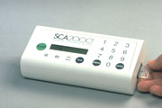
Coagulation Profiles
Prolonged coagulation times
  PTT
  +/- PT
Mild thrombocytopenia
Spontaneous bleeding rare
Notes:
Chronic PSS will have PTT, +/- PT prolongation versus ALF where both are prolonged. Due to many factors including impaired hepatic synthesis, qualitative abnormalities, clearance of coagulation factors. Might be due to factor XII. Study by Kummeling A et al JVIM 2006 showed lower platelet counts, lower activity of factors II, V, VII and X and increased FVIII (not made by liver, produced by megakaryocytes and endothelial cells) and prolonged PTT versus healthy dogs.
Center study (Toulza O 2006) found prolonged PTT in only 7% of PSS dogs while PT was prolonged in 50%

Slide 51
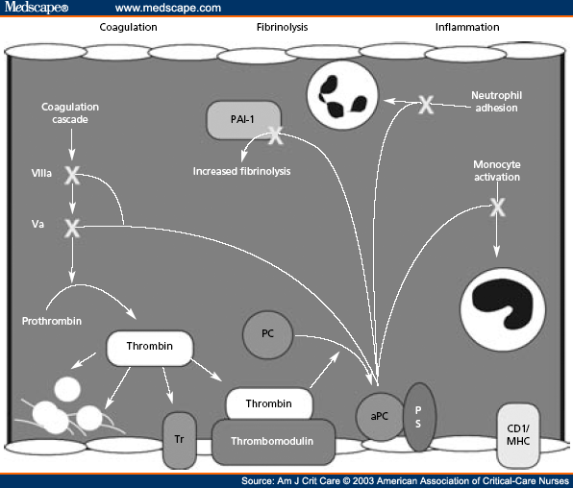
Protein C
Anticoagulant protein synthesized in the liver

Slide 52
Protein C
Measurement of plasma protein C activity used to assess hepatic function in human patients with hepatic disorders
Used as a prognostic indicator for monitoring hepatic transplant patients after surgery
Walker SJ, 1990
Bilik R, 1992

Slide 53
Protein C
Low protein C activity seen with:
Acute phase inflammation
Sepsis
DIC
Hepatic failure
Vitamin K deficiency
Notes:
Seen with portal vein thrombosis as well: not sure if cause or effect

Slide 54
Protein C
Dogs with hepatobiliary disease:
59% had low protein C activity
Specificity for PC activity and TSBA was similar (76% and 78%, respectively)
Best overall sensitivity was with TSBA but PC activity had a high sensitivity for detecting PSS and hepatic failure
Toulza O, 2006
Notes:
Low protein C activity was a biomarker of liver function and perfusion, not solely due to end-stage hepatobiliary disease or synthetic failure

Slide 55
Protein C
Dogs with PSVA (n = 105):
88% had low protein C activity
53% had low AT activity
50% prolonged PT
7% prolonged aPTT
Low fibrinogen not detected in any dogs
Toulza O, 2006

Slide 56
Additional Biochemical Markers
Author | Study Design | Findings
Holford AL et al. JVIM 2008 | Prospective study dogs: 8 control, 8 OHE and 8 CPSS undergoing surgical shunt attenuation | • Baseline cortisol levels similar in CPSS and healthy dogs • Postoperative hypoglycemia more common in CPSS • 10/16 dogs with CPSS has inadequate postop ACTH response
Gow AG et al. JVIM 2010 | Prospective study dogs: 18 CPSS, 26 non-hepatic disease, 14 healthy | • Dogs with CPSS had higher whole blood manganese concentration
Deppe TA et al. JVIM 1999 | Prospective study dogs: 21 CPSS undergoing surgical shunt attenuation | • GFR increased in 81% dogs • Renal volume increased in 70% dogs • Both decreased after shunt ligation
Peterson SL et al. JVIM 1991 | Prospective study dogs: 10 CPSS undergoing surgical shunt attenuation. All undergoing medical management prior to surgery. | • Systemic endotoxemia was not detectable in dogs with CPSS undergoing preoperative medical management
Notes:
Inadequate response to ACTH more common in dogs with CPSS after surgery when defined as < 50% rise in post-ACTH cortisol (10/16) but not when defined as an increase of < 30 ng/ml over baseliness. All dogs with inadequate response to ACTH had increased baseline post-op cortisol concentration. Response to ACTH did not correlate with postop hypoglycemia or prolonged anesthetic complications.
Mn toxicity causes neurologic disturbances and has been implicated in pathogenesis of HE

Slide 57
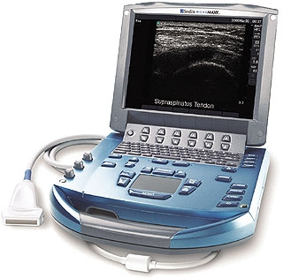
Diagnostic Imaging
Abdominal radiographs
Ultrasonography
Colo-rectal scintigraphy
Angiography
Portovenography

Slide 58
Abdominal Radiographs
Microhepatica
  60-100% dogs
  50% cats
Bilateral renomegally
+/- marginally radiopaque calculi in bladder, ureters or kidneys
Notes:
Stones can be radiolucent: ammonium biurate with associated calcium salt or struvite shells

Slide 59
Ultrasonography
Non-invasive
Does not require general anesthesia
Sensitivity of 74-95%
  Overall sensitivity is higher for IHPSS
Specificity of 67-100%

Slide 60
Ultrasonography
Decreased number of hepatic and portal veins
Microhepatica
Anomalous vessel(s)
Portal vein velocity
  ↑or variable in 53% dogs with EHPSS and 92% dogs with IHPSS
Uroliths

Slide 61
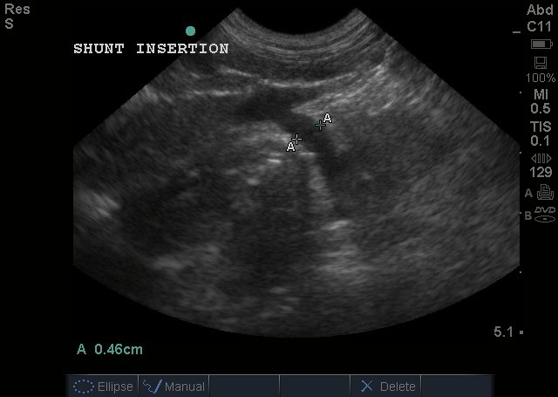
Ultrasonography

Slide 62

Scintigraphy
Uses technetium pertechnetate (TC^{99M})
  Half-life of 6 hours
Infuse TC^{99M} labeled enema into colon
Image with a gamma camera

Slide 63
Scintigraphy
Isotope absorption:
colonic veins → caudal mesenteric → portal vein → liver → heart
PSS:
colonic veins → caudal mesenteric → portal vein → heart → liver (via arterial circulation)

Slide 64
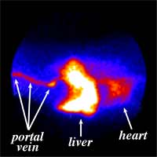
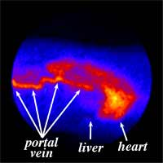
Scintigraphy
NORMAL
SHUNT
Notes:
Composite image showing the uptake of a radioactive dye from the rectum into the portal vein. Notice that the dye bypasses the liver and appears in the heart and lungs first.

Slide 65
Scintigraphy
Shunt fraction
Estimate of percentage of portal blood bypassing the liver
<15% Normal

Slide 66
Scintigraphy
Limitations
Does not provide morphologic information about shunt type or location
Cannot distinguish IHPSS from EHPSS
Cannot differentiate single from multiple shunts

Slide 67
Angiography
Computed Tomographic Angiography (CTA)
Magnetic Resonance Angiography (MRA)

Slide 68
Computed Tomographic Angiography (CTA)
Gold standard in people
Non-invasive and fast
Images all portal triburaries and branches from single peripheral venous contrast injection
Can provide three-dimensional, preoperative shunt images

Slide 69
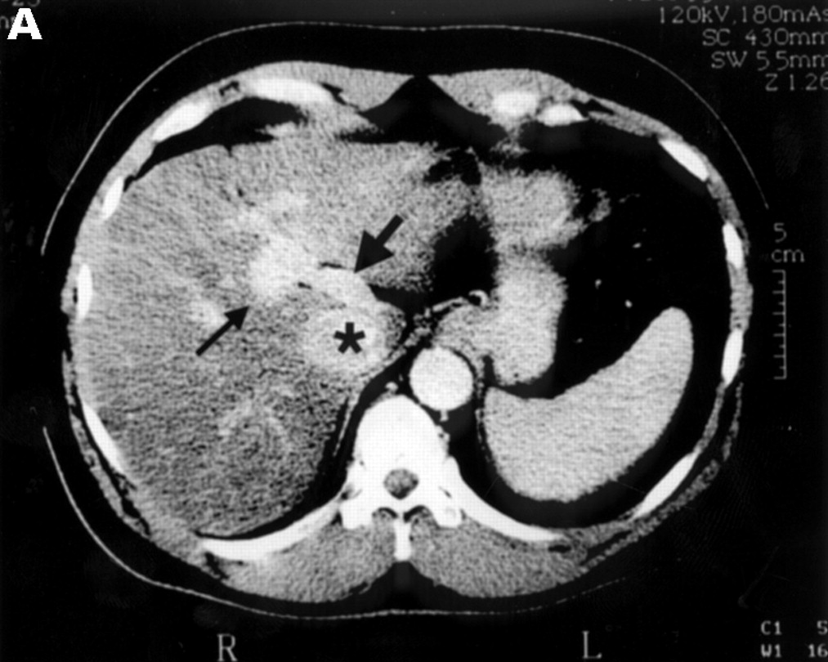
CTA
Notes:
Computed tomography of the abdomen of patient 1 during infusion of contrast into the superior mesenteric artery, showing the patent ductus venosus. The thin arrow points to the portal vein, the thick arrow to the patent ductus venosus, and the asterisk marks the inferior vena cava.

Slide 70
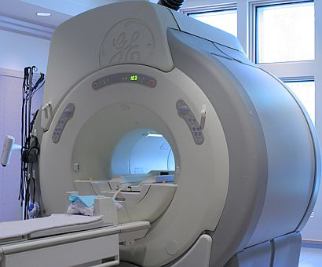
Magnetic Resonance Angiography (MRA)
Can provide three-dimensional, preoperative shunt images
More expensive than CTA
Notes:
Aids in procedural planning

Slide 71
Portovenography
Not commonly performed due to availability of less invasive imaging modalities
Types
Surgical mesenteric portography
Percutaneous splenic venography

Slide 72
Surgical Portal Venography
Most commonly performed angiographic test in dogs in cats
Excellent imaging and localization of shunting vessel(s)
Requires laparotomy, portable fluoroscopy and IV contrast material
Sensitivity of 85-100%

Slide 73
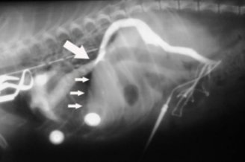
Positive contrast portogram
Notes:
Abnormal portogram with large arrow pointing to shunt and small arrows pointing to lack of vasculature in liver.

Slide 74
Percutaneous Splenic Venography
Simultaneous ultrasonographic and fluoroscopic evaluation of contrast material
Inject 2-4 ml/kg of sterile radiopaque contrast material as a bolus
  iohexol 240 to 360 mg/ml
Image splenic venous drainage through the portal vein

Slide 75
Histopathology
Liver biopsy
No statistical association between histological features and survival times
Histological features associated with a poor prognosis:
  Fibrosis
  Biliary hyperplasia
  Necrosis
Parker JS, 2008
Matthews KG, 2005
Center, S, 1996
Notes:
Histologic examination of hepatic biopsy samples as a prognostic indicator in dogs undergoing surgical correction of congenital portosystemic shunts: 64 cases (1997–2005), JAVMA 2008.
None of the histologic features examined were significantly associated with survival time.

Slide 76
Treatment
Medical management
Decrease production and absorption of ammonia
Surgical management
Redirection of blood through the liver parenchyma by attenuation of the shunting vessel

Slide 77
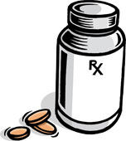
Medical Management
Nutrition
Antibiotic therapy
Cathartics
Gastroprotectant
Anti convulsants
Hepatoprotective therapy
Notes:
Aimed at controlling clinical signs but does not treat underlying diminished hepatic perfusion

Slide 78
Nutritional Management
Goals:
Provide adequate energy/nutrient intake
Maintain positive or neutral nitrogen balance
Supplement vitamins and micronutrients
Modifications for HE
Notes:
Moderate protein restriction Low protein diet 18-22% for dogs 30-35% for cats. Dairy and vegetable proteins Lower in aromatic amino acid. Tyrosine, phenylalanine. Higher in branch chain amino acids Valine, leucine, isoleucine More fiber

Slide 79
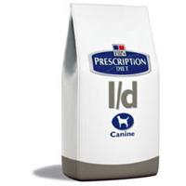
Nutritional Management
Adequate energy/nutrient intake
If NOT encephalopathic: feed a normal maintenance diet
If encephalopathic: restricted protein intake with frequent reassessment of:
  Body weight and condition
  Activity level
  Serum albumin, creatinine
Notes:
Healthy adult cats require 3-5x more dietary protein than adult dogs
Renal diets are low in protein but may contain insufficient protein to maintain the animals aa requirements
Ratio of non-protein energy to protein important
Energy distribution is important. Increasing the energy:nitrogen ratio. Increase fat and carbohydrate calories.

Slide 80
Protein: Quantity and Quality
Feed smaller meals with increased frequency
Vegetable and dairy in dogs > meat
Amino acid profile, methionine concentration and BCAA:AAA cannot predict encephalopathic potential of diets
Center SA, 1998
Notes:
Believed that vegetable or dairy protein performs better than meat, fish or egg protein sources in humans susceptible to HE. Changing a meat-based diet to a vegetable or dairy protein base yields better results than overall protein restrictions in controlling subclinical HE and maintaining body condition.
Diets containing dairy and vegetable quality protein are less encephalogenic and produce lower blood ammonia concentrations in humans and dogs with hepatic insufficiency compared with meat based diets.
Cassein is the main dairy protein. It forms a “clot” in the stomach and is slowly digested so you get a slower release of amino acids and better nitrogen balance.

Slide 81
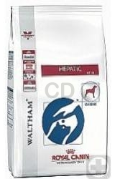
Soy vs. Meat-Based Low-Protein Diet for Dogs with CPSS
Prospective double-blind cross-over study
16 dogs with confirmed CPSS
Compared two diets:
  Test diet (Royal Canin Canine Hepatic)
  Control diet (low-protein, poultry)
Proot S, 2009
Notes:
Both diets had equal fiber content and comparable branch chain: aromatic amino acid content

Slide 82
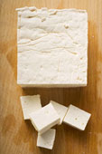
Soy vs. Meat-Based Low-Protein Diet for Dogs with CPSS
Both diets achieved a significant improvement in the HE score and PT time
Soy-based diet
Significantly lowered blood NH₃ concentration
Higher fibrinogen concentration
(p = 0.054)
Proot S, 2009

Slide 83
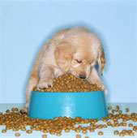
Soy vs. Meat-Based Low-Protein Diet for Dogs with CPSS
Conclusion:
Soy-based diet would decrease risk of HE and give better support of liver function
Proot S, 2009

Slide 84
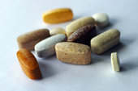
Vitamins and Micronutrients
vitamins
micronutrients
Vitamin B complex
Vitamin E
Thiamine
Arginine
Vitamin K-1
Copper restriction
Zinc
L-carnitine
Notes:
Water soluble vitamins should be supplemented at 2x maintenance
Fat soluble vitamins include Vitamin K-1 and Vitamin E which is a free radical scavenger
Breed related Cu toxicity, cholestasis
Zinc is a free radical scavenger, aids in urea cycle function, blocks copper uptake, offers hepatoprotection from selected hepatotoxins
L-carnitine: cats with HL

Slide 85
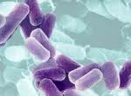
Antibiotic Therapy
Activity against urease-producing bacteria
Reduce production of intestinal ammonia
Decrease risk of bacterial translocation

Slide 86
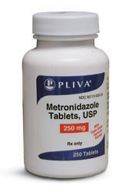
Antibiotic Therapy
Antibiotics
Metronidazole 7.5 mg/kg IV or PO q 12 h
Ampicillin 22 mg/kg IV q 6 h
Neomycin 22 mg/kg PO q 8 h
  Ototoxicity, nephrotoxicity

Slide 87
Cathartics
Nonabsobable disaccharides
Promote the acidification of colonic contents
  Decreased bacterial numbers
  Elimination of ammonia and bacteria in feces
Lactulose 0.5-1 ml/kg PO q 6-8 h to effect of 2 to 3 soft stools per day
Notes:
The decrease in colonic pH creates an environment that is hostile to the survival of urease-producing intestinal bacteria and may promote the growth of non-urease-producing lactobacilli resulting in decreased production of ammonia in the colonic lumen

Slide 88
Gastroprotectants
Prevention and treatment of GI ulceration and hemorrhage
Antacids
Famotidine 0.5-1 mg/kg/day PO
Omeprazole 0.5-1 mg/kg/day PO
Misoprostol 2-3 mcg/kg PO q 12 h
Protectants
Sucralfate 1 g/25 kg PO q 8 h
Notes:
Blood is highly ammoniagenic

Slide 89
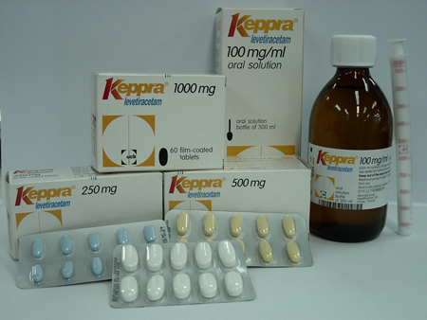
Seizure Control
Anticonvulsants
Avoid benzodiazepines (?)
  Midazolam
Levetiracetam (Keppra)
Zonisamide
Phenobarbitol
Potassium bromide
Notes:
Midazolam preferred over diazepam due to lack of propylene glycol as a carrying agent, which requires liver metabolism. Remember that anticonvulsants can be hard on the liver as well.

Slide 90
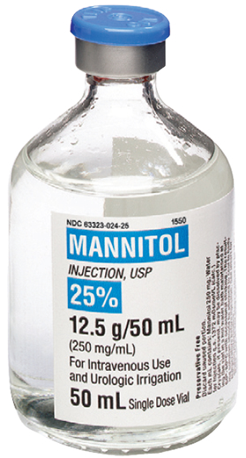
Seizure Control
Decrease cerebral edema
Mannitol 0.5-1 g/kg IV bolus
Hypertonic saline

Slide 91
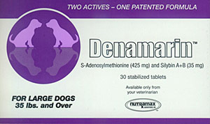
Hepatoprotectant Therapy
S-adenosylmethionine
  17-22 mg/kg/day
Milk thistle (Silymarin)
  8-20 mg/kg divided q8h
Ursodeoxycholic acid
  10-15 mg/kg/day

Slide 92
Additional Therapies
Probiotics
Lactobacillus acidophilus
Flumazenil
Benzodiazapine receptor antagonist
Short-term improvement in human patients with HE and cirrhosis
Have failed to demonstrate a significant effect on recovery or survival
Lock BG, 2006
Notes:
some evidence in the human literature that populating the gut with non urease producing bacteria is beneficial

Slide 93
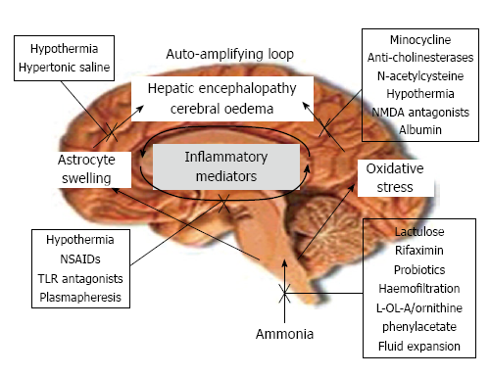
Novel Therapeutic Strategies
Seyan AS, 2010
Notes:
Figure 1 The “Two-hit” hypothesis. In a background of liver injury and hyperammonemia,
a second “hit”, such as an ammonia load following an upper
gastrointestinal bleed, systemic inflammation/infection, or the development of
hyponatremia can drive further astrocyte swelling, oxidative stress and lead to
a rapid deterioration in neurocognitive function. The close relationship between
astrocyte swelling and oxidative stress leads to an “auto-amplifying signalling
loop”. The sites of action of potential therapies are indicated on the Figure.
L-OL-A: L-ornithine L aspartate; NMDA: N-methyl D-aspartate; NSAID: Nonsteroidal
anti-inflammatory; TLR: Toll-like receptor.

Slide 94
Medical Management
> 50% of dogs treated with medical therapy alone will be euthanized within 10 months of diagnosis
Approximately 33% can survive long term
Long-term survival is better with EHPSS than IHPSS
Euthanasia most often due to recurrent HE or portal hypertension
Richter KP, 2003

Slide 95

Surgical Management
Redirection of blood through the liver parenchyma by attenuation of the shunting vessel

Slide 96
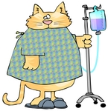
Preoperative Stabilization
Initiate therapy to support and improve liver function prior to anesthesia
Correct fluid and electrolyte abnormalities
Anticonvulsant therapy
Treatment for HE if present
Control vomiting and diarrhea
Plasma transfusion
Notes:
Plasma with support intravascular volume, help maintain COP, and provide coagulation factors

Slide 97
Prophylactic Anticonvulsant Therapy
Prophylactic antibiotics did not significantly reduce the risk of postoperative neurologic signs in dogs with PSS but may have reduced their severity
Phenobarbitol
1 to 2 mg/kg PO q 12 h
Potassium bromide
Loading dose: 100 mg/kg PO q 6 h x 4 doses
Maintenance dose: 60 to 100 mg/kg PO SID
Tisdall PLC, 2000

Slide 98
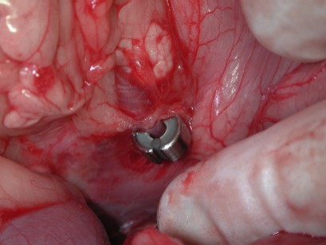
Surgical Management
Procedures include:
Suture ligation
Cellophane banding
Ameroid ring constrictor
Thrombogenic intravascular coil
Hydraulic occluder
Notes:
Ameroid constrictor has been shown to result in shorter surgery times and less complications than other surgical approaches.

Slide 99
Shunt Attenuation
Shunt is temporarily occluded for 3 to 5 minutes
Viscera evaluated for portal hypertension
Measure portal and central venous pressures
  Normal portal pressure: 8 to 13 cmH₂0
  Post-ligation: max 17 to 24 cm H₂O
  Maximum change: 9 to 10 cm H₂O

Slide 100
Extrahepatic Shunt Ligation
40-68% of dogs and cats can tolerate only partial ligation
Liver size relative to bodyweight is significantly greater in dogs that are tolerant of complete CPSS ligation
Doran IP, 2008
Notes:
Tolerance based on degree of portal venous pressure post-operatively

Slide 101
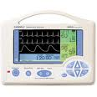
Postoperative Monitoring
Clinical parameters
Laboratory parameters
Heart rate
Respiratory rate
Temperature
Direct arterial pressure
Central venous pressure
ECG
Urine output
Abdominal circumference
Intraabdominal pressure
Mentation and neurologic status
PCV
TP
Glucose
Lactate
Electrolytes
Acid-base status

Slide 102
Post-Operative Complications
Portal hypertension
Coagulopathy
Seizures
Encephalopathy
Hemorrhage
Hypoglycemia
Recurrence of clinical signs
Portal vein thrombosis
Notes:
Rogers CL 2008: PVT found in 3 cats with CPSS
Roy RG 1992: PVT in 2 dogs following PSS ligation

Slide 103
Portal Hypertension
Seen in 2-14% of patients undergoing acute ligation
Liver unable to accommodate the increase in portal blood flow
Venous congestion of abdominal organs
Hypovolemic shock
Notes:
Less common in patients who have gradual shunt occlusion

Slide 104
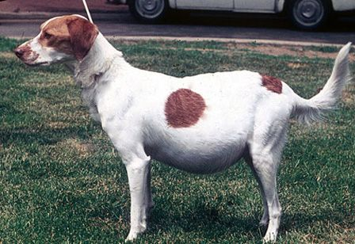
Portal Hypertension
Clinical signs
Systemic hypotension
Abdominal pain
Abdominal distention
Melena
Diarrhea

Slide 105
Seizures
Reported in 0-18% of animals after shunt attenuation
Occur during immediate post operative period up to 96 hours after surgery
Notes:
Generalized seizures used to be associated with a high mortality rate

Slide 106
Seizures
Case series looking at outcome from status epilepticus after shunt attenuation in 3 dogs
Seizures occurred 46-96 hours after surgery
Not responsive to benzodiazepines
Propofol CRI and phenobarbital
All 3 made a complete recovery
  Free from antiepileptic drugs without recurrence of neurologic signs
Gommeren K, 2010

Slide 107

Recurrence of Clinical Signs
Reported in 30-50% dogs undergoing partial ligation of shunts
May recur 1-3 years after shunt ligation

Slide 108
Prognosis
Acute mortality rates 0-25%
Lowest complication rates
  Dogs with EHPSS without preoperative HE
  Animals that undergo complete ligation, particularly with gradual attenuation
Notes:
Acute mortality depends on experience of surgeon, location of shunt, method and degree of shunt attenuation, health status of patient.

Slide 109
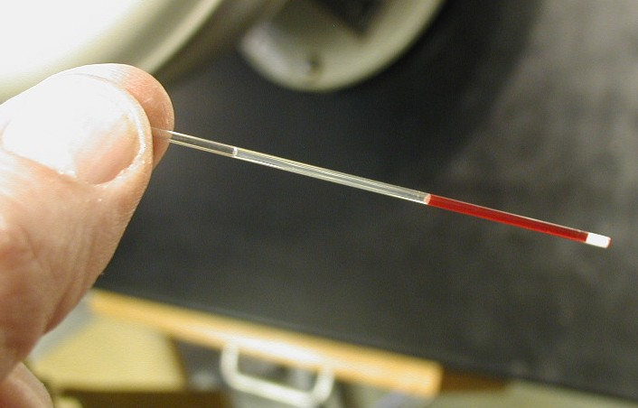
Outcome Predictors – Dogs with IHPSS
Short-term outcome
Body weight
TP
Albumin
BUN
Long-term outcome
PCV
TP
Papazoglou LG, 2002
Notes:
BW > 10 kg, TP > 4, lower BUN, Alb 2.6 vs 2 in non-survivors

Slide 110
Prognosis
Surgical intervention associated with a better chance of long-term survival
126 dogs with single PSS
18/126 (14.3%) dogs died as a result of PSS
Overall mortality
Medically treated: 48.1% (13/27 dogs)
Surgically treated: 12.1% (12/99 dogs)
Greenhalgh SN, 2010
Notes:
78.6% treated surgically, 21.4% treated medically
Decision regarding treatment method for each dog was made by each owner after discussion with the attending clinician. Many owners chose surgical intervention simply because it had been recommended by their referring veterinarian at the time of diagnosis

Slide 111
Prognosis
Cats with PSVA have a poor prognosis
More than 65% of cats had recurrence or progression of clinical signs within 1 to 12 months following ameroid constrictor placement
67% dead or euthanized within 3 years of ameroid constrictor placement
Havig M, 2002

Slide 112

CPSS in Cats
Retrospective study
49 cats who underwent ligation of single CPSS
Only 4% (2/49) died perioperatively
83% (30/36) cats alive at 47 months
Owner perceived outcome
Excellent: 20 cats
Good: 7 cats
Development of neurologic signs in 37% of cats (18/49)
Lipscomb VJ, 2007
Notes:
None of the 27 cats was on any long term medication or special diet
10/18 cats (56%) that developed neurologic signs recovered normal neurologic function long term

Slide 113
Primary Hypoplasia of the Portal Vein (PHPV)
Previously termed microvascular dysplasia (MVD)
A congenital, most likely inherited, malformation in the microscopic hepatic portal vasculature

Slide 114
PHPV
Characterized by the presence of multiple microscopic intrahepatic shunts
Occurs as a single entity or coexists with PSVA
Can develop portal hypertension and acquired shunting

Slide 115
PHPV
Dogs affected only with PHPV
In most dogs the disease is subclinical (asymptomatic)
Hepatic vascular abnormalities are non-progressive
Do not require medical treatment
May demonstrate intolerance to drugs that are metabolized or excreted by the liver

Slide 116

PHPV
Breed predisposition
Cairn Terriers
Yorkshire Terriers
Maltese
Tibetan Spaniels

Slide 117
Diagnosis of PHPV
Asymptomatic predisposed breed
Increased TSBA
PC activity ≥ 70% in 95% of dogs with PHPV
Normal abdominal ultrasound
  Inability to visualize the presence of an intra- or extrahepatic shunt
  Liver is generally of normal size, with normal perfusion
Notes:
Versus PC activity < 70% in 88% of dogs with PSVA

Slide 118
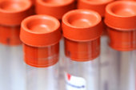
Diagnosis of PHPV
Do NOT have high blood ammonia levels
Do NOT develop ammonia biurate crystals

Slide 119
Treatment of PHPV
Avoiding hepatotoxic drugs
Use caution with sedatives and anesthesia
Small subset of dogs may develop progressive disease:
  Monitor serum liver enzymes
  Hepatoprotective agents

Slide 120
References
Breznock EM, Whiting PG: Portocaval shunts and anomalies. In Slatter DH, editor: Textbook of small animal surgery, ed 3, St Louis, 2003, Saunders
Deppe TA et al. Glomerular filtration rate and renal volume in dogs with congenital portosystemic vascular anomalies before and after surgical ligation. J Vet Intern Med 1999;13:465-471
Dimski DS. Ammonia metabolism and the urea cycle: function and clinical implications. J Vet Emer Crit Care 1994;8(2):73-78
Doran IP et al. Liver size, bodyweight and tolerance to acute complete occlusion of congenital extrahepatic portosystemic shunts in dogs. Vet Surg 2008;37:656- 662
Gerritzen-Bruning MJ et al. Diagnostic value of fasting plasma ammonia and bile acid concentrations in the indentification of portosystemic shunting in dogs. J Vet Intern Med 2006;20:13-19
Gommeren K et al. Outcome from status epilepticus after portosystemic shunt attenuation in 3 dogs treated with propofol and phenobarbital. J Vet Emer Crit Care 2010;20(3):346-351
Gow AG et al. Whole blood manganese concentrations in dogs with congenital portosystemic shunts. J Vet Intern Med 2010;24:90-96
Greenhalgh SN, et al. Comparison of survival after surgical or medical treatment in dogs with a congenital portosystemic shunt. J Am Vet Med Assoc 2010;236:1215-1220

Slide 121
References
Holford AL et al. Adrenal response to adrenocorticotropic hormone in dogs before and after surgical attenuation of a single congenital portosystemic shunt. J Vet Intern Med 2008;22:832-838
Holt, D: Hepatic encephalopathy. IN Silverstein DC, Hopper K, editors. Small animal critical care medicine, St. Louis, 2009, Saunders
Holt, D et al. Cerebrospinal fluid glutamine, tryptophan and tryptophan metabolite concentrations in dogs with portosystemic shunts. AJVR 2002;63:1167-1171
Krotscheck U et al. Epidemiologic factors associated with the anatomic location of intrahepatic portosystemic shunts in dogs. Vet Surg 2007;36:31-36
Kummeling A et al. Coagulation profiles in dogs with congenital portosystemic shunts before and after surgical ligation. J Vet Intern Med 2006; 20: 1319-1326
Kummeling A et al. Hepatic volume measurements in dogs with extrahepatic congenital portosystemic shunts before and after surgical attenuation. J Vet Intern Med 2010;24:114-119
Lipscomb VJ et al. Complications and lobg-term outcomes of the ligation of congenital portosystemic shunts in 49 cats. Vet Record 2007;160:465-470
Parker JS et al. Histological examination of hepatic biopsy samples as a prognostic indicator in dogs undergoing surgical correction of congenital portosystemic shunts: 64 cases (1997-2005). J Am Vet Med Assoc 2008;232:1511-1514

Slide 122
References
Peterson SL et al. Endotoxin concentrations measured by a chromogenic assay in portal and peripheral venous blood in ten dogs with portosystemic shunts. J Vet Intern Med 1991;5:71-74
Proot S et al. Soy protein isolate versus meat-based low-protein diet for dogs with congenital portosystemic shunts. J Vet Intern Med 2009;23:794-800
Riordan SM, Williams R. Treatment of hepatic encephalopathy. N Engl J Med 1997;337(7):473-479
Rogers CL et al. Portal vein thrombosis in cats: 6 cases (2001-2006). J Vet Intern Med 2008;22:282-287
Seyan AS et al. Changing face of hepatic encephalopathy: role of inflammation and oxidative stress. World J Gastroenterol 2010;16(27):3347-3357
Steenbeek FG et al. Evidence of inheritance of intrahepatic portosystemic shunts in Irish Wolfhounds. J Vet Intern Med 2009;23:950-952
Tobias KM et al. Association of breed with the diagnosis of congenital portosystemic shunts in dogs: 2,400 cases (1980-2002). J Am Vet Med Assoc 2003;223:1636-1639
Toulza O et al. Evaluation of plasma protein C activity for detection of hepatobiliary disease and portosystemic shunting in dogs. J Am Vet Med Assoc 2006;229:1761-1771
Van Straten G et al. Inherited congenital extrahepatic portosystemic shunts in Cairn Terriers. J Vet Intern Med 2005;19:321-324

Slide 123



Questions?

