Slide 1
Chapter 13: Inhalation Anesthetics
Jenefer Stillion
Board Review Nov 16, 2010

Slide 2
Introduction
Inhalation anesthetics are unique
Administered and removed from the body via the lungs
Predictable and rapid adjustment of anesthetic depth
Patient breathing circuit, source of oxygen and means of eliminating CO₂ help minimize morbidity and mortality
Facilitate lung ventilation and improve PaO₂

Slide 3
Chemical Characteristics
All inhalation anesthetics are organic compounds except N₂O
Classified as aliphatic hydrocarbons or ethers
Halogenation (addition of fluorine, chlorine or bromine)
Less reactive, more potent, nonflammable?
Flourine ion is toxic to some tissues (kidneys)

Slide 4
Properties that determine methods of administration
Molecular weight
Boiling point
Liquid density
Vapor pressure

Slide 5
Gas vs Vapor
Gas: an agent that exists as a gas at room temperature and sea level pressure (N2O)
Vapor: gaseous state of a substance that at room temperature and sea level pressure is a liquid (all other inhalation anesthetics)

Slide 6
N₂O
Boiling point is -89 degrees celcius
Exists as a gas at room air
Distributed in steel tanks compressed to a liquid state
As N₂O gas is drawn from tank, liquid N₂O is vaporized
Gas pressure remains constant
Weight of tank will tell you how much is left

Slide 7
N₂O: Second gas effect
N₂O has a low blood solubility and rapid onset of action
Does not have the potency to produce anesthesia as a sole agent
Second gas effect: administration of a high concentration of N2O concurrently in a mixture with an inhalation agent
Notes:
The loss of volume associated with the uptake of nitrous oxide concentrates the second gas
Replacement of the gas taken up by an increase in inspired ventilation augments the amount of the anesthetic agent present in the lung

Slide 8
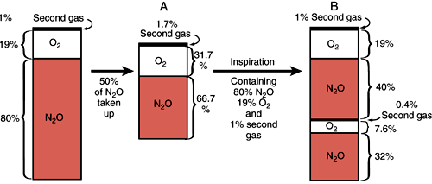
Second Gas Effect
Notes:
FIGURE 4–3 The rectangle to the left represents a lung filled with 80% nitrous oxide plus 1% of a second gas. (A) Uptake of half the nitrous oxide does not halve the concentration of nitrous oxide, and the reduction in volume thereby increases the concentration of the second gas. (B) Restoration of the lung volume by addition of gas at the same concentration as that contained in the left-most rectangle will increase the nitrous oxide concentration and add to the amount of the second gas present in the lung. (Modified from Stoelting and Eger⁸ )

Slide 9
N₂O: Diffusion hypoxia
Occurs at the end of anesthesia with N₂O when patient breaths room air versus O₂
Large volume of N₂O enters the lungs from the blood
Early rapid inflow of N₂O to the lung displaces other gases within the lung
Marked decrease in alveolar PO₂ with a resultant decrease in PaO₂
Life threatening hypoxia
Notes:
The blood:gas partition coefficient of nitrous oxide is 34 times that of nitrogen, so it can leave blood and enter air-filled cavities more rapidly than nitrogen can move from the cavity to blood. This is a problem for patients with pneumothoraces (air between lung and chest), venous air emboli, and severe bowel obstruction.

Slide 10
Vapor Pressure
The pressure (mmHg) that the vapor molecules exert when the liquid and vapor phases are in equilibrium
Vapor pressure of an anesthetic is a measure of its ability to evaporate
Must be sufficient enough to provide enough anesthetic in the vapor state to produce anesthesia at room temperature
Influenced by changes in temperature

Slide 11
Anesthetic Quantity
Described in terms of
  Pressure (mmHg)
  Concentration (%)
  Mass (mg or g)
Vaporizers are calibrated in concentration (%) of agent

Slide 12
Vaporizers
Dilute the vapor generated from the liquid anesthetic with O₂ (or an O2 and N₂O mixture) to produce an inspired anesthetic concentration

Slide 13
Vaporizers
Diverts the gas entering vaporizer into two streams
  One enters the vaporizer chamber (V_{anes})
  One bypasses the vaporizer chamber (V_{dilution})
Gas entering vaporizer chamber completely saturated to an anesthetic concentration (%)
Anesthetic concentration is decreased (diluted) downstream by the second gas stream

Slide 14
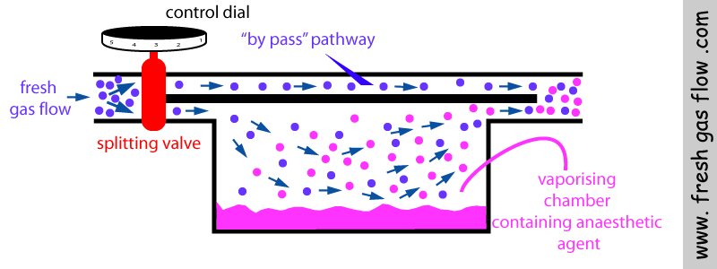
Vaporizers

Slide 15
Solubility
The extent to which a gas will dissolve in a given solvent
For inhalation anesthetics solubility is measured and expressed as a partition coefficient (PC)

Slide 16
Partition Coefficient
The concentration ratio of an anesthetic in the solvent and gas phases or between two tissue solvents (i.e. brain and blood)
Blood-gas partition coefficient provides a means for predicting the speed of anesthetic induction, recovery and change of anesthetic depth

Slide 17
Partition Coefficient
Anesthetics with a high PC
  More soluble
  Longer induction time
  Prolonged recovery
Ideally want an anesthetic with a low PC
Notes:
Concentration of anesthetic in blood is 15 times greater at equilibrium than that in alveolar gas. Blood acts as a sink for anesthetic.

Slide 18
Pharmacokinetics
Goal in administering inhalation anesthetic is to achieve an adequate partial pressure or tension of anesthetic in the CNS
Administered via the lungs
Gas exchange at the alveolar level is sufficient when P_{a}Anes (arterial) is close to the P_{A}Anes (alveolar)

Slide 19
Factors related to changes in P_{A}Anes
Increased alveolar delivery
  Increased inspired anesthetic concentration
    ↑Vaporization
    ↑Vaporizer dial setting
    ↑Fresh gas flow
    ↓Gas volume of patient breathing circuit
  Increased alveolar ventilation
    ↑Minute ventilation
    ↓Dead space ventilation
Decreased removal from alveoli
  Decreased blood solubility of anesthetic
  Decreased CO
  Decreased alveolar-venous anesthetic gradient
Notes:
PAAnes: alveolar anesthetic tension or alveolar partial pressure of anesthetic

Slide 20
Anesthetic Elimination
Requires a decrease in alveolar anesthetic partial pressure (P_{A}Anes) which in turn leads to a decrease in arterial (P_{a}Anes) and then CNS partial pressure

Slide 21
Minimum Alveolar Concentration
MAC: the minimum alveolar concentration of an anesthetic at 1 atm that produces immobility in 50% of patients exposed to a noxious stimulus.
Median effective dose (ED₅₀)
ED₉₅ is 1.2 to 1.4MAC
Anesthetic potency is inversely related to MAC
  Potency = 1/MAC (high MAC = low potency)

Slide 22
Potency of Inhalational Anesthetics
(most to least)
Halothane
Isoflurane
Sevoflurane
Desflurane
N₂O
Notes:
High MAC = less potency

Slide 23
CNS
Inhalation anesthetics:
Affect electrical activity of brain
↓ Cerebral metabolism
0 to ↑ Cerebral perfusion
↑ ICP
Analgesia
Notes:
CBF: anesthetics decreased cerebral O2 demand but cause vasodilation
Some evidence for antianalgesic effect with enhanced perception of noxious stimuli

Slide 24
Respiratory
Depress respiratory system function
Dose-dependent
  Decreased tidal volume
  Decreased RR
  Respiratory arrest at 1.5 to 3 MAC
Direct action on medullary and peripheral chemoreceptors depresses respiratory drive with increased PaCO2

Slide 25
Cardiovascular
Dose dependent
Decreased CO
  Decreased SV due to negative inotropy
Increased HR (vagolytic)
Decreased ABP
  Decreased SV, SVR
Sensitize heart to catecholamine induced arrhythmias

Slide 26
Kidneys
Dose-related:
  ↓ Renal blood flow
  ↓ GFR
Counter with IV fluids to maintain CO
Methoxyflurane fluoride induced nephrotoxicity

Slide 27
Sevoflurane
Compound A: nephrotoxic breakdown product
Sevo is degraded to compound A by CO₂ absorbents such as soda lime
Avoid in patients with known or marginal kidney function

Slide 28
Liver
Decreased hepatic blood flow and oxygen delivery
Depression of hepatic function
Hepatocellular damage
Effects can be mild and transient or permanent
Reduction in hepatic drug clearance
Isoflurane best choice
Halothane hepatitis

Slide 29
Malignant Hyperthermia
Inherited myopathy characterized by a hypermetabolic state which is triggered when the patient is exposed to anesthetic agents
Can be initiated by all inhalation anesthetics
Rapid rise in body temperature that can lead to death
Treat with dantrolene
Notes:
Due to decrease in reuptake of Ca from SR leading to sustained muscle contraction

Slide 30
Use of what potent inhaled anesthetic was discontinued due to fluoride induced nephrotoxicity?
A. Halothane
B. N2O
C. Methoxyflurane
D. Sevoflurane

Slide 31
What would be the first step in treating intraoperative bronchospasm?
A. Administer a neuromuscular blocking agent
B. Increase inspired concentration of inhaled anesthetic
C. Administer propofol
D. Albuterol

Slide 32
Of the inhaled anesthetics, ______ is the only gas at room temperature
A. Sevoflurane
B. Isoflurane
C. N2O
D. Halothane

Slide 33
The minimum alveolar concentration (MAC) is the concentration of anesthetic at
1 atmosphere of pressure that produces immobility in 50% of patients exposed to a noxious stimulus. Which anesthetic is most potent by this measure?
A. N₂O
B. Isoflurane
C. Halothane
D. Sevoflurane

Slide 34
In a patient with liver disease which inhalation anesthetic would you use?
A. Sevoflurane
B. Isoflurane
C. Halothane
D. N2O

Slide 35
The halogenated anesthetic which is advantageous in patients with cardiovascular disease because it maintains cardiac output, produces systemic and coronary vasodilation, and catecholamine dependent arrhythmias are uncommon.
A. Sevoflurane
B. Halothane
C. N2O
D. Isoflurane

Slide 36
All of the following factors influence the rate of induction of anesthesia with an inhaled anesthetic EXCEPT:
A. aqueous solubility of the anesthetic
B. patient history of malignant hyperthermia
C. ventilation rate
D. tension of gas administration
E. pulmonary blood flow rate

