Slide 1

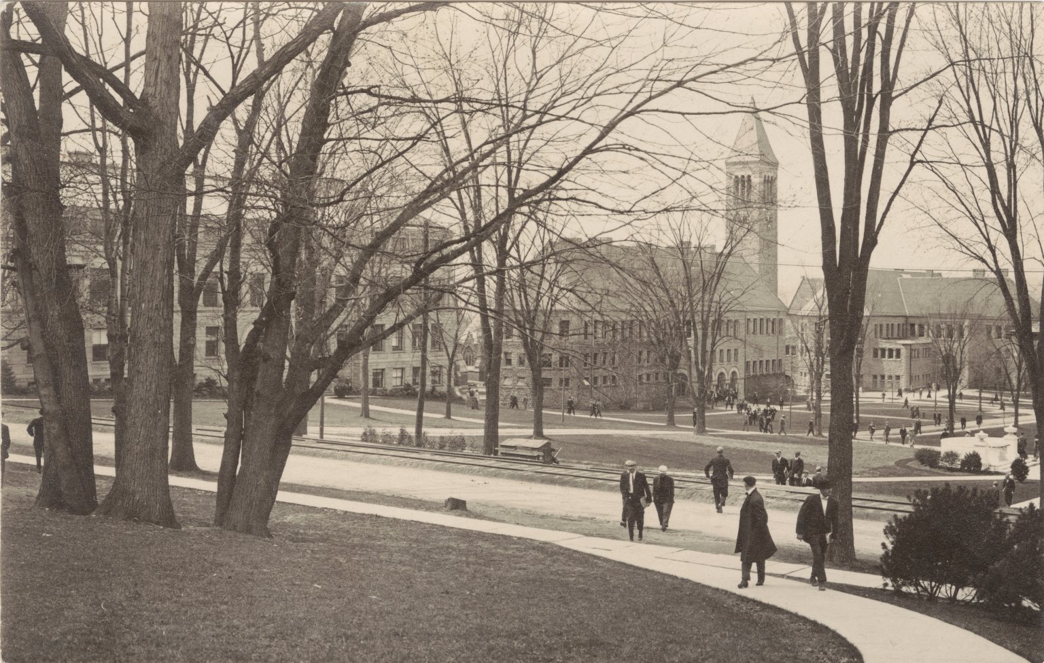
The Changing Landscape of Image Resources at Cornell University
Liz Muller
Metadata Librarian
Kaila Bussert
Special Projects Librarian

Slide 2
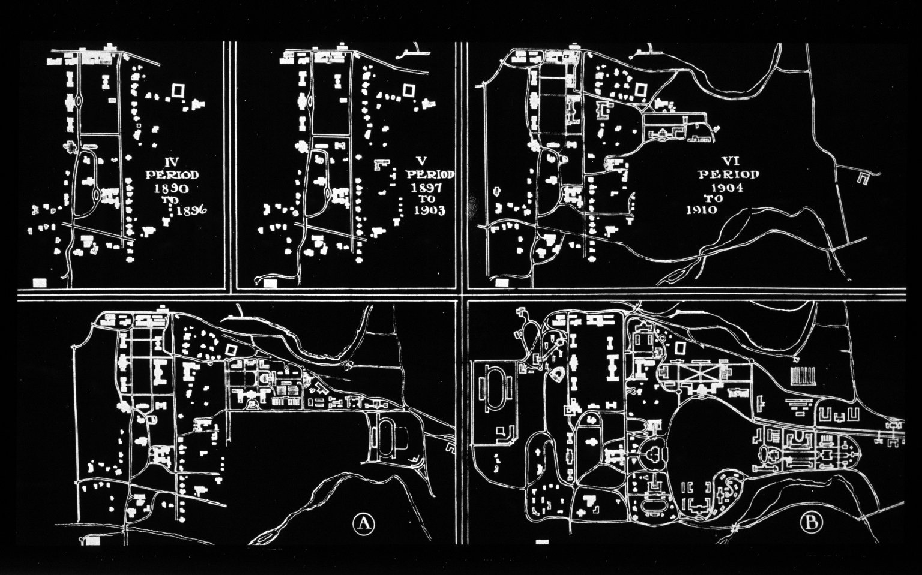
Overview
Liz Muller
    Transitions during past year
    Existing and new services
Kaila Bussert
    Public interfaces to image resources
    Looking ahead

Slide 3
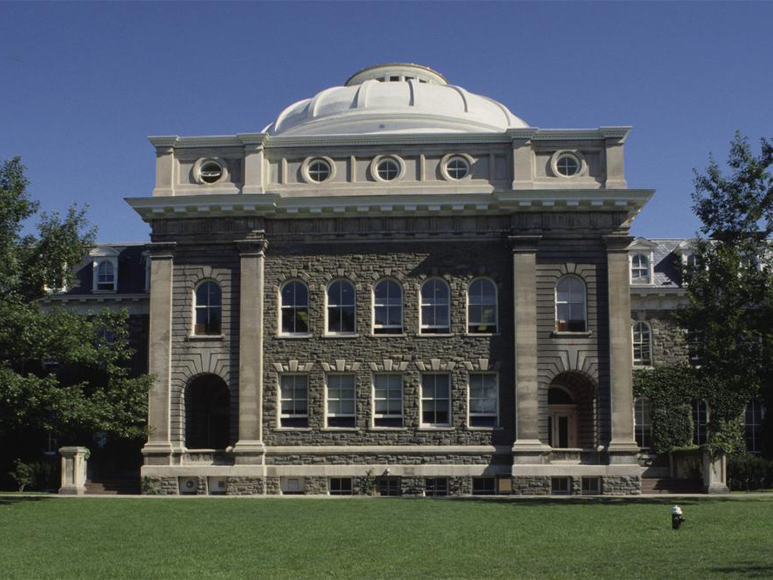
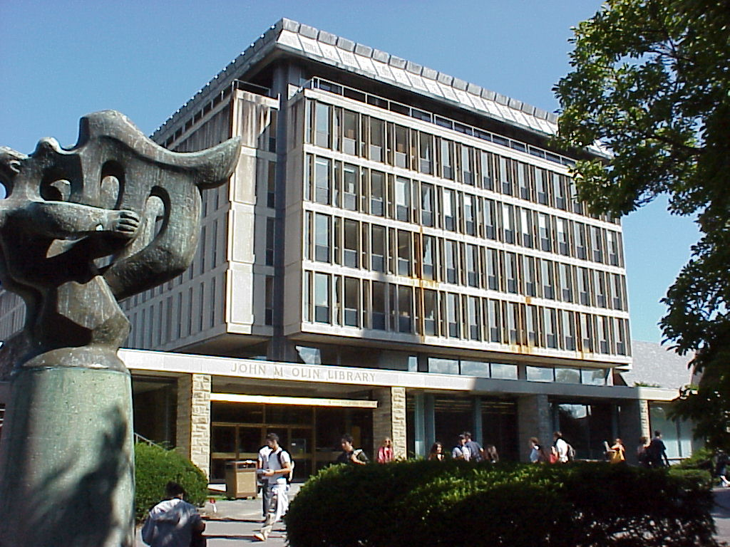
Background
Knight Visual Resources Facility
Cornell University Library
March 2009 College of Art, Architecture & Planning announced closure of facility
May 2009 Visual resources facility closed
March 2009 Cornell University Library began planning
June 2009 Library increased image-related services

Slide 4
Image-related services
Collection stewardship
      Recontextualization of collection, comprises 16% of images in Luna
Digital image delivery
      Assumed responsibility for ARTstor uploads
Digitization
      Adjusted scanning methods – images, not artifacts
Metadata creation
      Assumed responsibility for PiCtor database – production, 0.5 FTE
Instruction and faculty support
      Advanced courses offered, more outreach
Equipment lending
      Equipment cage added to Fine Arts Library, very high use
Copyright consultation

Slide 5
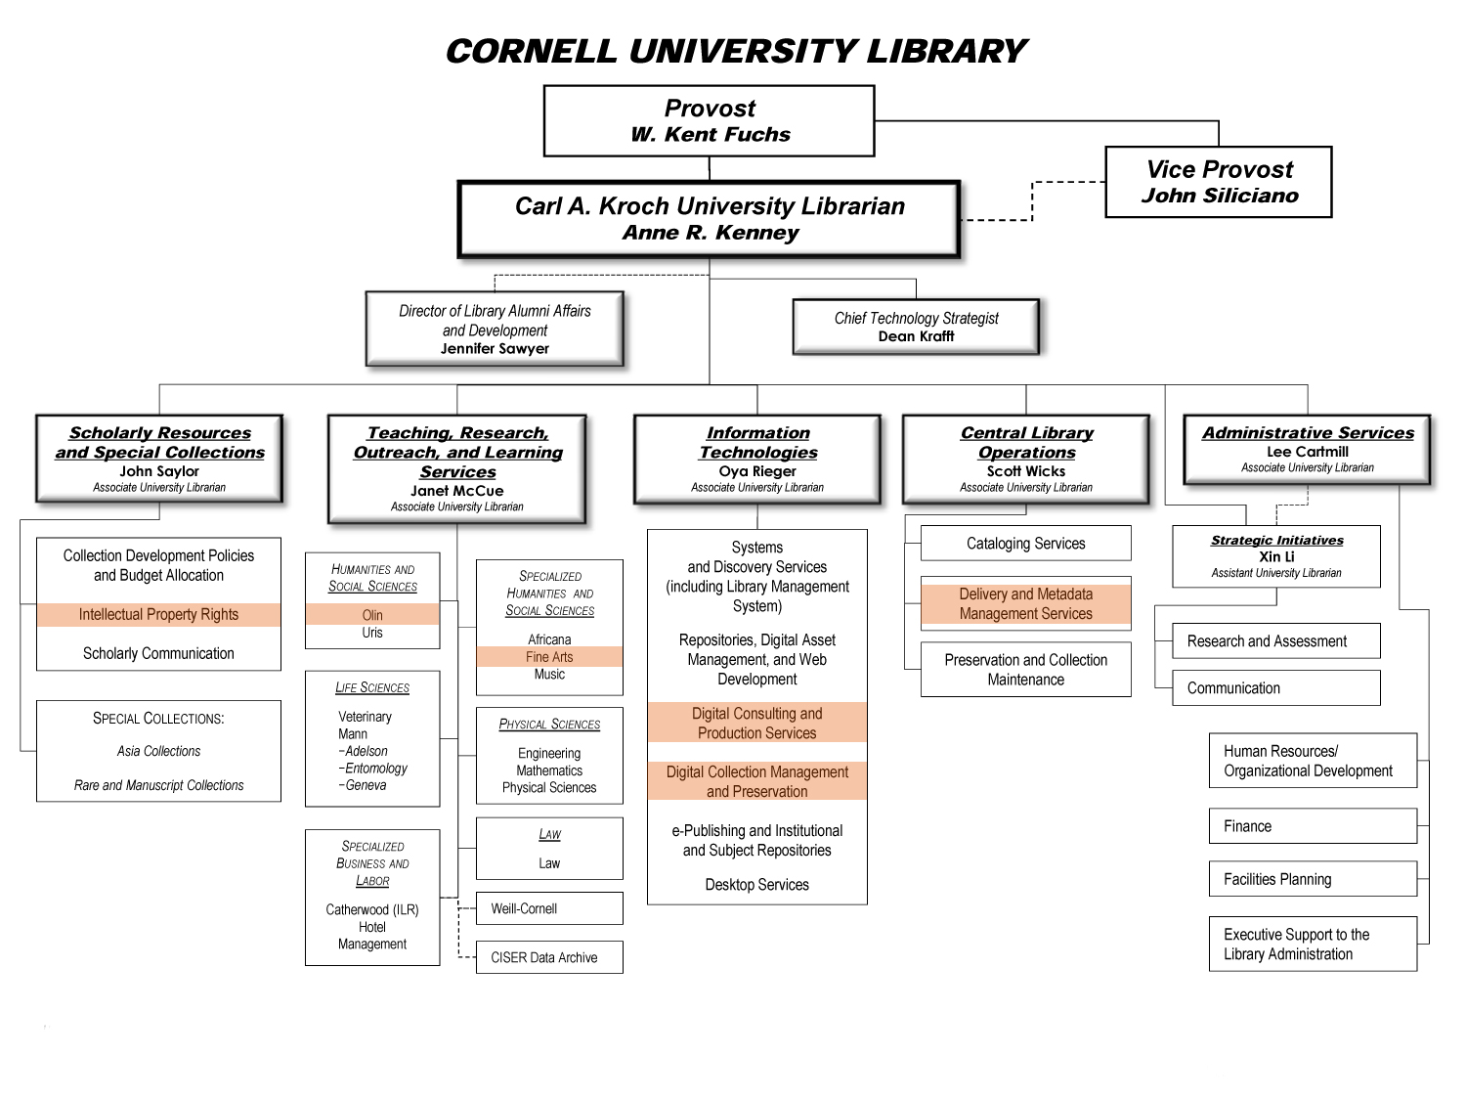
Distribution of services
Metadata
Digitization
Copyright
Instruction/
reference
Digital image delivery
Collection stewardship
Equipment

Slide 6
Visual Resources Working Group
Mira Basara Digital Media Group
Eleanor Brown Rare & Manuscript Collections
Kaila Bussert, co-chair Research & Learning Services
Matt Conway Herbert F. Johnson Museum of Art
Terry Kristensen Veterinary Library
Danielle Mericle, co-chair Digital Media Group
Boris Michev Maps & Geospatial Information Collection
Barb Morley Kheel Labor Archives
Liz Muller Metadata Services
Susette Newberry Research & Learning Services
Maaike Oldemans Fine Arts Library
Martha Walker Fine Arts Library
Glen Wiley Metadata Services
Co-Sponsors
  Janet McCue AUL for Teaching, Research, Outreach & Learning Services
  Oya Rieger AUL for Information Technologies

Slide 7
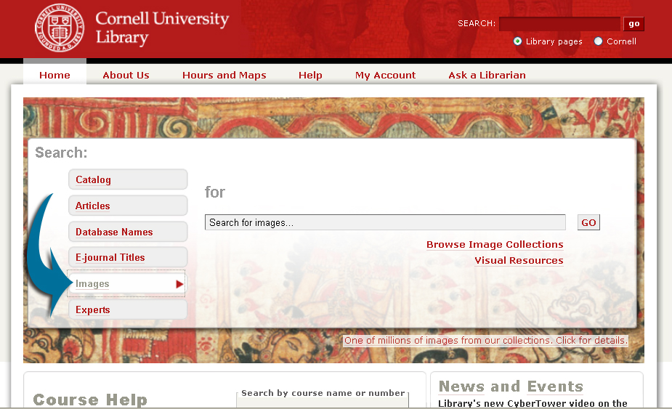
Location, location, location…

Slide 8
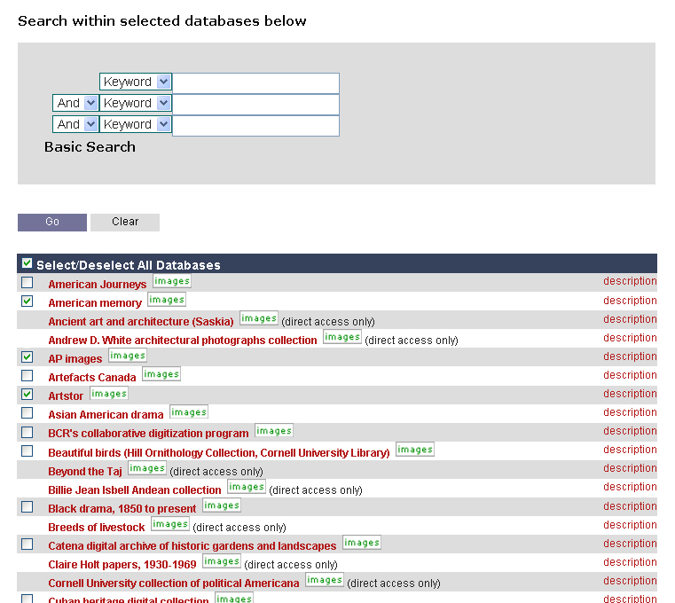
WebFeat federated search

Slide 9
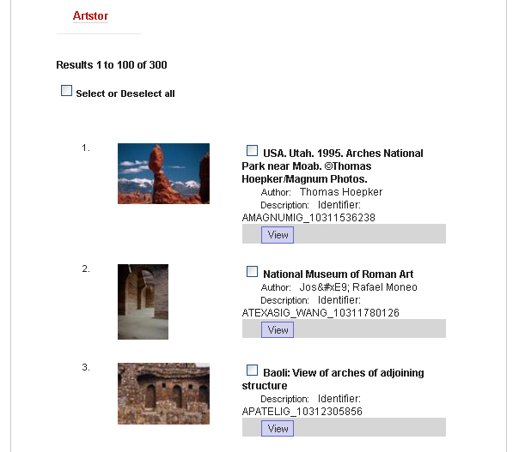
WebFeat search results

Slide 10
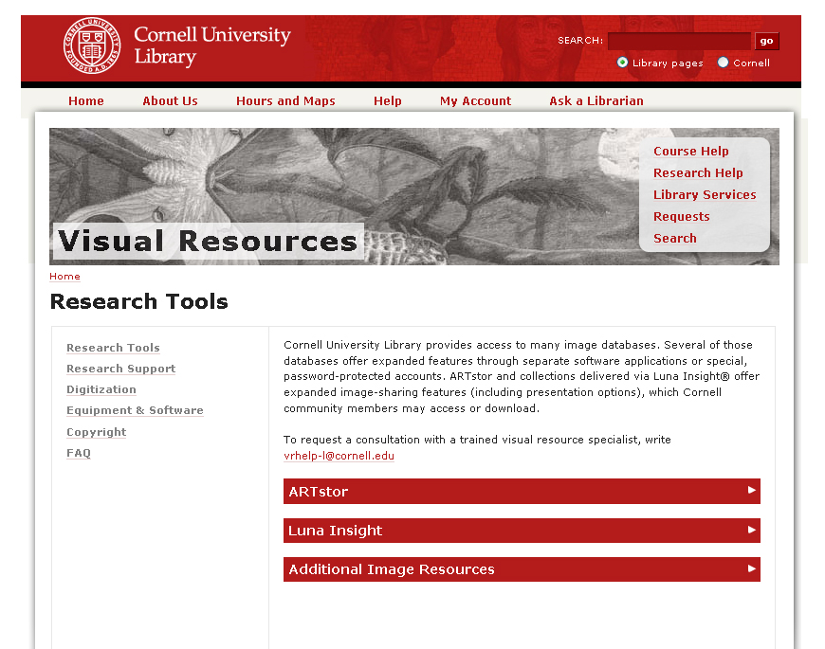
Visual resources web site

Slide 11
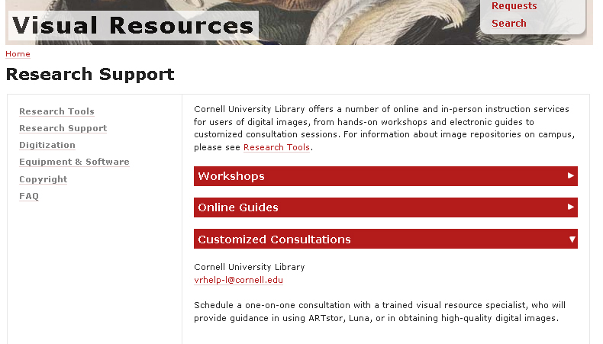
Instruction and research support

Slide 12
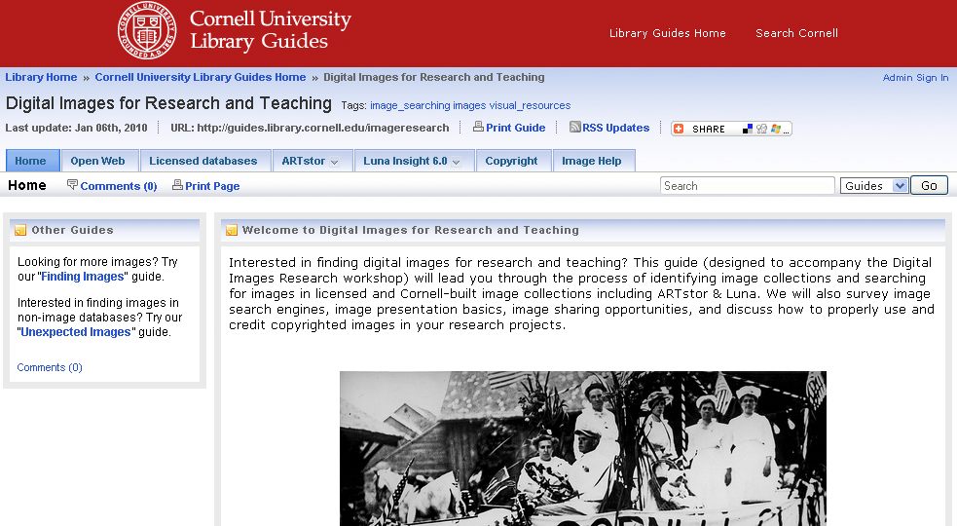
Online guides

Slide 13
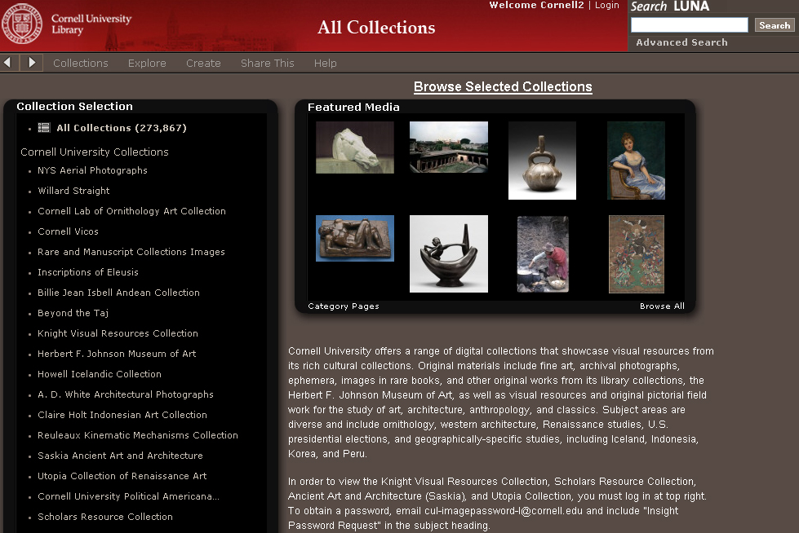
Building interdisciplinary collections

Slide 14
Future directions
Faculty grants for digital collection-building in the College of Arts & Sciences
Participation in ARTstor Shared Shelf Initiative
Collections in Flickr
Multimedia collections

Slide 15
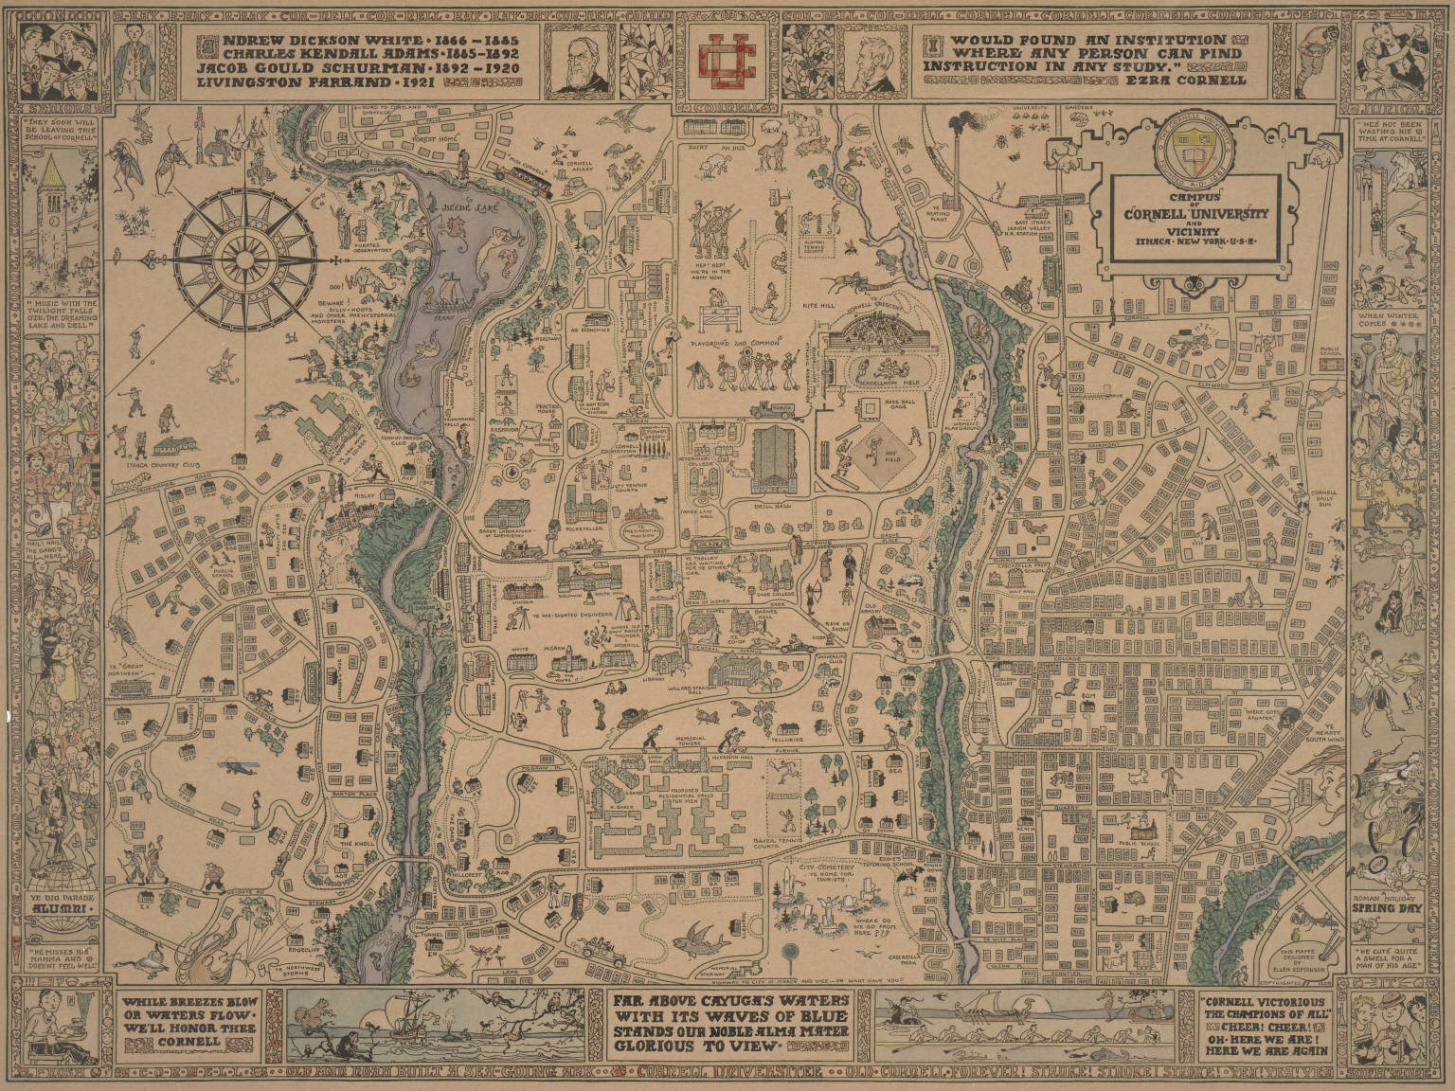
PHEW!
Questions?
Liz Muller
edm29@cornell.edu
Kaila Bussert
kjb82@cornell.edu

