Slide 1
An Introduction
January 26, 2010
Monroe Weber-Shirk

Slide 2
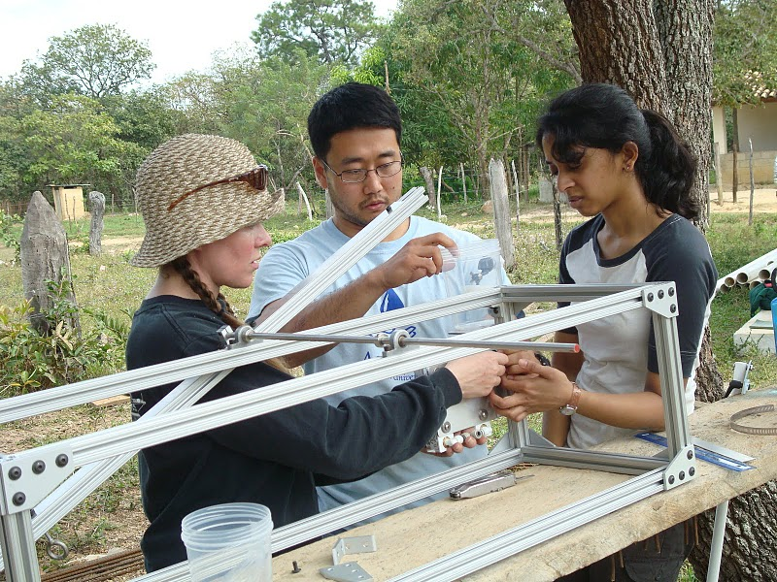
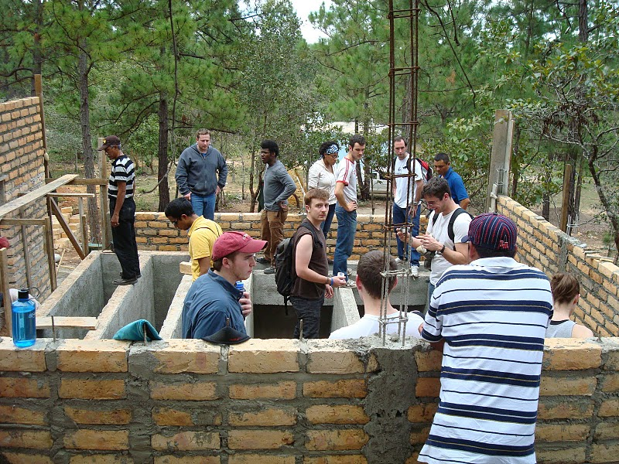
Who are we?
We are group of Cornell students and faculty who are passionate about making the world a better place

Slide 3
Safe Drinking Water
We have chosen to use our skills to tackle one of the planet’s great needs: safe drinking water
We conduct research and design high performing – low cost municipal scale drinking water treatment plants that remove turbidity and pathogens
We have developed an innovative approach that has already proven to be successful

Slide 4
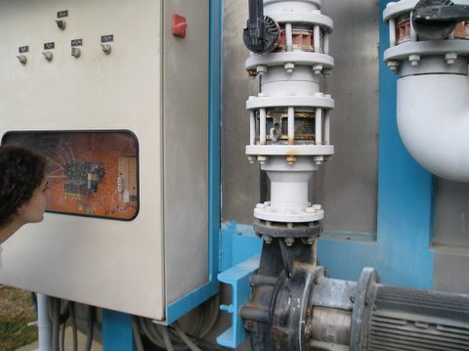
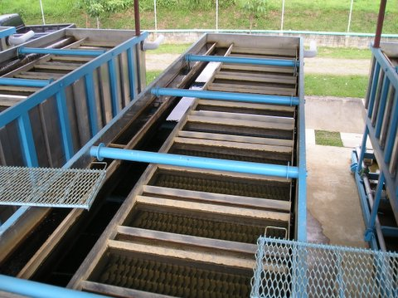
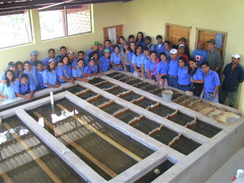
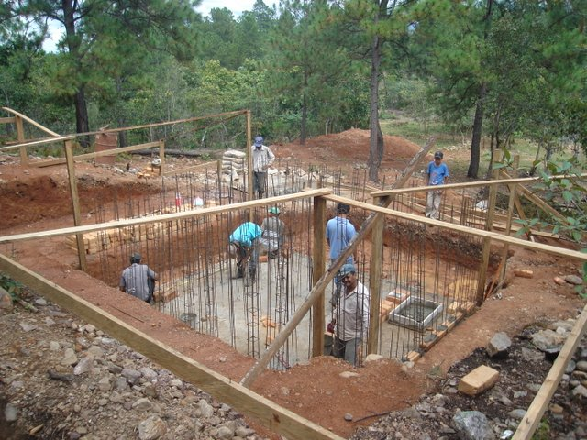
A new approach to Municipal Water Supply
Dependency
Empowerment
Knowledge
Closed Proprietary
Open Source
Primarily to a single multinational firm
local labor/small business some multinationals
Capital flow
Hardware
Specialized Proprietary
Generic – locally available
Energy Source
Electricity
Renewable

Slide 5
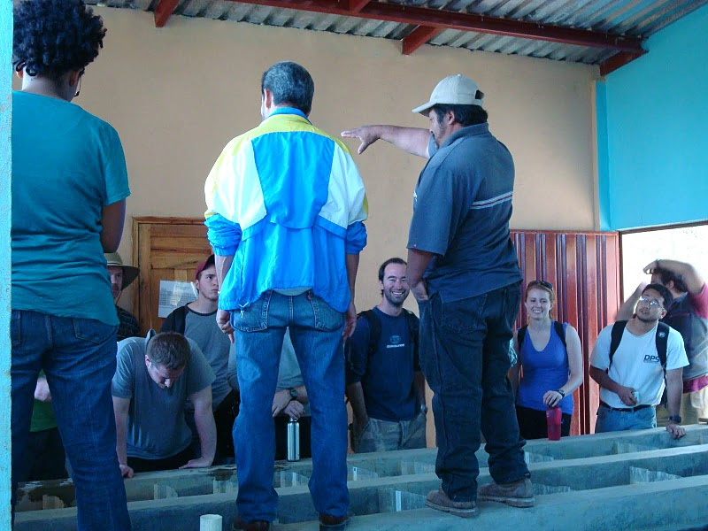
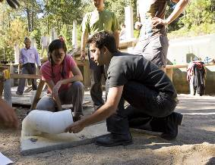
The Grand Challenge
Globally we estimate that 125 million could benefit from AguaClara water treatment plants
To meet that need in 10 years our partners would need to be building approximately
3 plants per day
Notes:
5

Slide 6
AguaClara Mission Statement
AguaClara is a program in Civil and Environmental Engineering at Cornell University that is improving drinking water quality through innovative research, knowledge transfer, open source engineering and design of sustainable, replicable water treatment systems.
But it is more… It is a global program to improve water supply infrastructure. It includes implementation partners and communities. It is a dynamic entity!

Slide 7
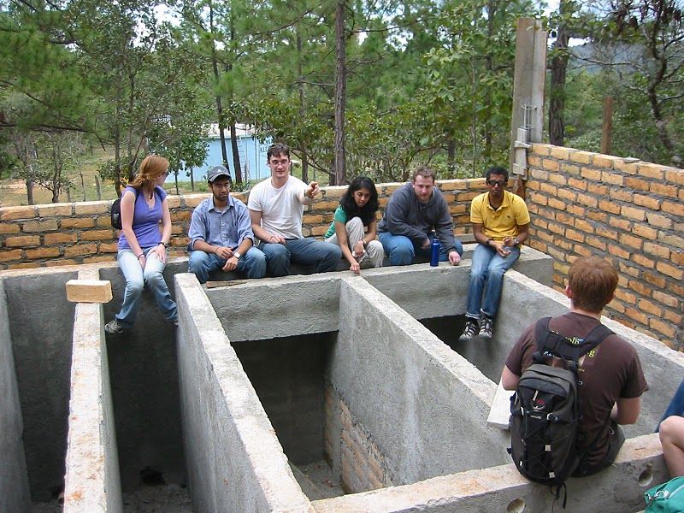
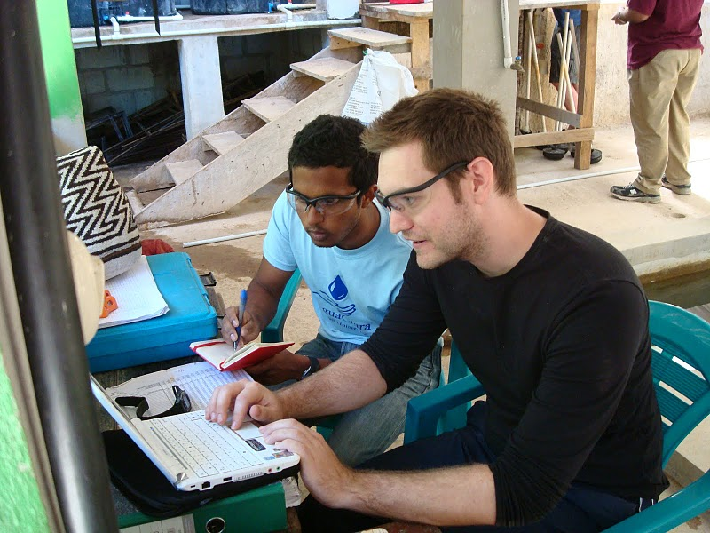
We are committed to…
education and empowerment of ourselves and others
learning by doing
doing the best that we can with the skills that we have
partnerships

Slide 8
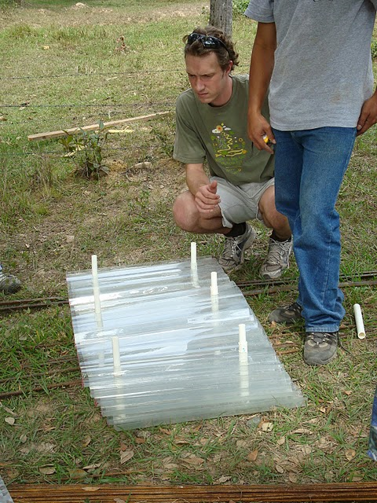
Partnerships
Agua Para el Pueblo – Honduran NGO
AguaClara Engineers abroad
Goal of working with more partners
By partnering we benefit from each other’s experience and skills
The partnership is far stronger than the individual members

Slide 9
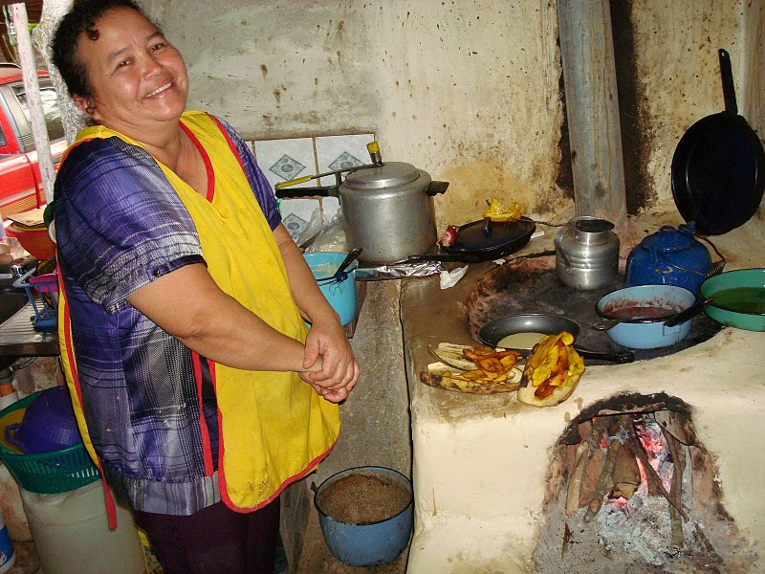
AguaClara Philosophies
Use locally available materials rather than specialized components whenever possible
Use potential energy to power the plant rather than electricity
Optimize technologies to enhance sustainability in context
  Plant operator
  Community
Do more with less

Slide 10
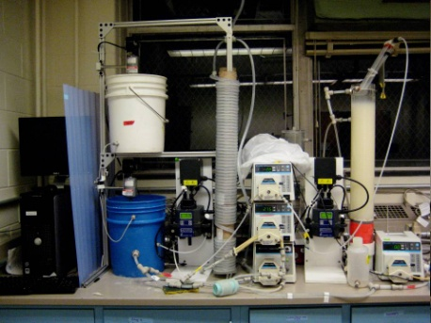
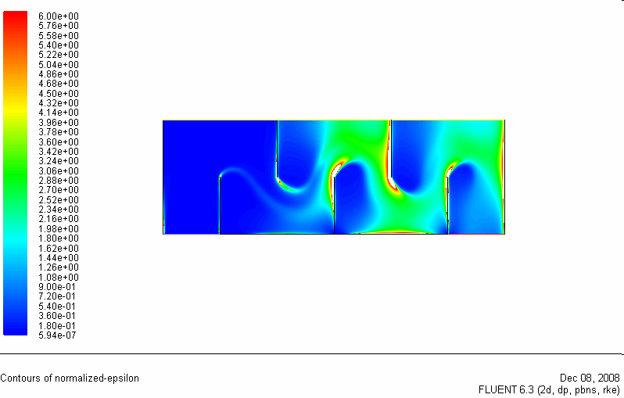
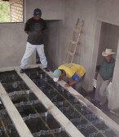
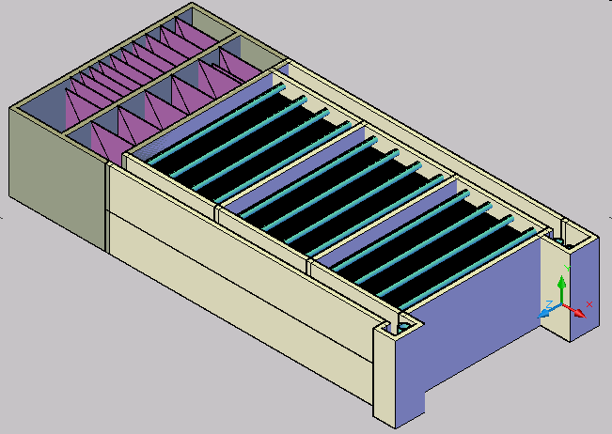
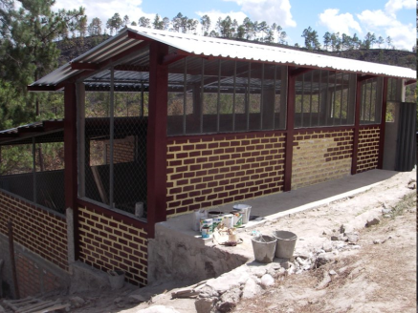
AguaClara Process: Learning by doing
Laboratory Research
Analytical
Modeling
CFD
Evaluation
Normalized energy dissipation
Full Scale Implementation,
Capacity Building, Training, and Empowerment
Automated Design

Slide 11
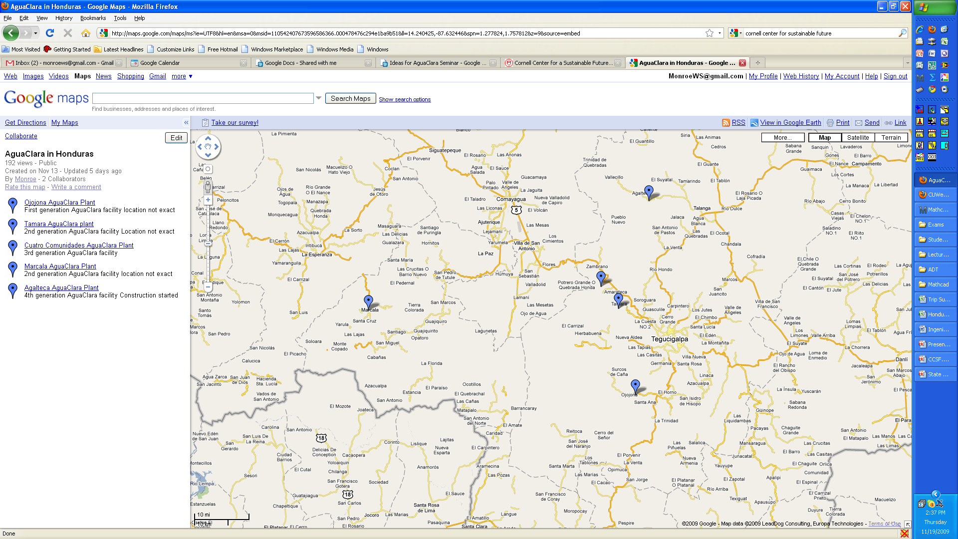

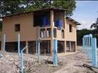
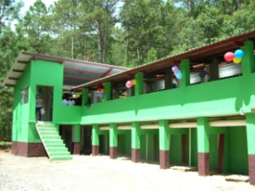

AguaClara in Honduras

Slide 12
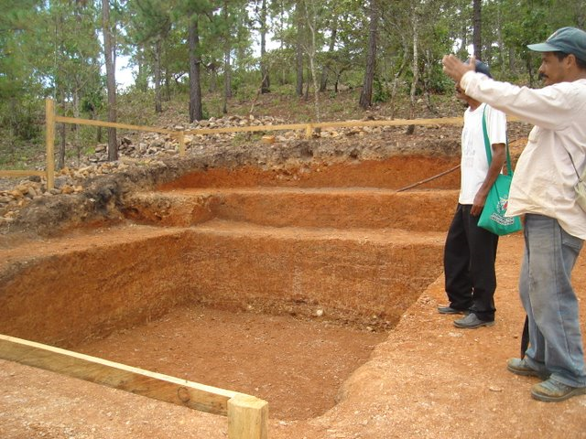

Slide 13
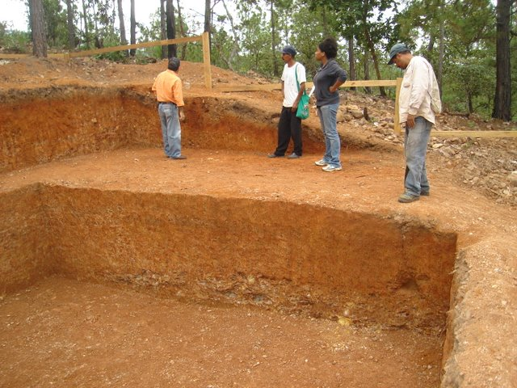

Slide 14
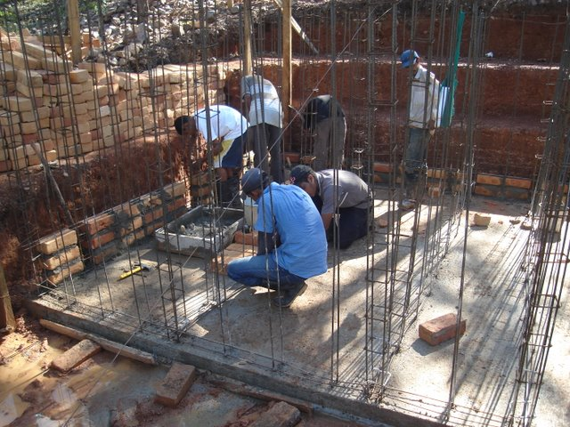

Slide 16
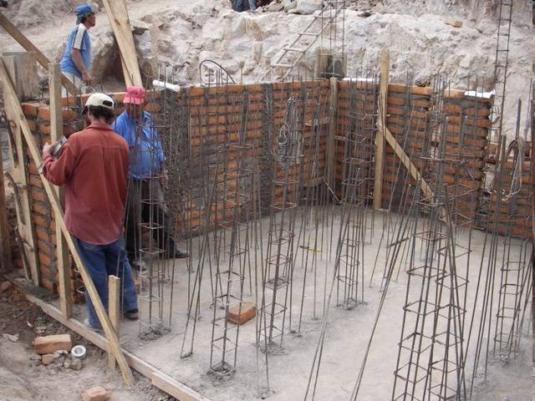

Slide 17
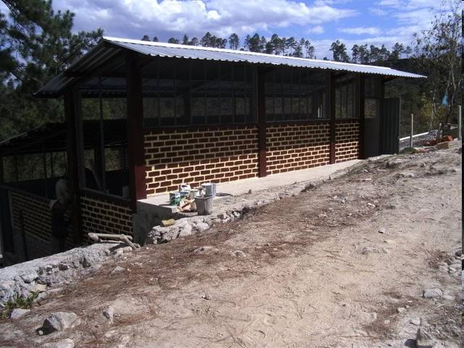

Slide 18
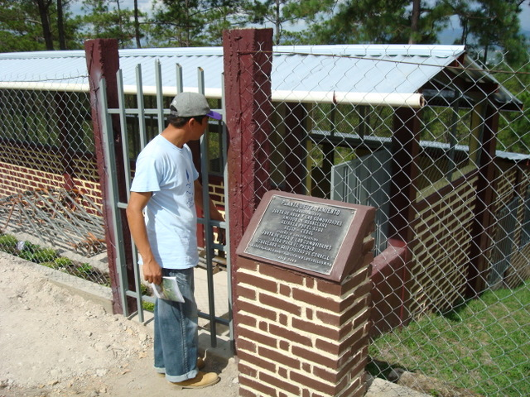
Cuatro Comunidades Plant

Slide 19
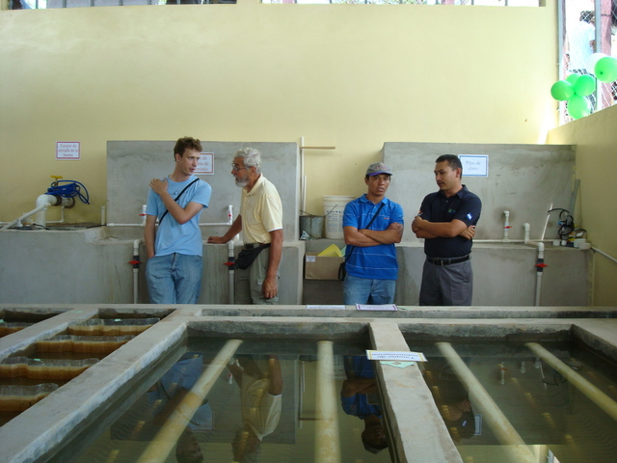
Chemical tanks

Slide 20
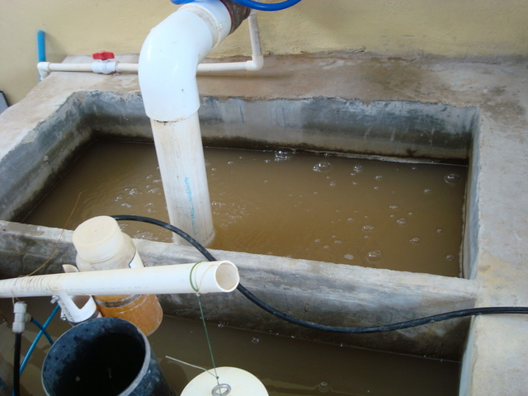
Raw Water (Entrance tank)

Slide 21
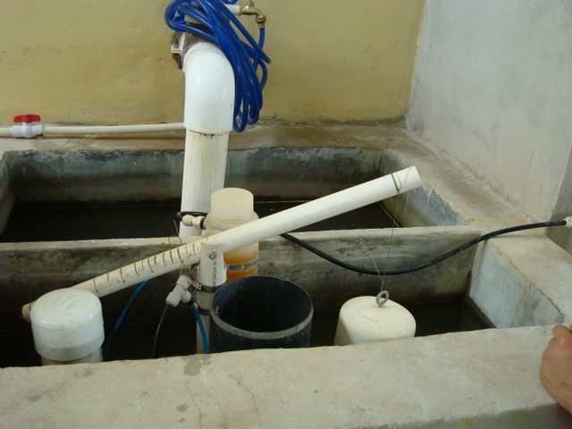
Chemical Doser

Slide 22
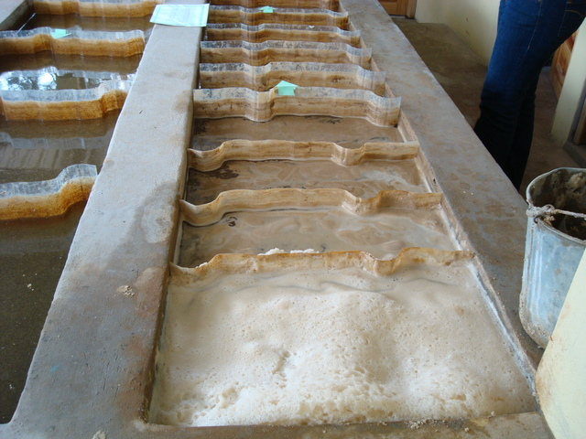
Flocculator

Slide 23
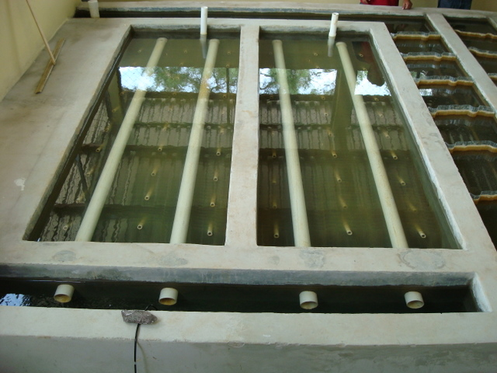
Sedimentation tank

Slide 24
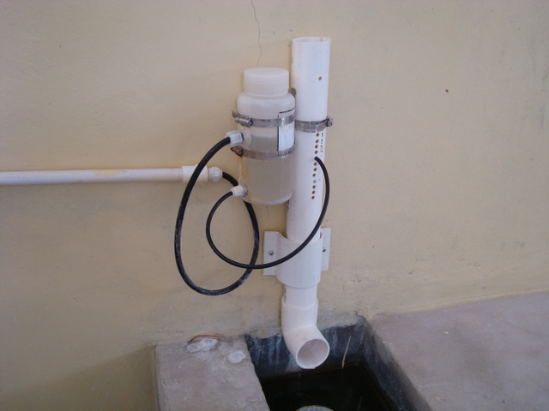
Chlorinator

Slide 25
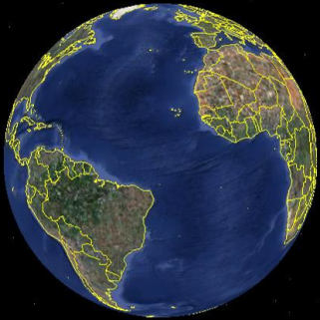
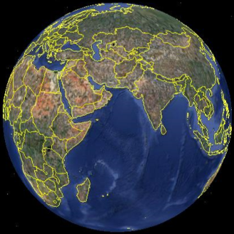
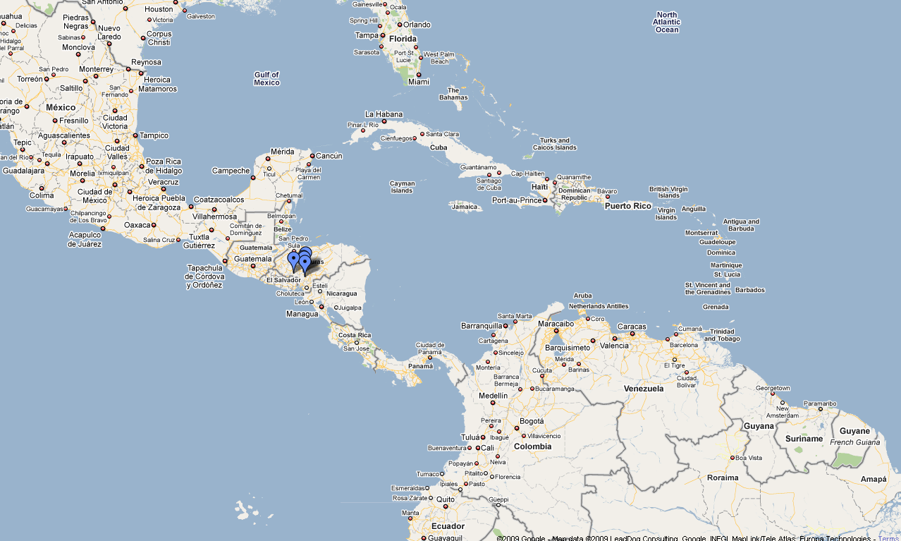

Project Expansion

Slide 26
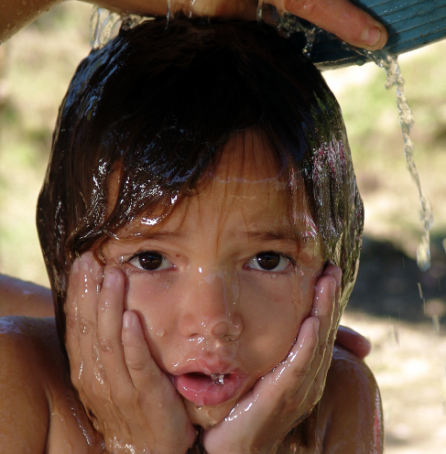
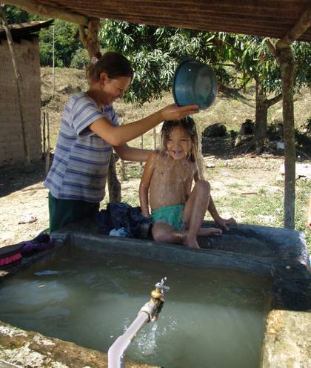
Why we do what we do...
Find out more at AguaClara.cee.cornell.edu

Slide 27
Research projects
Flocculator energy dissipation rate measurements using PIV
Inlet manifold flow distribution measurements using ADV
Filtration

Slide 28
Flocculator energy dissipation rate measurements using PIV
Conduct laboratory studies using Particle Image Velocimetry to measure the energy dissipation rate in a vertical flow flocculator

Slide 29
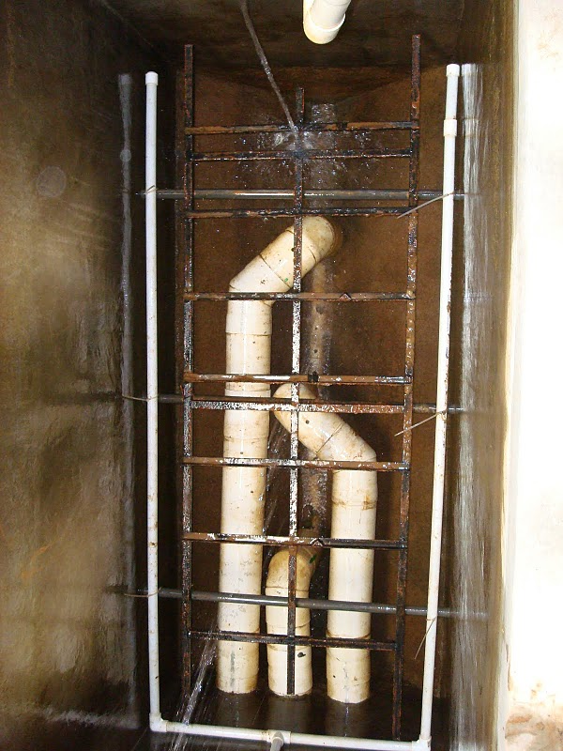
Inlet manifold flow distribution measurements using ADV
Single pipe with orifices
Goal is to get same velocity from each orifice
Will likely need to use a tapered geometry
Laboratory study to measure the actual port velocities

Slide 30
Tapered Manifold
Using a series of standard pipe sizes is possible, but minor losses are prevalent and transitioning with a level base is difficult.
Our idea: Cut pipes at an angle θ to easily create a tapered pipe
θ
Team Ripples CEE 4540 Fall 2009

Slide 31
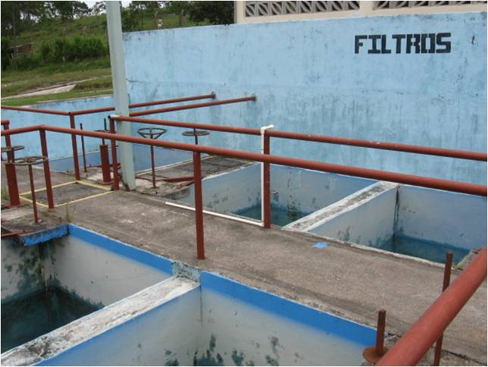
Filtration
The time has come to begin investigating filtration options to further reduce effluent turbidity

Slide 32
Filtration
The goals of the filtration research are to develop a filtration technology that
  is more economical
  wastes less backwash water
  is sustainable
The filtration technology should not require any electricity, should make minimal use of specialized components, and should be easy to construct and to maintain

Slide 33
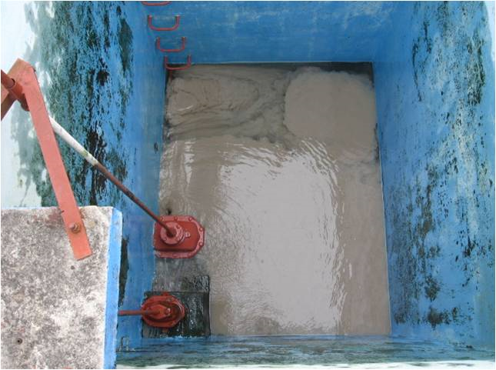
Filtration
The first stage of this project is to conduct a literature review and analytical triage of available or potential technologies to see which technologies might be best suited for application in resource poor communities.
Begin laboratory research
to further explore
potential technologies

Slide 34
Publicity - Outreach
Our wiki needs to provide a better window on the project for donors and water treatment engineers
The Spanish wiki needs a lot of work!
We need professional brochures describing the technology and our implementation model

