Slide 1
Focused on Engineering Excellence
But what facilitates the focus?
February 16, 2010
Monroe Weber-Shirk

Slide 2
Threads
AguaClara as a high performing team and the connection to community
Belonging to a community that supports your beliefs (or guiding principles) can lead to happiness!
A few thoughts on guiding principles
AguaClara: A shared dream that you are turning into reality

Slide 3
Types of Teams
High-Performing
Cooperative
members
team
Cooperative
Performance Level
Traditional
Pseudo
Types of Teams

Slide 4
Cooperative Learning Teams
Have a goal of maximizing all members’ learning
Hold themselves accountable for doing high quality work
Work face-to-face to produce joint work-products
Promote success through helping, sharing, assisting, explaining, and encouraging
Provide both academic and personal support based on a commitment to and caring about each other
Use teamwork skills to coordinate their efforts and achieve their goals
Share responsibility for providing leadership
Emphasize continual improvement of the teamwork process

Slide 5
High-performance Cooperative Learning Team
Meets all the expectations of the cooperative learning team
Outperforms all reasonable expectations, given its membership
High level of commitment
Mutual concern for each other’s personal growth
Achieve high-performance and also have lots of fun

Slide 6
What Makes Cooperative Learning Work?
Positive interdependence - synergy
Face-to-face interaction
Individual accountability/personal responsibility
Teamwork skills
Group processing – do you do this?
Commitment to each other that extends beyond the team task
Reflections on these characteristics?

Slide 7
AguaClara as a Community?
High performing teams create a strong sense of community
The AguaClara lunches may be more significant than they first appear! - Shall we pick a different day?
Challenges… We need to take deliberate steps to build the community spirit given the high turnover rate

Slide 8
Keys to happiness: Belief and the company of believers
To make sense of a complicated world and our place in it, humans need to construct meaning. We need to know what is expected of us, how to behave and how to function among other people. Otherwise, our sense of self is at risk.
But our protective systems of belief cannot work without the support of others.
Regardless of "what religious or belief system you accept, if you have a set of philosophical beliefs that you hold strongly, and you have others who support you in those beliefs, there's less likelihood you'll be unhappy."
Hanging out with friends who share your values can make you happy!
Keys to happiness: Belief and the company of believers
By George Lowery
Brashears
Notes:
http://www.news.cornell.edu/stories/Jan10/BrashearsHappy.html

Slide 9
Why talk about beliefs
(or guiding principles)?
Having the same guiding principles as the people you hang out with isn’t enough… (the guiding principles matter too)
If you can connect what you are doing to your guiding principles, then you won’t need to compartmentalize your life into “earning money”, leisure, family, friends.
Connecting your passion, your skills, and your guiding principles is very powerful (and empowering)
Notes:
I know this isn’t always possible…

Slide 10
What are guiding principles that influenced you to join AguaClara?
Make the world better
Do something that makes a lasting difference (legacy)
Tired of years of school that didn’t include contributing to society
Are you connecting with your motivation?

Slide 11
Monroe’s Philosophy – a work in progress
Positive Energy
  Surround yourself with people who can dream
  Dreaming creates a new reality
If you feel boxed in, climb out of the box
Don’t burn bridges
You always have a choice – use it!
Exceed Expectations
Identify a need and then invent

Slide 12
An Optimist’s Perspective
What is the minimum annual budget required to sustain AguaClara as an educational program?
  Trip to Honduras (20k)
  Research supplies (10k)
  Software for computers (5k)
  AguaClara Engineers (30k)
Do you like this question?
Rephrased this question is: “When would you throw in the towel?”
An optimist always sees the opportunities for creative engagement. From an optimist’s perspective this question can’t be answered! So climb out of the box and then create an answer.

Slide 13
An optimist’s perspective
I will creatively use whatever resources AguaClara is able to acquire to make the world a better place.
Remember… we started this program with only a few thousands of dollars.

Slide 14
Monroe’s Philosophy
Positive Energy
  Surround yourself with people who can dream
  Dreaming creates a new reality
If you feel boxed in, climb out of the box
Don’t burn bridges
You always have a choice – use it!
Exceed Expectations
Identify a need and then invent

Slide 15
Don’t burn bridges
The individual who frustrates you today may be a powerful ally tomorrow
Everyone has the opportunity (and the right!) to mature and become a healthier person.

Slide 16
Monroe’s Philosophy
Positive Energy
  Surround yourself with people who can dream
  Dreaming creates a new reality
If you feel boxed in, climb out of the box
Don’t burn bridges
You always have a choice – use it!
Exceed Expectations
Identify a need and then invent

Slide 17
You always have a choice
There is a huge difference between not having much money and not having choices
Learn to live so that even if you don’t have lots of money, that you still have choices
Example… I wanted to be able to devote more time to AguaClara. I negotiated a reduction in my teaching load in exchange for part of my salary. I saw it as a choice because money isn’t my guiding principle.

Slide 18
A career goal: Connecting passion, skills, and guiding principles
This is my choice…
I want to maximize the amount of time that I am working on things that I am passionate about and that I can connect with my guiding principle
Is that my employer’s goal?

Slide 19
How did AguaClara get started?
Complicated series of events, but I (and others) identified the need and proceeded to organize a team to address that need.
My job description does not include AguaClara!
No one at Cornell has ever asked me to lead the AguaClara project
If you wait for your employer to ask you to take on a cool new initiative, it might never happen!

Slide 20
Use your choice
I suspect that many positions have some flexibility for you to exceed expectations and contribute in ways that meet your objectives
Maximize the amount of your time that you are doing what you want to do
Mold your career by creating your own opportunities

Slide 21
Monroe’s Philosophy
Positive Energy
  Surround yourself with people who can dream
  Dreaming creates a new reality
If you feel boxed in, climb out of the box
Don’t burn bridges
You always have a choice – use it!
Exceed Expectations
Identify a need and then invent

Slide 22
Exceed Expectations
When you are exceeding expectations you are doing it because you want to do it, not because someone told you what to do
Exceeding Expectations opens up doors for new opportunities
I like to maximize the amount of time that I am doing what I want to do…

Slide 23
Monroe’s Philosophy
Positive Energy
  Surround yourself with people who can dream
  Dreaming creates a new reality
If you feel boxed in, climb out of the box
Don’t burn bridges
You always have a choice – use it!
Exceed Expectations
Identify a need and then invent

Slide 24
Thomas A. Edison
I never did a day's work in my life. It was all fun.
I never pick up an item without thinking of how I might improve it.
I never perfected an invention that I did not think about in terms of the service it might give others.
I want to save and advance human life, not destroy it. I am proud of the fact that I never invented weapons to kill.

Slide 25
Monroe’s Philosophy
One more… Sharing is more fun
Life is a gift… my story…
Turning gratitude into action

Slide 26

guiding principles
Open Source
Free hydraulic designs
Empowerment of others
Collaborative work environment
Commitment to continual improvement
Careful matching of our strengths and weaknesses with the task
Distributed Intelligence!

Slide 27
Design Challenge
We are in a transitional stage where we have demonstrated that we can design plants that perform well.
The demand for our designs is going to increase.
With that increased demand comes the need for better documentation

Slide 28
Research Challenge
There is so much to learn about optimizing the design
There are new unit processes and design improvements that we need to invent
We need strategies for methodically testing, validating, and incorporating improvements into the design tool

Slide 29
Outreach Challenges
Professional presence on the web
Sustainable funding strategy for the program here at Cornell

Slide 30
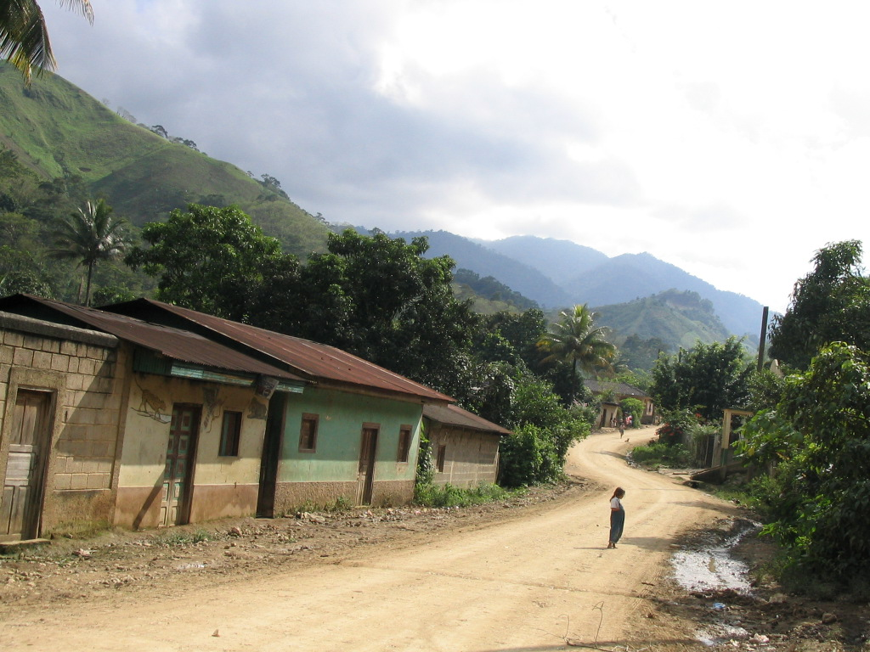
Where is AguaClara going?
Do you know why you are doing what you are doing?
Where are you taking AguaClara?
Where do you want AguaClara to be 5 years from now?
What steps do we need
to take now to get
where we want to go?

Slide 31
challenge
Continue to be a VERY HIGH PERFORMING TEAM and DREAM

