Slide 1
Emerging Technologies and the mobile Library: Take Aways from the internet Library 2009 Conference
Oct. 26-28
Monterey, Ca

Slide 2
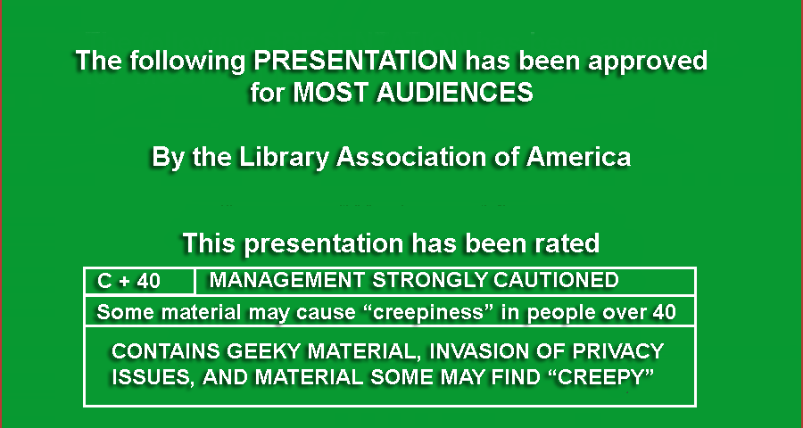

Slide 3
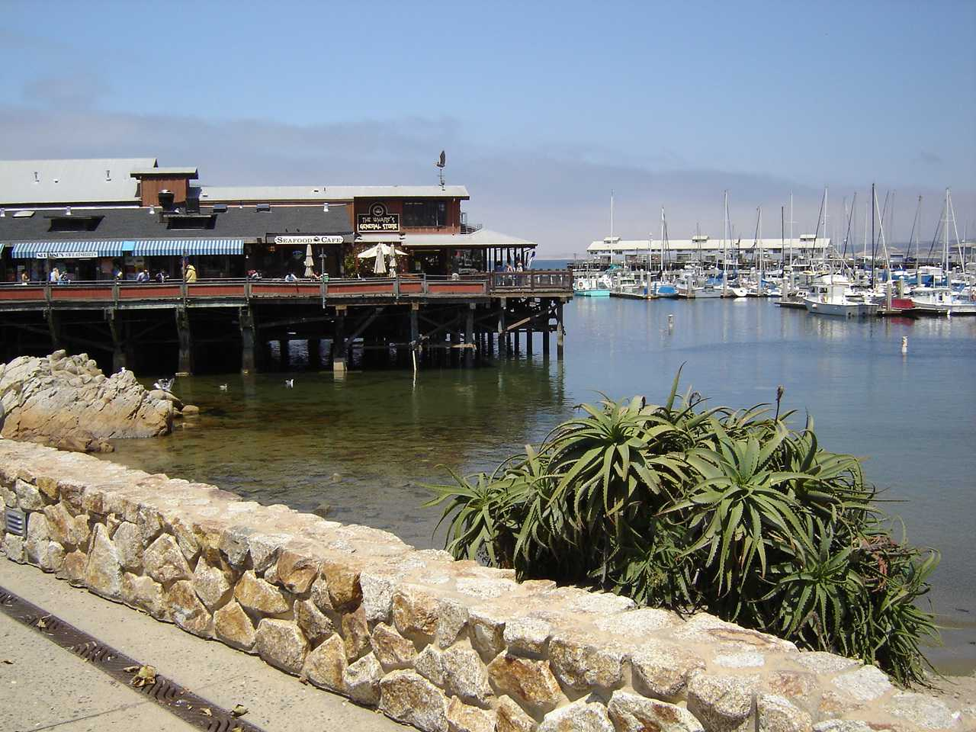

Notes:
Did not take a lot of pictures
Could not compete with the scenery shown in the Bhutan presentation

Slide 4
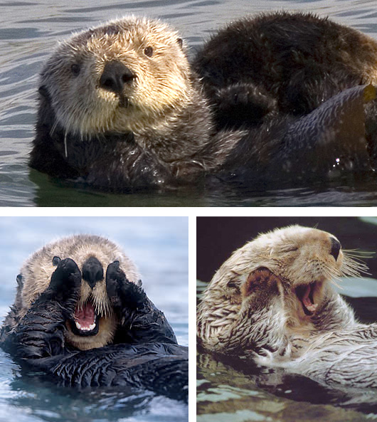

Slide 5


Slide 6
Who (ELSE) attendeD
~1000 attendees, 185 speakers/moderators
Academic Librarians
Public Librarians
Corporate Librarians
Commercial Vendor Reps
Notes:
Tell Story about dinner with Law School Librarian, K1-12 Librarian, public librarian, Kaiser Medical librarian, Mary Kay Librarian.

Slide 7
The phenomenon that is twitter
Follow what was going on using #IL2009
Guess how many “tweets” were posted?
Archive of twitter stream linky
Was able to follow other concurrent sessions
Wireless performance, even room temperature was monitored and addressed via twitter
Found someone to have lunch with on Monday
Found lots of related links (Clay Shirky video)
Notes:
Twitter Stream archive: http://twapperkeeper.com/il2009/?limit=all
Clay Shirky video: http://www.ted.com/talks/clay_shirky_how_cellphones_twitter_facebook_can_make_history.html

Slide 8
Monday Keynote
Digital Publishing, Preservation, & Practices
Vint Cerf interviewed by Paul Holdengraber
  Streamed/recorded on ustream.tv
  http://www.ustream.tv/recorded/2435118
Invented (along with Bob Kahn) TCP/IP in Aug. 1973
Currently Chief Internet Evangelist at Google
Notes:
Vint Cerf:
Invented (along with Bob Kahn) TCP/IP in Aug. 1973
Currently Chief Internet Evangelist at Google
Recorded presentation: http://www.ustream.tv/recorded/2435118
Paul Holdengraber:
Director of public programs at NYPL

Slide 9
KeyNote Take AWays
Google was originally “Googol” but an attorney spelled it incorrectly when filing incorporation papers
Cerf: “People asked what religion I am. It’s easy. I’m Geek Orthodox”
Cerf: “I’m convinced that the Internet still has 99% of it’s possibilities left to be discovered.”

Slide 10
Take Aways, cont.
Paul: Is email influencing our patterns of thought..the interruptions..reduce the amount of time we think about things
Vint: Kids that learn to multitask a lot are training their brains differently than we did.

Slide 11
Take AWays, cont
Bit Rot: Bits won’t continue to be meaningful if the applications which render them are not available…chain of problems
  Media may not be readable..floppy drives
  Apps which read bits (i.e Word 97)
  O/S on which apps run
  Hardware which supports O/S…emulators needed
Cloud computing may be the answer
“Cloud Computing today is where the Internet was in 1973…largely uninvented”

Slide 12
Monday Sessions
iGoogle Gadgets for the Library
Data Visualization
Evaluating, Recommending Web 2.0 Tools

Slide 13
iGoogle Gadgets for the Library
Creating simple “dashboard” gadgets for library services
Montana State U: catalog search, subject map, library rss feed, map of stacks/local area, your database (user configurable)
Gadgets use general existing gadgets, mostly just configuration
Demo

Slide 14
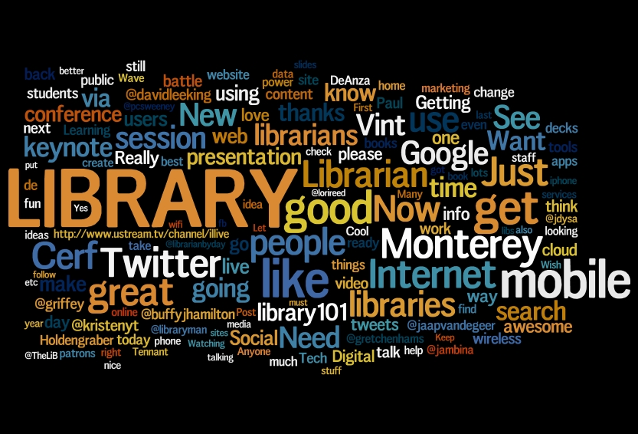
Data visualization
Used a tool called GraphViz
Used visualization to show journal usage information
“A picture is worth 1000 words. Take as much time as you would to read 1000 words to look at a visualization.”
Don't use to visualizations to try to "prove something". Look at how the data is visualized and draw your own conclusions.
Internet Librarian Twitter word cloud
Notes:
Will and Lisa Kurt: University of Reno
GraphViz: http://www.graphviz.org/
Word Clouds: http://www.wordle.net)
Internet Librarian Word Cloud
http://www.wordle.net/show/wrdl/1287613/IL2009_%234
Visualization vs. Virtualization

Slide 15
Evaluating, recommending Web 2.0 tools
Learning 2.0, an online self-discovery program that encourages the exploration of web 2.0 tools and new technologies, specifically
  23 Things.
Try something that can actually be useful, not shiny, new, cool (Tinselware)
Social Media policies
  http://socialmediagovernance.com/policies.php
Notes:
23 Things: http://plcmclearning.blogspot.com/
23 Things (or small exercises) that you can do on the web to explore and expand your knowledge of the Internet and Web 2.0. Awards for completion of exercises (mp3 player)
Week 1: Introduction
Week 2: Blogging
Week 3: Photos & Images
Explore Flickr and learn about this popular image hosting site.
Week 4: RSS & Newsreaders
Social Media Policies
http://socialmediagovernance.com/policies.php

Slide 16
Tuesday Keynote
Interview with Paul Holdengraber: Libraries of the Future: Places of Desire
  Make the library a lively place for debate and ideas.
  “I'm not a librarian, nobody’s perfect.”
  "Don't only give people what they want. Give them something that surprises them."
Notes:
www.nypl.org/LIVE
Recorded Stream
http://www.ustream.tv/recorded/2435118

Slide 17
Tuesday Sessions: Mobile Technologies
Mobile Technology Statistics
Native apps vs. mobile apps
Best Practices
Future of Mobile Technologies

Slide 18
Mobile Technology Statistics
More than 740 billion text messages sent in first half 2009. That’s an average of 4.1 billion messages sent/received per day.
63 million users in the US access "news and information" on their mobile at least once a month (excludes social networking)
In South Africa, there are about 2 times as many mobile web users as desktop web users
In some African countries there may be more mobile phones than lightbulbs
Notes:
Last Week Google bought AdMob for 750 million, a company with 400 million in revenue…
Google expects mobile marking to produce revenue in the billions.

Slide 19
More Statistics
More Mobile Browsing
  95% of iPhone users regularly surf the Internet
100,000 mobile apps in the Apple AppStore
Android 2.0 Open API, Android Developer Challenge (contest)… 10,000 Android apps
At Harvard, Blackberry users outnumber iPhone user 4 to 1

Slide 20
Mobile Web statistics, cont
Mobile Web of 2009 is about equivalent to desktop web in 1998 (Vint Cerf)
Be careful when looking at stats
  Don't ask users what phones they are using to access internet, but what phone users have
  Sites which show a large number of users on an iPhone may just mean that the site works much better on an iPhone than on other devices.

Slide 21

Statistics are Boring

Slide 22
Native Apps vs. Mobile WEB Apps
Native apps are programs which only run on a specific platform.
Native apps are downloaded
Mobile Apps are just web pages which can be accessed with a mobile browser
Mobile Browers: Opera, Safari, IE Mobile, etc

Slide 23
Native Apps
Advantages
  Access to native hardware (GPS, Camera, accellerometer)
  Faster
  Discovery: a “desktop” icon to start it
Disadvantages
  Only runs on one platform (iPhone marketshare only about 13% of smart phones)
  Requires significant developer skills (Objective C)
  Harder to update..requires “approval”

Slide 24
MobILE Apps
Advantages
  Can use from many different devices
  Typically only requires html, css, js skills to create site
  Does not require hardware vendor approval
  Easy to debug/update (just change the html, instant update)
Disadvantages
  75% said browser apps were too slow (gomez.com)
  Screen size detection not always accurate (50% in gomez survey said page size wrong for display)

Slide 25
Influencing factors for where it’s going
HTML5/CSS3 mobile browsers=more powerful browsers designed for mobile devices
Mobile Web page publishing tools
  Wirenode, wapple.net, ubik.com, etc.
Native App “code generators”
  PhoneGap - code once, deploy on iPhone, Droid, etc
  Boopsie.com – fill out a spreadsheet, create an app
  RhoMobile – HTML + Ruby = native app
Notes:
Wirenode: www.wirenode.com
Ubik: http://ubik.com/
PhoneGap: www.phonegap.com
Boopsie: www.boopsie.com

Slide 26
Mobile Development Best Practices
New paradigm: touch vs. click
Allow plenty of space to touch links
Be uber-sparse with text – “even good connections may be slow”
Be consistent with urls (m.mysite.edu, mysite.edu/mobile)
“don’t make crappy mobile sites from crappy web sites”
Select and promote databases, sites that are already mobile ready (iPhone demo)

Slide 27
Future of Mobile Technologies
The landscape is changing
It’s not just the iPhone anymore. Droid is here!
Mobile Web Browser Improvements
  Browsers based on HTML5 and CSS3
    geolocation API
    appCache
    native audio and video
  New Browser (Fennec)
    Runs on Android, Nokia, Windows Mobile devices
    Extendible with plugin architecture (zotero?)
Notes:
Changing Landscape
Lots of new Android based phones, Blackberry is still the leader for smart phones
Mobile browsers (HTML5/CSS3)
Geolocation API: Long/Lat values passed as easily as “Remote IP address” is passed to a web server now.
location aware web sites: loki.com http://www.loki.com/findme
appCache: maintains a Manifest of all the resources needed by a web pages (images, stylesheets, javascript)
once resources or loaded, future requests are loaded from the cache….
Don’t lose web experience when going through a tunnel.
native audio/video: Just include <audio> or <video> tags in markup
Inconsistent format support (Firefox supports mp3, others ogg format)
best practices for fallback for non html5 compliant browsers not fool proof
Fennec: Mobile version of Firefox.

Slide 28
Future of Mobile Technologies, etc
4G Networks
  Time Warner D/L speed is about 7MB per second
  3G iphone gets about 5 MB per second
  WiMax , LTE two major players
  WiMax claims to get up to 10MBS, but with longer range (measured in miles instead of feet for hotspots)
  LTE (long term evolution) 100-300MPS
  WWRF expects 4G will be a collection of technologies and protocols, not just one single standard.
  What you need to know about 4G
Notes:
WWRF = World Wide Research Forum
http://www.networkworld.com/news/2007/052107-special-focus-4g.html

Slide 29
Future of Mobile Technology, cont
Smarter Mobile Apps
Notes:
Show videos of Google Maps Navigation
Demo QR Codes

Slide 30

What is this?

Slide 31
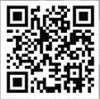
QR Codes
2 dimensional bar code
Can represent up to 4000 characters
Up to 3K binary data

Slide 32
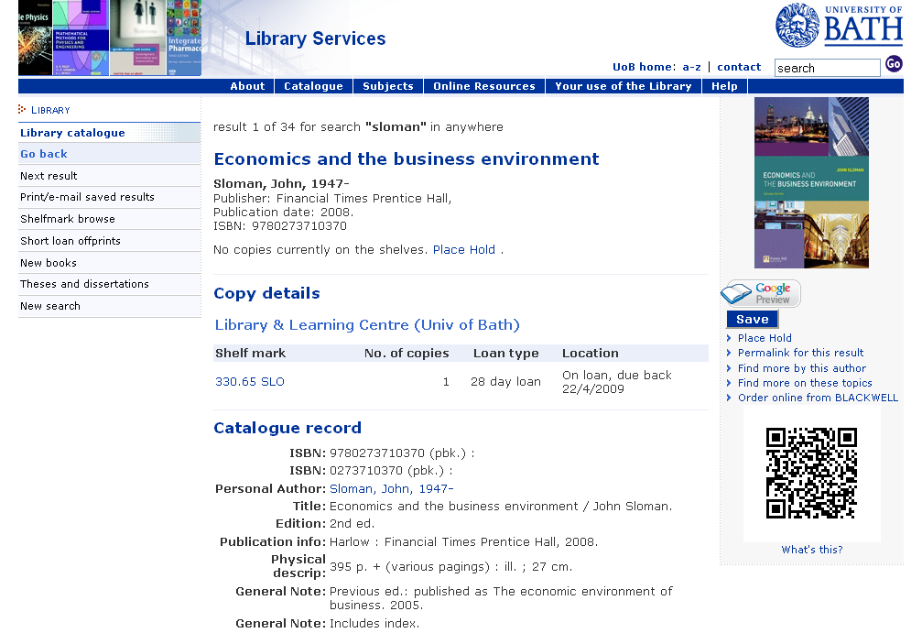
QR Codes in the Library

Slide 33
Wednesday Morning Keynote
Growing and Growing Up Digital: Net-Gen speaks
  Two high school students and a first year community college student
  Interviewed by Stephan Abrams, VP SirsiDynix
Notes:
Q: How do you get music?
-- I used to use “Ares”, Now I buy music...mostly from iTunes, I feel better now
Q: Do expect a better standard of living, about the same, worse?
A1: better! There are so many options available...school counselors are so connected…I plan on going places [big applause]
A2: “technology is almost too available…it represents a distraction...it’s too easy to get caught up on Facebook, MySpace”
Q: When you have homework… Where do you start?
A1: “I put on a headset and speak to the computer to write essays”
A2: “I use text books.... and try to stay away from the computer...too many distractions (Facebook alerts)”

Slide 34
Wednesday Sessions
Mashups for library data
Connecting Through “Lights, Camera, Action”
Mobile Gadgets and Apps

Slide 35
Data Mashups for Libraries
What: A web application that combines data from more than one source into a single site
  35% of mashups are mapping mashups
Why: Let someone else be the data steward (google does a good job of managing map data)
How:
  Look for sources of data via open APIs
  Tools: Yahoo Pipes, Dapper, Open Kapow

Slide 36
Data Mashups
Yahoo Pipes Demo
  Google Image Search
  Find something you like, use “View Source”
  Modify and save
  Output results as RSS
Notes:
Google Image Search:
http://pipes.yahoo.com/pipes/pipe.info?_id=Zp1RnpFz3RGqWHjy1L3fcQ

Slide 37
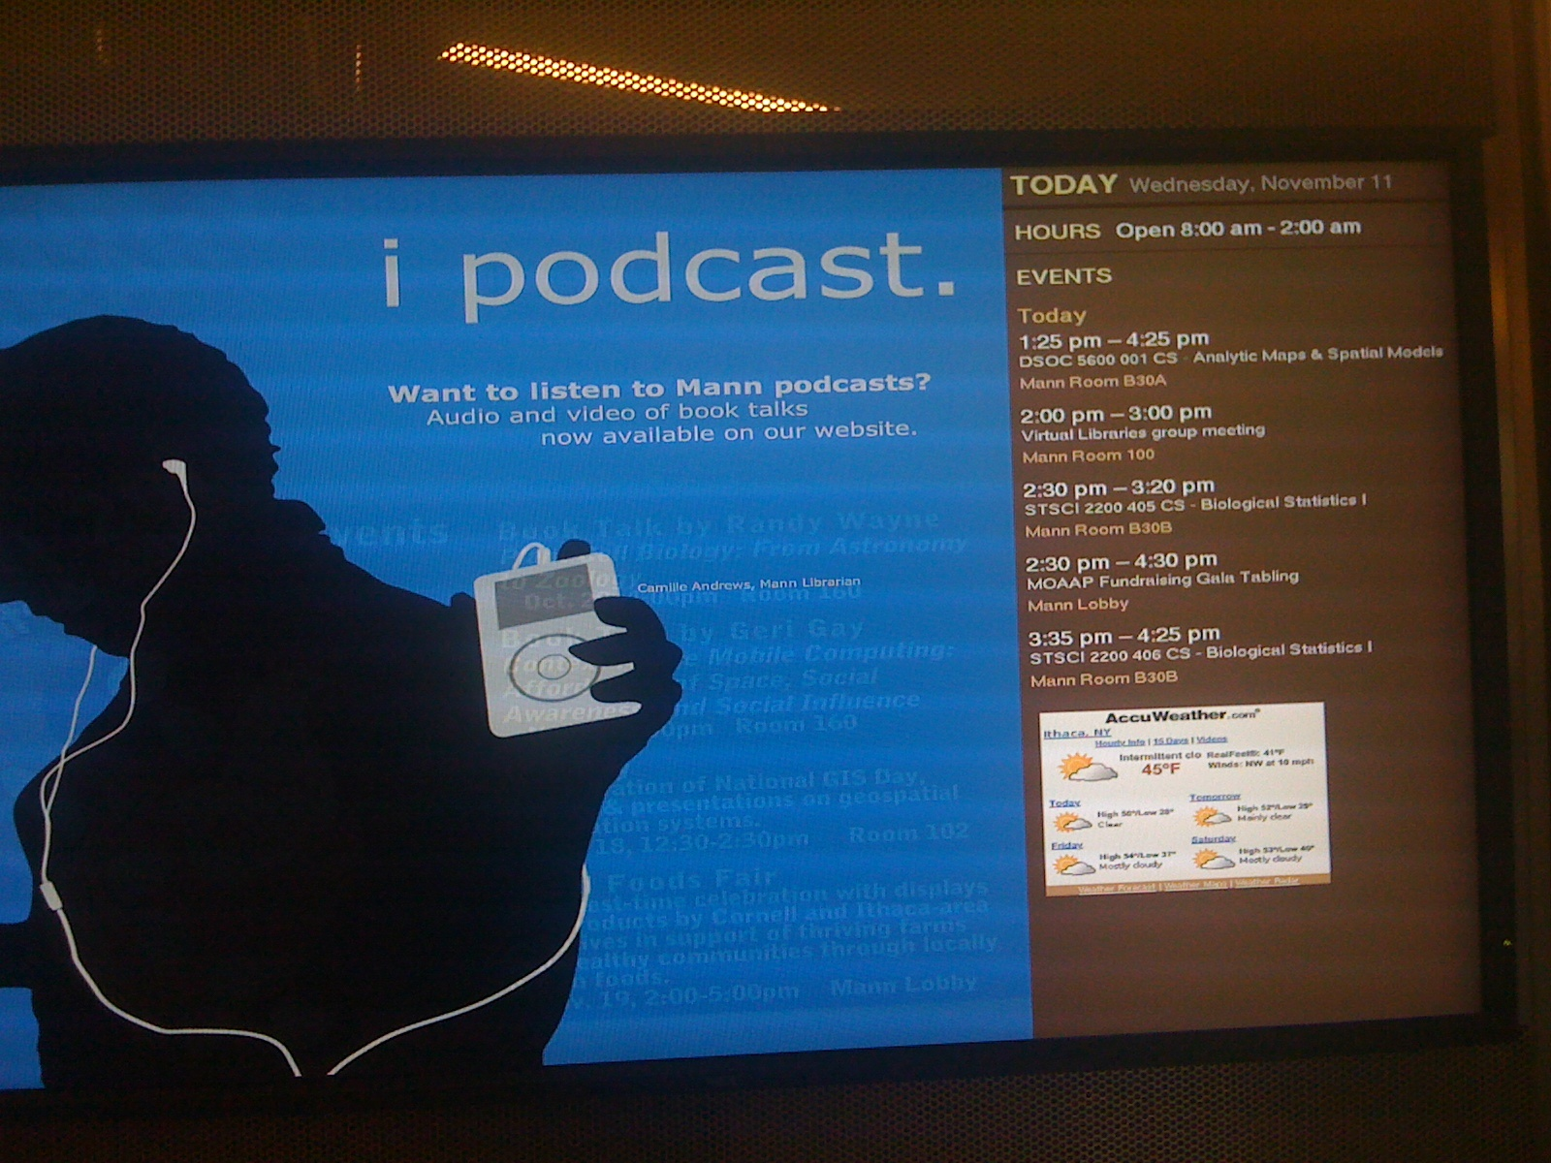
Data Mashups AT MANN

Slide 38
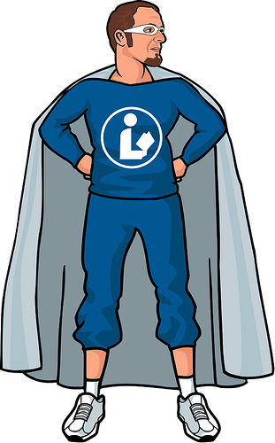
Lights, Camera, Action
Library 101
Michael Porter (aka Libraryman)
David Lee King
The Website
Notes:
Library 101
http://libraryman.com/library101/

Slide 39
Gadgets, Games
Bluff the Internet Librarian
Take off on NPR “Wait, Wait, Don’t Tell Me”
  iPhone charger using a bicycle
  Microvision Pico Projector
  Warning…Creepy content ahead
Notes:
Creepy content…cover your ears and close your eyes

Slide 40

Creepy Content…cover your eyes
  Bluetooth Spyware

Slide 41
More Gadgets
Augmented Reality
  an information layer placed over what you see.
LAYAR
  Augmented Reality Browser (Android/iPhone)
  203 data layers available now
Purdue has AR arboretum tour and campus map
Available now. Search iPhone AppStore for “Augmented Reality”…~50 apps
Notes:
iDriver: http://www.youtube.com/watch?v=oHDwKT564Kk&feature=player_embedded
LAYAR: http://www.youtube.com/watch?v=b64_16K2e08&feature=player_embedded
EyeTour: http://www.youtube.com/watch?v=drShiFnufok&feature=player_embedded
Wikitude:

Slide 42
Gadgets, Demo

Slide 43
Gadgets, DEMO 2

Slide 44
Gadgets DEMO

Slide 45
Additional Takeaways
Google Wave
  Who has it? Add your name to this wiki page:
  https://confluence.cornell.edu/x/RxHjBg
Never put your car keys in your checked baggage
Notes:
Google Wave: http://www.google.com/wave
Wiki Page for user handles: https://confluence.cornell.edu/x/RxHjBg

Slide 46
Thanks
Presentation on Wiki with notes and all links

