Slide 1


Library Directors Leadership Team
Presented by:
Ellen J. Cramer and Kathy Chiang
Notes:
Both this presentation and the project are a collaborative effort and represents the work of many people….
Target Audience: Potential VIVO users, local faculty members, administrators, public
Presentation Goals: To provide a general overview of the VIVO project. How VIVO will be implemented at a local level and how local installations will feed the national network. To provide general information about VIVOs main features, functionalities, and advantages

Slide 2
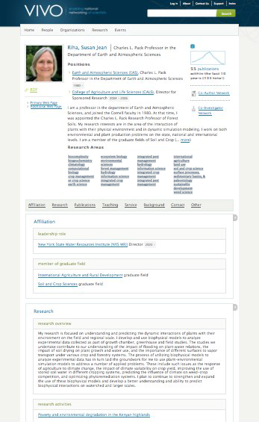
VIVO is:
An open-source semantic web application that enables the discovery of research and scholarship across disciplines in an institution.
Populated with detailed profiles of faculty and researchers; displaying items such as publications, teaching, service, and professional affiliations.
A powerful search functionality for locating people and information within or across institutions.
Notes:
What is VIVO?
It’s a semantic web application with consistent contextual rich profiles that display publications, teaching, service and professional affiliations. Faceted search for fast and meaningful results.
---------
Foster team science by providing tools for identifying potential collaborators.
Improve collaboration by creating tools using this information for enhancing new and existing teams.
Not limited to science – at Cornell, VIVO covers all disciplines across the entire institution

Slide 3
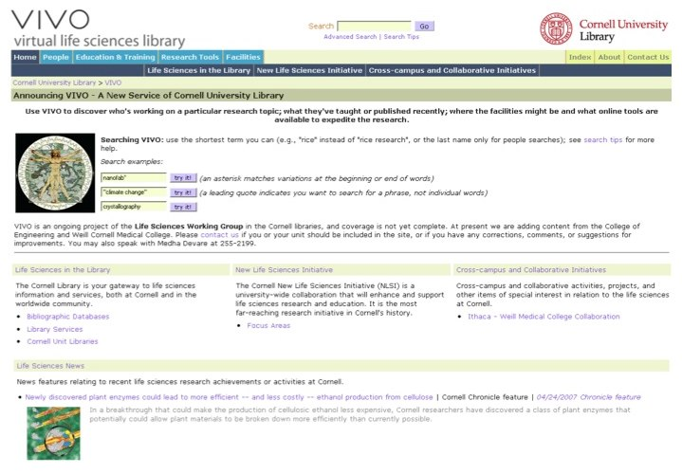
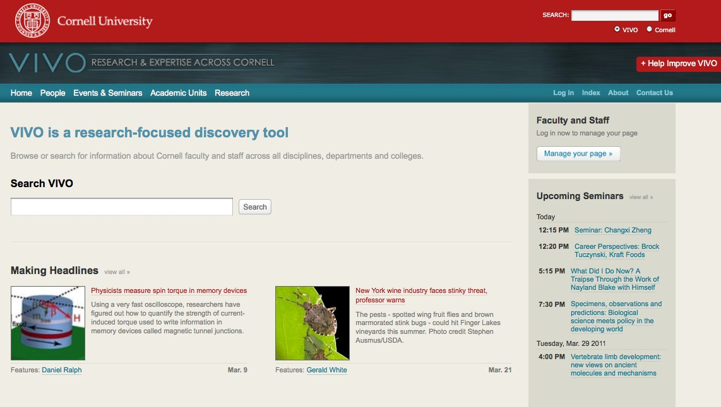
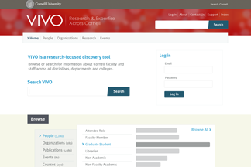
VIVO Cornell: In-house to National Cloud
2003-2007 Development of research profiles using ontologies in a database-driven website to meet the needs of the Life Sciences initiative.
2007-2009 Converted to Semantic Web standards. Expanded to include disciplines across the institution
2009–2011+ NIH grant, moved to national and international network of institutions and organizations and their faculty and researcher profiles.
Notes:
VIVO Search – between campuses, states, agencies, consortiums, international

Slide 4
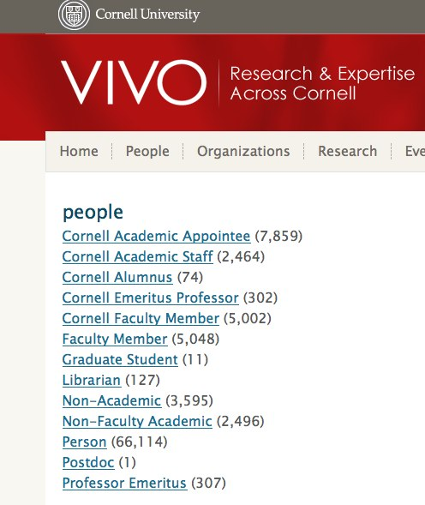
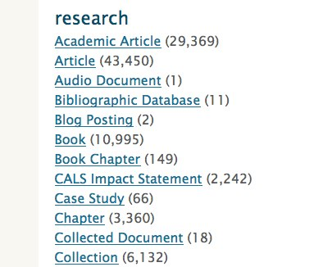
VIVO Cornell Status
Version 1.2.1 (1.3 soon…)
Close to 10 million triples
1, 200 visitors/day
Notes:
Triples: 9,835,291
Jan 1 - June 1: 172, 219 unique visitors

Slide 5
VIVO Cornell Features
Search and browse improvements
Self-editing (cuwebauth) and image upload
Link to contact information in CU directory
Overivew of CU (org structure, research, funding)
Provides re-usable structured data
Linking between individuals (people, subject areas, geographic areas, grants, departments, publications, etc.)
  Co-author and co-investigator visualizations
Notes:
Find by subclasses, subject area, department, courses.
Upcoming viz: Map of Science (org structure)

Slide 6
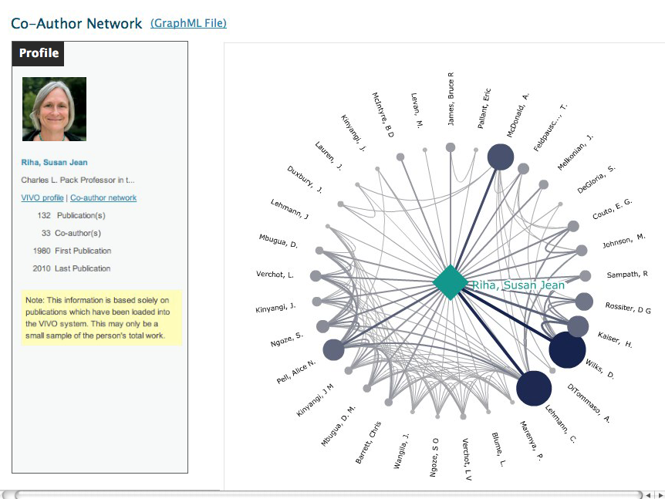
Notes:
Hr
Manual
Faculty reporting tool
OSP
Registrar

Slide 7
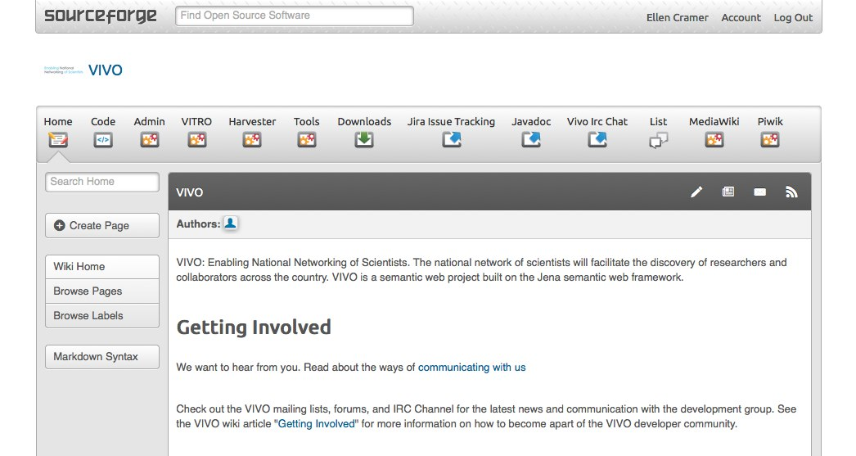
Open Source Community Development
https://sourceforge.net/p/vivo/home/VIVO/
Notes:
Open source community development
Code and documentation, wiki, mail lists (over 200 msgs in June), bug reporting, IRC chat, etc.

Slide 8
Outreach and Adoption
Other sites piloting or adopting VIVO technology
AAAS, Duke University, CTSAs, GeorgiaTech, Los Alamos National Laboratory, Northwestern University, Stony Brook University, University of Arkansas, University of Buffalo, University of Colorado – Boulder, University of Delaware, University of Oregon, USDA
Integration partners
APA (Digital Trust), Duke (Widgets), Harvard University (Harvard Profiles), Indiana University (HUBzero), Orchid, Stony Brook University (UMLS), University of Hong Kong (Knowledge Exchange), University of Pittsburgh (Digital Vita), Weill Cornell Medical College (Google Refine).
International efforts
ANDS-Vitro Consortium (Griffith, QUT, University of Melbourne, VeRSI)
Chinese Academy of Sciences
IICA (Inter-American Institute for Cooperation on Agriculture) is
considering options like VIVO for a researcher network for their SIDALC
Application and there is a pilot VIVO implementation at the El Colegio de Postgraduados of Mexico.

Slide 9
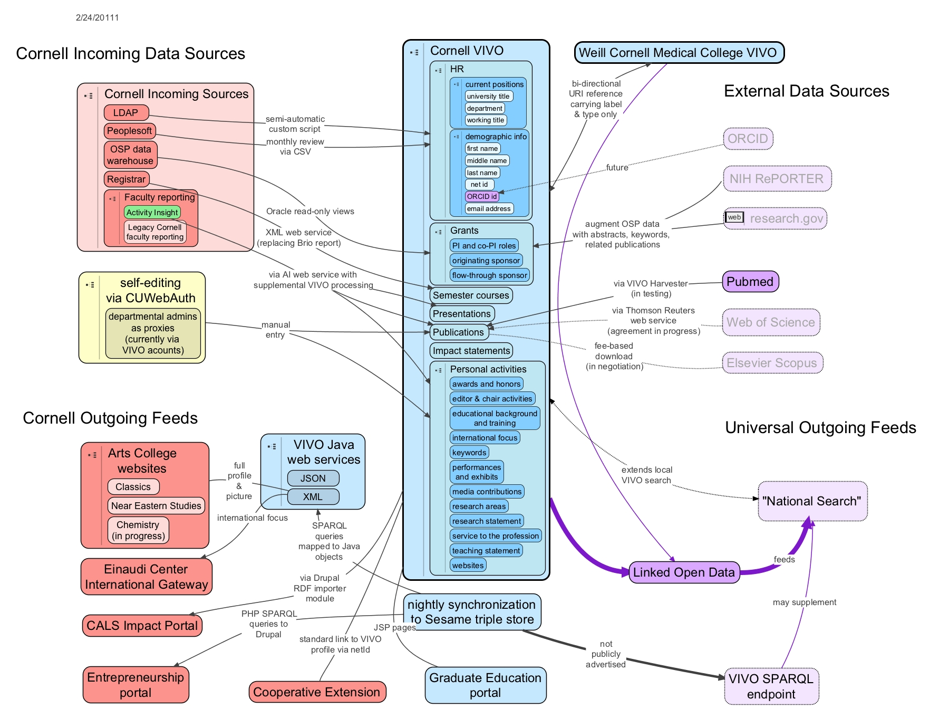
VIVO Cornell: Data Sources

Slide 10
VIVO Anecdotes
During a user test of VIVO, a senior faculty member and well-funded biomedical researcher, claimed he did not need VIVO as he had his network and collaborations all established, but as he was leaving, stopped and asked if he could use the system for a moment as he wanted to look up someone that was speaking at his seminar the next day and wanted to draft an introduction. He found the speaker in the search results and the profile was printed out for him.
University of Florida: Over dinner last night (April 4, 2011), my husband mentioned that the Director of the Florida Sea Grant emailed him regarding network visualization (this is my husband’s research focus). The Director has a dataset that he thinks would be particularly interesting to visualize, but has no experience doing this type of work himself – thus the email to Chris asking if he wants to work together on the project. Long story short, the Director found Chris from a VIVO search. They did not now each other prior to this email, and their worlds probably never would have collided otherwise. VIVO brought them together.
A couple years back, the Cornell Alumni Affairs and Development Office was contacted by a major company interested in making research funds available to scientists working on issues related to urology; a search in VIVO Cornell quickly returned several faculty in diverse disciplines working in this area, translating to real dollars for the faculty member at the Weill Cornell Medical College.
We had a faculty member recently write in using the VIVO contact form thanking us for providing a profile with accurate information. At that point it was populated programmatically with information from university data sources. With an encouraging response from the program aid, he started editing his profile with more data and now uses it as his resume page.
Notes:
Facilitating internal communication for new faculty, students, researchers seeking resources or collaborators, bridging gaps between NY and Ithaca.
Providing consistent, contextual, rich profiles of researchers for external discovery, through search engines and cornell.edu
Demonstrating the value of common data and coordinating IT infrastructure (AI).
Providing an integrated feed of content to reduce duplicative effort on other web sites (A&S).
Reducing demands on faculty time while giving the information they do provide greater exposure in may contexts – entrepreneurship, international gateway, graduate education portal.
Serving data not just web pages
Federal agencies looking for data sources like this and are excited about tapping into VIVO for reviewers, as well as using it themselves
Other univerisities are clearly doing competitive landscape analysis,
Publishers, Orcid, author disambiguation efforts
Datastar and collaborations with the Australians address DMP. Answer questions such as top 20 funding agencies for Cornell

Slide 11
In addition to collaboration…
Serving data not just web pages
Data exposed in many contexts - entrepreneurship, international gateway, graduate education portal
Federal agencies looking for data sources like this and are excited about tapping into VIVO for reviewers
Connection with other universities’ and professional organizations
Publishers, Orcid - author disambiguation efforts
Datastar and collaborations with the Australians address data management plan
Answer questions such as top 20 funding agencies for Cornell
Notes:
Facilitating internal communication for new faculty, students, researchers seeking resources or collaborators, bridging gaps between NY and Ithaca.
Providing consistent, contextual, rich profiles of researchers for external discovery, through search engines and cornell.edu
Demonstrating the value of common data and coordinating IT infrastructure (AI).
Providing an integrated feed of content to reduce duplicative effort on other web sites (A&S).
Reducing demands on faculty time while giving the information they do provide greater exposure in may contexts – entrepreneurship, international gateway, graduate education portal.
Serving data not just web pages
Federal agencies looking for data sources like this and are excited about tapping into VIVO for reviewers, as well as using it themselves
Other univerisities are clearly doing competitive landscape analysis,
Publishers, Orcid, author disambiguation efforts
Datastar and collaborations with the Australians address DMP. Answer questions such as top 20 funding agencies for Cornell

