Slide 1
Changing Landscape of Academic Libraries
May 20, 2012
Susan Gibbons, University Librarian

Slide 2
Disruptive Forces
Return on Investment (ROI)
Online Learning
Legal Challenges

Slide 3
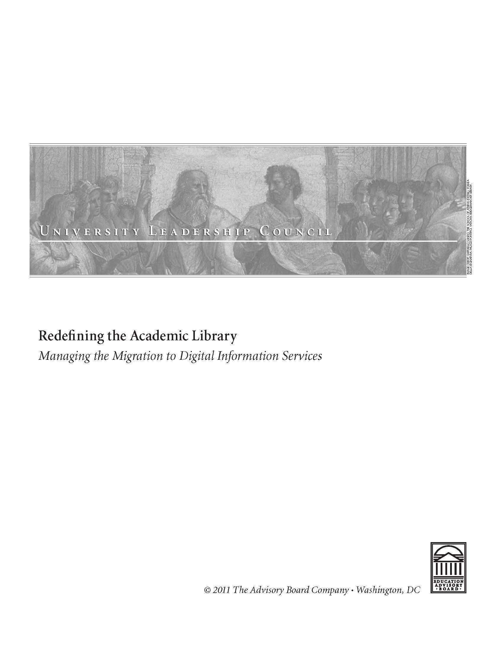
How do Presidents/Provosts Think about Libraries?
Education Advisory Board’s Redefining the Academic Library: Managing the Migration to Digital Information Services. 2011.

Slide 4
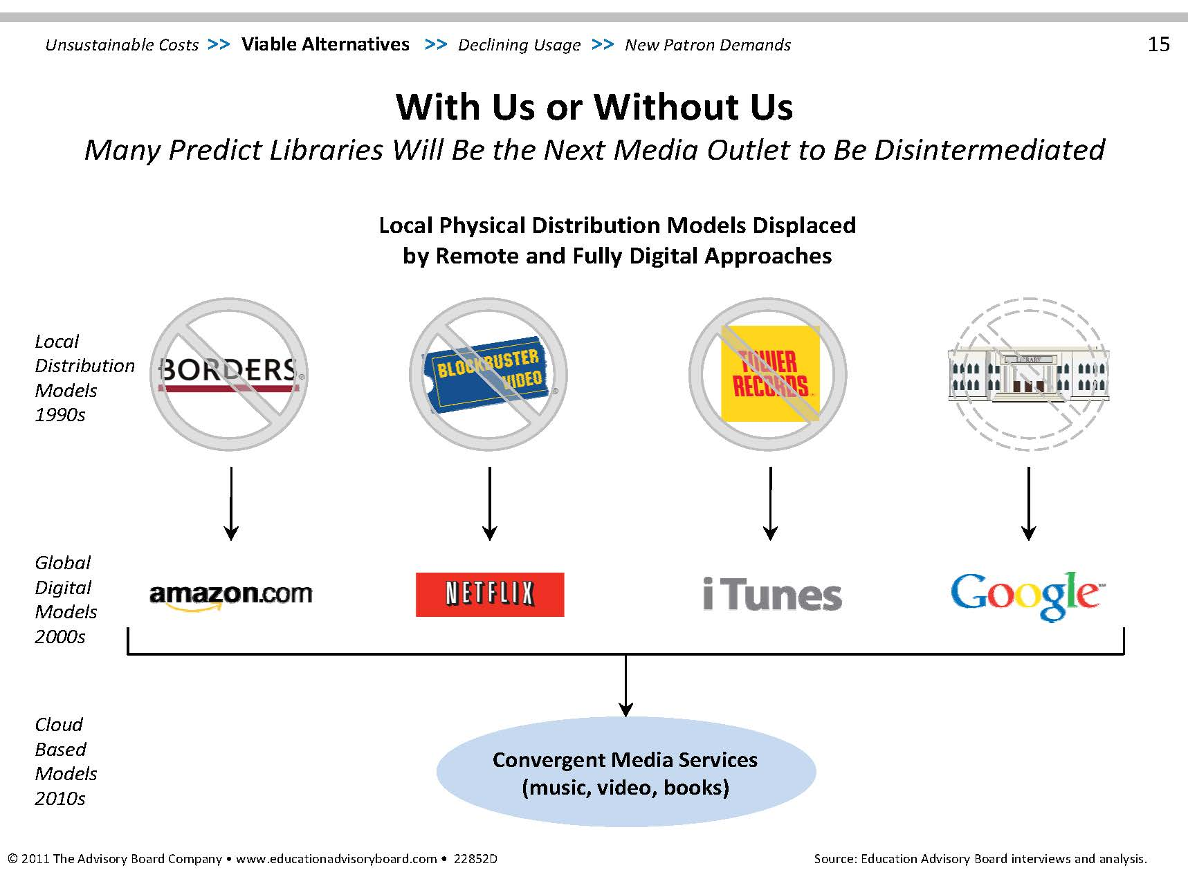

Slide 5
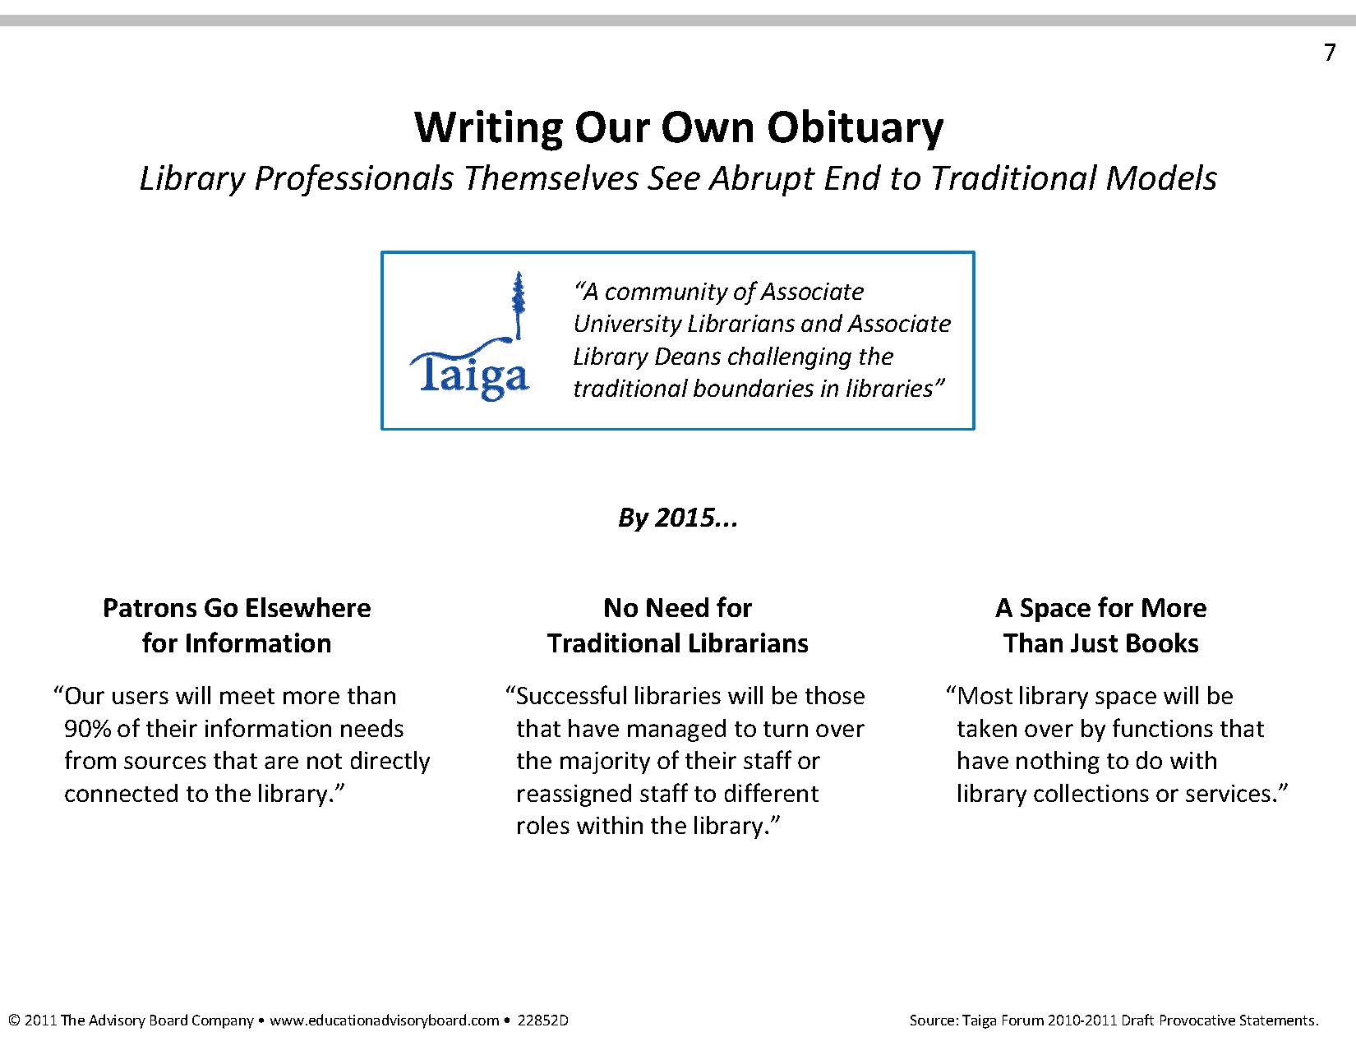

Slide 6
Return on Investment Metrics
Size of collection

Slide 7
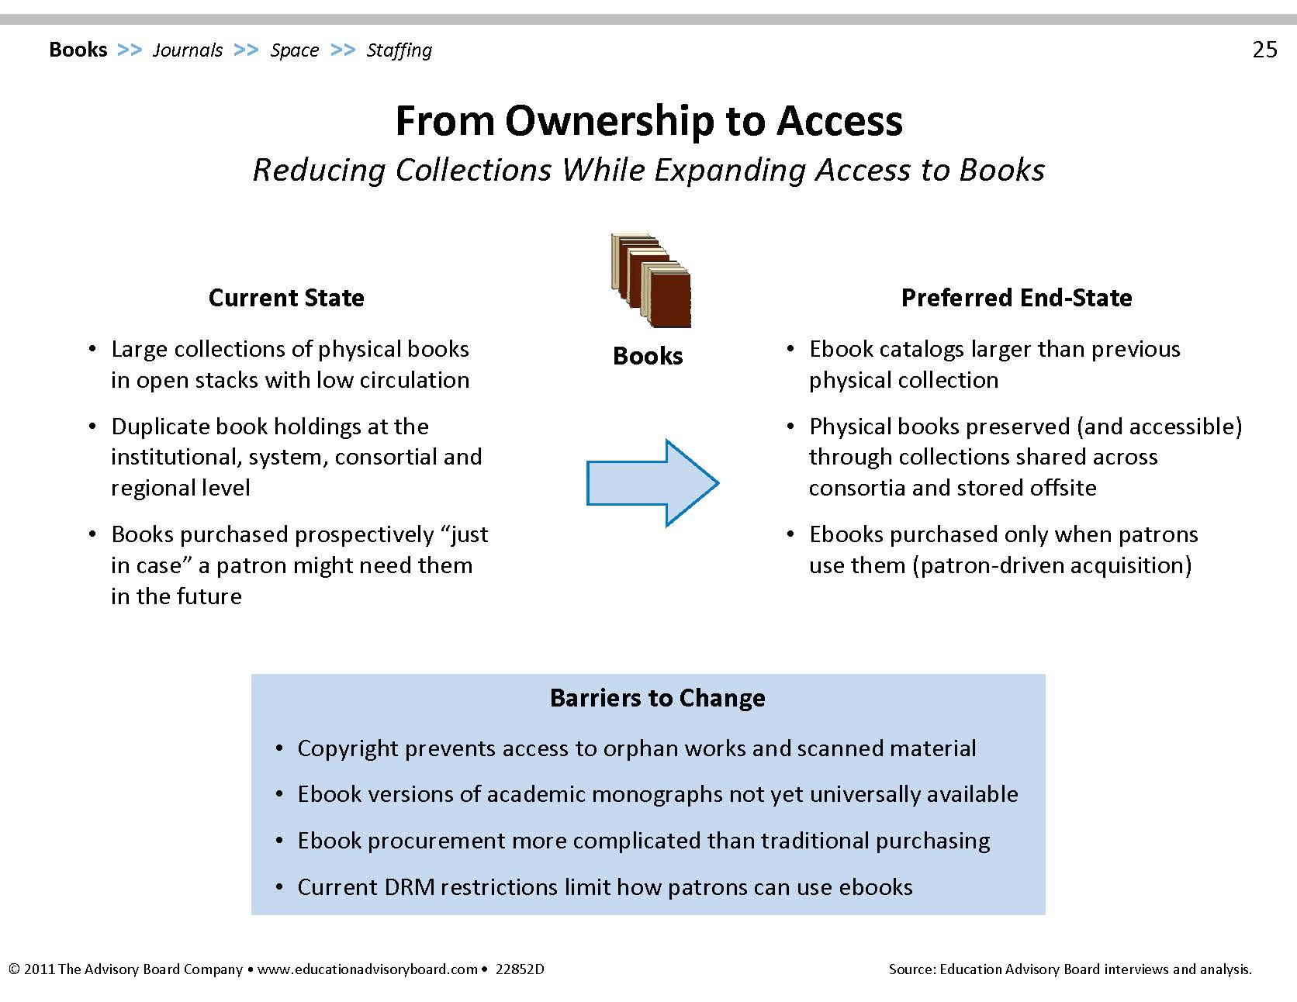

Slide 8
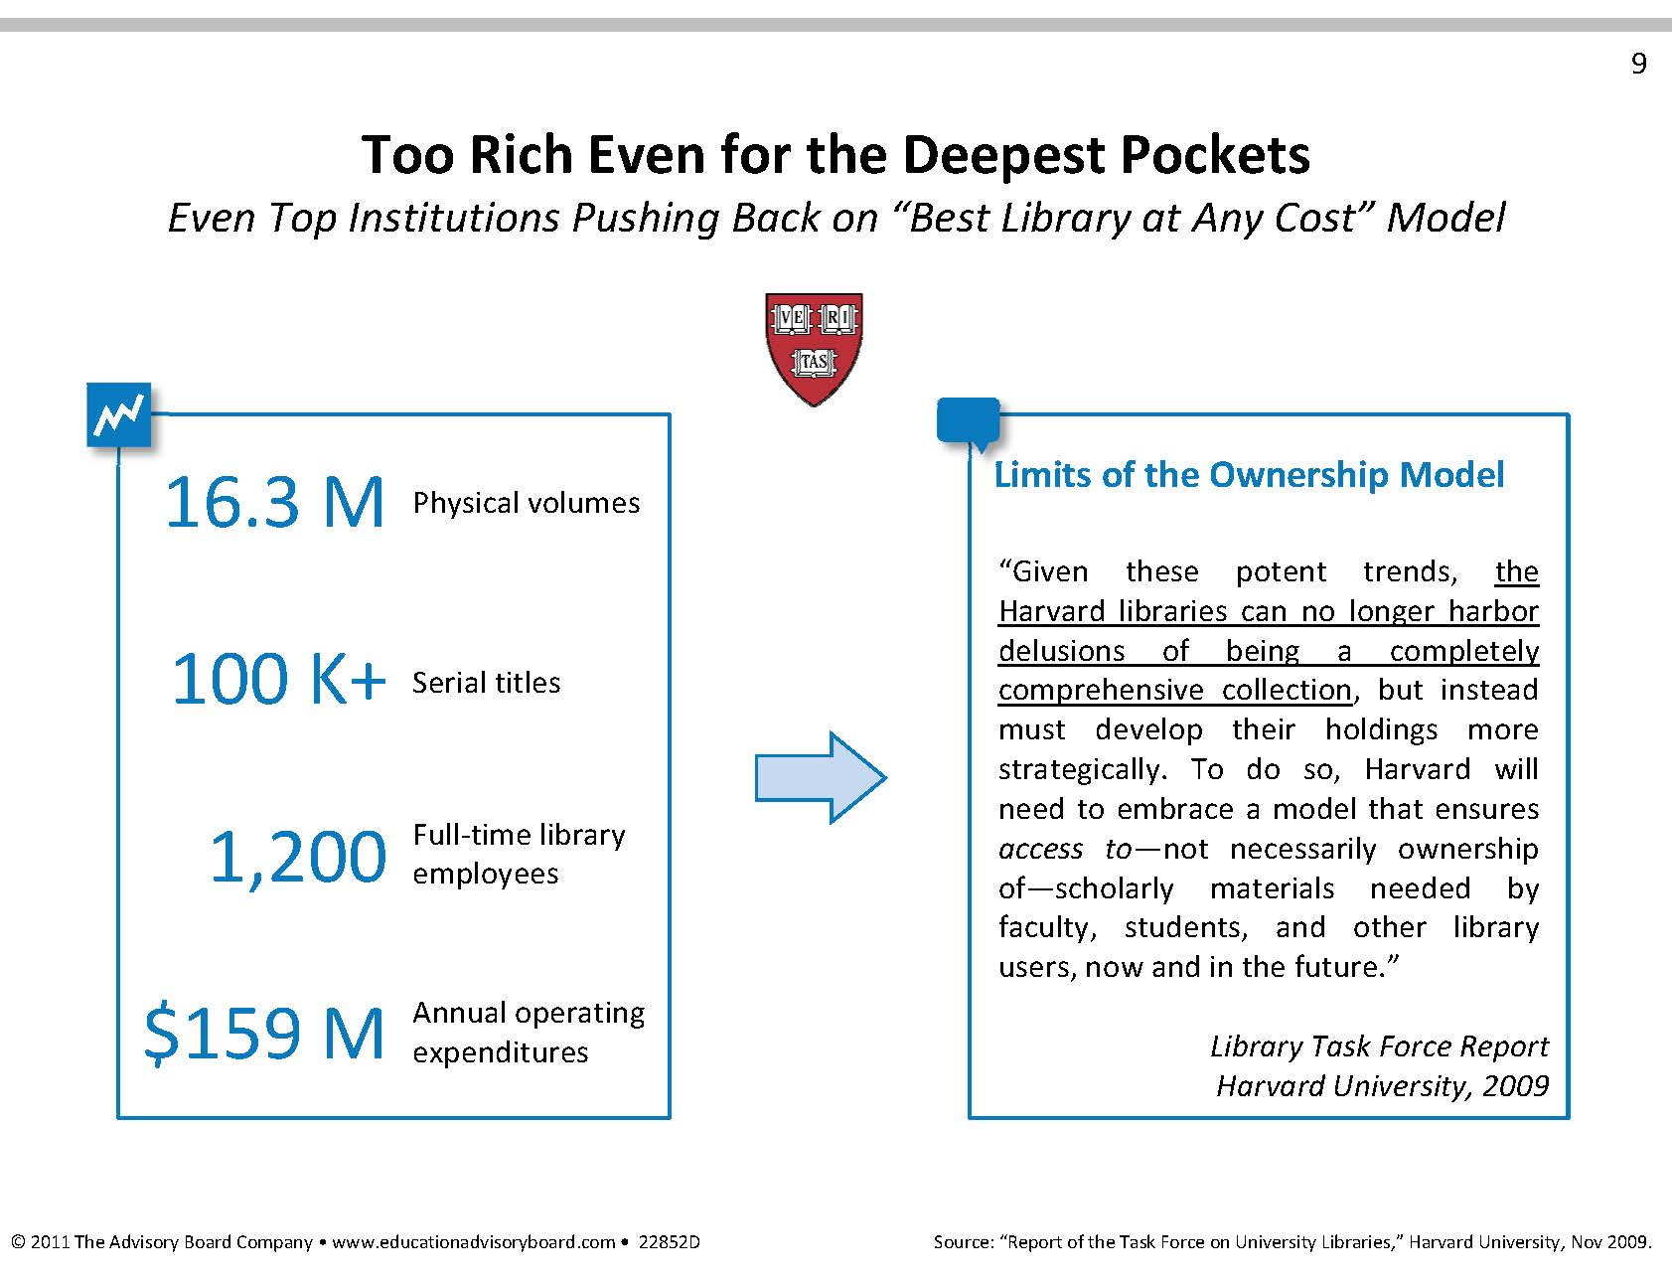

Slide 9
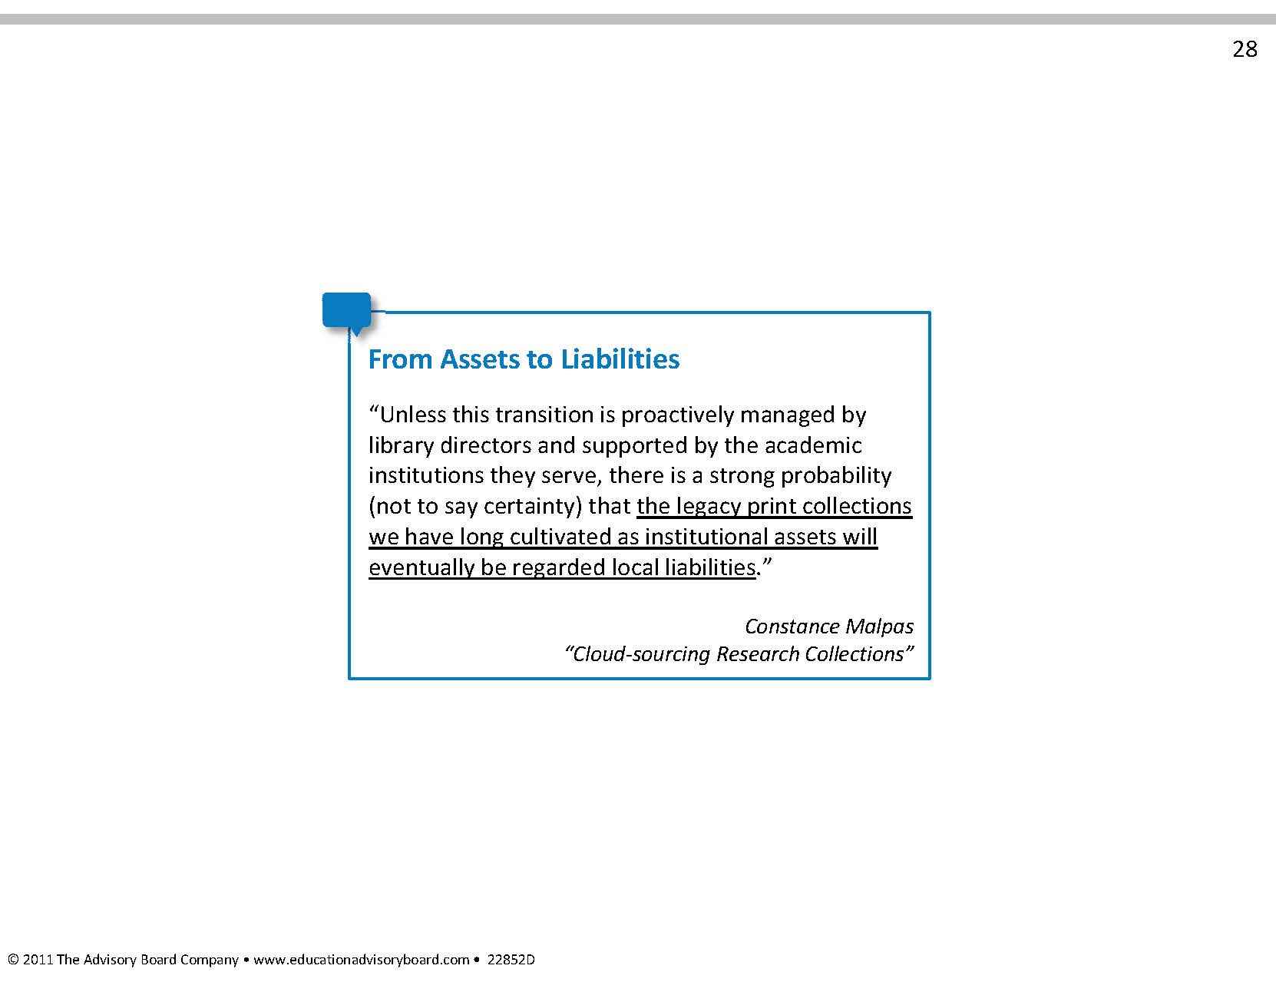

Slide 10
Cooperative Collection Development
Delivery mechanisms of collections & expertise
Robust, real-time collection analysis tools
Trust beyond a handshake
Response of scholars

Slide 11
Return on Investment Metrics
Size of collection
Circulation

Slide 12
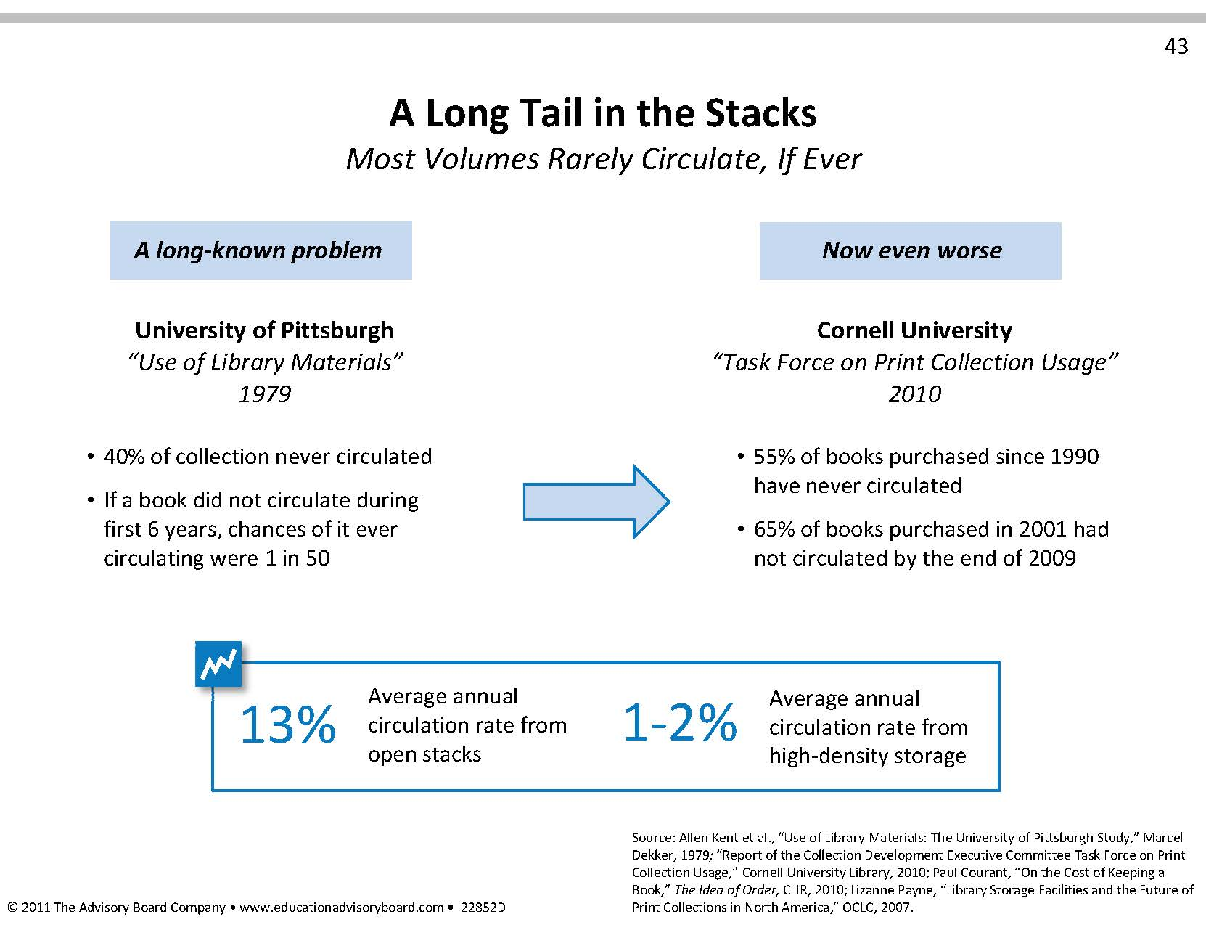

Slide 13
Patron-Driven Acquisitions
Discovery mechanisms for what’s available
Buy or Borrow?
Response time
  Print on demand
Impact on future generations

Slide 14
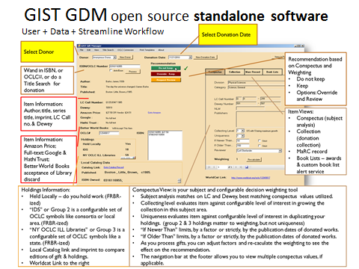

Slide 15
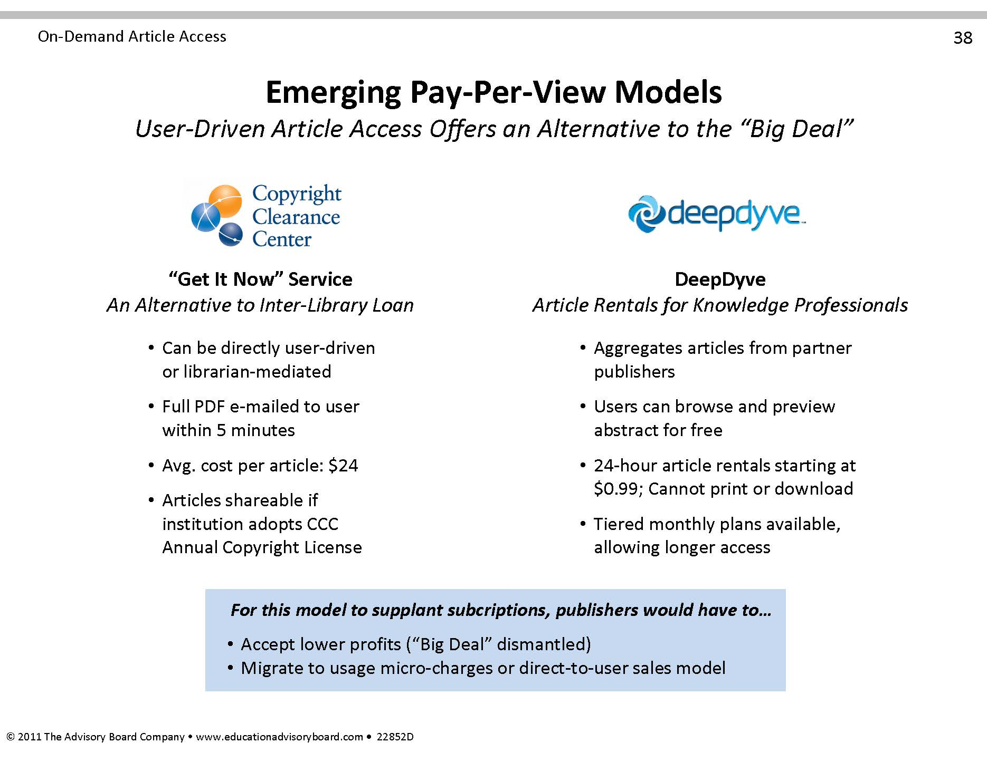

Slide 16
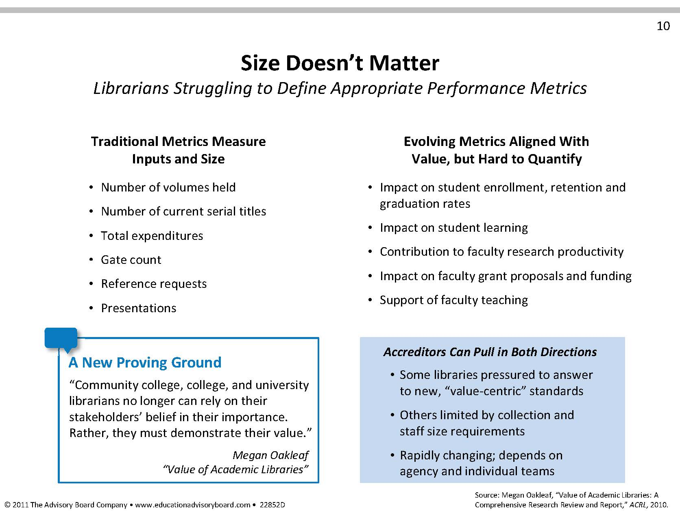

Slide 17

University of Rochester
“Rochester Method”: Adopting methods from anthropology & ethnography to study library users
What are the barriers to dissertation completion?
What steps do undergraduate take in completing a research paper?
Why are the faculty not using the institutional repository?
Why do students continue to use the physical science library facility when so much of the science literature is now available online?

Slide 18
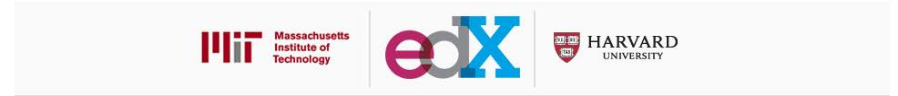
Online Learning
EdX is a joint partnership between The Massachusetts Institute of Technology (MIT) and Harvard University to offer online learning to millions of people around the world. EdX will offer Harvard and MIT classes online for free. Through this partnership, the institutions aim to extend their collective reach to build a global community of online learners and to improve education for everyone

Slide 19
Legal Challenges
Section 108- copyright exceptions for libraries and museums.
John Wiley & Sons Inc. v. Supap Kirtsaeng- does first sale doctrine apply to works “manufactured” outside of the US?
Georgia State University- electronic reserves. “Reasonably priced, readily available license for digital excerpts”

Slide 20
