Slide 1
Non-Linear Chemical Dose Controller Teach-In
Yoon Choi
Kayti Curtis
Monica Hill
Dale Johnson
Harrison Ko
Akta Patel
Karen Swetland
Notes:
Karen

Slide 2
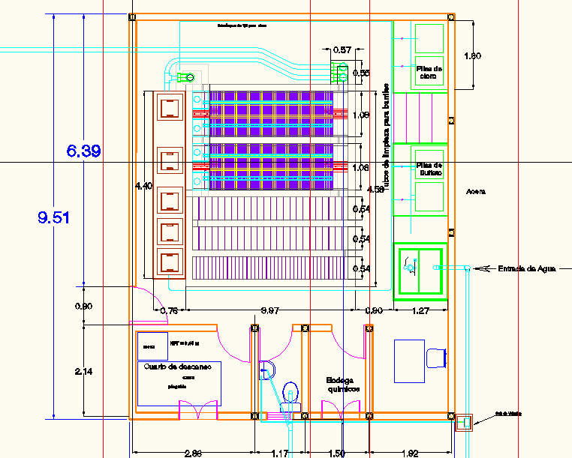
Agalteca
Notes:
Karen

Slide 3
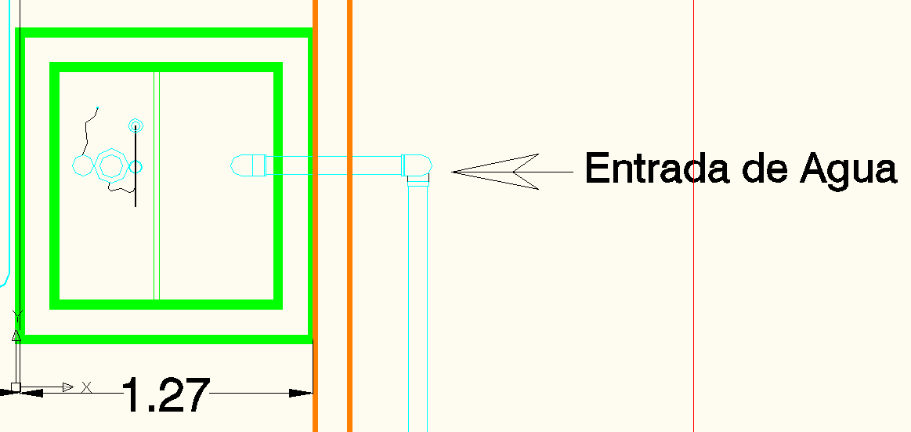
Agalteca
Notes:
Karen

Slide 4
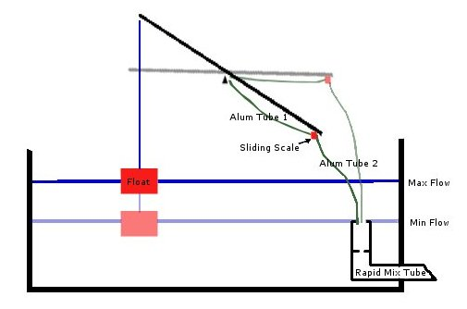
Dose Controller
Plant flow rate changes
  Float moves changing the head and the chemical flow rate
Varies chemical dosage with varying flow rates not just turbidity
More precise
chemical dosage
  Necessary for proper
  flocculation and
  sedimentation
Notes:
Akta

Slide 5
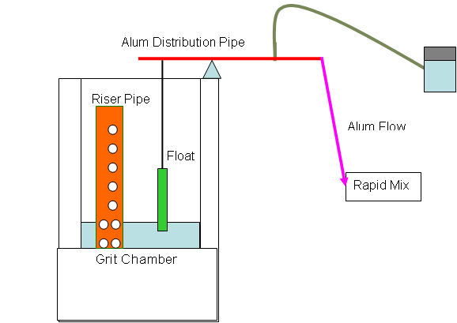
Linear Dose Controller
Linear Flow Orifice Meter
  Linear relationship between plant flow rate and the water height in the entrance tank
Linear Chemical Doser
  Linear relationship between water level in entrance tank and outflow level of flow controller tube
Flow Controller
  Maintains constant head in a small bottle so dosing can be controlled by outflow level of tube
From CDC Fall 2008
Notes:
Akta

Slide 6
Limitations of the Linear Dose Controller
Linear relationships require laminar flow in the chemical dosing tube
At high flow rates, need high chemical flow rates because of turbulence
Notes:
Akta

Slide 7
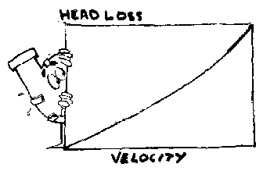
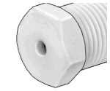
Non-Linear Dose Controller
Non-linear relationship between head loss and plant flow rate
  Use orifice
Notes:
Harri

Slide 8
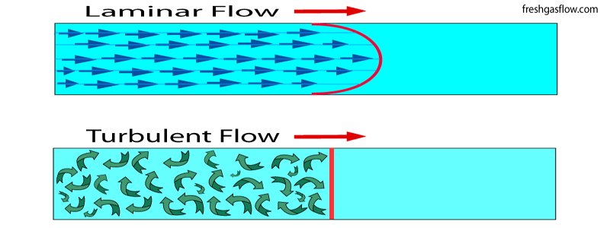
Advantages of Non-Linear Design
Handles turbulent flow through the dosing tubes
Able to dose higher flows
Higher specificity in choosing dose
http://www.freshgasflow.com/physics/flow/flow.html
Notes:
Harri

Slide 9
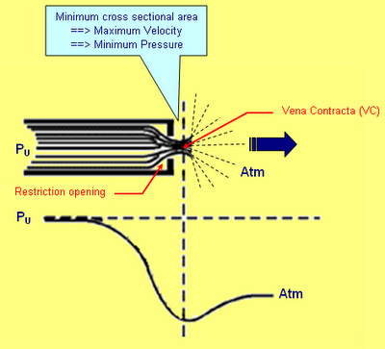
Non-Linear?
The new design for the dose controller is considered “non-linear” because of the dominant equation
where
is the chemical flow rate
is the orifice coefficient
is the available head
http://2.bp.blogspot.com/_YOjepBEvjc8/R2y_NOoPxSI/AAAAAAAAAjQ/xa2pM_sUlQY/s400/Pipe_Hole.PNG
Notes:
Harri

Slide 10
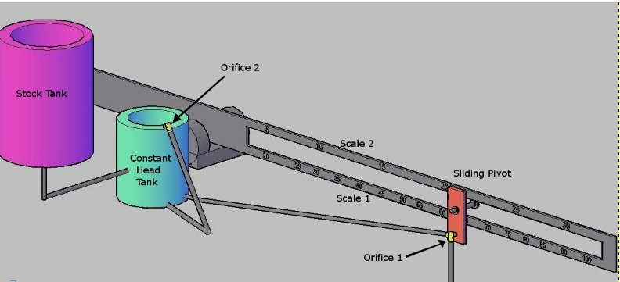
Chemical Dose Controller Design
The orifice equation is used in:
Constant head tubes
Chemical dosing tube
Rapid mix tube
Other components:
Stock Tank
Constant Head Tank
Lever arm
Entrance Tank
Notes:
Harri

Slide 11
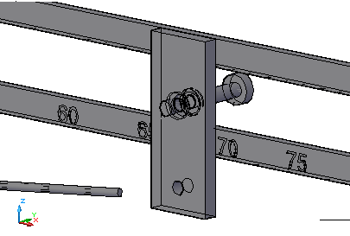
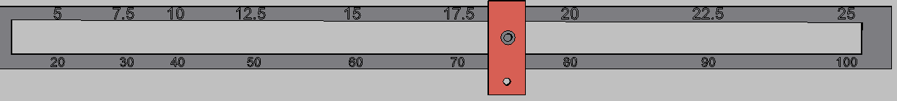
Lever Arm: Dual Scales
Benefits of Dual Scale
Lever Arm Drawing
Possible to dose at wider range (5-100mg/L)
More precision at lower doses leads to higher quality effluent
Reduces wasted alum from overdosing
Notes:
Yoon

Slide 12
Linking Dosage to the Non-linear Scale
Alum
Dosage
Alum
Flow
X 2 =
Increase Diameter of Orifice
Decrease Length Scale
Point
on
Scale
Pivot Point
20
30
40
50
60
70
80
90
100
5
7.5
10
12.5
15
17.5
20
22.5
25

Slide 13
Linking Dosage to the Non-linear Scale
Alum
Dosage
Point
on
Scale
Pivot Point
20
30
40
50
60
70
80
90
100
5
7.5
10
12.5
15
17.5
20
22.5
25

Slide 14
Calculation of Max Angle and Length
Process | Headloss
Rapid Mix Tube | 10 cm
Flocculator | 13.5 cm
Launder | 5 cm
Weir | 5 cm
Total | 33.5 cm
Notes:
Dale - With the new max delta H of 33.5 cm, with a 80 cm equal length lever we get a max angle of 57 degrees and orifices of .123 inch and .062 inch.

Slide 15
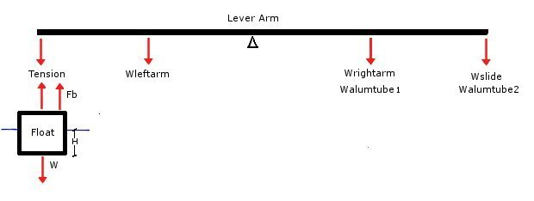
Lever Arm: Force Balance
Notes:
Dale

Slide 16
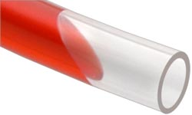

Sources of Error
Headloss from Tube
Use smooth PVC
Wide diameter to minimize headloss
Don’t make the tube any longer than necessary
Change in Δh from moving tube
Float Design Parameters
Increase diameter
Decrease depth
Must be of reasonable size
Float
Notes:
Dale

Slide 17
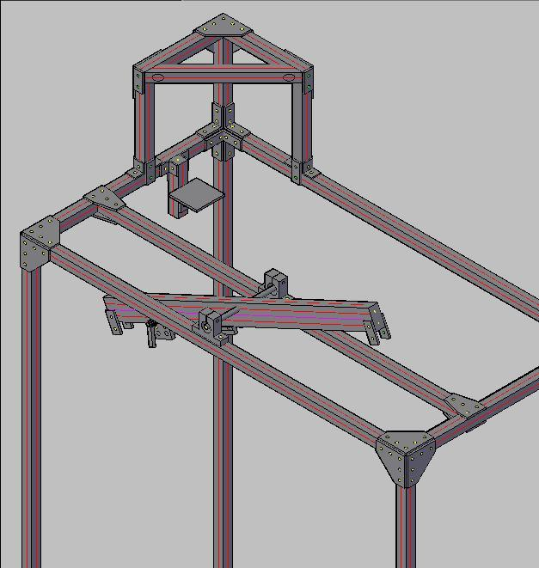
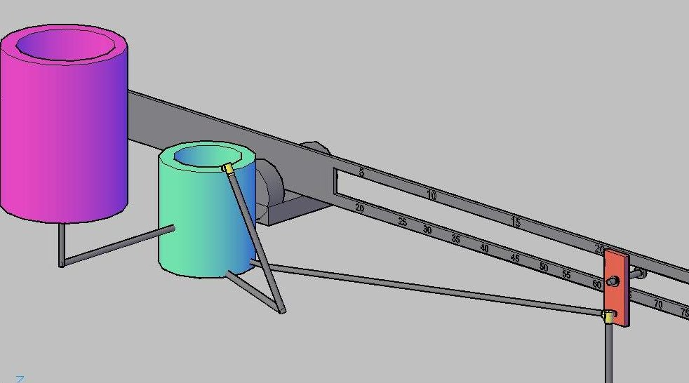
Conceptual & Actual Designs
Screen clipping taken: 10/28/2009, 7:16 PM
AutoCAD Model
Full-Scale Prototype
Notes:
Monica

Slide 18
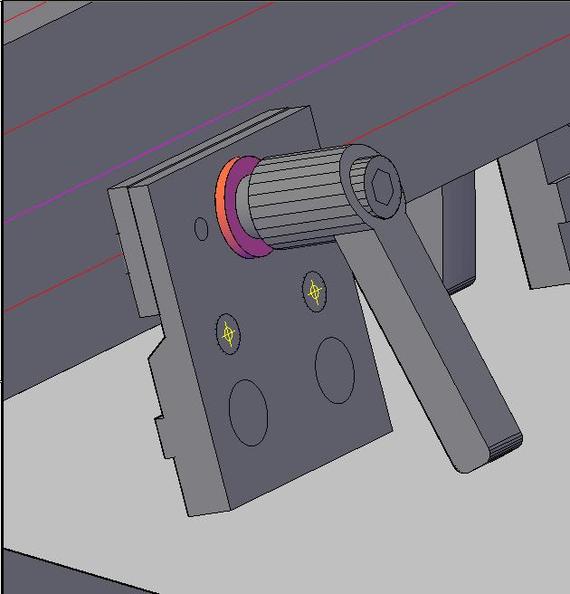
Prototype Design
Slide Brake
Stock Tank Platform
Notes:
Monica

Slide 19
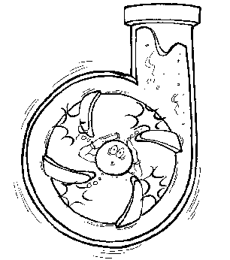
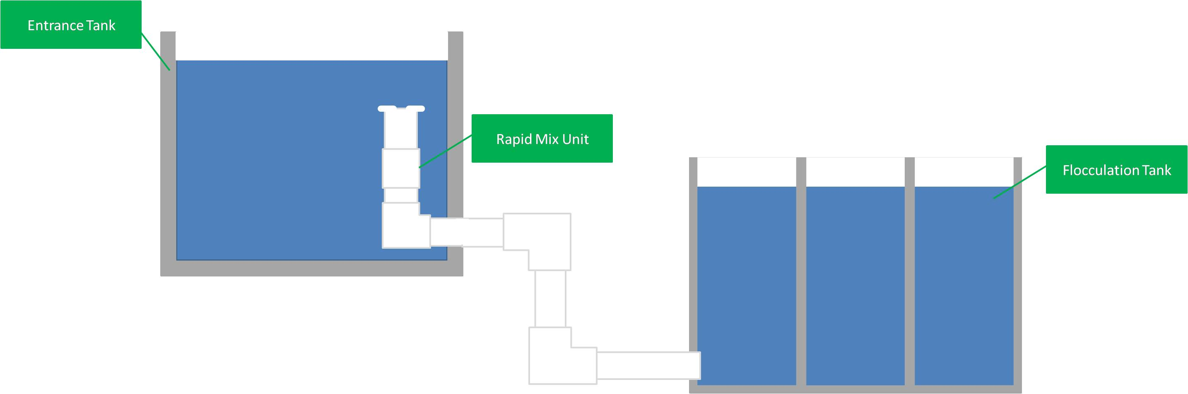
Rapid Mix Tube Design
Notes:
Kayti

Slide 20
Large Scale Mixing Orifice
Need: 1< K <2 (exit loss coefficient)
Ain here is based off of the area of the large scale mixing orifice that causes the constricted flow area
Aout is equal to the area of the pipe
Calculated diameter of the orifice ~3.4 in
Large scale mixing will take place in the first section of the tubing
Ain
Notes:
Kayti

Slide 21
Small Scale Mixing Orifice
The small scale mixing orifice is designed with a target head loss, Δh
Using the following equation, we calculate the maximum length of the smallest dimension of a rectangular orifice
We can then design the rectangular orifice dimensions based on these calculations—the top two designs on the right are feasible
Notes:
Kayti

Slide 22
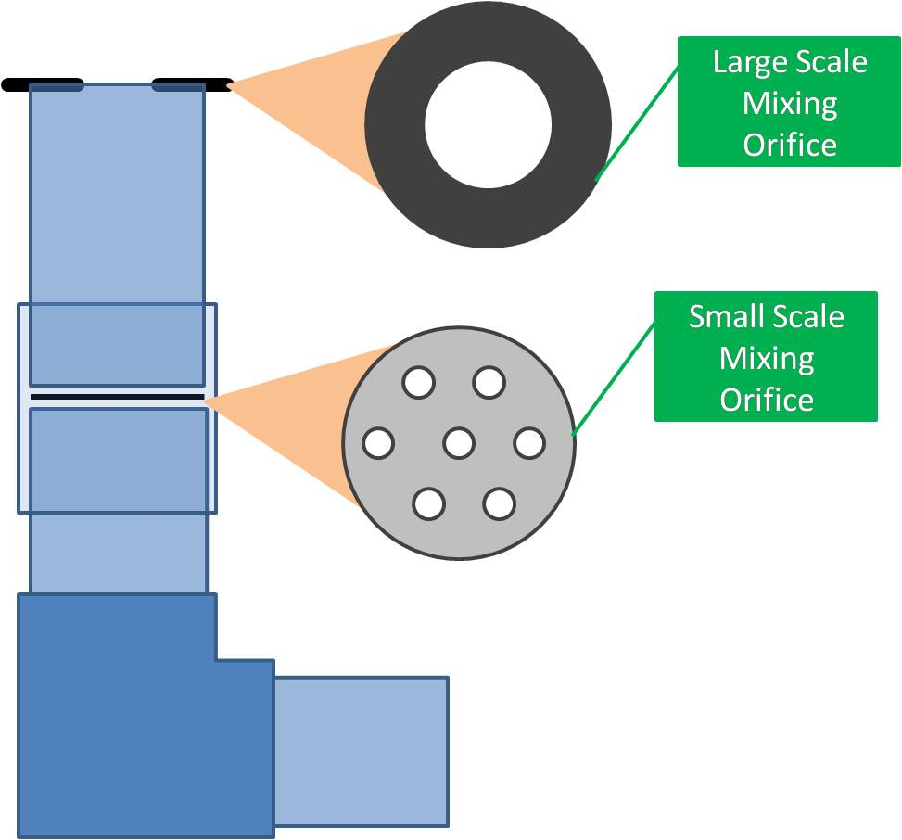
Rapid Mix Tube Design
Problems were occurring with the old design:
  Submerged rapid mix orifice made it difficult to clean when clogged
New design provides a large scale rapid mixing orifice
Makes cleaning much easier: small and large scale orifices can be removed easily
Simple system: easy to build and take apart
Notes:
Kayti

Slide 23
Future Objectives
General Semester Goals
Current Challenges
√
Design orifice sizes for chemical dosing tubes
Design orifice for the rapid mix tube
Calculate head losses at each stage of the plant
Create a schematic for the new chemical dosing system
Design tube sizes
Develop non-linear scales for lever arm
Design the float for the lever arm
Manufacture full-scale model of the doser
Build scale model of plant
Conduct experiments to compare design results with actual results
Verifying results
Rapid mix design
Calibrating flow based on weight of system
Building the prototype
Testing overall system design
√
√
√
√
√
√
Notes:
Karen

Slide 24

Notes:
Karen

