Slide 1
Non-Linear Chemical Dose Controller
Akta Patel Dale Johnson
Harrison Ko Karen Swetland
Kayti Curtis Monica Hill
Yoon Choi
Notes:
Karen

Slide 2
Watch our video!
Notes:
Karen

Slide 3
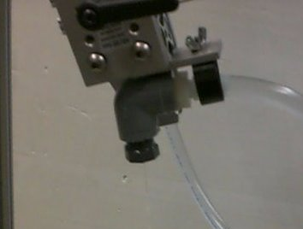
Clogging Experiment
Problems with dosing in current plants
  Constant head tank orifice is clogging
  Is it precipitate, foreign material, or influent water chemistry?
New orifices
  New design utilizes multiple orifices
  Small orifice size
Notes:
Akta

Slide 4
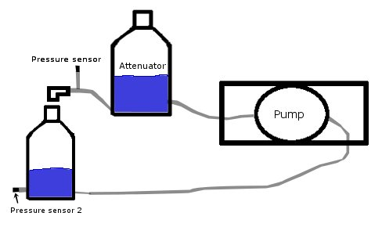
Clogging Experiment
-0.1 cm diameter orifice
-Alum at 125 g/L
-38.6 mL/s or 7 cm head difference
Notes:
Akta

Slide 5
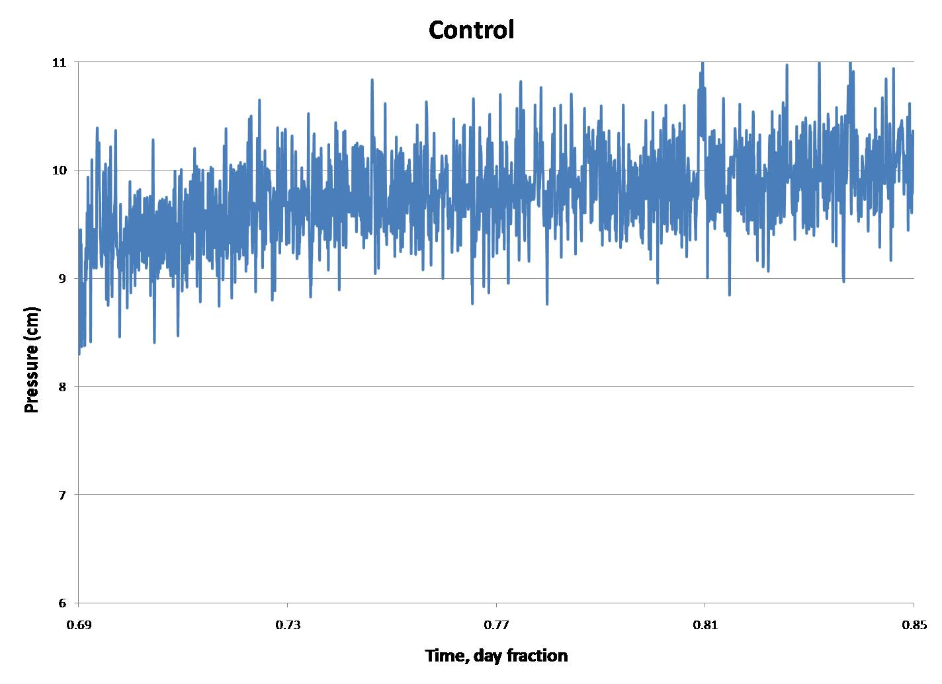
Control Experiment - Water
Notes:
Akta

Slide 6
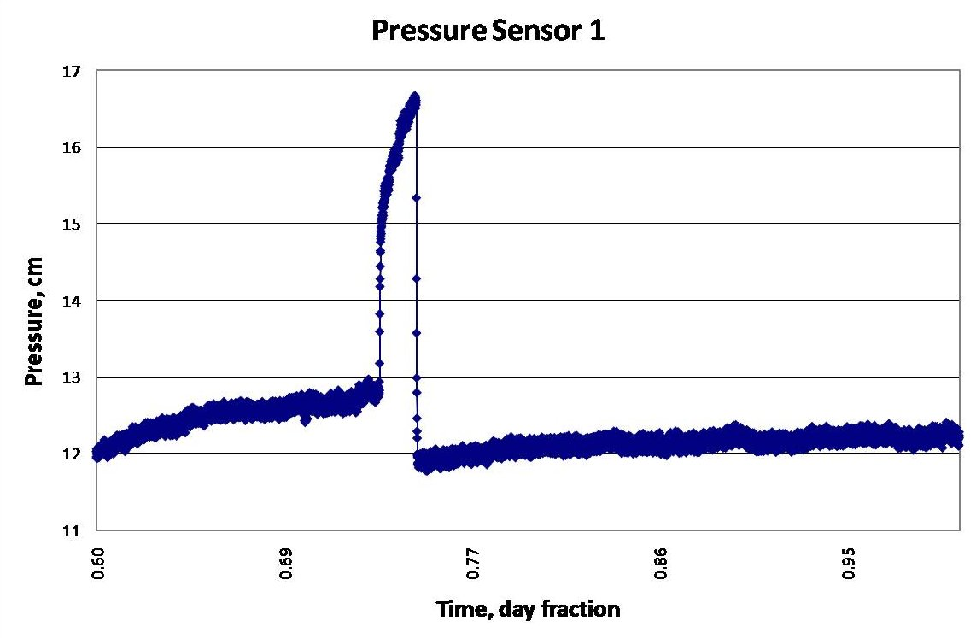
24-Hour Alum Experiment
Spike indicates the possible presence of a clog
Notes:
Dale

Slide 7
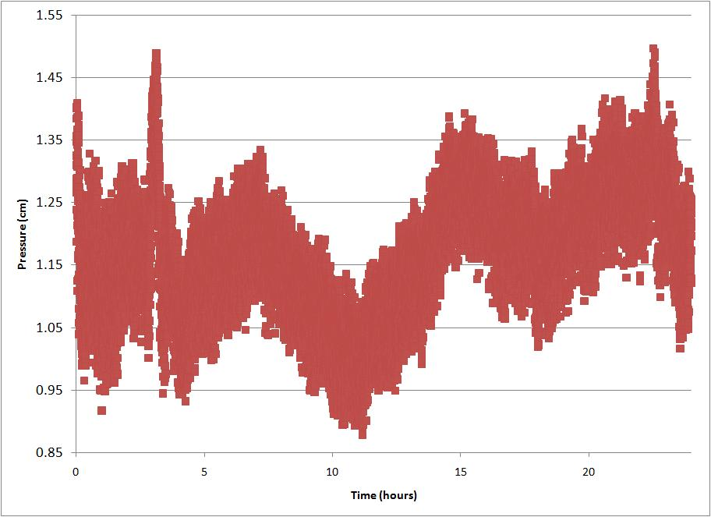
Alum Experiment #2
-Some inconclusive evidence for clogging, which makes it difficult to estimate the frequency of clogging.
Notes:
Dale

Slide 8
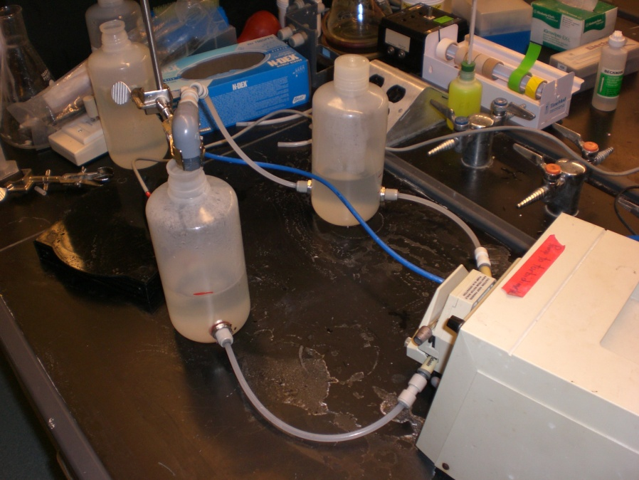
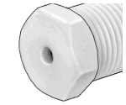
Clogging Experiment
Next Step
  Inconclusive evidence of a clog
  Change orifice size: 1.01, 2.28 mm diameter to 1.587, 3.175 mm
  Recommend lower dose of alum: 125 g/L to 51 g/L
  Stock tank will have to be refilled more often
Notes:
Dale

Slide 9
Recommend using the 25 Kg bag
Notes:
Dale

Slide 10
Orifice and Dual Scale Design
Top View
30 100
22.5 90
5 to 25, 2.5 mg/L
20 to 100, 10 mg/L
Target Dosage
2.471 … 12.353mL/s
.618 to 3.088mL/s
Alum Flow Needed
20 80
0.013 m … 0.313 m
17.5 70
15 60
Q=6.3L/s
Orifice Diameter
Size
Orifice1=3.175mm
Orifice2=1.5875mm
12.5 50
Orifice
10 40
Scale
What
We
Learned
7.5 30
5 20
PIVOT
PIVOT
Error from HL in Tube:
-Selected PVC as the tube material
-Make length as short as possible to 30-50cm
-Increased diameter to 9.525mm
Max error occurs at 10 mg/L – 5.5% w/ 50 cm, 1.3% w/30 cm
Notes:
Yoon

Slide 11
Float Calculation
L/2
X of Maximum Dosage
CONSTANT
HEAD
TANK
Slider
Assembly
Alum Tube
Dosing Tube
We calibrate the lever arm at maximum dosage.
We find the weight of the Float that gives us the
correct alum at maximum dosage.
FLOAT
Water Surface
Notes:
Yoon

Slide 12
Float Calculation
CW
L/2
X 8
CONSTANT
HEAD
TANK
Slider
Assembly
Slider
Assembly
Dosing Tube
Dosing Tube
FLOAT
Water Surface
Float Diameter=.102 to .152m
Float Height=.305m
Notes:
Yoon

Slide 13
Rapid Mix Tube Construction
Previous rapid mix tube design was completed and designed for the Agalteca plant
  General MathCAD design was also completed for future plant implementation
A full-scale model of the rapid mix tube was constructed to test the ease and feasibility of the constructed system
Small scale mixing orifice presented a unique materials problem
  Solution: Bucket Lid material

Slide 14
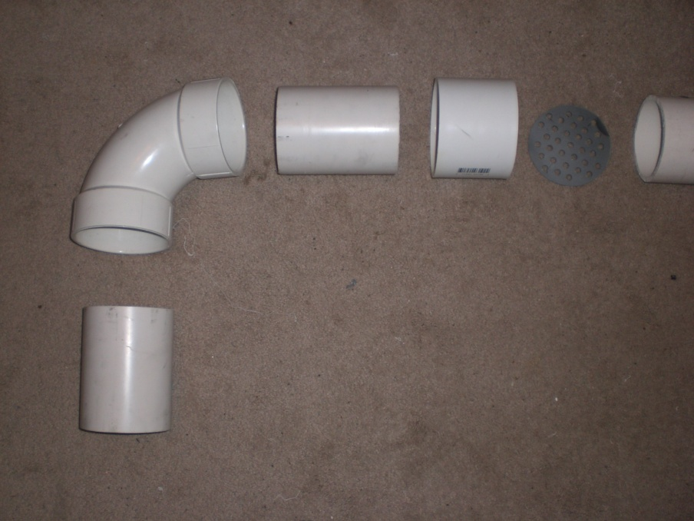
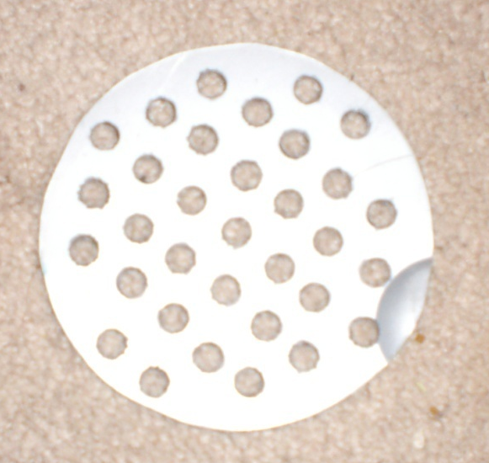
Rapid Mix Tube Future Experiments
Series of experiments proposed to test the necessity and effect of rapid mix on effluent water turbidity
  Alum Accumulation Tank
  Change current rapid mix system out for the new design
  Is inadequate rapid mix having an adverse effect on effluent turbidity?

Slide 15
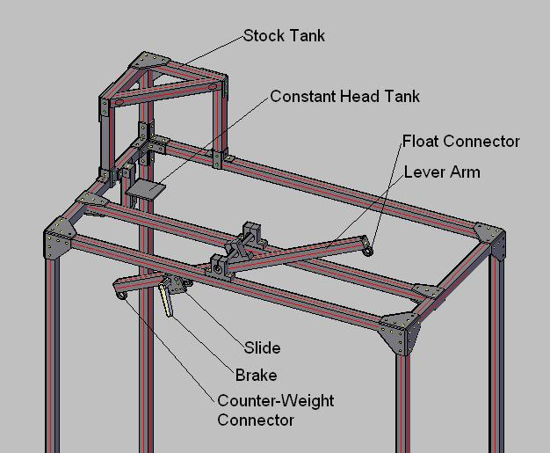
AutoCAD Drawing of Prototype
Notes:
Harri

Slide 16
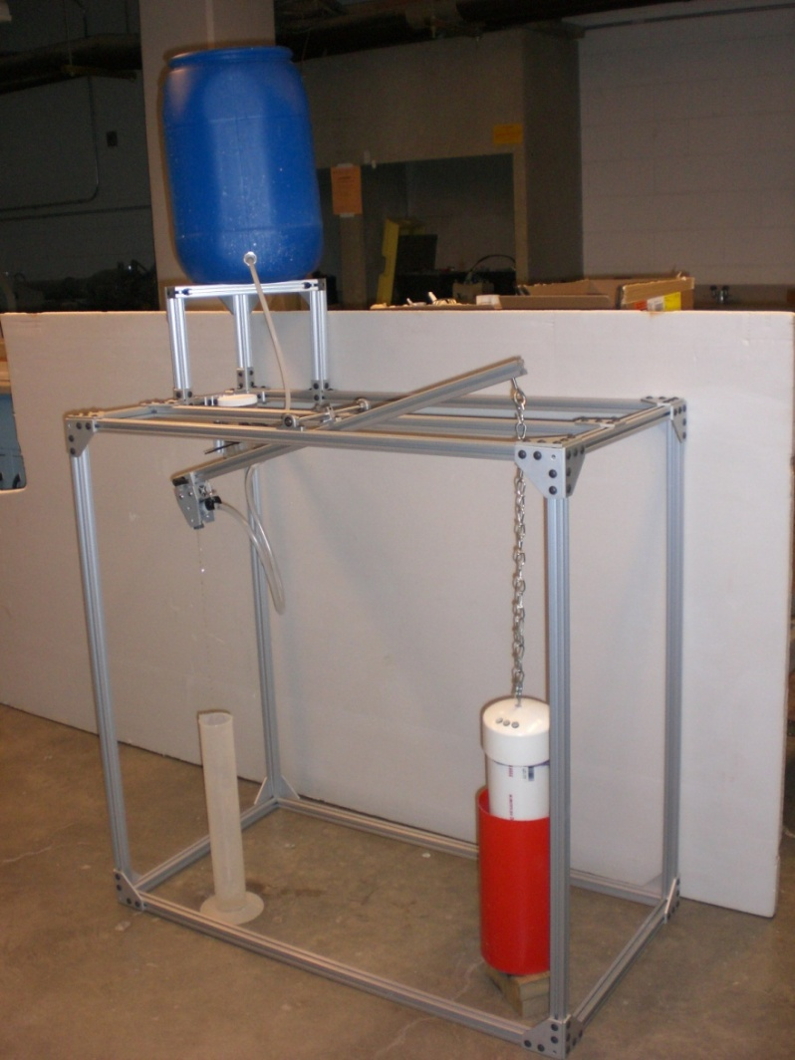
Assembled Doser with Hydraulic Components Attached
Notes:
Monica

Slide 17
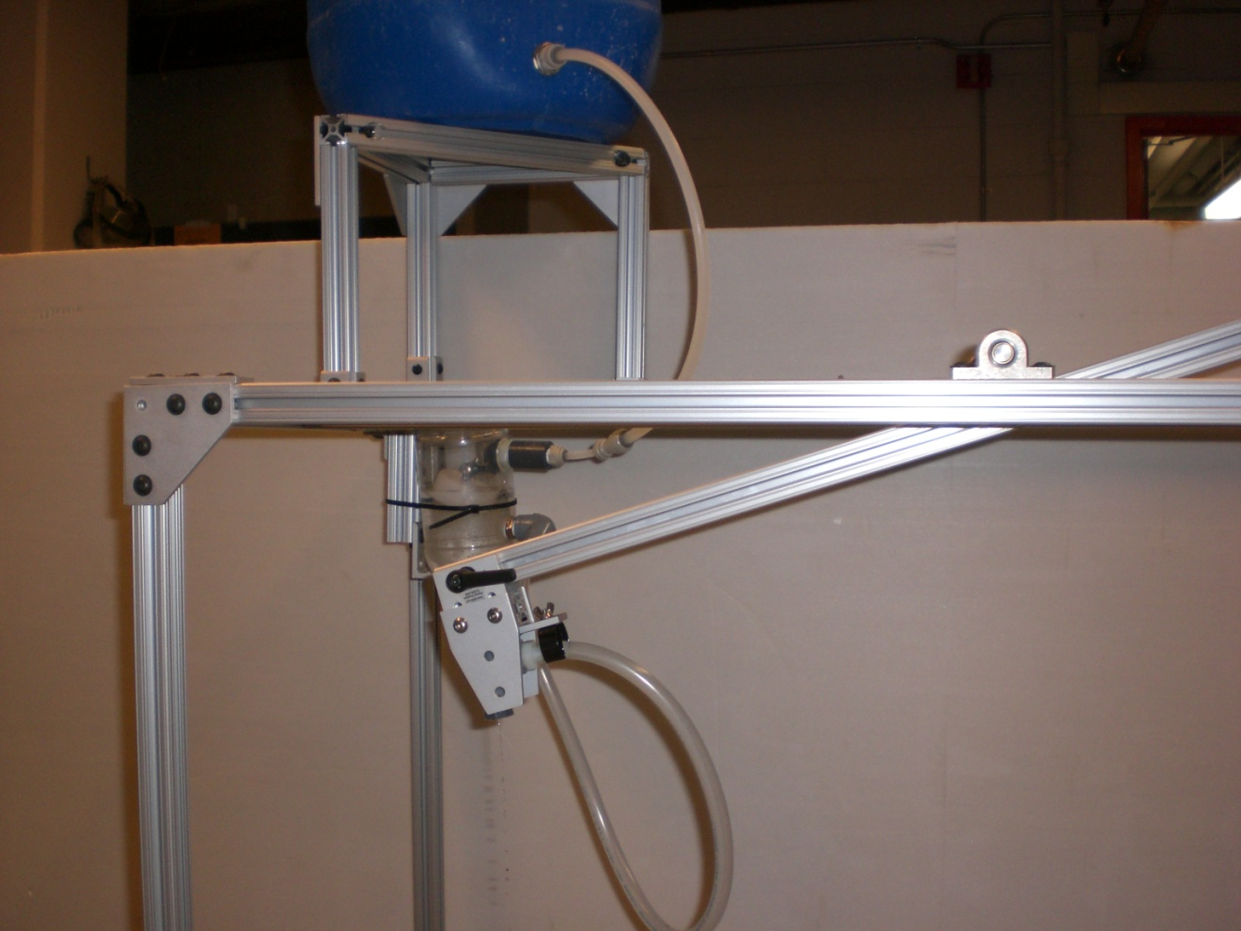
Close up of dosing orifice
Notes:
Monica

Slide 18


THE END
Notes:
Karen

