Slide 1
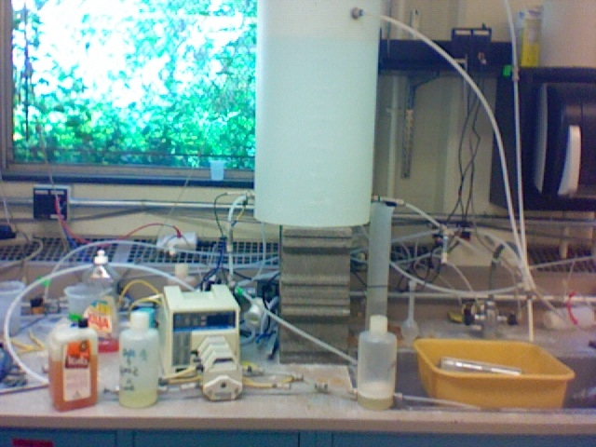
Setups
Water container
Pump
Soap
+
Water
Flow accumulator
Tank + incline plane
Dial Soap

