Slide 1
Solar Cooker - Water Distillation Team
Kevin Keene, Joanna Cherches, Dias Nurgazy,
Deanna Steers, Kristy Macias

Slide 2
Background
Original design based on existing distiller currently used in Nicaragua
Solar distiller used to purify water to sell to companies
Existing design used black paint to absorb sunlight, probable cause of bacteria growth
Made with steel frame, styrofoam insulation, and glass cover

Slide 3
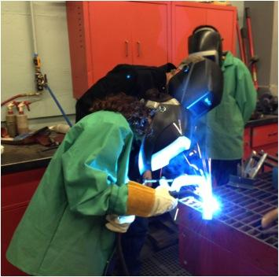
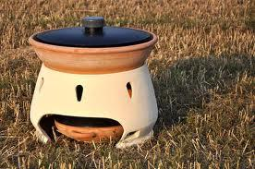
Original Goals
Finish building frame
  Add rubber seal
  door/hinges
  finish welding metal
  glue glass
  insulate
Build stand
  water input/output
  water collection
Testing
Eliodomestico

Slide 4
Problems and Issues
Change in our original cuts
  Angled supports
  Change from hinge to lift-off top design
Post-trip bacteria accumulation realization
  Paint chipping into water
Issues with rubber seal
Aluminum box sizing

Slide 5
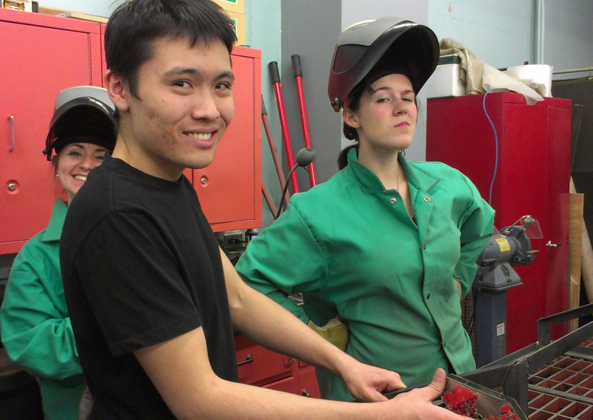
Construction

Slide 6
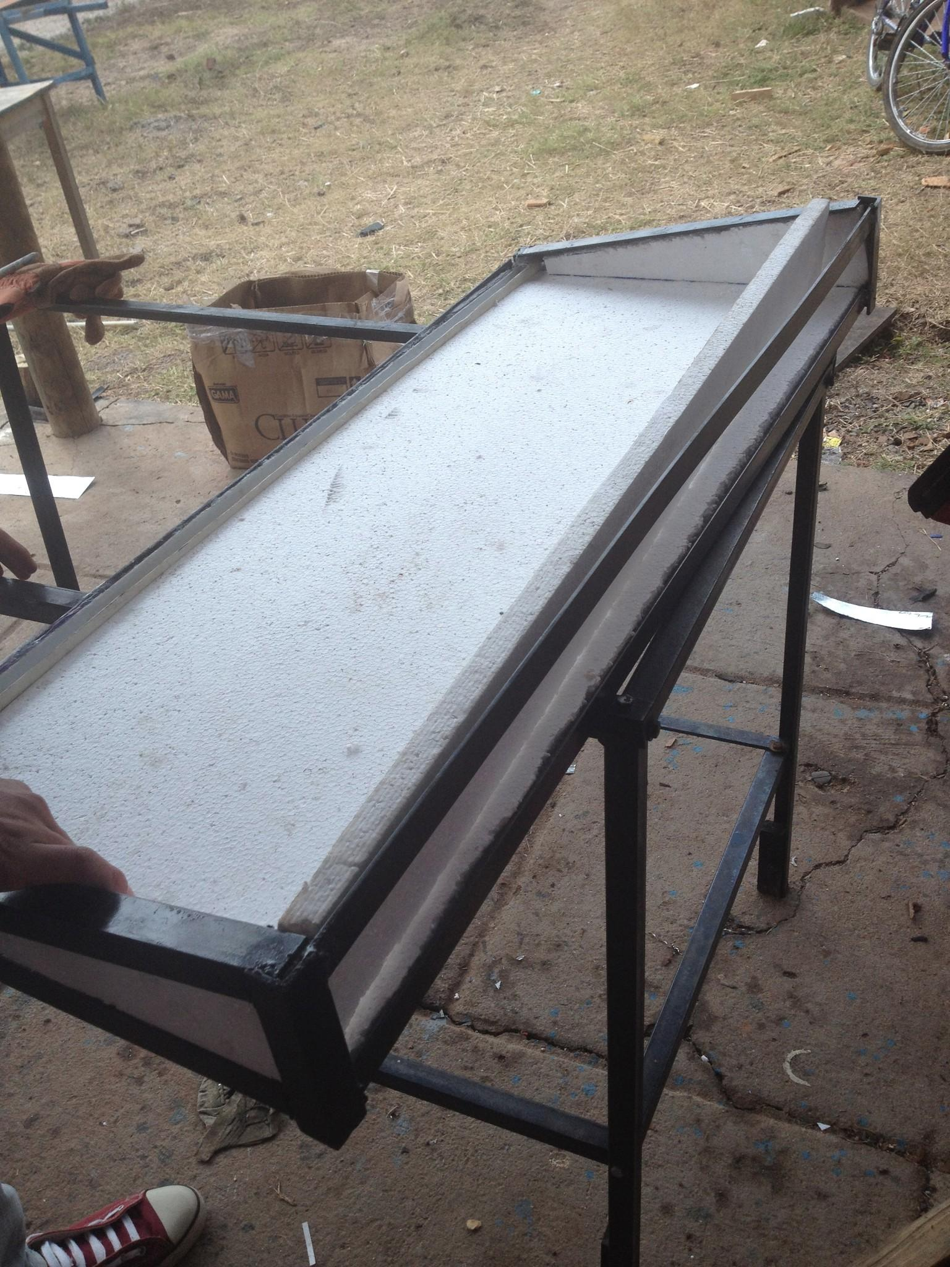
Accomplishments
Completed the construction of a
water still frame in the laboratory
Constructed a frame in Nicaragua for
testing purposes
Synthesized ideas to avoid paint corrosion as experienced in Nicaragua
Decided on ceramic tile for the base of the distiller
Tested the distiller to determine whether a ceramic tile base is efficient
Have the distiller set up and we are eager to test some more in the fall
frame completed in Nicaragua

Slide 7
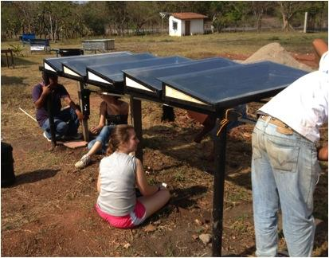
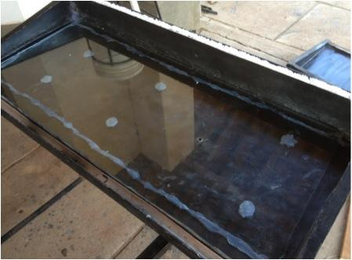
Future Goals/Improvements
Build system
  Water input/output
  Tubing/Frame structure
Testing
  Compare other designs
Eliodomestico Design

