Slide 1

Public Relations
Michelle Kim, Raquel Sghiatti, Maya Tellman, Mahina Wang

Slide 2
PR Mission
Manage any public relations with publications, awards, etc
On-campus fundraising → Corporate sponsorship
Maintain social media for AguaClara

Slide 3

Semester Goals
Secure corporate sponsorships
Apply for/obtain awards and grants
Increase transparency of PR team
Partner up with other student groups on campus

Slide 4
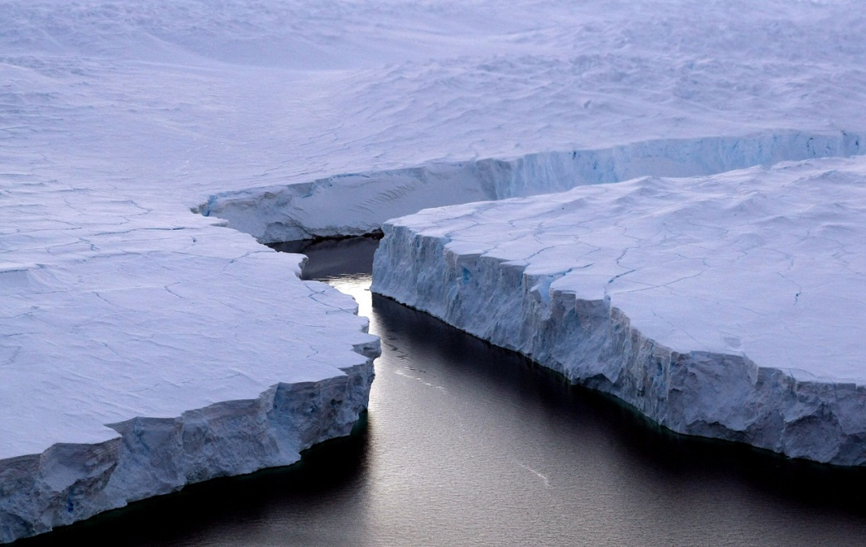
Icebreaker
Your name
Team
Year & major
How did you hear about AguaClara?

Slide 5
Publications
APP/AguaClara Brochure
Sponsorship

Slide 6
Awards
Cornell Venture Challenge
  Prestigious Business Plan Competition
  Submitted an executive summary
Reed Elsevier Environmental Challenge
  Demonstrate how to provide sustainable access to safe water where is is presently at risk
Odebrecht Award for Sustainability
  Technically exceptional work that pushes the boundaries
  Demonstrates holistic application of sustainability principles

Slide 7
Social Media
Wikipedia Page
  OLD versus NEW
Cuaguaclara.blogspot.com
  Check out recent posts about trips to Honduras/India
  If you have something to report, let us know!
  Examples: reports on sand filter, foam filter (P3)

Slide 8

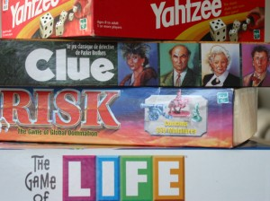
Events/Social
  Carnival Coming Up!
    When: March 30th @ WSH
    Hosted by the Global Health Student Council and benefits a nonprofit started by a current Cornellian:
    the AAvia Foundation provides healthcare for children in Bolivia
    For Every 20 Tickets we sell, AguaClara makes $50
  AguaClara End-of-year BBQ
    When: April 28th
  Game Night? AguaClara party?

Slide 9
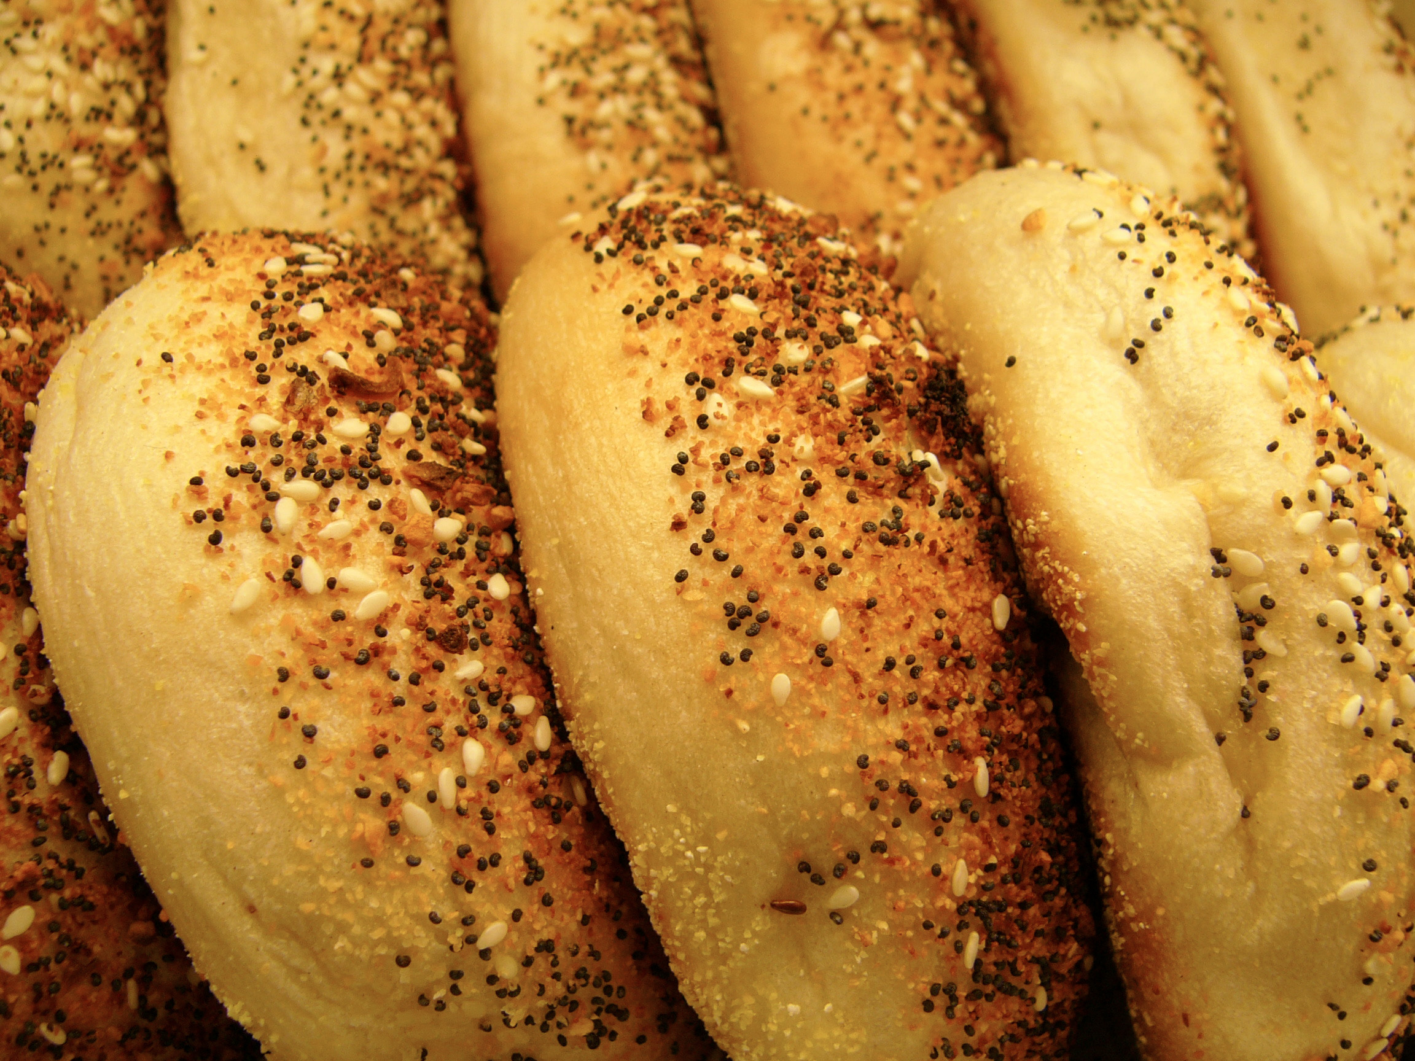

BAGEL TUESDAY TOMORROW

Slide 10
Comments? Questions?

