Slide 1
Public Relations
Erika Axe and Bridget Cheng

Slide 2
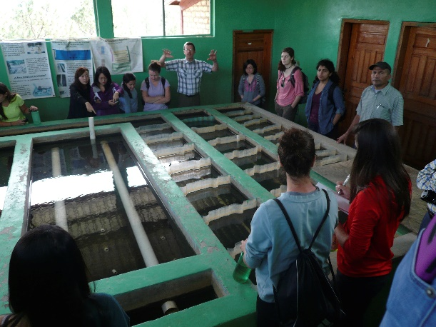
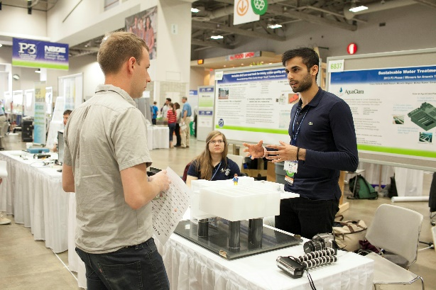
What We Do
Spreading the word: AguaClara!
Try to get new members for AguaClara
Inter-subteam Communication and Events
AguaClara Item Sales
General System Improvements
Competitions!
Notes:
The work that AguaClara is doing is not only impressive, but is making a genuine difference in the world. There should be recognition for that! Make our work well known to people. We want to make our presence on campus KNOWN
How did you hear about AguaClara? Why did you join AguaClara? When? For how long have you been on the team? Knowing this would help us to best understand where our new members are coming from
One of the other things Public Relations hopes to do is to connect the subteams together and encourage intercommunication on the team. With nearly 60 people, it’s hard to communicate with everyone, but we’d like to provide those opportunities!
We make sure there’s enough AguaClara swag to go around [do NOT say swag during the presentation], whether it’s t-shirts or quarterzips or stickers, we like to see everyone showing their team pride around campus! Have an idea? Make sure to let us know!
We know everyone on the team is very busy with the research and designing that they do, part of our job is to help make that easier for people. We try to look into ways to make the website easier to navigate and understand, we try to create some kind of system for funds, we try to make the little things in the team go more smoothly
The work we do is not only impressive on Cornell standards, but on national and global standards. We can show what we’ve got through competitions!

Slide 3
Semester Goals
Facebook Updates and Twitter Updates
Bagel Wednesdays
Information to Tour groups
Stickers vs T-Shirts for AguaClara
Future Information Event in Duffield
Create pamphlets for AguaClara to put in the Engineering Office In Hollister
Posters for Hollister/Campus Buildings
Video Competition: National Academy of Engineering (due 3/2)
Individual Subteams Competition: Odebrecht Award
Website Updates
Notes:
In the first couple weeks of the semester we sat and brainstormed ideas for what we’d like to accomplish or see done by the end of the year. The list of things to do eventually broke down into this list [read list outloud].

Slide 4
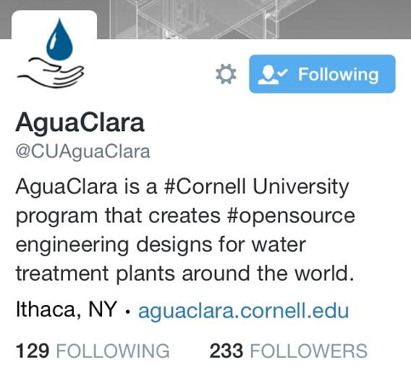
What We’ll Do…
To Spread the Word
Completed:
Facebook and Twitter Updates
Future:
Collaborate with other team members to create posters to hang around Hollister and the Engineering Quad
Contact magazines and newspapers to get articles written about our work

Slide 5
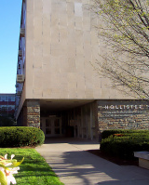
What We’ll Do…
To Try To Get New Members
Future:
Make sure tour guides have our information
Create plans to have a pamphlet for prefreshmen and new members available in the Engineering Office
Set up some kind of information event during in the Spring

Slide 6
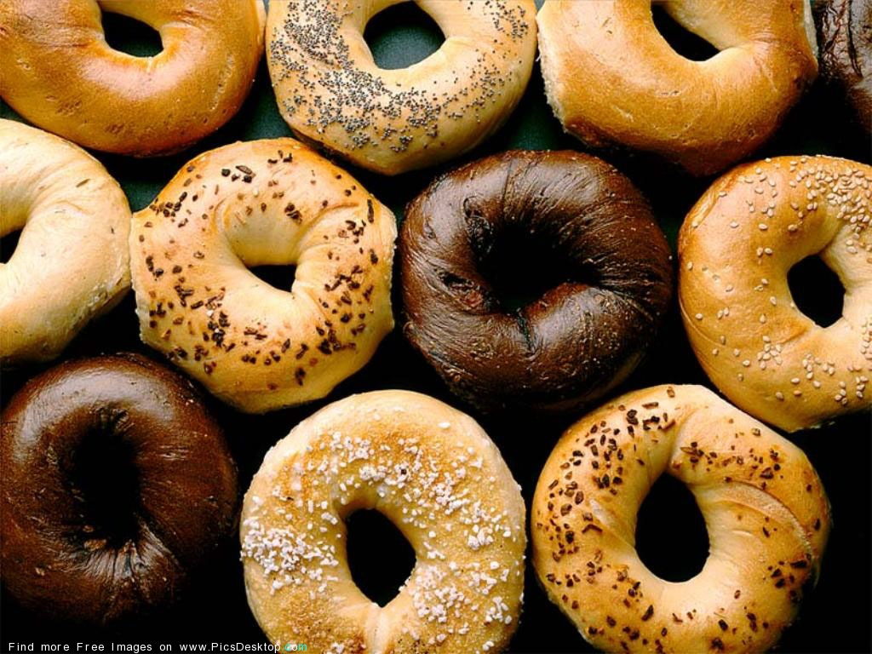
What We’ll Do…
To Connect Our Team
Completed:
Our first Bagel Wednesday of the Semester!
Future:
More Bagel Wednesdays
Organize a full team picture for this semester
Plan socialization events for future Fridays

Slide 7
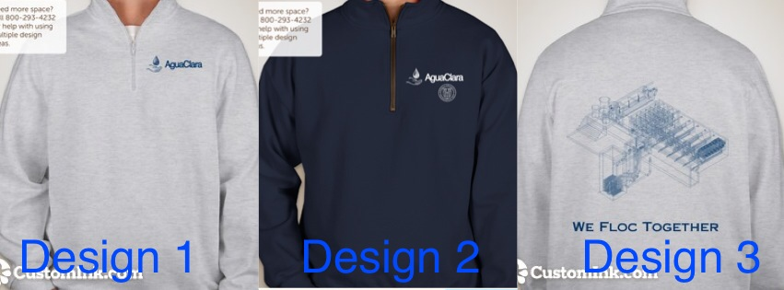
What We’ll Do…
With Item Sales
Completed:
Had a sale of old AguaClara merchandise from previous years
Future:
Create new designs for long-sleeve apparel and possible sticker sales

Slide 8
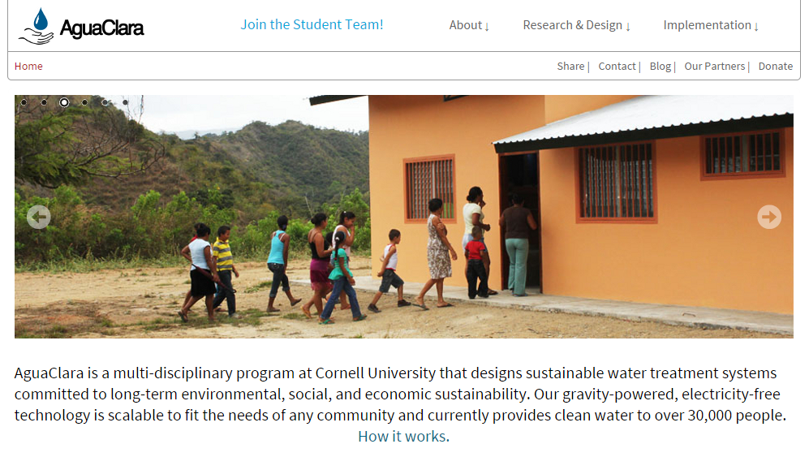
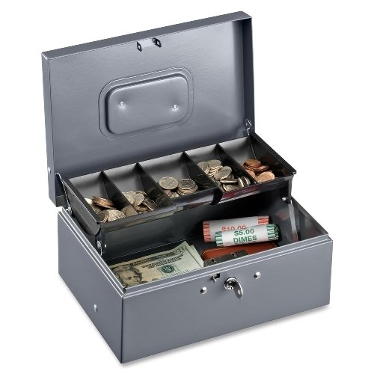
What We’ve Done…
With System Improvements
Future:
Create a set system or dealing with the money that AguaClara has
Website Updates

Slide 9
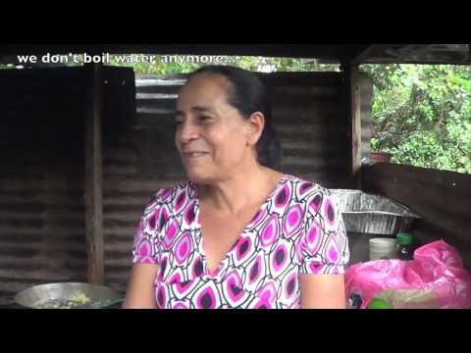
What We’ve Done…
With Competitions
Completed:
Video Competition: National Academy of Engineering (due 3/2)
Future:
Individual Subteams Competition: Odebrecht Award

Slide 10

Public Relations…
Looking Forward
We would love to hear any ideas from people on the team to work on either this semester or in the future!
Please contact either Erika (ena7@cornell.edu) or Bridget (bjc267@cornell.edu)

