Slide 1
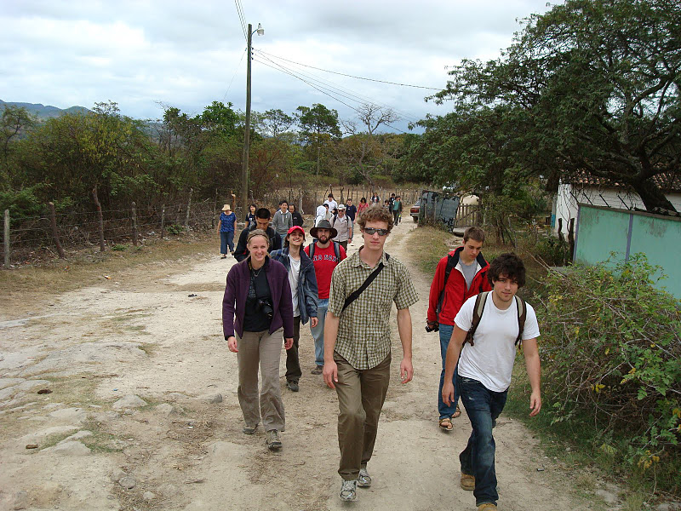
AguaClara PreTrip Meeting
Fall 2011

Slide 2
Agenda
Introductions
Health
and Safety
Personal budgets
Reflections on traveling in a group
Tasks
Packing List
Itinerary
Objectives

Slide 3
Introductions
Name
How long you’ve been on the AguaClara team
One brief goal for the Honduras trip
Notes:
Comment on reading through what they wrote when applying for the trip. Incredible wealth of knowledge and experience. Iit is a total pleasure to be meeting with a group of students who don’t see a conflict of interest between making the world a better place and furthering your education!

Slide 4
Health
Travel Clinic
Malaria and Dengue
Water and Food borne pathogens

Slide 5

Malaria and Dengue Risk
Malaria risk area in Honduras: Risk throughout the country at altitudes below 1000 m (<3,281 ft).
  Copan 600 m
  Atima 725 m
  Siguatepeque 1080 m
  Tamara 1080 m
  Cuatro Comunidades 10?? M
  El Paraiso 811 m
  Alauca ?
  Marcala 1250 m
Dengue 14,600 cases this year (16 fatalities in 2011 per 6.5 million)
Notes:
http://www.doctorswithoutborders.org/news/article.cfm?id=4706&cat=field-news

Slide 6
Travelers' diarrhea
Travelers' diarrhea (TD) is the most common illness affecting travelers. Each year between 20%-50% of international travelers, an estimated 10 million persons, develop diarrhea.
The onset of TD usually occurs within the first week of travel but may occur at any time while traveling, and even after returning home.
High-risk destinations are the developing countries of Latin America, Africa, the Middle East, and Asia.
The primary source of infection is ingestion of fecally contaminated food or water.
Notes:
http://www.cdc.gov/ncidod/dbmd/diseaseinfo/travelersdiarrhea_g.htm

Slide 7
The Bad Guys
Infectious agents are the primary cause of TD. Bacterial enteropathogens cause approximately 80% of TD cases.
The most common causative agent isolated in countries surveyed has been enterotoxigenic Escherichia coli (ETEC).
ETEC produce watery diarrhea with associated cramps and low-grade or no fever.
Besides ETEC and other bacterial pathogens, a variety of viral and parasitic enteric pathogens also are potential causative agents.
Notes:
http://www.cdc.gov/ncidod/dbmd/diseaseinfo/travelersdiarrhea_g.htm

Slide 8
Travelers' diarrhea Prevention
Avoid eating foods or drinking beverages purchased from street vendors or other establishments where unhygienic conditions are present. Avoid eating raw or undercooked meat and seafood. Avoid eating raw fruits (e.g., oranges, bananas, avocados) and vegetables unless the traveler peels them.
If handled properly well-cooked and packaged foods usually are safe. Non-AguaClara-tap water, ice, unpasteurized milk, and dairy products are associated with increased risk for TD. Safe beverages include bottled carbonated beverages, hot tea or coffee, and AguaClara.
Notes:
http://www.cdc.gov/ncidod/dbmd/diseaseinfo/travelersdiarrhea_g.htm

Slide 9
Hygiene
WASH YOUR HANDS before you touch and food – bring personal bottles of hand sanitizer
Use a water bottle with a sanitary cover
Dust is everywhere and it has been everywhere

Slide 10
Personal Safety
Petty theft - Do not resist a robbery attempt. Most criminals have weapons, and most injuries and deaths have resulted when victims have resisted
Personal protective equipment –
  Closed footwear
  Long pants
  Eye protection anytime we are using hand tools
Emergency plans – will provide contact info
Notes:
http://www.usaid.gov/locations/latin_america_caribbean/democracy/honduras_profile.pdf

Slide 11
Gangs – US exported and sponsored Violence
The current level of youth violence in Honduras is among the worst in Central America.
The gang phenomenon is considered by many as one of the biggest problems affecting Honduras. According to police statistics, at the end of 2003, there were 36,000 gang members in Honduras.
MS-13 became prominent in Honduras in 1989; 18th Street became prominent in 1993.
These two gangs are now well entrenched, particularly in Tegucigalpa and San Pedro Sula, where they are responsible for many crimes.
Notes:
http://www.usaid.gov/locations/latin_america_caribbean/democracy/honduras_profile.pdf

Slide 12
Gangs
In 1992, the United States Immigration and Naturalization Service (INS) began to deport these youths in earnest. As one INS official explained, “If a gang member is out on the street and the police can’t make a charge, we will go out and deport them for being here illegally if they fit that criteria.”
Many people who work with gangs cite 1995 as a year of massive deportations of gang members to Honduras. Deportees who returned to Honduras were instrumental in the proliferation of the two dominant gangs there.
Notes:
http://www.usaid.gov/locations/latin_america_caribbean/democracy/honduras_profile.pdf

Slide 13
How many guns?
The proliferation of weapons, many left over from the conflicts of the 1980s in Central America, has contributed to the gang violence.
During the 1990s, it became possible to buy an AK-47 for very little money.
The Honduran Attorney General’s Office declared in the mid 1990s, that there were 67,000 AK-47s in circulation
1 person in 100 could have an AK-47
Notes:
http://www.usaid.gov/locations/latin_america_caribbean/democracy/honduras_profile.pdf

Slide 14
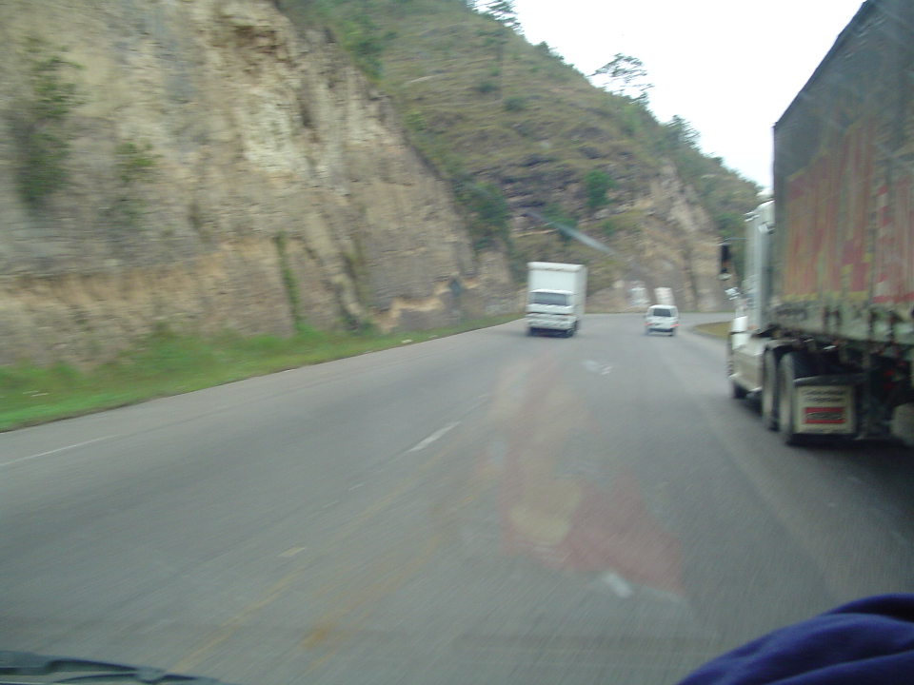
How many Homicides?
Notes:
http://www.nisat.org/publications/Honduras/Honduras-%20Violence%20in%20Numbers.doc
http://www.disastercenter.com/crime/uscrime.htm for us crime statistics
58 murders for every 100,000 inhabitants in 2008 (http://www.unhcr.org/refworld/country,,,QUERYRESPONSE,HND,,4b8631d919,0.html0
77/100,000 in 2009

Slide 15
Risk Factors
60% of homicides in Honduras occurred on weekends between 9 pm and midnight with 91.7 % of victims being men.
Alcohol, guns, nighttime, and men make a bad combination
Avoid mixtures!!!
Notes:
http://www.marrder.com/htw/travel.htm
Monday, July 17, 2006 Online Edition 26

Slide 16
HIV AIDS
Honduras has highest rate of HIV AIDS in Central America
28,000 people living with HIV/AIDS (0.7% of the population).
1800 deaths in 2007

Slide 17
Recommendations for Personal Safety
Travel in small groups rather than alone
Don’t display wealth
Don’t resist robbery
Learn what places to avoid from our hosts
We will give our hosts an opportunity to provide more guidance for us early in the trip
Make sure that the “team head counters” always know where you are

Slide 18
Unwanted Attention: Advice column from Roslyn Odum
CLOTHING: Most of the time, but especially in the cities, I would wear extremely modest and sort of unattractive clothing. As a woman, you will get attention regardless, and as a gringo, you really don't want to look like you've got money. Buy a cheap watch if you wear one, don't do the jewelry thing, and don't wear short shorts or tight pants (ha! I always found it funny that the Honduran women would wear such revealing clothing while I was working on the polar opposite)... common sense is to draw as little attention as possible. Be smart about where you keep your money, don't flash around American dollars, don't carry loose purses, travel with a compañero...

Slide 19
Personal budgets
Lempira! Stable exchange rate of 19 L/US$
Food 225 L/day
Total for food 3375L or $175
Tourist activities $40-80 (some might be payable in $)
Suggest that you convert $200 into Lempira at the SPS airport or use the ATM machine there to get Lempira
Exit fee of approximately $37.5 (can be paid in Lempira and/or in USD)

Slide 20
Group Tools
We are about to embark on an intensive 2 week long cross cultural experience
We will be sharing hotel rooms and living with Honduran families
In addition to the issues of health and safety, we need to figure out how to live together and enjoy it!

Slide 21
Traveling as a Team
Form groups of 3 and come up with
  2 reasons why there are different expectations when traveling as a team (rather than as an individual)
  1 behavior or action that should be avoided
  3 behaviors, actions, or attitudes that you think would help make this a healthy (and fun) experience for everyone

Slide 22
Team Awareness
The behavior that is required of you on this trip is not the same as if you were traveling on your own.
You are traveling with a group and it is essential that you keep the group needs in mind at all times.
You can not make decisions as if you are the only person on the trip.
You must be mindful of how your decisions affect the team and make sure that your decisions are respectful of the other team members and helpful for the safety and performance of the team.

Slide 23
Alcohol
Alcohol is an expensive, unhealthy drink that is the source of an incredible amount of suffering.
There is a significant population of Hondurans who view alcohol as a drug (alcohol has a much more negative connotation among many Hondurans than smoking has here).
My strong preference is that we all stick to non alcoholic drinks while we are on this trip. (This is after all, AguaClara!)
Bottled and AguaClara water will be available and are safer to drink than alcoholic beverages.
Consumption of alcohol outside of the evening meal is prohibited (see contract).

Slide 24
Reporting in
Before you leave the team for any purpose, tell at least 1 of the team head counters where you are going and where and when you plan to meet up with the team again
If you walk off without telling others in the team where you are going and when you are returning the team will be forced to try to locate you
Walk the streets in groups of at least 2

Slide 25
Punctuality
Take responsibility for knowing the team schedule and ensuring that you are ready to participate fully.
Use an alarm clock.
Organize your time so you are ready a few minutes before the planned times for scheduled events.
Be creative with “wait time” activities
You will be more relaxed and you will be showing your respect for the entire team.
Quick math Quiz: If you show up 5 minutes late for a meeting how much team time have you wasted?

Slide 26
Tasks
Head counter(s)
Time keeper
Accountant for non Cornell Expenses
  Collect money for meals and tourist activities
We will ask for menu organizers as needed
Engineering Activities…
  Dose Controller update
  SRSF evaluation
  Sed tank geometry upgrade
Journaling – come prepared to write to deepen your experience
What are our goals?

Slide 27
Packing List
Carry on bag (ONLY!!!!)
Small is beautiful
Need a couple of volunteers to have a checked bag to take everyone’s checked items
We will check engineering supplies
See https://confluence.cornell.edu/display/AGUACLARA/Packing+tips
We can leave our winter gear on the bus

Slide 28
Trip info
See https://confluence.cornell.edu/display/AGUACLARA/Team+Trips for lots of trip info
US Cell phones – don’t work in Honduras unless you have a special international plan
Honduran cell phones are cheap and could be shared by the students.
Trip leaders will carry Honduran cell phones that can be borrowed.

Slide 29
Flight and Transport Details
Leave Hollister Hall Loading Dock at 7:30 pm on January 6 (Ithaca Airport Limo)
Leave JFK at 02:45 am on January 7 (TACA)
Arrive SAP at 6:25 am
Depart from SAP at 9:39 pm on January 20
Arrive JFK at 02:49 am on January 21
Arrive Ithaca at 8:30 am

Slide 30
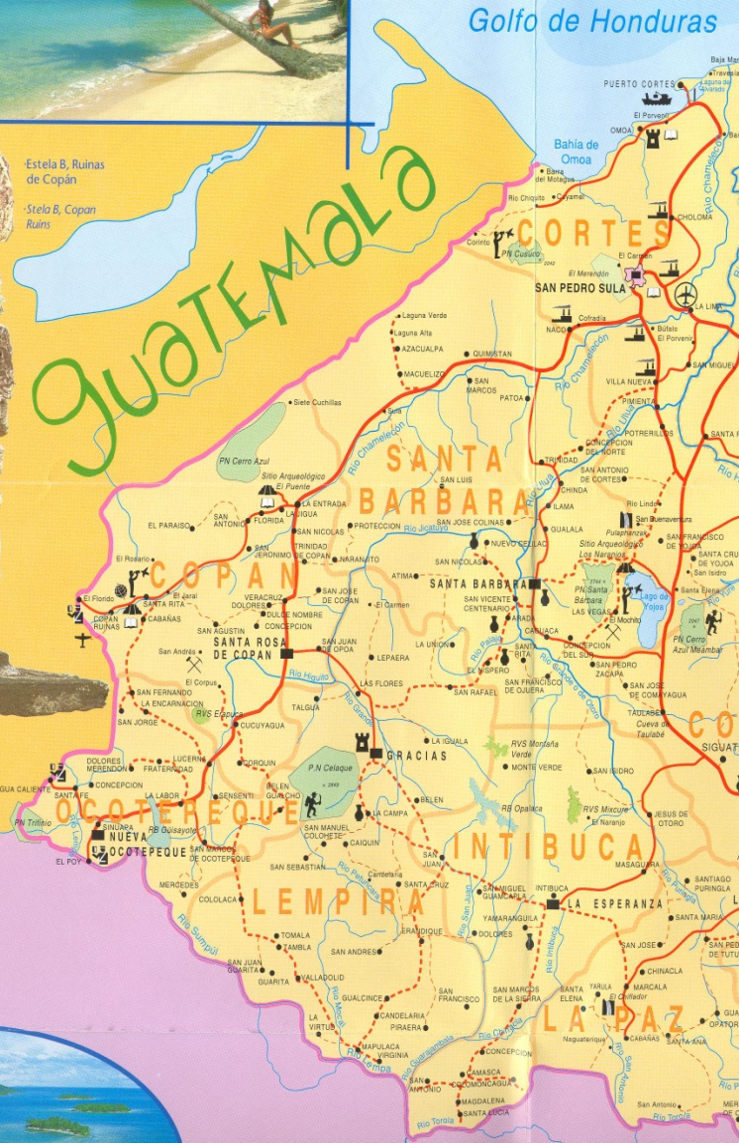
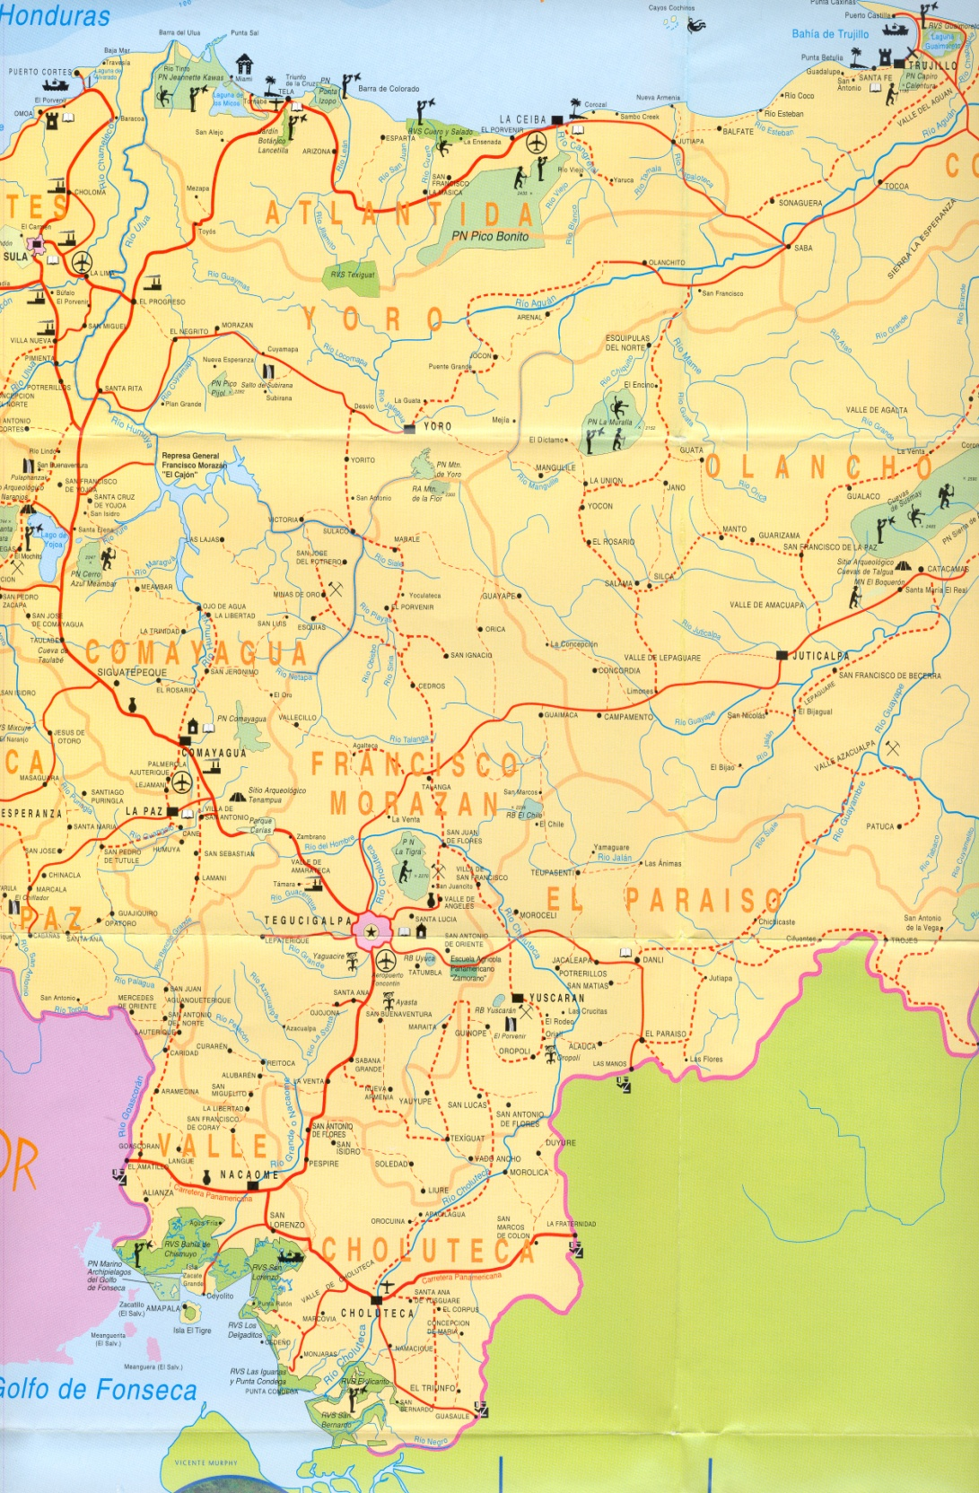
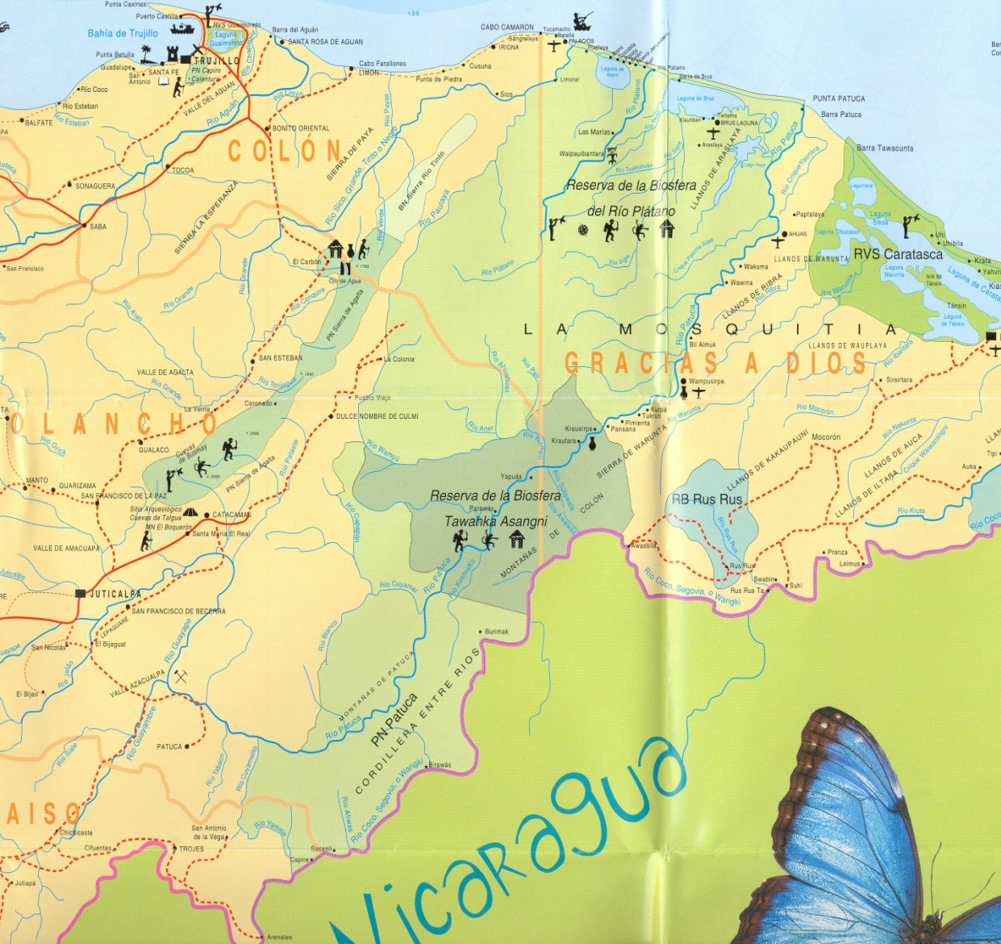
Copan Ruinas
Atima
San Nicolas
Siguatepeque
Tamara/Cuatro Comunidades/Ojojona
Valle de Angeles
Paraiso (Danli and Alauca)
Zamorano
Marcala

Slide 31
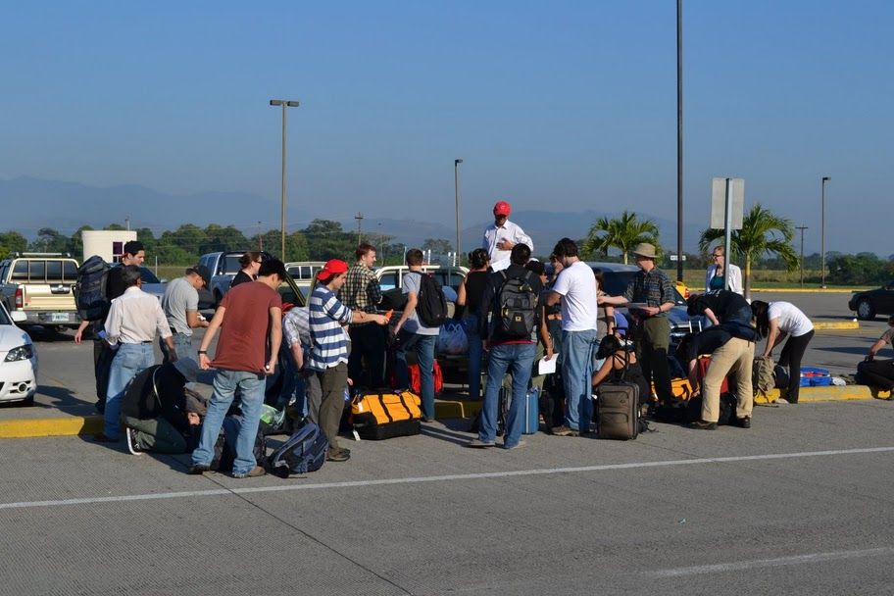

Slide 32
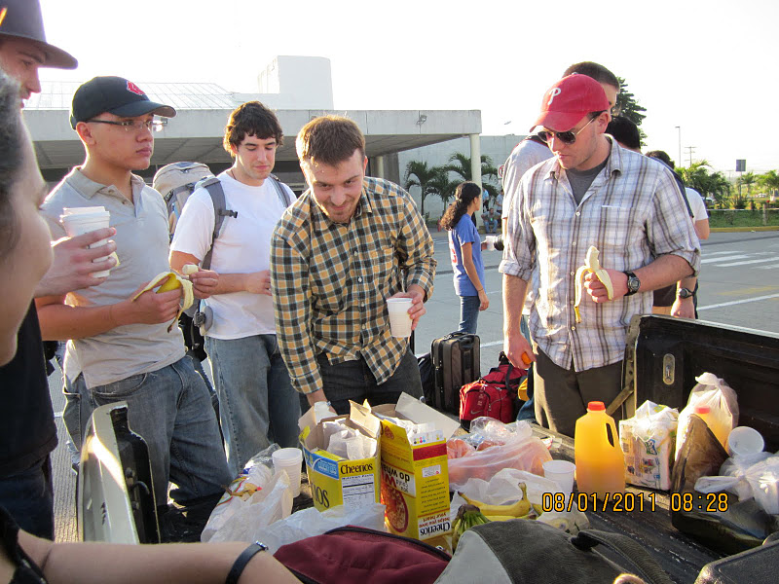

Slide 33
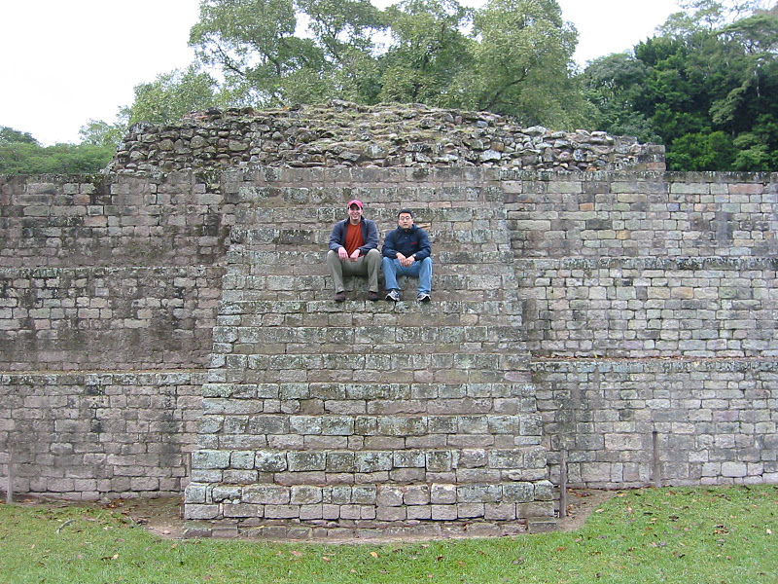
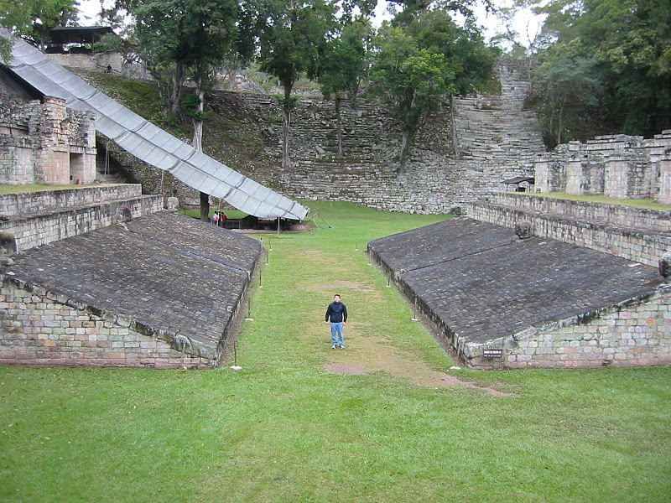

Slide 34
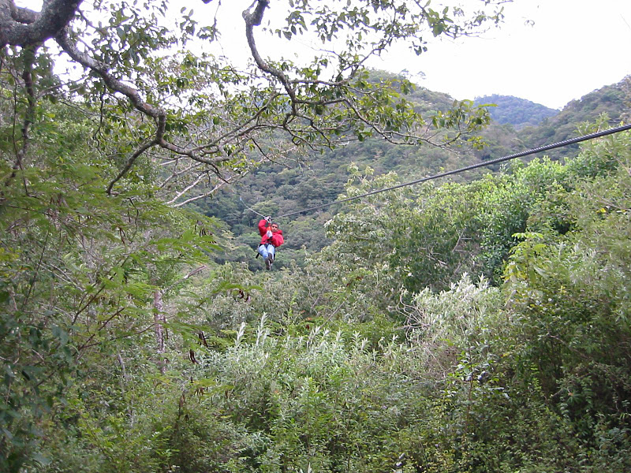
Travelers should be warned that in addition to the inherent risk of injury and death in these activities, there is little or no oversight of safety standards for adventure sports operators in Honduras.

Slide 35
Safety standards
(Honduras has gravity issues)
Missing manhole covers
Uneven (3 ft drop) sidewalks
Construction sites
Steep hillsides
  75% of Honduras is steeper than 35%
  falling out of a field is a real possibility
ALWAYS look where you are going!

Slide 36
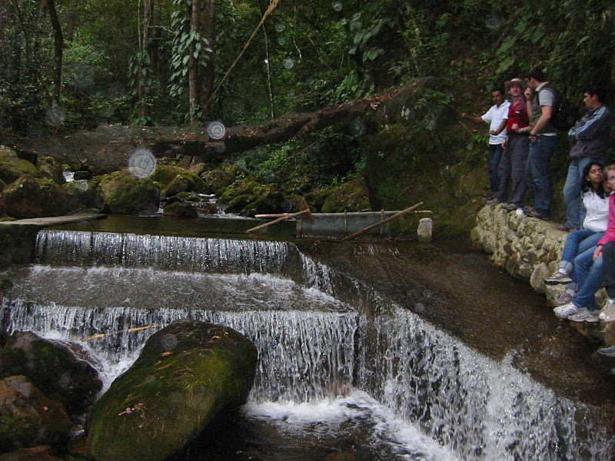
Footwear

Slide 37
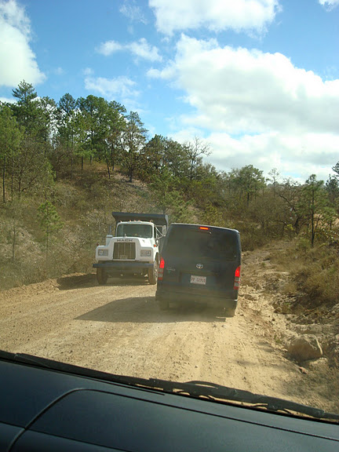
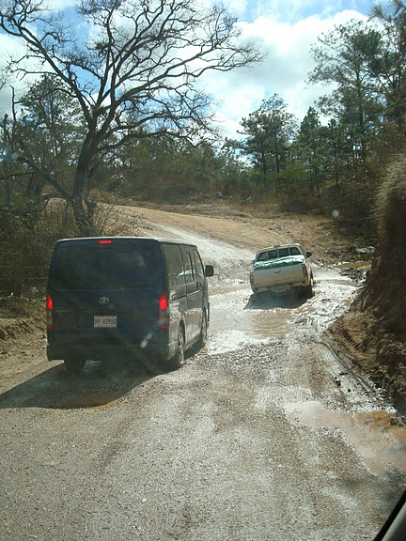

Slide 38
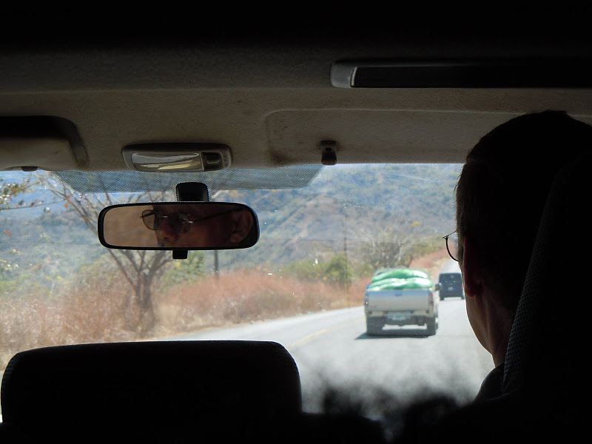
Motion Sickness

Slide 39
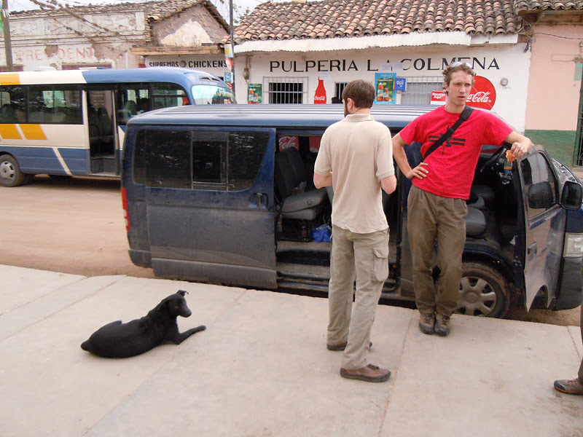

Slide 40
Gratitude
Gifts for host families for home stays in
  Atima
  Tamara
Household tools (kitchen items)
Toys for children

Slide 41
Trip Objectives
Cultural experience
Learn to know a few Hondurans
AguaClara program goals
  Improve our designs, reduce costs, feedback
  Develop relationships with APP staff
  Really see (eyes that understand what is beneath the surface)
  Reflect on why, why not, now what

