Slide 1
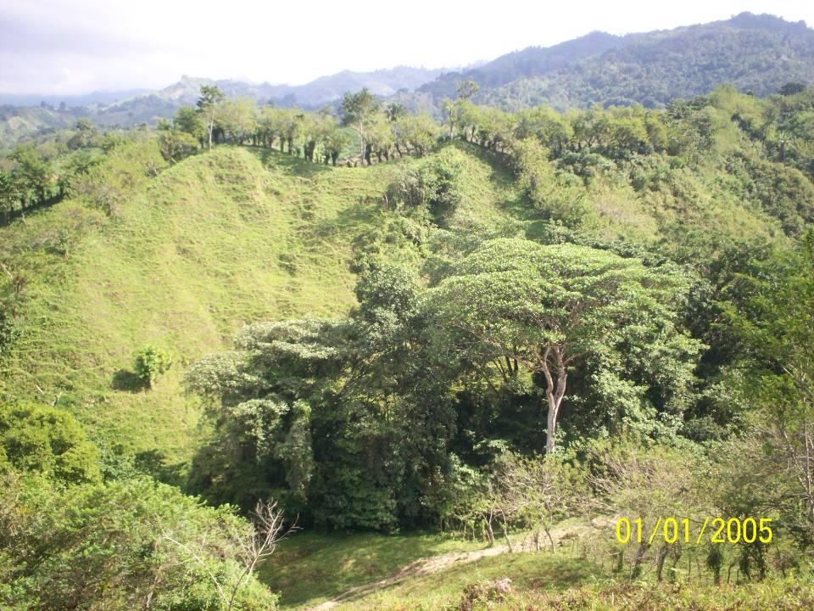
AguaClara PreTrip Meeting
Fall 2010

Slide 2
Agenda
Introductions
Health
and Safety
Personal budgets
Reflections on traveling in a group
Tasks
Packing List
Itinerary
Fundraising and pledges

Slide 3
Introductions
First, kudos…
Name
How long you’ve been on the AguaClara team
One brief goal for the Honduras trip
Notes:
Comment on reading through what they wrote when applying for the trip. Incredible wealth of knowledge and experience. Iit is a total pleasure to be meeting with a group of students who don’t see a conflict of interest between making the world a better place and furthering your education!

Slide 4
Health
Travel Clinic
Malaria and Dengue
Water and Food borne pathogens

Slide 5

Malaria and Dengue Risk
Malaria risk area in Honduras: Risk throughout the country at altitudes below 1000 m (<3,281 ft) and in Roatán and other Bay Island. Risk exists in the outskirts of Tegucigalpa and San Pedro Sula.
  La Ceiba (on the coast)
  Gracias 800 m
  Agalteca 740 m
  Atima 725 m
  Siguatepeque 1080 m
  Tamara 1080 m
  Cuatro Comunidades 10?? m
  Marcala 1250 m
Dengue 50,000 cases this year (160 fatalities per 6.5 million)

Slide 6
Travelers' diarrhea
Travelers' diarrhea (TD) is the most common illness affecting travelers. Each year between 20%-50% of international travelers, an estimated 10 million persons, develop diarrhea.
The onset of TD usually occurs within the first week of travel but may occur at any time while traveling, and even after returning home.
High-risk destinations are the developing countries of Latin America, Africa, the Middle East, and Asia.
The primary source of infection is ingestion of fecally contaminated food or water.
Notes:
http://www.cdc.gov/ncidod/dbmd/diseaseinfo/travelersdiarrhea_g.htm

Slide 7
The Bad Guys
Infectious agents are the primary cause of TD. Bacterial enteropathogens cause approximately 80% of TD cases.
The most common causative agent isolated in countries surveyed has been enterotoxigenic Escherichia coli (ETEC).
ETEC produce watery diarrhea with associated cramps and low-grade or no fever.
Besides ETEC and other bacterial pathogens, a variety of viral and parasitic enteric pathogens also are potential causative agents.
Notes:
http://www.cdc.gov/ncidod/dbmd/diseaseinfo/travelersdiarrhea_g.htm

Slide 8
Travelers' diarrhea Prevention
Avoid eating foods or drinking beverages purchased from street vendors or other establishments where unhygienic conditions are present. Avoid eating raw or undercooked meat and seafood. Avoid eating raw fruits (e.g., oranges, bananas, avocados) and vegetables unless the traveler peels them.
If handled properly well-cooked and packaged foods usually are safe. Tap water, ice, unpasteurized milk, and dairy products are associated with increased risk for TD. Safe beverages include bottled carbonated beverages, hot tea or coffee, and water boiled or appropriately treated with iodine or chlorine.
Notes:
http://www.cdc.gov/ncidod/dbmd/diseaseinfo/travelersdiarrhea_g.htm

Slide 9
Hygiene
WASH YOUR HANDS – we will bring personal bottles of hand sanitizer
Use a water bottle with a sanitary cover

Slide 10
Personal Safety
Gangs
Petty theft
Unwanted attention
Notes:
http://www.usaid.gov/locations/latin_america_caribbean/democracy/honduras_profile.pdf

Slide 11
Gangs – US exported Violence
The current level of youth violence in Honduras is among the worst in Central America.
The gang phenomenon is considered by many as one of the biggest problems affecting Honduras. According to police statistics, at the end of 2003, there were 36,000 gang members in Honduras.
4 Gangs established themselves in Tegucigalpa in the 1980s. MS-13 became prominent in Honduras in 1989; 18th Street became prominent in 1993.
These two gangs are now well entrenched, particularly in Tegucigalpa and San Pedro Sula, where they are responsible for many crimes.
Notes:
http://www.usaid.gov/locations/latin_america_caribbean/democracy/honduras_profile.pdf

Slide 12
Gangs
In 1992, the United States Immigration and Naturalization Service (INS) began to deport these youths in earnest. As one INS official explained, “If a gang member is out on the street and the police can’t make a charge, we will go out and deport them for being here illegally if they fit that criteria.”
Many people who work with gangs cite 1995 as a year of massive deportations of gang members to Honduras. Deportees who returned to Honduras were instrumental in the proliferation of the two dominant gangs there.
At the outset of 1995, there was a significant assimilation of small-scale street gangs into the MS-13 and 18th Street gangs in Honduras.
Notes:
http://www.usaid.gov/locations/latin_america_caribbean/democracy/honduras_profile.pdf

Slide 13
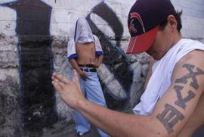
How many gang members?
Based on interviews, a USAID field team estimated that the number of gang members in 2006 in Honduras to be between 5,000 to 70,000.
Honduras population is 7,300,000
So somewhere between 1/1000 and 1/100 Hondurans are gang members
Notes:
http://www.usaid.gov/locations/latin_america_caribbean/democracy/honduras_profile.pdf

Slide 14
How many guns?
The proliferation of weapons, many left over from the conflicts of the 1980s in Central America, has contributed to the gang violence.
During the 1990s, it became possible to buy an AK-47 for very little money.
The Honduran Attorney General’s Office declared in the mid 1990s, that there were 67,000 AK-47s in circulation
1 person in 100 could have an AK-47
Notes:
http://www.usaid.gov/locations/latin_america_caribbean/democracy/honduras_profile.pdf

Slide 15
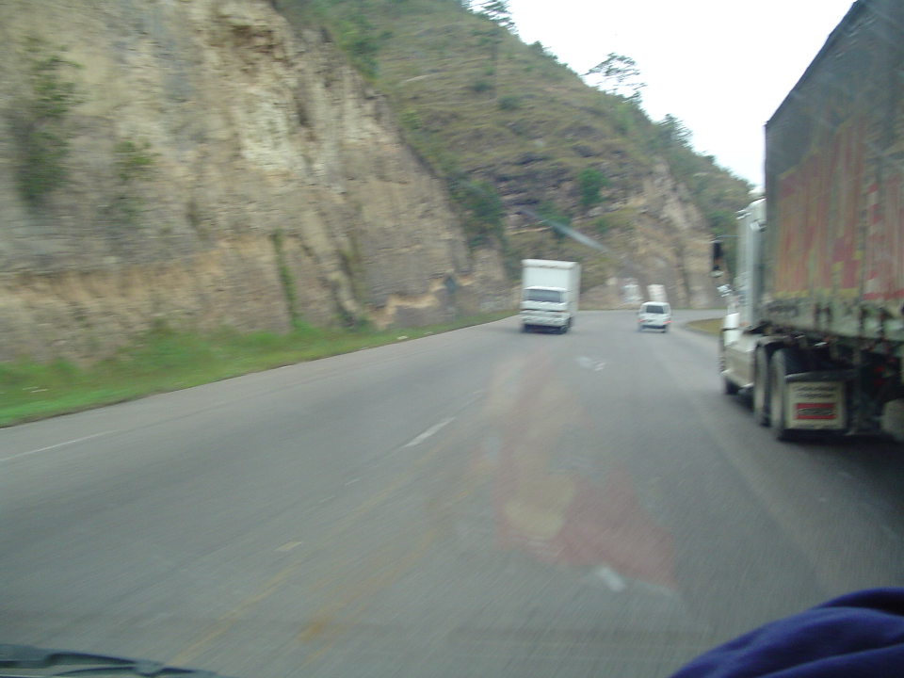
How many Homicides?
Notes:
http://www.nisat.org/publications/Honduras/Honduras-%20Violence%20in%20Numbers.doc
http://www.disastercenter.com/crime/uscrime.htm for us crime statistics

Slide 16
Risk Factors
60% of homicides in Honduras occurred on weekends between 9 pm and midnight with 91.7 % of victims being men.
Alcohol, guns, nighttime, and men make a bad combination
Avoid mixtures!!!
Notes:
http://www.marrder.com/htw/travel.htm
Monday, July 17, 2006 Online Edition 26

Slide 17
HIV AIDS
Honduras has highest rate of HIV AIDS in Central America
28,000 people living with HIV/AIDS (0.7% of the population).
1800 deaths in 2007

Slide 18
Recommendations for Personal Safety
Travel in small groups rather than alone
Don’t display wealth
Learn what places to avoid from our hosts
Make sure that the “team head counters” always know where you are

Slide 19
Unwanted Attention: Advice column from Roslyn Odum
CLOTHING: Most of the time, but especially in the cities, I would wear extremely modest and sort of unattractive clothing. As a woman, you will get attention regardless, and as a gringo, you really don't want to look like you've got money. Buy a cheap watch if you wear one, don't do the jewelry thing, and don't wear short shorts or tight pants (ha! I always found it funny that the Honduran women would wear such revealing clothing while I was working on the polar opposite)... common sense things to draw as little attention as possible. Be smart about where you keep your money, don't flash around American dollars, don't carry loose purses, travel with a compañero...

Slide 20
Personal budgets
Lempira! Stable exchange rate of 19 L/US$
Food 225 L/day
Total for food 3375L or $175
Tourist activities $40-80 (some might be payable in $)
Suggest that you convert $200 into Lempira at the SPS airport or use the ATM machine there to get Lempira
Exit fee of approximately $35 (can be paid in Lempira and/or in USD)

Slide 21
Group Tools
We are about to embark on an intensive 2 week long cross cultural experience
We will be sharing hotel rooms and living with Honduran families
In addition to the issues of health and safety, we need to figure out how to live together and enjoy it!

Slide 22
Traveling as a Team
Form groups of 3 and come up with
  2 reasons why there are different expectations when traveling as a team (rather than as an individual)
  1 behavior or action that should be avoided
  3 behaviors, actions, or attitudes that you think would help make this a healthy (and fun) experience for everyone

Slide 23
Reflections on Traveling in a Group
Even though the University expects certain standards of conduct, I understand that as an adult, I am responsible for my own conduct. I further understand that there may be times during this activity where there will be no supervision, and during these times I alone am responsible for my personal safety. I understand that whatever activity I choose to engage in, I shall not bring shame, embarrassment or ridicule upon the University or this program on account of my behavior.

Slide 24
Team Awareness
The behavior that is required of you on this trip is not the same as if you were traveling on your own.
You are traveling with a group and it is essential that you keep the group needs in mind at all times.
You can not make decisions as if you are the only person on the trip.
You must be mindful of how your decisions affect the team and make sure that your decisions are respectful of the other team members and helpful for the safety and performance of the team.

Slide 25
Alcohol
Alcohol is an expensive drink that is also the source of an incredible amount of suffering among the poor.
There is a significant population of Hondurans who view alcohol as a drug (alcohol has a much more negative connotation among many Hondurans than smoking has here).
My strong preference is that we all stick to non alcoholic drinks while we are on this trip.
Bottled and AguaClara water is available and is safer to drink than beer.
If you are certain that you won’t be offending our hosts it is permissible to drink one beer in an evening. More than one beer is completely unacceptable.
Remember that poor judgment not only affects you but also has implications for the entire team and the project.

Slide 26
Reporting in
Before you leave the team for any purpose, tell at least 1 of the team head counters where you are going and where and when you plan to meet up with the team again
If you walk off without telling others in the team where you are going and when you are returning the team will be forced to try to locate you
Walk the streets in groups of at least 2

Slide 27
Punctuality
Take responsibility for knowing the team schedule and ensuring that you are ready to participate fully.
Use an alarm clock.
Organize your time so you are ready a few minutes before the planned times for scheduled events.
Be creative with “wait time” activities
You will be more relaxed and you will be showing your respect for the entire team.
Quick math Quiz: If you show up 5 minutes late for a meeting how much team time have you wasted?

Slide 28
Tasks
Head counter(s)
Time keeper
Accountant for non Cornell Expenses
  Collect money for meals and tourist activities
We will ask for menu organizers as needed
Engineering Activities…
  Dose Controller for Agalteca
  SRSF
  Inlet Manifold upgrade
Journaling – required posting of a page of reflections on the wiki by the end of January. https://confluence.cornell.edu/display/AGUACLARA/journals11

Slide 29
Packing List
Carry on bag
Small is beautiful
Need a couple of volunteers to have a checked bag to take everyone’s checked items
We will check engineering supplies
See https://confluence.cornell.edu/display/AGUACLARA/Packing+tips

Slide 30
Trip info
See https://confluence.cornell.edu/display/AGUACLARA/Team+Trips for lots of trip info
US Cell phones – don’t work in Honduras unless you have a special international plan
Honduran cell phones are cheap and could be shared by the students.
Trip leaders will carry Honduran cell phones that can be borrowed.

Slide 31
Flight and Transport Details
Leave Hollister Hall Loading Dock at 7:30 pm on January 7 (Ithaca Airport Limo)
Leave JFK at 02:47 am on January 8 (TACA)
Arrive SAP at 6:25 am
Depart from SAP at 9:15 pm on January 21
Arrive JFK at 02:35 am on January 22
Arrive Ithaca at 8 am

Slide 32
Itinerary
La 34
La Ceiba
  Pico Bonito
  Playa de Garifunas o Rio Cangrejal
Atima
Gracias
Siguatepeque
Tamara and Cuatro Comunidades
Tegucigalpa
Agalteca
Yuscaran
Ojojona
Marcala

Slide 33
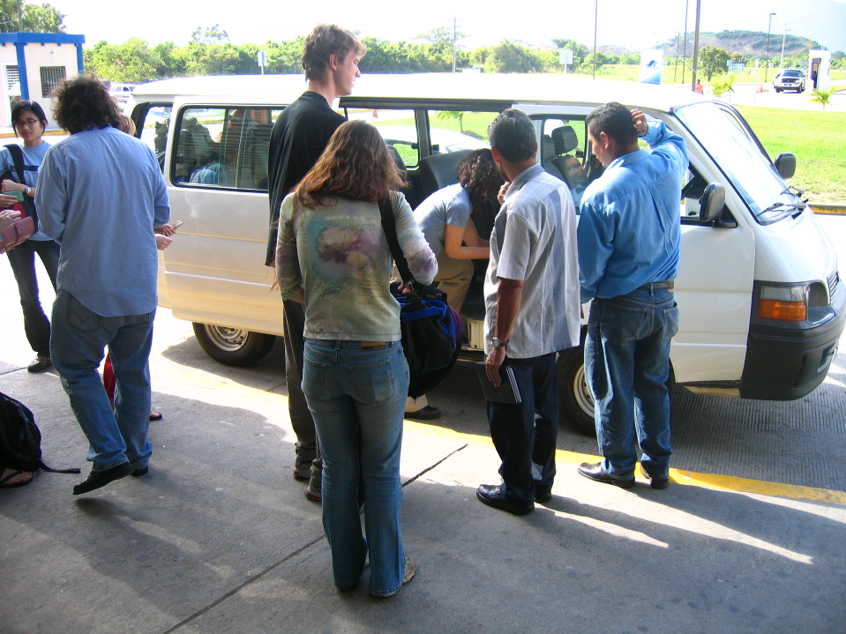

Slide 34
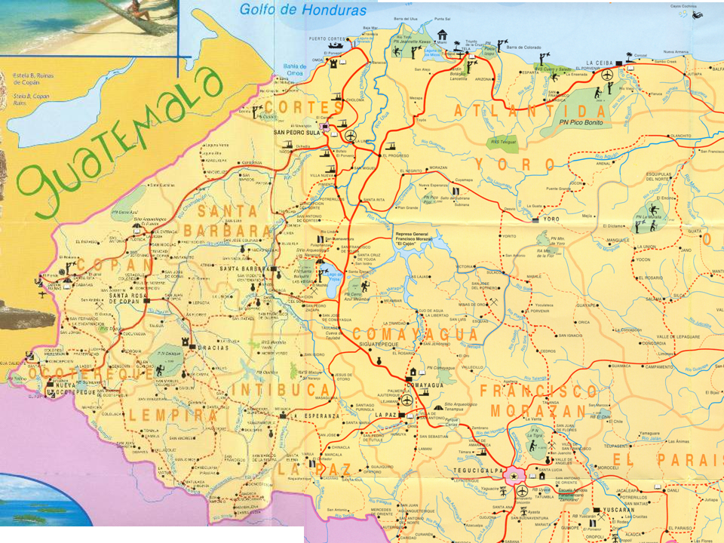

Slide 35
Gratitude
Gifts for host families for home stays in
  Atima
  Agalteca
  Ojojona?

Slide 36
Fundraising and Pledges
We managed to get 20k funding for this trip at the last minute from the ACSF. It is clear that we can not expect any future funding for student trips from ACSF.
The College of Engineering is providing 5k this year.

Slide 37
Preparing for Next Year
The AguaClara advisory council recommends that students could be raising a significant fraction of the trip costs.
I don’t want to have the ability to participate in the trip dependent on students’ ability to pay.
Suggestions?

