Slide 1

Demo Plant Team
Diana Kelterborn, Owen Guldner, and Susan Chen

Slide 2
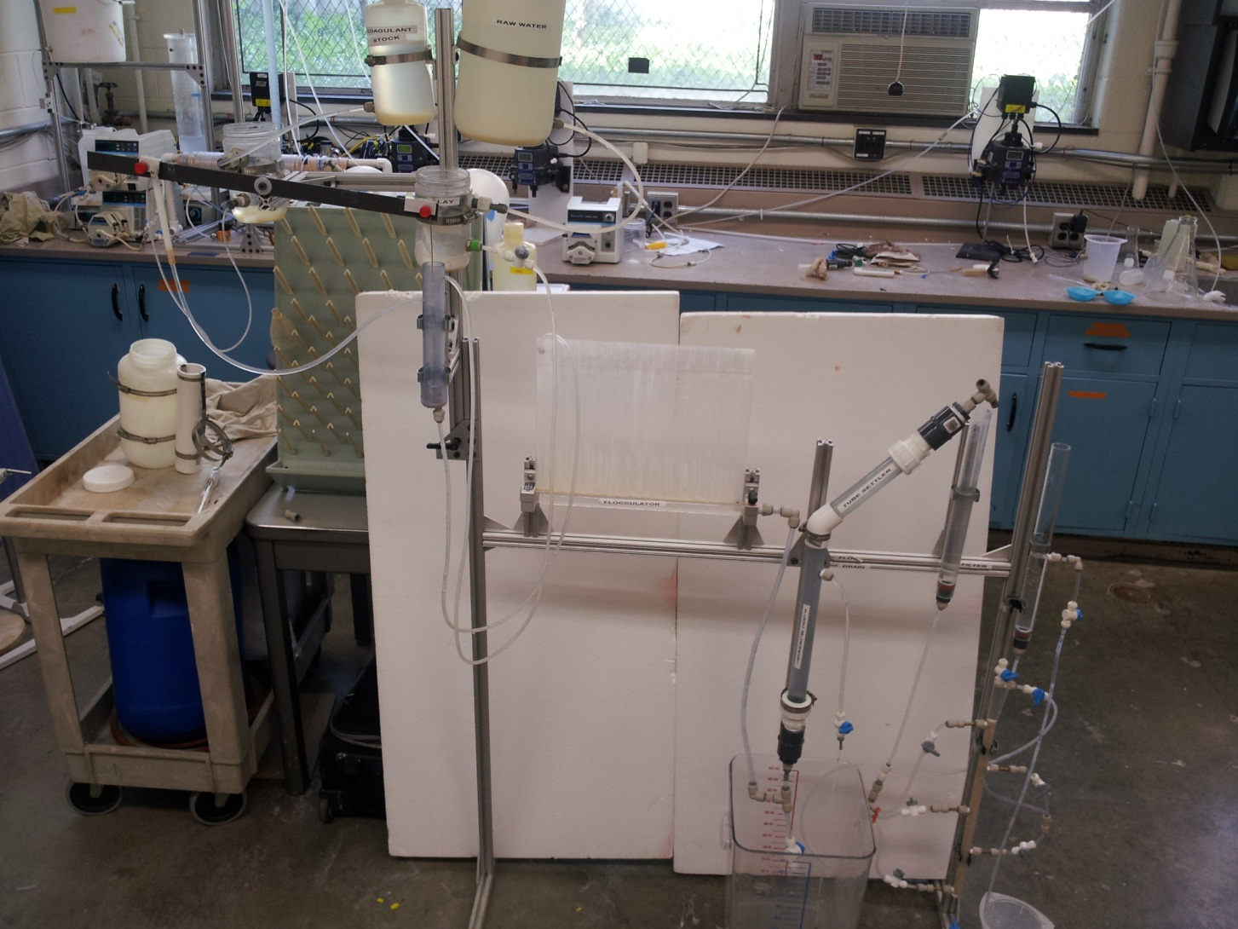
Old Demo Plant

Slide 3

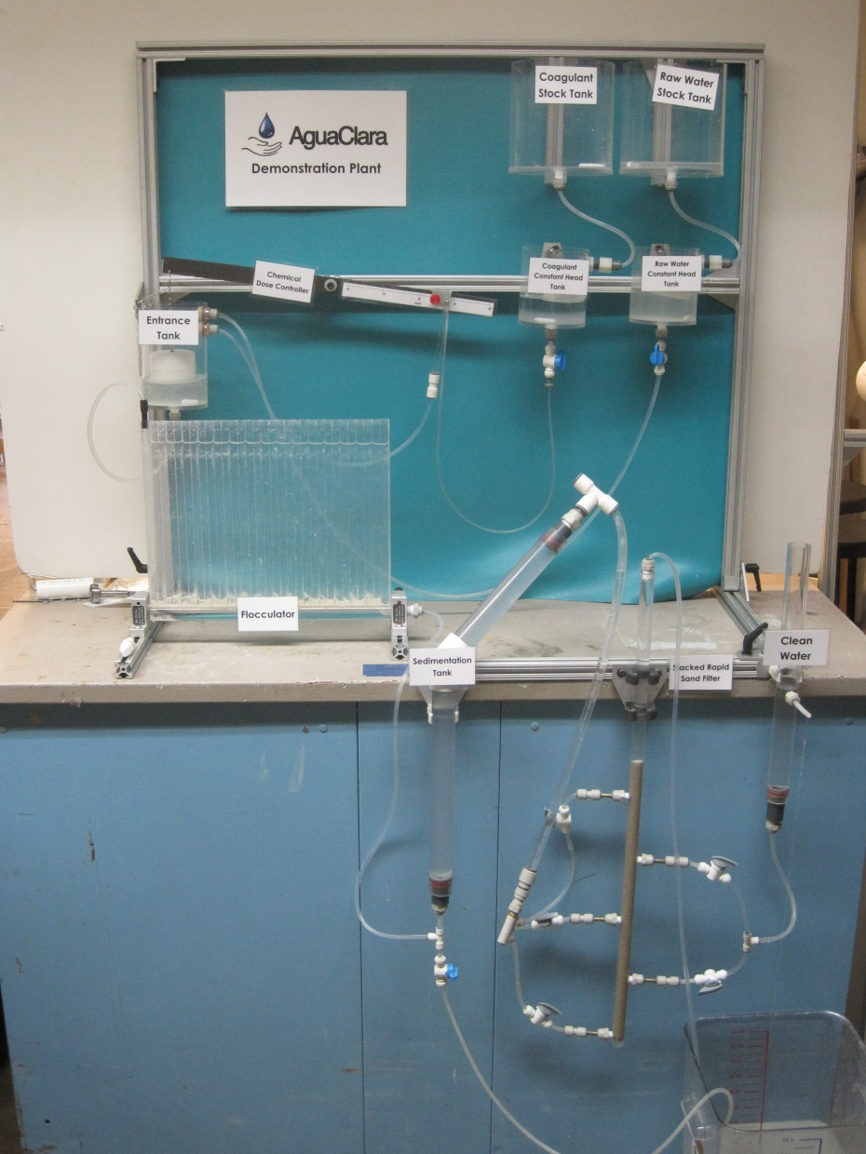
New Demo Plant

Slide 4
Improvements Made
Entire frame more contained and presentable
Added vinyl backdrop
New stock tanks, constant head tanks, and entrance tank
Chemical Doser properly labeled with a better float
Shortened Sed Tank
Lengthened SRSF column
Replaced spoons with magnetic stir bars
Converted stock concentrations to ‘spoonfuls’

Slide 5
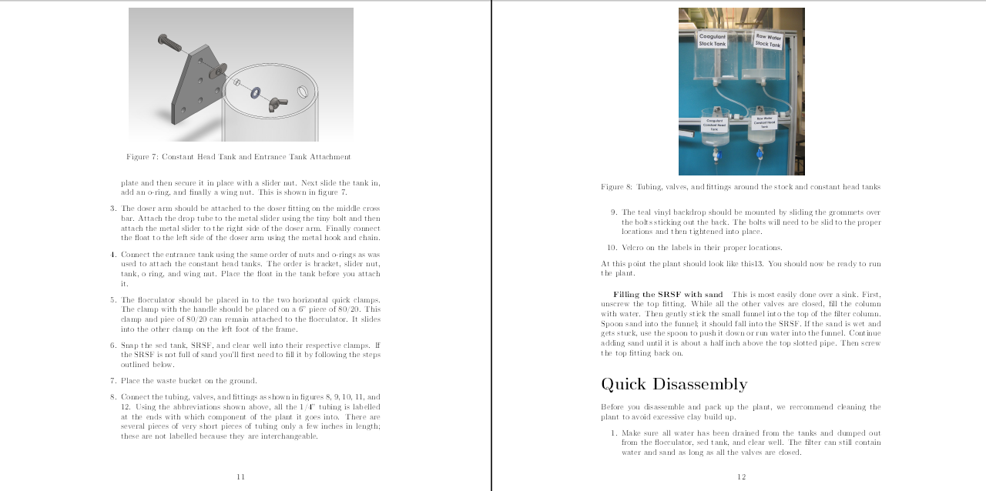
User Manual
Catalog of parts
How to construct, assemble, operate, and disassemble plant
Troubleshooting tips

Slide 6
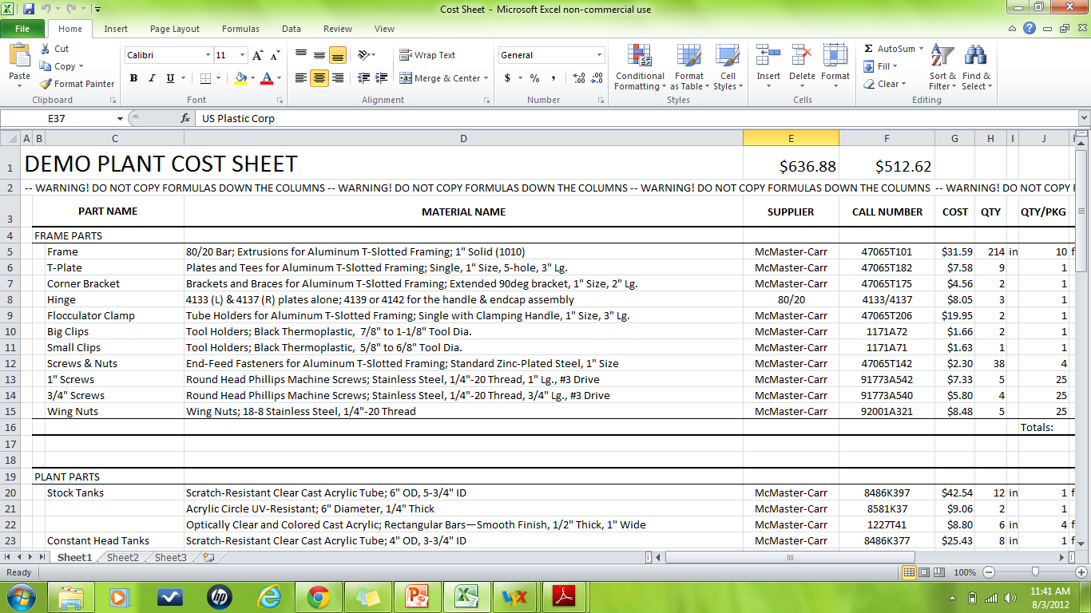
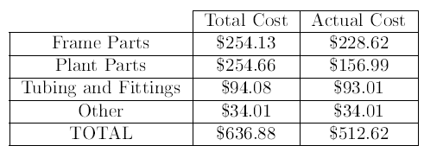
Cost Sheet
An Excel Spreadsheet
Contains list of all parts with their supplier, price, cost per package, and actual cost
Cost of a new Demo Plant is $640 though only $512 are used for each plant
Building multiple plants at one time will lower their individual costs

Slide 7
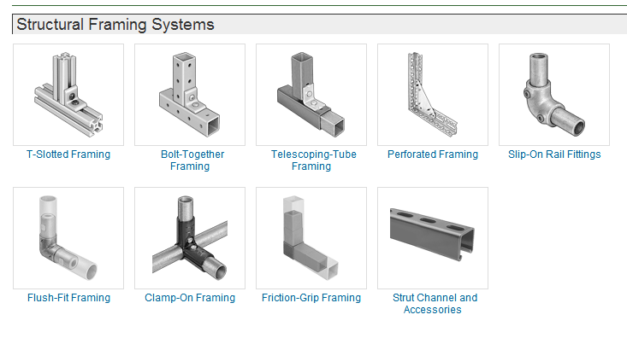

Future Work
Look into using a different, cheaper modular system rather than 80/20 such as friction-grip framing
Build more plants

Slide 8

Any Questions?

