Slide 1
Demo Plant Team
Alice Reis
Lauren Frazier
Erin Loughlin

Slide 2
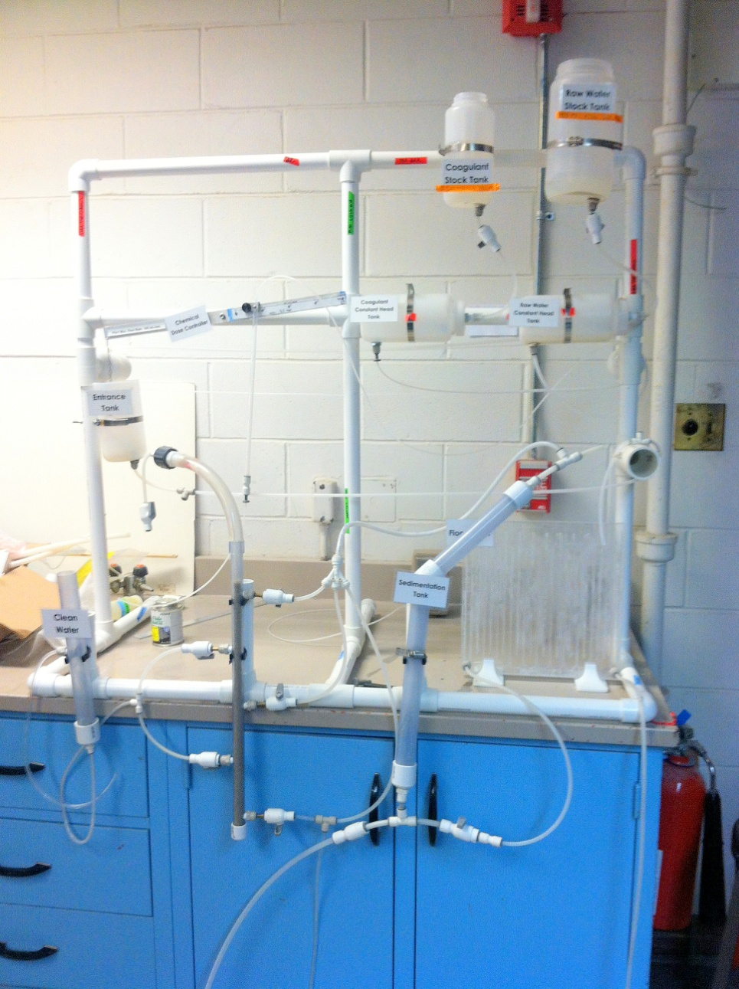
Overview: The Demo Plant
Notes:
The Demo Plant:
is an important tool to promote AguaClara;
Effectively demonstrates how the plant works;
The team’s work:
Recreate the fluid mechanics and physics of the real plant;
Make it look professional and still fit a carry-on size luggage;
Fix the problems of the current Demo Plant and make it work efficiently.
Outline of how the plant is supposed to work:
The raw water stock tank is mixed with a proportionate amount of clay and water; the coagulant stock tank is dosed with a known concentration of coagulant. Both stock tanks feed into respective head tanks, which are controlled by float valves, which control the head through the plant. The pipe from the raw water head tank feeds directly into the entrance tank, while the pipe from the coagulant head tank is attached to a tube that hangs from our chemical dose controller. Depending on what dosage is set on the controller, controls the amount of coagulant reaching the entrance tank. The tube hanging from the doser is connected to the tube that comes out the bottom of the entrance tank, where the coagulant and raw water mix rapidly in a rapid-mix circular tube. The head in the entrance tank is also controlled by a float valve. Once the coagulant and water mix, they are fed directly into the first baffle of the flocculator. The flocculator creates flocs that settle at the bottom of the baffles and move cleaner water through the turns until it exits at the bottom of the last baffle. The tube then moves to the base of the sedimentation tank, where water fills up as the flocculator runs. Sedimentation develops as the water moves up and through the angled portion of the tank, and settles on the angled tube and slides back down with gravity. The cleansed water then exits at the top, where a T-shape valve provides atmospheric pressure and thus a way to control the head between the sed tank and the flocculator. The water enters the SRSF at three locations to account for the layering of the sand, and exits at two. The exit pipes join to meet at the clean water tank.

Slide 3
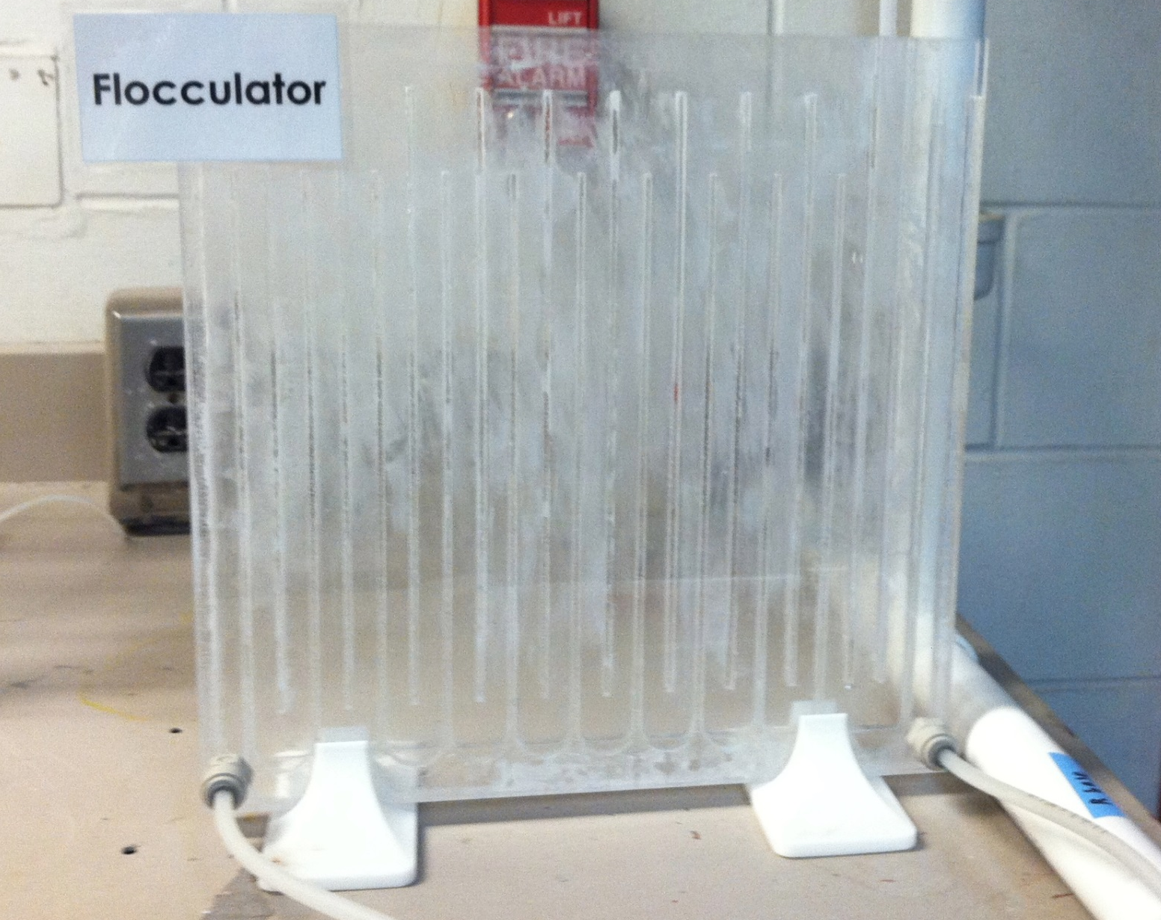
Accomplishments: Flocculator
Notes:
Flocculator – text on flocc.

Slide 4
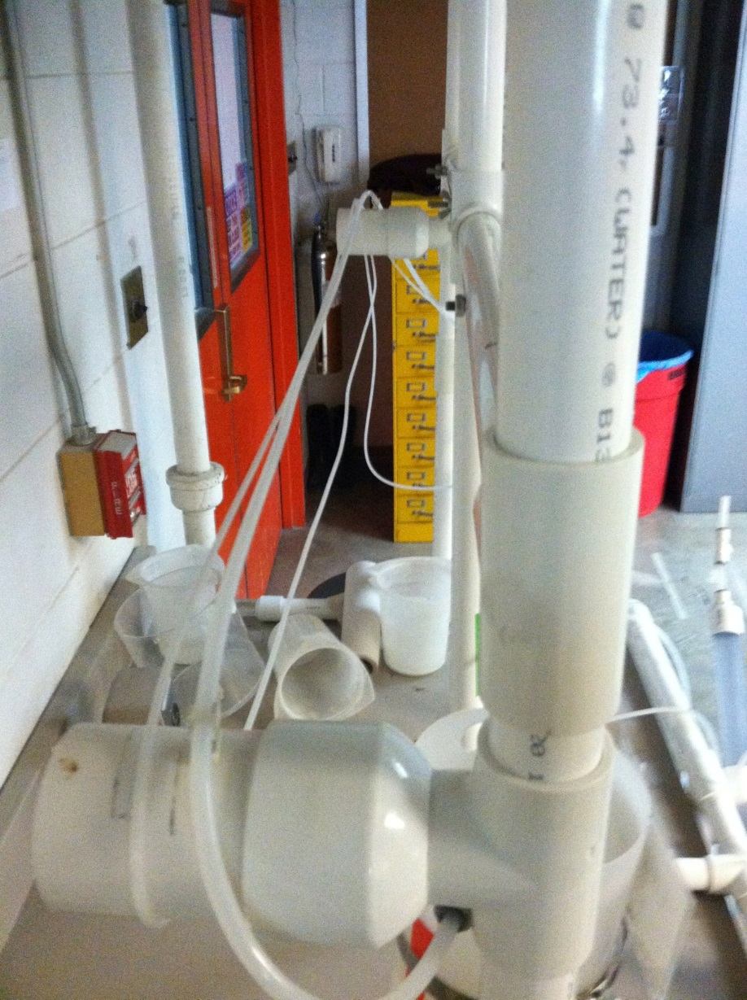
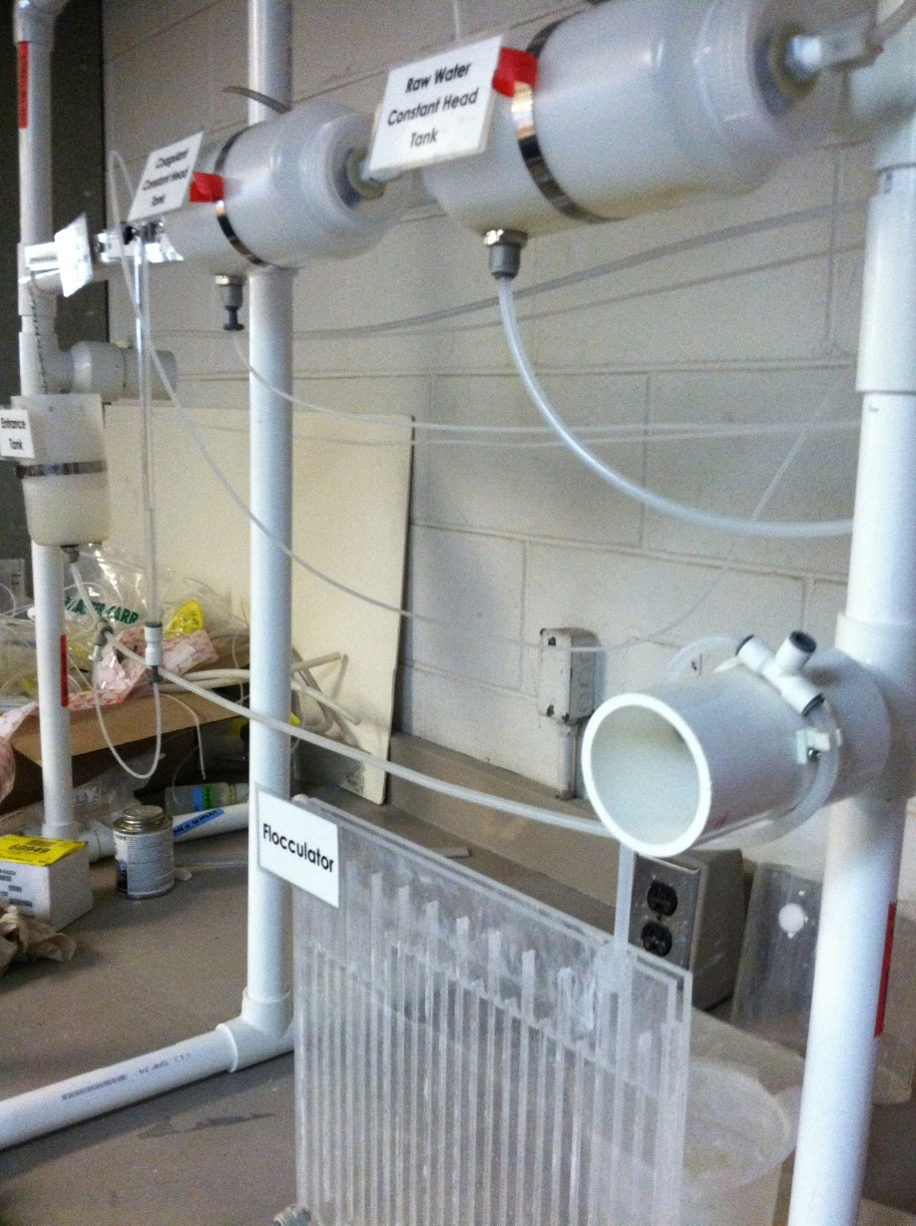
Accomplishments:
Head Loss
Notes:
Head loss using long straight pipes- 3 m pipe (1/16 diameter) from the coagulant head tank, 1.5 m (1/8 diameter) from the raw water head tank, and 1 m (1/8 diameter) from the entrance tank to flocculator.
Entrance tank head loss 10 cm difference, the loop around the z-direction pipe
Established creation of a MathCad file for calculations that should be maintained in the future
In previous demo plants, the focus has been to just construct a functioning mini plant. However, this year we attempted to tackle the fluid mechanics portion of the demo plant by trying to mimic the head loss and flow rate in a real plant. In order to maintain the linearity of our chemical dose controller float, we determined that the head loss of the entrance tank must be less than 10 cm. In order to achieve this we calculated new lengths and diameters for the pipes extending from the head tanks to the entrance tank. We found that the pipe extending from the raw water head tank must be 1.5 m long and have a diameter of 1/8 inch. The pipe from the coagulant head tank must be 3 m long and have a diameter of 1/16th inch. The tubes must also be long and straight to achieve the correct head loss. Our solution in constructing these pipes was to wrap them around the back of the plant in a snaking pattern so that they did not have to increase the overall height of the plant.
We also created a loop for the tube that extends from the entrance tank to the flocculator to maintain a zero-flow height. This loop we opened to the atmosphere to get a point of atmospheric pressure so the head was set at that height. The loop then dropped back down into the highest point of the flocculator.

Slide 5
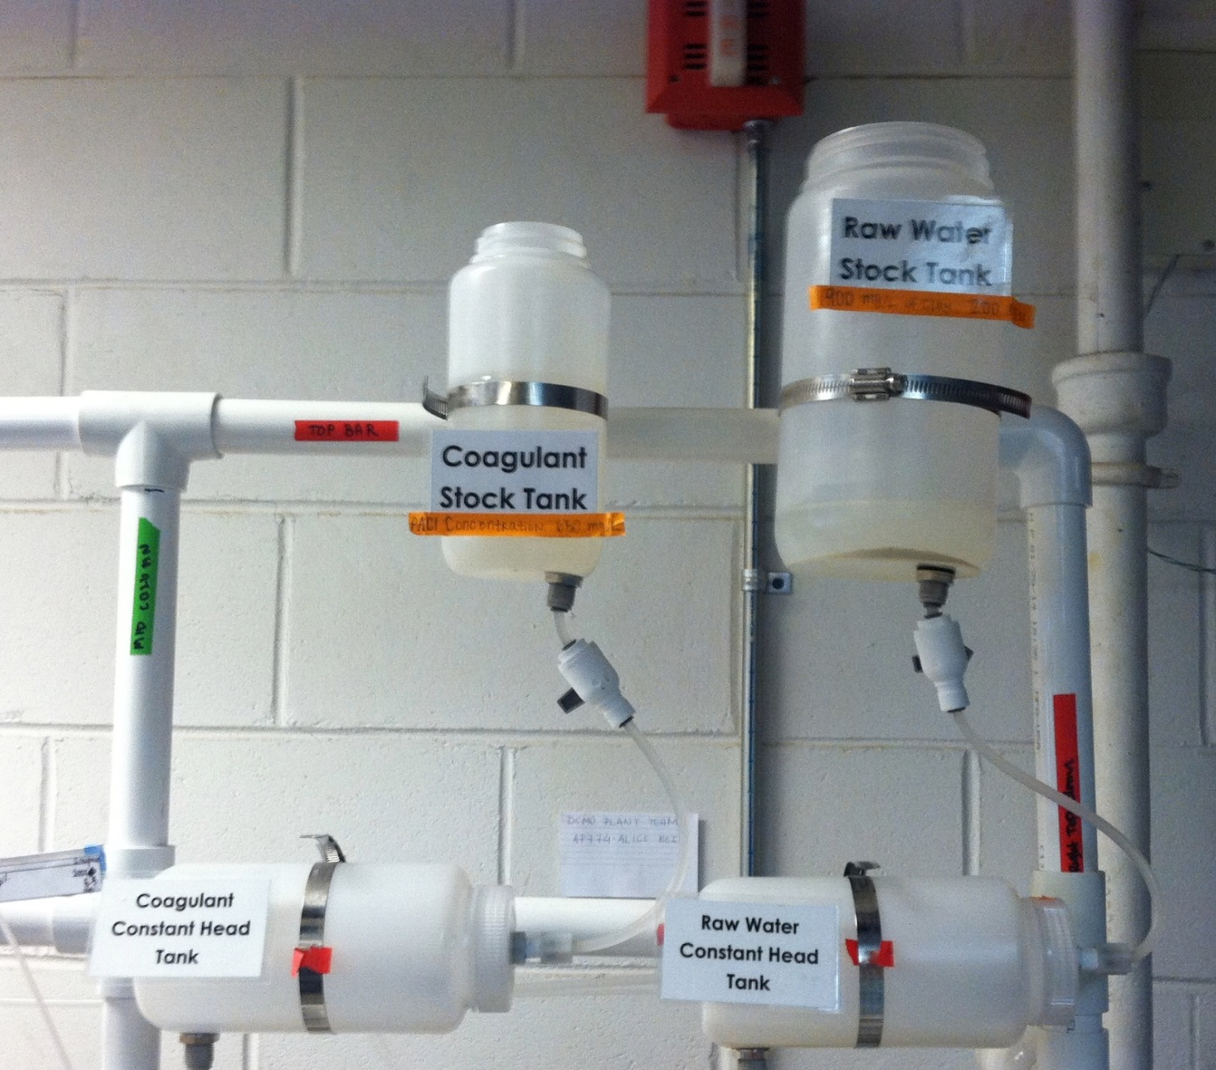
Accomplishments:
Frame & materials
Notes:
Added stability to the new frame – extra diameter, third vertical pipe, connection on the bottom to form the bottom loop.
Switched out the stock, head, and entrance tanks for nalgenes, which are extra stable and not brittle (the old acrylics would crack under drilling). These were connected with hose clamps which are very secure and easily loosened and tightened.
Also turned the head tanks horizontal so that the floats would fit inside without having to change their original shape
Another of our major focuses this semester was improving the overall structure of the frame and the materials used in the plant. We determined that extra stability would come from increasing the diameter of the pipes. Last semester’s plant also had trouble because there was no middle piece, and the two horizontal pieces would slip out and sag, causing its complement to also sag. We solved this problem by adding a third vertical pipe in the middle. We also added extra PVC to connect the pipe at the bottom into a full loop. We also switched out the old acrylic stock and head and entrance tanks for Nalgene bottles. These bottles are nearly indestructible, while the last bottles were having issues with brittleness; they would snap when we had to drill through them and new holes had to keep being drilled. We also turned the head tanks horizontal, because the floats that fit inside them are structured for horizontal use and the previous plant had to bend the floats from their original shapes in order to fit them in a vertical tank. This way is easier and still serves the same function.

Slide 6
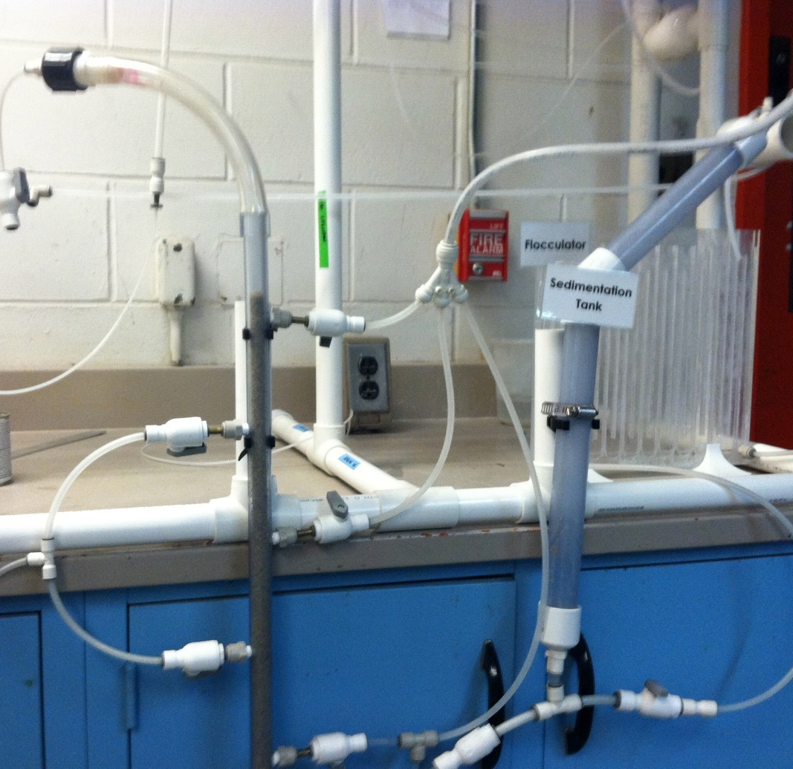
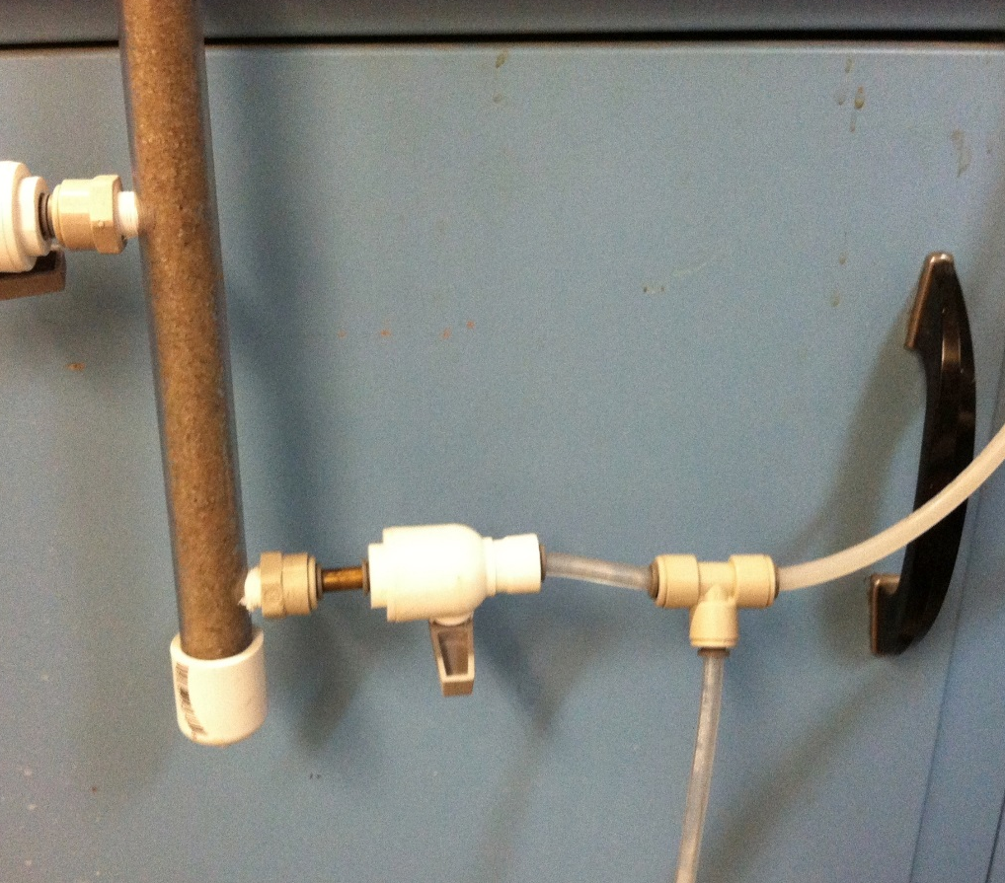
Accomplishments:
SRSF & Sed Tank
Notes:
Include: Soap run SRSF, fill sed tank before running, increased overall run time capacity
Further adjustments to the plant came in the form of increasing overall run time capacity. The old demo plant ran smoothly and fairly quickly up until the sedimentation tank and then took forever to fill because there’s so much water volume in there and the height of the rising water is too slow, which would cause the flocculator to back up and overflow. To remedy this we decided to fill the sed tank with clean water up until the vertical bend before starting the plant’s run. This way the sed tank only had to fill that smaller distance before it could flow out, which reduces the possibility of overflow in the flocculator, but it still must fill the diagonal bend so the sedimentation will still fall there and slide back down. Another way we increased overall run time was to eliminate the air bubbles in the SRSF. Before we did this, there were air pockets between the sand, which defeated the purpose of having the sand layers. So before we ran the plant we ran a soapy water mixture through the sand which broke the surface tension of the water and forced the sand particles to fall back down to each other. This increased the flow through the SRSF as well once we rinsed it out.

Slide 7
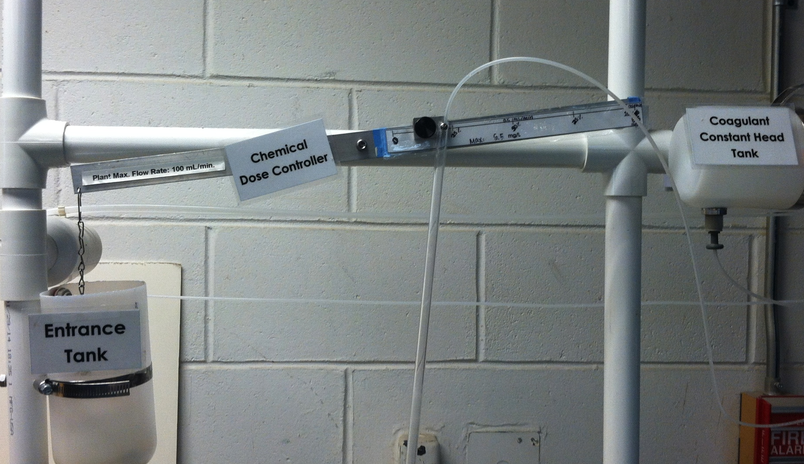
Future Work:
Chemical Dose Controller
Notes:
The chemical dose controller does not function properly
Is not maintained weight on both sides
Is not heavy enough to account for change in weight due to placement of glass tube

Slide 8

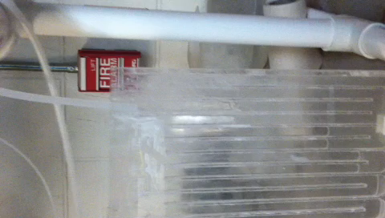
Future Work:
Flocculator

Slide 9
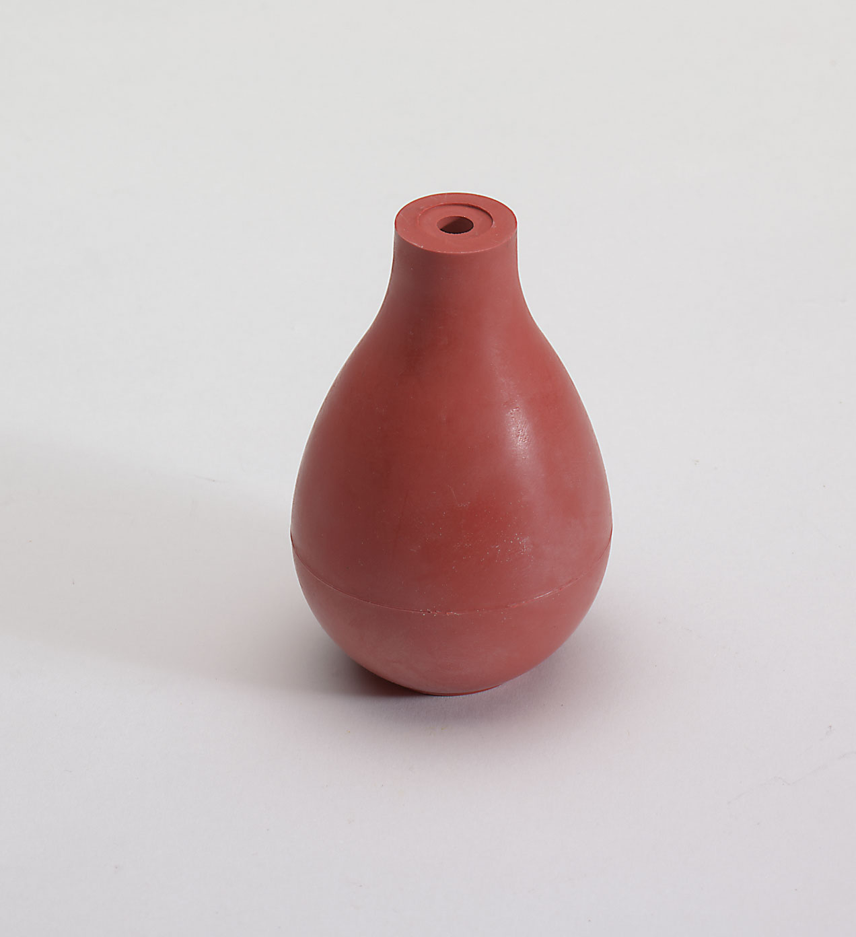
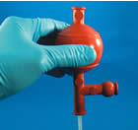
Future Work:
Air Bubbles
http://www.emsdiasum.com/microscopy/products/images/75000/70982.jpg

Slide 10
Thank You!
Any questions?

