Slide 1

Laminar Tube Flocculator
Fall 2013
Victoria Chou and Yining Dai

Slide 2

Outline
Introduction
Floc Breakup Theory
Base Case Testing
Experiments
Conclusions from our research
Challenges Faced
Future Work

Slide 3
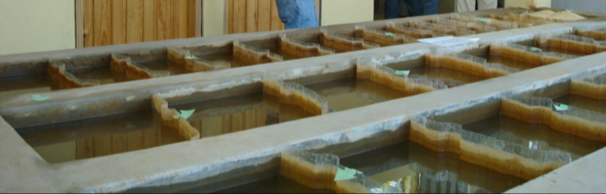
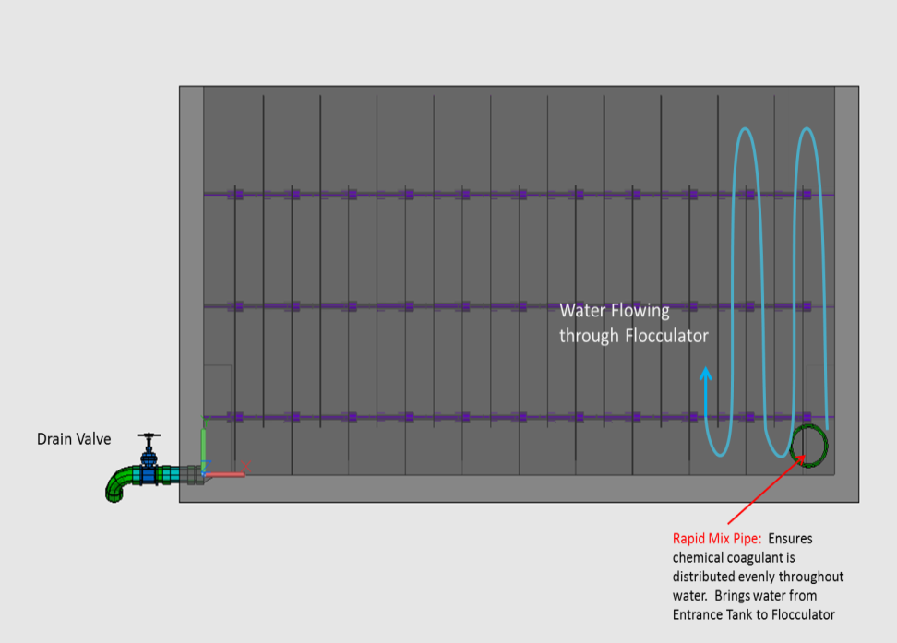
Introduction
Flocculation is an integral part of the water treatment process

Slide 4
Floc Breakup Theory
“Large flocs are useless”
  Shear is too large, so colloids cannot attach
Use clamps to break up flocs so that they can regrow and collect more colloids as they travel

Slide 5
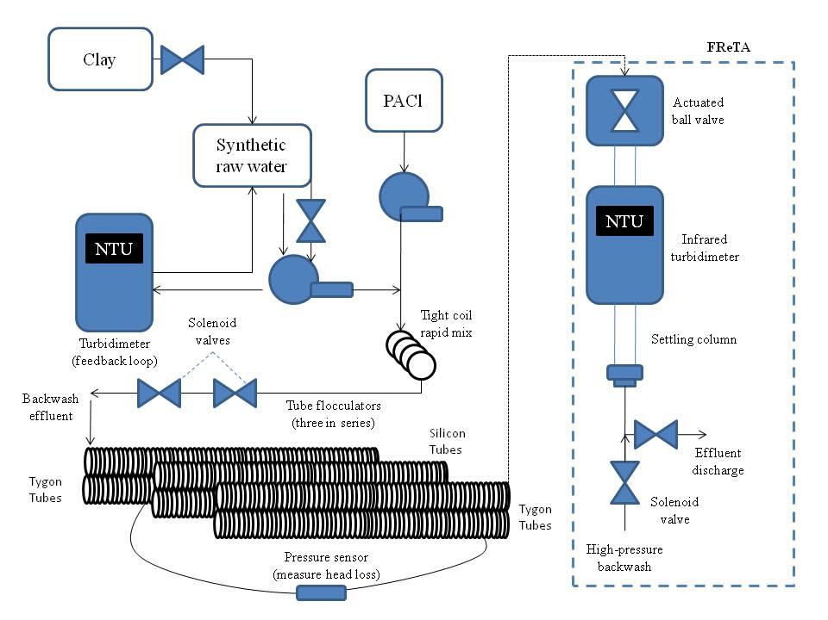
Set Up of Fall 2013 Testing
Notes:
Allow more time for the flocs to grow
Previously the two turbidimeters did not agree with each other
Also they wanted to test tygon tubes vs. silicon tubes (Spring 2013)

Slide 6
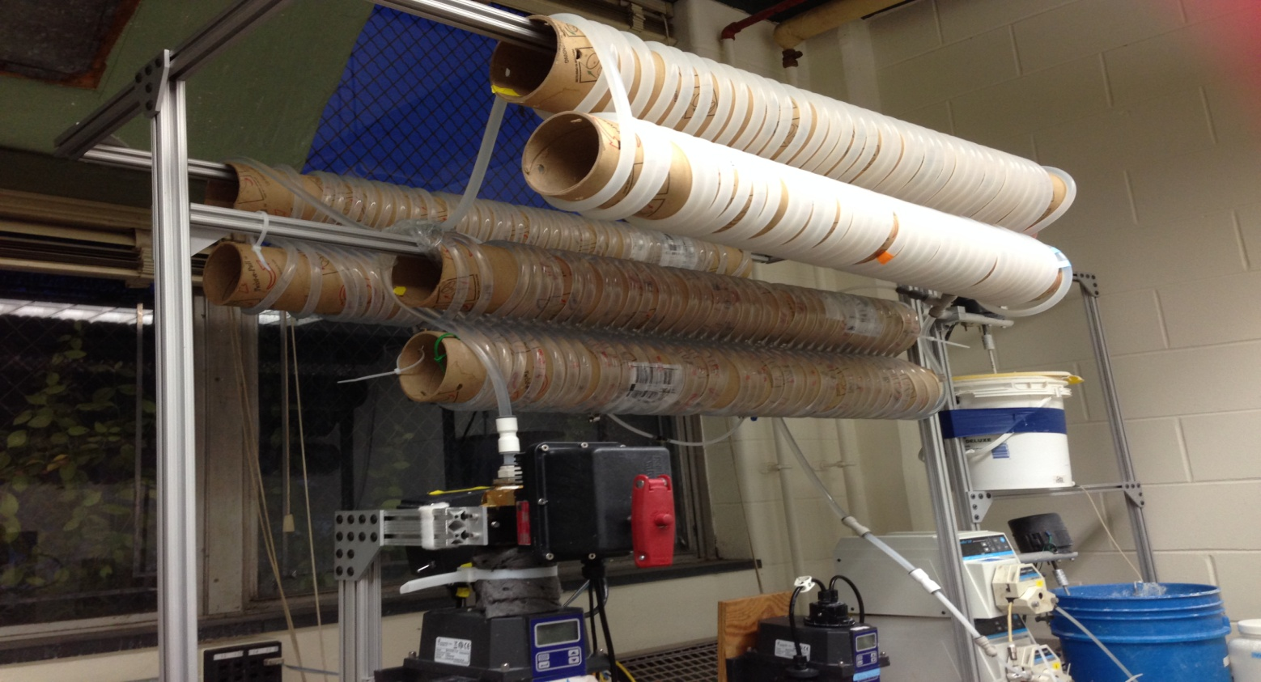
Set Up of Fall 2013 Testing
Length of tubing

Slide 7
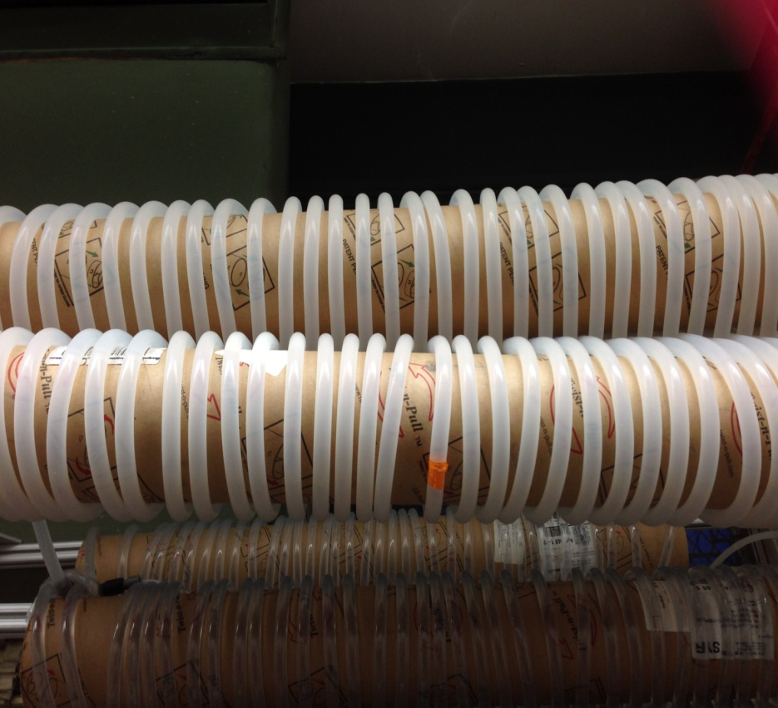
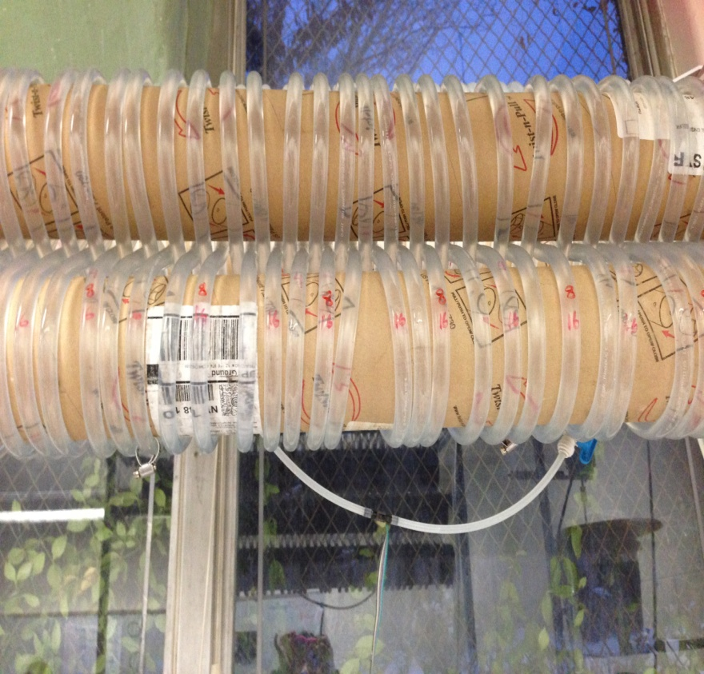
Set Up of Fall 2013 Testing
Material used for Tubing

Slide 8
Base Case Testing
Base Case Testing
  Linear dosing
  Power law dosing
  Dose=coefficient x base
  coefficient = .25
  base = 1.25
  max reps = 12
max reps

Slide 9
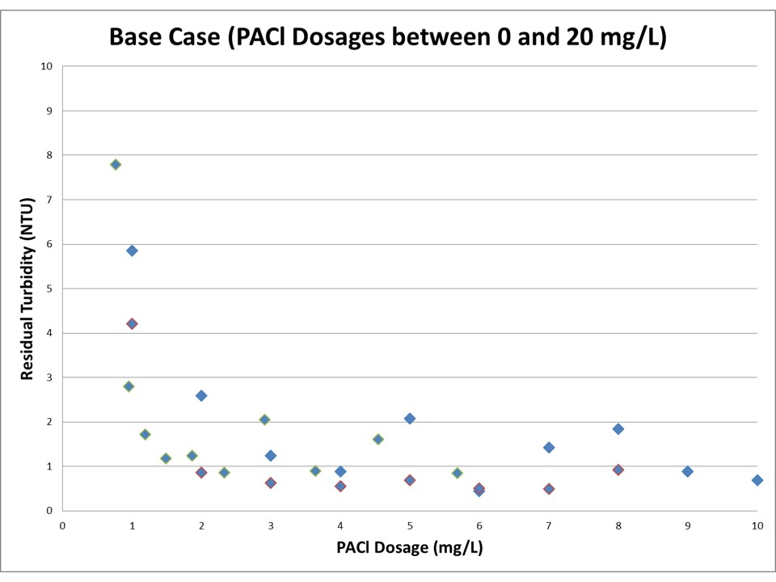
Base Case Results

Slide 10
1st Experiment- Clamp Size
Testing the Effectiveness of Different Sized Clamps
Have ONE clamp on the middle arrangement of tubing
4 mm & 5 mm
Have dosages of 0 to 2 mg/L PACl
4mm
5mm

Slide 11
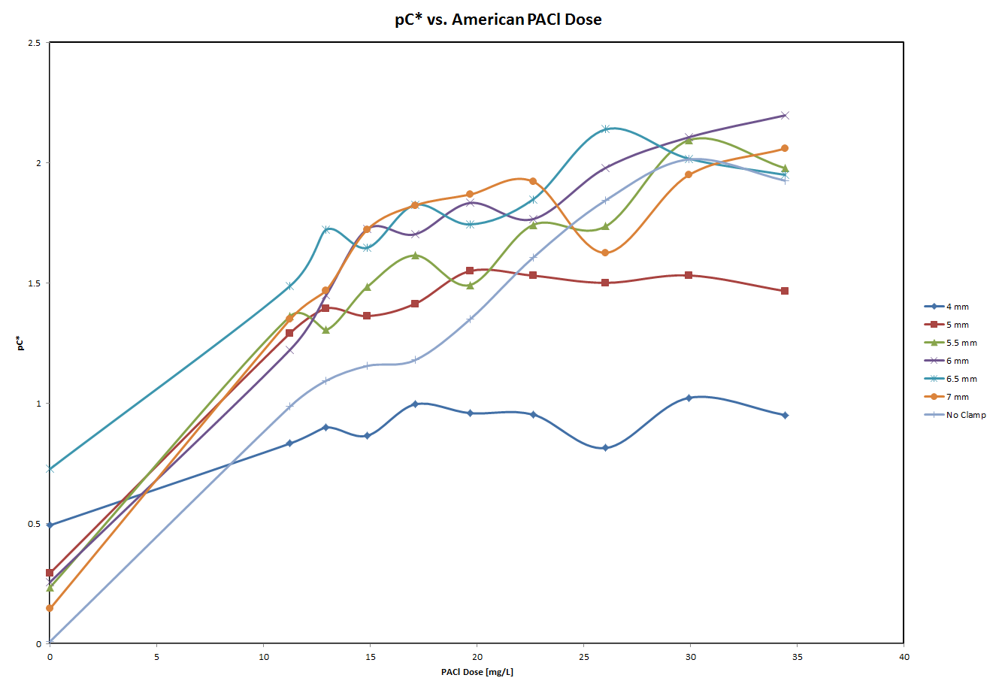
Results of Summer 2013 End Clamp Research
Notes:
Used results from summer to choose the clamp sizes (4mm-5mm) – end clamp testing

Slide 12
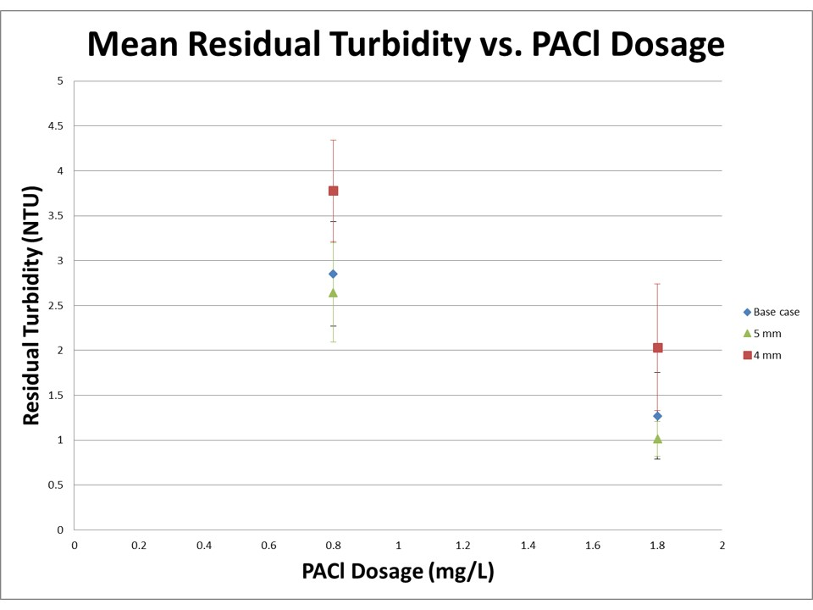
Results of Clamp Testing

Slide 13
Statistical Testing
Used a t-test to test for a significant difference between two sets of data
  Compared base case to 4 mm
  Dosage of 0.8 mg/L
  p-value = 0.008
  Dosage of 1.8 mg/L
  p-value = 0.036

Slide 14
Statistical Testing cont.
  Compared base case to 5 mm
  Dosage of 0.8 mg/L
  p-value = 0.934
  Dosage of 1.8 mg/L
  p-value = 0.177

Slide 15
Conclusions Drawn
4 mm clamp significantly increases residual turbidity
5 mm clamp – graphs vs. statistical testing
More trials of the 5 mm clamp
Experiment with 6 and 7 mm clamps

Slide 16
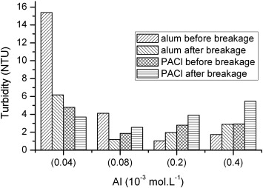
Literature
Fig. 4 Residual turbidities before and after ﬂocs breakage and re-formation in model water II.
Wenzheng Yu , Guibai Li , Yongpeng Xu , Xue Yang
Breakage and re-growth of flocs formed by alum and PACl
Powder Technology Volume 189, Issue 3 2009 439 – 443
http://dx.doi.org/10.1016/j.powtec.2008.07.008

Slide 17

Future Work
Testing the Effectiveness of Different Number of Clamps
1-16 clamps spread evenly across the middle arrangement of tubing
Tapered Flocculator
Increase the tube diameter to decrease the energy dissipation rate

Slide 18
Challenges Faced
Pump malfunction
  Centrifugal pump
Pressure Sensors
  The t-connectors are facing upwards

Slide 19
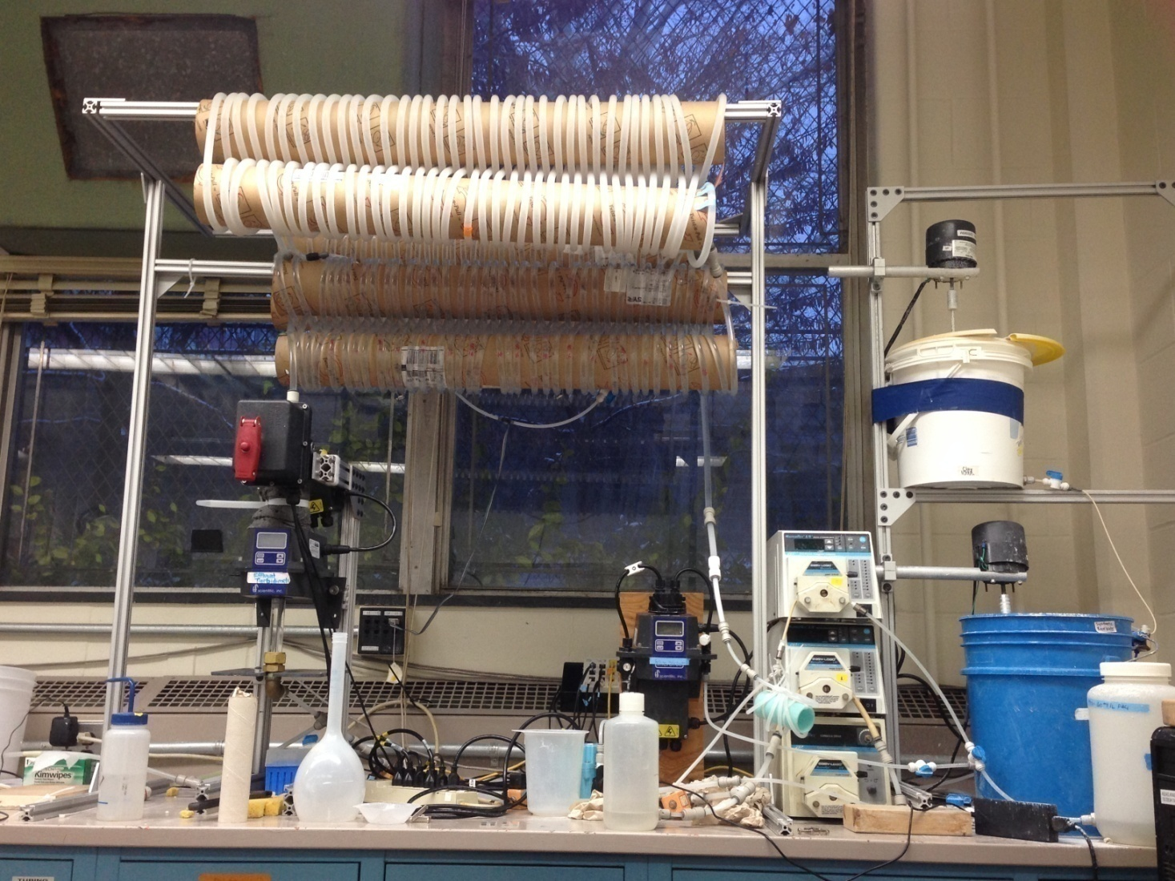
Questions?

