Slide 1

Tube Flocculator
Spring 2013
Patience Li
Margaret Fleming

Slide 2
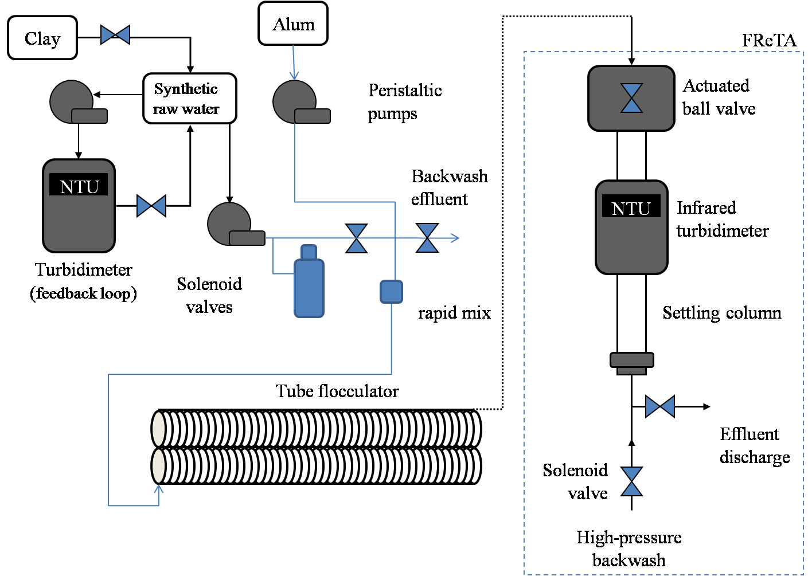
Introduction -- Apparatus
PACl

Slide 3
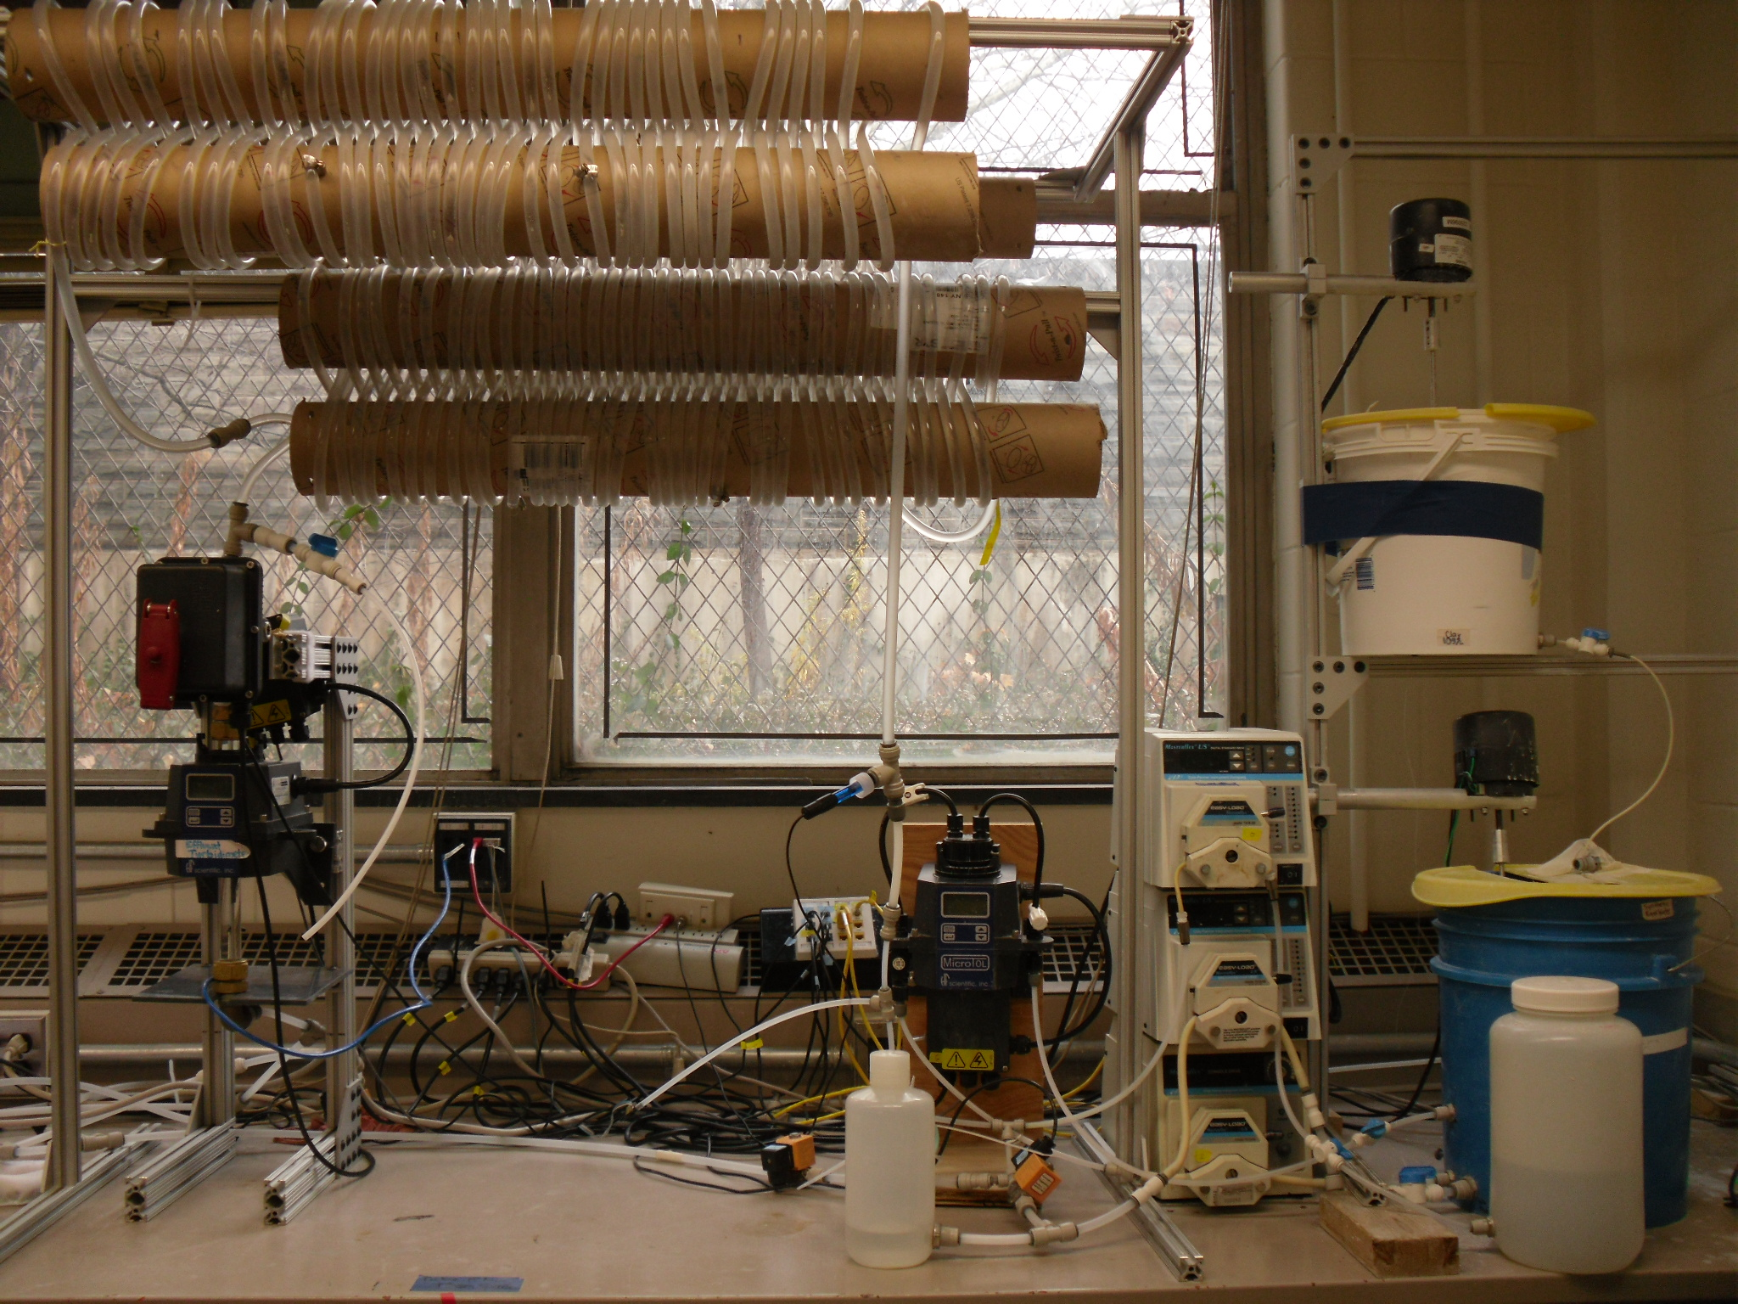

Slide 4
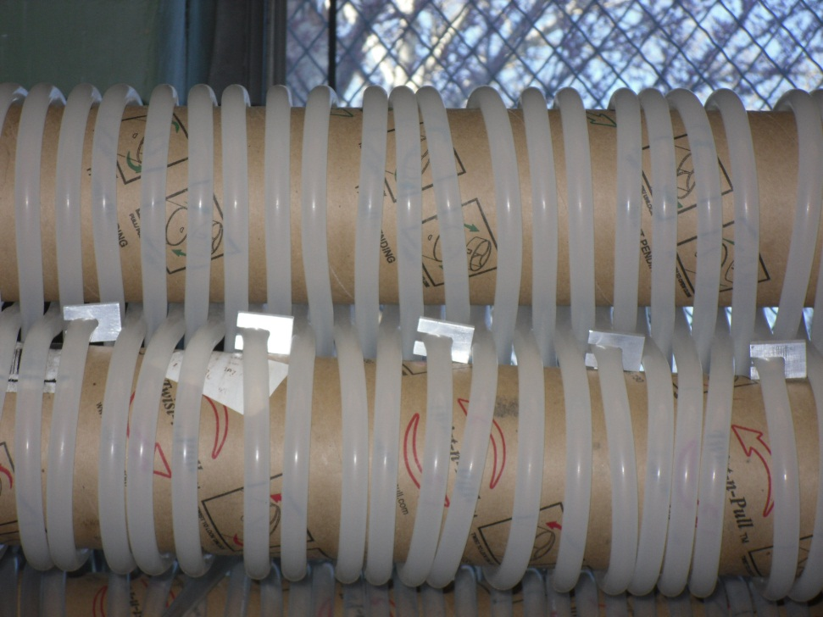
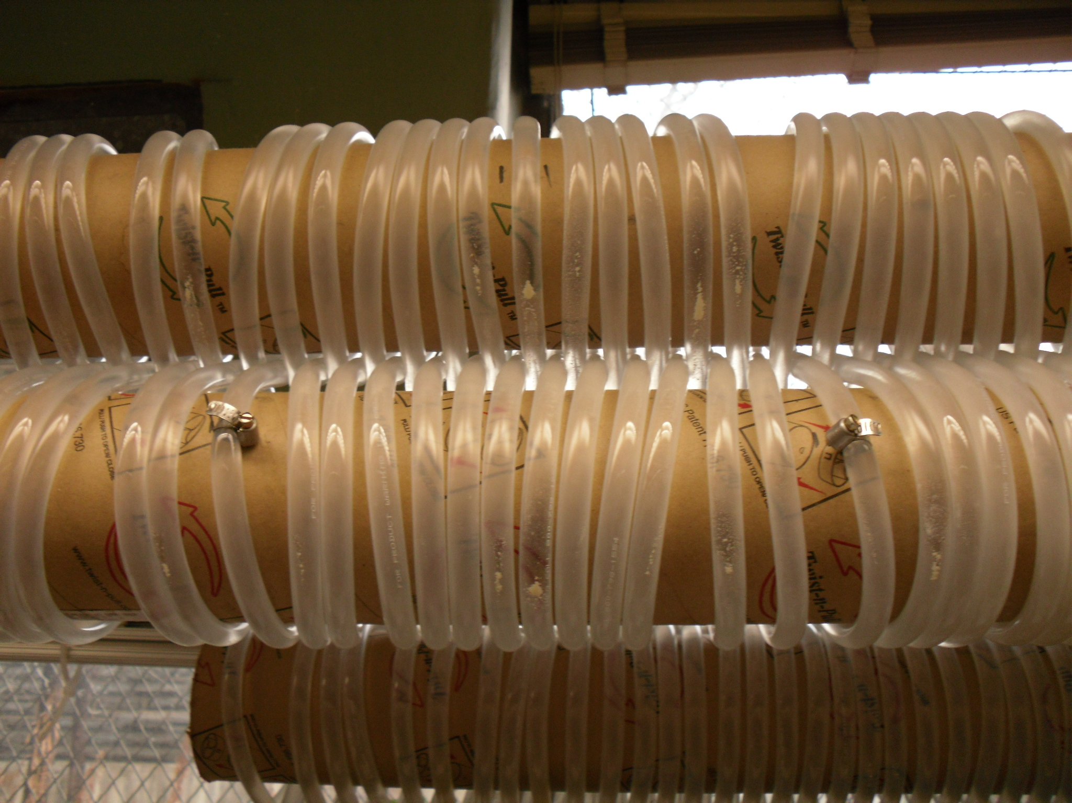

Experiments: Silicone vs. Tygon
Goals– Reduce coagulant and clay attachment
Silicone
Tygon

Slide 5
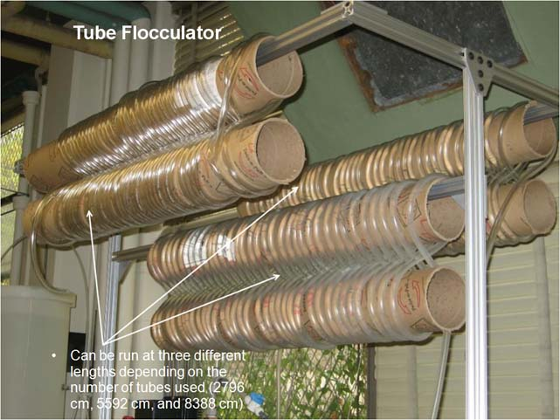

Experiment: Silicone vs. Tygon
Process Controller Method
Set Point | Value
Target influent turbidity | 100 NTU
Raw water flow rate | 5.5 mL/s
Length of tube flocculator (1 unit) | 28 m
PACl base | 1.1
PACl coefficient | 0.9
Max reps | 15
$$Dose=Coefficient∗{Base}^{rep \#}$$

Slide 6
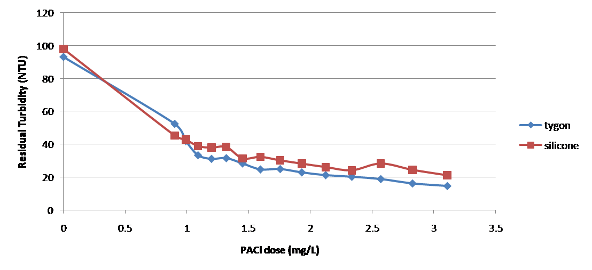
Experiments: Silicone vs. Tygon
Results
Silicone tube is better!

Slide 7
Floc Breakup
Terminal floc size is determined by energy dissipation rate.
Large flocs are useless.
Breaking flocs that are at terminal floc size will create more, smaller flocs that collide and grow when they travel.

Slide 8
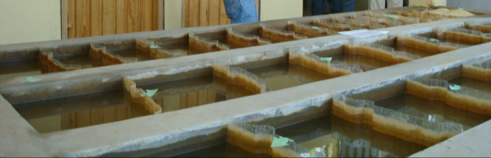
Floc Breakup Goals
Floc Break up
Orifice size = f (ε)
Positioning of break up points
Capture velocity (constraint)
No. of break up positions
Improve Flocculation Performance

Slide 9
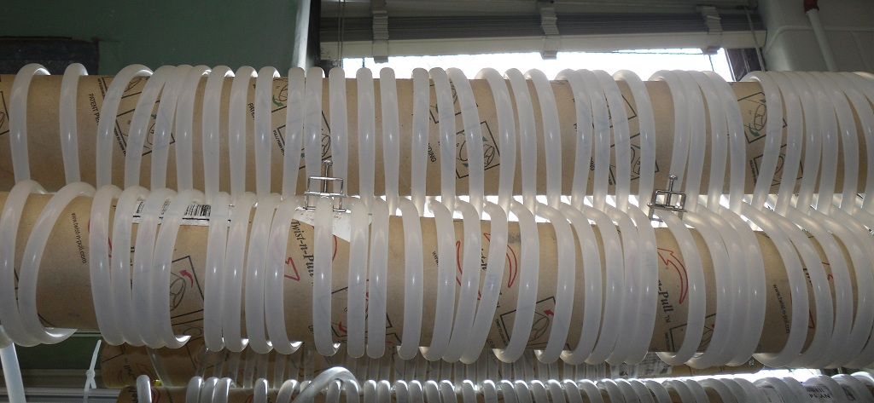
Experiment: Floc Breakup

Slide 10
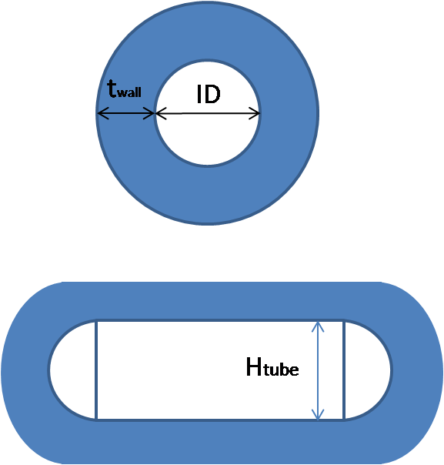
Experiment: energy dissipation rate clamp size
Assumptions
1) No vena contracta
2) Inner perimeter conserved
3) Rectangle + 2 half circles
4) Wall thickness conserved

Slide 11
Experiment: energy dissipation rate clamp size

Slide 12
Experiment: energy dissipation rate clamp size

Slide 13
Experiments:
Floc Breakup at Low Coagulant Dose
Results – low PACl dose is not beneficial

Slide 14
Experiments:
Optimal Coagulant Dose
Ideal situation for floc breakup is what achieves a residual turbidity below 5 NTU Dose = 10 mg/L

Slide 15
Optimal Orifice Size for Floc Break Up Device
PACl dose: 10 mg/L
Orifice sizes (H_{tube}): 0.4 cm, 0.5 cm, 0.6 cm, 1.3 cm (no clamps)
Associated additional energy dissipation rates: >1000 mW/kg, 300 mW/kg, 90 mW/kg, 0 mW/kg

Slide 16
Optimal Orifice Size for 2 clamp set up
Results: best performance from 5 mm orifice size
orifice size without clamps
orifice size with optimal floc break up
(cm)

Slide 17
Optimal Number of Clamps
PACl dose: 10 mg/L
Orifice size: 5mm
Results:
  Floc Breakup points improve flocculator performance for high PACl dose
  Adding more than two clamps at a 5 mm orifice size does not improve flocculator performance

Slide 18
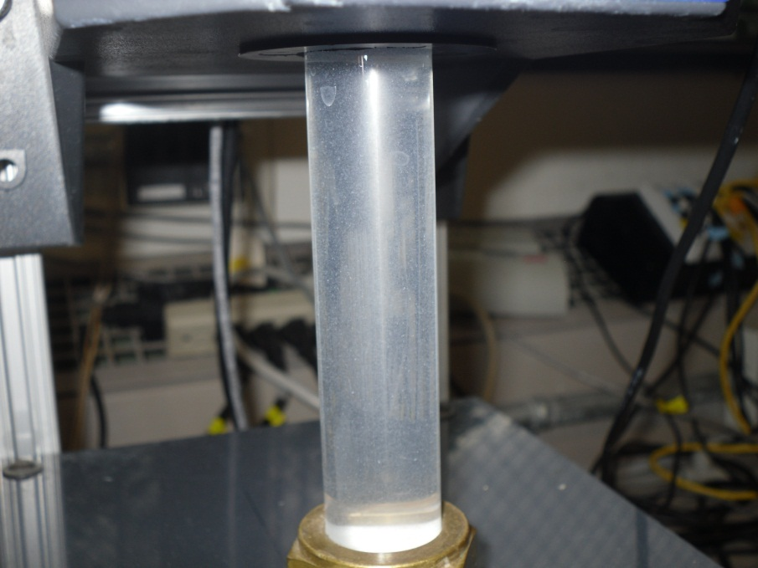
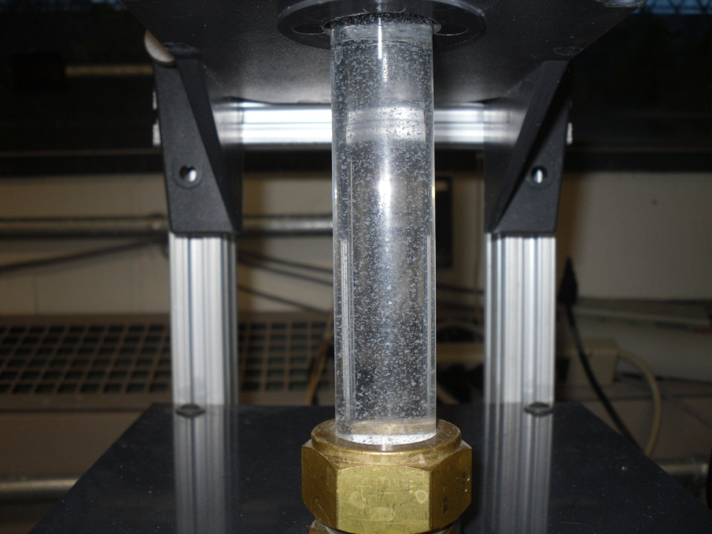
Conclusions
Silicone tube provides a more accurate environment for measuring effluent turbidities than tygon.
Floc break up is only beneficial at higher coagulant dose.
PACl dose 5 mg/L
PACl dose 10 mg/L

Slide 19
Conclusions
At a coagulant dose of 10 mg/L, adding clamps improves flocculator performance compared with no clamps.
For a two clamp floc break up system, the optimal clamp size is approximately 5 mm.
  When more clamps are added at this orifice size, flocculator performance does not improve due to breakup occurring closer to FReTA.
  It should not be assumed that a 5 mm clamp size remains optimal when clamp number is increased.

Slide 20
Future Work
Floc Break up:
Optimal orifice size for 4, 8, and 16 clamp system
Optimal break up device positioning
Tapered Flocculation

Slide 21

Questions

