Slide 1
Laminar Tube Flocculator
Katherine Dao, Yining Dai, and Kevin Shao

Slide 2
Overview
Introduction to Flocculation
Apparatus Description
SWaT
Summer 2014
Semester Goals
Progress Made
Results
Problems Faced
Future Works
Notes:
Katie

Slide 3
Flocculation
The purpose of flocculation in the water treatment process is…
  to allow particles suspended in the water to collide with each other to coagulate and transform into larger flocs
  to improve the performance of sedimentation
  to reduce the number of colloids
Notes:
Yining

Slide 4
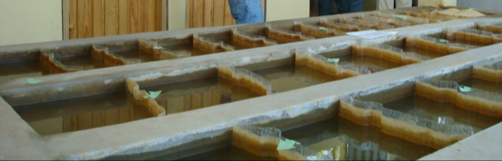
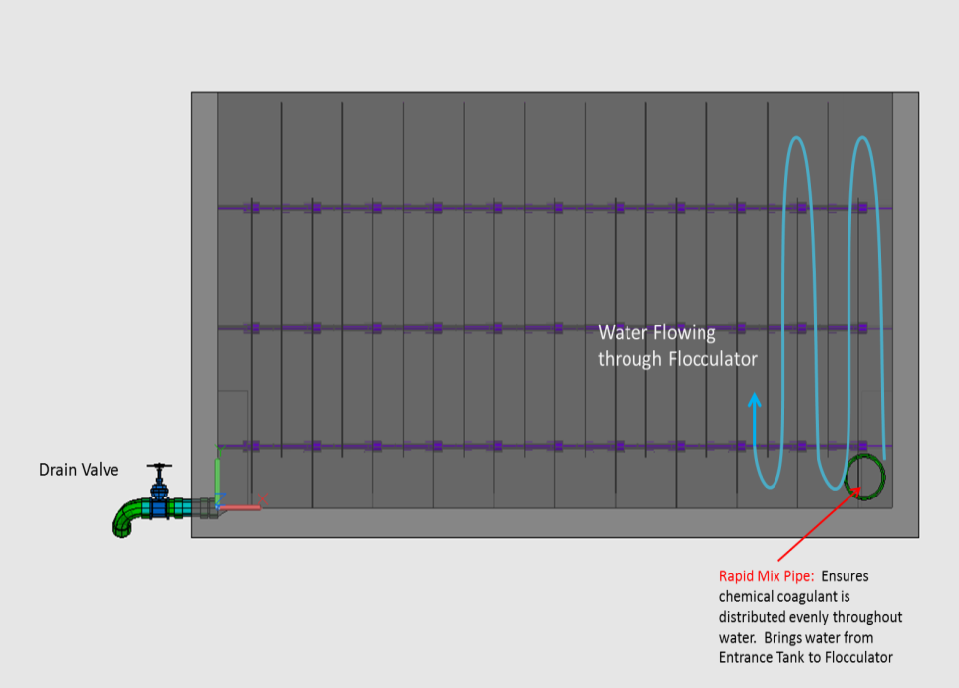
Flocculation
Flocculation is an integral part of the water treatment process

Slide 5
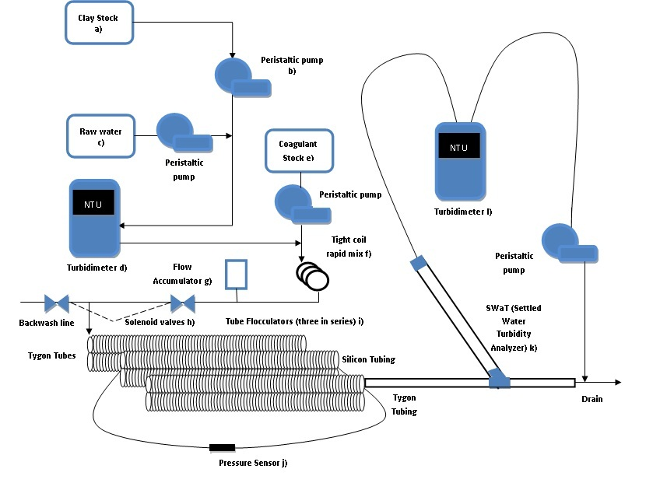
Apparatus

Slide 6
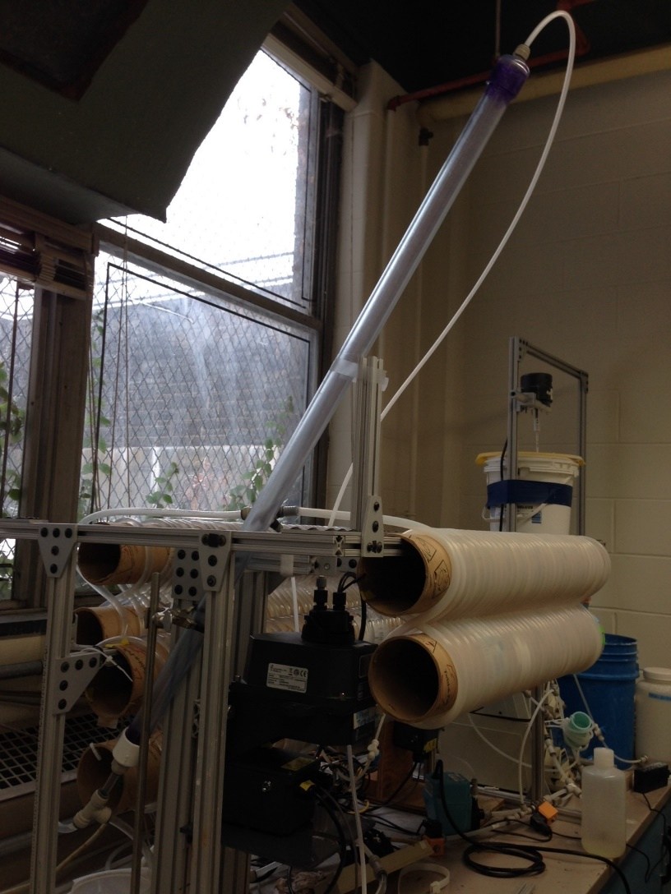
SWaT
“Settled water turbidity” measurement system
Replace FReTA (Flocculator Residual Turbidity Analyzer)
Continuous flow system with a tube settler
More closely models plate settlers in actual AguaClara plants
Notes:
Yining

Slide 7
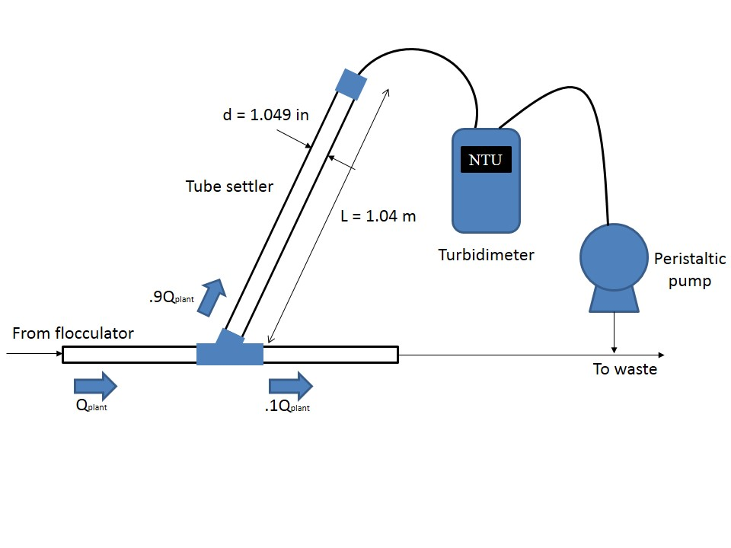
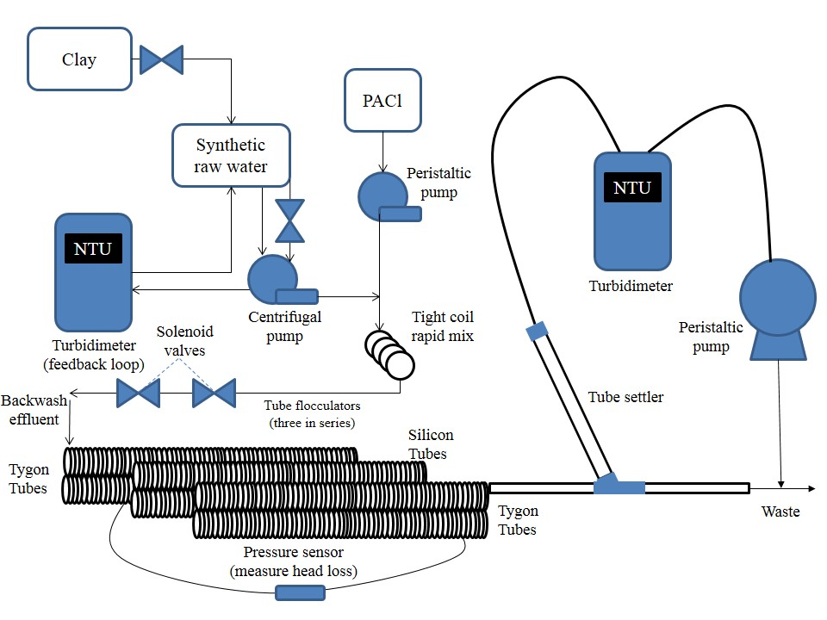
Set Up
60 °
Notes:
Yinning
Allow more time for the flocs to grow
Previously the two turbidimeters did not agree with each other
Also they wanted to test tygon tubes vs. silicon tubes (Spring 2013)

Slide 8
System States
Off
Loading – 35 minutes
SwaT – 40 minutes
Backwash with tube – 10 minutes
Backwash without tube – 5 minutes

Slide 9
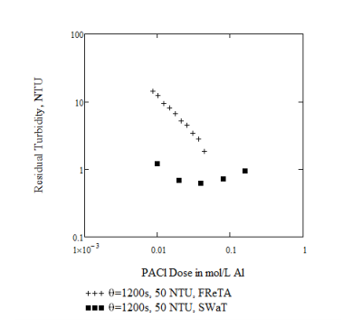
Summer 2014
Ran similar dosages at same capture velocity as FReTA using SWaT
Data had an unexpectedly high pC* value with a decrease in performance as dosage was increased
Notes:
Kevin

Slide 10
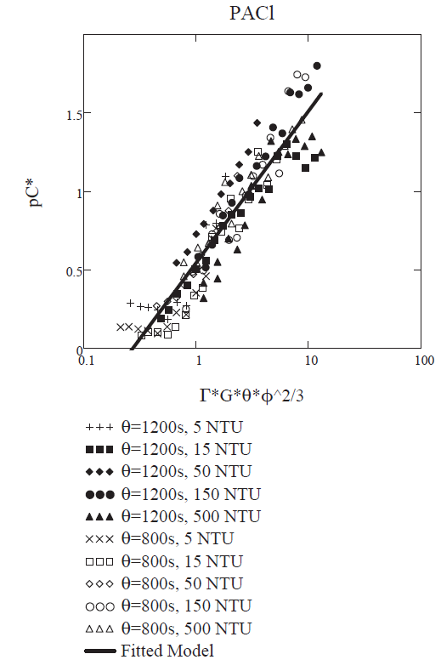
Semester Goals
Establish a base case
    1.05 mg/L
Test new, lower PACl dosages
Obtain results that resemble the trend determined by Karen Swetland
Test various capture velocities
Notes:
Katie

Slide 11
Progress Made
Adjusted Summer 2014 method file
    Added a “SWaT counter”
Created a “Laminar Tube Flocculator User Manual”
Ran experiments at PACl dosages of 0 to 1.05 mg/L
  Kept all other variables constant
Determined an appropriate P value for PID
Notes:
Kevin

Slide 12
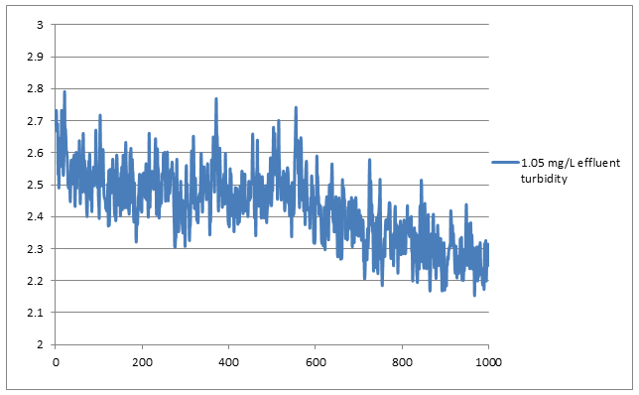
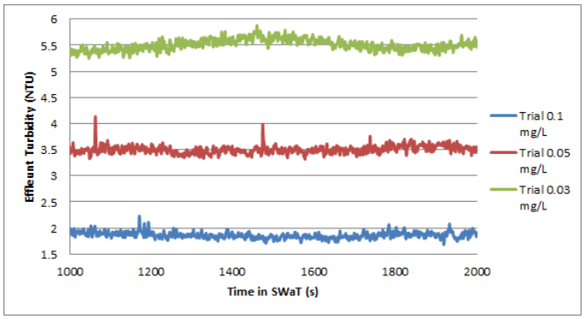
Results: Effluent
1.05 mg/L Trials
0.1, 0.03, 0.05 mg/L Trials

Slide 13


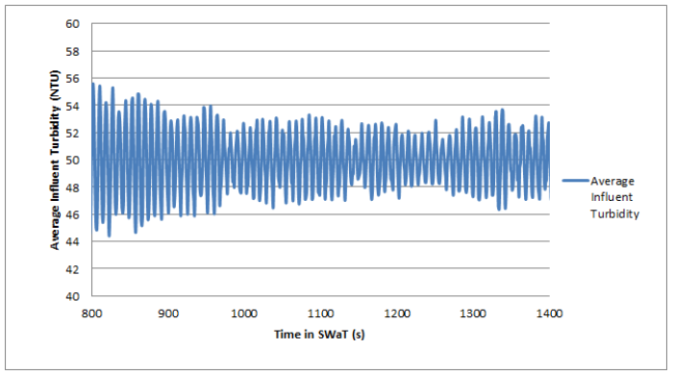
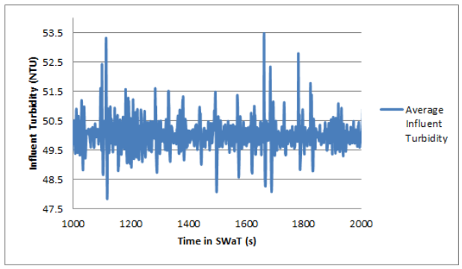


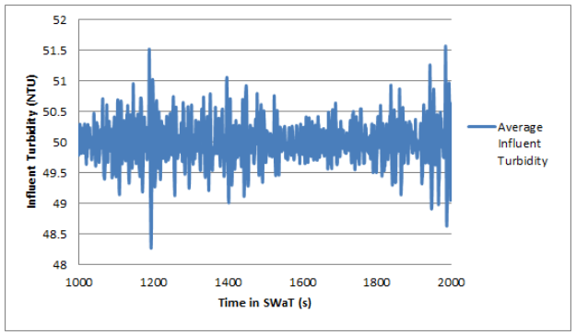
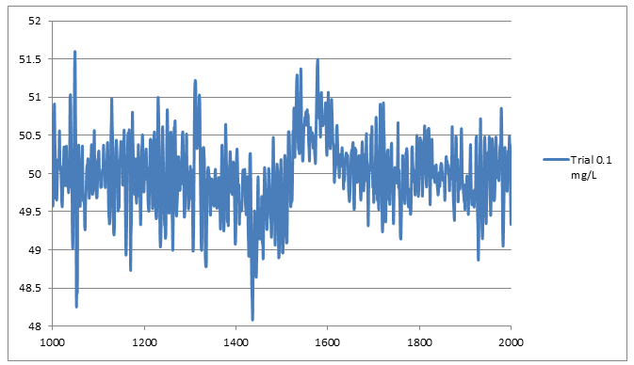
Results: Influent

Slide 14
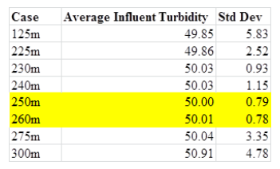
Results: Determining P
PID
  P – represents to what degree the system should change in response to reading
  I – how system responds to amount of past error based on integral
  D – Response based on rate of change of turbidity value

Slide 15
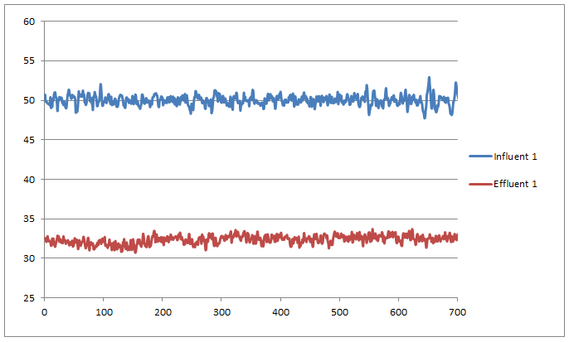
Results: 0 mg/L

Slide 16

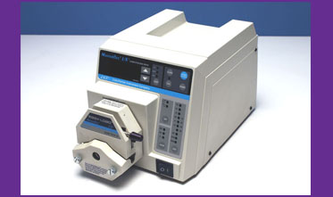
Problems Faced
Understanding the Summer 2014 Method File
Parameters in Process Controller vs. Real Life
    Pump problems
Notes:
Yining

Slide 17
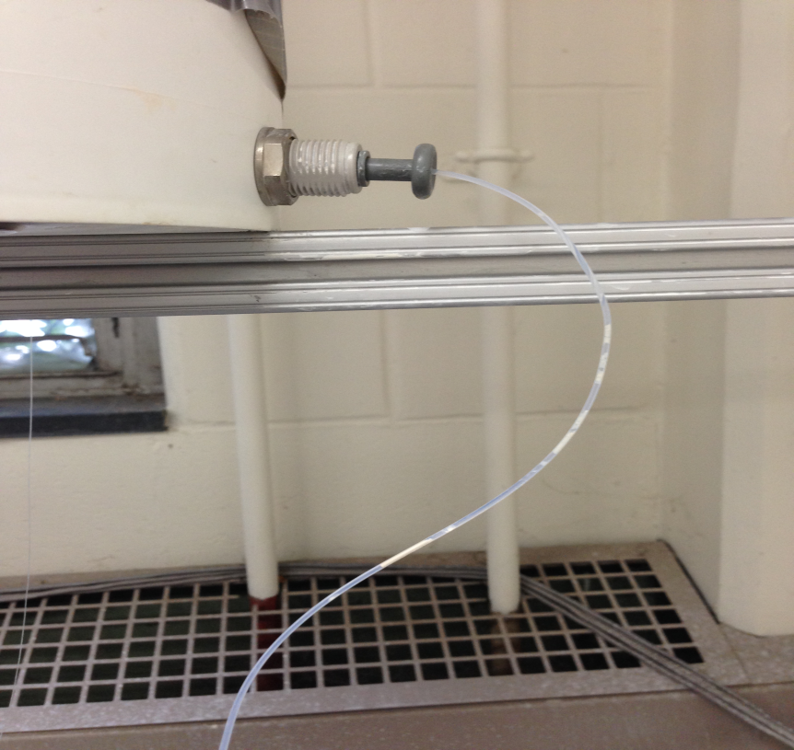
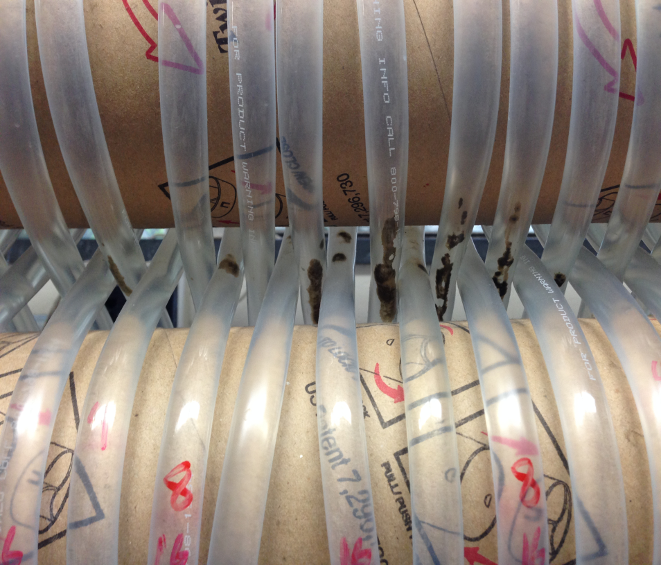
Problems Faced
Clay clogged in PID system
Algae growth in tubes

Slide 18
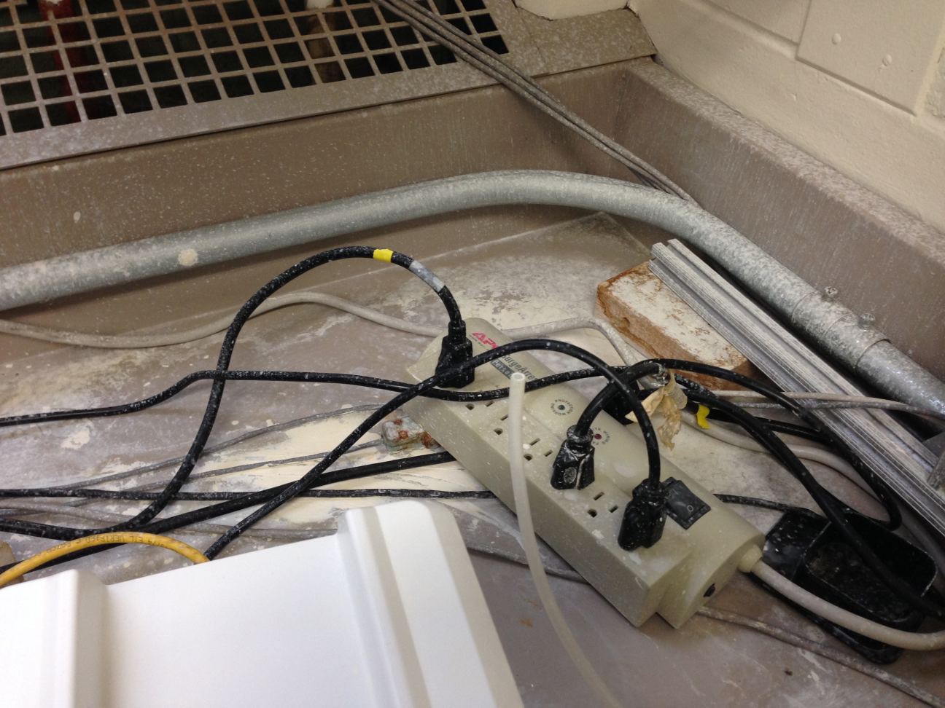
Problems Faced Cont.
Explosions from Clay Bucket

Slide 19
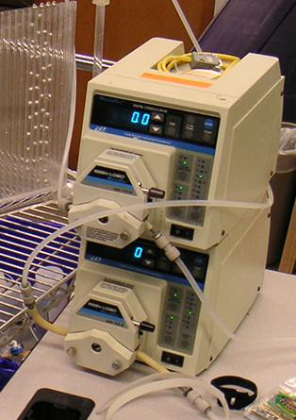
Resolving Problems
Testing PID
Physically measured all input parameters
  Coagulant pump and raw water pump
  Calibrated pumps
Added to the Pre-Experiment Checklist

Slide 20
Future works
Reason for NTU drop in 0 mg/L case
Redo PACl dosages beginning at 0.5 mg/L and either increasing or decreasing by 0.1 mg/L.
Determine nanoglob size
Compare results to Karen Swetland’s data and determine nature of inconsistencies
Test effects of various capture velocities at previously tested dosages
Notes:
Katie

Slide 21

Questions?

