Slide 1
Tube Flocculator
Patience Ruijia Li

Slide 2
Outline
Introduction
Apparatus
Experiments
Results
Conclusion
Future work

Slide 3
Introduction
Tasks
-- Verify existing experiments
-- Break large flocs at regular intervals
Application for AguaClara
-- Update flocculation model to guide design

Slide 4
Hypotheses
Large flocs are useless
Flocs will collide and grow when they travel from one breakup position to another.
Broken flocs can aggregate with small colloids with the same attachment efficiency.

Slide 5
Data is consistent with the hypothesis that large flocs are useless
PACl
Alum
Capture velocity: 0.12 mm/s
244,000 data points
Notes:
These are the results! For a capture velocity of 0.12 mm/s the data collapses to a line with an R^2 around 0.9 for both. Keep in mind that this graph encompasses 244,000 data points…
k = 0.7

Slide 6
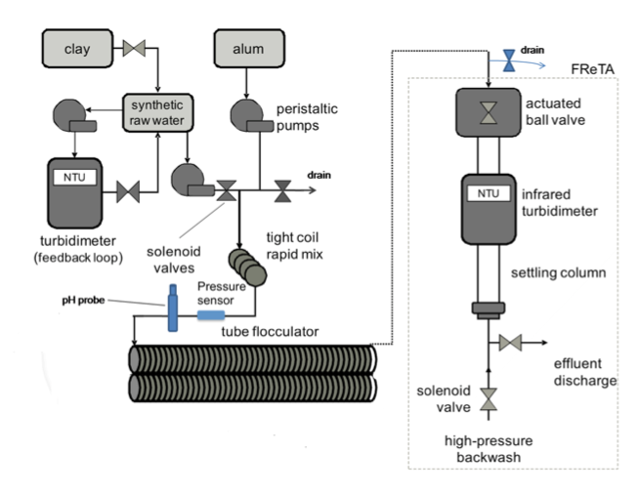
Apparatus schematic

Slide 7
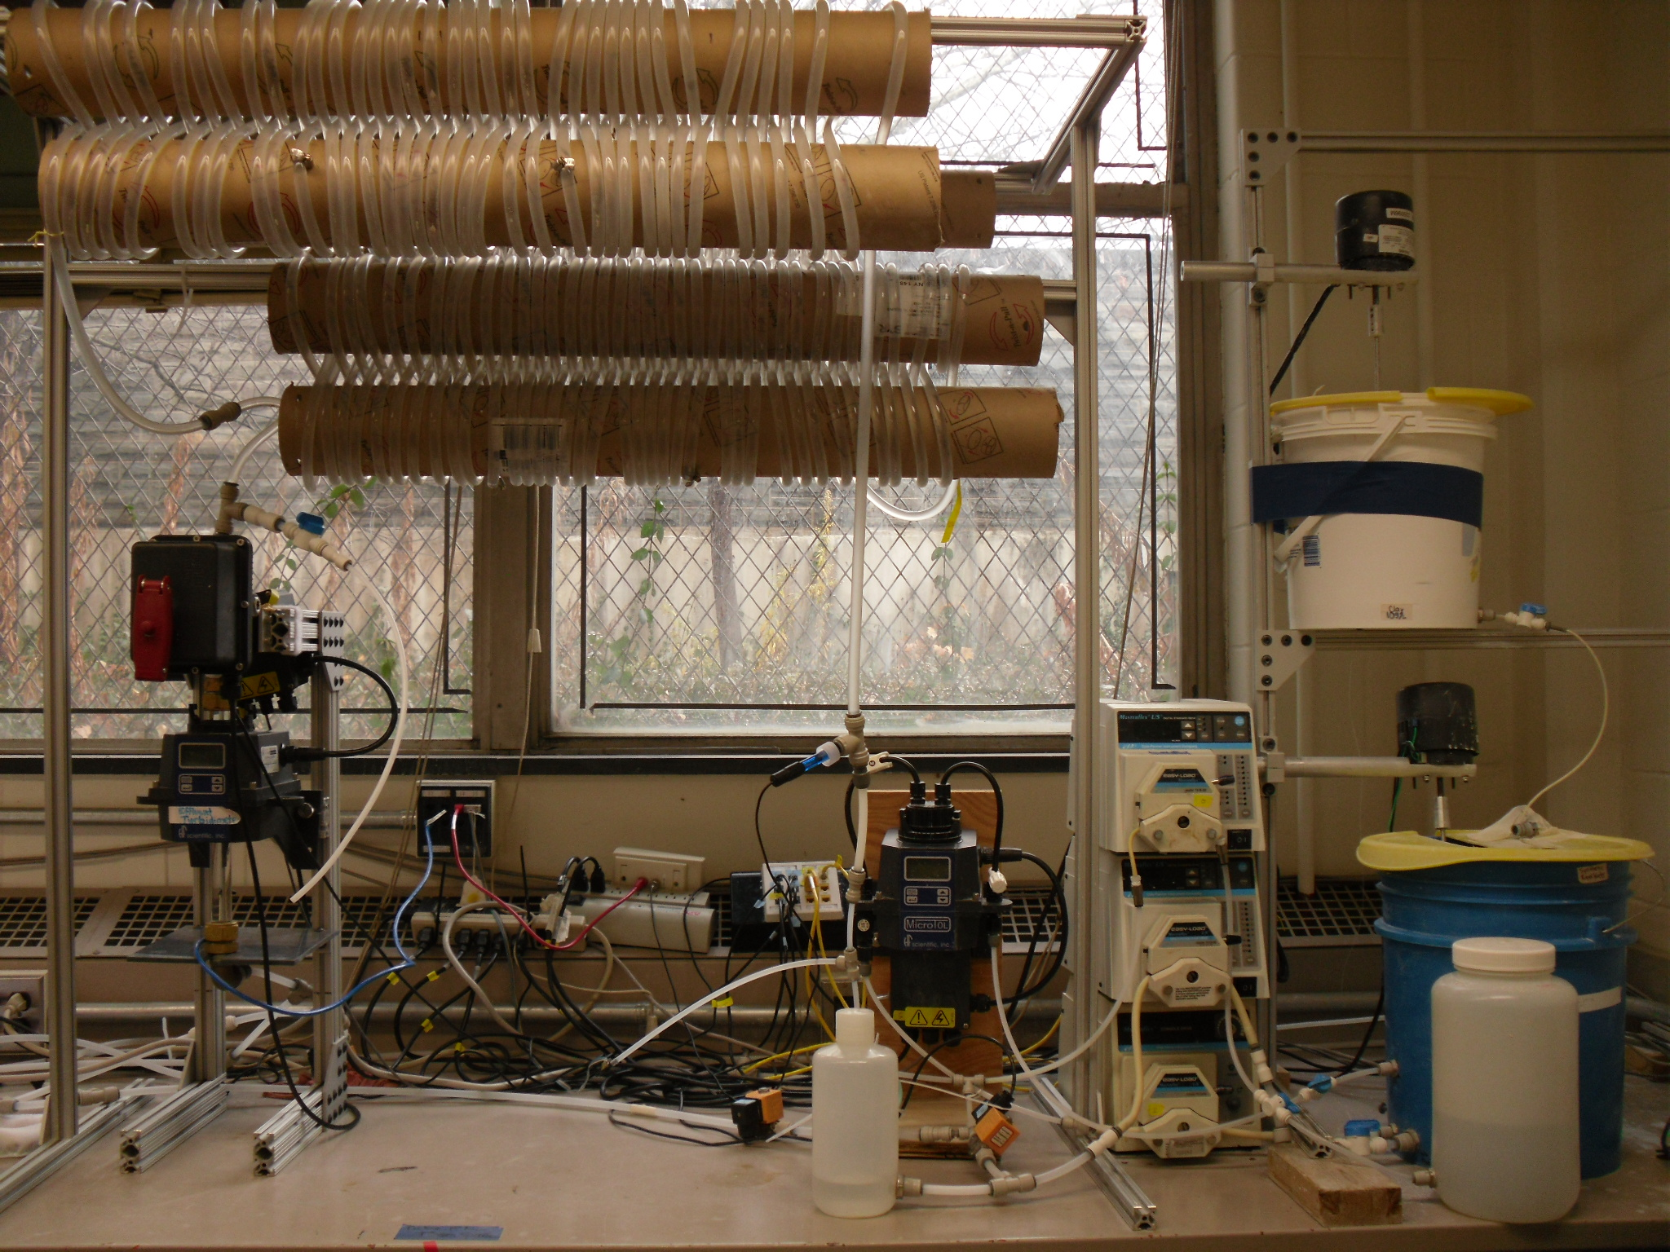

Slide 8
Experiment : verification
Dr. Karen Swetland’s Dissertation research
Notes:
Here we plotted the residual turbidity, the turbidity of the water after settling, against the coagulant dose. We noticed that when we used a log-log plot, there was a linear trend in the data. So we explored further.

Slide 9
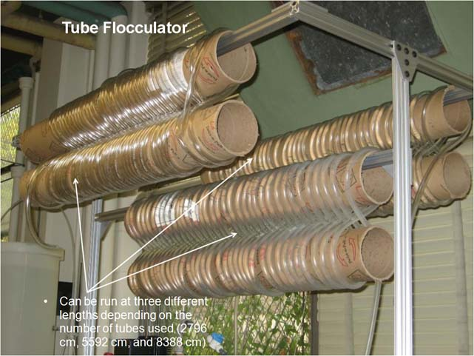
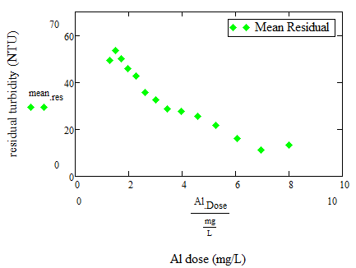

Control Experiment
Set Point | Value
Target influent turbidity | 100 NTU
Raw water flow rate | 5.5 mL/s
Length of tube flocculator | 83.88 m
Alum base | 1.3
Alum coefficient | 1.15
Max reps | 15

Slide 10
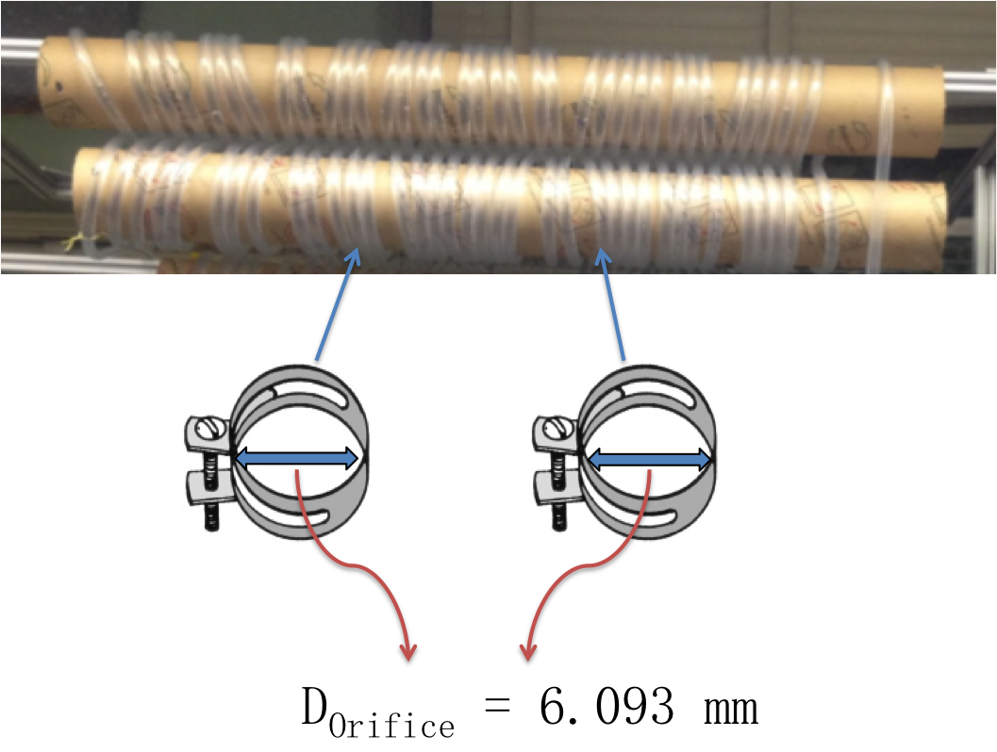
Floc breakup installation
1 cm

Slide 11
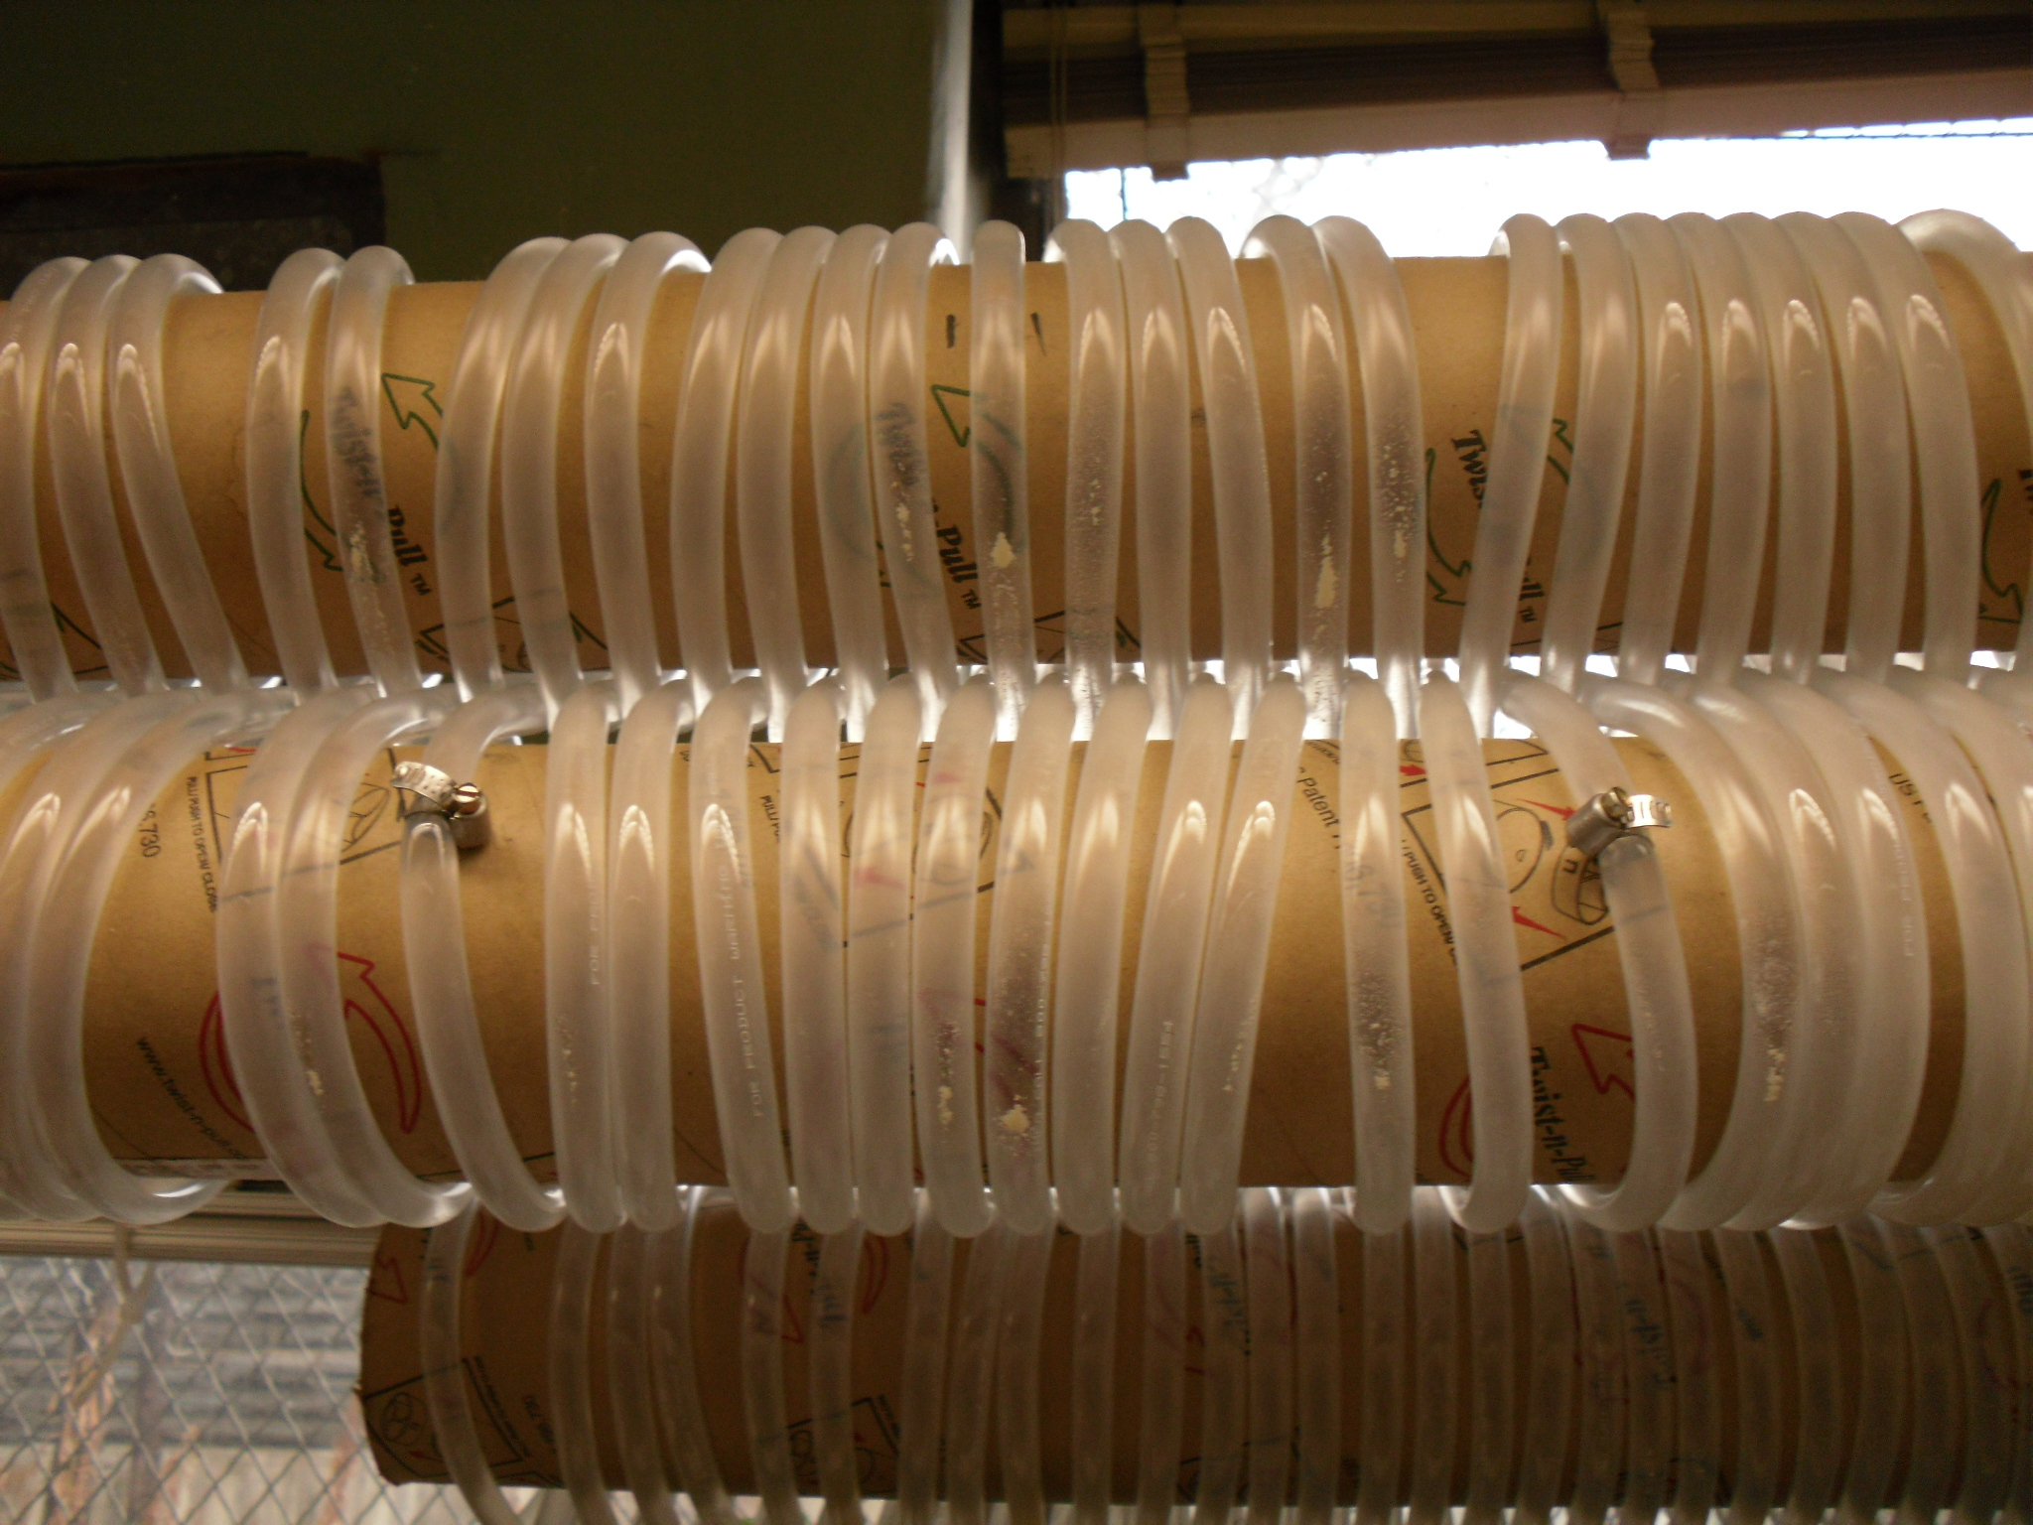
Floc breakup installation

Slide 12
Results
With floc breakup

Slide 13
Results

Slide 14
Conclusion
Breaking large flocs works!!!
Flocculation model update
Design change
Common problems and troubleshooting
https://confluence.cornell.edu/display/AGUACLARA/Problems+and+troubleshooting

Slide 15
Future work
Acid wash – remove coagulants on tube walls
Try different floc breakup intervals to determine optimal spacing of clamps or orifices.
Tapered flocculation

Slide 16

Questions?

