Slide 1

Laminar Tube Flocculator
Fall 2013
Victoria Chou and Yining Dai

Slide 2

Outline
Introduction
Floc Breakup Theory
Base Case Testing
Experiments
Challenges Faced

Slide 3
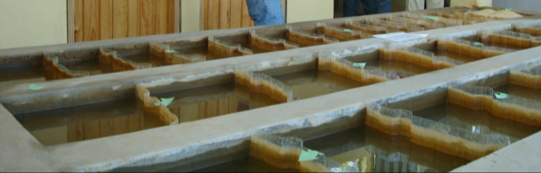
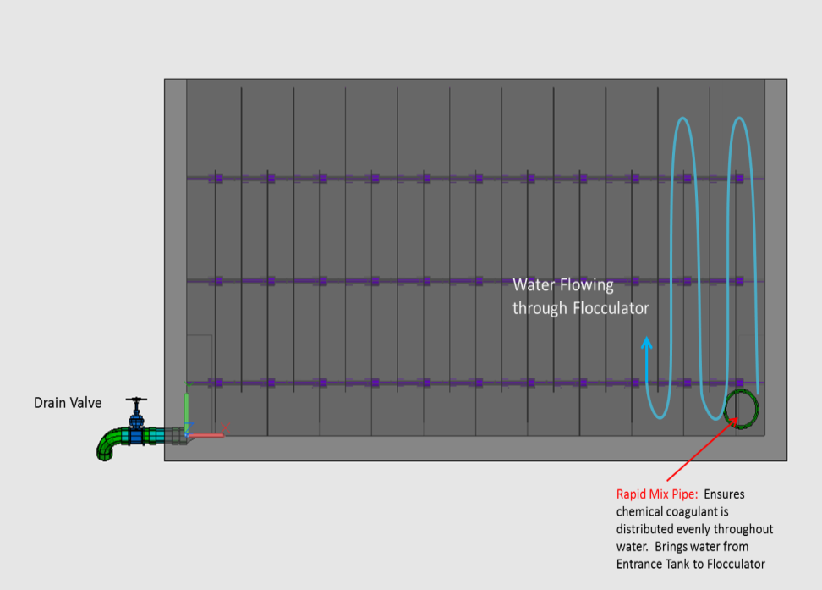
Introduction
Flocculation is an integral part of the water treatment process

Slide 4
Floc Breakup
“Large flocs are useless”
  Shear is too large, so colloids cannot attach
Use clamps to break up flocs so that they can regrow and collect more colloids as they travel

Slide 5
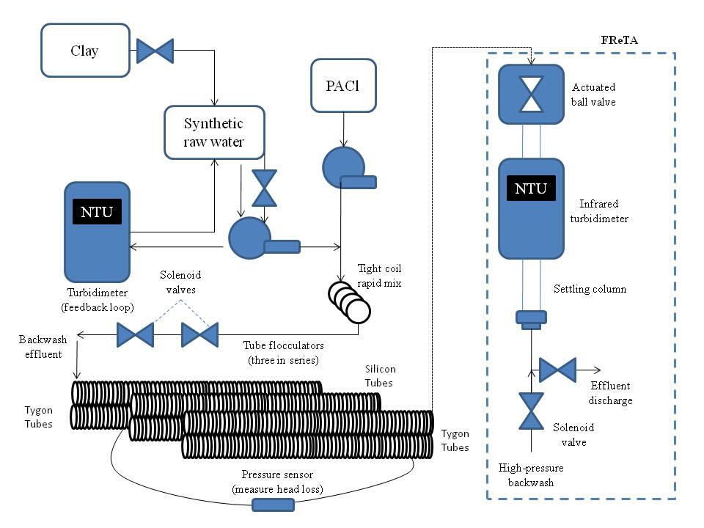
Set Up of Fall 2013 Testing
Notes:
Allow more time for the flocs to grow
Previously the two turbidimeters did not agree with each other
Also they wanted to test tygon tubes vs. silicon tubes (Spring 2013)

Slide 6
Experiment- Process Controller
1. Backwash entire
6. Reopening of ball valve
2. Loading
Operational States
5. Settling
3. Pump ramp down
4. Closing of ball valve
Notes:
Stage 1-3 Yining
Stage 4-6 Vicki

Slide 7
Base Case Testing
Base Case Testing
  Linear dosing
  Power law dosing
  Dose=coefficient x base
  coefficient = .25
  base = 1.25
  max reps = 12
max reps

Slide 8
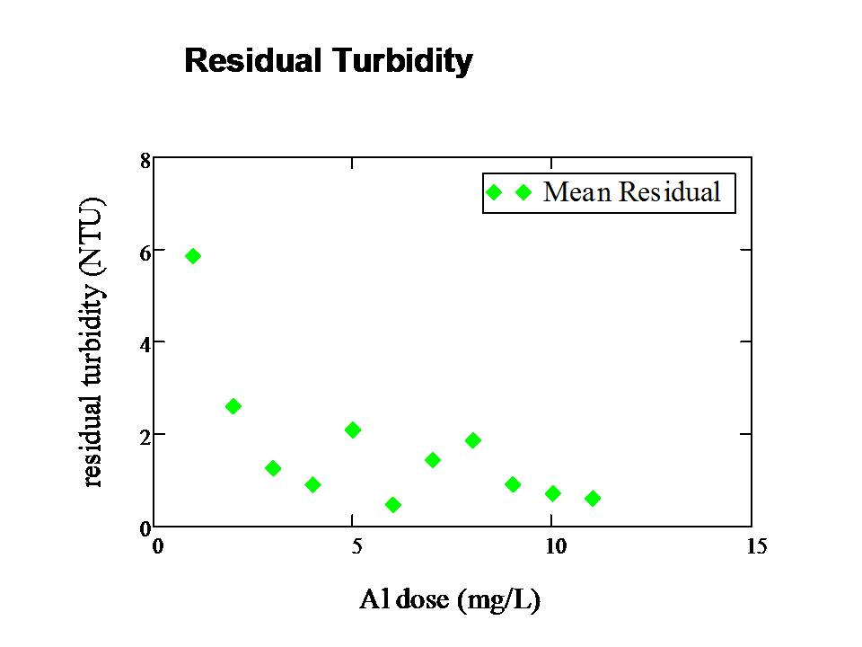
Base Case One

Slide 9
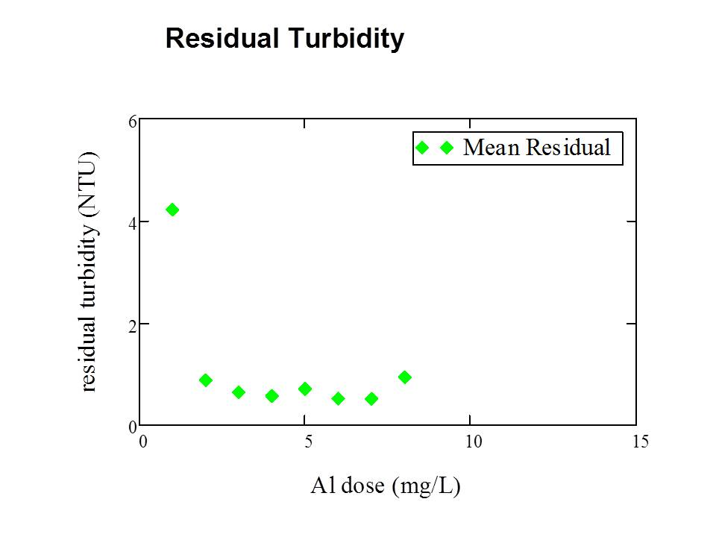
Base Case Two

Slide 10
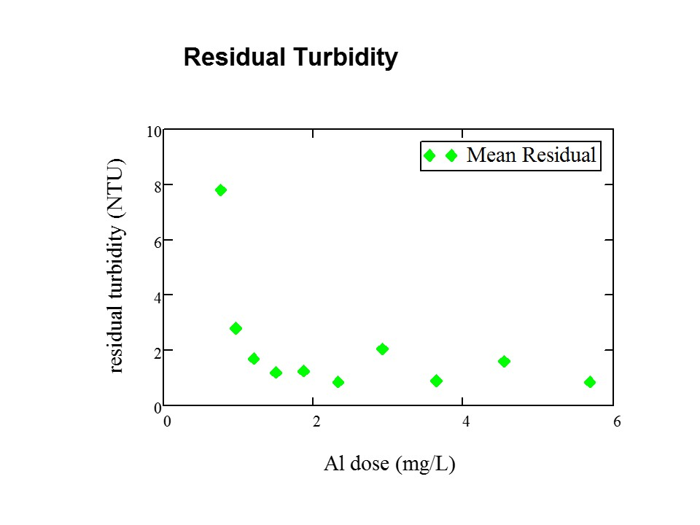
Base Case Three
Notes:
10/11

Slide 11
1st Experiment- Clamp Size
Testing the Effectiveness of Different Sized Clamps
Have ONE clamp on the middle arrangement of tubing
4 mm & 5 mm
Have dosages of 0 to 3 mg/L PACl
4mm
5mm

Slide 12
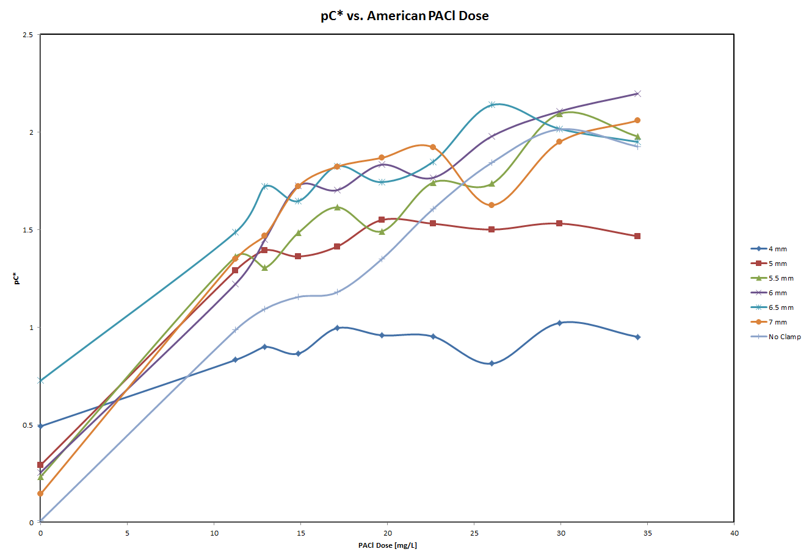
Results of Summer 2013 Research
Notes:
Used results from summer to choose the clamp sizes (4mm-5mm)

Slide 13
Preliminary Results
Notes:
One 4mm clamp
-has higher residual turbidity than with no clamps
-suggesting that floc breakup may not help

Slide 14
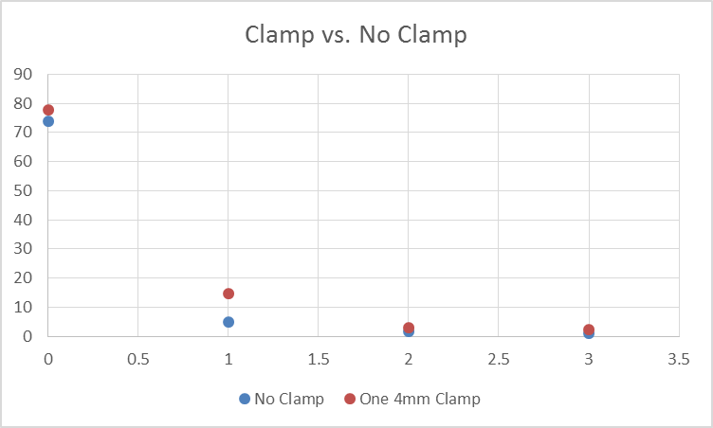
Preliminary Results
Notes:
One 4mm clamp
-has higher residual turbidity than with no clamps
-suggesting that floc breakup may not help

Slide 15
2nd Experiment- Clamp Number
Testing the Effectiveness of Different Number of Clamps
1-16 clamps spread evenly across the middle arrangement of tubing

Slide 16
Challenges Faced
Residual coagulant on tubing
  “Pigging”
Turbidimeters
  Clean the glass column
  Clean the vial
  Calibration
Pump malfunction
Pinch valve
  Keep it unclogged by washing periodically
Algae growth in the tubing
  Replaced with clean tubing

Slide 17
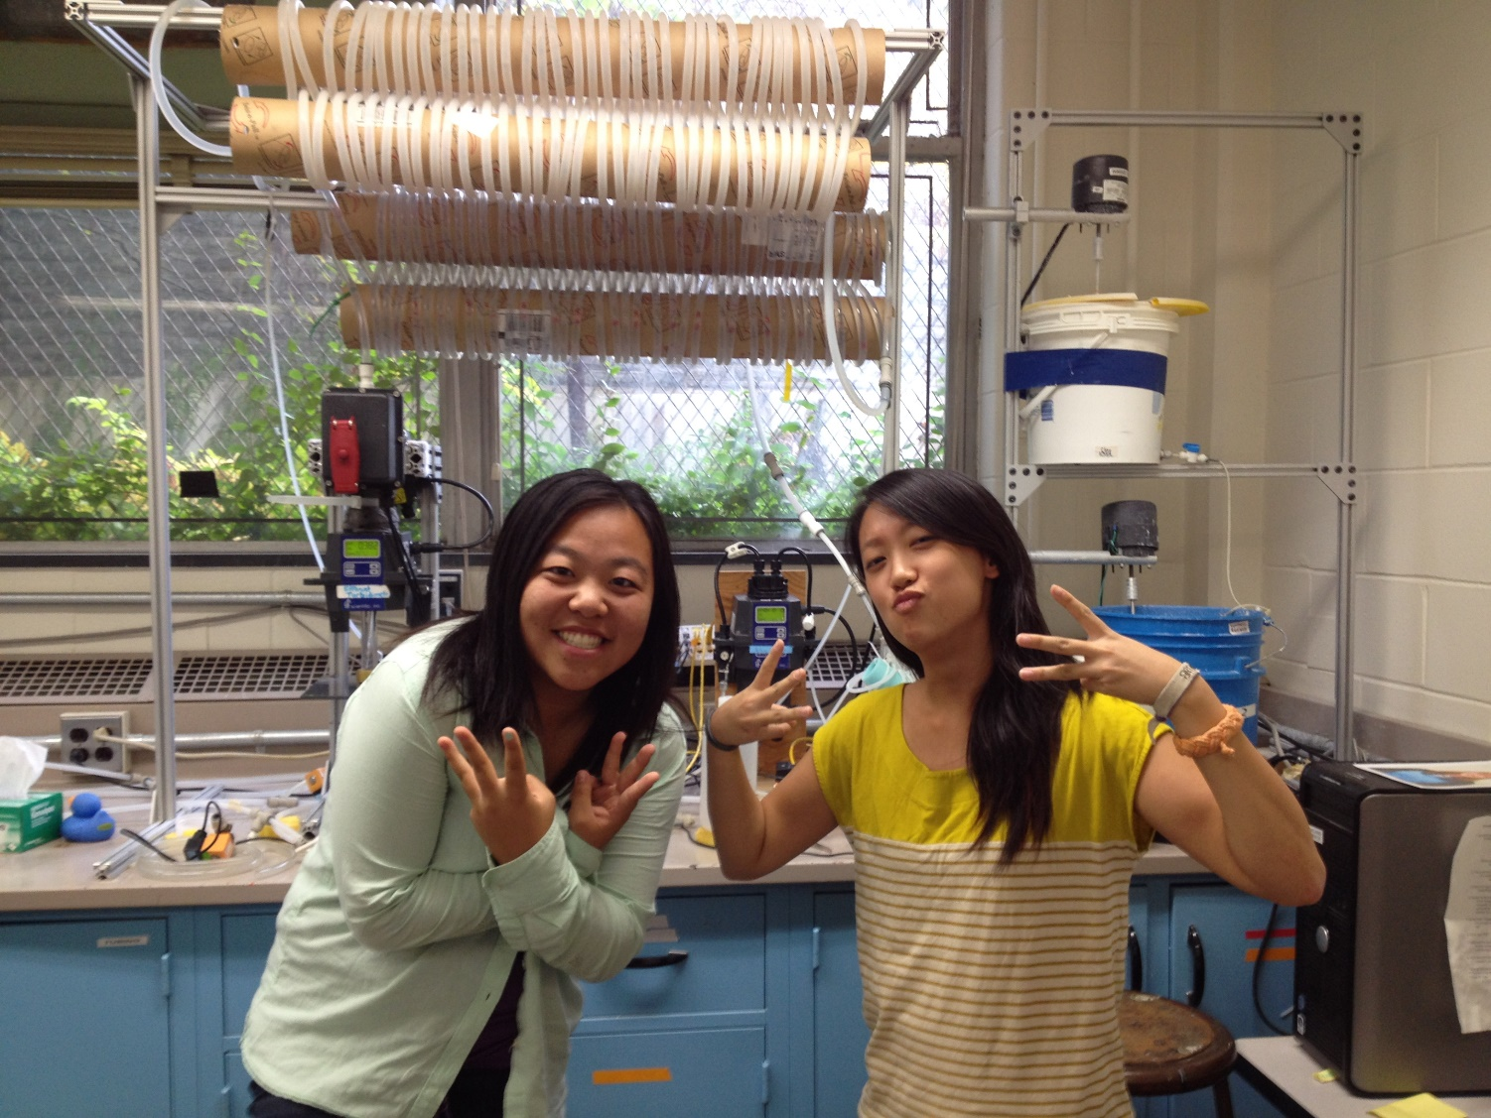
Questions?

