Slide 1
Laminar Tube Flocculator
Luyan Sun, Tanvi Naidu, and Kevin Shao

Slide 2
Laminar Tube Flocculator Spring 2015
How does our work fit into the big picture of AguaClara research?
Key Deliverables
Importance & Impact
Flocculation Mechanism
Apparatus
Produced reliable and repeatable results
Provided additional proof to the theory of flocculation AguaClara teams developed
Process Controller
Determined P and I values
Design of Hydraulic Flocculator
The model can be applied as a basis for designing flocculators in AguaClara plants
Made possible for future AguaClara teams to explore alternate flocculator designs
Flocculation Model
Validated the model for SWaT System
Notes:
How does our work fit into the big picture of AguaClara research?

Slide 3
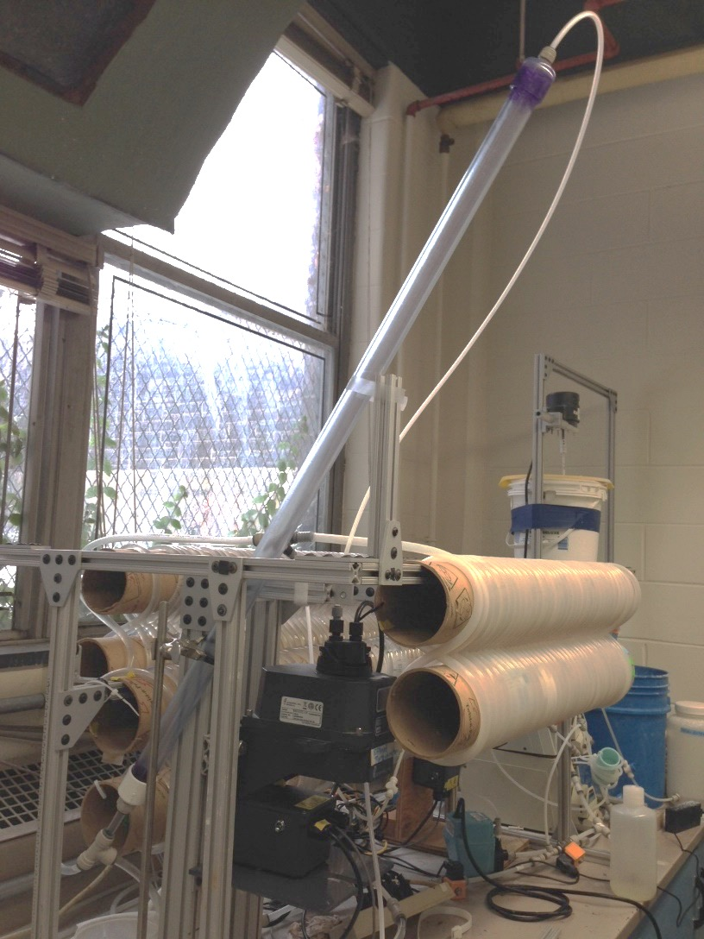
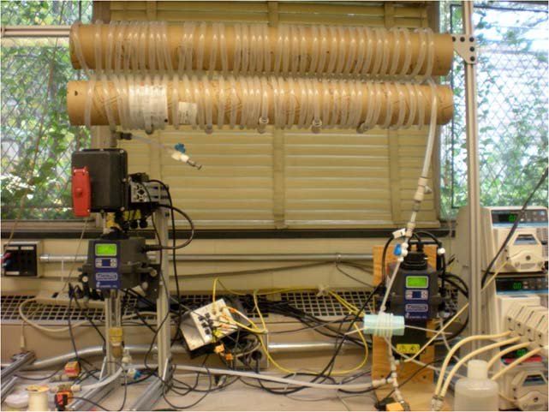
Ex1: FReTA VS SWaT
FReTA (Flocculator Residual Turbidity Analyzer)
Background slide-- tanvi
SWaT (Settled Water Turbidity Analyzer)
Continuous flow system with a tube settler
More closely models plate settlers in actual AguaClara plants
Measures both settling velocity and residual turbidity under different flocculator operating conditions
Notes:
Swat is the new residual turbidity monitoring system
But there were fluctuations in the data due to flocs being recirculated within the glass column
Continuous flow system with a tube settler
More closely models plate settlers in actual AguaClara plants

Slide 4
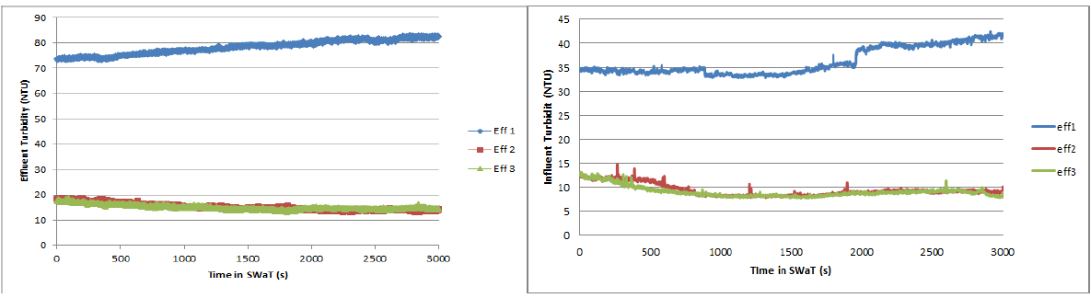
Improvements to apparatus
PACl solution minimum concentration
Use of finer, less compacted clay
Addition of barbs and replacement of flexible tubing

Slide 5
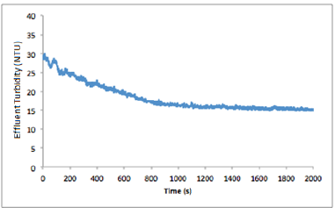
Improvements to apparatus
Increase in loading time

Slide 6
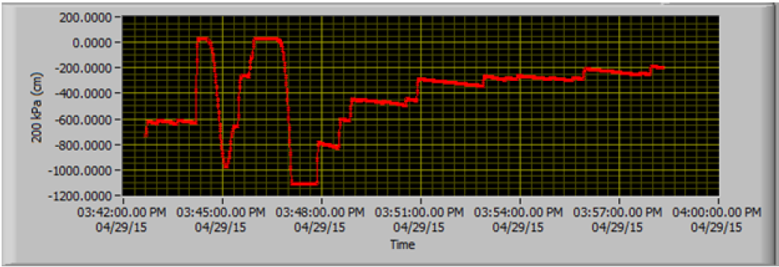
Improvements to apparatus
Replacing Peristaltic pump-head due to periodic pressure drops.

Slide 7
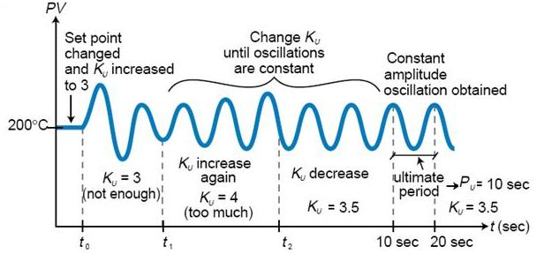

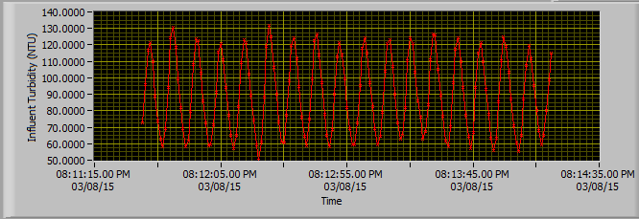
Determining P and I
Zeigler - Nichols Method
← P =500m

Slide 8
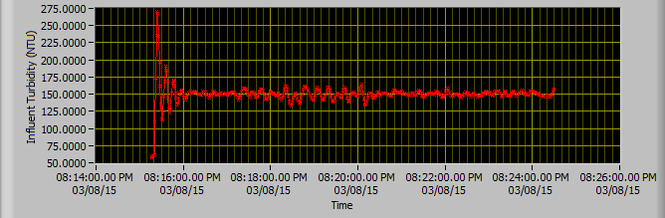
Determining P and I
Observed constant level with small variation (less than 10% of the target NTU 150) March 8.

Slide 9
Trials – Consistent Influent Turbidity

Slide 10
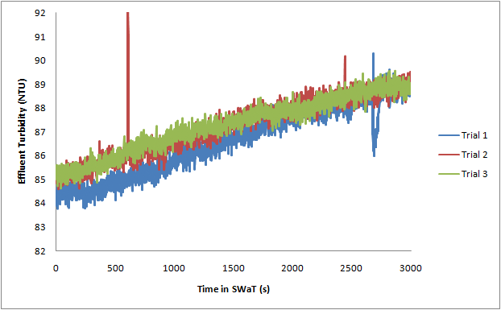
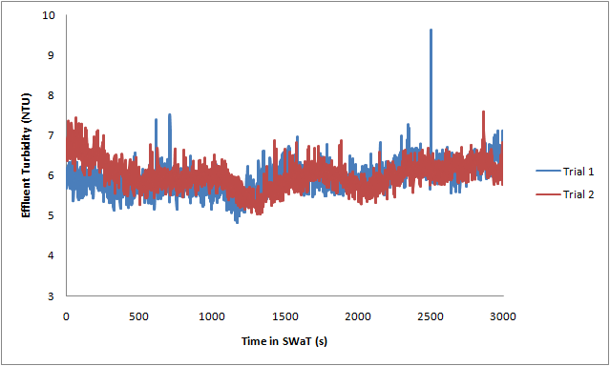
Results
Baseline
General Case
0 mg/L Aluminum Dosage
0.04, 0.05, 0.06, 0.08 mg/L
0.1 to 0.7 mg/L increments of 0.1 mg/L

Slide 11
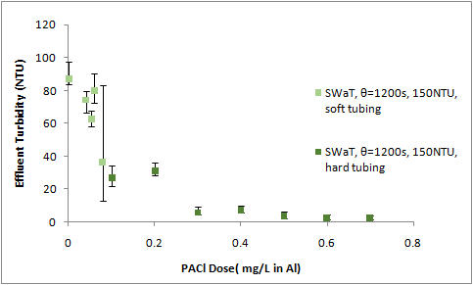
Results from SWaT
Effluent turbidity decreased significantly at low PACl dose and reached a lower limit of 2.6 NTU as PACl dose increased beyond 0.5 mg/L in Al.

Slide 12
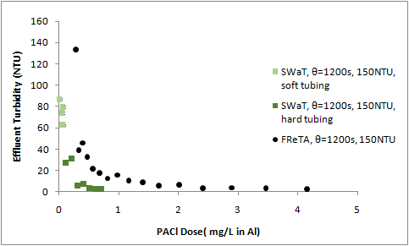
FReTA vs SWaT
SWaT system with the finer PACl reduced more turbidity than the FReTA system using the granular PACl.

Slide 13

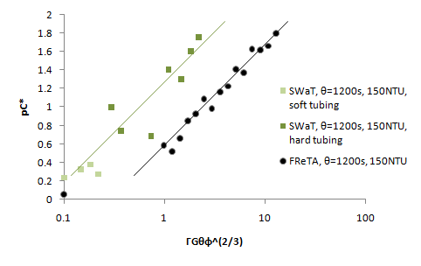
Performance Comparison
y _SWaT= 0.496ln(x) + 1.233
R² = 0.853
Confirmed
y _FReTA= 0.498ln(x) + 0.532
R² = 0.974

Slide 14
Future works
If offset is consistent, there might be modifications to make the the model (different intercept).
Liquid PACl instead of granular
How the model would be adapted for other influent turbidity?
Other coagulants
Taper
Ideal floc size
DOM

Slide 15

Lessons learned
Better understanding of process controller and apparatus
How to trouble-shoot the apparatus efficiently
Using our resources effectively (such as pressure sensor!)
Teamwork and effective communication
-- tanvi

Slide 16
Thank you!

Slide 17
Appendix

Slide 18
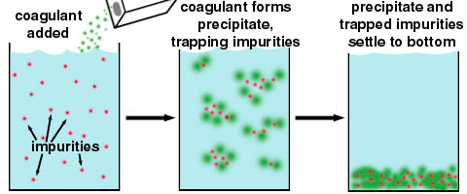
Flocculation
An essential process that transforms small colloidal particles into larger particles so that they can settle out in a sedimentation tank.
Requires sticky particles and successful collisions between particles
Source: http://water.me.vccs.edu/courses/env110/lesson4.htm

Slide 19
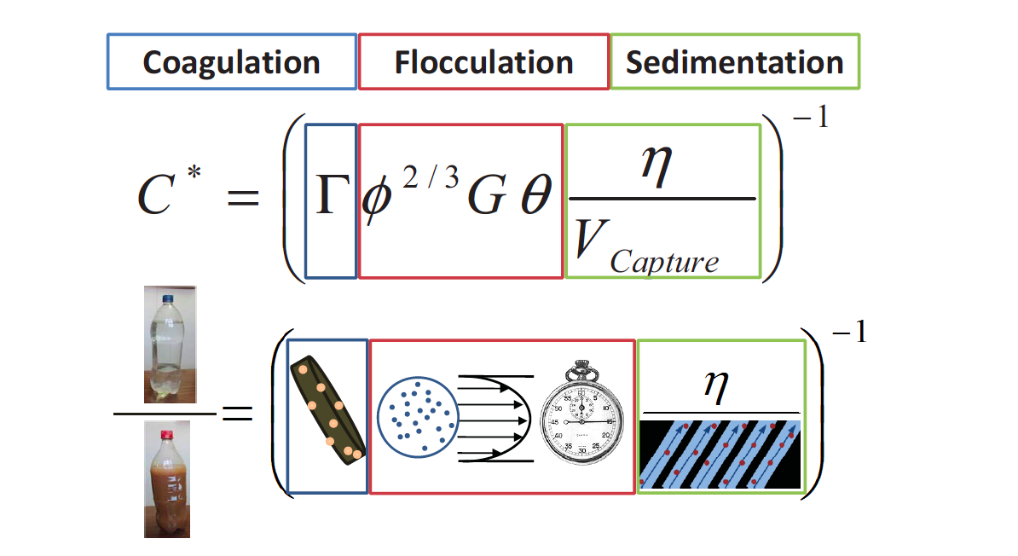

Slide 20
Laminar Flow Floc Model
Sedimentation velocity of ???
Collisions to make first big flocs = 0.4
Empirical
Floc volume fraction
Fractional surface coverage of colloid by coagulant
Lambert W Function
Flocculation time
Sedimentation tank capture velocity
Velocity gradient
Notes:
Monroe’s cee 4540 slide

