Slide 1
Laminar Tube Flocculator
Luyan Sun, Tanvi Naidu, and Kevin Shao

Slide 2
Laminar Tube Flocculator Agenda
Introduction and Team Goals
Previous work and experiment set-up
Progress & Result in Spring 2015
  Pump Calibration
  Correction Factor
  Tuning PI value
  Recent tests
Challenges and Plans for Future work

Slide 3
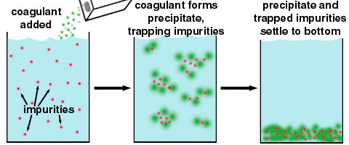
Flocculation
An essential process that transforms small colloidal particles into larger particles so that they can settle out in a sedimentation tank.
Requires sticky particles and successful collisions between particles
Source: http://water.me.vccs.edu/courses/env110/lesson4.htm

Slide 4
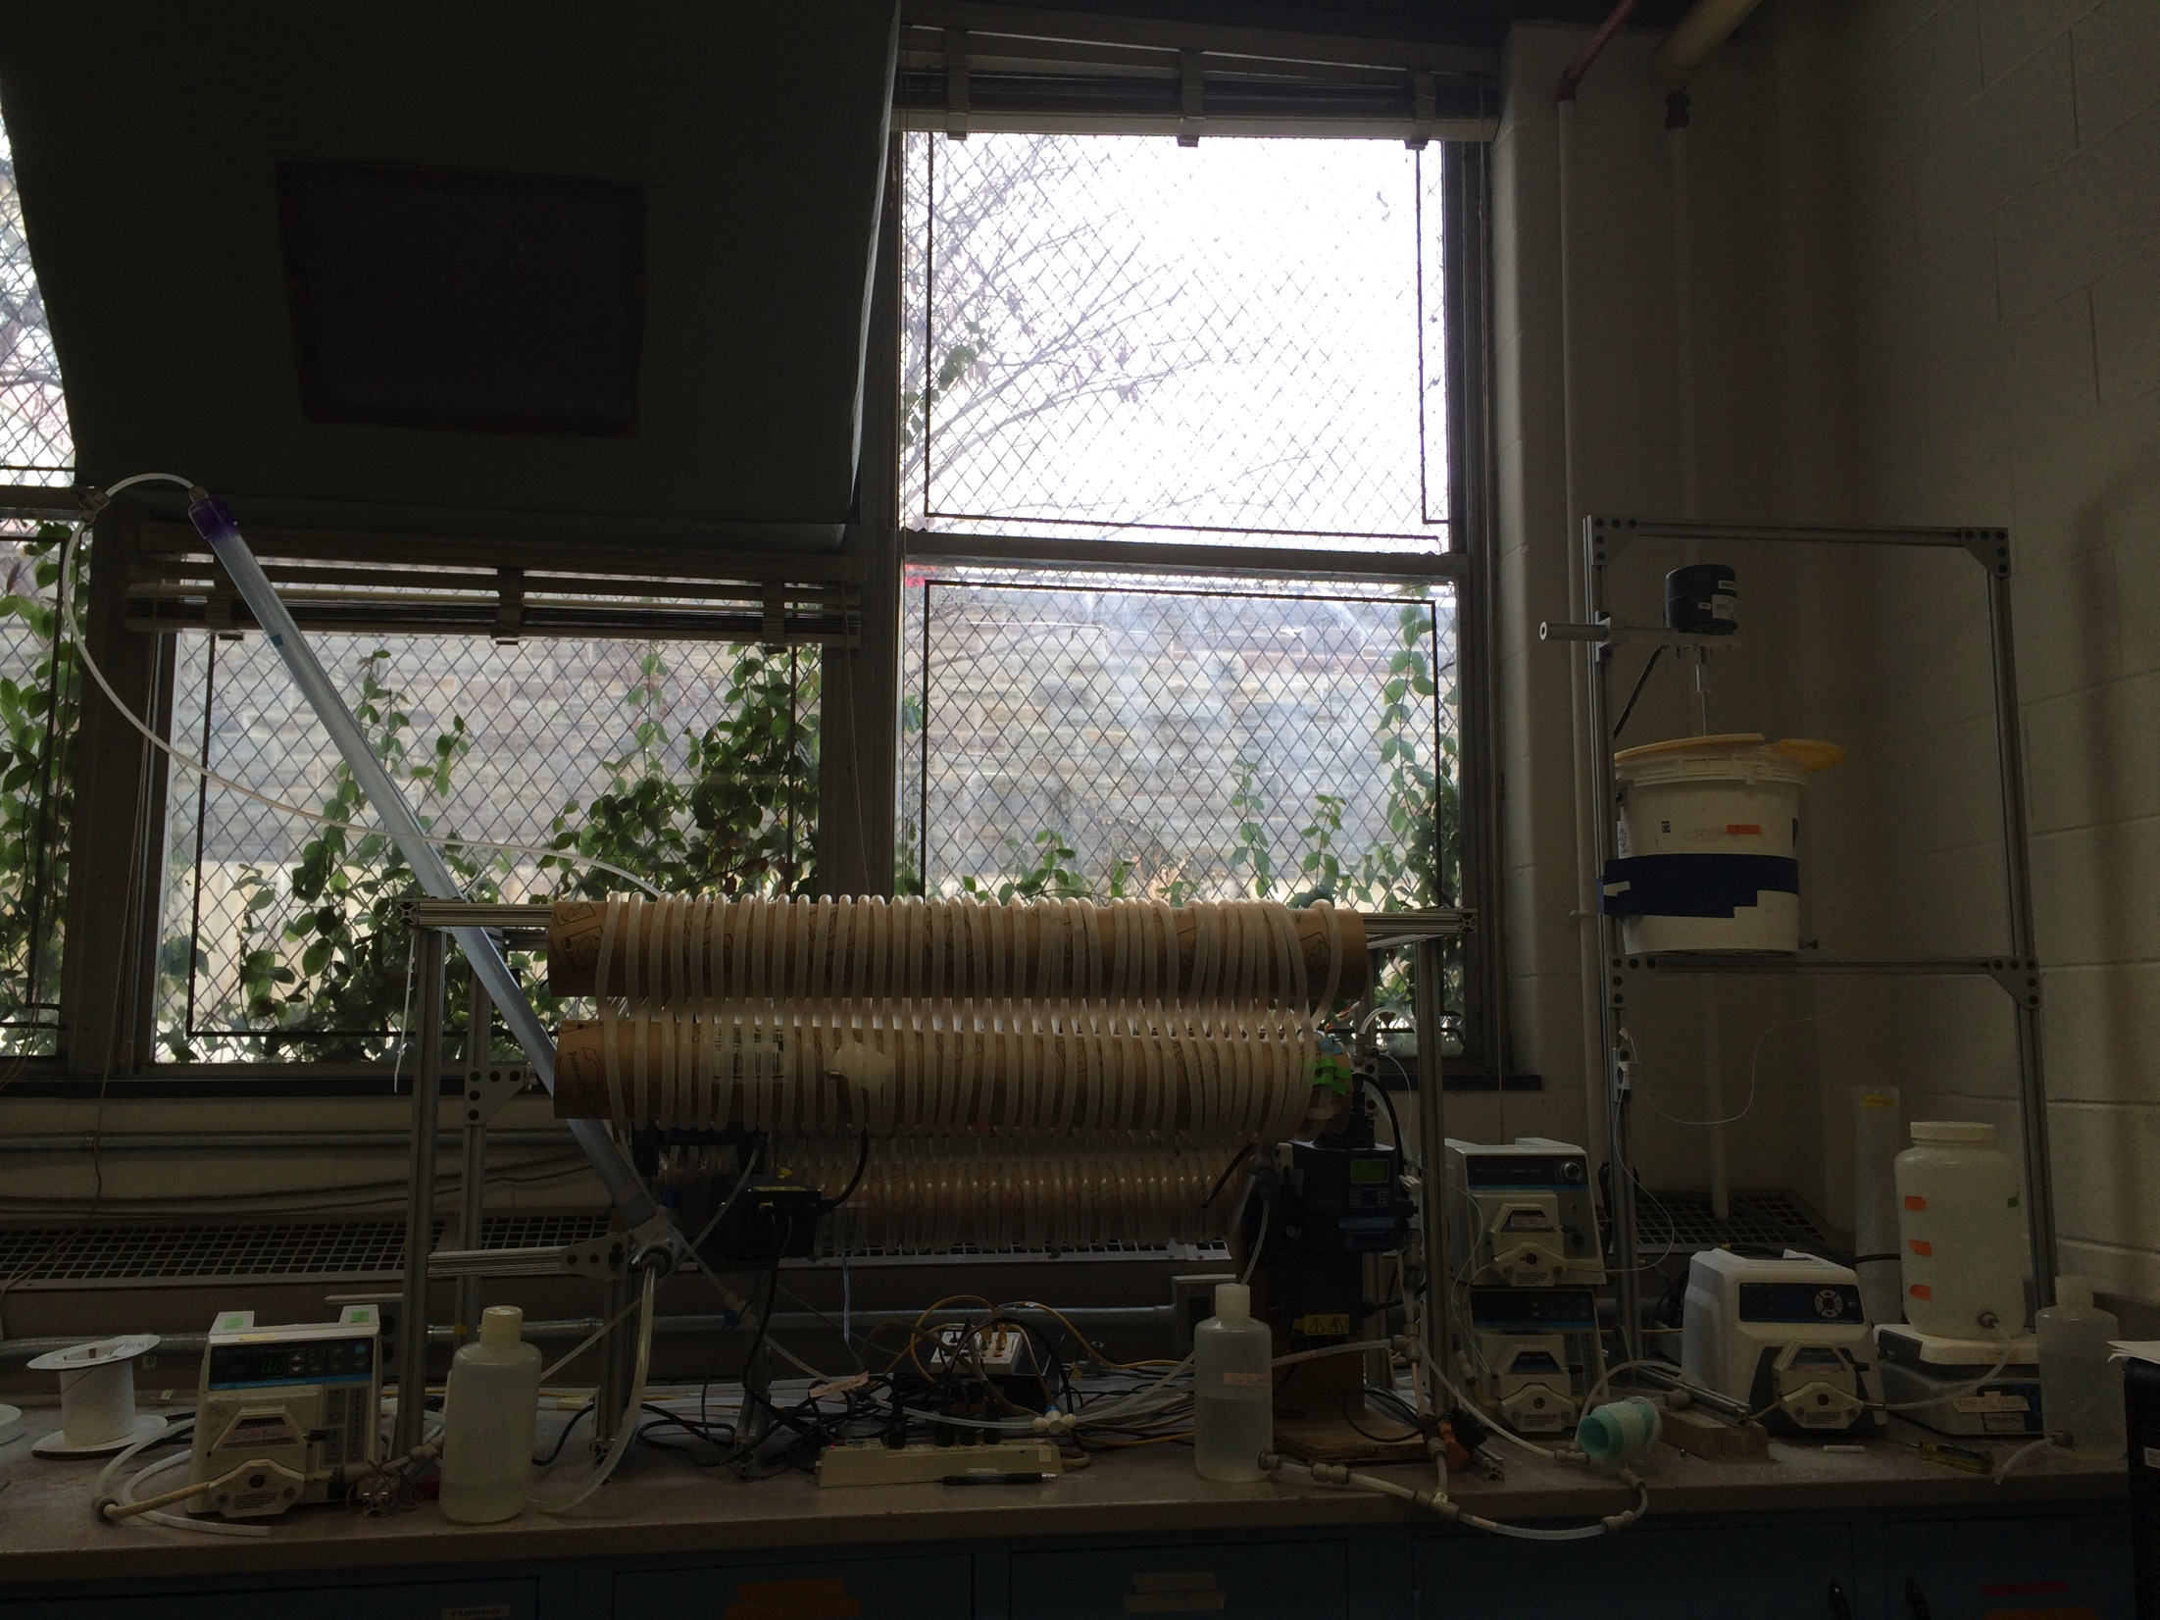
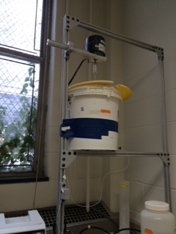
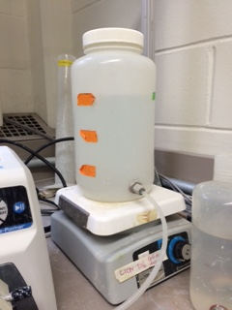
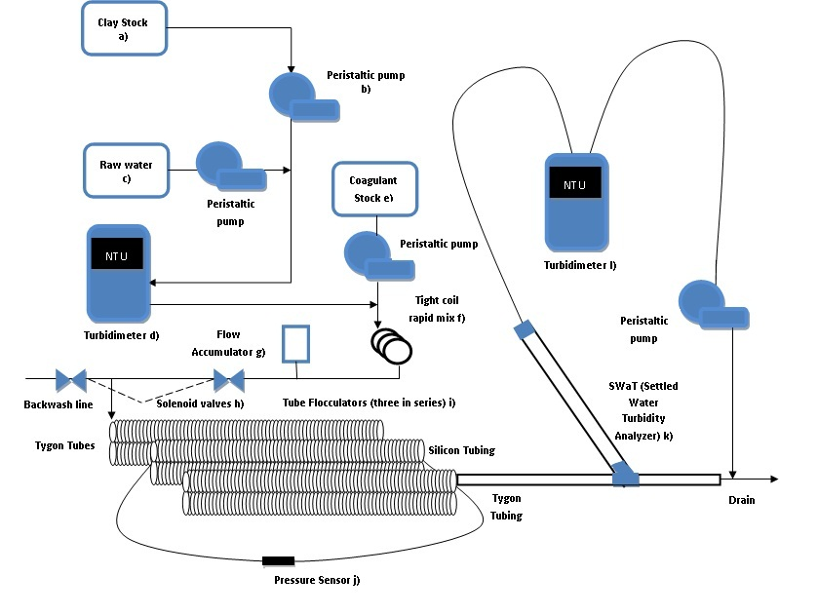
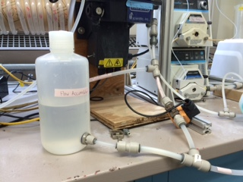
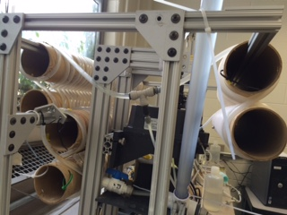
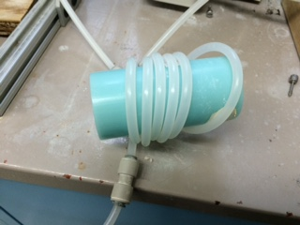
Schematic
First and third: Tygon tubing
Second: silicone
Source: Laminar Tube Flocculation Final Report, Summer 2014
Notes:
Schematic of the experimental assembly
Polyaluminum choloride

Slide 5
Five States in Process Controller
Off
Backwash w/ pump
Backwash no tube
Loading
SWaT
Notes:
Backwash With pump: with the tap water pump, tube settler pump
No tube: without the tube settler pump – but with the tap water pump
Loading: tap, tube settler, pacl pump

Slide 6
Goals
Troubleshoot system errors
This is the real challenge..
Experiment 1: SWaT comparison with FReTA
Experiment 2: Floc breakup
Experiment 3: Dissolved Organic Matter
Notes:
Problem of using the wrong tubing size in the pump control method files in process control
can combine with small clay particles and also be separated in the sedimentation tank.
study how dissolved organic matter (DOM) affects the performance of the flocculator

Slide 7
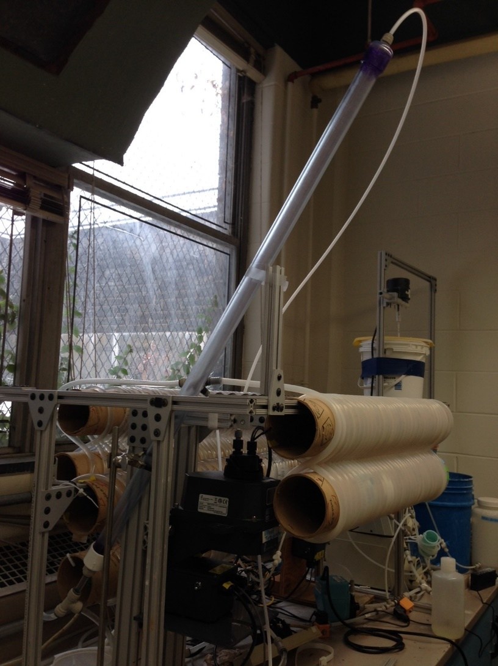
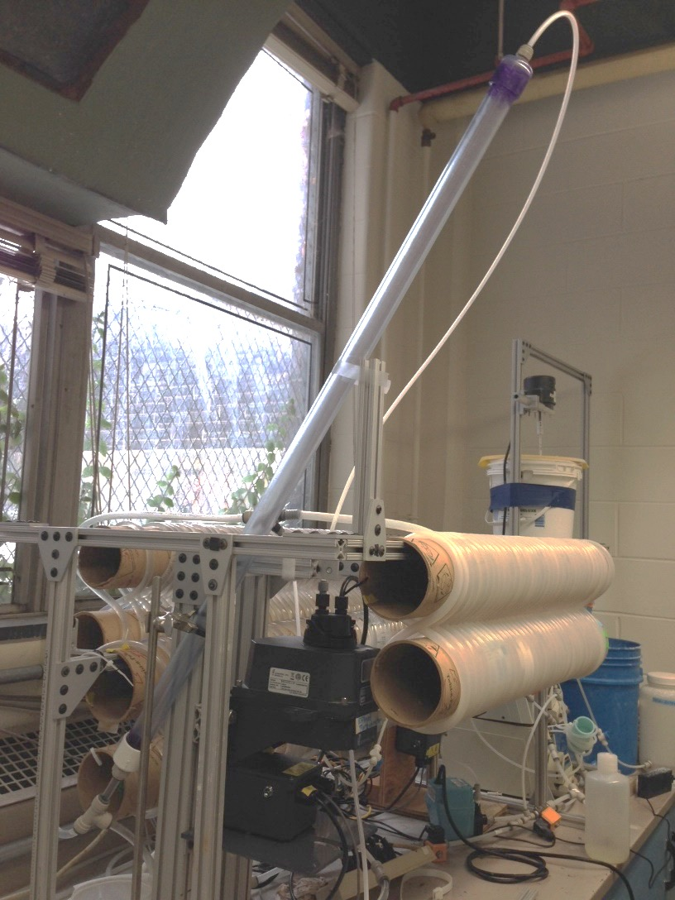
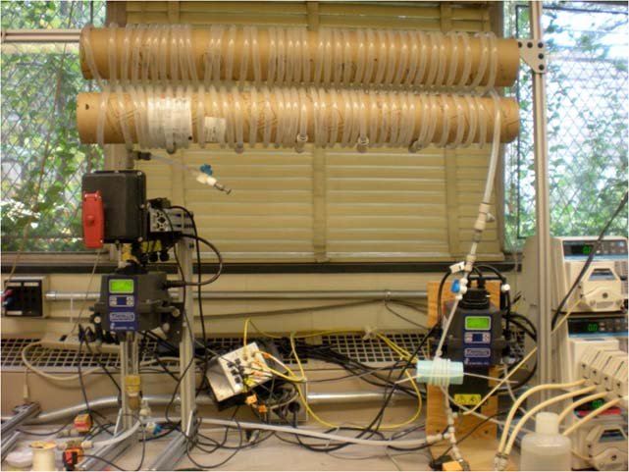
Ex1: FReTA VS SWaT
FReTA (Flocculator Residual Turbidity Analyzer)
SWaT (Settled Water Turbidity Analyzer)
Continuous flow system with a tube settler
More closely models plate settlers in actual AguaClara plants
Measures both settling velocity and residual turbidity under different flocculator operating conditions
Notes:
Swat is the new residual turbidity monitoring system
But there were fluctuations in the data due to flocs being recirculated within the glass column
Continuous flow system with a tube settler
More closely models plate settlers in actual AguaClara plants

Slide 8
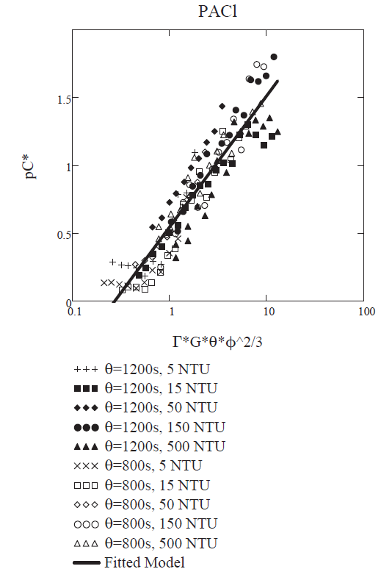
Ex1: Results from FReTA
Notes:
the residual turbidity, the turbidity of the water after settling, against the coagulant dose. We noticed that when we used a log-log plot, there was a linear trend in the data.

Slide 9
Correction Factor for Last Semester’s Data
Some Fall 2014 results were at incorrect dosages due to incorrect tubing size
OLD DOSE (mg/L) | 0.01 | 0.03 | 0.05 | 0.1
OLD PS (RPM) | 2.3 | 3.0 | 4.17 | 8.33
NEW PS (RPM) | 2.3 | 2.3 | 2.3 | 2.9
CORR FACTOR | 1 | 1.30 | 1.81 | 2.87

Slide 10
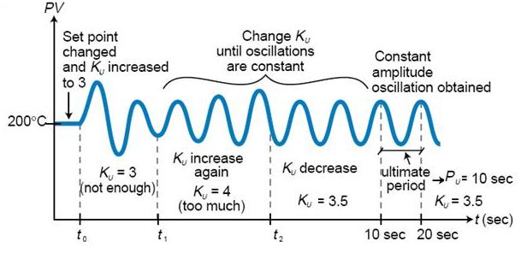

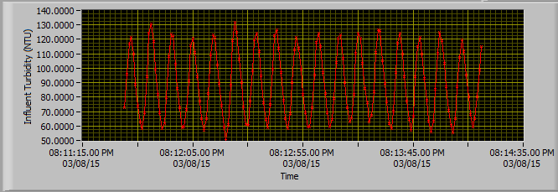
Determining P and I
Zeigler - Nichols Method
← P =500m

Slide 11
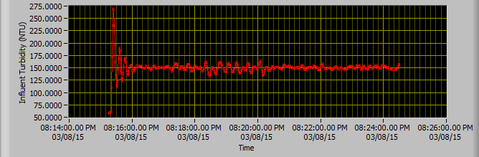
Results of Determining P and I
Observed constant level with small variation (less than 10% of the target NTU 150) March 8.

Slide 12
Trials – Consistent Influent Turbidity

Slide 13
Trials – Inconsistent Effluent Turbidity

Slide 14
Trials – With PACl Stirrer and Loose Cap
Influent Turbidity
Effluent Turbidity

Slide 15
Trials – Without PACl Stirrer and Loose Cap
Influent Turbidity
Effluent Turbidity

Slide 16
Future works
Figure out what’s going on: trouble-shoot component by component. Why are effluent turbidity values increasing despite adding the magnetic stirrer
Finish verifying the results obtained Karen Swetland.
Conduct experiments to determine ideal floc size
Conduct experiments to study how Dissolved organic matter

Slide 17
Challenges & Questions
The GREAT FLOOD
Getting used to the process controller
Manually calibrated raw water pump because RPM was not translating to the required flow rate
Determining P and I through trial and error
Loading time was not sufficient because we increased influent turbidity so it took longer to settle out to a consistent value
Effluent turbidity not consistent

Slide 18
Thank you!

Slide 19
Appendix

Slide 20
Laminar Flow Floc Model
Sedimentation velocity of ???
Collisions to make first big flocs = 0.4
Empirical
Floc volume fraction
Fractional surface coverage of colloid by coagulant
Lambert W Function
Flocculation time
Sedimentation tank capture velocity
Velocity gradient
Notes:
Monroe’s cee 4540 slide

