Slide 1

Laminar Tube Flocculator
Spring 2014
Victoria Chou and Yining Dai

Slide 2

Outline
Introduction
Semester Goals
SWaT Measurement System
Experiments

Slide 3
Introduction
The purpose of flocculation in the water treatment process is…
  to allow particles suspended in the water to collide with each other to coagulate and transform into larger flocs
  to improve the performance of sedimentation
  to reduce the number of colloids
Notes:
Have students answer this question through polleverywhere?

Slide 4
Floc Breakup Theory
“Large flocs are useless”
  Shear is too large, so colloids cannot attach
Use clamps to break up flocs so that they can regrow and collect more colloids as they travel

Slide 5
Floc Breakup Theory

Slide 6
Floc Breakup Theory

Slide 7
Goals
Design and implement SWaT
Run base case testing
Clamp testing – Experiment One
Conclusions on Floc Break up Theory
Tapered Flocculation?

Slide 8
SWaT
“Settled water turbidity” measurement system
Replace FReTA (Flocculator Residual Turbidity Analyzer)
Continuous flow system with a tube settler
More closely models plate settlers in actual AguaClara plants

Slide 9
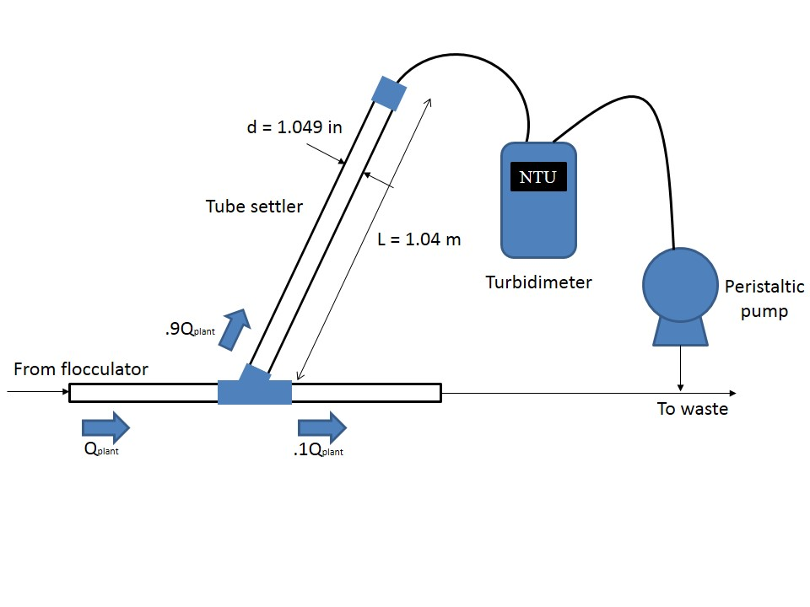
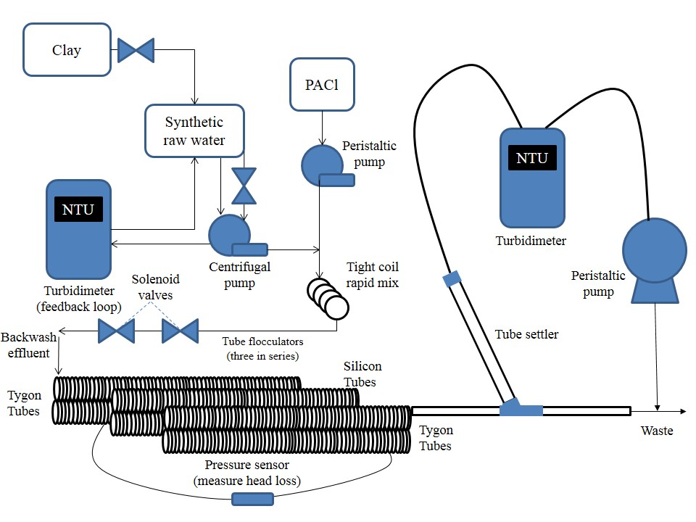
Set Up
60 °
Notes:
Allow more time for the flocs to grow
Previously the two turbidimeters did not agree with each other
Also they wanted to test tygon tubes vs. silicon tubes (Spring 2013)

Slide 10
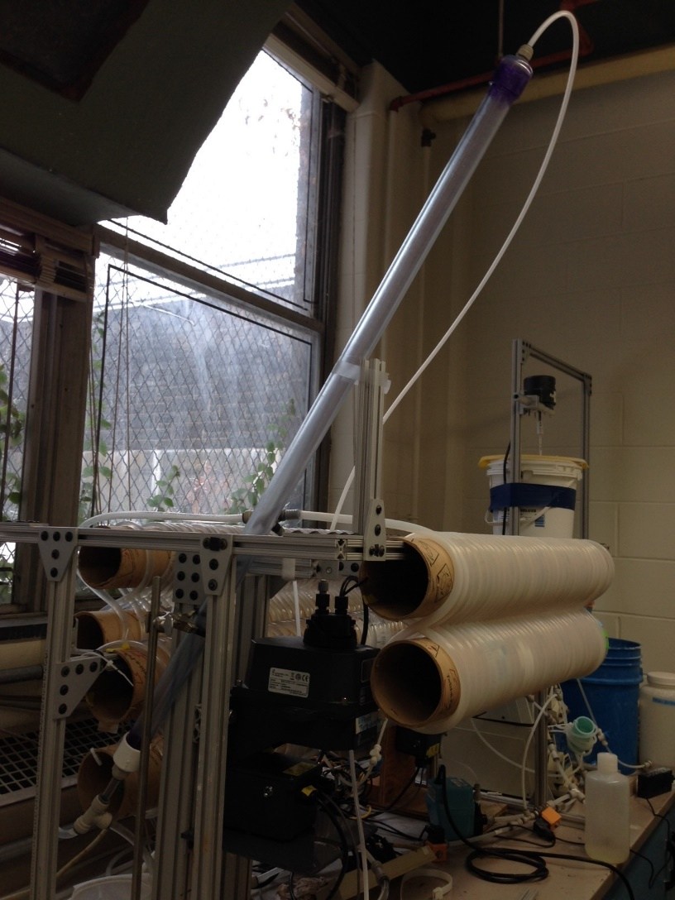

Slide 11
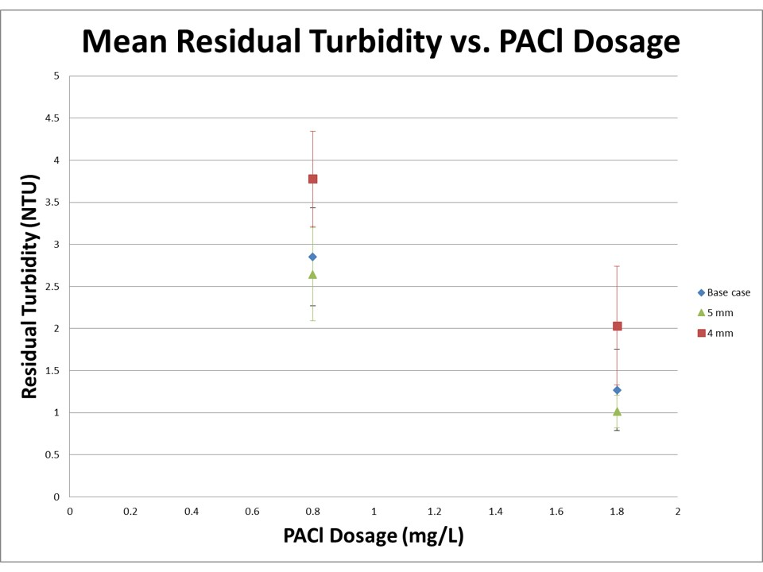
Fall 2013 Research

Slide 12
1st Experiment- Clamp Size
Testing the Effectiveness of Different Sized Clamps
Have one clamp on the middle arrangement of tubing
4 mm & 5 mm
Have dosages between 0 to 2 mg/L PACl
4mm
5mm

Slide 13
Possible Experiments
Tapered Flocculator
  Decreasing energy dissipation rate
Clamp Number
  Test the optimal number of clamps to breakup flocs

Slide 14
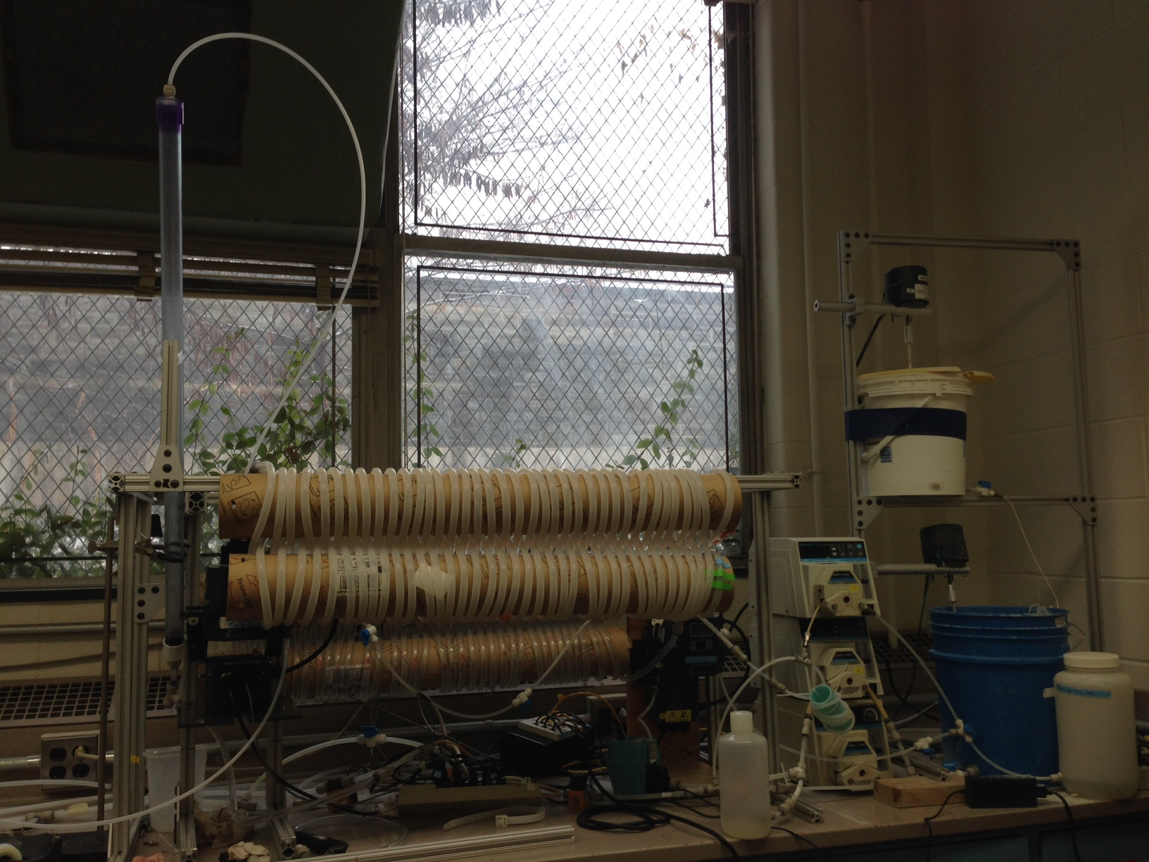
Questions?

