Slide 1

Laminar Tube Flocculator
Spring 2014
Victoria Chou and Yining Dai

Slide 2

Outline
Introduction
Semester Progress
SWaT Measurement System
Experiments
Future Work

Slide 3
Introduction
The purpose of flocculation in the water treatment process is…
  to allow particles suspended in the water to collide with each other to coagulate and transform into larger flocs
  to improve the performance of sedimentation
  to reduce the number of colloids
Notes:
Have students answer this question through polleverywhere?

Slide 4
Floc Breakup Theory
“Large flocs are useless”
  Shear is too large, so colloids cannot attach
Use clamps to break up flocs so that they can regrow and collect more colloids as they travel

Slide 5
Semester Progress
Designed and implemented SWaT
Ran base case testing to troubleshoot new setup
Added new design elements to the turbidimeter system

Slide 6
SWaT
“Settled water turbidity” measurement system
Replace FReTA (Flocculator Residual Turbidity Analyzer)
Continuous flow system with a tube settler
More closely models plate settlers in actual AguaClara plants

Slide 7
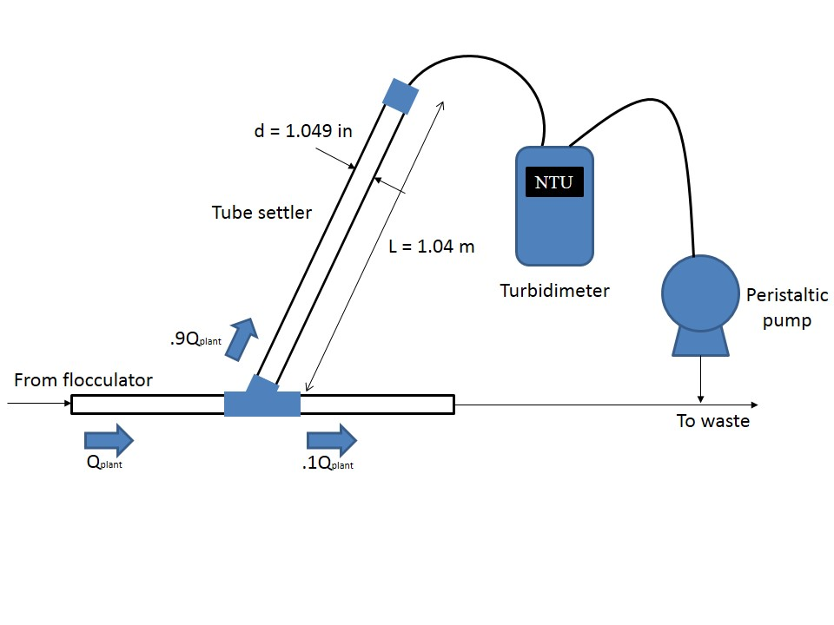
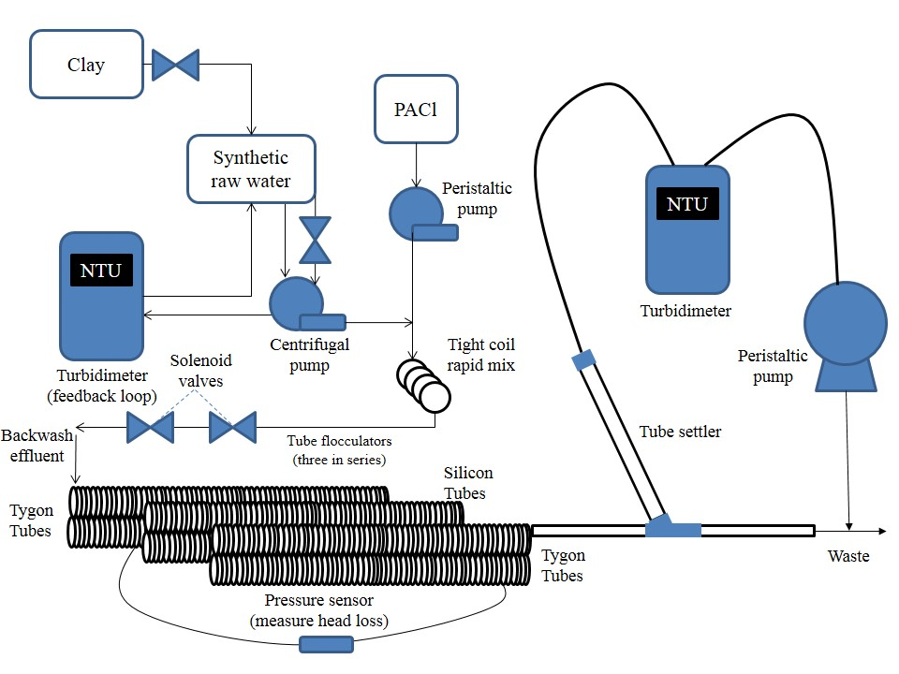
Set Up
60 °
Notes:
Allow more time for the flocs to grow
Previously the two turbidimeters did not agree with each other
Also they wanted to test tygon tubes vs. silicon tubes (Spring 2013)

Slide 8
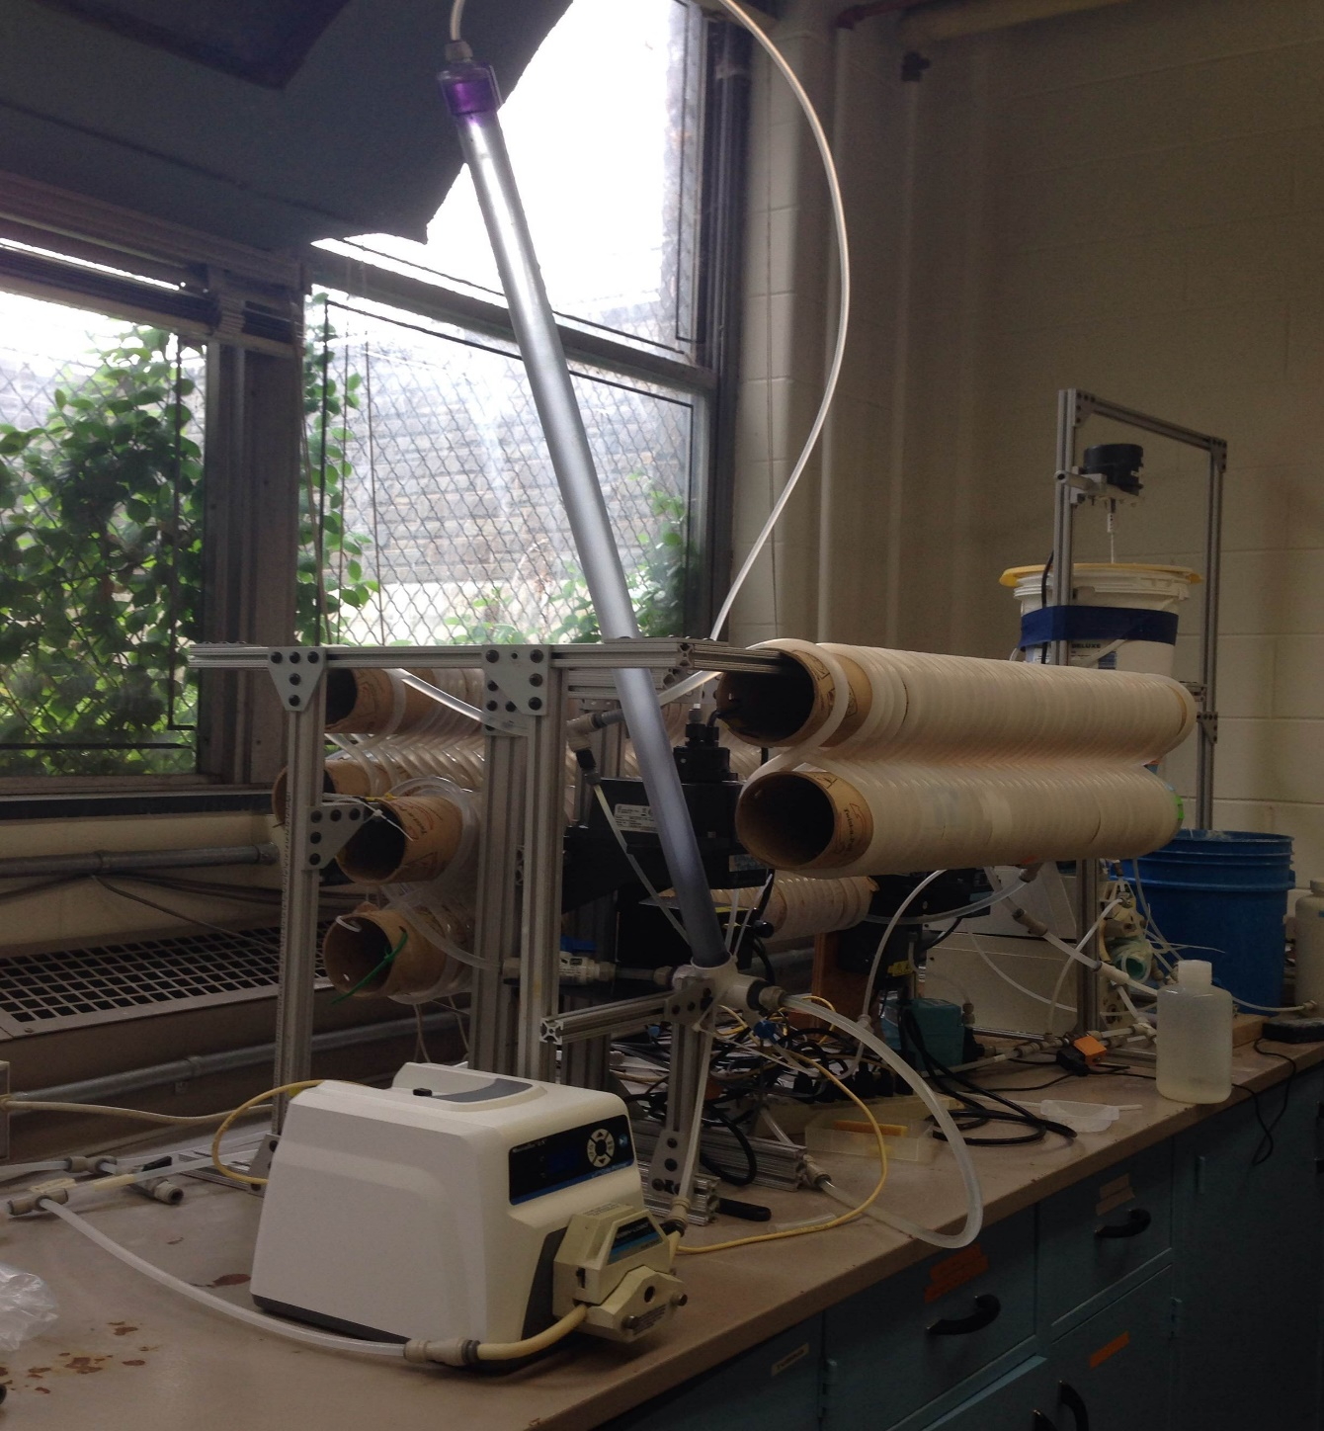

Slide 9
Updates in Process Controller
Reduced to three states:
  1) Backwash
  2) Loading State
    Accounted for additional residence time from tube settler
  3) SWaT
    Data collection

Slide 10
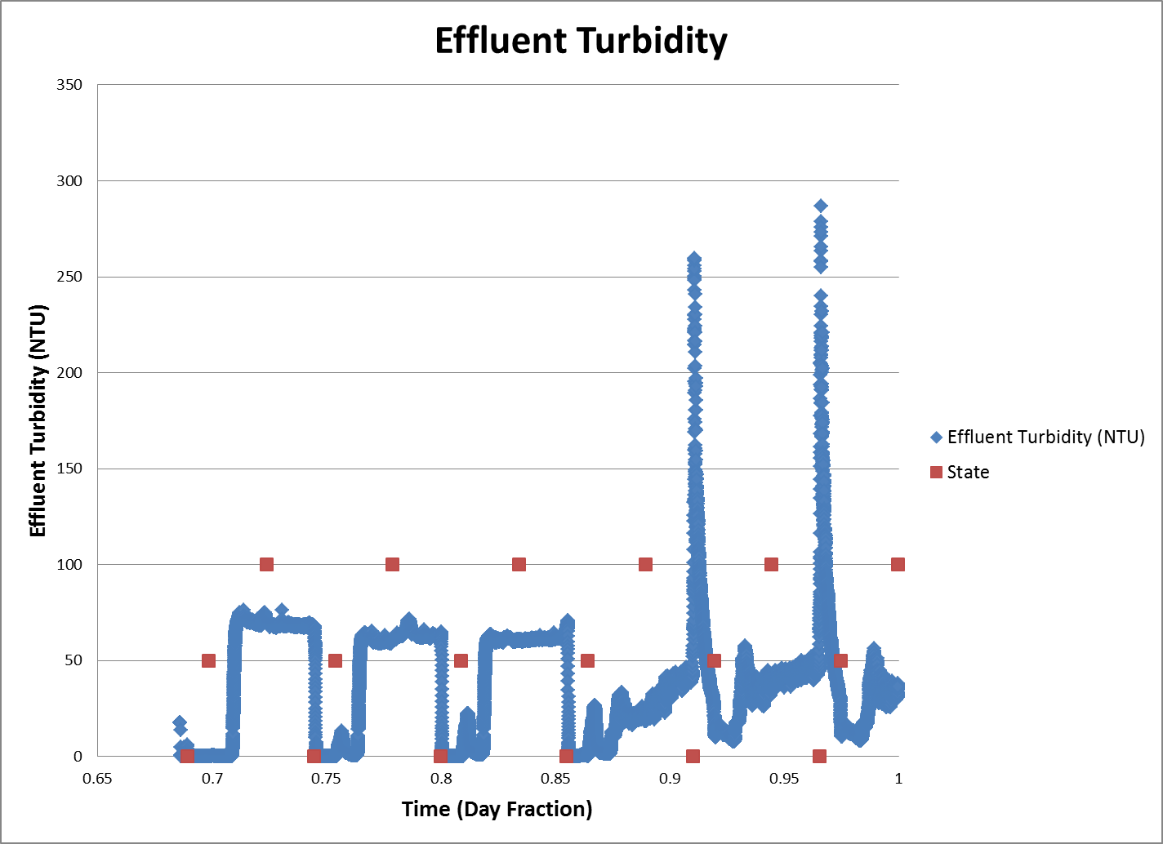
1st Experiment – Base Case
SWaT
Loading
Backwash

Slide 11
Problems Faced
Lower performance by SWaT than by the FReTA turbidimeter system
  Residual turbidity higher for each PACl dose
Zero NTU readings and extremely high NTU readings (greater than 300 NTU)

Slide 12
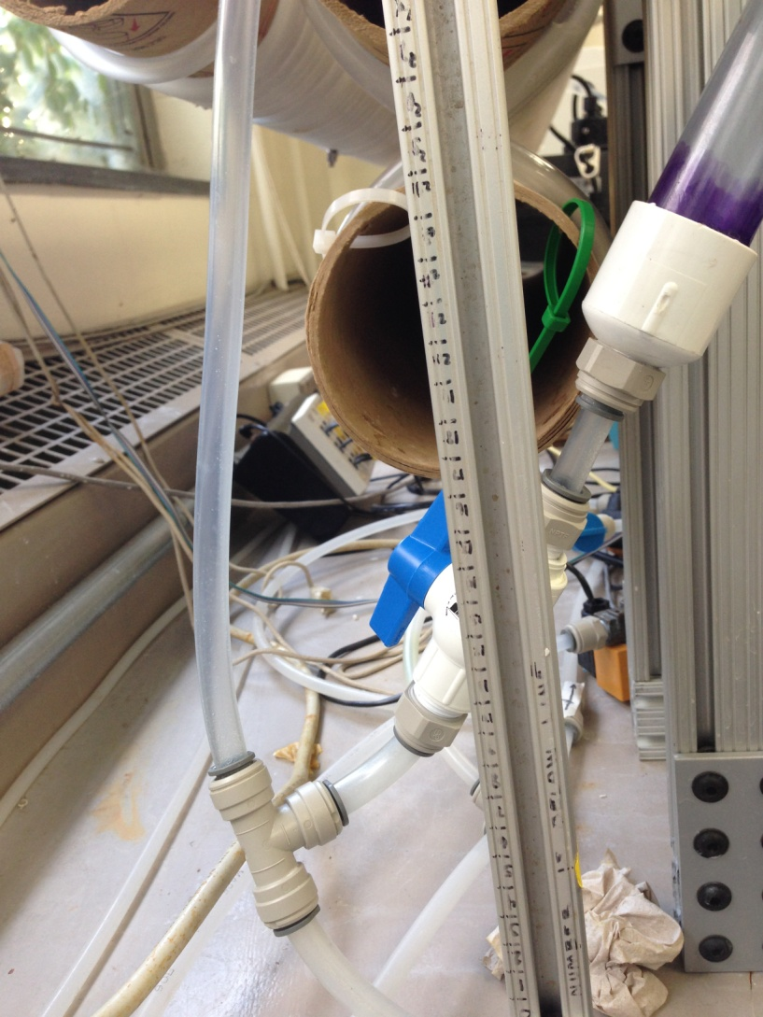
Issues with Tube Settler
No mechanism leading flocs to waste in this setup of the tube settler
Flocs circulating at the bottom of the tube settler not being directed to drain leading to a buildup of flocs

Slide 13
Issues with Tube Settler
Flocs accumulating in the tubing leading to the tube settler
60 °

Slide 14
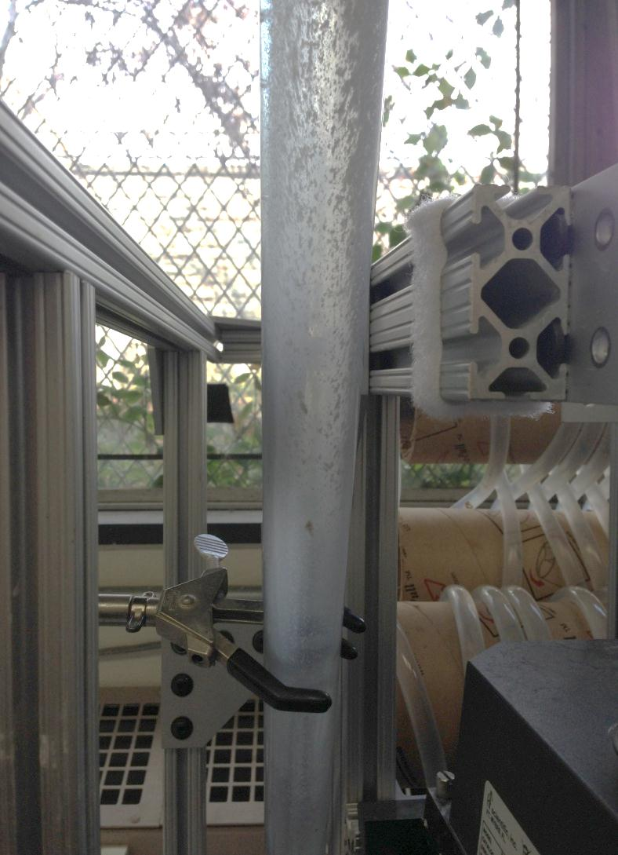
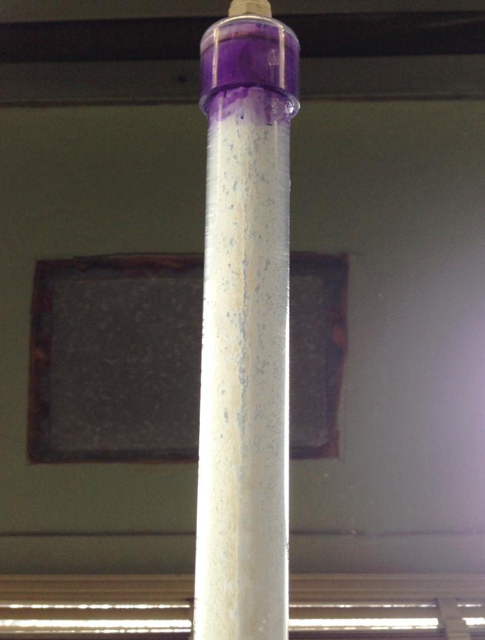
Waste Stream Problem

Slide 15
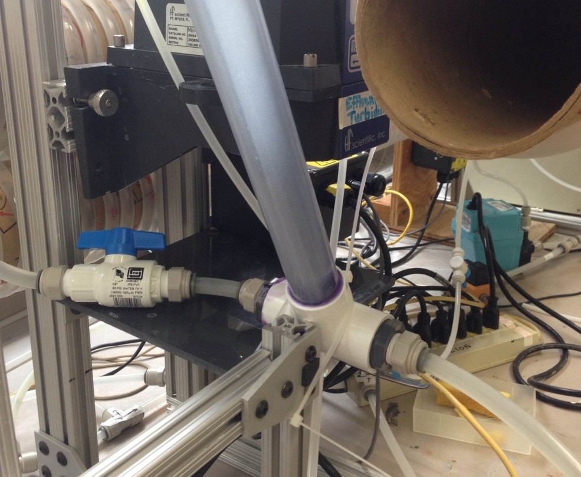
Tube Settler Design Updates
Create a T-fitting that has inlet water flowing directly into the tube settler and takes flocs away to waste

Slide 16
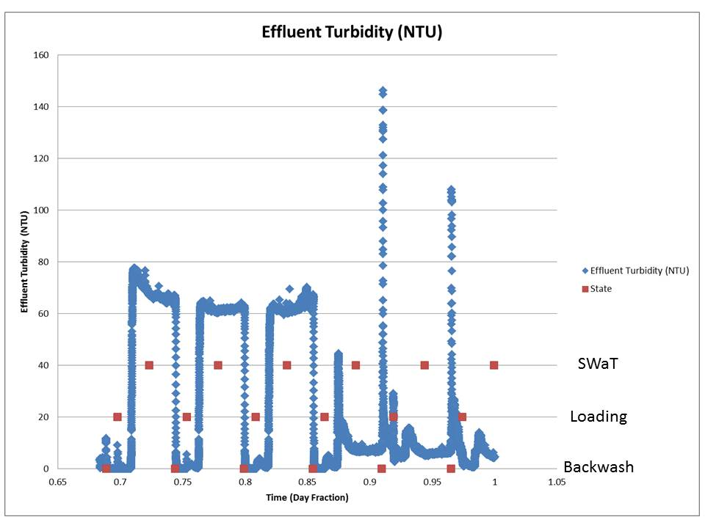
Base Case Run

Slide 17
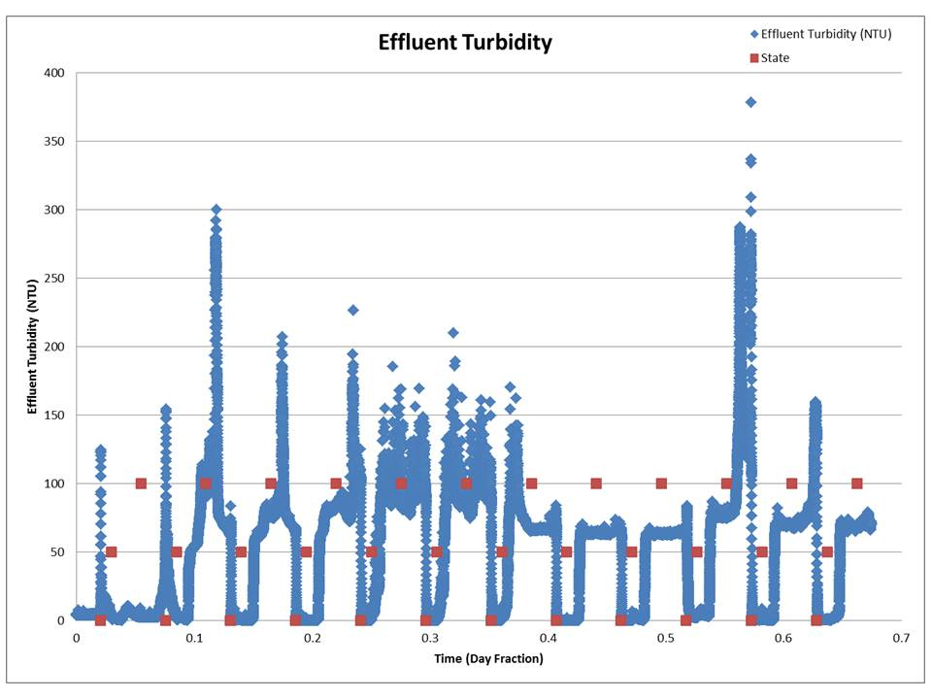
Base Case Run (cont’d)
SWaT
Loading
Backwash

Slide 18
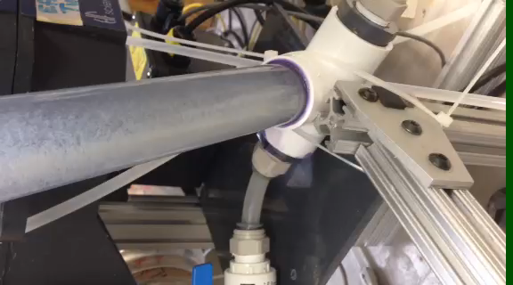
2 mg/L PACl Run

Slide 19
Future Experiments/Work
Clamp Testing
  Use different sized clamps
    4 & 5 mm to replicate Fall 2013 experiments
  Use different number of clamps
Tapered Flocculator
  Decreasing energy dissipation rate
Conclusions toward Floc Breakup Theory
  Offer alternative explanation

Slide 20

Questions?

