Slide 1
Laminar Tube Flocculator
Katherine Dao, Yining Dai, and Kevin Shao

Slide 2
Overview
Introduction to Flocculation
Apparatus Description
SWaT
Summer 2014
Semester Goals
Progress Made
Results
Future Works
Notes:
Katie

Slide 3
Flocculation
The purpose of flocculation in the water treatment process is…
  to allow particles suspended in the water to collide with each other to coagulate and transform into larger flocs
  to improve the performance of sedimentation
  to reduce the number of colloids
Notes:
Yining

Slide 4
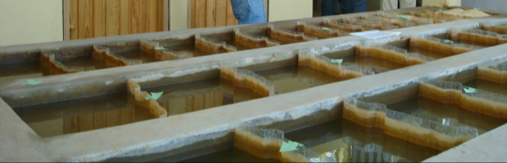
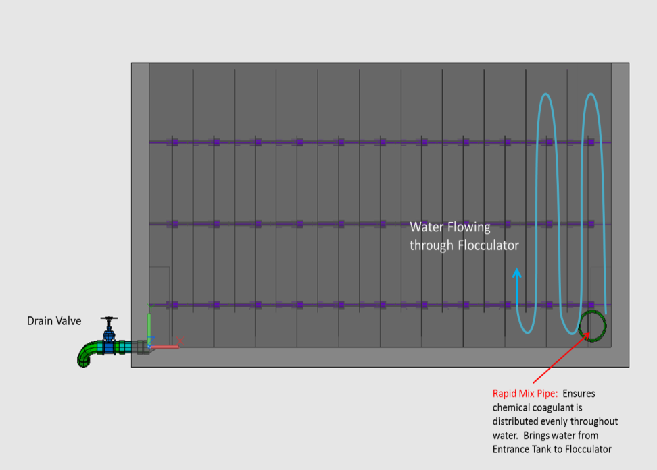
Flocculation
Flocculation is an integral part of the water treatment process

Slide 5
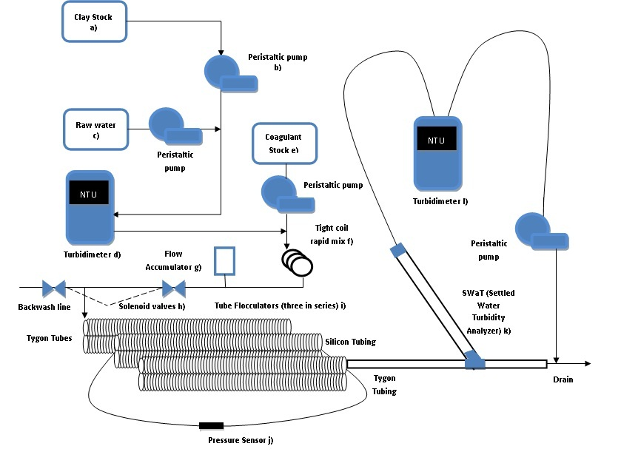
Apparatus

Slide 6
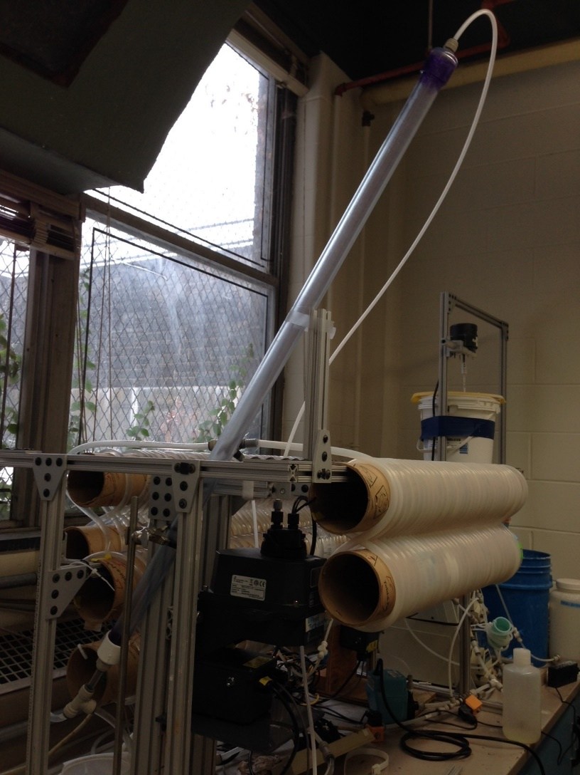
SWaT
“Settled water turbidity” measurement system
Replace FReTA (Flocculator Residual Turbidity Analyzer)
Continuous flow system with a tube settler
More closely models plate settlers in actual AguaClara plants
Notes:
Yining

Slide 7
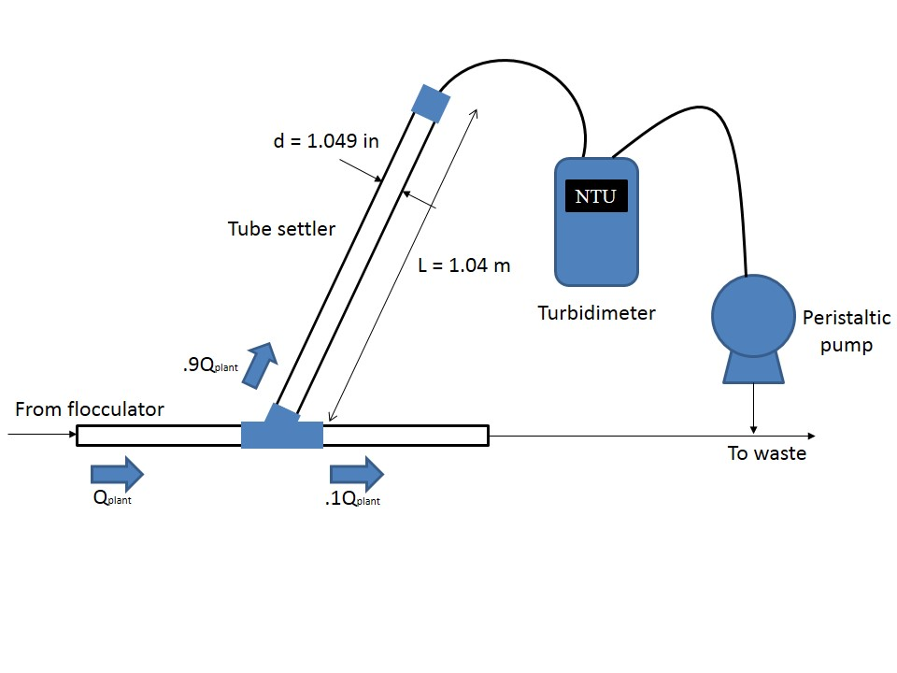
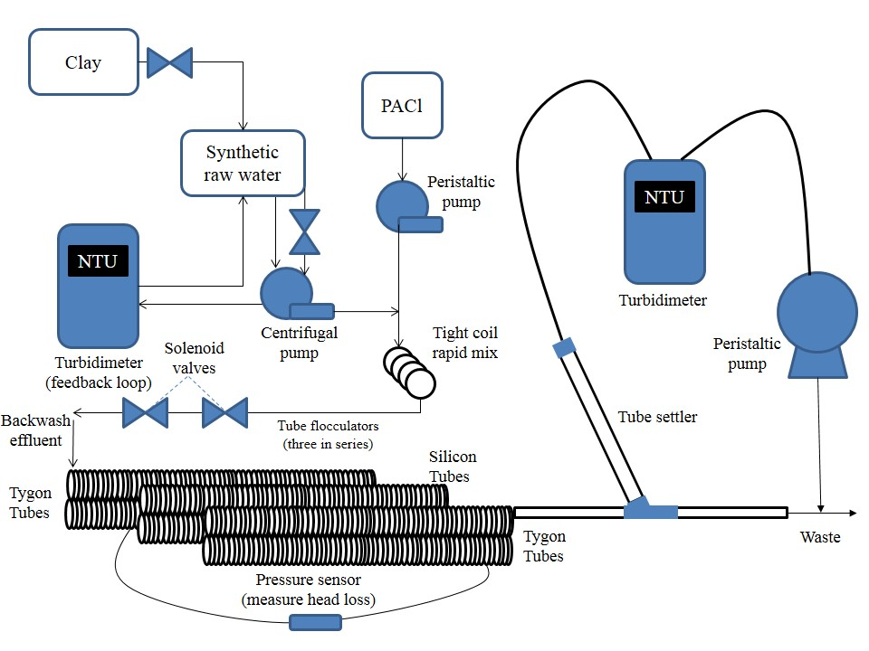
Set Up
60 °
Notes:
Yinning
Allow more time for the flocs to grow
Previously the two turbidimeters did not agree with each other
Also they wanted to test tygon tubes vs. silicon tubes (Spring 2013)

Slide 8
System States
Off
Loading – 35 minutes
SwaT – 40 minutes
Backwash with tube – 10 minutes
Backwash without tube – 5 minutes

Slide 9
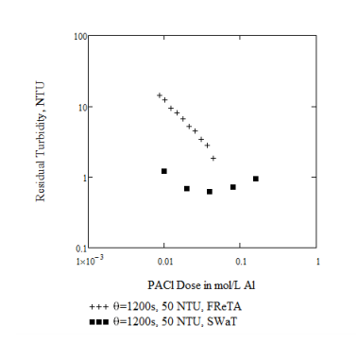
Summer 2014
Ran similar dosages at same capture velocity as FReTA using SWaT
Data had an unexpectedly high pC* value with a decrease in performance as dosage was increased
Notes:
Kevin

Slide 10
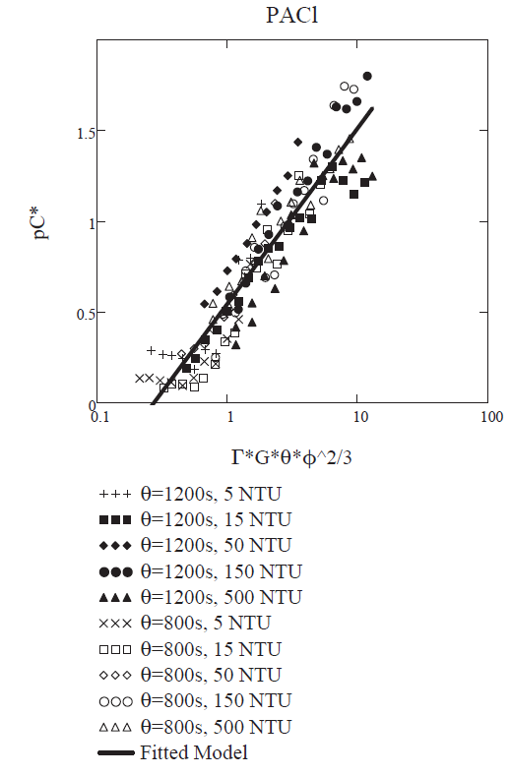
Semester Goals
Establish a base case
    1.05 mg/L
Test new, lower PACl dosages
Obtain results that resemble the trend determined by Karen Swetland
Test various capture velocities
Notes:
Katie

Slide 11
Progress Made
Adjusted Summer 2014 method file
    Added a “SWaT counter”
Ran five trials at a PACl dosage of 1.05 mg/L
    Kept all other variables constant
Currently measuring flow rates of various parts of the system
Notes:
Kevin

Slide 12
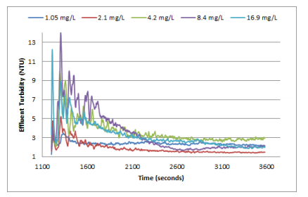
Results of Replication
1.05 mg/L Case
Fall 2014 Results
Summer 2014 Results
Notes:
Kevin

Slide 13
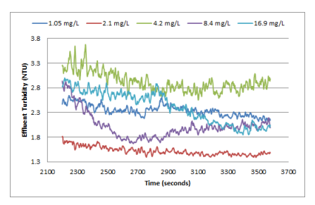
Results of Replication
Closer Look
Fall 2014
Summer 2014
Notes:
Kevin

Slide 14

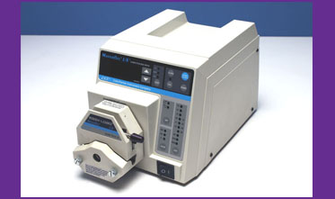
Problems Faced
Understanding the Summer 2014 Method File
Parameters in Process Controller vs. Real Life
    Pump problems
Notes:
Yining

Slide 15
Future works
Determine the reason for the difference in magnitude of our results in effluent turbidity
Test various PACl dosages beginning at 0.5 mg/L and either increasing or decreasing by 0.1 mg/L.
Compare results to Karen Swetland’s data and determine nature of inconsistencies
Test effects of various capture velocities at previously tested dosages
Notes:
Katie

Slide 16

Questions?

