Slide 1
Assessing Research support for very, very, very big Undergraduate Business Classes
Tom Ottaviano
Business & Economics Librarian – Mann Library

Slide 2

The Classes – AEM 1200/AEM 2200
AEM 1200
Sophomores/Juniors
Minors
Spring 2013 – 415 Students
Spring 2014 – 511 Students
AEM 2200
First-year Students
Majors
Fall 2012 – 90 Students
Fall 2013 – 88 Students
Almost all of the students are new to business research!

Slide 3
AEM 1200/2200 – The Assignment
Company Research Project (must be a publicly traded company!)
20-30 pages long
The project includes:
  Basic Company Information
  Financial Research
  Market Research
  Marketing Research
  Industry Research
  Operations Research
  Legal Research
  More!
Students work in groups of 3 or 4

Slide 4

AEM 1200/2200 – The Lesson
One shot Information Literacy Lesson
“Interactive Lecture”
NO FORMAL ASSESSMENT!
Image from flickr Creative Commons

Slide 5
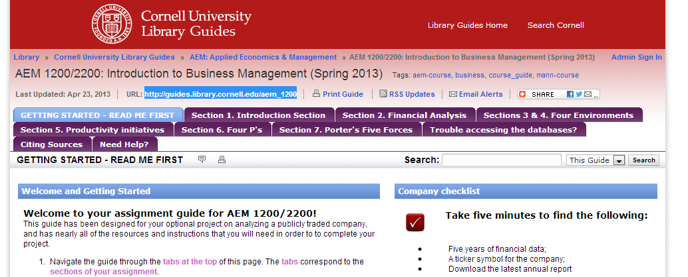
AEM 1200/2200 – The Guide
http://guides.library.cornell.edu/aem_1200

Slide 6
AEM 1200/2200 – Guide Use
 | Fall 2012 | Spring 2013 | Fall 2013 | Spring 2014
Number of Students | 90 | 415 | 88 | 396 handed in the assignment
Guide Hits | 4427 | 9195 | 4088 | 7636
Hits per student | 49.2 | 22.2 | 46.5 | 19.3

Slide 7
AEM 1200/2200 – Guide Use
 | Fall 2012 | Spring 2013 | Fall 2013 | Spring 2014
Total Hits | 4427 | 9195 | 4088 | 7636
Getting Started | 1608 | 3866 | 1313 | 2351
Financial Analysis | 426 | 1012 | 609 | 1560
Five Environments | 715 | 1465 | 580 | 1095
Porter’s Five Forces | 445 | 837 | 603 | 710
Four P’s | 336 | 650 | 395 | 656
Introduction Section | 412 | 503 | 199 | 510
CEO/Productivity | 309 | 512 | 175 | 475
Citing Sources | 104 | 143 | 104 | 166
Need Help? | 0 | 146 | 52 | 57
Trouble accessing databases? | 72 | 61 | 38 | 56

Slide 8
AEM 1200/2200 – Guide Use

Slide 9
AEM 2200 – Support (Fall 2012)
There were a total of 90 students in the class
The only requirement was that students had to attend consultations as a full group.
This past fall there were 30 groups
In a span of 3 weeks:
  11 of these groups sought out consultations
  4 of these groups sought out repeat consultations
  There were a total of 15 consultations

Slide 10
AEM 1200 – Support (Spring 2013)
This semester there are a total of 415 students
Students are required to attend a “Review Session” if they want an individual consult.
There are between 120 and 125 different groups
In a span of 3 weeks:
  90 students attended group working (or “review”) sessions
  10 students attended multiple review sessions for a total of 100 students.
  6 students requested consultations for a total of 106 help requests

Slide 11
AEM 1200/2200 - comparing the support
Fall 2012
Spring 2013
90 students
30 groups
11 out of 30 groups sought help (36.7%)
30 students sought help (33%)
Time commitment – about 12 hours in 3 weeks.
  ~24 minutes per student
415 students
120-125 groups
Members from 48 of the 120-125 groups sought help (~39%)
90 students sought help (21.7%)
Time commitment – about 15 hours in 3 weeks
  ~10 minutes per student
  ~17.3 minutes per student if you include other staff at Review sessions (11 hours)

Slide 12
AEM 2200 – Support (Fall 2013)
Support in the Spring 2013 seemed to go well… why not try the “Review Session” model for a smaller group?
Relabeling of “Review Sessions” to “Working Sessions”
No Emphasis on either Consultations or Working Sessions
34 Students sought help a total of 62 times!
Representatives from 20 of the 30 groups sought help!
11 students requested consultations
Brought in TAs to help with the Working Sessions

Slide 13
AEM 1200 – Support (Spring 2014)
Same model as Fall 2013
The main difference this semester was that the Assignment was Optional.
511 students in the class – 396 completed the assignment
71 students sought help a total of 94 times
  note: 5 students sought help but didn’t complete the assignment
Representatives from 36 of 112 Groups sought help

Slide 14
AEM 1200/2200 – Support findings
 | Fall 2012 | Spring 2013 | Fall 2013 | Spring 2014
Total Students | 90 | 415 | 88 | 511 / 396
Students who sought help | 30 | 90 | 34 | 71
% students who sought help | 33% | 22% | 39% | 17%
Total Groups | 30 | 122 | 30 | 112
Groups who sought help | 11 | 47 | 20 | 36
% groups who sought help | 37% | 39% | 66% | 32%
Total Consultations | 15 | 6 | 11 | 8
Grades | 84.4 | 88.0 | 82.5 | 86.0
Grades - Sought help once | 84.9 | 91.2 | 82.7 | 89.1
Grades - Sought help more than once | 85.6 | 92.1 | 83.9 | 94.3
Grades – Didn’t Receive Help | 84.2 | 87.4 | 82.3 | 85.3
Grades – Consultations | 84.9 | 94.3 | 85.6 | 92.5

Slide 15
AEM 1200/2200 – What the findings show
Research support for these classes do have an impact, but it’s not as big an impact as I originally expected.
If students need help, they will take advantage of whatever options are open to them.
One notable exception - Forcing an entire group to attend a consultation together will prevent some students from asking for help (even if they want/need it).
When given the choice, students seem to prefer Working Sessions to Consultations.
First-year/majors seek help more often than upperclassmen/minors. This could also be related to the size of the class.
Despite this, upperclassmen seem to perform better on the assignment, even as minors.
Upperclassmen seem to benefit more from research support
Consultations seem to have a greater impact when they are supplemented by the working sessions.
Students seem to perform better on required assignments.
Unsurprisingly, students who seek help multiple times perform better on the assignment.
Students (particularly those who are already familiar with research) need more help with Financial research than any other area covered by this assignment.

Slide 16
AEM 1200/2200 – Other observations
The impact on the quality of sources used is greater than the impact on student performance synthesizing their report.
At times, students clearly came representing their entire group.
Research support is amplified when an assignment is optional.
  My hypothesis: When an assignment is required, students with a range of skills will seek help. When an assignment is optional, the stronger academic students seem to seek help more often.

Slide 17
Thanks for Listening!

