Slide 1

Integrating Theory into Library Instruction to Help Students Understand Themselves
Anne Larrivee

Slide 2
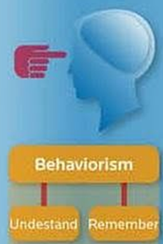
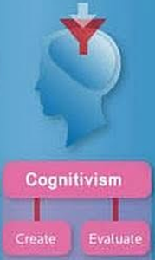
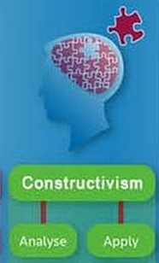
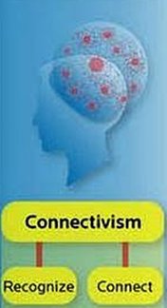
Learning Theory Categories
image: http://www.edudemic.com/a-simple-guide-to-4-complex-learning-theories/

Slide 3
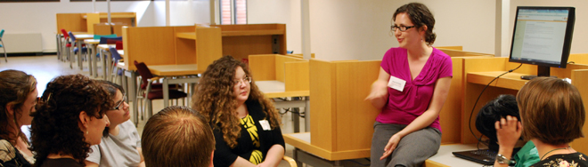
Why explain theoretical frameworks to students?

Slide 4
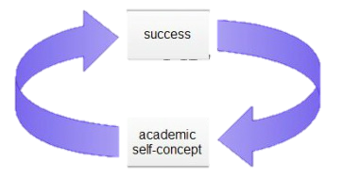
Academic Self Concept
Many studies show the concept of one’s academic self is often linked to academic achievement
Choi, N. (2005). Self‐efficacy and self‐concept as predictors of college students' academic performance. Psychology in the Schools, 42(2), 197-205.
Image:http://educ107creativeresponse.weebly.com/self-concept.html

Slide 5
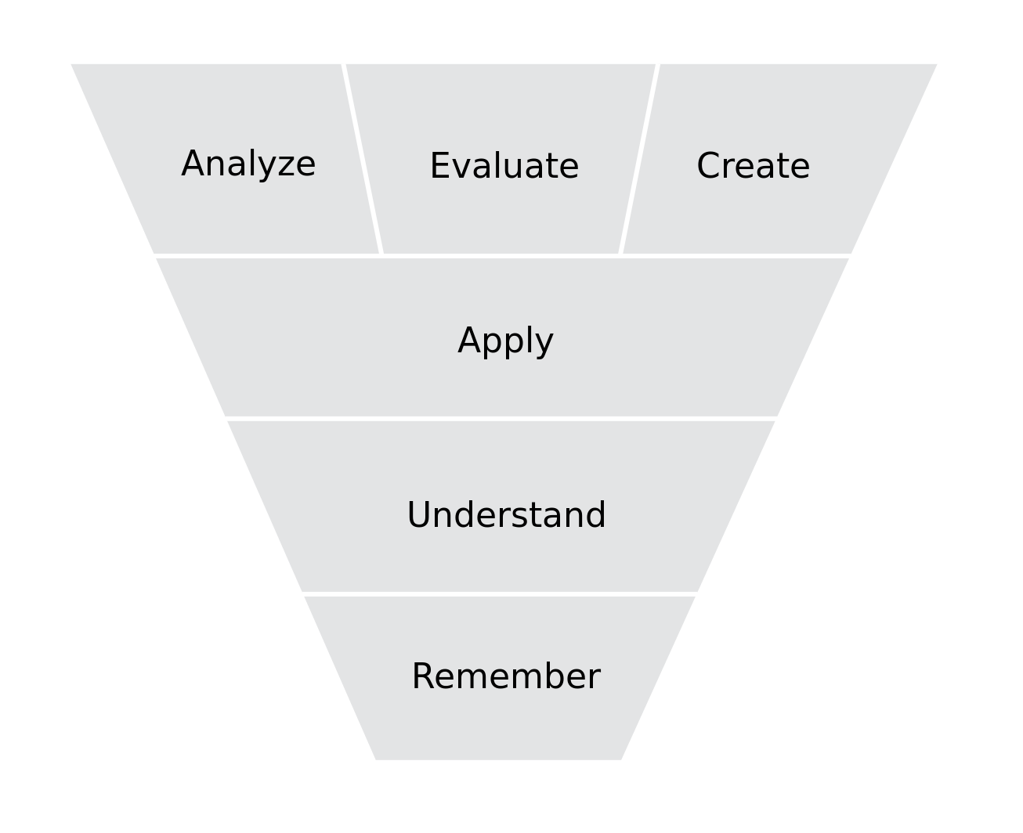
Bloom’s Taxonomy of Learning
image:http://en.wikipedia.org/wiki/File:BloomsCognitiveDomain.svg

Slide 6
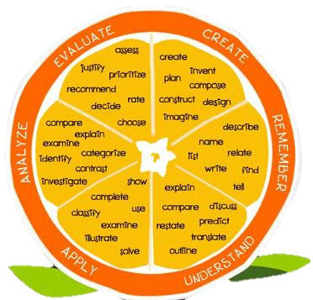
image:http://www.learningtutor.com/

Slide 7
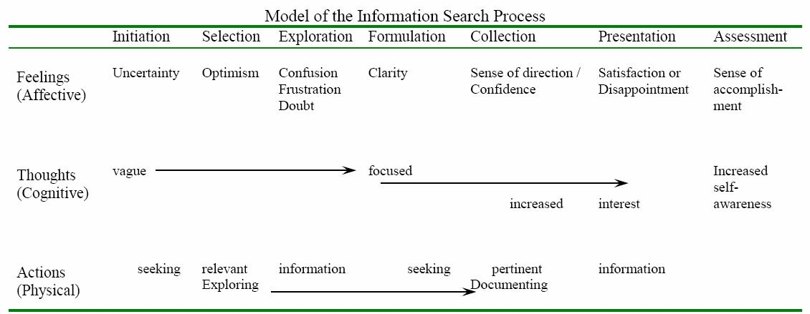
Kuhlthau’s Information Search Process
image: http://comminfo.rutgers.edu/~kuhlthau/information_search_process.htm

Slide 8
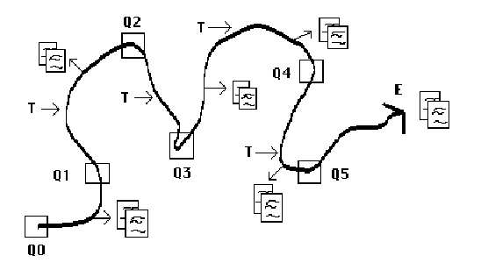
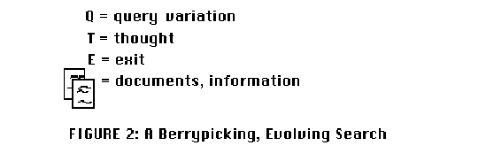
Bate’s Berrypicking
image:http://pages.gseis.ucla.edu/faculty/bates/berrypicking.html

Slide 9
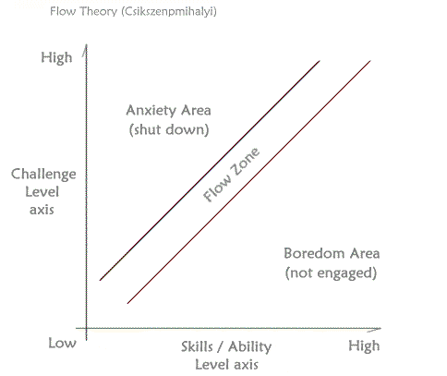
Csikszenpmihalyi’s Flow Theory
image:http://beacon.wharton.upenn.edu/remurphy/files/2008/02/flow_original.gif

Slide 10
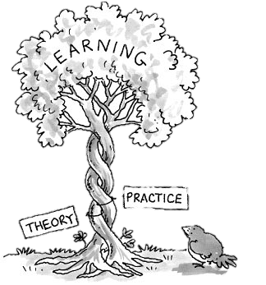
To conclude...
image: http://www.loisdalphinis.co.uk/wp-content/uploads/2013/11/theorypracticetree.jpg

Slide 11
Bibliography
Bates, M. J. (1989). The design of browsing and berrypicking techniques for the online search interface. Online Information Review, 13(5), 407-424.
Bloom, B. S., & Krathwohl, D. R. (1956). Taxonomy of educational objectives: The classification of educational goals. handbook I: Cognitive domain.
Choi, N. (2005). Self‐efficacy and self‐concept as predictors of college students' academic performance. Psychology in the Schools, 42(2), 197-205.
Csikszentmihalyi, M. (1997). Finding flow: The psychology of engagement with everyday life Basic Books.
Dweck, C. S. (2000). Self-theories: Their role in motivation, personality, and development Psychology Press.
Fisher, K. E., Erdelez, S., & McKechnie, L. (2005). Theories of information behavior Information Today, Inc.
Kuhlthau, C. C. (2004). Seeking meaning: A process approach to library and information services libraries unlimited. Westport, CT,
Kuhlthau, C. C. (2013). Carol collier kuhlthau: Model of the information search process. Retrieved 05/ 28, 2014, Retrieved from http://comminfo.rutgers.edu/~kuhlthau/information_search_process.htm
Lepi, K. (2013). A simple guide to 4 complex learning theories. Retrieved 05/ 28, 2014, Retrieved from http://www.edudemic.com/a-simple-guide-to-4-complex-learning-theories/
Ortiz, Y. (2007). The influence of perceived social support, academic self-concept, academic motivation, and perceived university environment on academic aspirations ProQuest.
Salkind, N. J., & Rasmussen, K. (2008). Encyclopedia of educational psychology Sage.

