Slide 1
Effective Engagement to Deliver Discipline-Based Information Literacy: A Model
Cornell University Library
Information Literacy Assessment Expo
May 29, 2014
Laura Kuo
Lisabeth Chabot

Slide 2
Objective
Identify connections:
Information literacy (IL) skills
Disciplinary curriculum design and learning outcomes
Undergraduate Speech Language Pathology and Audiology (SLPA)degree program.

Slide 3
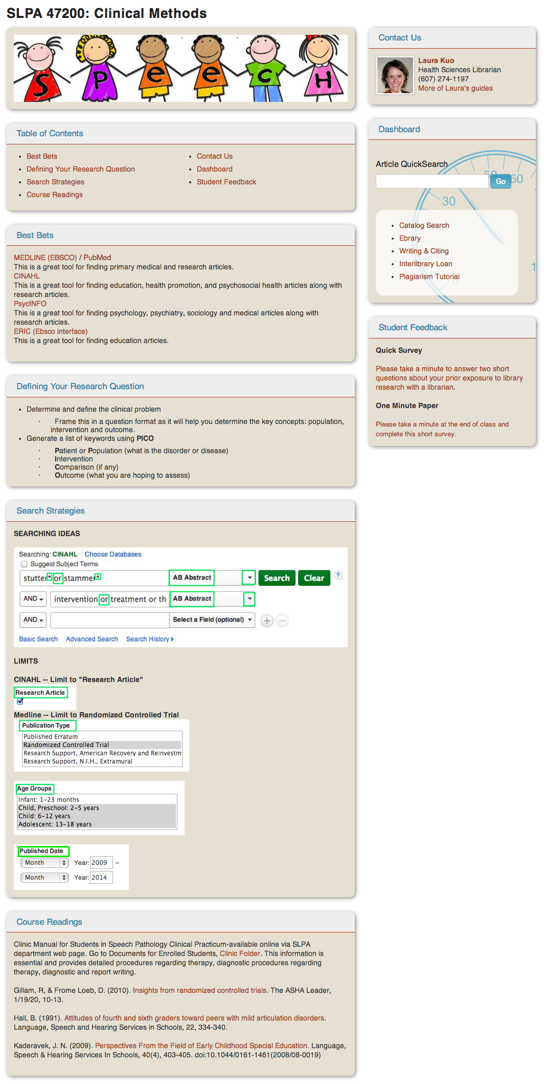
SLPA Course Guide
http:///www.ithacalibrary.com/sp/subjects/CPII

Slide 4
Methodology: Part 1
The One Minute Paper
Q1: What information did you learn today that
you think will be most useful to you in your
SLPA coursework?
Q2: What question(s) do you still have?

Slide 5
Results: Q1
95%: Search Strategies
“I learned how to research articles properly. I used to struggle a lot with this. I would have to search through 1,000s of articles before I would find something that I like.”
“I learned better techniques to find relevant information to a specific topic (PICO questions).”

Slide 6
Results: Q1
45%: Access and Navigate Database
“It was useful to know which databases would be most helpful....”
“there are databases that allow for research specific to fieldwork.”

Slide 7
Results: Q1
21%: Earlier IL Implementation
“I would have loved to have had this presentation earlier in my studies.”
“I wish I had learned this sooner.”

Slide 8
Results: Q2
13%: Maybe in the future
“I do not have any at this time”
100%: No Questions
13%: Positive Feedback
“Nothing, this was really helpful”
“None. It was a thorough presentation. The information was detailed.”

Slide 9
Curriculum Review
The OMP assessment results reinforced our belief that a sequential skill building approach that is linked to curricular objectives would enhance both learning and teaching success
ASHA: Standard III-F (2005) and Standard IV-F (2014)

Slide 10
Sequential Skill/Outcomes Collaborative Review
What Knowledge, Skills, Abilities, and Dispositions Should Each Student Who Completes your Major Program Demonstrate?
Which Competencies Should Be Developed in 100 Level, 200 Level, 300 Level, and 400 Level Courses in the Discipline?
Which Competencies Should Be Reinforced and/or Enhanced at Every Level?

Slide 11
Levels of Outcomes - SPLA
100 Level:
Introduce PICO: Population, Intervention, Comparison, Outcome
200 Level:
Develop a clinical question and conduct a therapy-based PICO search.
300 Level:
Identify the type of clinical question (therapy, etiology, prognosis, outcomes) and study design and conduct a literature search in the appropriate databases. Critically appraise the results to find the best evidence to answer the clinical question.
400 Level:
Integrate, Interpret, and synthesize information to develop a diagnosis and recommend appropriate interventions.

Slide 12
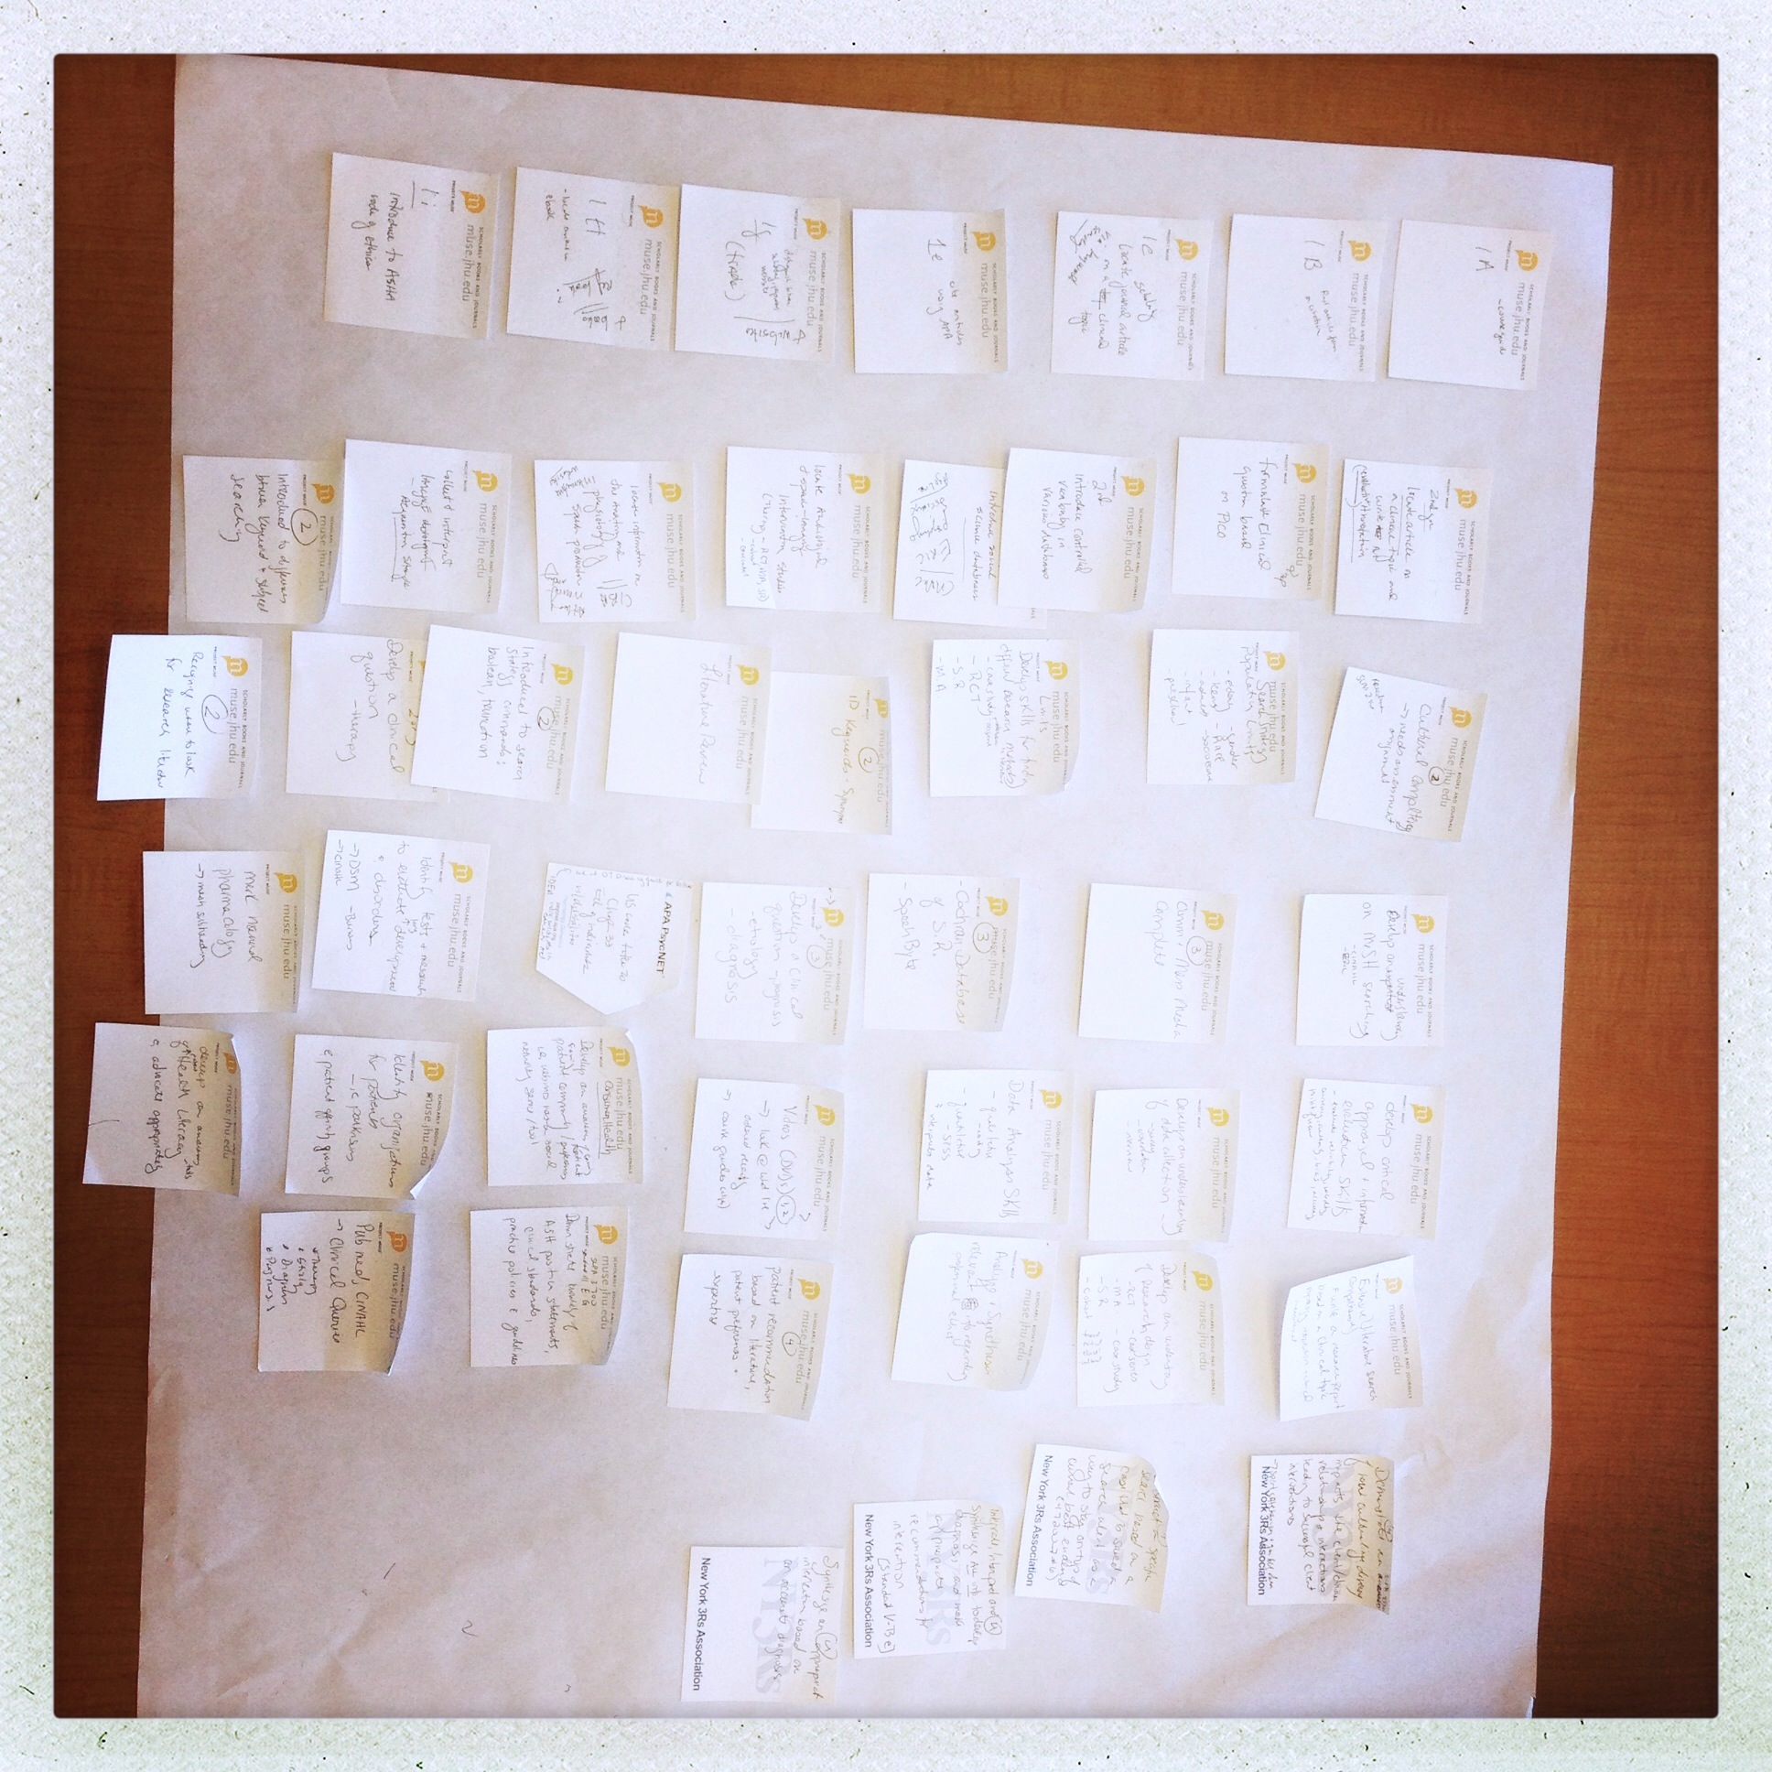

Slide 13
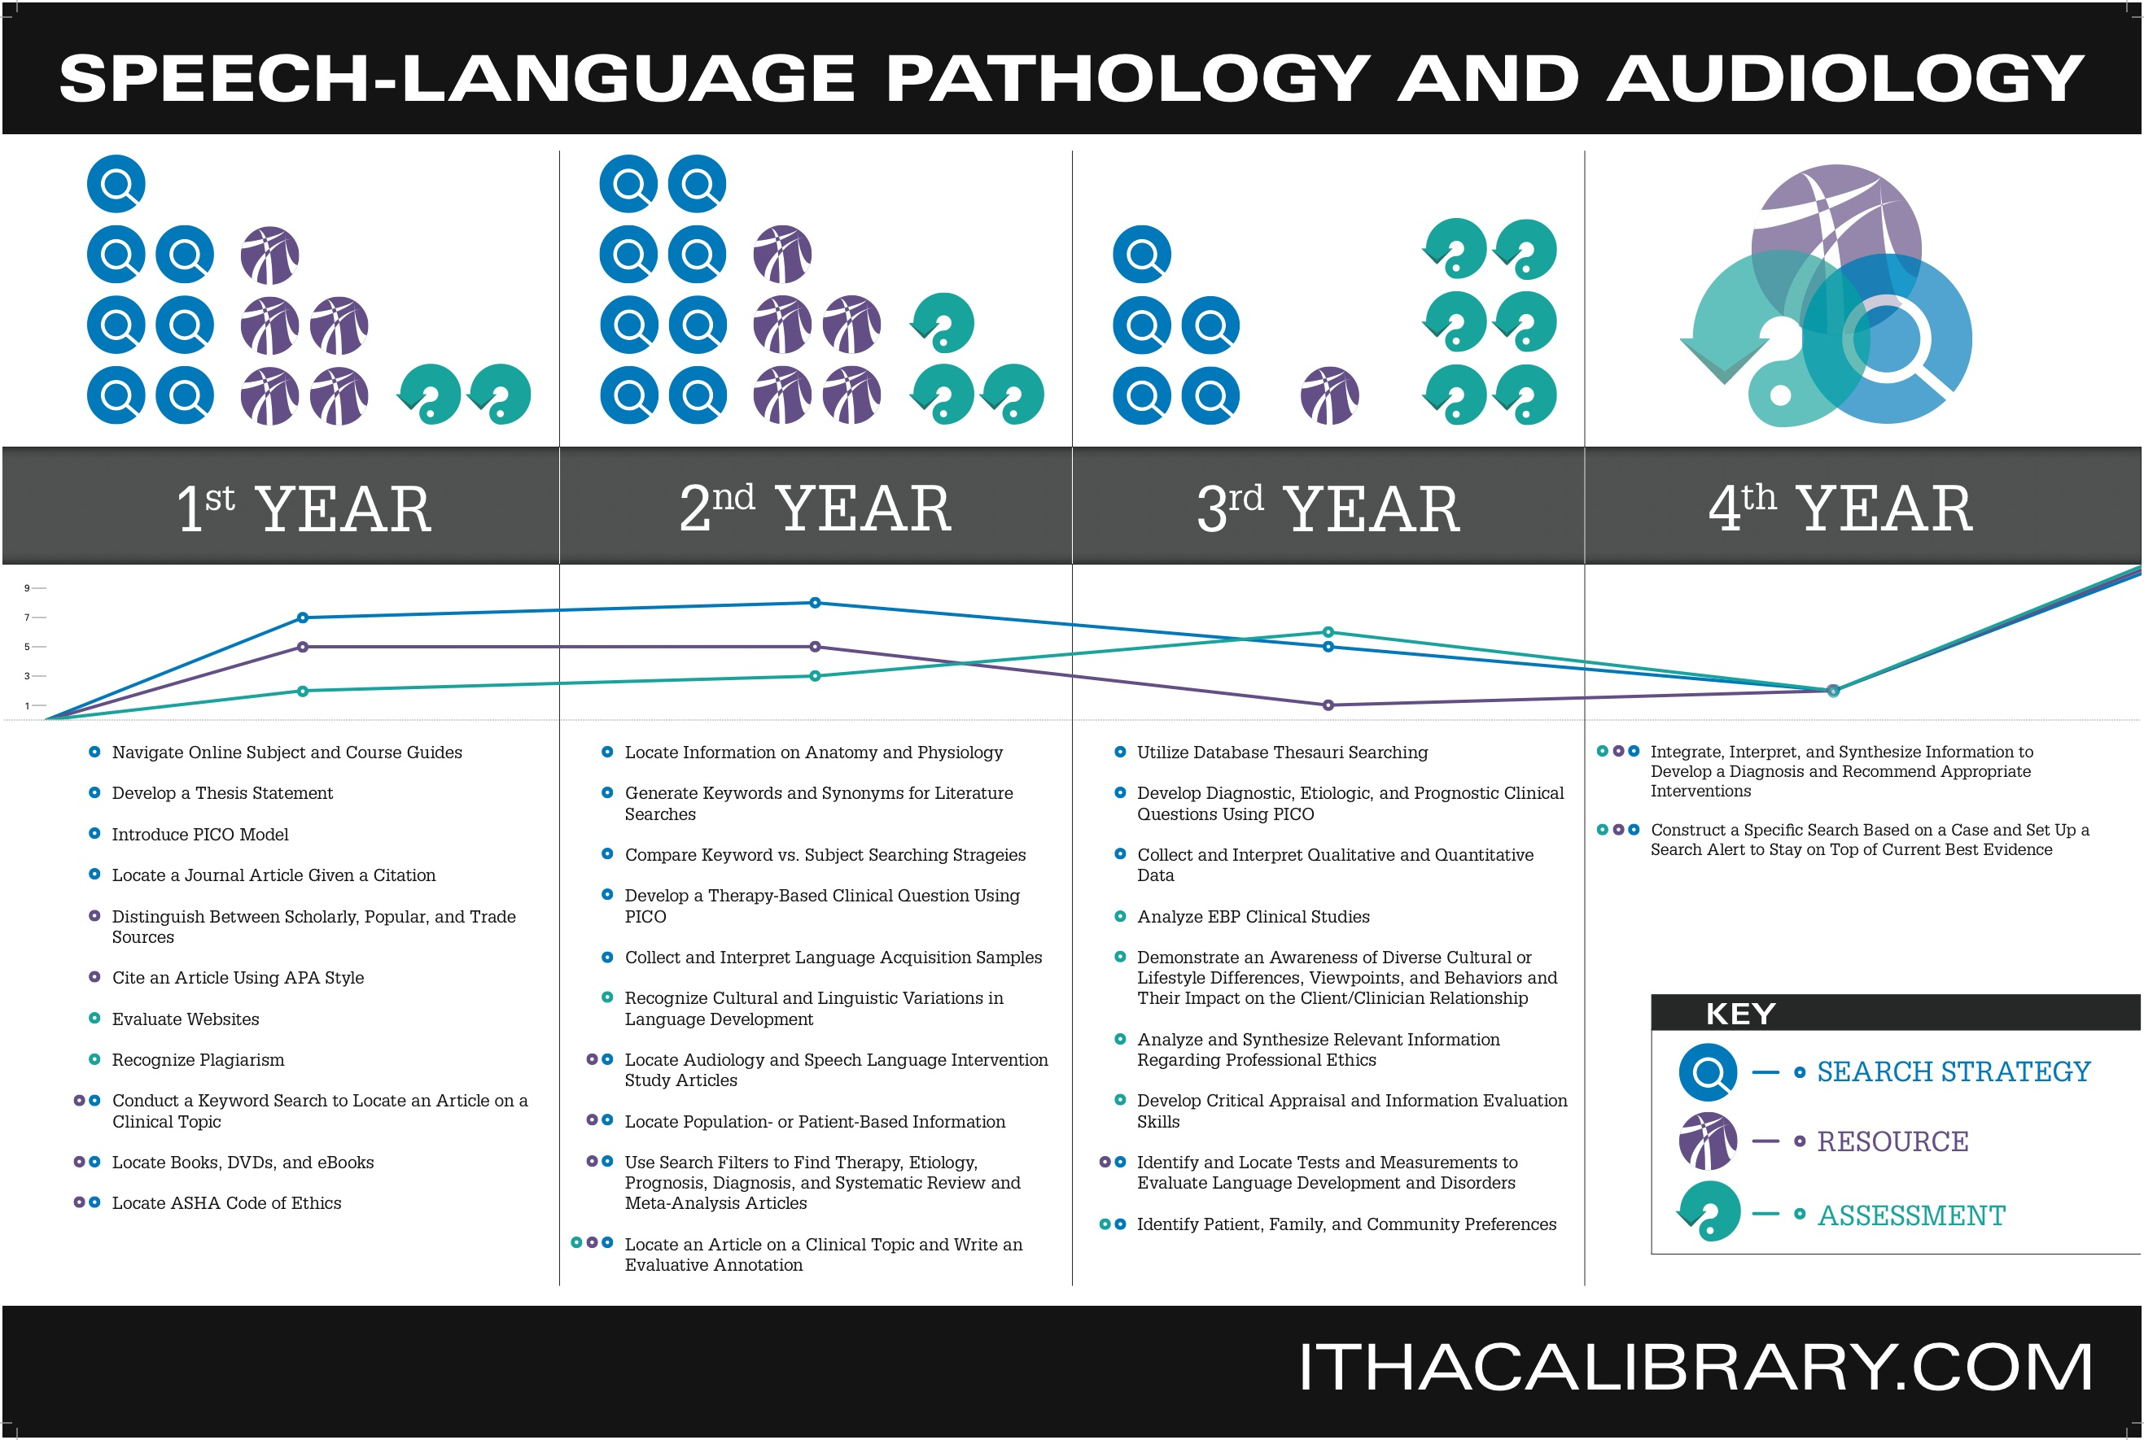

Slide 14
Conclusion
Student Feedback Endorses Sequential Skill Development
Collaboration Is Essential for Successful Integration of IL Skill Development
IL Curricular Maps Are Effective Communication & Implementation Tools

Slide 15
Thank You
Questions?

