Slide 1
Badges for Information Literacy assessment
Camille Andrews
Kelee Pacion

Slide 2
Objectives
describe digital badges
outline some recent initiatives (particularly concerning libraries and information literacy)
discuss what a digital badge program for information literacy might look like using a potential information literacy class on Wikipedia and embedded assessment for biological sciences

Slide 3
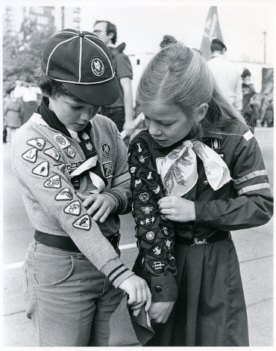
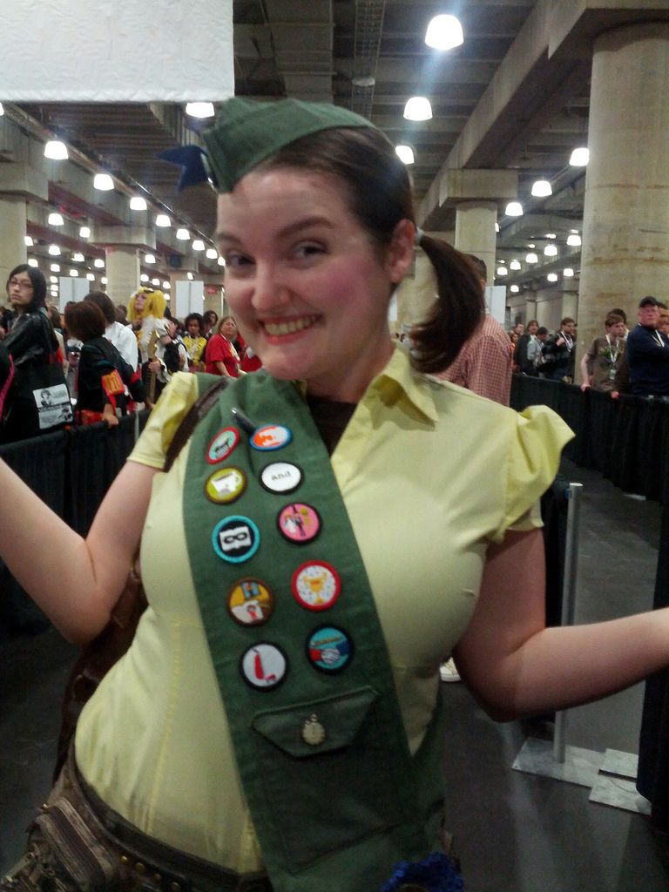
Cory Doctorow-Nerdbadge Scout!-https://www.flickr.com/photos/doctorow/8081093880/
Hamilton Spectator-Girl Guides of Canada: https://www.flickr.com/photos/girlguidesofcan/8488348265/
Notes:
Kelee’s scout story
Old style physical badges certifying gaining knowledge, skills, abilities/competencies
Badges for 21st century

Slide 4
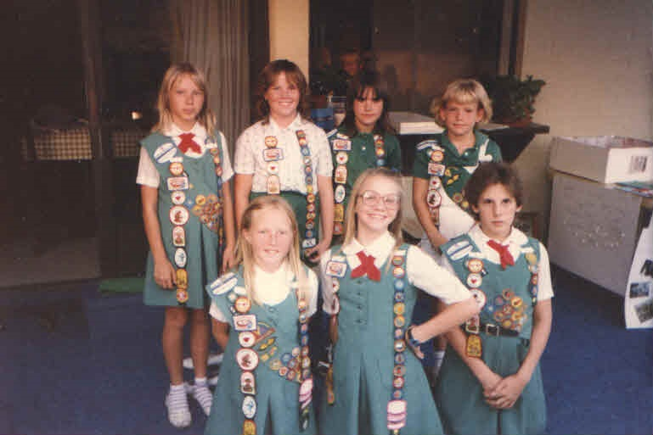
The Power of the Badge
Motivation
Friendly Competition
Collaboration
Learning
Scaffolded

Slide 5
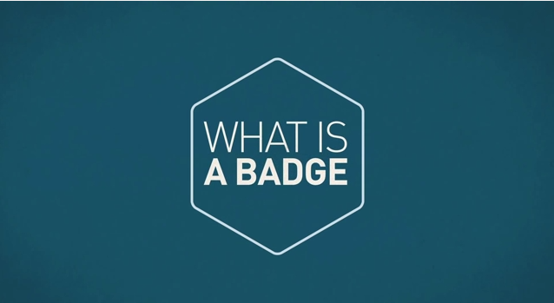
“Badges are digital tokens that appear as icons or logos on a web page or other online venue. Awarded by institutions, organizations, groups, or individuals, badges signify accomplishments such as completion of a project, mastery of a skill, or marks of experience.” (ELI, 2012, 7 Things About Digital Badges: http://net.educause.edu/ir/library/pdf/eli7085.pdf ).
http://youtu.be/_051cGs6n8w
Notes:
Educause Learning Initiative, “Badges are digital tokens that appear as icons or logos on a web page or other online venue. Awarded by institutions, organizations, groups, or individuals, badges signify accomplishments such as completion of a project, mastery of a skill, or marks of experience.” (2012, 1).
People complete activities through informal or formal channels (classes, workshops, club meetings, online courses or learning modules, etc) and can gain badge that certifies or validates skills, accomplishments, knowledge according to criteria set forth by badge issuing authority. Digital badges can be collected displayed on webpages, blogs, online portfolios, etc and stored in online repositories; therefore they are a kind of portable resumes of skills that are more granular and “validateble” than ordinary resumes or CVs

Slide 6
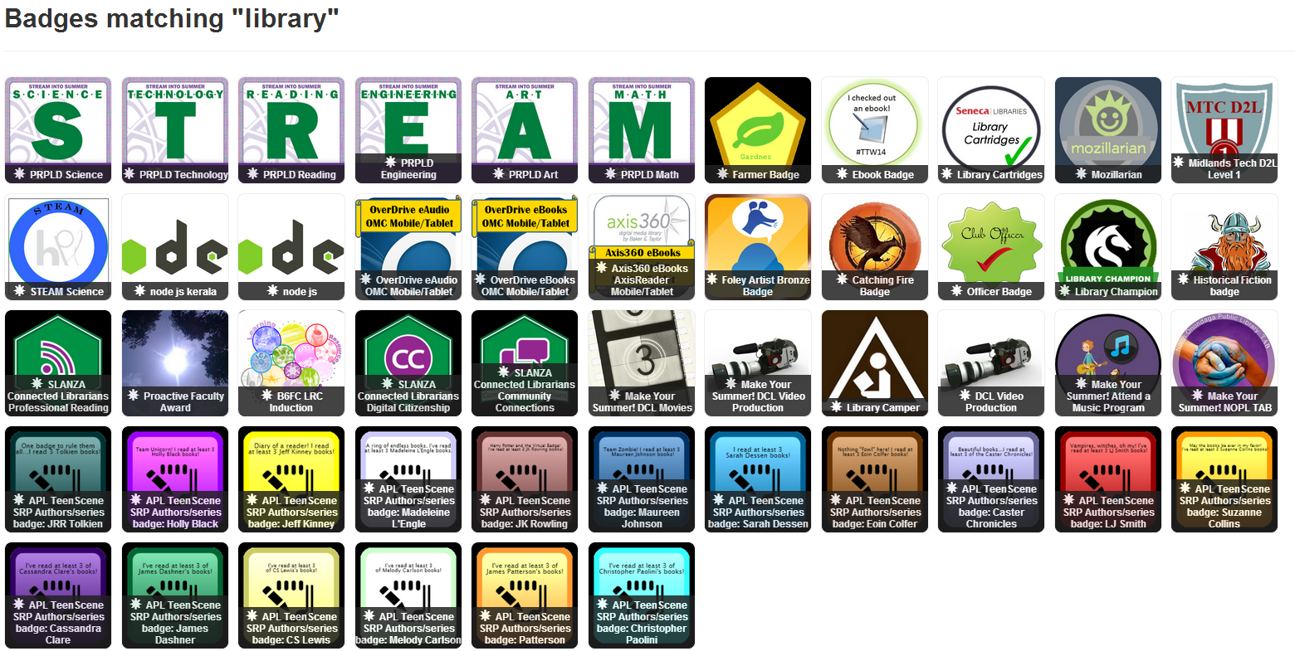
Notes:
All kinds of badges (from badg.us

Slide 7
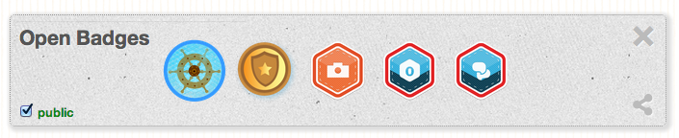
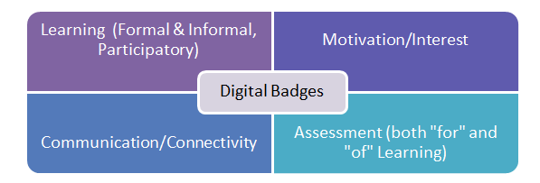
Badges
Anyashy http://commons.wikimedia.org/wiki/File:Openbadges.png
Scaffold & illustrate granular skills, achievements & outcomes visually
Assess, validate & communicate both informal & formal learning
Motivate & encourage reflection on competencies across curriculum
Angela Elkordy: http://ncpeapublications.blogspot.com/2012/10/the-future-is-now-unpacking-digital.html
Notes:
Why badges? Transcripts and grades don’t tell whole story in terms of skills and outcomes. Resumes and CV don’t illustrate and are self reports. Badges can and could motivate and encourage students to see connection between outcomes across curriculum or program of study

Slide 8
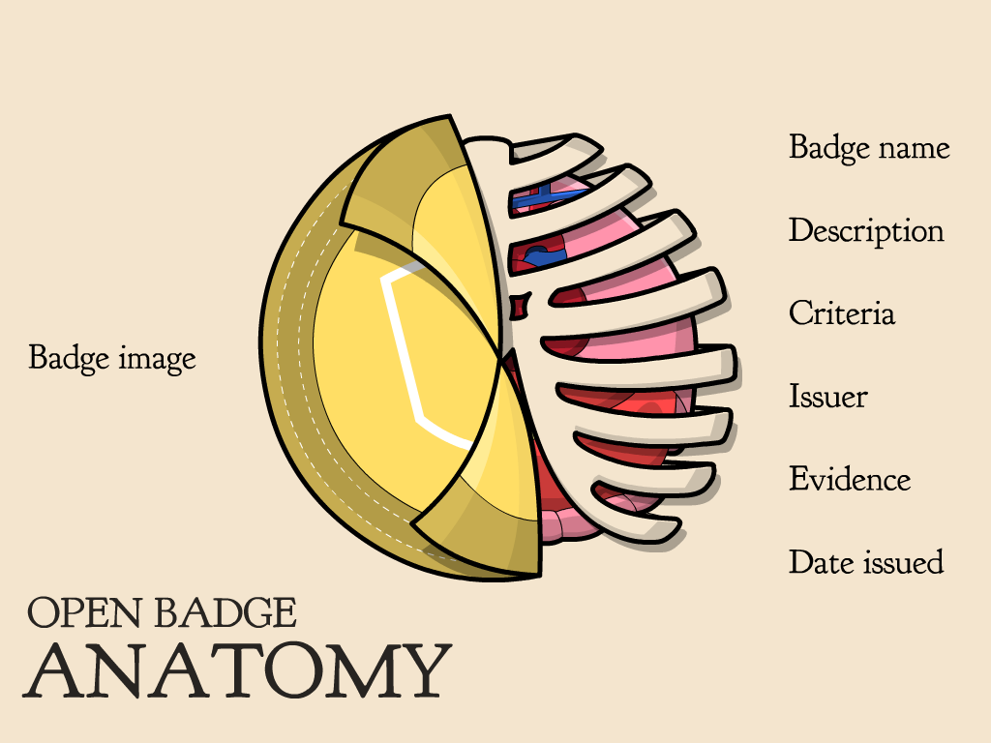
http://www.dontwasteyourtime.co.uk/mooc/openbadgesmooc-fundamentals/

Slide 9
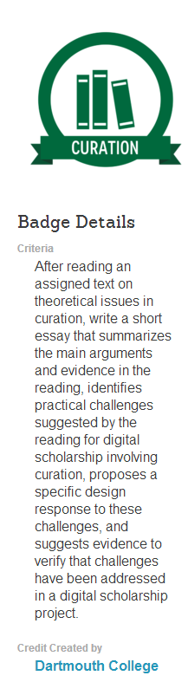
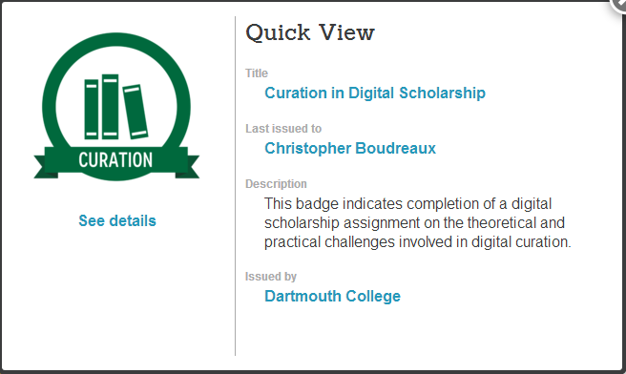
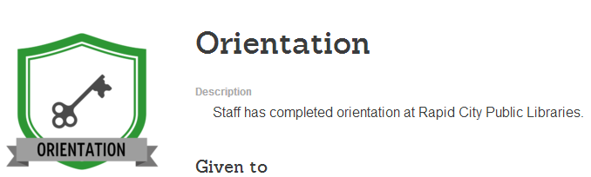
More complex and detail on badge completion requirements given
https://credly.com/recipients/15046
Simple
https://credly.com/recipients/18823
Notes:
From simple “hey I did a thing” to full assignments with learning outcomes (which are digitally attached to badge)

Slide 10
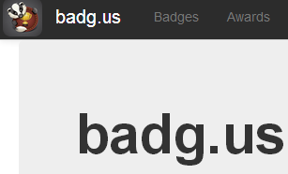





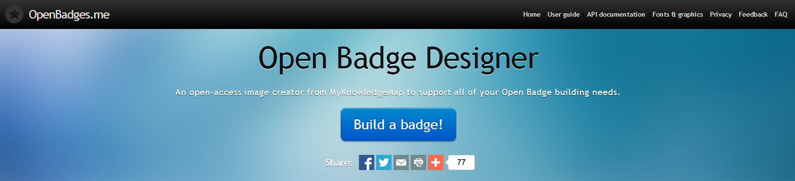
Notes:
Various badge creation programs, from simple images to open, standards-based creation platforms (either standalone or integrated into CMSes, blogs, etc)
From Mozilla Open Badges wiki: https://wiki.mozilla.org/Badges
Digital Badges vs Open Badges
A digital badge is an online representation of a skill you’ve earned. Open Badges take that concept one step further, and allows you to verify your skills, interests and achievements through credible organizations and attaches that information to the badge image file, hard-coding the metadata for future access and review. Because the system is based on an open standard, earners can combine multiple badges from different issuers to tell the complete story of their achievements — both online and off. Badges can be displayed wherever earners want them on the web, and share them for employment, education or lifelong learning.
Open Badges are:
Free and open: Mozilla Open Badges is not proprietary. It’s free software and an open technical standard any organization can use to create, issue and verify digital badges.
Transferable: Collect badges from multiple sources, online and off, into a single backpack. Then display your skills and achievements on social networking profiles, job sites, websites and more.
Stackable: Whether they’re issued by one organization or many, badges can build upon each other and be stacked to tell the full story of your skills and achievements.
Evidence-based: Open Badges are information-rich. Each badge has important metadata which is hard-coded into the badge image file itself that links back to the issuer, criteria and verifying evidence.
Open Badges make it easy to:
Get recognition for the things you learn;
Give recognition for the things you teach;
Verify skills; and
Display your verified badges across the web.

Slide 11
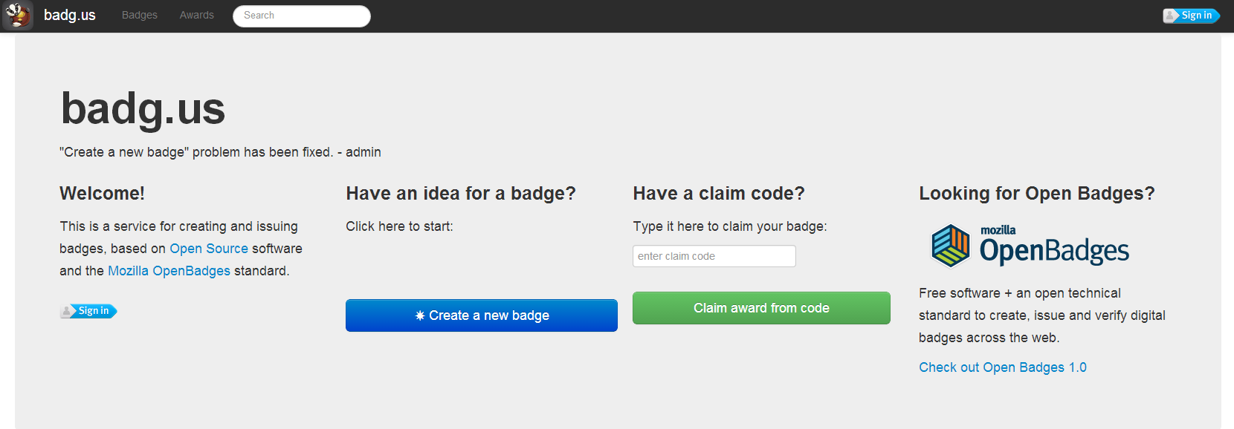
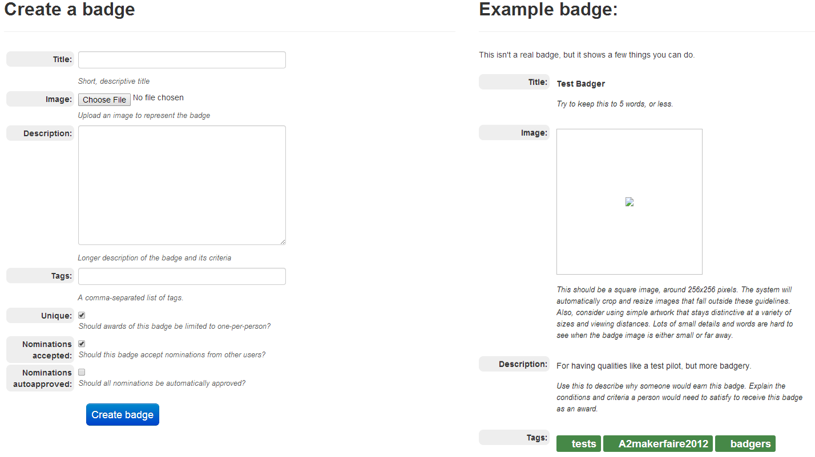
http://badg.us/en-US/
Notes:
Simple creation

Slide 12
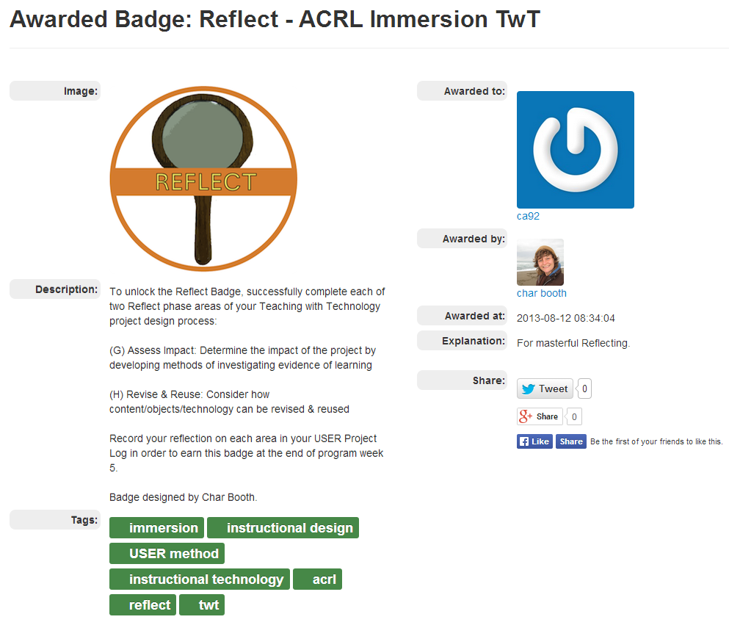
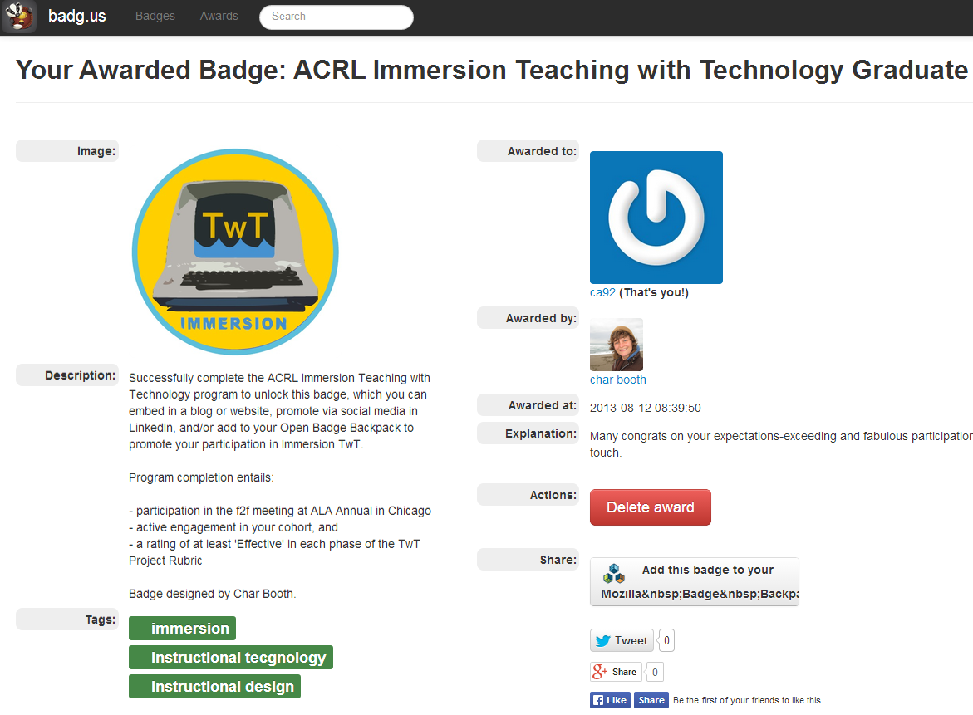
Notes:
Badge for individual skill or assignment or Badge for completion of whole program

Slide 13
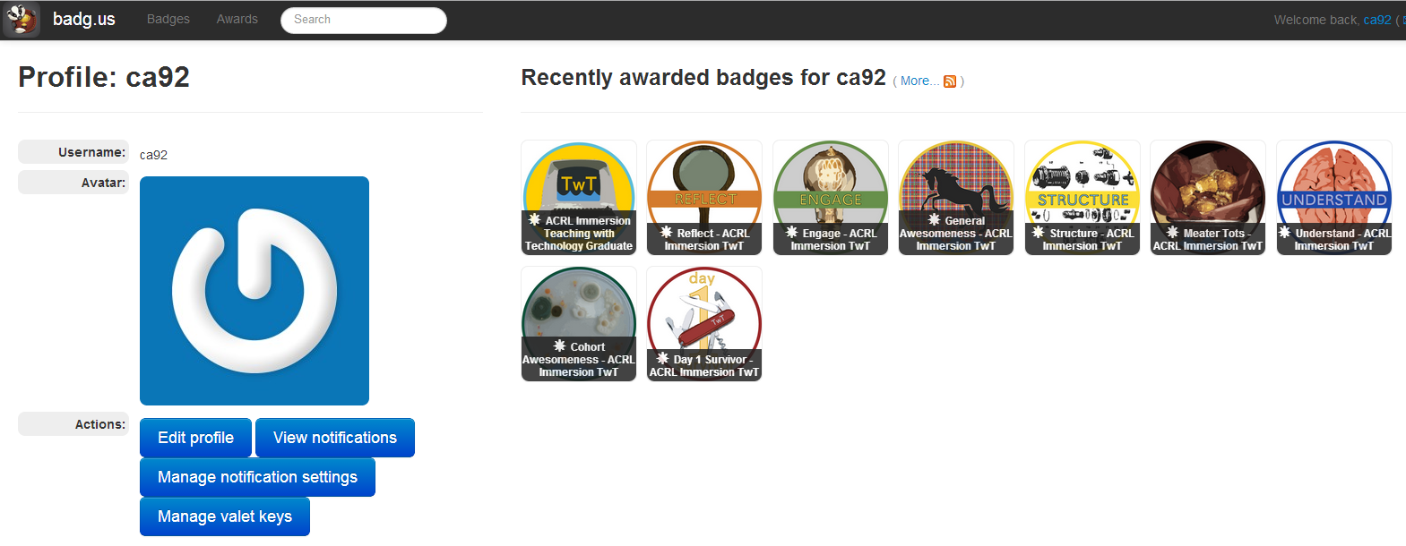
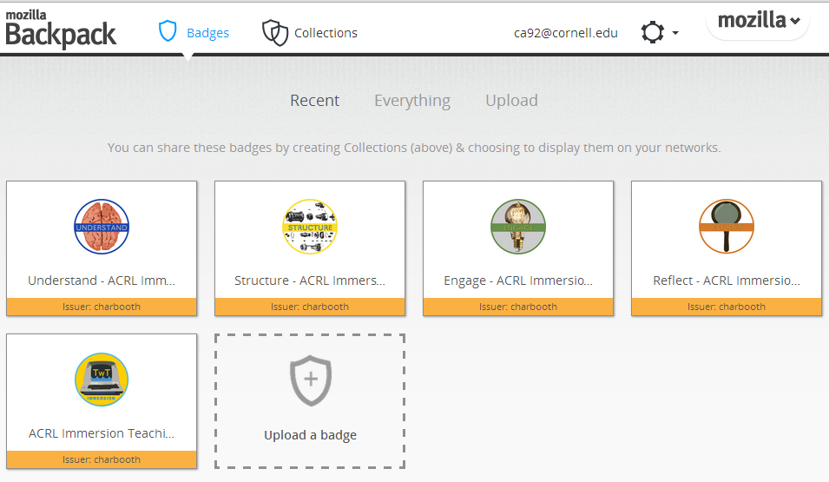
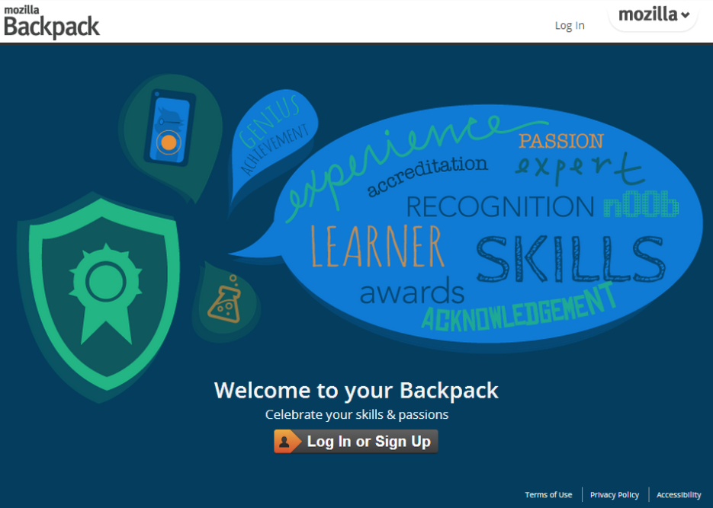
Notes:
Can collect badges all in profile
But what if badges from several different services? Open standards-based Mozilla Backpack. Can upload badges from different providers (that are Open Badge) in one place

Slide 14
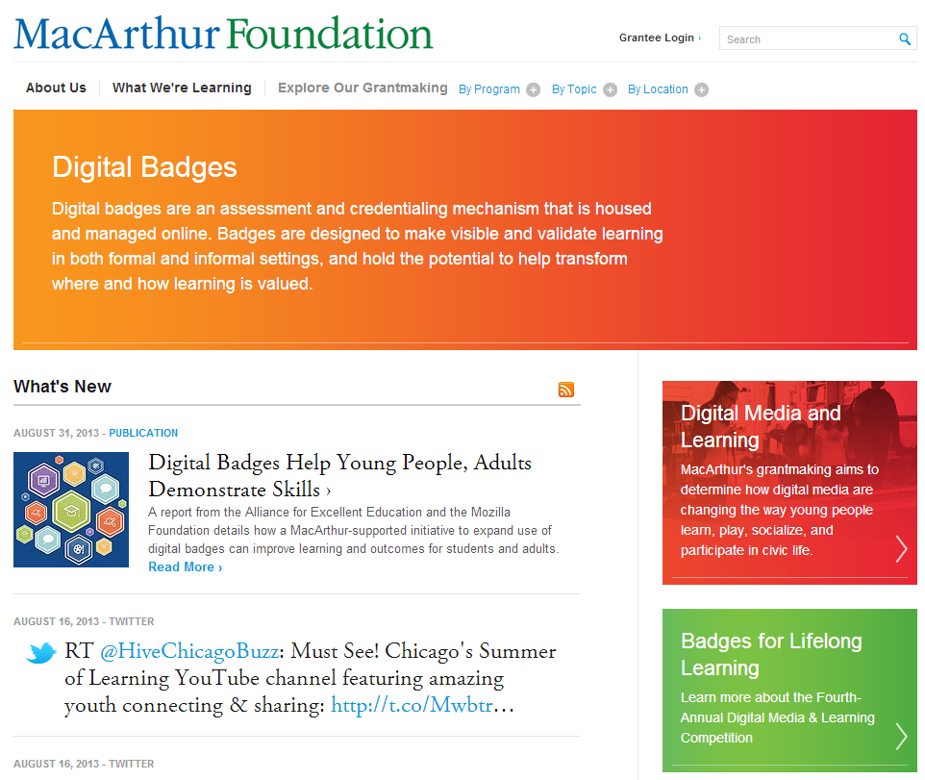

http://www.macfound.org/programs/digital-badges/
http://www.hastac.org/dml-competitions/2012
Notes:
Lots of interest in digital badges from foundations

Slide 15
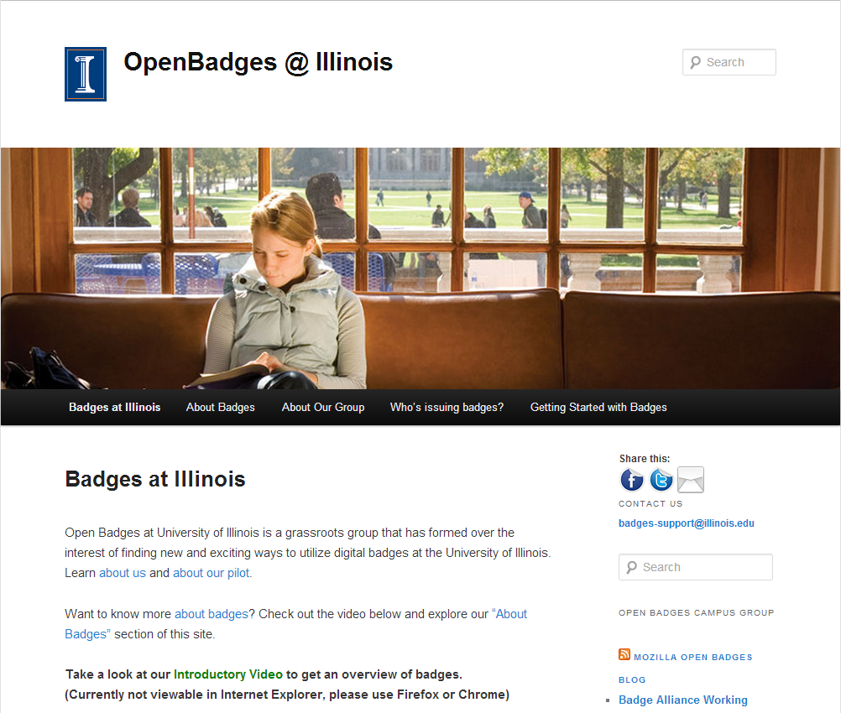
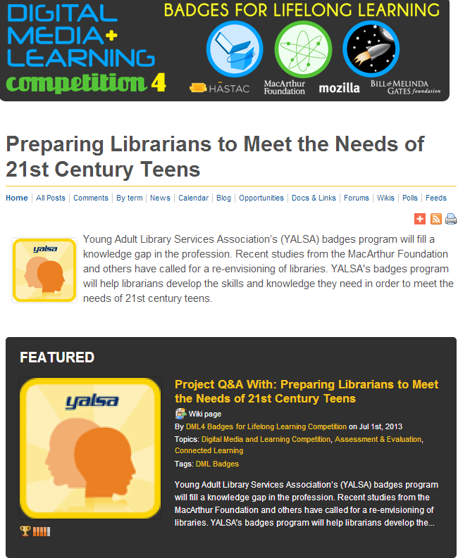
http://news.badges.illinois.edu/
http://www.hastac.org/dml-badges/Preparing-Librarians-Meet-Needs-of-21st-Century-Teens
Notes:
Associations (esp. youth associations) & Universities,

Slide 16
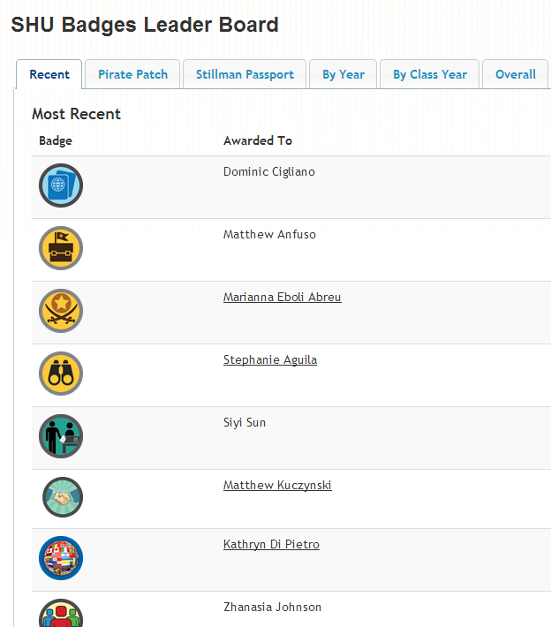
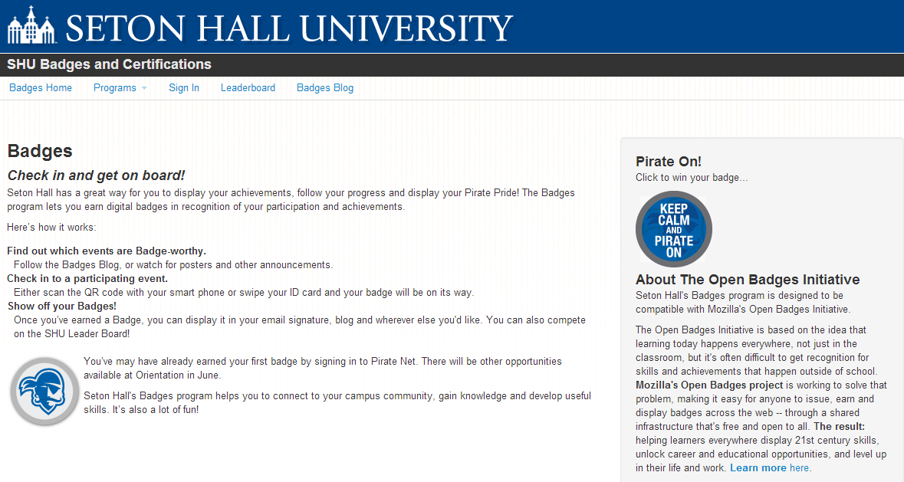
http://tltc.shu.edu/badges/index.php
http://tltc.shu.edu/badges/leaders.php
Notes:
Note: Leaderboard feature to encourage achievement/competition, gaming aspect

Slide 17
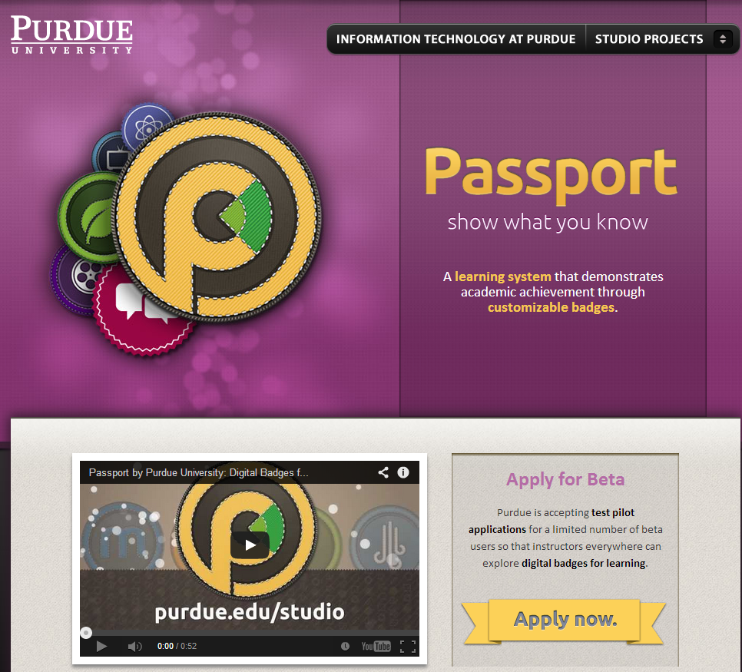
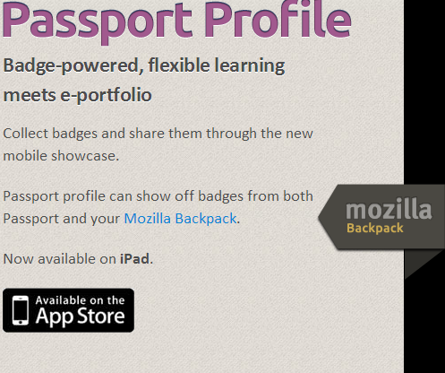
http://www.itap.purdue.edu/studio/passport/
Notes:
Note: mobile apps

Slide 18
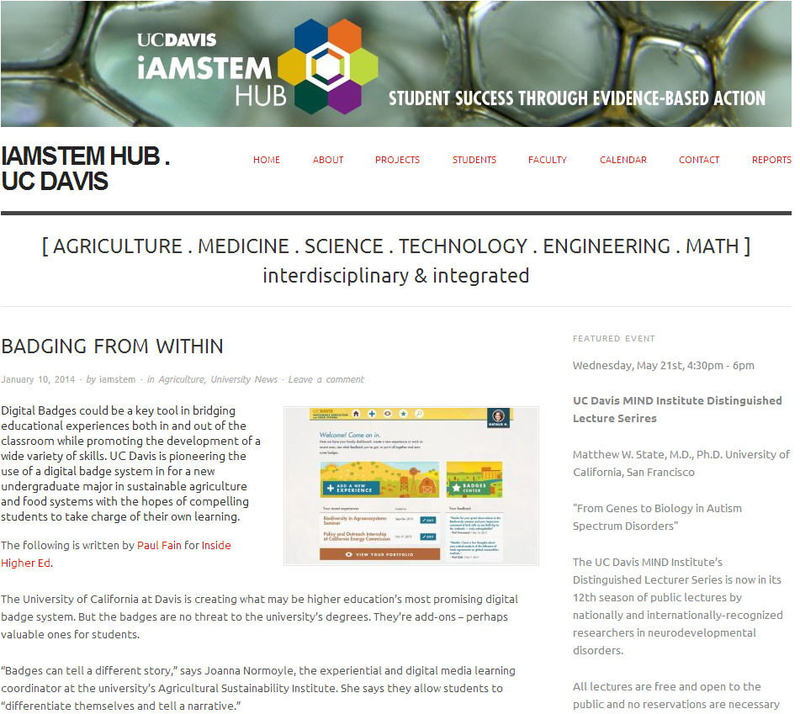
http://www.hastac.org/competitions/winners/safs-learner-driven-badges-project
Notes:
Note: whole majors including badges (UC Davis Sustainable Agriculture & Food Sysytems which is part of DML competition)

Slide 19
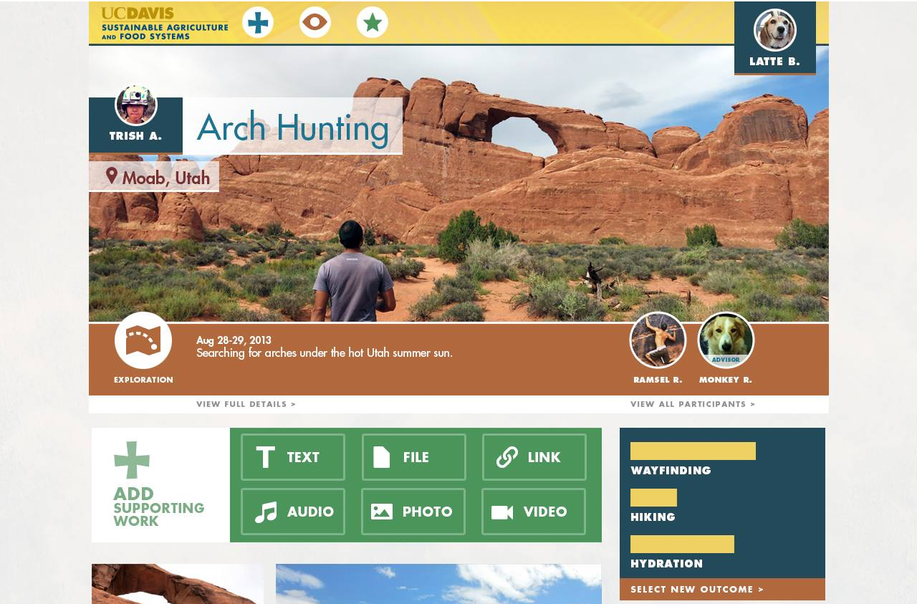
http://asi.ucdavis.edu/sf/images/badges-viewexperience.jpg/view
Notes:
Design template

Slide 20
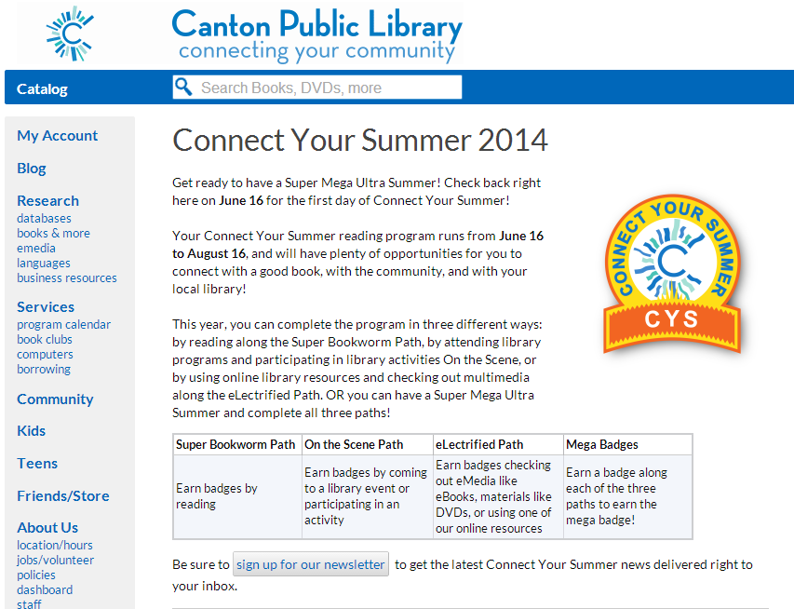
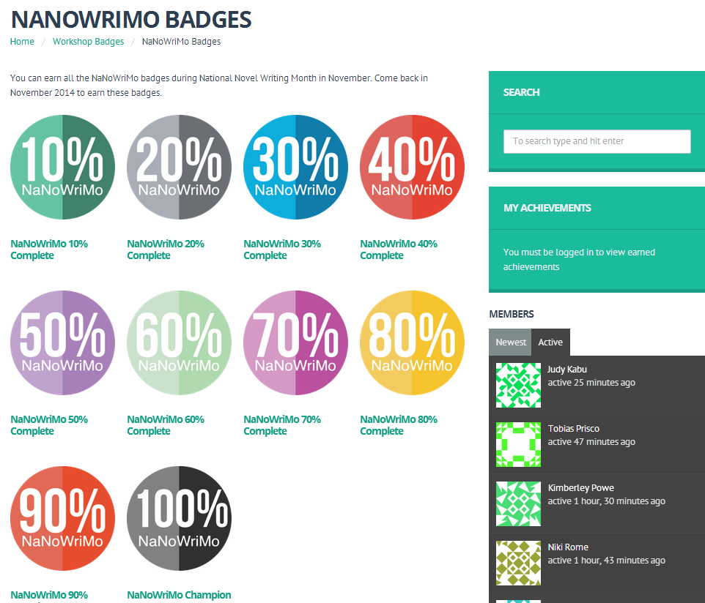
Chicago PL & YouMedia Nanowrimo badges: http://youmediabadges.org/workshop-badges/nano-badges/
https://www.cantonpl.org/page/connect-your-summer-2014
Notes:
Canton Public Library summer reading badge program & Chicago PL YouMedia’s workshops

Slide 21

http://www.reconnectlearning.org/wp-content/uploads/2014/01/YALSA_case_study_final.pdf
Notes:
YALSA’s professional development badges for Competencies for Serving Youth in Libraries funded by DML competition

Slide 22
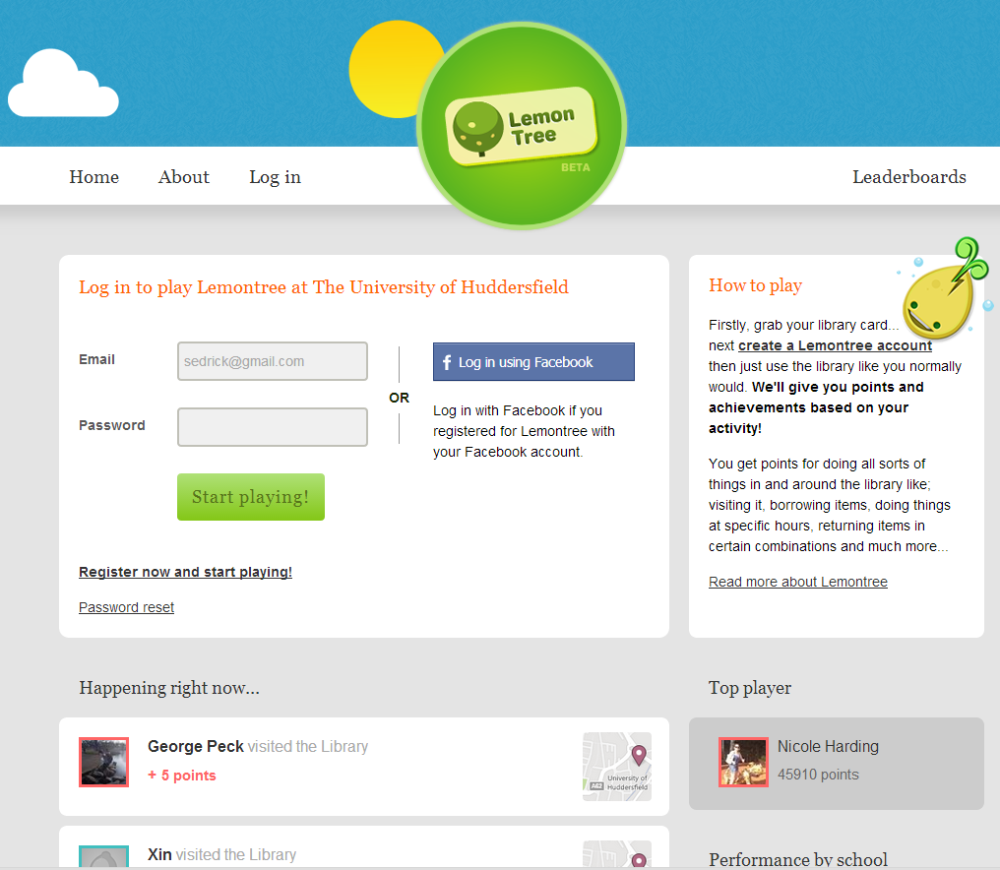
https://library.hud.ac.uk/lemontree/
Notes:
U of Huddersfield’s Lemontree proprietary game for library

Slide 23
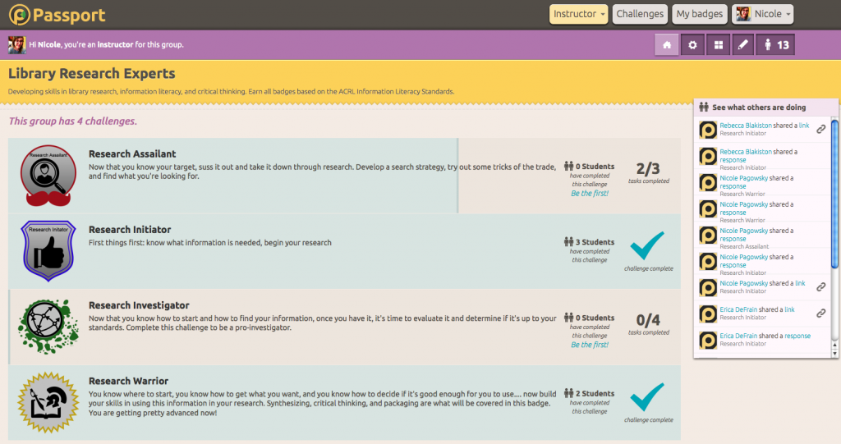
http://acrl.ala.org/techconnect/?p=2676
Notes:
U of Arizona using Purdue’s Passport platform for information literacy

Slide 24
Assessment in a Proposed Wikipedia Course
Known and newsworthy
Changing platform
Working within the system
Applying Information Literacy Concepts
Barnstars

Slide 25

Question Driven
What will we measure?
How will we measure it?
Where do get the questions to use in assessment (badge system)?
Part of Copyright cleanup project on Wikipedia
Designed to address issues of any type of
Copyright concern

Slide 26



Authority- Threshold Concept
Barnstar 1- finding and evaluating credible sources
Barnstar 2- synthesizing sources to write or document knowledge
Barnstar 3- developing own level of authority- writing a full length article

Slide 27
IL & Badges
IL student learning outcomes
Assignment or action for student to complete
Assessment & Badge Issued if completed satisfactorily
Basic: Tutorial graded and if student gets at least 10 out of 12 right, then awarded Cite Alright! Badge
Basic: Student will be able to identify proper citation format
Basic: Student will read through plagiarism tutorial and complete exercises
Level Up: Student will be able to create citations of their own in proper format
Boss Level: e.g. Student will be able to create their own contribution to scholarly conversation building on previous citations and track impact in literature
Next Gen: Student will be able to discover and communicate highly cited works and works they built on in their field/topic area
Level Up: Student successfully completes citation exercise in one-shot instruction session or submits bibliography of at least 10 sources in specified format for assignment
Next Gen: Student completes literature review on topic with proper citation format
Level Up: Exercise or bibliography graded for citation & if 80% or above received Citation All Star badge
Next Gen: Lit review graded via rubric by professor; if meets or exceeds expectations receives Scholarly Conversation Star badge
Boss Level: Synthesis project evaluated by peers in field and impact tracking plan by librarian. If accepted, receives SPARC All Star badge
Boss Level: Student completes synthesis project (article, thesis, multimedia project, etc) with appropriate references to prior works and identifies methods for tracking impact (WoS, impactstory, etc)

Slide 28

IL & Badges
Citation workshop
Basic
Biological Sciences
BioG 1500
BioEE 1780
BioMG 2800/2801
Level Up
IL Certified
Next Gen
Boss Level
Notes:
Great for distributed programs since can follow your own path through content but people can see which outcomes you’ve completed

Slide 29
Assessment Issues & Questions
Improved motivation (intrinsic v. extrinsic)? Improved student learning outcomes and retention?
Possibility of “badge fatigue” if overdone? Accuracy of assessment?
Basics of learning & assessment: What will we measure and how? Evidence of learning over time? Badge just signifier
Participation v. achievement
Technical and instructional design considerations
  Not too easy (or too hard)
  Implementation (platforms, portability & verification/use over time)
Meaning outside the institution
Notes:
Both positive and negative effects (increase in interest and decrease in counterproductive motivational goals; decrease in mastery). Differences in levels of prior knowledge and high v. low performers and also in type of badge (e.g. low performers more motivated to outperform others on participatory badges only) Skill (mastery) badges perhaps more intrinsically motivating.
Consider design elements (e.g. more mastery badges than participation and explicit instruction on how to earn badges and what their results are may help increase outcomes)
-Abramovich, 2013

Slide 30
Further Reading
EDUCAUSE Learning Initiative. (2012). 7 Things To Know About Digital Badges. Retrieved April 21, 2014 from http://net.educause.edu/ir/library/pdf/eli7085.pdf
Pagowsky, N. (n.d.). Keeping up with Digital Badges for Instruction. Retrieved April 21, 2014 from http://www.ala.org/acrl/publications/keeping_up_with/digital_badges
Frederiksen, L. (2013). Digital Badges, Public Services Quarterly, 9(4): 321-325,
DOI: 10.1080/15228959.2013.842414
Abramovich, S., Schunn, C., & Higashi, R. (2013). Are badges useful in education?: It depends upon the type of badge and expertise of learner. Educational Technology Research & Development, 61(2), 217-232. doi:10.1007/s11423-013-9289-2

Slide 31
Questions?
Contact
  Camille Andrews (ca92@cornell.edu)
  Kelee Pacion (klp92@cornell.edu)

